Slide 1
Classroom-in-the-Cloud
Using AWS in a Virtual Machine Environment
CDW & Suffolk County Community College
October 2019

Slide 2
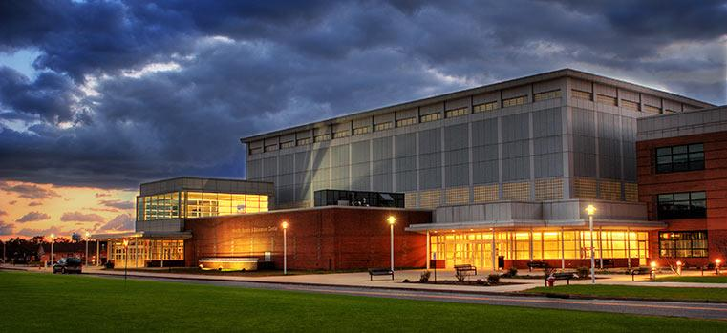
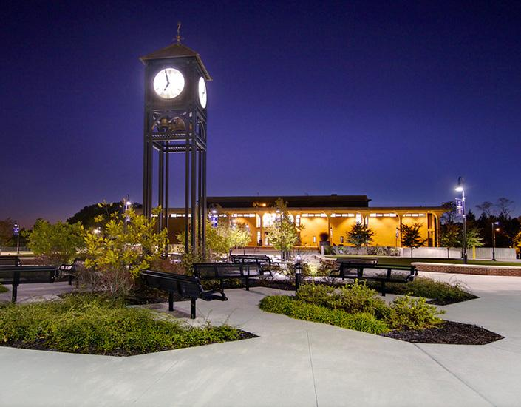
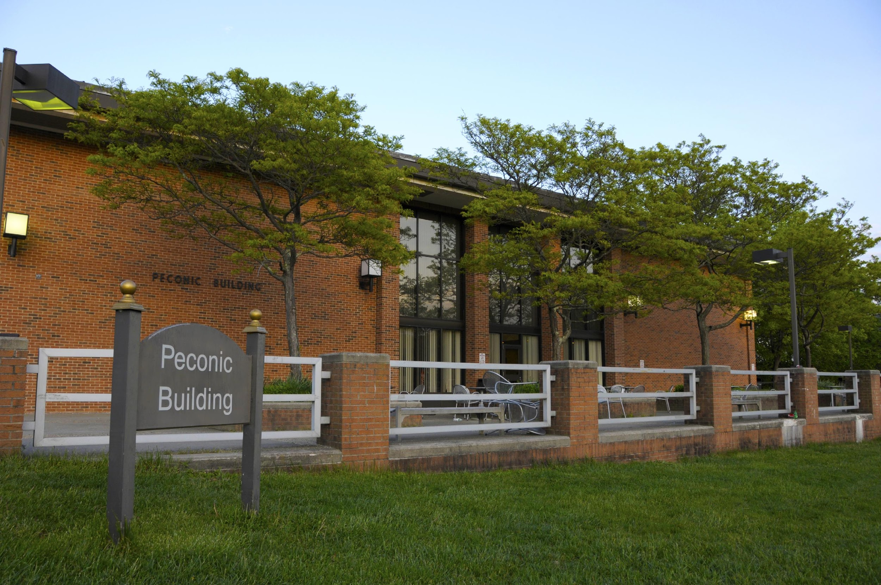
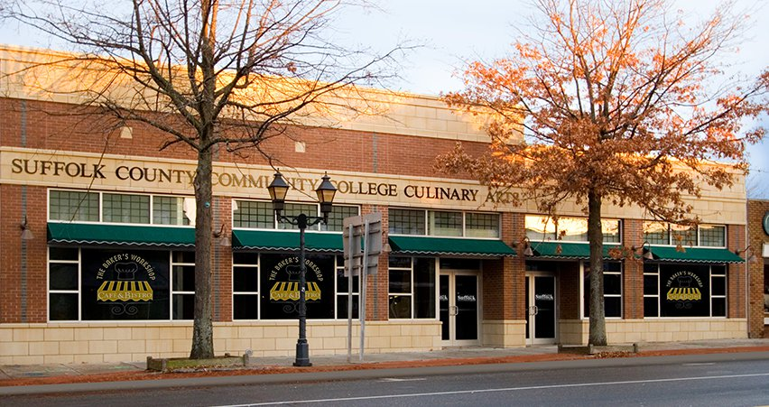
About Suffolk County Community College (SCCC)
Largest community college in New York
~27,000 students
5 locations
Leader in Cybersecurity education

Slide 3
Evolution of SCCC Cybersecurity Lab (v1.0)
Awarded NSF Grant
Expanded to 120 students
On-premises Lab v1.0
2014
2015
2016
2017
2018
Launched Cybersecurity program with 75 students
Notes:
Took 24 months to launch

Slide 4
Lessons Learned: Cybersecurity Lab (v1.0)
Took a long time to implement
2014: Grant
2017: First Class
Access limited to onsite lab
Relatively inflexible
Expensive to maintain
$100K setup
$250K annual maintenance

Slide 5
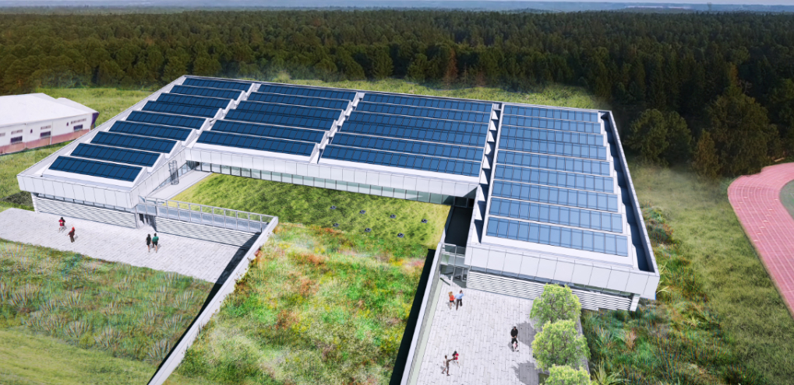
Additional Requirements
Reduce emissions
Deliver course at multiple campuses
Move courses online to comply with new SUNY requirements
Provide access to lab environment outside of class
Decrease dependence on grants
Reduce cost per student to price of text book ($3/day)
Notes:
(Moving to new Net-Zero emission building

Slide 6
Evolution of SCCC Cybersecurity Lab (v2.0)
Full Production
2Q19
Beta Launch
1Q19
On-premises Lab v1.0
2014
2015
2016
2017
2018
2019
Classroom-in-the-Cloud
3 years
6 months
Time to Production
Notes:
Took 24 months to launch

Slide 7
Why AWS & CDWG?
Reduced Cost / Pay-as-you-Go
On-premises lab: Setup $100K; Annual $250K
Classroom-in-the-Cloud: Setup $25K; Annual $60K
3 year savings of 76%
Increased Access
Students can get access anywhere there is internet
Windows, Mac, Chromebook, iPad and Android clients
Offsite access for students and instructors
Improved Security
Moving the lab activities off the network vastly improved security for the school
Greater Flexibility
Can upgrade technology on the fly (i.e., new applications, operating systems, hardware)
$

Slide 8
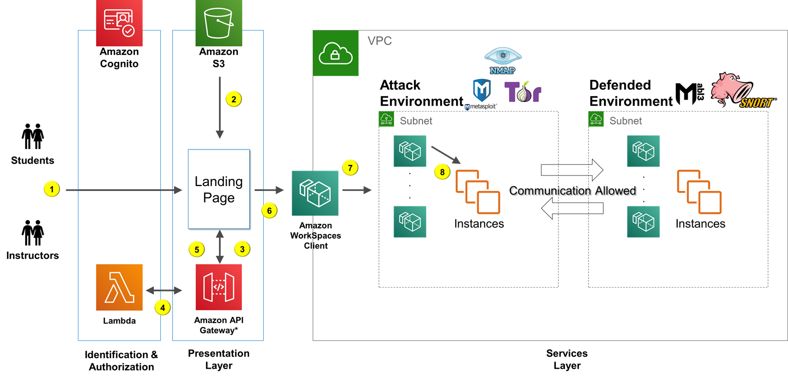
Infrastructure Overview
Notes:
Networks are isolated by either student or by class
Students with an isolated network could not affect other students in their class
No concerns of leakage to Internet
Network design can be unique for each class\section

Slide 9
Learnings and Improvements
SNORT and NMAP
Snort and NMAP are a port scanning and intrusion detection tool set
Issue: Prior to 2019, AWS did not allow customers to conduct security assessments of AWS infrastructure themselves
Solution: Per the policies and guidelines at Penetration Testing, this testing can now be carried out against resources on your AWS account. Approval is no longer required
Workspaces Web Client
Workspace Web client provides simple expanded access from anywhere
Issue: Lacks the functionality of the client version of WorkSpace
Solution: There is a client for Windows, Mac, iPad, Android, Fire, Zero and Chromebook

Slide 10
Student Login Demo

Slide 11
Login and Use Root Demo

Slide 12
Run Install Package from CentOS Demo

Slide 13
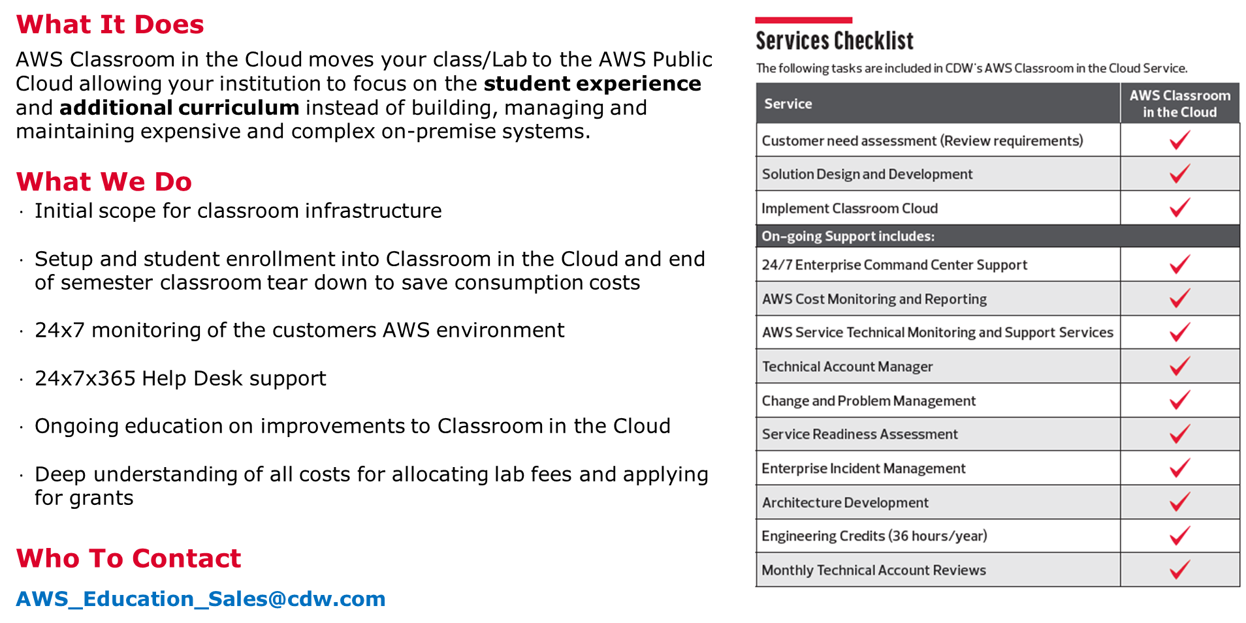
CDW Classroom-in-the-Cloud

Slide 14
Summary of Benefits
Faculty
Not constrained by local policies or resources
Academic Freedom
Ability to add online Faculty
College
Security Posture does not need to be reduced to allow access for students
CDW Managed Service provides alerting of usage and mitigating over-use via hours limits
Costs are usage-based
Technical support included in the solution
Students
24X7 access
Ability to complete work or repeat work outside classroom
Demonstrate to potential employers’ examples of completed work through lab reports

Slide 15
Question & Answer

Slide 16
Appendix

Slide 17
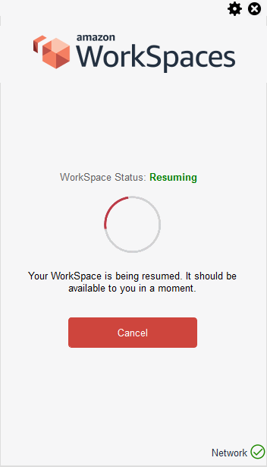
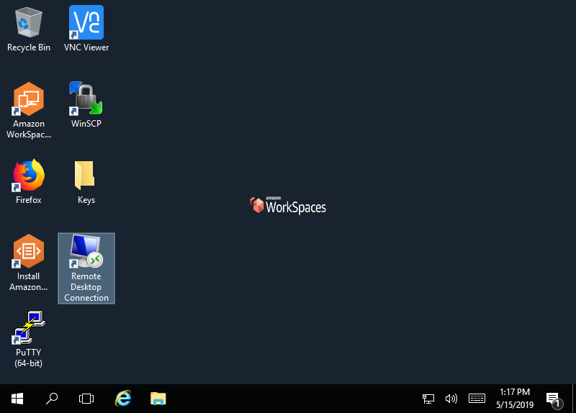
Accessing the Classroom-in-the-Cloud
Notes:
Just talk about the need for the landing page the web workspace of client workspace then connecting to different types of machines ..
Students access their environment through their own Workspace
Windows Desktop Clients
Allows Remote Desktop, SSH and VNC into the isolated network
Accessed by Desktop Client or Web Client
The Web Client’s functionality was affected by a bug which Amazon is working to correct

Slide 18
Administrative Oversight in Environment
Allows for auditing of students work
Instructors have access to all student systems in their classes
Student questioned whether they received the correct grade on exam
Server that was used in the exam was started and reviewed for correct scoring
This would not have been possible with our existing Desktop Virtualization solution.
Notes:
Instructors can audit systems to see if student’s work was actually completed and information was not obtained from another source

