Slide 1
Virtual Teaching Space
Grant Irons – AWS Educate
David Lin – VP of Business Development Vocareum
This presentation leaves copyright of the content to the presenter. Unless otherwise noted in the materials, uploaded content carries the Creative Commons Attribution 4.0 International (CC BY 4.0), which grants usage to the general public, with appropriate credit to the author.

Slide 2
Agenda
Introduction to AWS Educate
Introduction to Vocareum
AWS Educate Classrooms

Slide 3
AWS Educate

Slide 4
Demand for Cloud Skills
For the fourth year in a row, Cloud Computing continues to be the #1 LinkedIn skill¹.
Average AWS Certification Salary²:
AWS Certified Developer, Associate: $138k
AWS Certified Solutions Architect, Associate: $115k
AWS Certified SysOps Admin, Associate: $108k
1 https://learning.linkedin.com/blog/top-skills/the-skills-companies-need-most-in-2018--and-the-courses-to-get-t
2 Global Knowledge 2016 IT Skills and Salary Report

Slide 5
AWS Educate is Amazon’s global initiative to provide students and educators with the resources needed to accelerate cloud-related learning.

Slide 6
Provide educators and students with resources for cloud-related learning. Those at member institutions receive twice as many AWS credits, demos and special on-campus programs.
Institutions
Professors, teaching assistants, and educators receive access to AWS technology, open source content for their courses, training resources, and a community of cloud evangelists.
Educators
Students receive credits for hands-on experience with AWS technology, training, content, career pathways and the AWS Educate Job Board.
Students

Slide 7
Demand for Cloud Skills
2400+ Educational Institutions
100s of 1000s
Of Students
Top 10
Global Computer Science & Information Systems Institutions
Over 200 Countries and Territories
Over 10,000
Educators
QS World University Rankings by Subject 2016 - Computer Science & Information Systems

Slide 8
AWS Educate Resources & Features

Slide 9
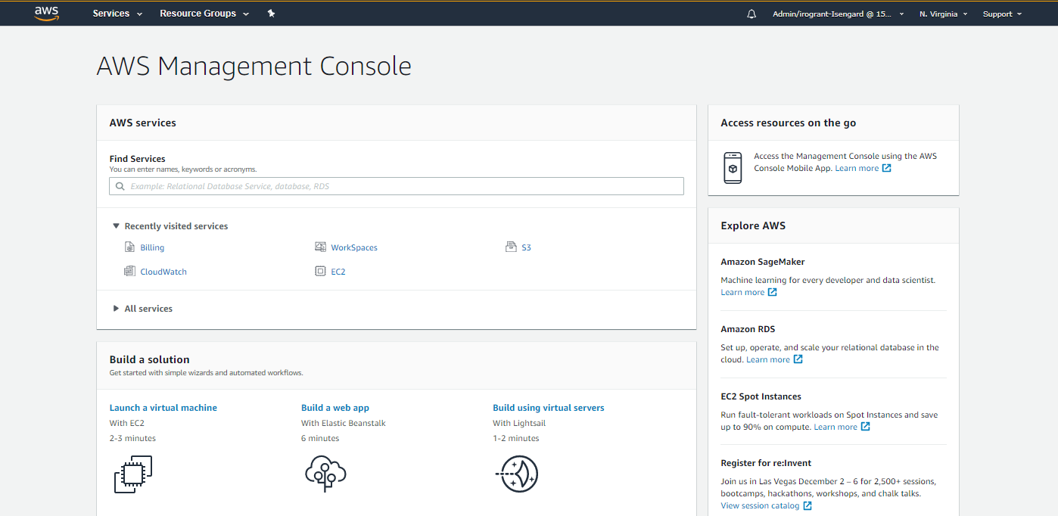
AWS Console Access

Slide 10
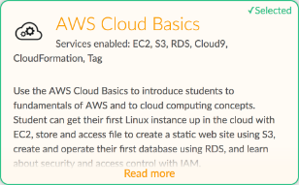
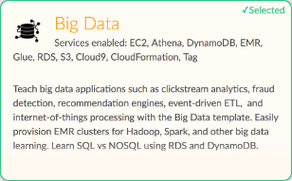
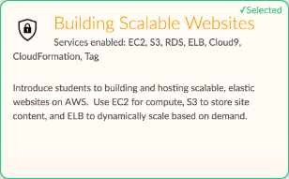
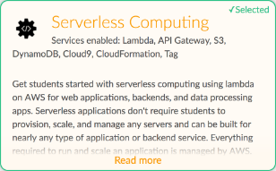
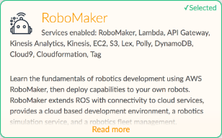
Classrooms

Slide 11
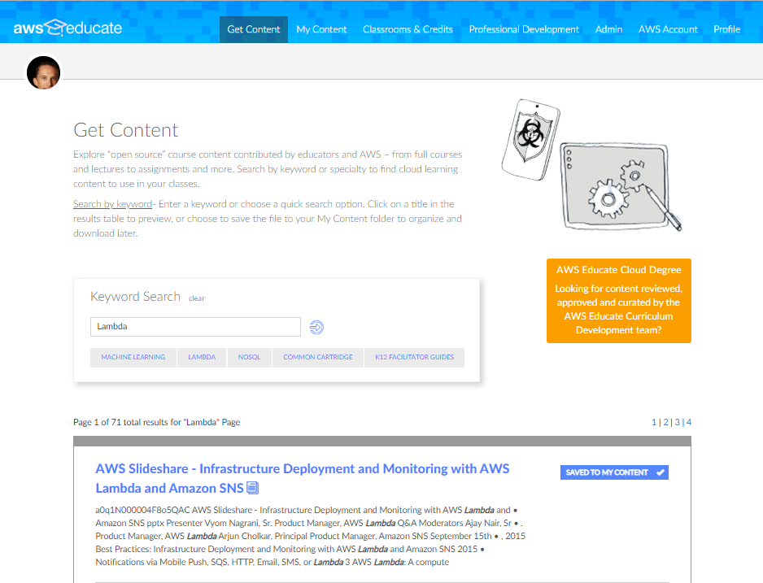
Content & Resources for Educators

Slide 12
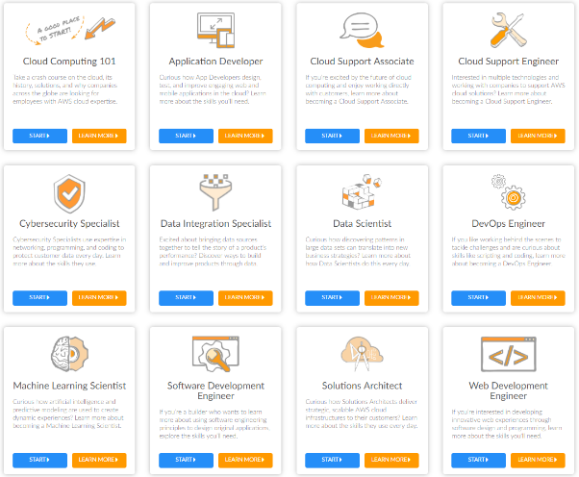
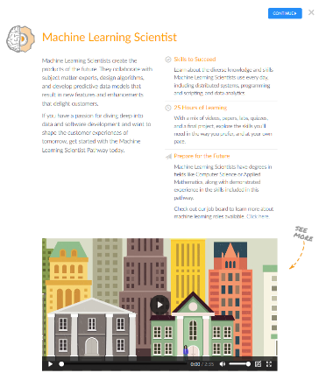
AWS Educate Career Pathways
Notes:
26K completions

Slide 13
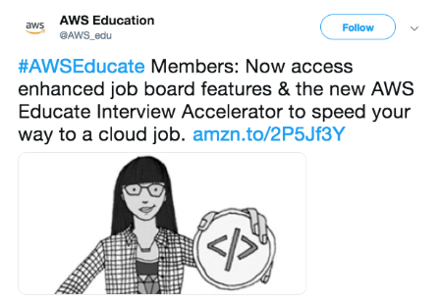
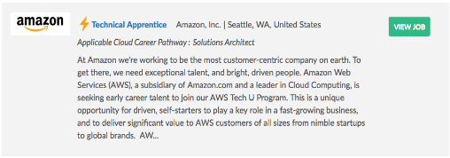
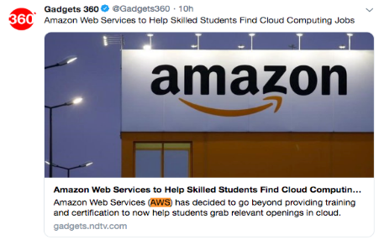
Job Board & Interview Accelerator*
AWS Educate members have access to cloud-related jobs from Amazon and employers in the AWS Partner Network via the AWS Educate Job Board.
* Students 18 and up

Slide 14
Cloud Degree Initiative
A collaboration between AWS Educate & leading educational institutions to develop academic programs mapped to entry-level positions in cloud computing.
Flexible degree, certificate, or specialization conferred by member institutions.
Faculty training & student access to state-of-the-art cloud tools.
Assessment of existing IT courses
& support for curriculum development.
Job Placement – Interview Accelerator

Slide 15
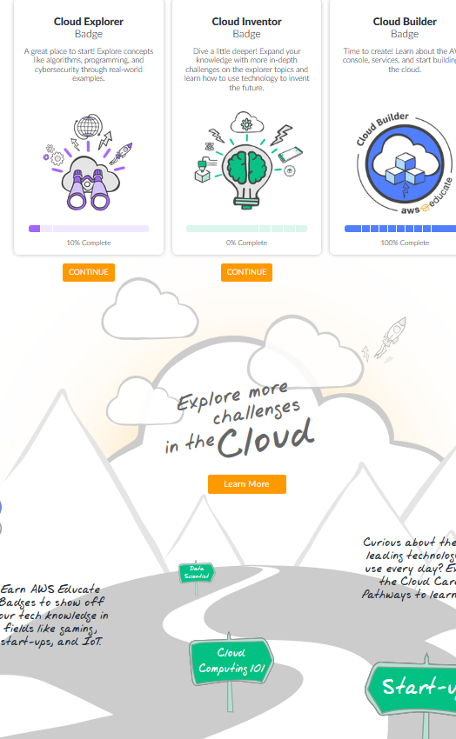
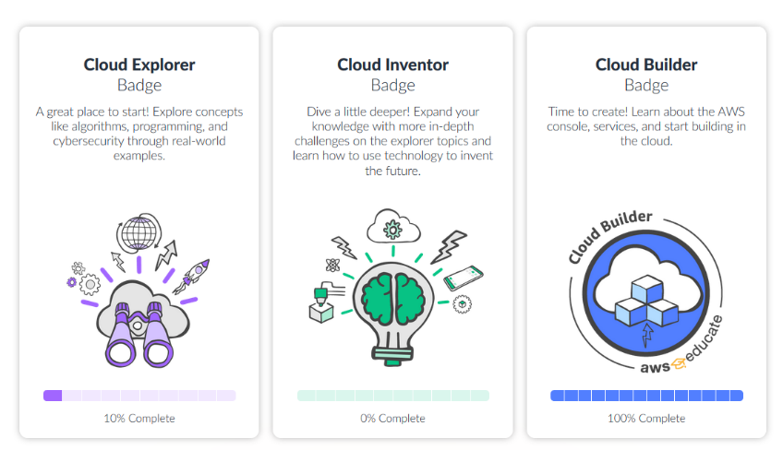
K12 Program
3 cloud badges for students 14 – 17
Access to guides which map to core computer science principles.

Slide 16
Access using Vocareum
Educate Classroom
Starter Account
AWS Account
Capped
Educator Selected AWS Services
Additional AWS Credit
Temporary Environment
Individual Work
Easy Access to Student Accounts
Capped
Annual AWS Credit Preloaded
Access to Most AWS Services
Individual Work
No Credit Card Required
Full AWS Access
Annual AWS Promotional Credit Code
User & Group Creation
Credit Card Required

Slide 17
Vocareum

Slide 18
BRIDGING THE GAP BETWEEN INDUSTRY & ACADEMIA
CLOUD LEARNING LABS
VOCAREUM, INC.
OCTOBER 10, 2019

Slide 19
Enhancing the learning experience
Vocareum’s learning platform helps you deliver
course content, cloud-based labs,
and performance-based exams to
customers, partners, students, and employees.

Slide 20
Value Proposition
Learning Lab Environments | Global 24/7 Access | Increased Product Adoption
Content Management & Distribution | Learning Management & Assessment | Consistent Learner Experience

Slide 21
Vocareum Pre-Configured Labs
Interactive Notebooks Fully hosted solution; Pre-installed packages; Autograding / nbgrader; HPC: GPU, Cluster | Programming / Full Stack Broad range of languages; Pre-installed packages; Linux terminal; IDE: standard, spyder, eclipse, etc. | Windows & Applications Stream desktop or applications; Customize apps; Private network; License flexibility
Big Data Hadoop processing; Predictive analysis on statistical models; Run MapR on Clusters; Access data sources | Machine Learning Any ML framework; Develop & train computational models; Dedicated GPU; Evaluate results | Cloud Computing Policy controlled, budgeted; User or group accounts; Student enrollment, Aggressive resource mgmt

Slide 22
Vocareum Configuration Options
COMPUTE |  | VM, Cluster, GPU, Containers
SOFTWARE |  | Operating System, Tools, Licensing
DATA |  | Data sets, Course material, Student work areas
USER PERSONA |  | Administrator, Content Creator, Instructor, Grader, Student
POLICY & ACCESS |  | Permissions & temporary credentials
BUDGET |  | Resource cost, resource type, lab time
PRESENTATION |  | Terminal, Desktop, SSH, etc.

Slide 23
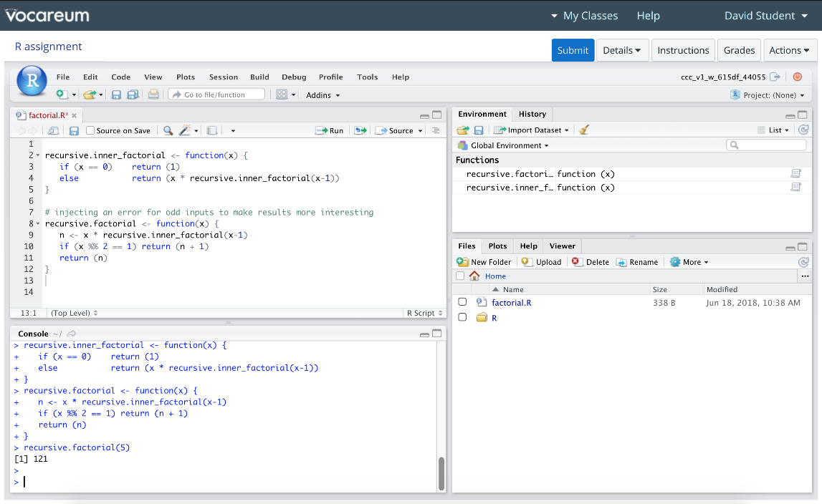
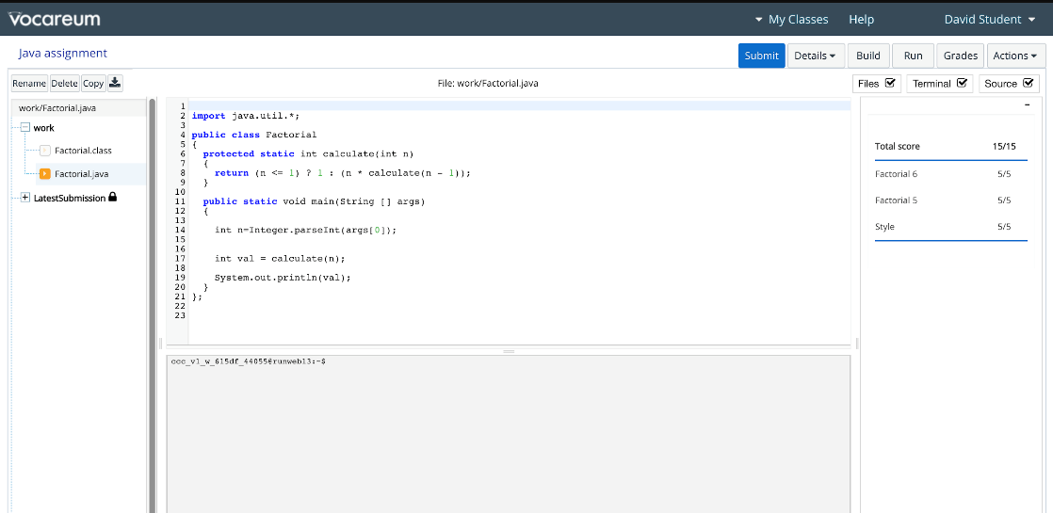
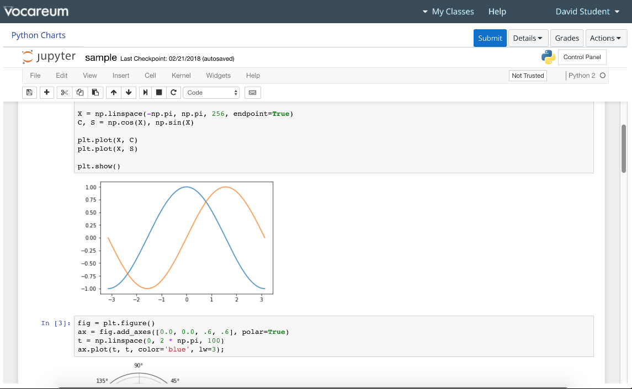
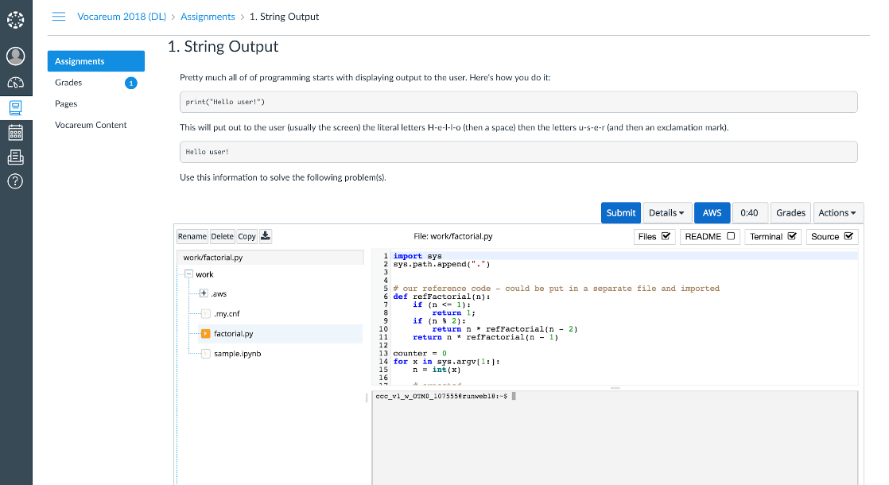
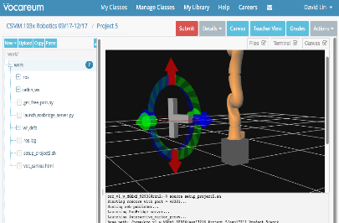
Learner Lab Interfaces

Slide 24
Deploying Vocareum
 | Hands-on Labs / MOOC Labs for learners to use tools, technology and services in managed environment (policy, budget, etc) |  | Skills-based Exams Administer proctored skills-based certification exams, with automatic scoring
 | Training / Bootcamps / Hack-a-Thons Course material + lab environments to support instructional training events |  | Research Team-based lab environment with data security, grant management, etc.
 | Syndication Course material + labs packaged and distributed to Universities, partners, etc. |  | Virtual Campus Labs Upgrade on-prem computer labs with purpose-built cloud labs and tools

Slide 25
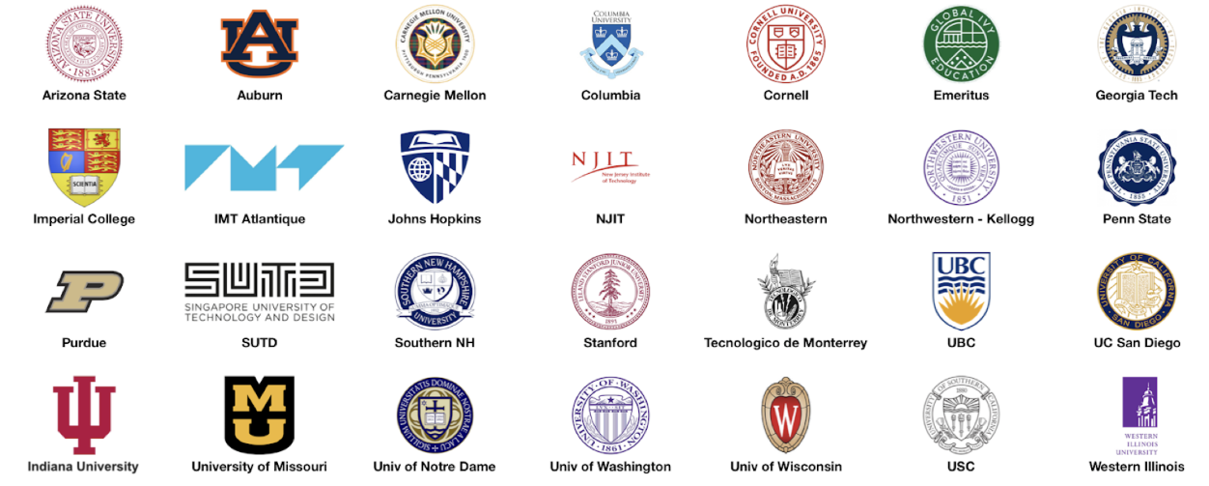
Academic Partners
… over 600 institutions using Vocareum Labs today …

Slide 26
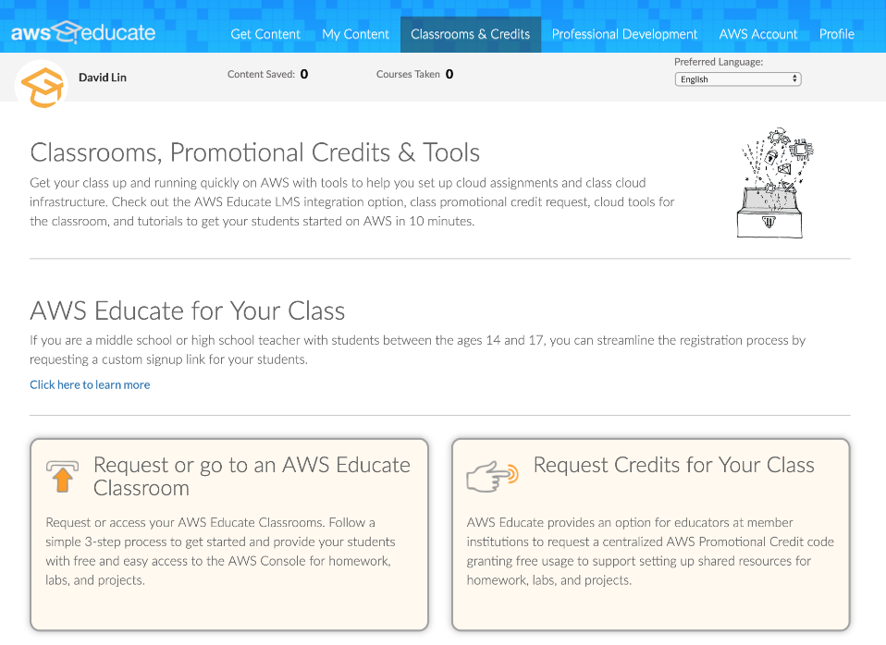
AWS Educate Partnership
INSTRUCTOR ACCESS
Request commercial lab environment for class
Full access to student workarea to provide assistance and to evaluate student work
PRE-CONFIGURED ENVIRONMENT
Students are enrolled into labs configured for learning/using specific skills
Single-sign-on via API or LTI
BUDGETING, CREDENTIALS
Students are provided free access to commercial resources and console
Spend is strictly tracked and controlled
Our work with Vocareum helps AWS Educate provide the resources necessary for students around the world to develop the skills necessary to pursue a career in cloud computing.
- Ken Eisner, Global Lead, AWS Educate

Slide 27
AWS Educate Classrooms

Slide 28
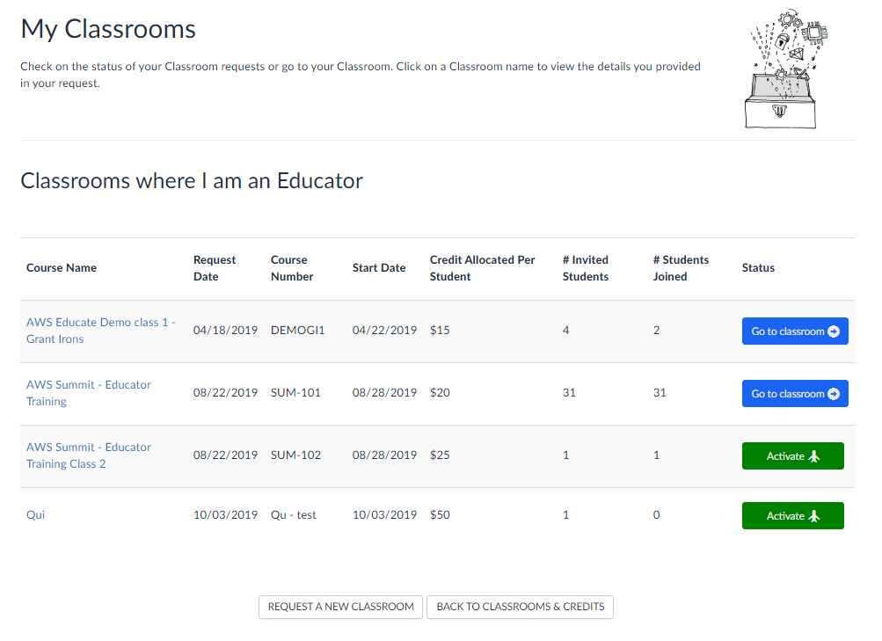
Classrooms Demo

Slide 29
Thank You for your time
AWS Booth – 1107
Vocareum Booth -

