Slide 1
IT Service Management in Higher Education
Face-to-Face ITSM Community Group
PRESENTED BY:
Todd Jensen, ITSM CG Chair
University of Nebraska

Slide 2
Agenda
About IT Service Management Community Group – ITSM CG
Year in Review
Plans for 2020
Community Discussion – Open Spaces

Slide 3
About the CG
~1500 members – ITSM Educause listserv
Steering committee - Meets monthly
  Community event planning
  Educause content and programming
  Working Group opportunities
  Collaborate to drive change in solutions

Slide 4
Steering Committee

Slide 5
Steering Committee
Todd Jensen, ITSM CG Chair - Manager, IT Service Management, U Nebraska (todd.Jensen@nebraska.edu)
Mitch Pautz, ITSM CG Chair – Outgoing - IT Service Management Analyst, USC (mpautz@usc.edu)
Kara Frase, ITSM Implementation Coordinator, UNC Wilmington (frasek@uncw.edu)
Ann Gerwitz, Director, IT Service Management, University of Delaware (agerwitz@udel.edu)
Corey Liss, Manager, Service Delivery, U Chicago - (cpl1@uchicago.edu)
John Lowe, App System Analyst, North Arizona University (John.Lowe​@nau.edu)
Scott Nemes, Director, Service Management, San Francisco State University (scottnemes@sfsu.edu)

Slide 6
Steering Committee
Deborah McDaniel, Associate Director, IT Service Management, Rutgers University (dm1315@oit.rutgers.edu)
TJ Martinez, Director, IT Customer Support, University of New Mexico (tjm@unm.edu)
Andrea Tanner, Senior Director, Tech Support, Community College of Baltimore County (atanner3@ccbcmd)
Leetza Pegg, Business Analyst, University of Washington (lrpegg@uw.edu)
Beth Rugg, Assistant Vice Chancellor for Client Engagement, UNC Charlotte (beth.rugg@uncc.edu)
Taj Wolff, Director, IT Service Management and Ops at Vanderbilt University (taj.wolff@vanderbilt.edu)

Slide 7
Events

Slide 8
Past Events
February 28: Panel discussion with ECAR working group members
March 21: IT4IT for Higher Education: A value chain IT operating model and reference architecture
April 18: High Velocity Service Delivery through DevOps
May 15: Project Management and Service Management - A panel discussion
June 26: Using the Relationship Management role to drive real value
July 9: ITSM Benchmark survey results
August 6: Better Allies; Building an inclusive mindset
August 28: Extending relationships and driving improvement
September 26: Future of Work with AI
October 3:Business Relationship Management Practices in Higher Education

Slide 9
Upcoming Events
October 21: ITIL 4 training survey results
November 20: Service Catalog - Defining Services
December 12: Service Catalog - Developing an online service catalog
See the ITSM CG Events for past recordings and upcoming events.

Slide 10
Year Ahead

Slide 11
2020 - Year Ahead
Diversity, Equity, and Inclusion
ITILv4
Digital Transformation
AI Support models
Customer Experience Framework
Continued collaboration with other CGs
  IT Support Services
  BRM
  Project Management
  DevOps
  IT Comm
  Women in IT
  ITANA

Slide 12
Interactive Discussion

Slide 13
Community Discussion
OpenSpaceWorld.Org
Unconference like – 30 years of use millions of meetings
The Law of Mobility: you take responsibility for what you care about - use your own mobility to move to whatever place you can best contribute, collaborate and learn.

Slide 14
Community Discussion
Four principles:
Whomever joins are the right people.
Whatever happens is the only thing that could have happened.
When it starts it’s the right time.
When it's over, it's over.

Slide 15
Seed Topics
PollEV.com/
toddjensen435

Slide 16
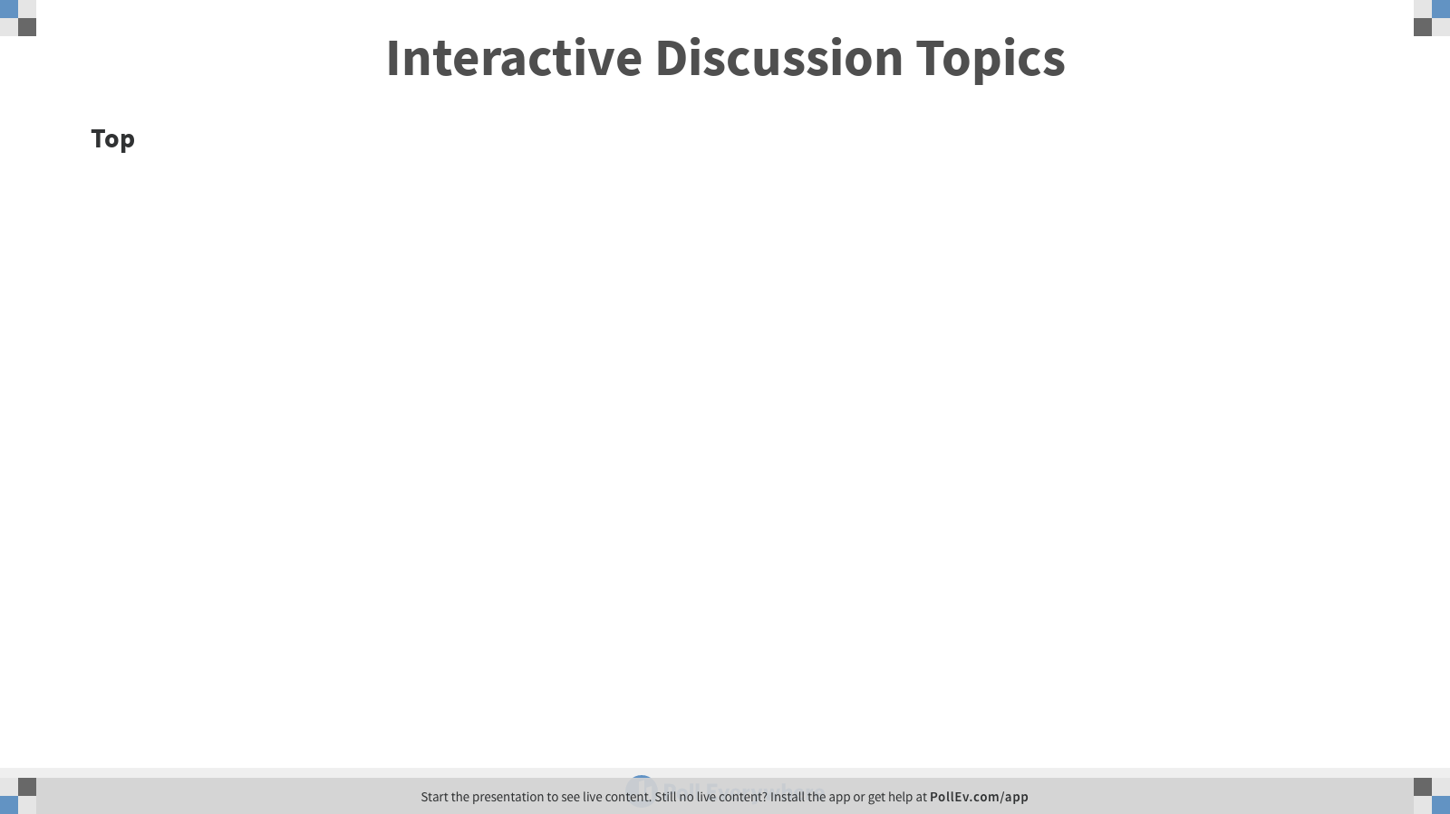

Slide 17
Seed Topics
DEI and Service Management
Service Catalog, what’s the big deal?
Service Management and the PMO

Slide 18
Contact Information
ITSM CG Web
Listserv - itsm@educause.listerv.edu
Slack - itsm-cg-educause.slack.com
Todd Jensen - CG Chair todd.Jensen@nebraska.edu
Mitch Pautz – CG Outgoing Chair mpautz@usc.edu
NOTE: This presentation leaves copyright of the content to the presenter. Unless otherwise noted in the materials, uploaded content carries the Creative Commons Attribution 4.0 International (CC BY 4.0), which grants usage to the general public, with appropriate credit to the author.

Slide 19
Thank you!
Write your name and email on the topic sheet(s) for which you wish to continue the dialogue started here today. * if you are willing to help facilitate.
Contact us if you want to be involved in our Steering Team or want help facilitating a dialogue of your own.
More details about the Educause ITSM CG

Slide 20
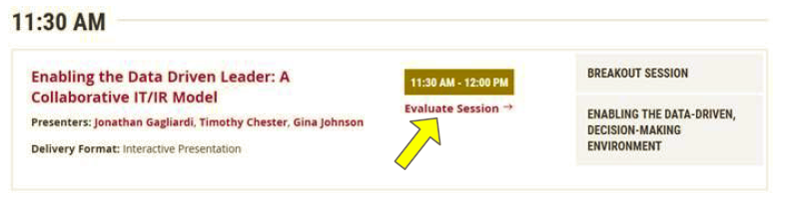
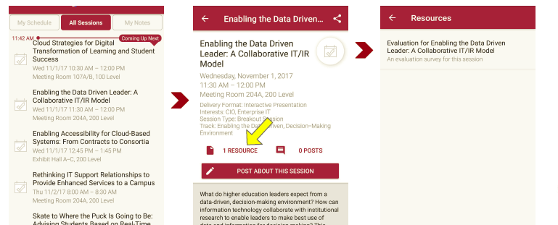
Session Evaluations
There are two ways to access the session and presenter evaluations:
1
2
In the online agenda, click on the “Evaluate Session” link
From the mobile app, click on the session you want from the schedule > then scroll down or click on the associated resources > and the evaluation will pop up in the list

