Slide 1
Research Computing Community Group
October 15, 2019

Slide 2
Co-leads
Curt Hillegas (curt@princeton.edu) Term began some time ago
Sandy Shew (shew.1@osu.edu) Term began 2018
Jackie Milhans (milhans@northwestern.edu) Term began 2019

Slide 3
Steering group
Determine and articulate the mission, goals and activities of the CG
Diverse representation
6—8 members
2-year staggered terms

Slide 4
Periodic discussions
Data management
Cloud
Research IT v. HPC
Regulated data processing
Electronic lab notebooks
Tools
New (or not) technologies
Funding
Training
Diversity
Intersection of research and instruction
Relationship with other research computing organizations
Overlap and synergies with other CGs

Slide 5
Next steps (tentative)
Convene steering group
Plan periodic steering group communications
Plan periodic community group discussions
Topics
Format
Cadence
Do it

Slide 6
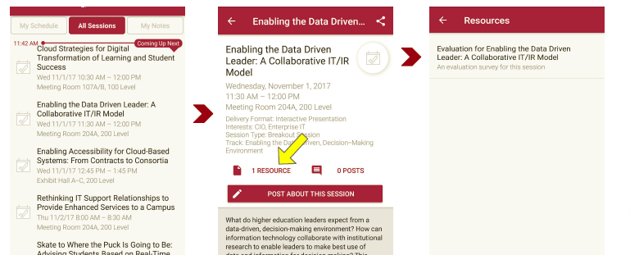
Session Evaluations There are two ways to access the session and presenter evaluations:
1
2
In the online agenda, click on the “Evaluate Session” link
From the mobile app, click on the session you want from the schedule > then scroll down or click on the associated resources > and the evaluation will pop up in the list

Slide 7
Contact Information
The EDUCAUSE Research Computing Community Group Listserv researchcomp@listserv.educause.edu
NOTE: This presentation leaves copyright of the content to the presenter. Unless otherwise noted in the materials, uploaded content carries the Creative Commons Attribution 4.0 International (CC BY 4.0), which grants usage to the general public, with appropriate credit to the author.

