Slide 1
Communications Infrastructure and Applications Community Group Session
Tuesday, October 15, 2019

Slide 3
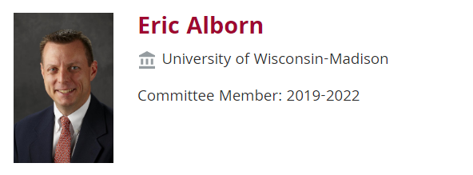
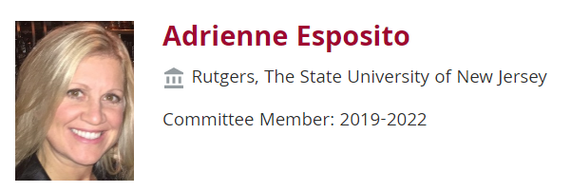
CIA CG Steering Committee
Meet the Co-Chairs!

Slide 4
2019 -Steering Committee Members
Member | Institution
Adrienne Esposito | Rutgers, The State University of New Jersey
Arthur Brant | Abilene Christian University
Eric Alborn | University of Wisconsin - Madison
Geoff Tritsch | Honorary
Jim Jokl, Virginia | University of Virginia
Jon Young | Vantage Communications
Mark Katsouros | Penn State University
Mark Reynolds | University of New Mexico
Richard Hach | Virginia Tech
Tim Lance | NYSERNET
Hank McCarthy | Duquesne University
James Monek | Lehigh University
Ray Soellner | University of Maryland, Baltimore County
Dave Donoho | George Washington University
Dena Mashburn | PCR
Clay Maddox | University of North Florida
Ellen Rayz | San Francisco State University

Slide 5
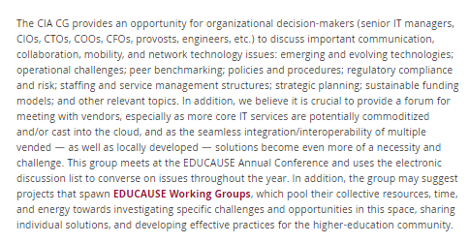
https://www.educause.edu/community/communications-infrastructure-and-applications-community-group

Slide 6
General Topics of Interest
Networking: Datacenter, Research, Convergence, SDN, Virtualization, Wireless
Emergency Communications Management / Mass Notification
Telephony / Unified Communications / Integrated Collaboration
Cellular
Videoconferencing
Mobility, Location Awareness, Presence
Innovation, Funding Models, Risk, Service Sustainability, Strategy

Slide 7
CIA Community Group – In Action!
Subscribe: commtech@listserv.educause.edu @ http://listserv.educause.edu/scripts/wa.exe?SUBED1=commtech&A=1
Subscribers: 448 (95 new for 2019)
Steering committee:
17 members
Meets and plans activities - biweekly calls
Monthly Virtual “Meet-Ups”
Annual EDUCAUSE meeting
Annual Pre-Conference Workshop!

Slide 8
Monthly “Virtual Meet-Ups”

Slide 9
Monthly “Virtual Meet-Ups”
50+ Participants per Call
Hosted 5 calls so far this year (May-September) – Next Call 10/23/19
CIA Constituent Group Virtual Meetup - Running Agenda and Notes: https://docs.google.com/document/d/1DWwu9uqd0DihKD0LtPi4a8oUKv_Zcq06lFF-JGCoaEg/edit (Topics inside)
Meeting Date/time: Meeting the 4th Wed of every month at 11am eastern.
Logistics: https://zoom.us/j/852040219
Dial by your location
+1 646 876 9923 US (New York)
+1 669 900 6833 US (San Jose)
Meeting ID: 852 040 219

Slide 10
Your Hosts! Arthur Brant & Jon Young

Slide 11
Get in on the ACTION!
Resource Links …
Topic Sign Up Sheet:
https://docs.google.com/document/d/1AljKcetfbu-IyWbWku-9JExZoHpmXM-qEKs5Q8hHAw8/edit?usp=sharing
List of potential meetup topics:
https://docs.google.com/document/d/1zZ_2HuwpAzkXMrvoAVs0NWMJZ4efVgF9tQz67_8Owyw/edit?usp=sharing
Potential Benchmarking Questions: https://docs.google.com/document/d/1tNHP3hdokkBNcta84A9Iik8bjVsbDKdd0tClOZB9fUk/edit?usp=sharing
For More Information:
Arthur Brant: branta@acu.edu
Jonathan Young: jonyoung@vantagetcg.com

Slide 12
Questions?

Slide 13
Interested? – We Want You!
For More Information – or to volunteer to serve!
Adrienne Esposito: aespos@oit.rutgers.edu
Eric Alborn: eric.alborn@wisc.edu

