Slide 1
Business Relationship Management Community Group
Presented by:
Mike Morris
Andre Harris
Shari Kearl
PLEASE SIGN-IN:
https://tinyurl.com/brm-cg-2019

Slide 2
Agenda
Welcome
CG Exercise: ‘Lightning Chats’
Next Steps
Networking

Slide 3
Lightning Chats
10 minute roundtable discussions of 3-4 BRM-related questions
Chat facilitators: Shari Kearl, Mike Morris, Andre Harris

Slide 4
Questions
How to market and promote BRM role to partners and lessons learned?
How to balance internal vs. external engagement (i.e., your department vs. not your department)?
How to perform the BRM function with less than optimal amount of resources?
Ways to deliver or demonstrate the value of BRM?

Slide 5
Next steps
Post-Educause Webinar – debrief of discussions
Feedback: Questions? Ideas?
Join the BRM Community Group!
BRM@listserv.educause.edu
To join: https://www.educause.edu/community/business-relationship-management-community-group
Join the BRM CG Slack Channel!
https://brmcg.slack.com

Slide 6
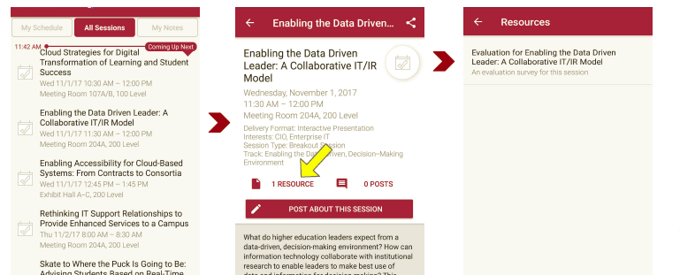
Session Evaluations There are two ways to access the session and presenter evaluations:
1
2
In the online agenda, click on the “Evaluate Session” link
From the mobile app, click on the session you want from the schedule > then scroll down or click on the associated resources > and the evaluation will pop up in the list

Slide 7
Contact Information
Shari Kearl
Assistant Director, Business Relationship Management
Cornell Information Technologies
Cornell University
slk9@cornell.edu
West Phinney
Director, Relationship Management
Information Systems & Computing
University of Pennsylvania
phinneyw@isc.upenn.edu
Andre Harris
Client Relationship Manager
Information Systems & Computing
University of Pennsylvania
harris2@isc.upenn.edu
Mike Morris
Client Relationship Manager
Information Systems & Computing
University of Pennsylvania
morrismi@isc.upenn.edu
NOTE: This presentation leaves copyright of the content to the presenter. Unless otherwise noted in the materials, uploaded content carries the Creative Commons Attribution 4.0 International (CC BY 4.0), which grants usage to the general public, with appropriate credit to the author.

