Slide 1
IT Accessibility Community Group Meeting
Kyle Shachmut (co-chair, facilitator)
Tuesday, October 15, 2019
4:15p | W187-C, Level 1
Chicago, IL

Slide 2
What is digital accessibility?
Making electronic content available to and usable by everyone [at the same time, with the same ease of use], including and especially people with disabilities
Why? To make our campus communities more inclusive and welcoming places

Slide 3
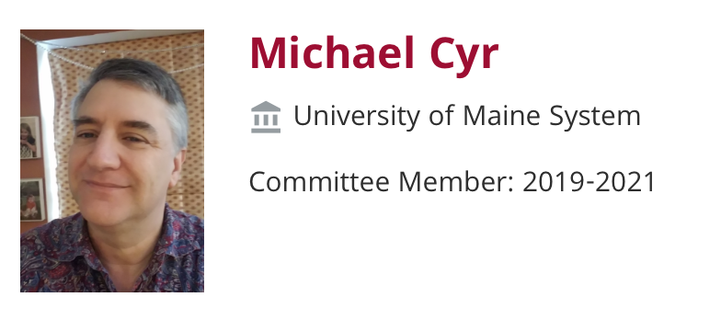
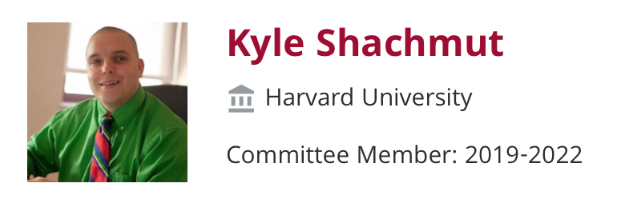
IT Access CG Leadership
Meet the Co-Chairs!

Slide 4
2019 – A Year of Transition
New CG co-chairs
Newly forming steering committee
New meeting platform (Zoom)
Meeting format tweaks
New Community Resources with ELI:
7 Things You Should Know About Procurement for Accessibility https://library.educause.edu/resources/2018/10/7-things-you-should-know-about-technology-procurement-for-accessibility
7 Things You Should Know About Accessibility Policy https://library.educause.edu/resources/2019/2/7-things-you-should-know-about-accessibility-policy

Slide 5
IT Access CG Resources
Meetings: 1st Wed of the month 1-2p Eastern / 10-11a Pacific
Next meeting: Nov 6, 2019
Topic: IT Accessibility Teams
Suggest a future meeting topic or speaker form: https://forms.gle/DZq8CzNW2WPXZVSM8
IT Access CG website: https://www.educause.edu/community/it-accessibility-community-group
IT Access Listserv: http://listserv.educause.edu/scripts/wa.exe?SUBED1=itaccess&A=1

Slide 6
Hot Topics in IT Accessibility
Within Institutions
For EDUCAUSE
How can EDUCAUSE continue to improve and model accessibility across digital platforms?
Websites, wikis, conferencing platforms, etc.
Facilitating role of info sharing among institutions
Disseminating information among institutions
Procurement of accessible information and communications technologies
Potential & limitation of automation technologies for accessibility
Setup & structure of a11y teams
DEI & Legal perspectives

Slide 7
Questions & Discussion

