Slide 1
SharePoint & Office 365 Community Group

Slide 2
SP & O365 CG Activity
 | 2018 |  |  | 2019
 | OCT | NOV | DEC | JAN | FEB | MAR | APR | MAY | JUN | JUL | AUG | SEP
Threads | 0 | 5 | 3 | 2 | 3 | 1 | 0 | 3 | 0 | 1 | 0 | 0
Posts | 0 | 8 | 3 | 6 | 11 | 4 | 0 | 22 | 0 | 1 | 0 | 0

Slide 3
INCREASE SP & O365 CG ENGAGEMENT

Slide 4
Collab365 Community’s Virtual Summits

Slide 5
The Periodic Table of Office 365 v3 beta
https://jumpto365.com

Slide 6
Monthly Discussions
November | December | January | February | March | April
May | June | July | August | September | October

Slide 7
New Questions Each Week
How has the tool been successfully leveraged in your organization?
What challenges prevented the tool from being used? How, if at all, were those challenges overcome?
What benefits does this tool offer your organization?
What are the best training resource you’ve used or would recommend for this tool?
Are any faculty members using this tool in their curriculum?

Slide 8
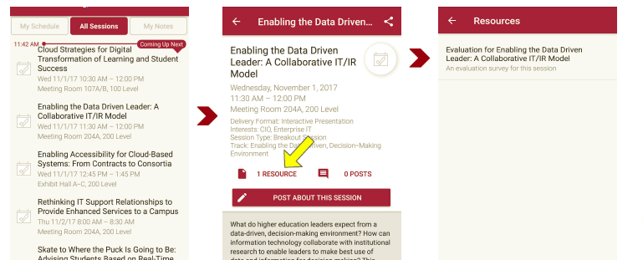
Session Evaluations There are two ways to access the session and presenter evaluations:
1
2
In the online agenda, click on the “Evaluate Session” link
From the mobile app, click on the session you want from the schedule > then scroll down or click on the associated resources > and the evaluation will pop up in the list

Slide 9
Resources
Collab365 Community’s Virtual Summits
jumpto365’s Periodic Table of Office 365

Slide 10
Contact Information
https://www.educause.edu/community/sharepoint-and-office-365-community-group
SHAREPOINT@LISTSERV.EDUCAUSE.EDU
NOTE: This presentation leaves copyright of the content to the presenter. Unless otherwise noted in the materials, uploaded content carries the Creative Commons Attribution 4.0 International (CC BY 4.0), which grants usage to the general public, with appropriate credit to the author.

