Slide 1
Diversity in IT 2019 Educause Annual Meeting #EDU19

Slide 2
Welcome to D.I.T.
This community group provides an environment for open dialogue and create avenues for collaboration to support group members, provide mentors, and advocate for diversity issues as they relate to members and higher education within Information Technology.

Slide 3
Co-Leaders of D.I.T.
Aisha Hamilton
Director – IT Communications
Washington University in St. Louis
Lamont Eddins
Senior Instructional Designer
Berkeley College

Slide 4
Expanding University Diversity Impact Through Community Outreach
Session Topic

Slide 5
Community Outreach!!!!
Can community outreach from higher education institutions expand IT diversity? What types of impact can it have? Will certain challenges stand in the way? We will discuss if and how community outreach from higher ed institutions could positively influence IT diversity.

Slide 6
Welcoming & Presenting the Session’s Topic Panel Discussion

Slide 7
Guest Speaker
Markeisha Einsley
Job Title: Service Specialist, Columbia University Information Technology (CUIT), Academic Services
Bio: Markeisha is co-chair of the Community Outreach Committee which is a part of the Women in Technology Initiative (WIT) at Columbia University. Dedicated to providing youth in underserved areas training and exposure to opportunities in technology, she is also a professional musician and teaching artist. She is grateful to share her passion for teaching and technology through WIT’s community outreach volunteering!

Slide 8
Guest Speaker
Robert Casarez
Job Title: Business Systems Analyst Specialist, Office of Information Technology, University of Notre Dame
Bio: Robert has the duties as business analyst and project manager for the University’s business units. Where he leads the Diversity & Inclusion Project for the OIT. He has served in various roles at the University of Notre Dame over the last 12 years, including Assistant Director for Residence Life and Housing and Senior Business and Technical Specialist for Auxiliary Operations

Slide 9
How significant is DIT to your institution?
Takeaway Question 1

Slide 10
Will Community Outreach positively impact DIT where your institution is located?
Takeaway Question 2

Slide 12
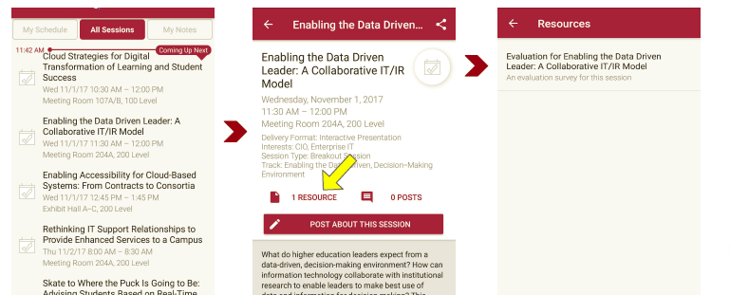
Session Evaluations There are two ways to access the session and presenter evaluations:
1) In the online agenda, click on the “Evaluate Session” link
2) From the mobile app, click on the session you want from the schedule > then scroll down or click on the associated resources > and the evaluation will pop up in the list

Slide 13
Contact Information
Aisha Hamilton
Director of IT Communication
Washington University in St. Louis
Aisha.Hamilton@wustl.edu
Lamont Eddins
Senior Instructional Designer
Berkeley College
cle@berkeleycollege.edu
Twitter: @cleidwork
NOTE: This presentation leaves copyright of the content to the presenter. Unless otherwise noted in the materials, uploaded content carries the Creative Commons Attribution 4.0 International (CC BY 4.0), which grants usage to the general public, with appropriate credit to the author.

