Slide 1
eXtended Reality (XR) Community Group Session
FACILITATED BY:
William McCreary, Bobbi Vaughan, Gemma Henderson, Art Sprecher

Slide 3
Agenda
1
2
3
4
5
6
Welcome
CG Survey & Interim Meetings Input
Subgroup Charter Overview & Discussion
XR Technologies Discussion
XR Content Discussion
XR CG Next Steps & Close

Slide 4
Welcome

Slide 5
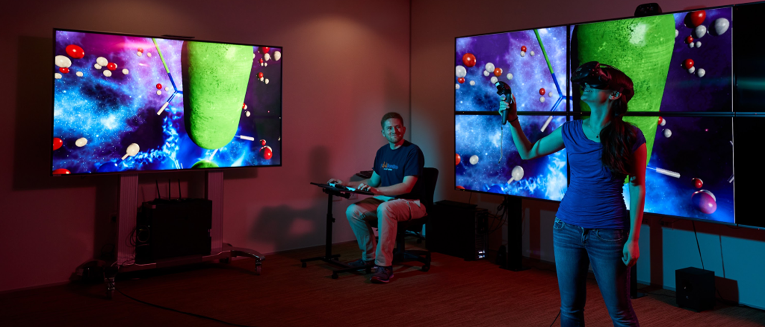
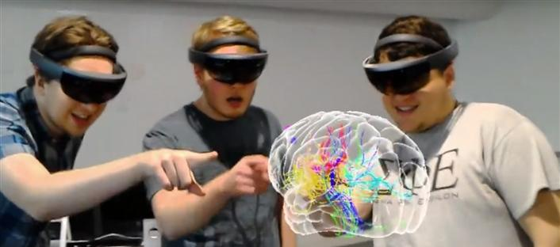
What is eXtended Reality (XR)?
XR encompasses virtual, augmented and mixed reality and captures both the continuum between and the growing convergence of the physical and virtual worlds we inhabit.
Virtual Reality (VR) or Virtual Immersive Reality (VIR)
Computer generated artificial environment that emulates reality. An immersive setting where no part of the real world exists.
Augmented Reality (AR) or “Mixed reality” (MR)
Live direct/indirect view of real world where elements are augmented, supplemented or enhanced by computer generated sensory inputs.
Notes:
Bill and Art
AR/MR Image from https://er.educause.edu/articles/2018/7/mixed-reality-a-revolutionary-breakthrough-in-teaching-and-learning

Slide 6
CG Survey & Interim Meetings Input

Slide 7
CG Survey & Interim Meetings Input
Three subgroups received the most interest:
XR Technology and Tools – All the gizmos and development tools
We have a volunteer for the subgroup lead – Thank you Bobbi!
XR Content – Raise awareness of VR/AR/MR content being developed and applied within higher education
We have a volunteer for the subgroup lead – Thank you Gemma!
XR and specific subject application – e.g. XR and Liberal Arts, XR and STEM
We do not have a volunteer for the subgroup lead
Notes:
Bill and Art

Slide 8
Subgroup Charter Overview & Discussion

Slide 9
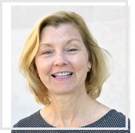
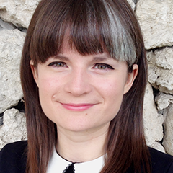
XR CG: Sub-Groups & Leaders
Focus on outreach, resources and guidance on use of XR technologies and content within higher education.
XR Technologies & Tools
XR Content
Bobbi Vaughan
Director of the Center for Creative Instruction
University of Toledo, Ohio
Gemma Henderson
Senior Instructional Designer, Academic Technologies
University of Miami, Florida
Notes:
Gemma Henderson is a Senior Instructional Designer in the Learning Innovation and Faculty Engagement team at the University of Miami. Gemma partners and consults with faculty, academic units and other university stakeholders across the University focusing on curriculum development and digital pedagogies. Gemma has designed and facilitated three faculty learning communities focused on 3D technologies (printing, scanning, visualization) within the undergraduate curricula, including the latest on Augmented Reality and Spatial Computing.

Slide 10
XR Technology & Tools SG

Slide 11
XR Technology & Tools
Provide access to a list of VR/AR/MR technology and tools to higher educational institutions for guidance on development and/or purchasing decisions.
Desired Outcomes
1
Inventory of Tools
Assemble a list of XR hardware/software.
2
Identify XR Use Cases
Associate use cases with inventory of tools.
Year 1: Initial Outreach Activities and Programming
Survey CG and Explore Ways to Share Results, Attend/Host Virtual Sessions in VR/AR/MR, Establish Repository of Technology & Tool Resources, Submit Presentation Topics for CG Meetings / Webinars.
Notes:
Bobbi

Slide 12
XR Technology & Tools: Questions for CG
What outcomes should we prioritize for Year 1?
Are there any other pressing issues you would like this group to address?
Are there any members interested in leading specific outcomes?
1
Assemble a list of XR hardware/software.
2
Associate use cases with inventory of tools.
Notes:
Which institutions are creating XR content, engaging with special collections, and implementing open content?

Slide 13
XR Content SG

Slide 14
XR Content
Raise awareness of VR/AR/MR content being developed and applied within higher education institutions for pedagogical and research purposes.
Desired Outcomes
1
Creation of Content
Identify institutions creating XR Content.
3
Crowdsource resources from community to create / apply XR Content.
2
Application of Open Content
Identify institutions applying Open Content.
4
Establish cross-institutional communities to shape other SGs.
Year 1: Initial Outreach Activities and Programming
Survey CG and Explore Ways to Share Results, Attend/Host Virtual Sessions in VR/AR/MR, Establish Repository of Resources, Submit Presentation Topics for CG Meetings / Webinars.
Notes:
Bobbi
Leaders: Collaborate with other sub-group leaders to ensure limited overlap across group resources and coordinate outreach efforts accordingly.
Participants: Identify their needs of an XR Community Sub-Group, and communicate their institutional XR efforts, attend or engage in webinars.

Slide 15
XR Content: Questions for CG
What outcomes should we prioritize for Year 1?
Are there any other pressing issues you would like this group to address?
Are there any members interested in leading specific outcomes?
1
Identify institutions creating XR Content.
3
Crowdsource resources from
community to create / apply XR Content.
2
Identify institutions applying Open Content.
4
Establish cross-institutional communities to shape other SGs.
Notes:
Which institutions are creating XR content, engaging with special collections, and implementing open content?

Slide 16
XR CG Next Steps & Close

Slide 17
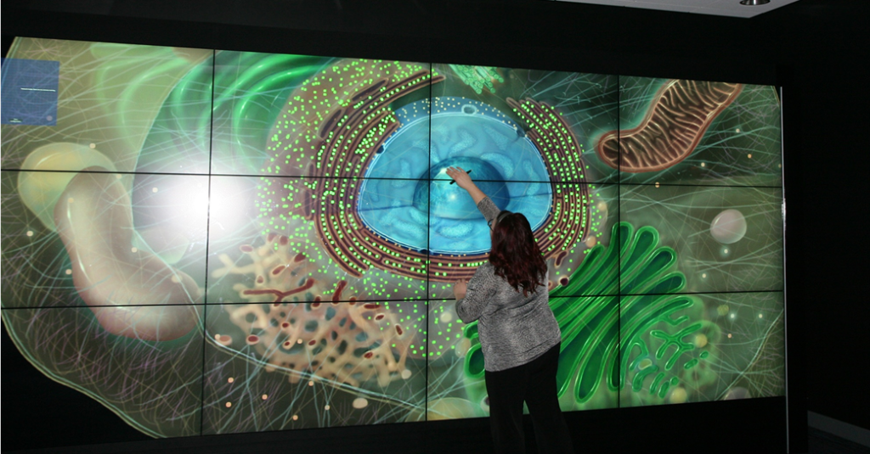

Slide 18
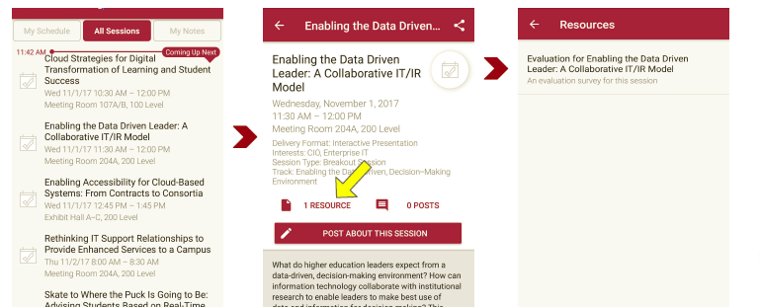
Session Evaluations There are two ways to access the session and presenter evaluations:
1
2
In the online agenda, click on the “Evaluate Session” link
From the mobile app, click on the session you want from the schedule > then scroll down or click on the associated resources > and the evaluation will pop up in the list

Slide 19
Contact Information
XR Technology & Tools: Bobbi Vaughan, University of Toledo, bobbi.vaughan@utoledo.edu
XR Content: Gemma Henderson, University of Miami, gemma@miami.edu
NOTE: This presentation leaves copyright of the content to the presenter. Unless otherwise noted in the materials, uploaded content carries the Creative Commons Attribution 4.0 International (CC BY 4.0), which grants usage to the general public, with appropriate credit to the author.

