Slide 1
Student Success Analytics Community Group
Tuesday, October 15, 2019
10:45am to 11:30am
W185bc, Level 1
While you are waiting, please log into our collaborative Google Doc: [http://tiny.cc/SSACGEAM19]
Notes:
Lou

Slide 2
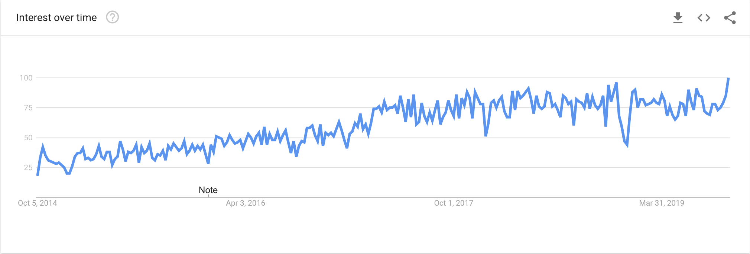
Goals
The goal of the community group is to promote, educate, and further a network of practitioners with a desire to improve student success through the use of analytics. The more we can collaborate and share on these efforts, the easier it is for these initiatives to grow and succeed.
Google Trends tracking of “learning analytics”
Notes:
Lou

Slide 3
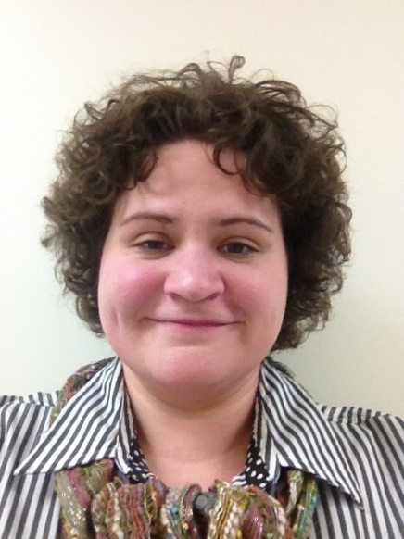
Domains
Our 5 domains:
Promotion of CG (Lou)
Quarterly webinar series (Andy/Mitchell)
Resource Hub (Deb/Bryan)
Outreach protocol– especially internationally (Ian)
Engagement and communication strategy (Linda)
Chair: Kim Arnold
UW-Madison
Notes:
Lou

Slide 4
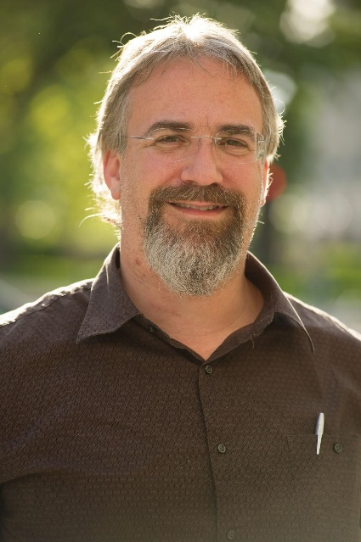
Domain #1: Promotion of SSA CG
Getting the word out
Everyone from interested neophytes to world experts are welcome.
People are at all levels of understanding and we need to reach them all.
Ways to contribute
Be engaged (slack, listserv, attend webinars, etc.)
Be active (give webinar, help with curation, etc.)
Be generous (eventually, we might be able to take small donations to help fund the group)
Continue the discussion, at lunch today!
Lou Harrison
NC State University
Notes:
Lou

Slide 5
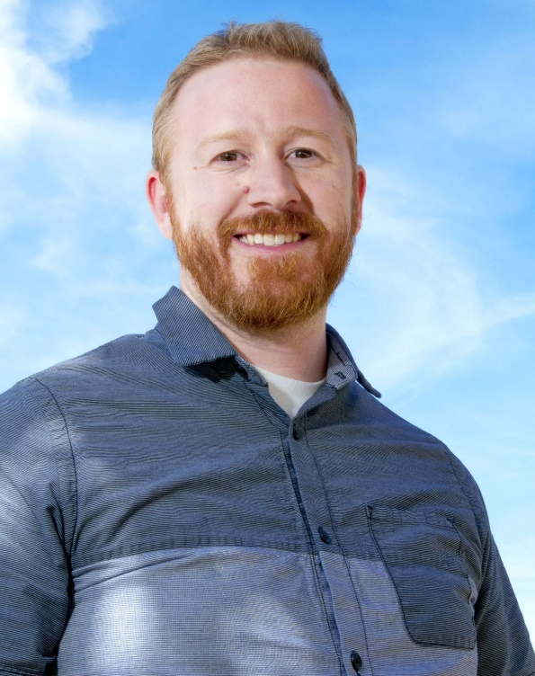
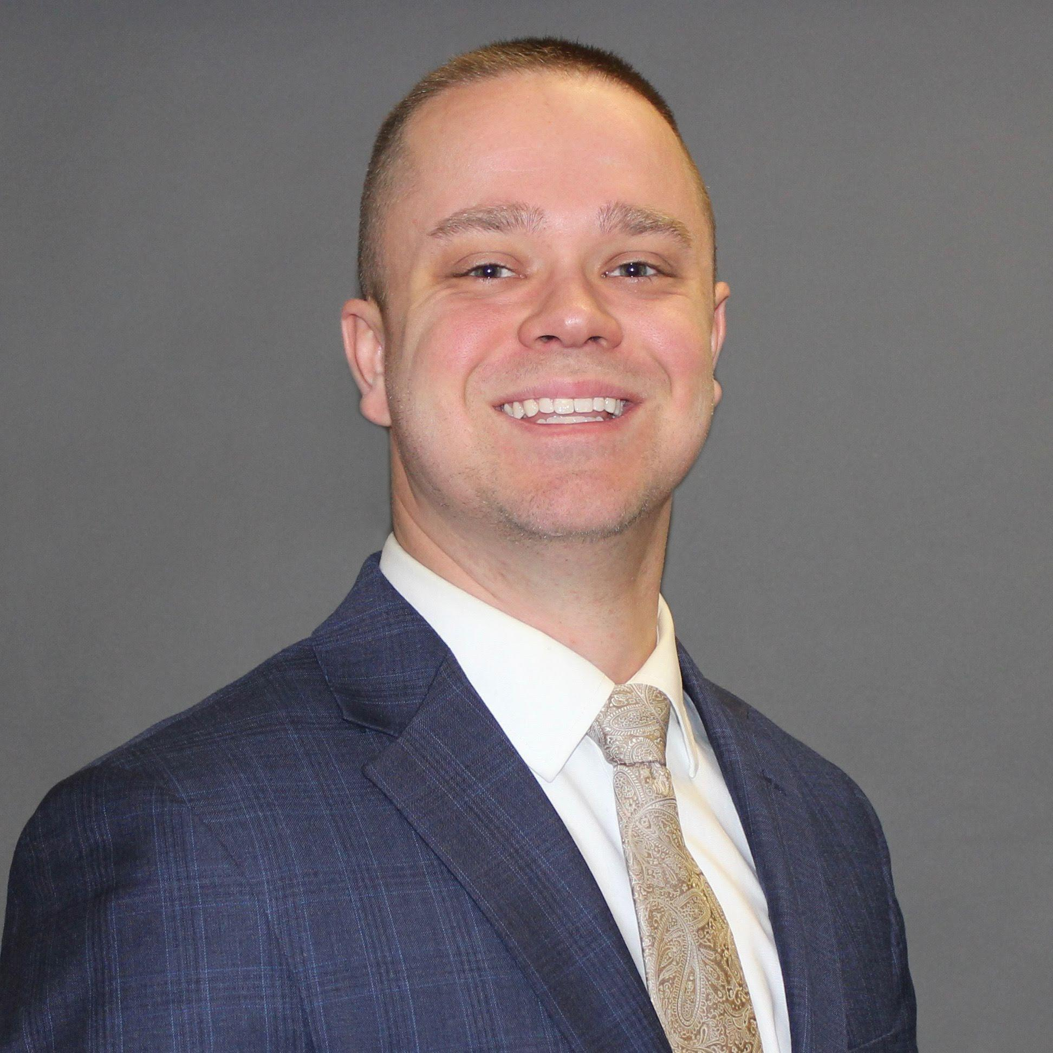
Domain #2: Quarterly Webinar Series
Host quarterly webinars
crowdsource topics most important to the CG and encourage CG submission of presentations
seek to balance topics (technical, theoretical, methods, etc)
align webinar topics with resource hub
Andy Miller
Blackboard Inc.
Mitchell Culver
Utah State University
Notes:
Lou

Slide 6
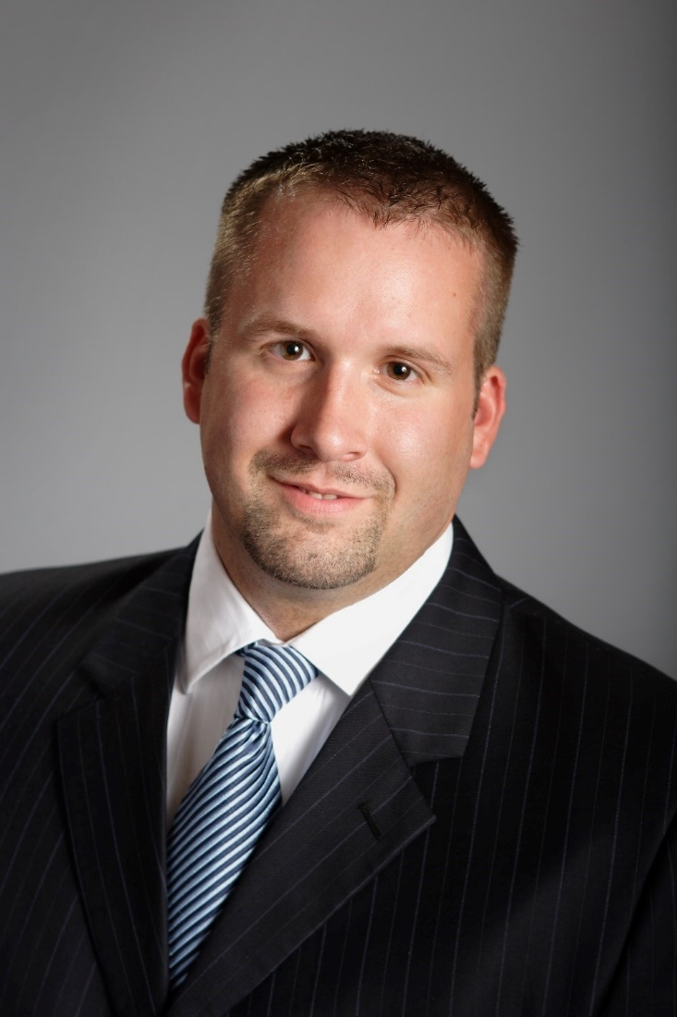
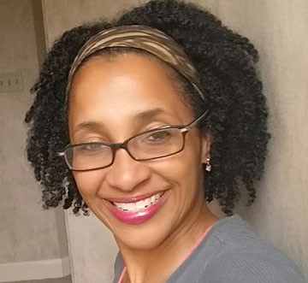
Domain #3: Resource Hub
Purpose
Content Type (Webinar Recordings, Whitepapers, Publications, Training Resources, Analytics Toolkit)
Organized by Audience
Administrators
Advisors / Success Coaches
Faculty
Institutional Research
Submission Process
Submission
Content Evaluation
Incoming chair: Deb Anderson
Ivy Tech Community College
Bryan Bell
Avisio Retention
Notes:
Lou

Slide 7
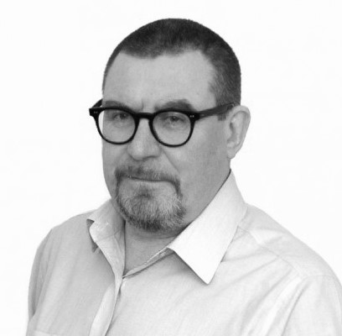
Domain #4: Outreach Protocol
LA activity is global, but at an early stage
Networking early practical activity brings benefits -
Validate practice against the experience and perspectives of peers
Learn of and iterate around the experience of innovation at other institutions
Raise the profile of the institution or individual concerned
Expose your methodology to peers
Explore possible synergistic activity
Create network to exchange key documentation easily & simply
Help understand differing contexts and objectives worldwide
Understand scope and goals of other analytics communities
Seek to add value by exchange, not duplicate existing activity
Be mindful of, and dovetail with, other EDUCAUSE partnership activity
Ian Dolphin
Apereo
Notes:
Linda

Slide 8
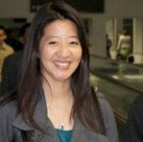
Domain #5: Engagement and Communication
Slack Channel - feel free to join the discussion here: (invite link)
ListServ: STUDENTSUCCESS@LISTSERV.EDUCAUSE.EDU
Guidelines for Participation: https://www.educause.edu/community/community-group-participation-guidelines
Post Responsibly
Linda Feng
Unicon
Notes:
Linda
Slack
link to sign up
right now, anyone who joins is free to invite others as well
also, everyone can @everyone, @channel, create and invite others to public and private groups
l
https://www.educause.edu/community/community-group-participation-guidelines

Slide 9
What have we been doing?
(other than meeting every two weeks)
Webinars, 4 webinars since last year, total 189 attendees
Discussions on Slack
Members tripled in last 9 months, now almost 200
Survey
Resource Hub
Click the SSA CG Webiste link at http://tiny.cc/SSACG
Global Conversations with Jisc and Université de Lorraine
Notes:
Linda
LIST OF ACCOMPLISHMENTS
Lou to ask Kim for membership growth #s

Slide 10
379
Oct 2018
post Educause
435
218
Feb 2018
Dec 2018
640
after adding webinar attendees
April 2019
CG Listserv Membership
after LAK/webinar
Notes:
Sept 2019 membership = 589 (note we didn't add anyone after our last 2 webinars.

Slide 11
240 new members in 2019 (41% of our total membership)
325 unique domains
40 internal domains
225 from .edu domains
12 from .org

Slide 12
2019 Survey Results in a nutshell
 | 2018 | 2019 | Change
Administrator | 44% | 23% | -21%
Customer Relations/Sales | 3% | 2% | -1%
Educational Researcher | 8% | 13% | +5%
Faculty Member/Instructor | 3% | 3% | --
Information Technologist | 21% | 26% | +5%
Librarian | 3% | 3% | --
Research & Development | 3% | 5% | +2%
Student Affairs | 3% | 7% | +4%
Other | 6% | 18% | +12%
Motivation to join SSA CG
I wanted to hear how others approach student success analytics (77%)
I wanted to stay current on method trends (68%)
I wanted to network with thought leaders in the field (61%)
 | 2018 | 2019 | Change
HigherEd | 90% | 95% | + 5%
K-12
Non Profit | 1% |  | -1%
EdTech, primary analytics focus | 9% | 5% | -4%
Edtech, non-primary analytics focus
Notes:
Linda

Slide 13
Your Chairs for 2020
Deb Anderson, SSA CG Chair
Ivy Tech Community College
Kim Arnold,
SSA CG Outgoing Chair
UW-Madison
Andy Miller, SSA CG Incoming Chair
Blackboard Inc.
Notes:
Kim will become outgoing chair
Deb becomes chair
Andy becomes chair elect

Slide 14
Thank you to retiring SC members
Bryan Bell, Aviso Retention
Lou Harrison, NC State
Notes:
Kim will become outgoing chair
Deb becomes chair
Andy becomes chair elect

Slide 15
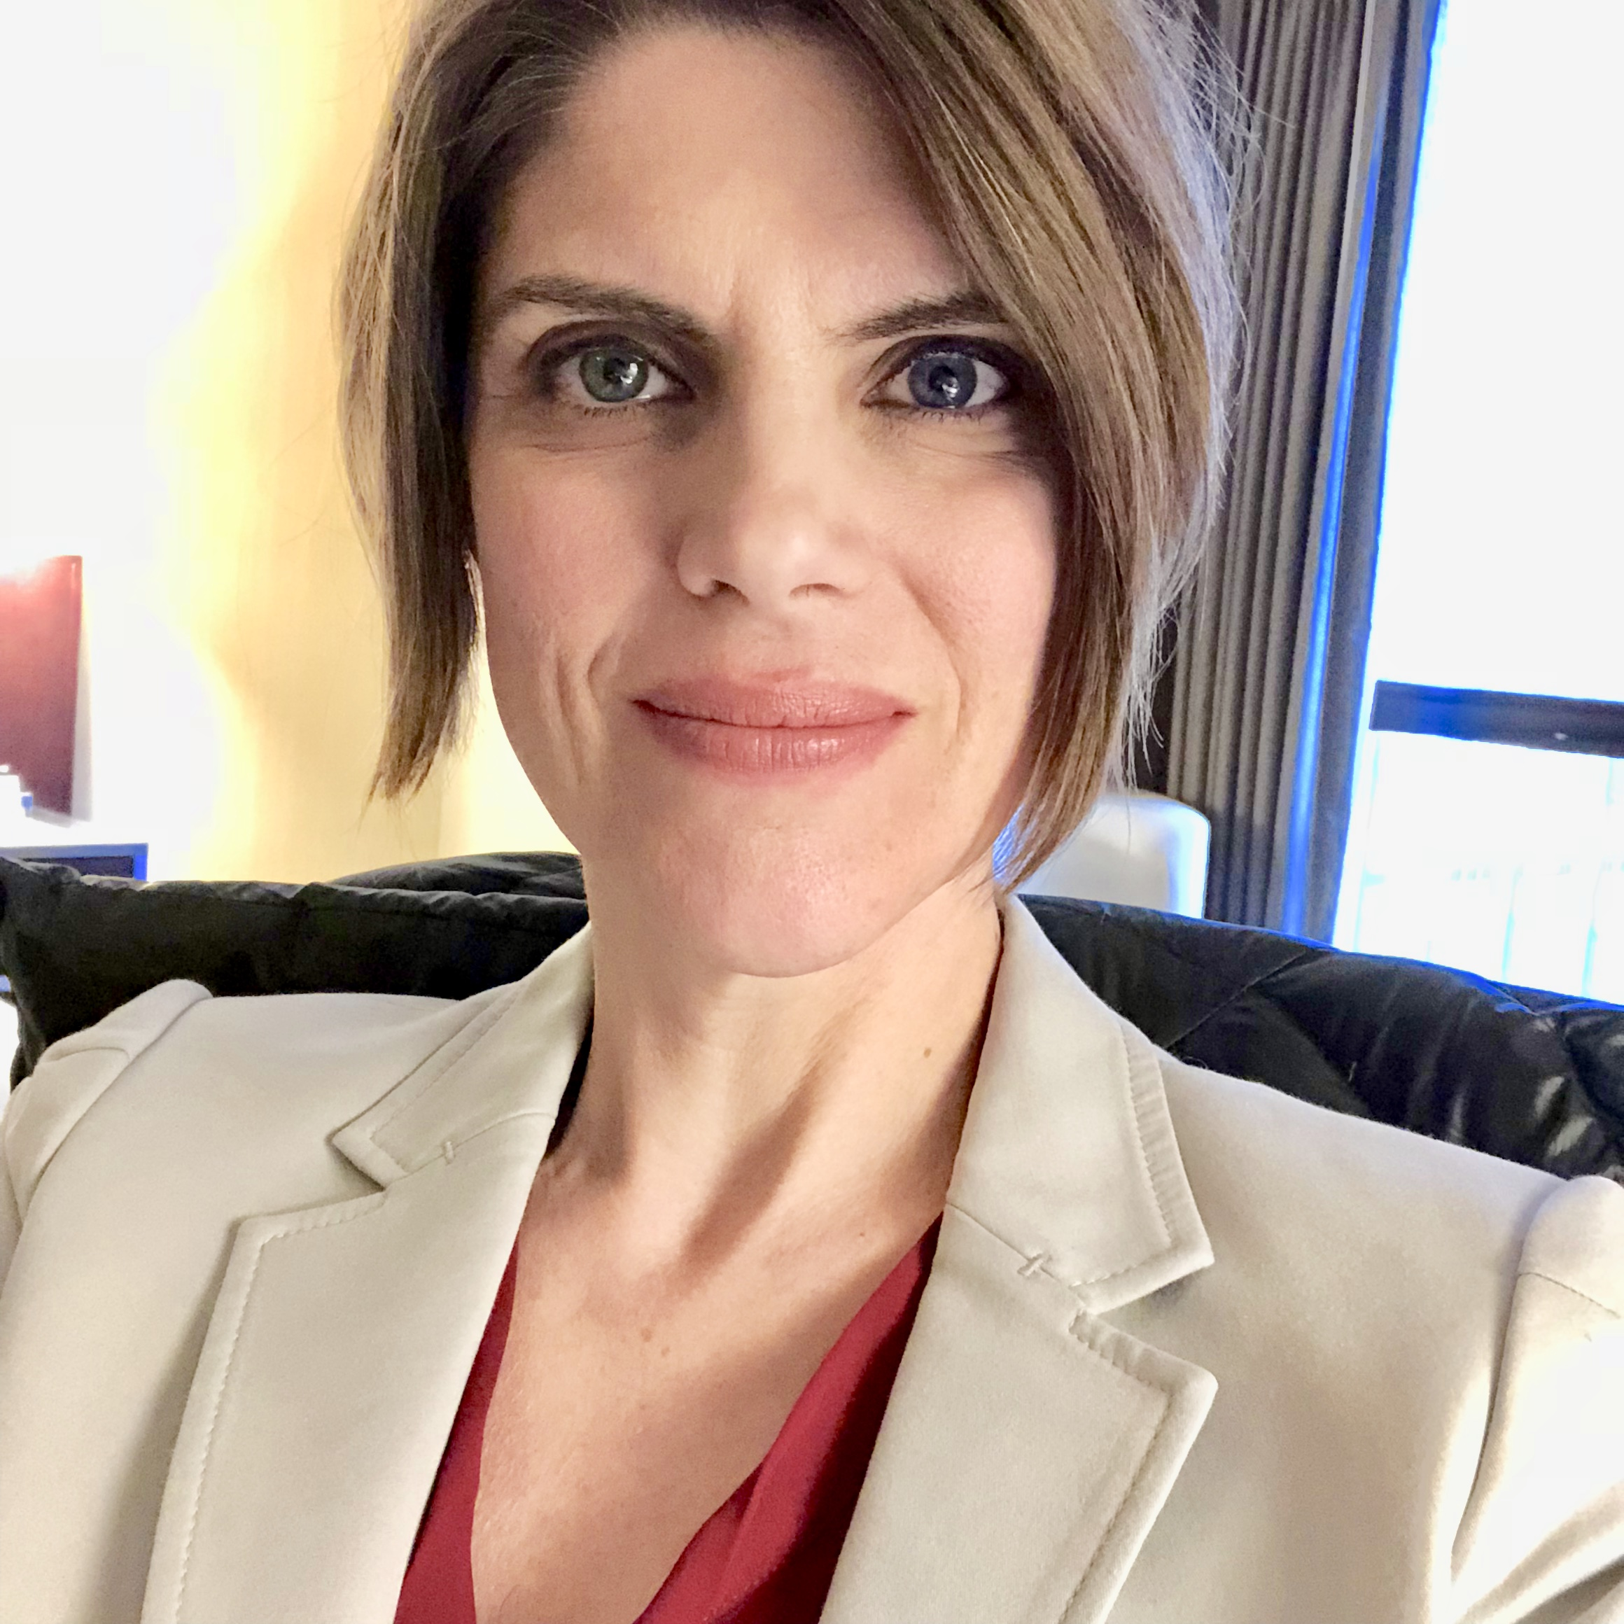
Your continuing SC members
Linda Feng, Unicon
Ian Dolphin, Apereo
Mitchell Culver,
Utah State University
Kathe Pelletier, EDUCAUSE
(ad hoc SC member)

Slide 16
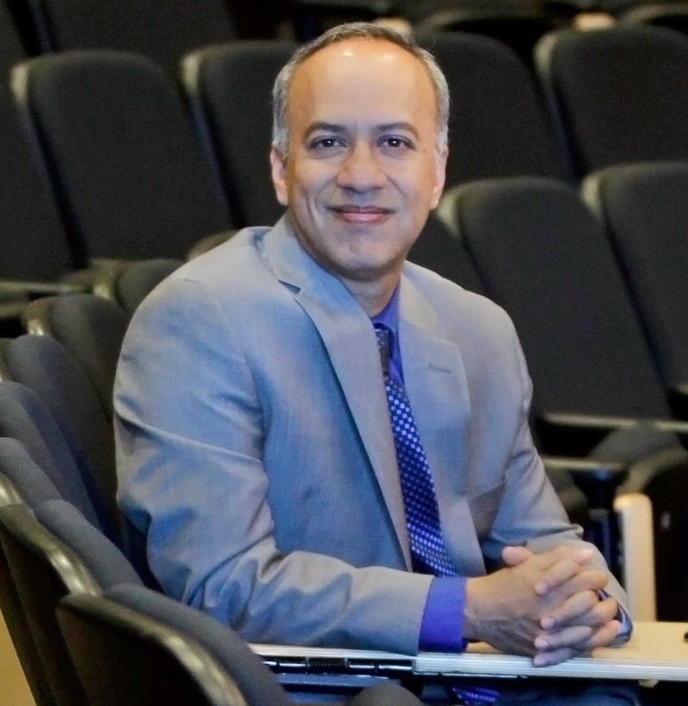
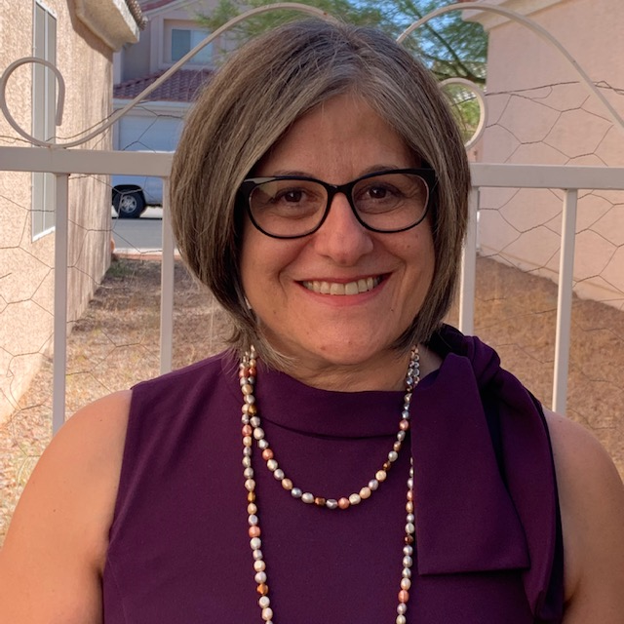
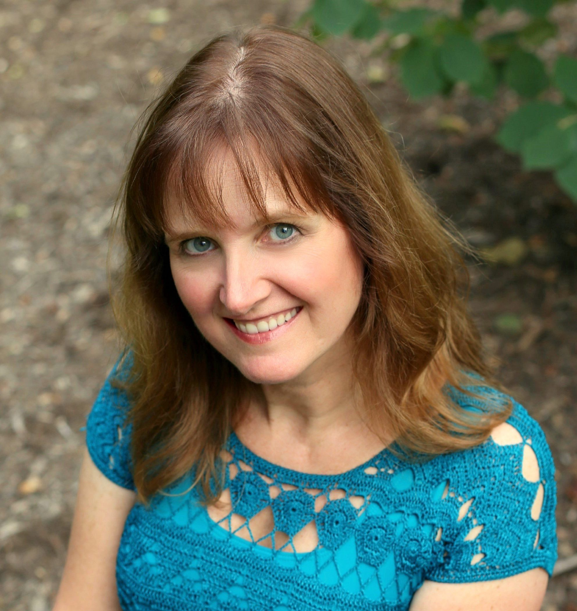
Your new SC members
Gautam Saha,
Georgetown University Qatar
Vartouhi Asherian,
College of Southern Nevada
Marcia Ham,
The Ohio State University

Slide 17
Now we want to hear from you
Notes:
Lou & Linda

Slide 18
…to get you thinking
Take a moment and think about SSA and add to the Google Doc (http://tiny.cc/SSACGEAM19):
What can you contribute to making this group a success?
What are your needs and expectations from this group?
What types of people would you like to meet via this group ?
Take a moment and review what others have including –upvote (+1) those that interest you the most
Notes:
Lou & Linda

Slide 19
Student Success Analytics Community Group
Let’s extend the conversation at lunch today (Tuesday, October 15, 2019)!
Come find the tables labeled for the Educause Student Success Analytics Community Group at the lunch area in hall F1-F2 on level 3 of McCormick Place West.
Lunch starts at 12:15pm.

Slide 20
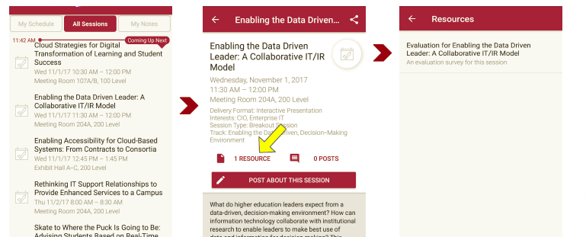
Session Evaluations There are two ways to access the session and presenter evaluations:
1
2
In the online agenda, click on the “Evaluate Session” link
From the mobile app, click on the session you want from the schedule > then click the associated resources > and the evaluation will pop up in the list

