Slide 1
OUR LEADERSHIP JOURNEYS
Becoming Bold & Connected
Linda Jorn
Recipient of 2019 EDUCAUSE Leadership Award
Associate Vice Provost for Learning Technologies and DoIT Director of Academic Technology University of Wisconsin-Madison

Slide 2
WHAT IS LEADERSHIP?
“Management is doing things right; leadership is doing the
right things.”
Peter Drucker
Establish Strategy
Deliver Results
Inspire & Develop People
Design Organizational Structures

Slide 3
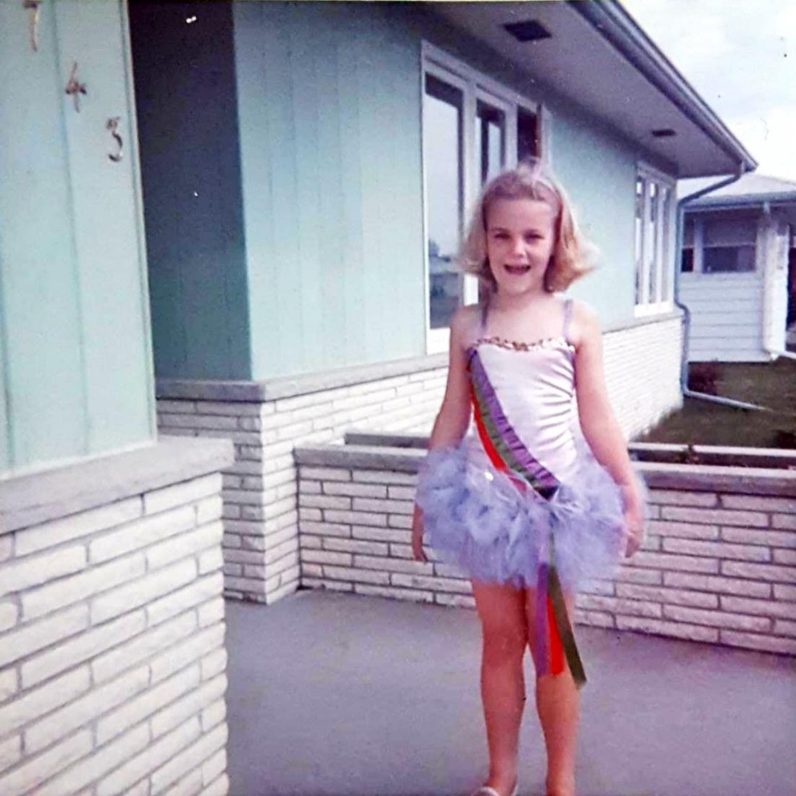
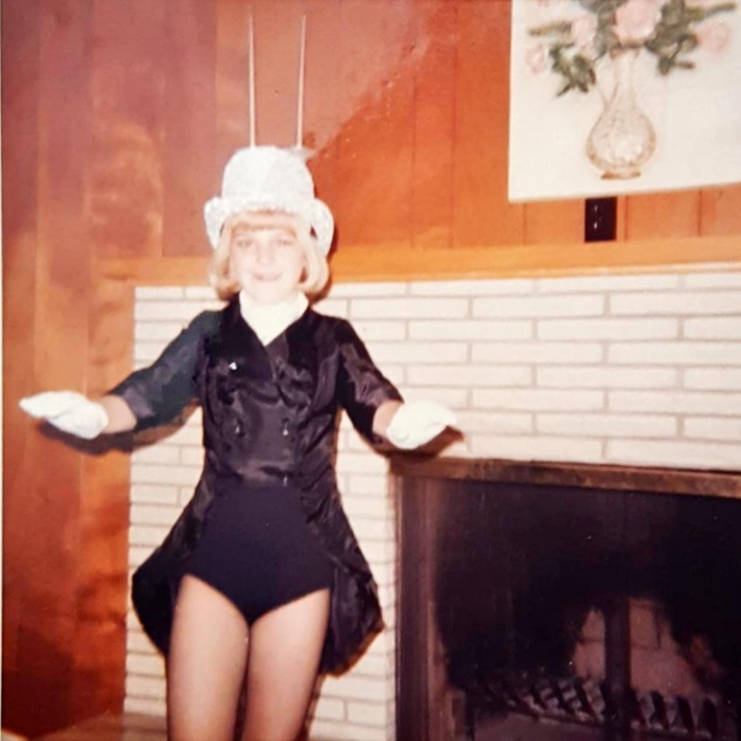
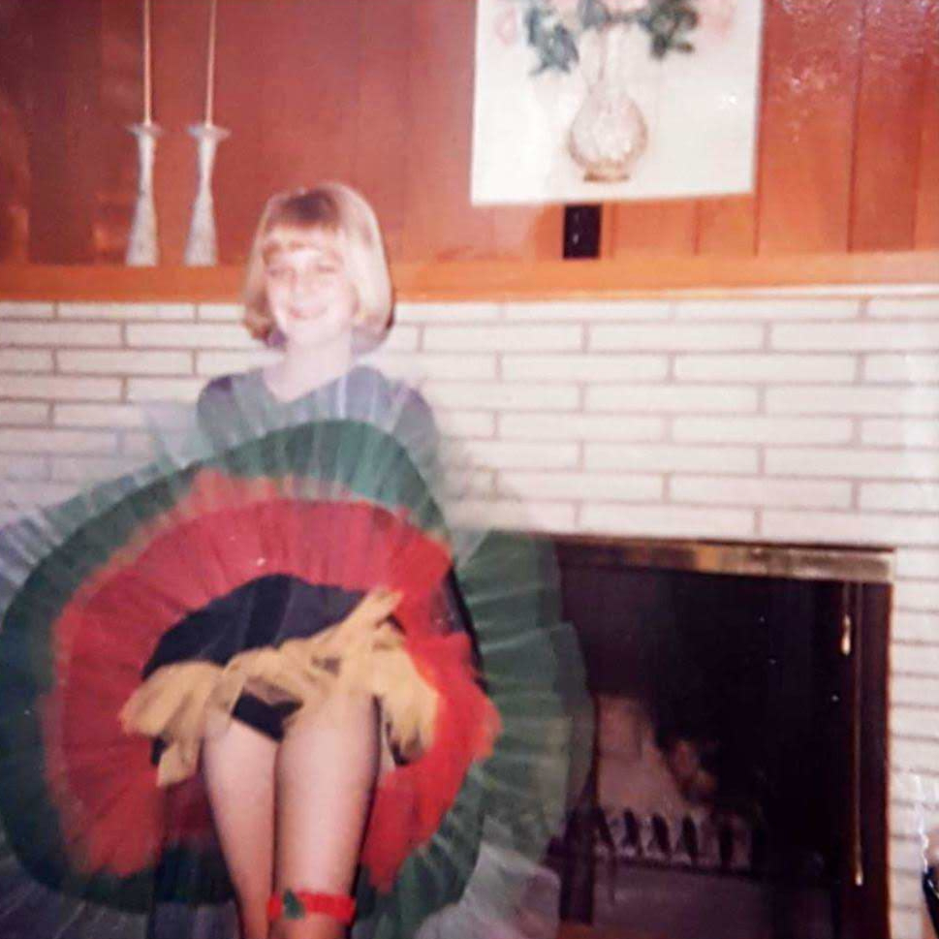
A MORE PERSONAL TAKE ON LEADERHIP

Slide 4
“Leaders inspire not because of what they do, but because of who they are. Leadership is about personal development.”
Margie Warrell

Slide 6
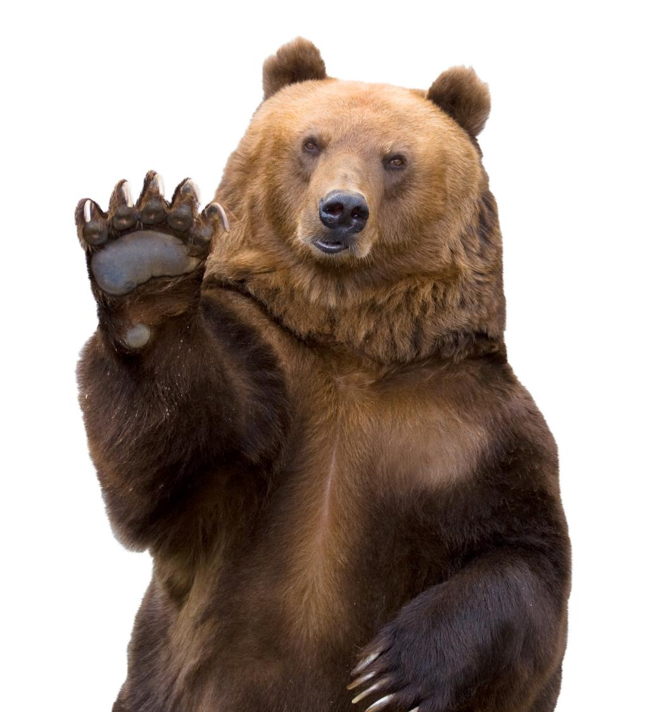
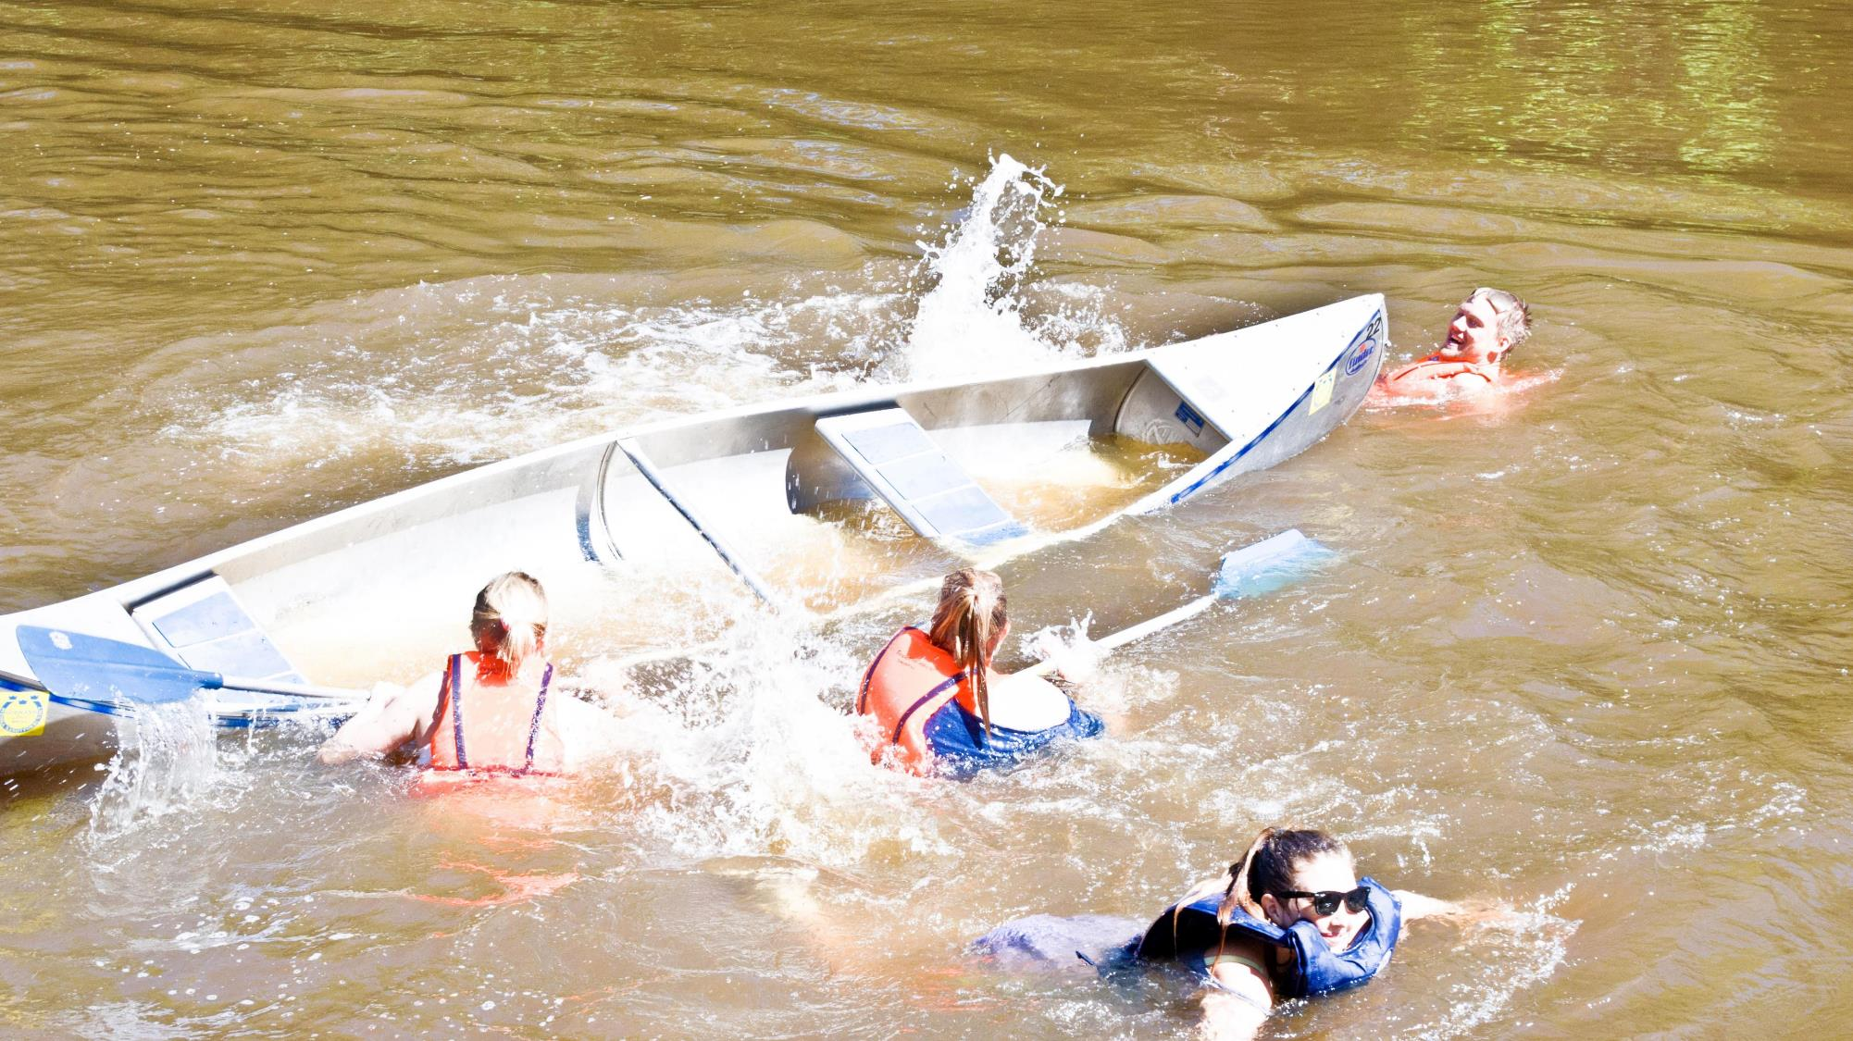
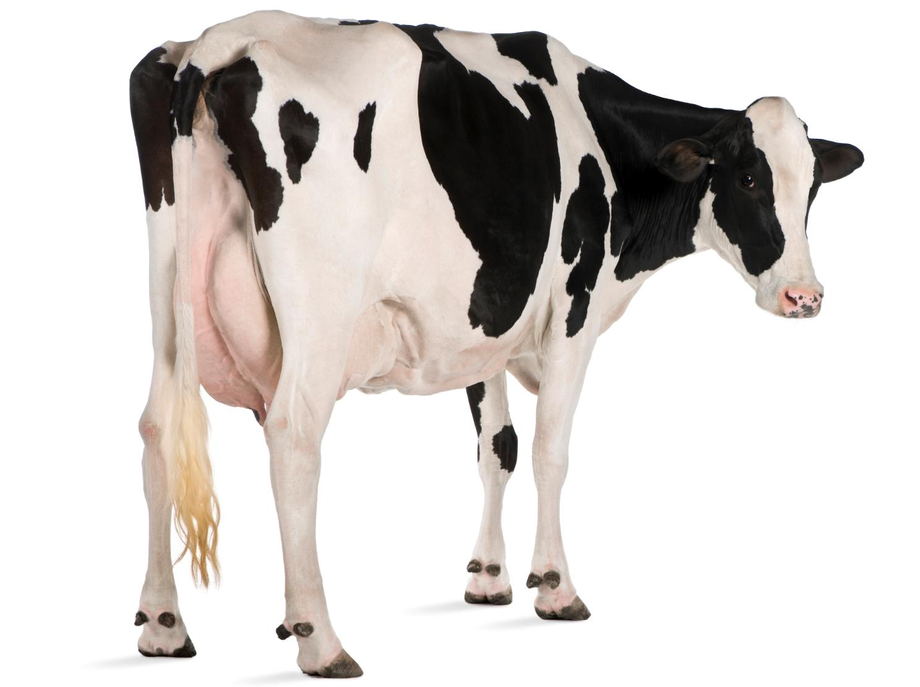
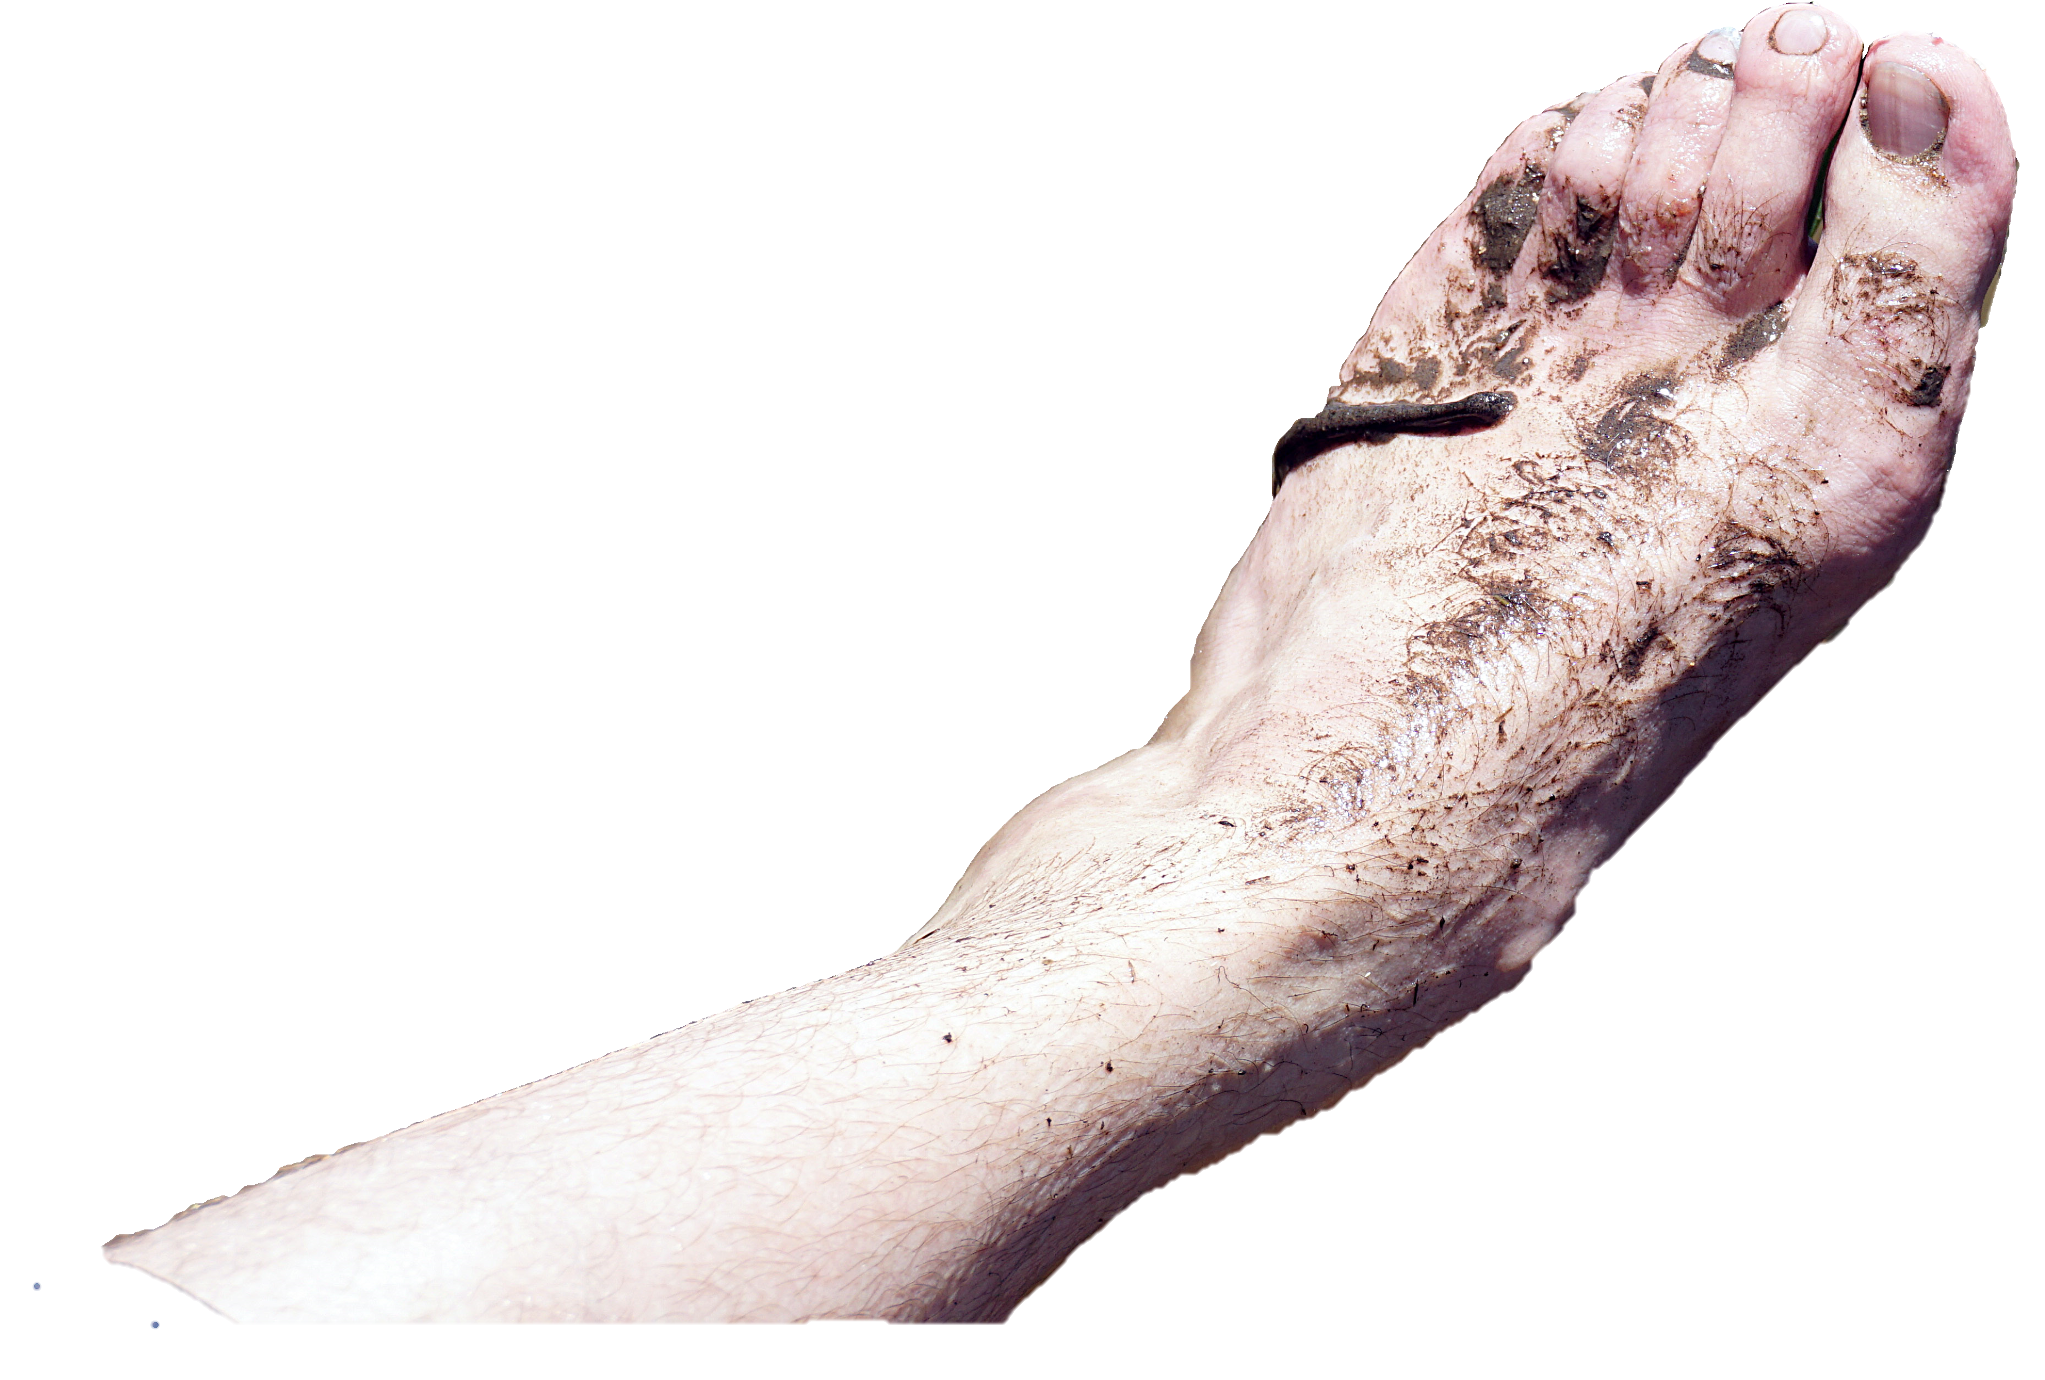

Slide 7
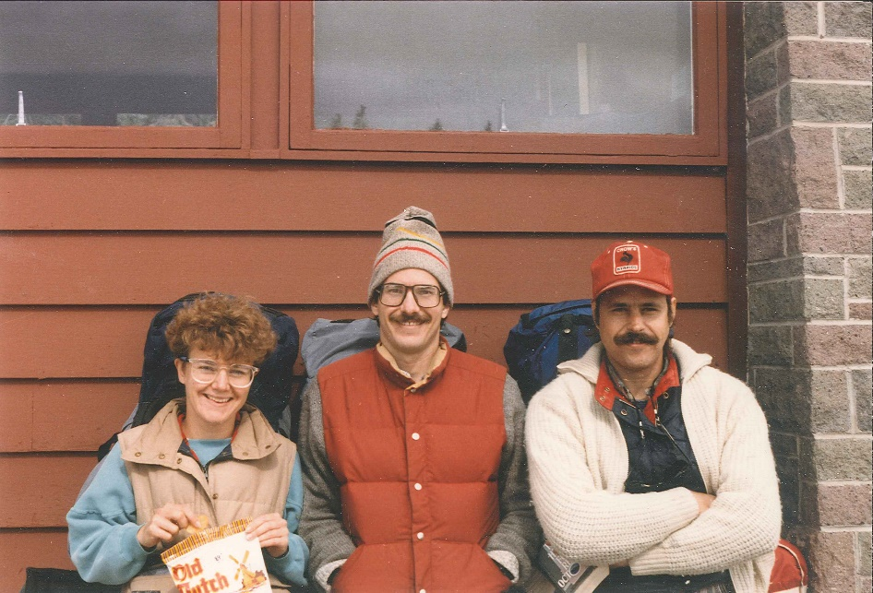
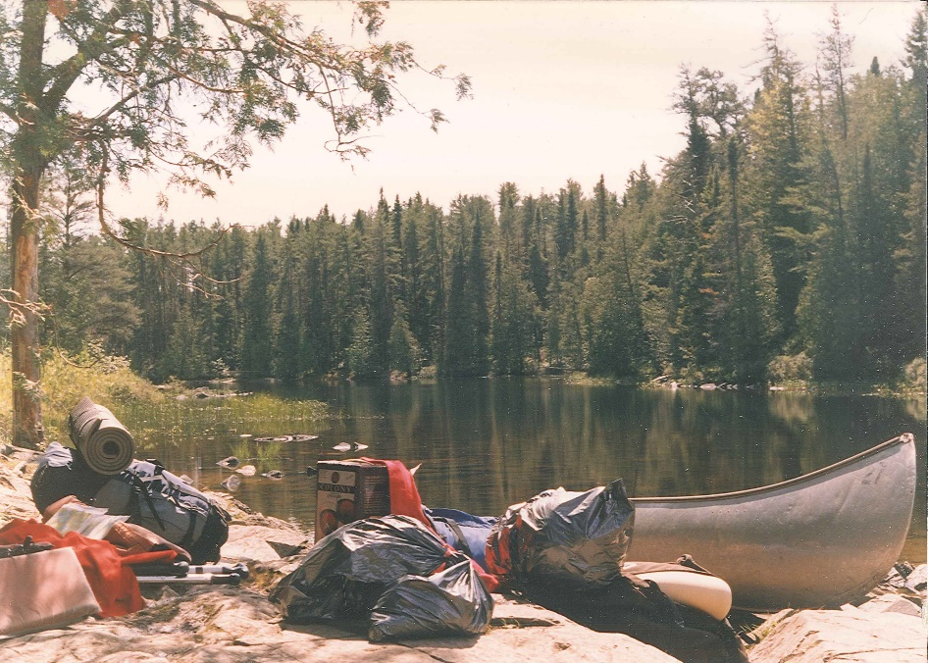
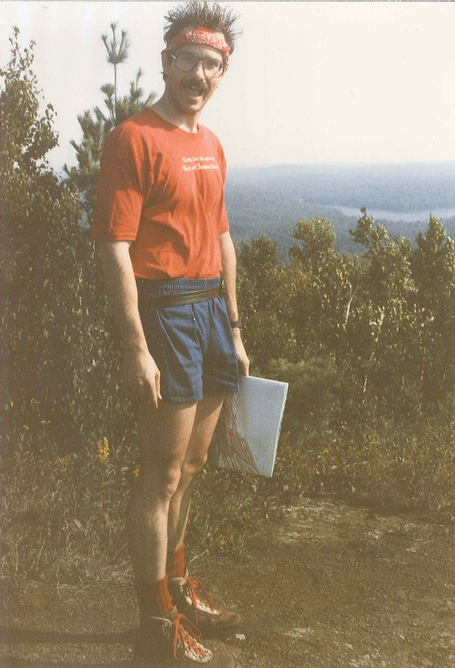
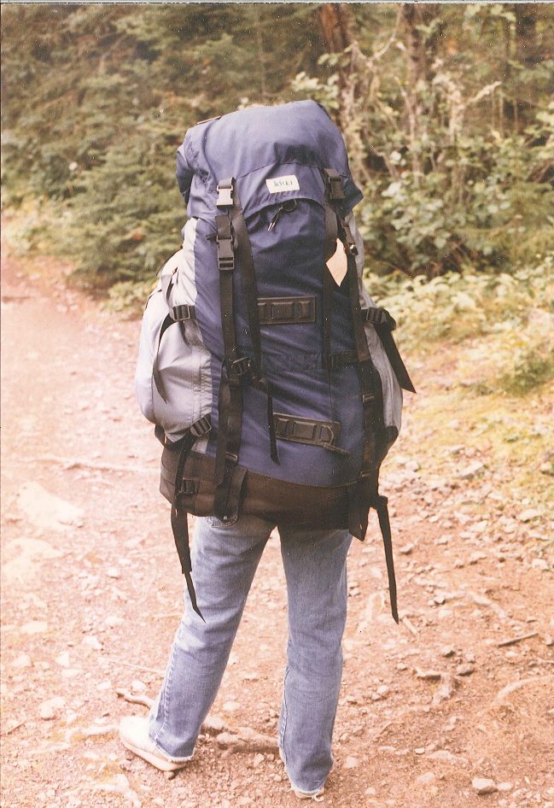
LEARN FROM EACH CANOE TRIP

Slide 8
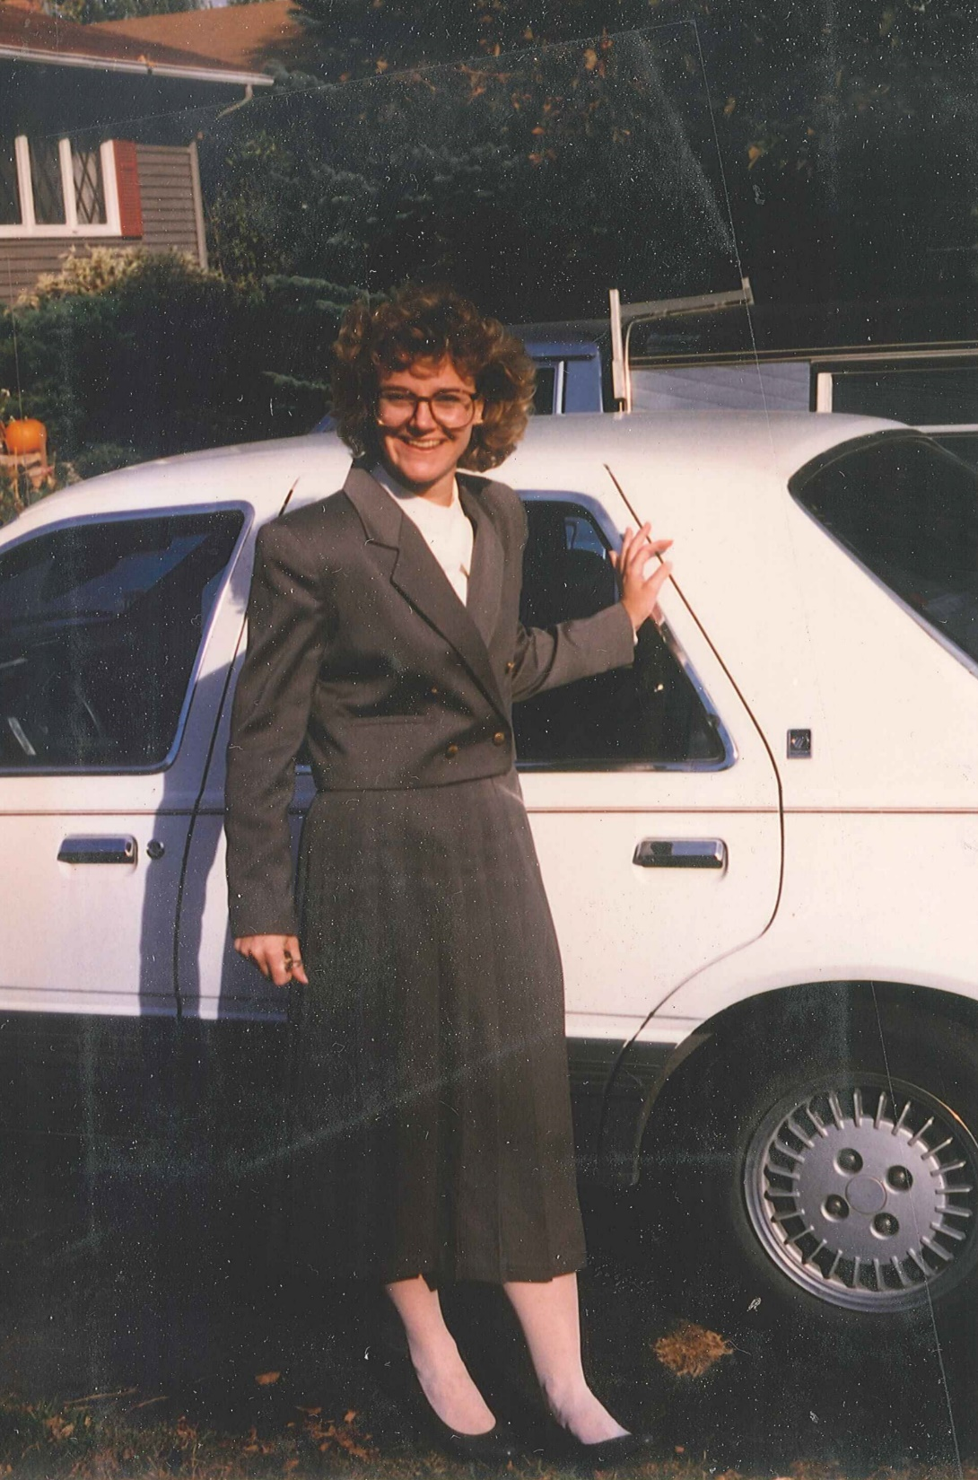
SIX PRINCIPLES
Do your best every day
Be curious
Practice gratitude
Be mindful of your words
Laugh
Be generous with time and knowledge

Slide 9
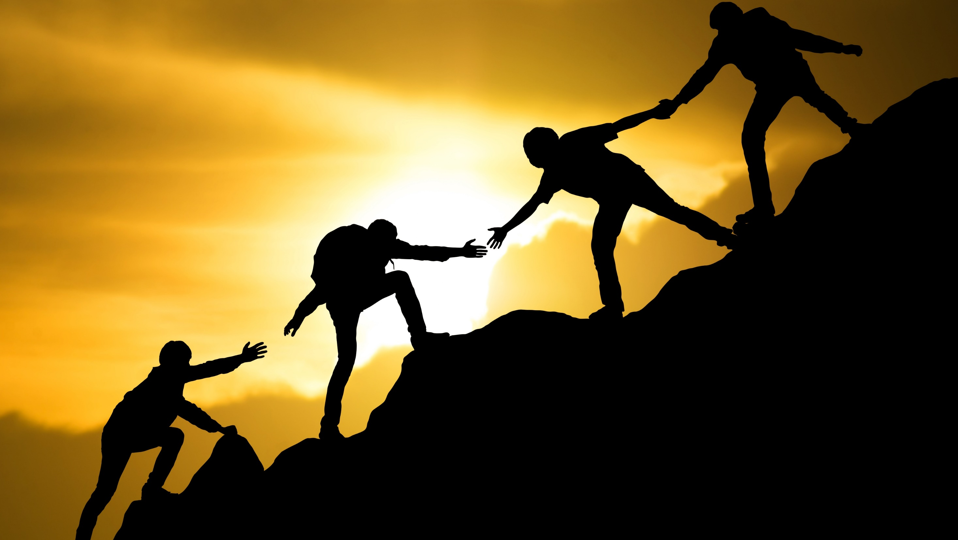
BE BOLD
STAY CONNECTED

Slide 10
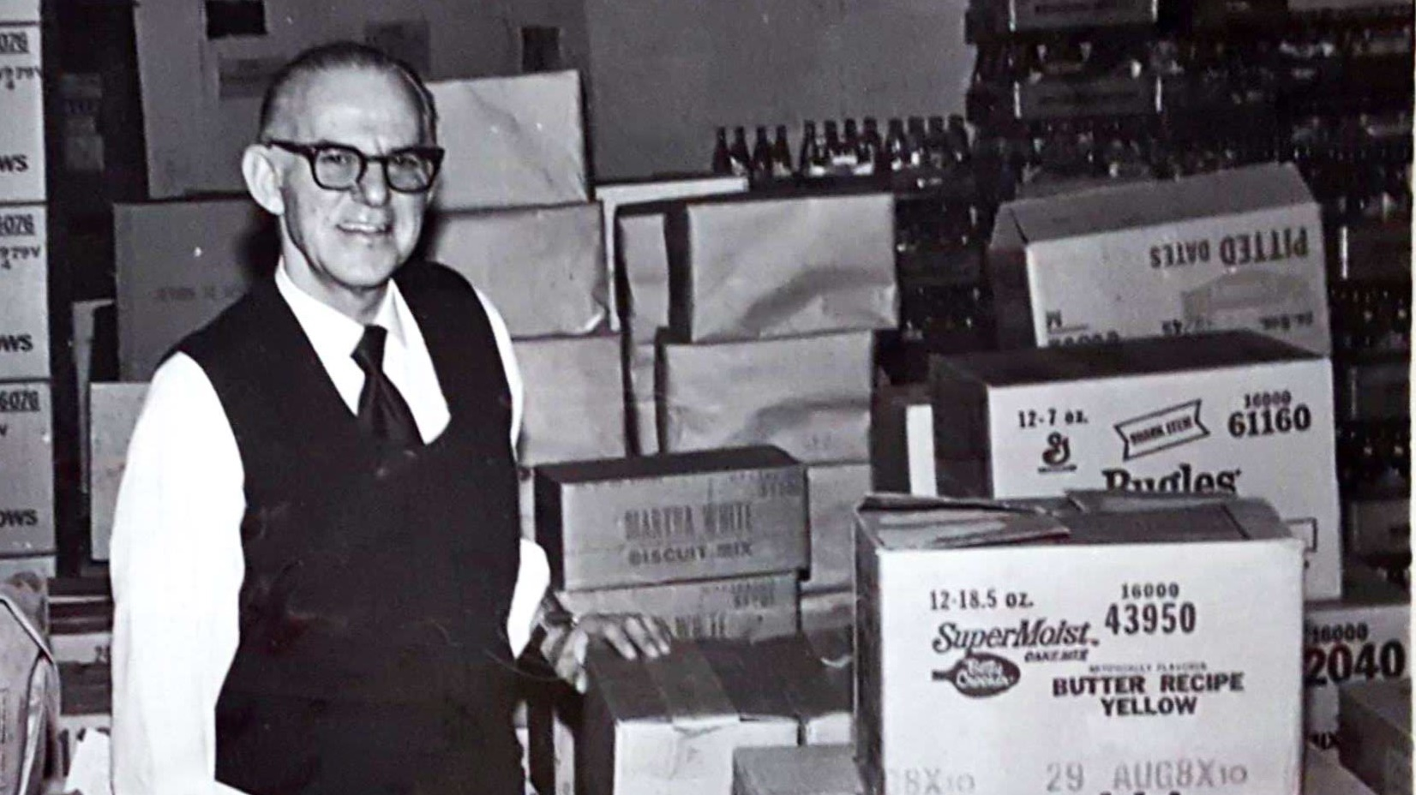
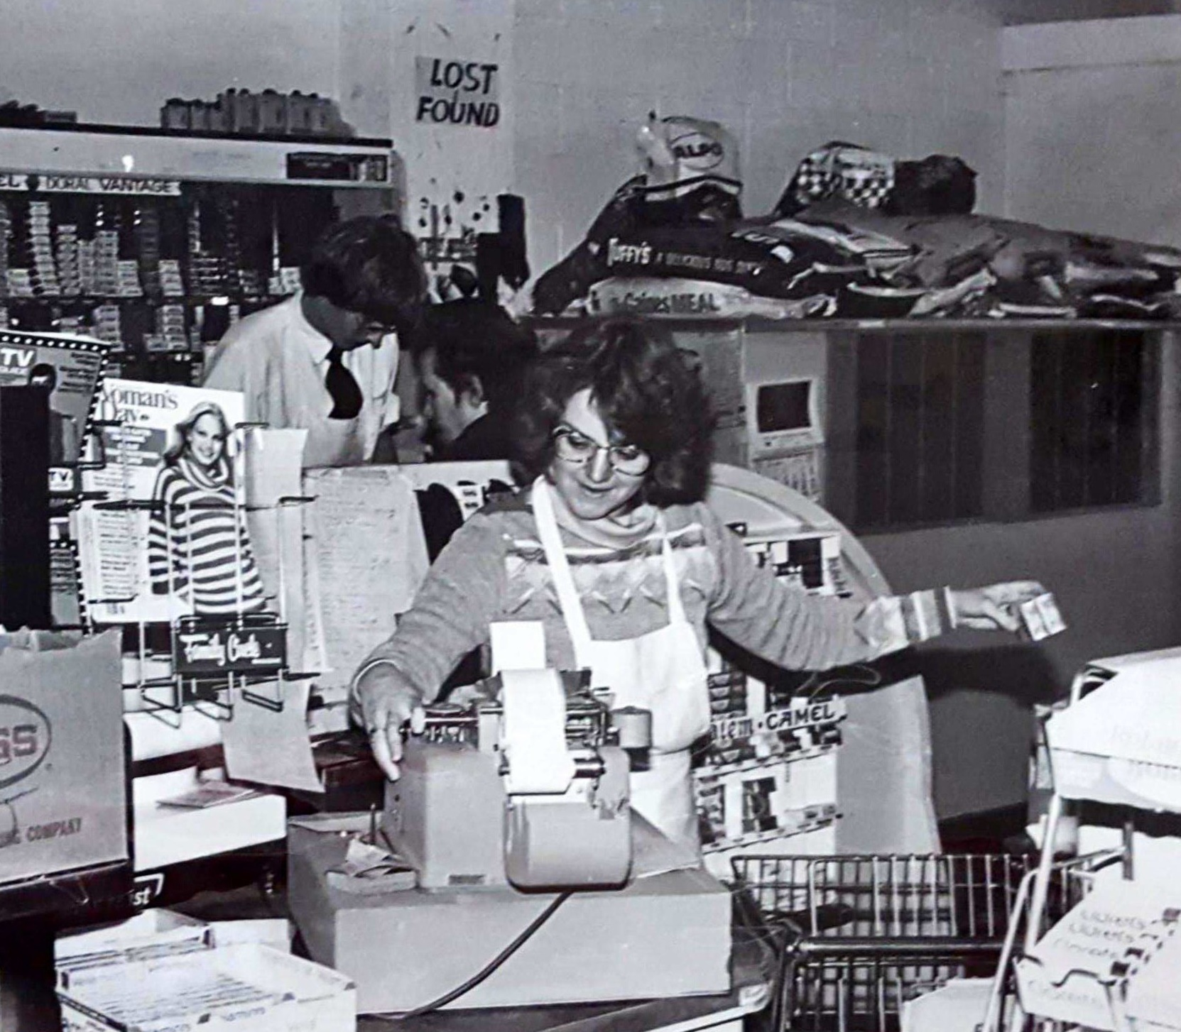

Slide 11
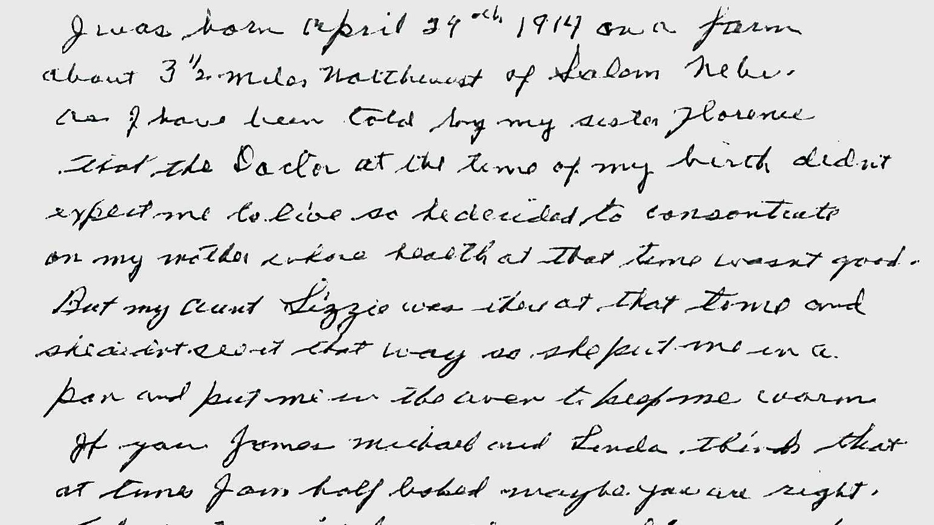
“I was born April 29th 1914 on a farm about 3 ½ miles northwest of Salem, Nebraska. As I have been told by my sister Florence that the Doctor at the time of my birth didn’t expect me to live so he decided to concentrate on my mother whose health at the time wasn’t good. But my Aunt Lizzie was there at the time and she did not see it that way so she put me in a pan and put me in the oven to keep me warm. If you, James, Michael and Linda think that at times I am half baked maybe you are right.”
Luther Paul Jorn

Slide 12
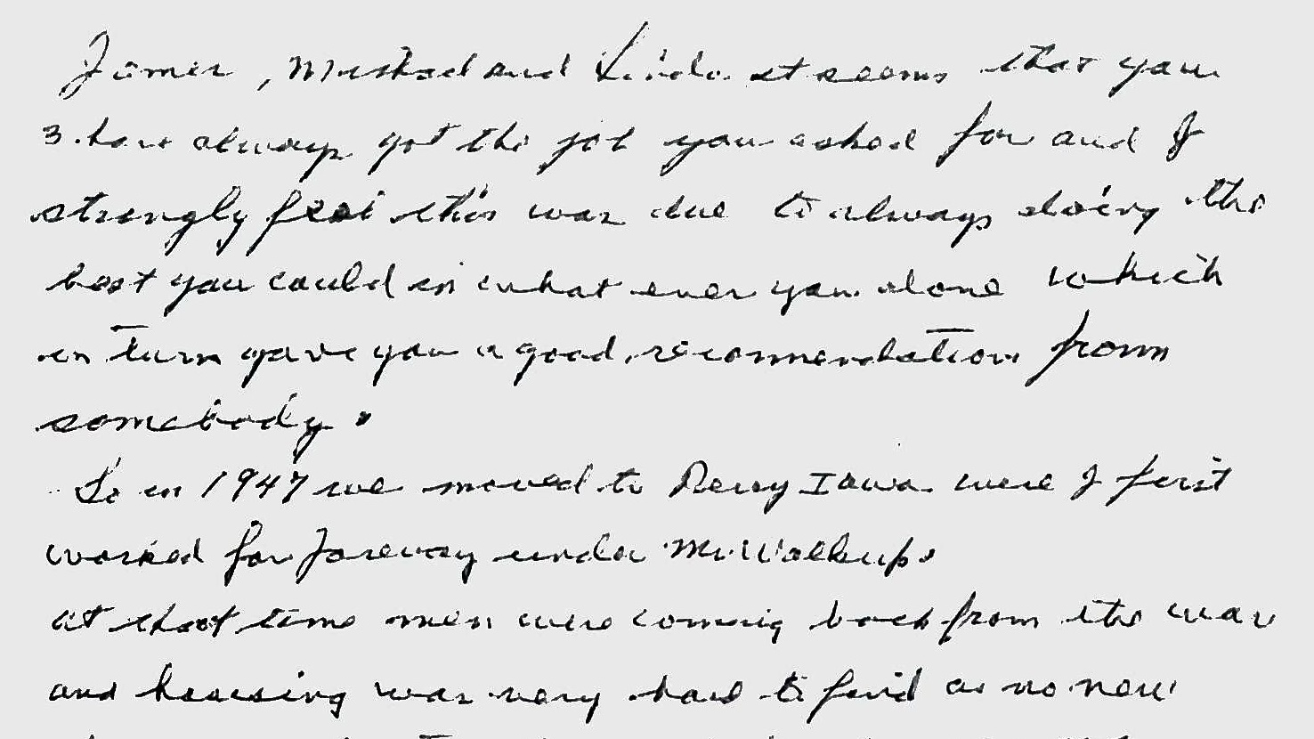
“James, Michael and Linda it seems that you 3 have always got the job you asked for and I strongly feel this was due to always doing the best you could in whatever you done which in turn gave you a good recommendation from somebody.”
Luther Paul Jorn

Slide 13
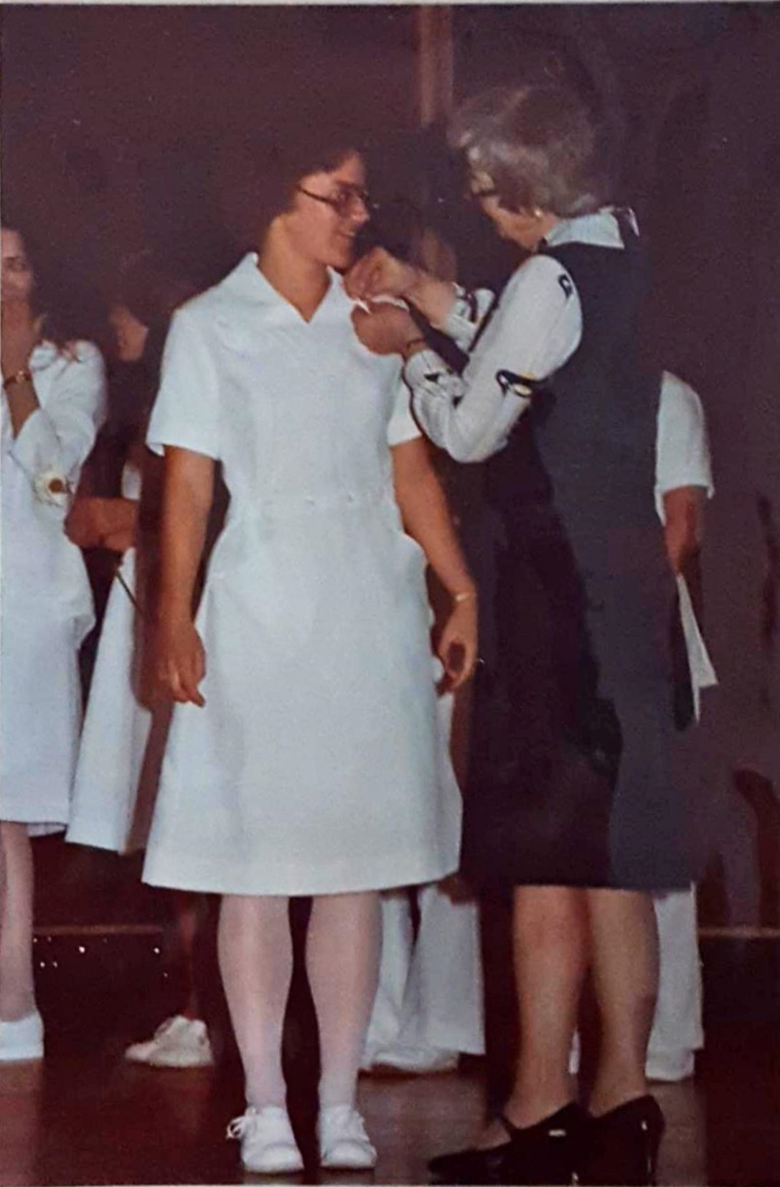
PRINCPLE ONE
Do your best every day
Build on your strengths
Collaborate
Manage your energy

Slide 14
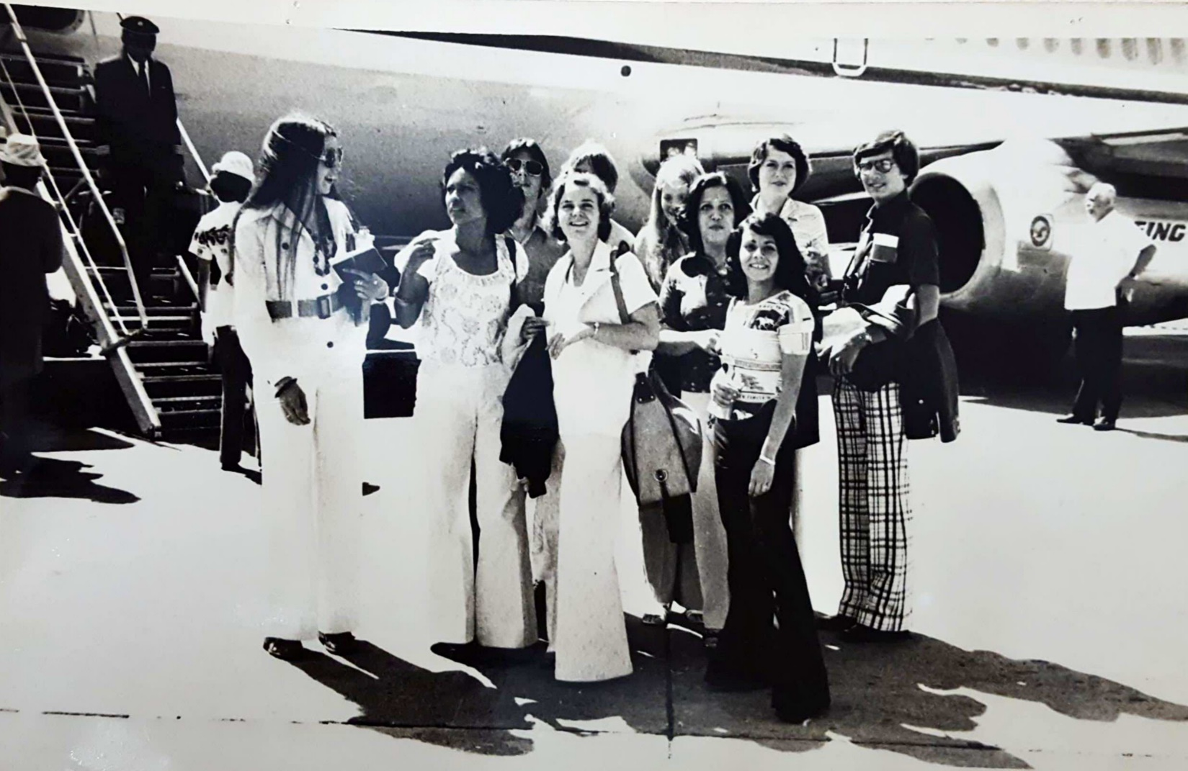
PRINCIPLE TWO
Be curious
Ask Questions ● Listen & Wait ● Don’t Take Things Personally

Slide 15
PRINCIPLE THREE
Practice gratitude

Slide 16
Activity
WHO?
Who do you have a strong, collaborative work relationship with?
Who inspires you?
WHY?
Why do you enjoy collaborating with them?
Why do they inspire you?
WHAT?
What principle do they have that speaks to you?
What is one principle that you want to develop that guides your daily actions?

Slide 17
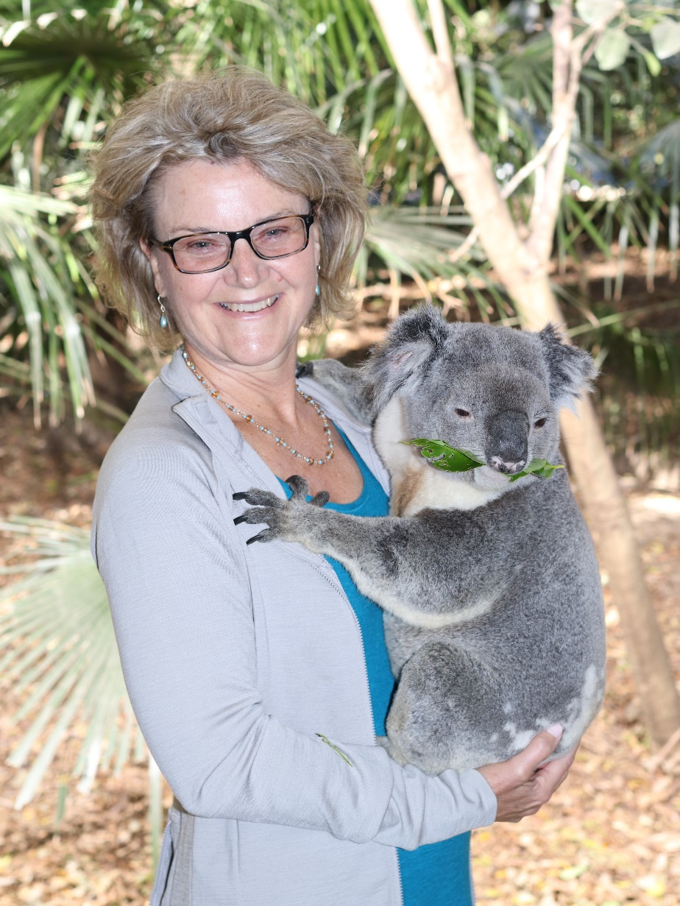
PRINCIPLE FOUR
Be mindful of your words

Slide 18
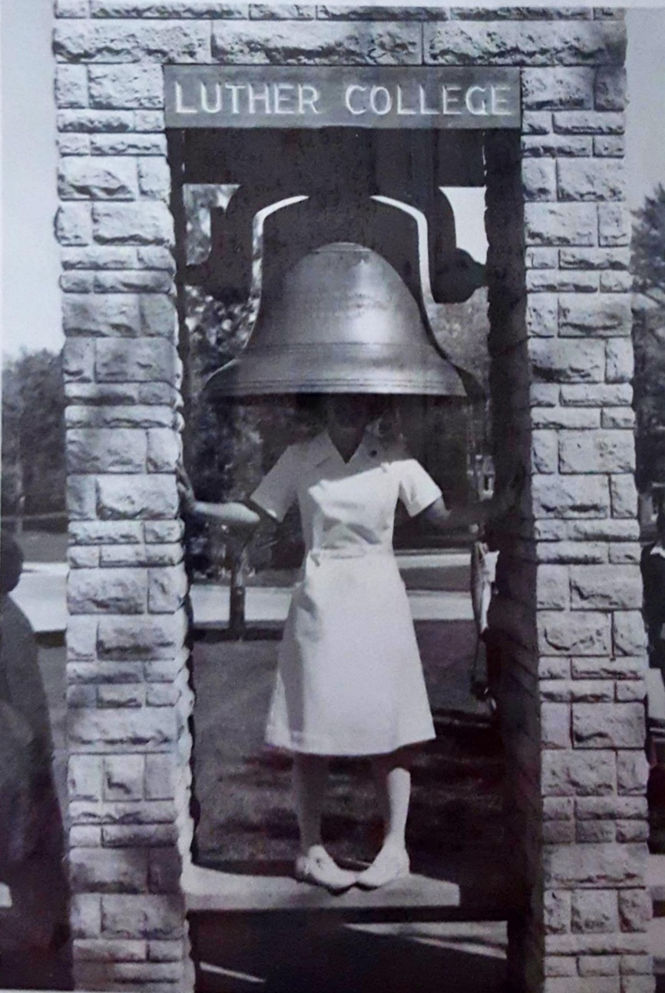
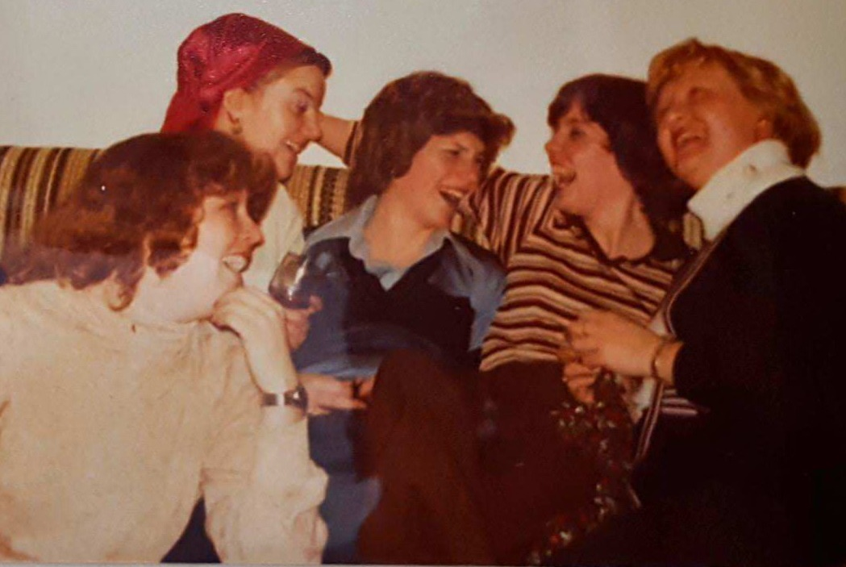
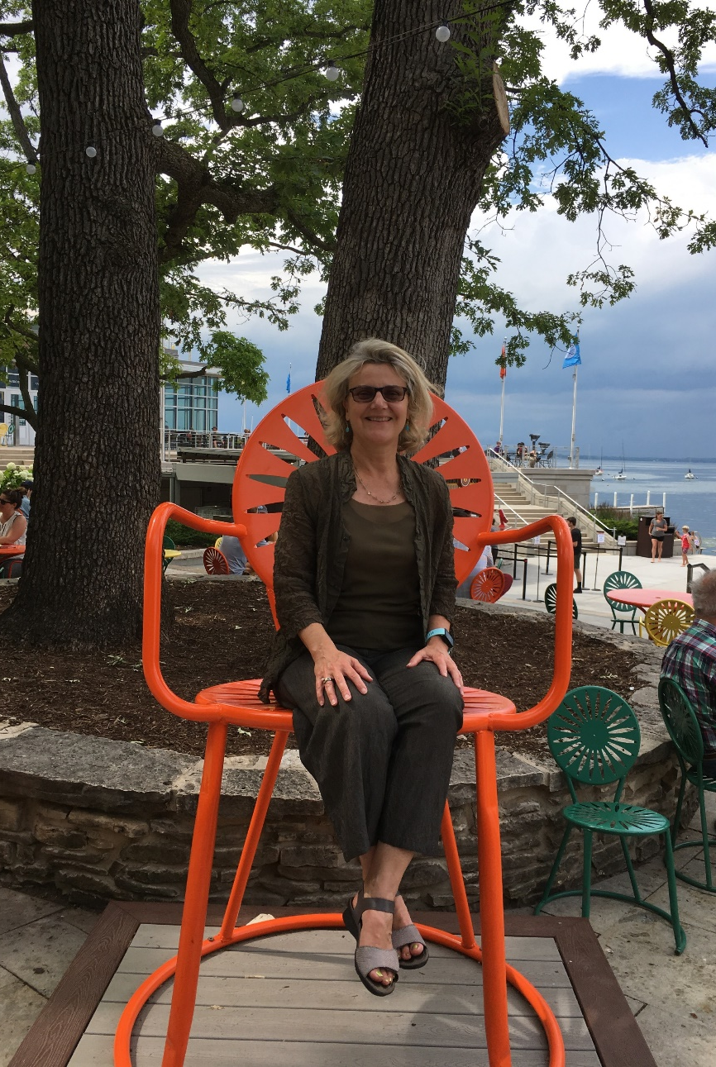
PRINCIPLE FIVE
Laugh

Slide 19
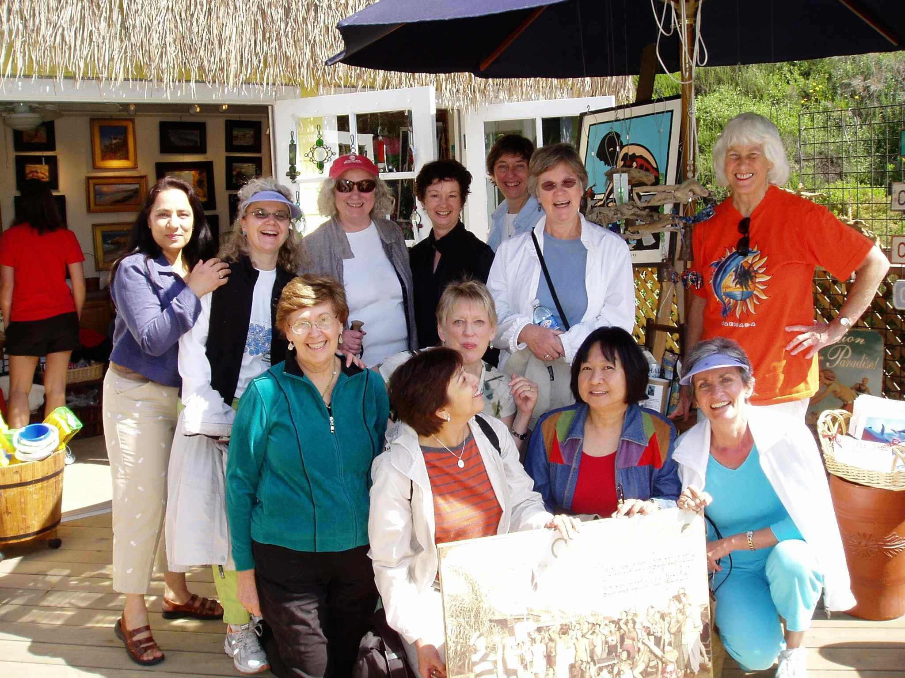
PRINCIPLE SIX
Be generous with time and knowledge

Slide 20
Activity
Reflect upon one or two daily leadership habits
Find a partner
Share and learn

Slide 21
LEADERSHIP RESOURCES
Bridges, William. Managing Transitions: Making the Most of Change. Da Capo Press. 2003.
Collins, Jim. Good to Great. Harper Business, 2001.
Davidson, Richard J., and Sharon Begley. The Emotional Life of Your Brain. Plume, 2013.
Gregersen, Hal. “Bursting the CEO Bubble.” Harvard Business Review, Mar. 2017.
Lama, Dalai, et al. The Book of Joy. Penguin Random House, 2016.
Toussaint, Loren, et al. “Forgiveness Working: Forgiveness, Health, and Productivity in the Workplace.” American Journal of Health Promotion, vol. 32, no. 1, 2018, pp. 59–67., doi:10.1177/0890117116662312.
Warrell, Margie. Stop Playing Safe. John Wiley & Sons Australia, Ltd, 2013.
Wheatley, Margaret J. Leadership and the New Science. Berrett-Koehler Publishers, 2006.

Slide 22
Questions?

Slide 23
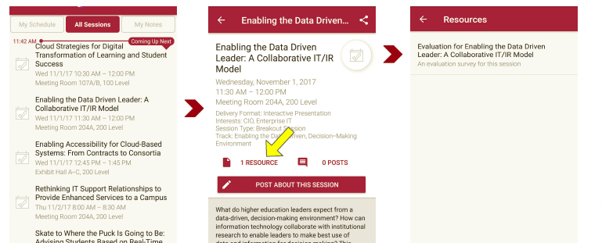
Session Evaluations There are two ways to access the session and presenter evaluations:
1
2
In the online agenda, click on the “Evaluate Session” link
From the mobile app, click on the session you want from the schedule > then scroll down or click on the associated resources > and the evaluation will pop up in the list

Slide 24
CONTACT INFORMATION
Linda Jorn
Linda.Jorn@wisc.edu
linkedin.com/in/lindajorn
NOTE: This presentation leaves copyright of the content to the presenter. Unless otherwise noted in the materials, uploaded content carries the Creative Commons Attribution 4.0 International (CC BY 4.0), which grants usage to the general public, with appropriate credit to the author.

