Slide 1
Journey Through a Mobile App
Posters 1a: Tuesday, October 15, 2019 1:15 PM - 2:15 PM
Posters 1b: Tuesday, October 15, 2019 5:00 - 5:45 PM
Presented by
Robert Birkline
Manager of Web Technologies
rbirkline@uh.edu
Diane Trippel
Web & Communication Services Director
dtrippel@uh.edu

Slide 2
What you will take away from today’s presentation
Mobile Ecosystem
How to select your infrastructure and why it is important.
What a mobile team looks like
What goes into testing your app
Different mobile Frameworks
Native verses hybrid mobile applications
Capturing the attention of your user with personalization

Slide 3


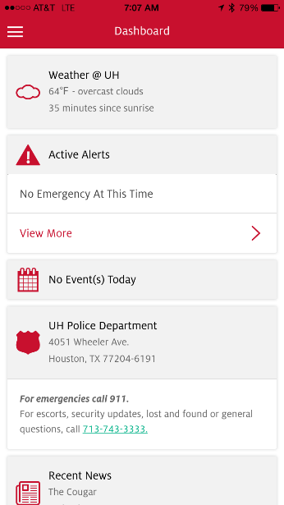
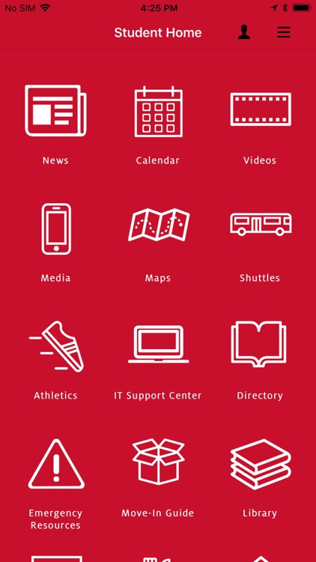
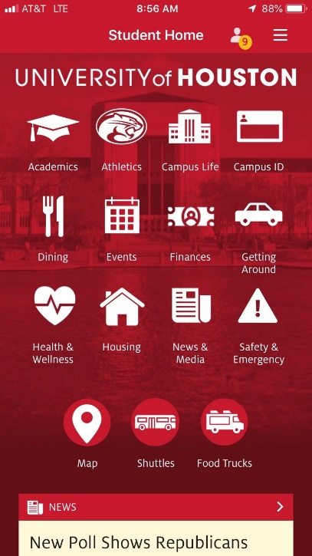
UH Redline
UH Go
UH Go
2014
October 2018
March 2019

Slide 4
UH Redline
2012 - 2017
UH Redline started as a student government (SGA) sponsored mobile app and then became the official UH app in 2014. SGA contracted a vendor to build the app and then UIT took it over, re-wrote it and maintained it until 2016.
The History
SGA and Student Affairs driven app, RFP process started.
2012 RFP, vendor chosen, we were one of the first Universities with a mobile app
2014, Launched
2015 ownership change and the Student Media center began directing the development with UIT. The decision was also made to rewrite the application. Relaunched the app.
2016 UIT developed native SDKs to introduce wayfinding for walking directions on campus
Challenges
Communicating needs to outside vendors
Vendors often don’t understand the needs of your consumer
Independent UI/UX reviews
Business owners that understand the needs of the consumer
Not putting the mobile app at a high enough priority

Slide 5
UH Redline Timeline

Slide 6
UH Go
October 2017 – March 2019
UH Go was launched using a new mobile platform powered by Modolabs and the goal was to provide a comprehensive mobile app for the University of Houston. Modolabs was selected as the platform that would provide for a fast and cost-effective development cycle.
The History
2017 October, Purchased Modolabs Campus Mobile
2017 November, Purchased GreyHeller (Appsian) PeopleMobile and PeopleUX
2018 January, met with stakeholders
2018 January, met with students
Launched July 28, 2018
2018 September – November, usability testing
Challenges
Stakeholder buy-off and participation
Communication
Lack of promotion of the app
Technical integration – negotiating with 3rd party vendors to get specs for API development
Usability – where should this responsibility lie?
Reducing the mobile ecosystem

Slide 7
UH Go
March 2019 – Present
Usability testing was performed on UH Go in fall 2018 and a new redesign based on those findings were used to redesign and relaunch the app with a full marketing campaign.
The History
November 2018 – March 2019, conducted usability studies and student focus groups
April 2019 – July 2019, redesigned the app based on usability and Modo assisted us
Personas were: Student, Future Student, Faculty & Staff and Visitor
2019 August, re-launched the UH Go and UH Marketing promoted it with a full-blown campaign
Challenges
Demand for integrations into the app
Making sure we properly measure success

Slide 8
UH Go Timeline

Slide 10
UH Go Roadmap: Next 6 months
Blackboard integration
Single Sign-On using biometrics, so that when a user signs on he/she will have access to every service on UH Go using their fingertip or facial recognition
Grade Center. Create a grade center for UH Go where students can login and get their grades from PeopleSoft Campus Solutions, Blackboard and CASA Testing Center. Students currently have to login to each system to retrieve their grades and asked for one place to get all their grades.
Create personas for Alumni and Faculty
Enhance the Messaging Center in UH Go

Slide 11
Services integrated in to UH Go
Feature | Product | Deployment Date
*Peoplsoft Campus Solutions integration | Appsian | July 28, 2018
*Food Truck locations | Chartwell | July 28, 2018
*Housing | Housing Management System (HMS) | July 28, 2018
*Laundry View | CSC ServiceWorks | July 28, 2018
*Parking Availability | Parking Guidance System | July 28, 2018
*Password Wizard | CougarNet Account Reset | July 28, 2018
Marketing admin for notifications | Message Center | July 28, 2018
UH Alert | Everbridge | July 28, 2018
UH calendar | LiveWhale | July 28, 2018
UH Map Wayfinding | Mapbox | July 28, 2018
*Parking | T2 | December 17, 2018
*UH undergrad and grad catalogs | Acalog | August 21, 2018
*CougarCard | Touchnet | August 9, 2019
* New features not originally in UH Redline

Slide 12
Evaluating the mobile ecosystem
How to select your infrastructure and why it is important
Native Development VS. Hybrid Development
Push notifications
The Skill set of your group
Data and why it is important
Recent changes in the stores
Analytics Tools
Authentication strategies
DevOps and what it means for your ecosystem
Notes:
Robert Birkline will be discussing the mobile ecosystem

Slide 13
Usability
create a usable, flexible and friendly user interface for a diverse audience.
Usability should be done as part of the development life-cycle.
Card sorting to help determine navigational schemes
Focus groups to determine needs
Individual testing to determine if the mobile app is easy-to-use
Incentives to help participation are helpful in finding subjects
Placing a banner on your web portal to promote the testing is also helpful in finding subjects
Notes:
Diane Trippel will discuss usability

Slide 14
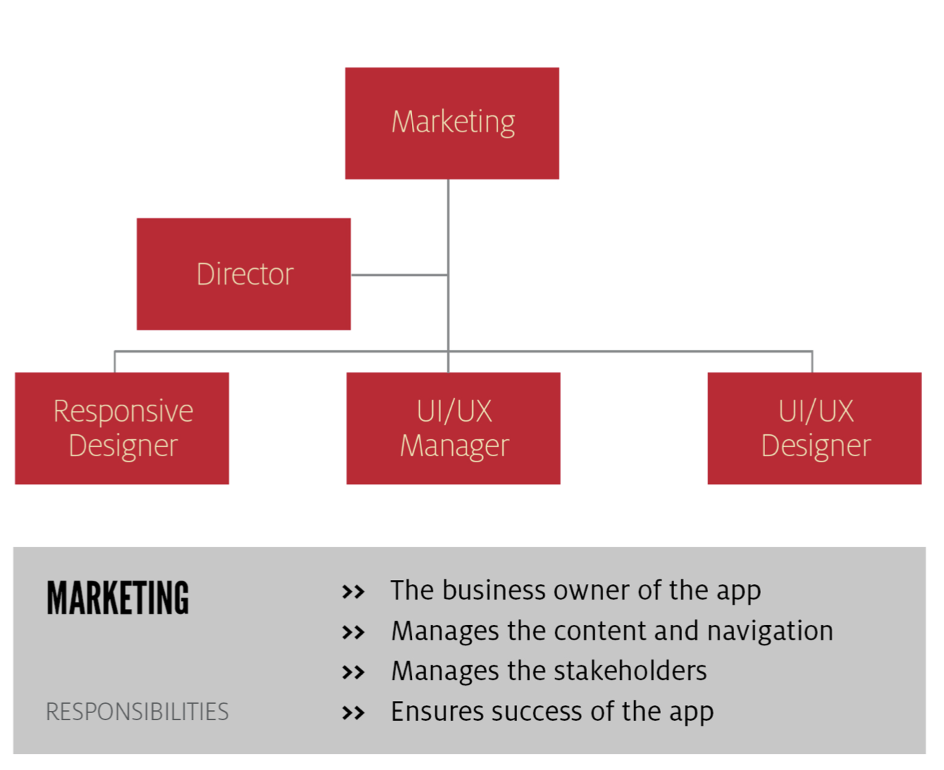
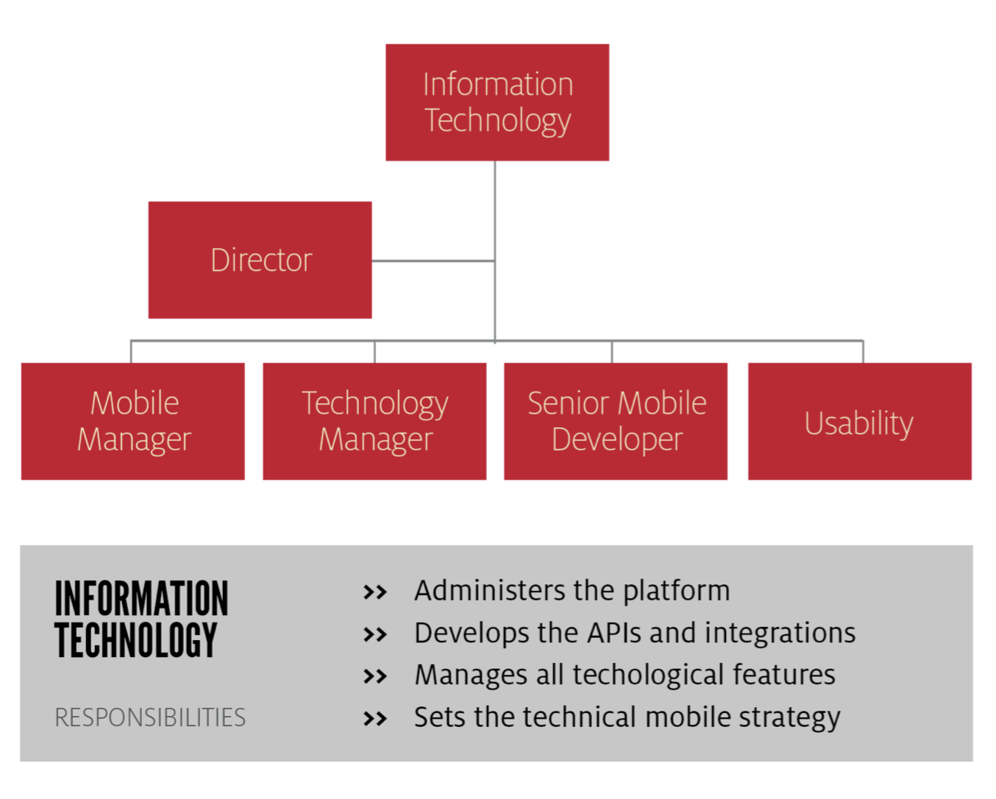
Mobile Team Organizational Chart

Slide 15
Personalization
using data to provide relevant just in time information
Explore your resources
Personalized notification
There can be too much information
Respect the users privacy
Engage your audience
How to know when you went too far
Finding the right places for data you have
Notes:
Robert Birkline will be presenting information about Personalization

Slide 16
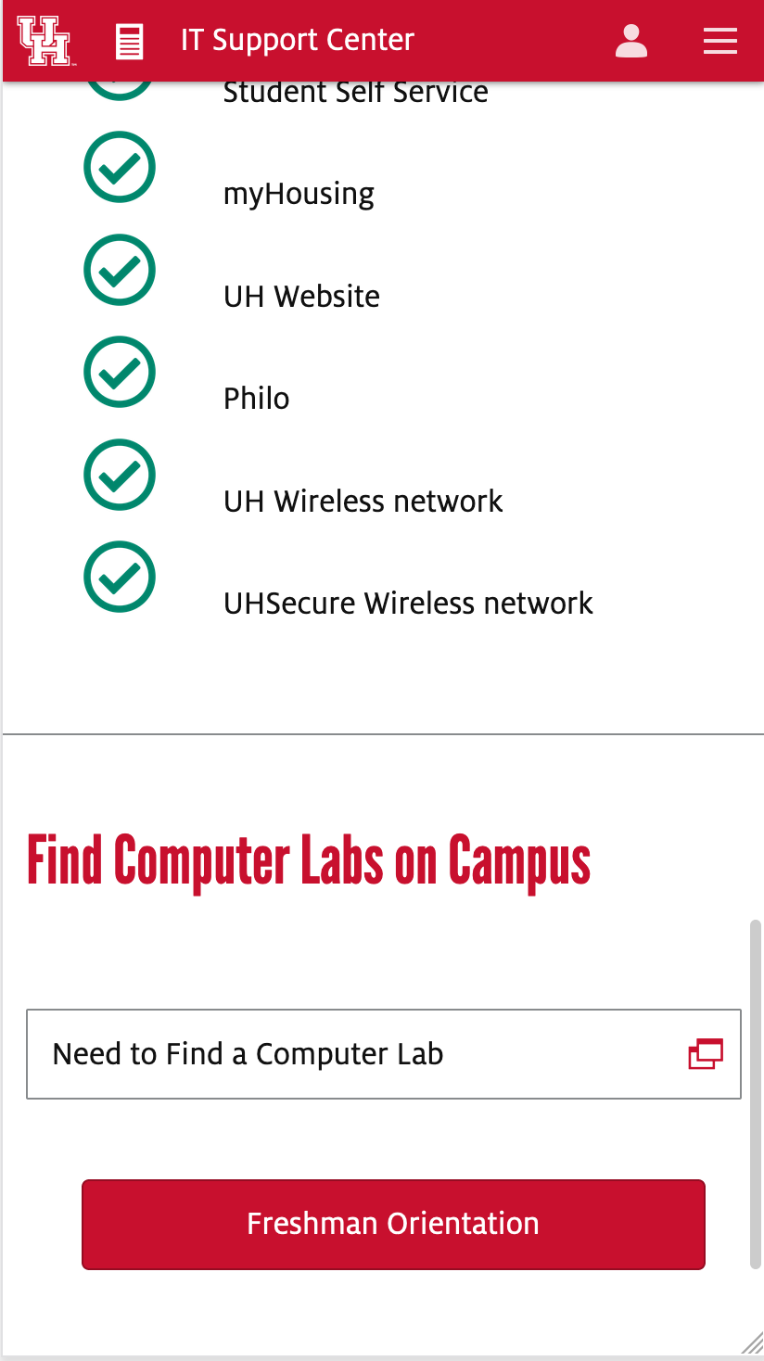
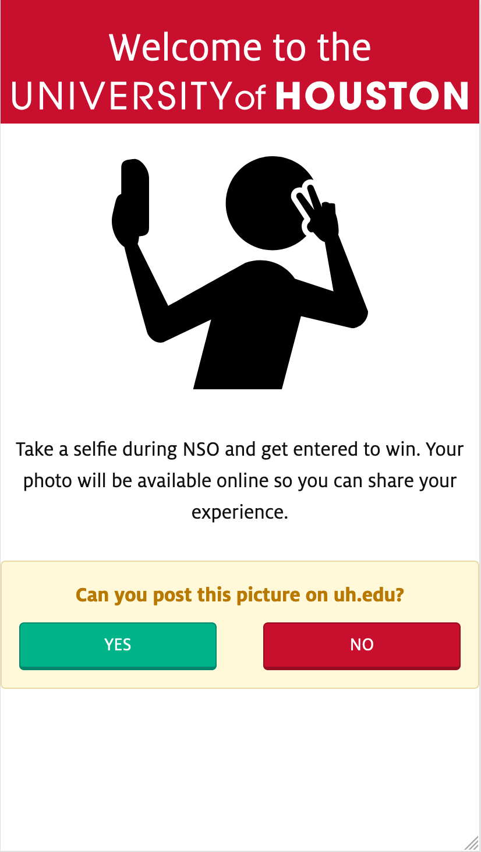
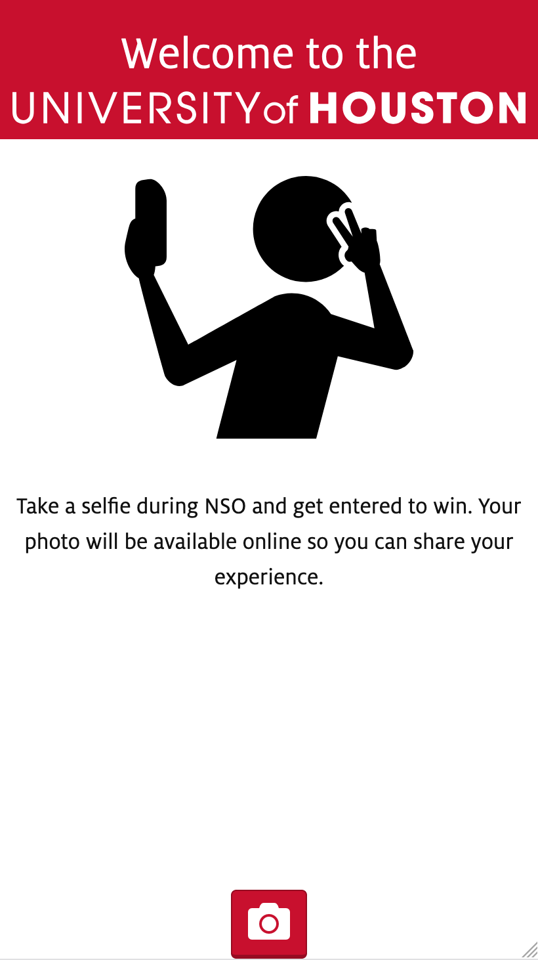
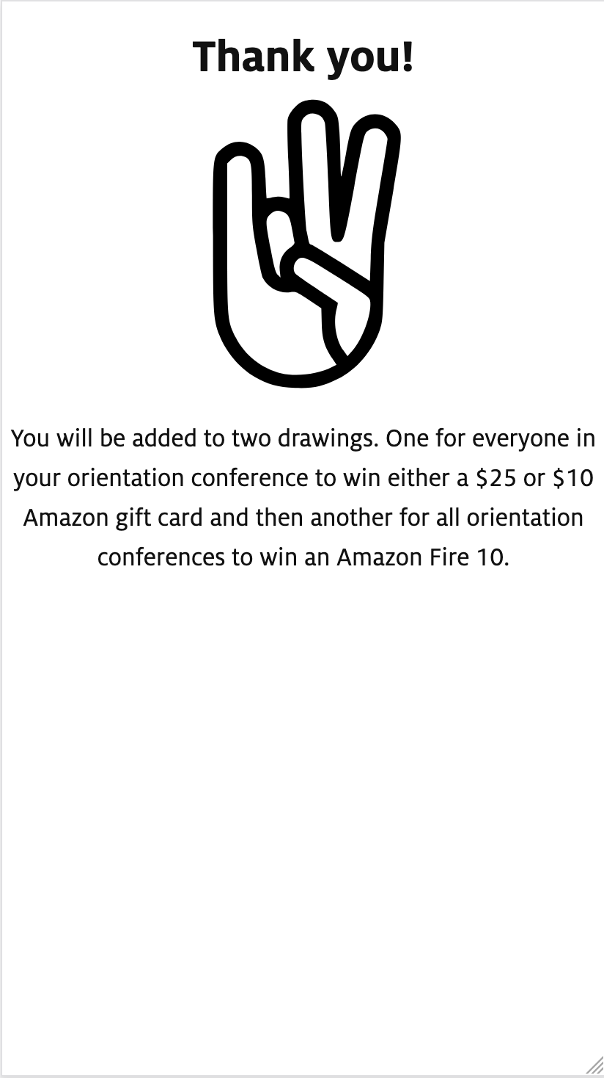
Ways to capture interest and get stakeholder buy-in: UIT Selfie contest
We rolled out this campaign out during new student orientation, summer 2019. We wanted to add a fun incentive to download the app and use it during the IT presentation. We gave away an Amazon gift card for each session and then gave away an Amazon Fire HD for all sessions.

Slide 17
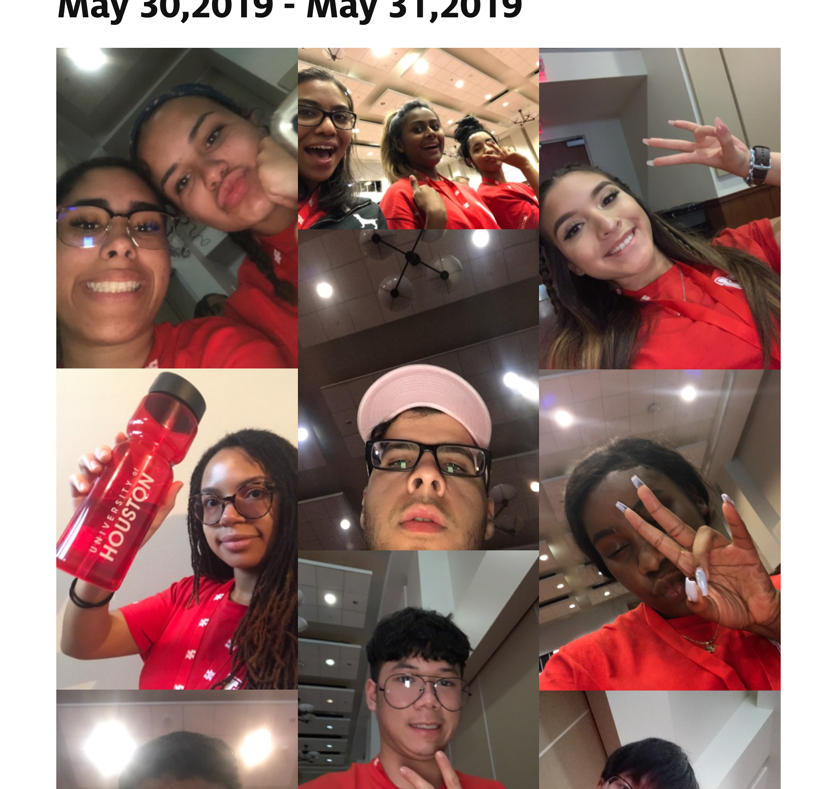
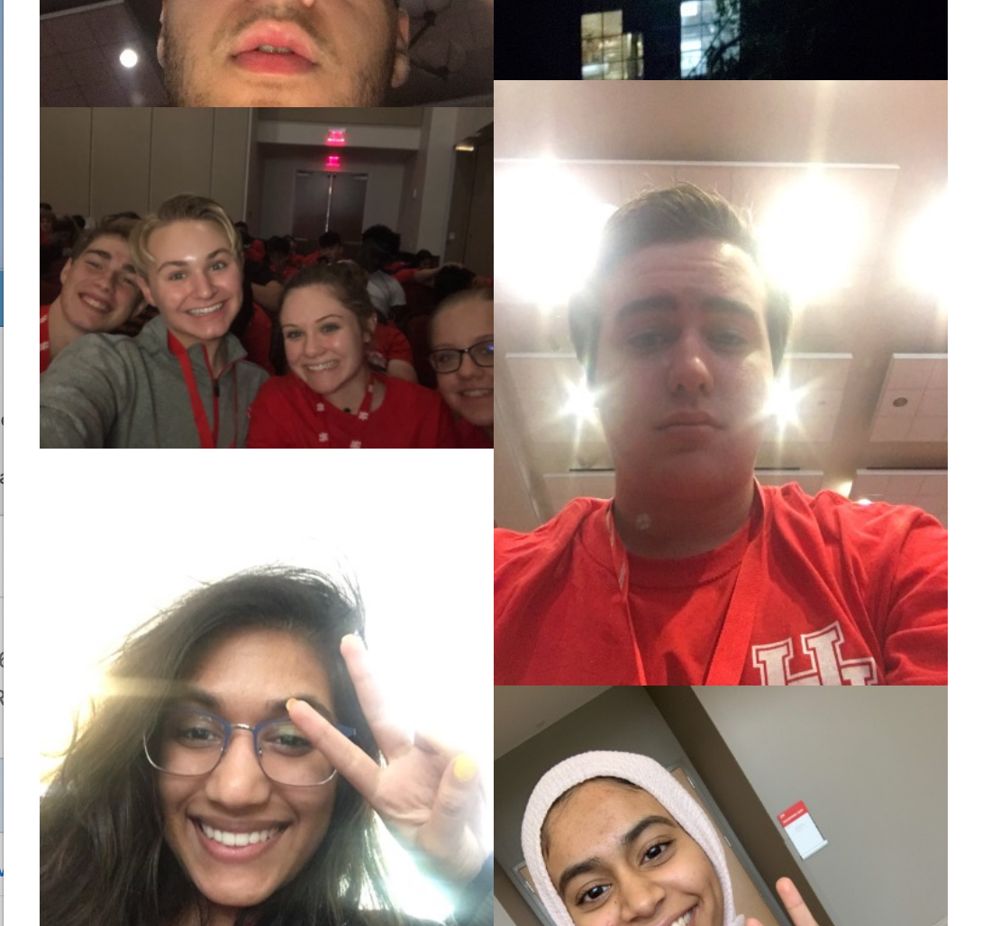
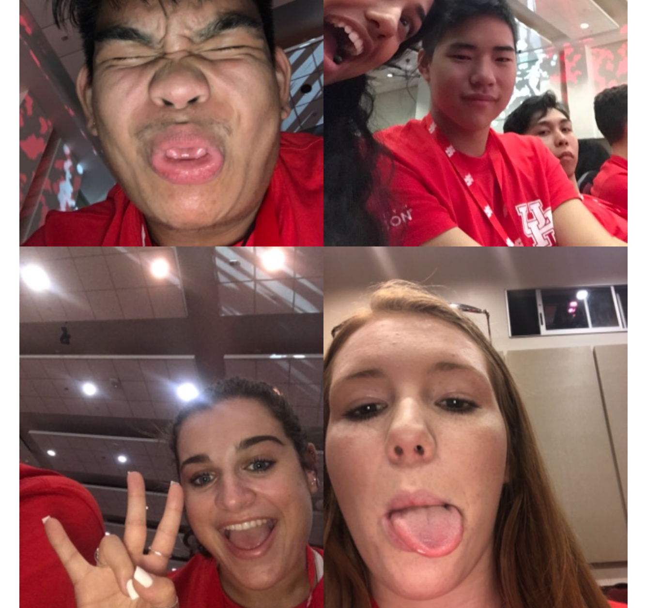
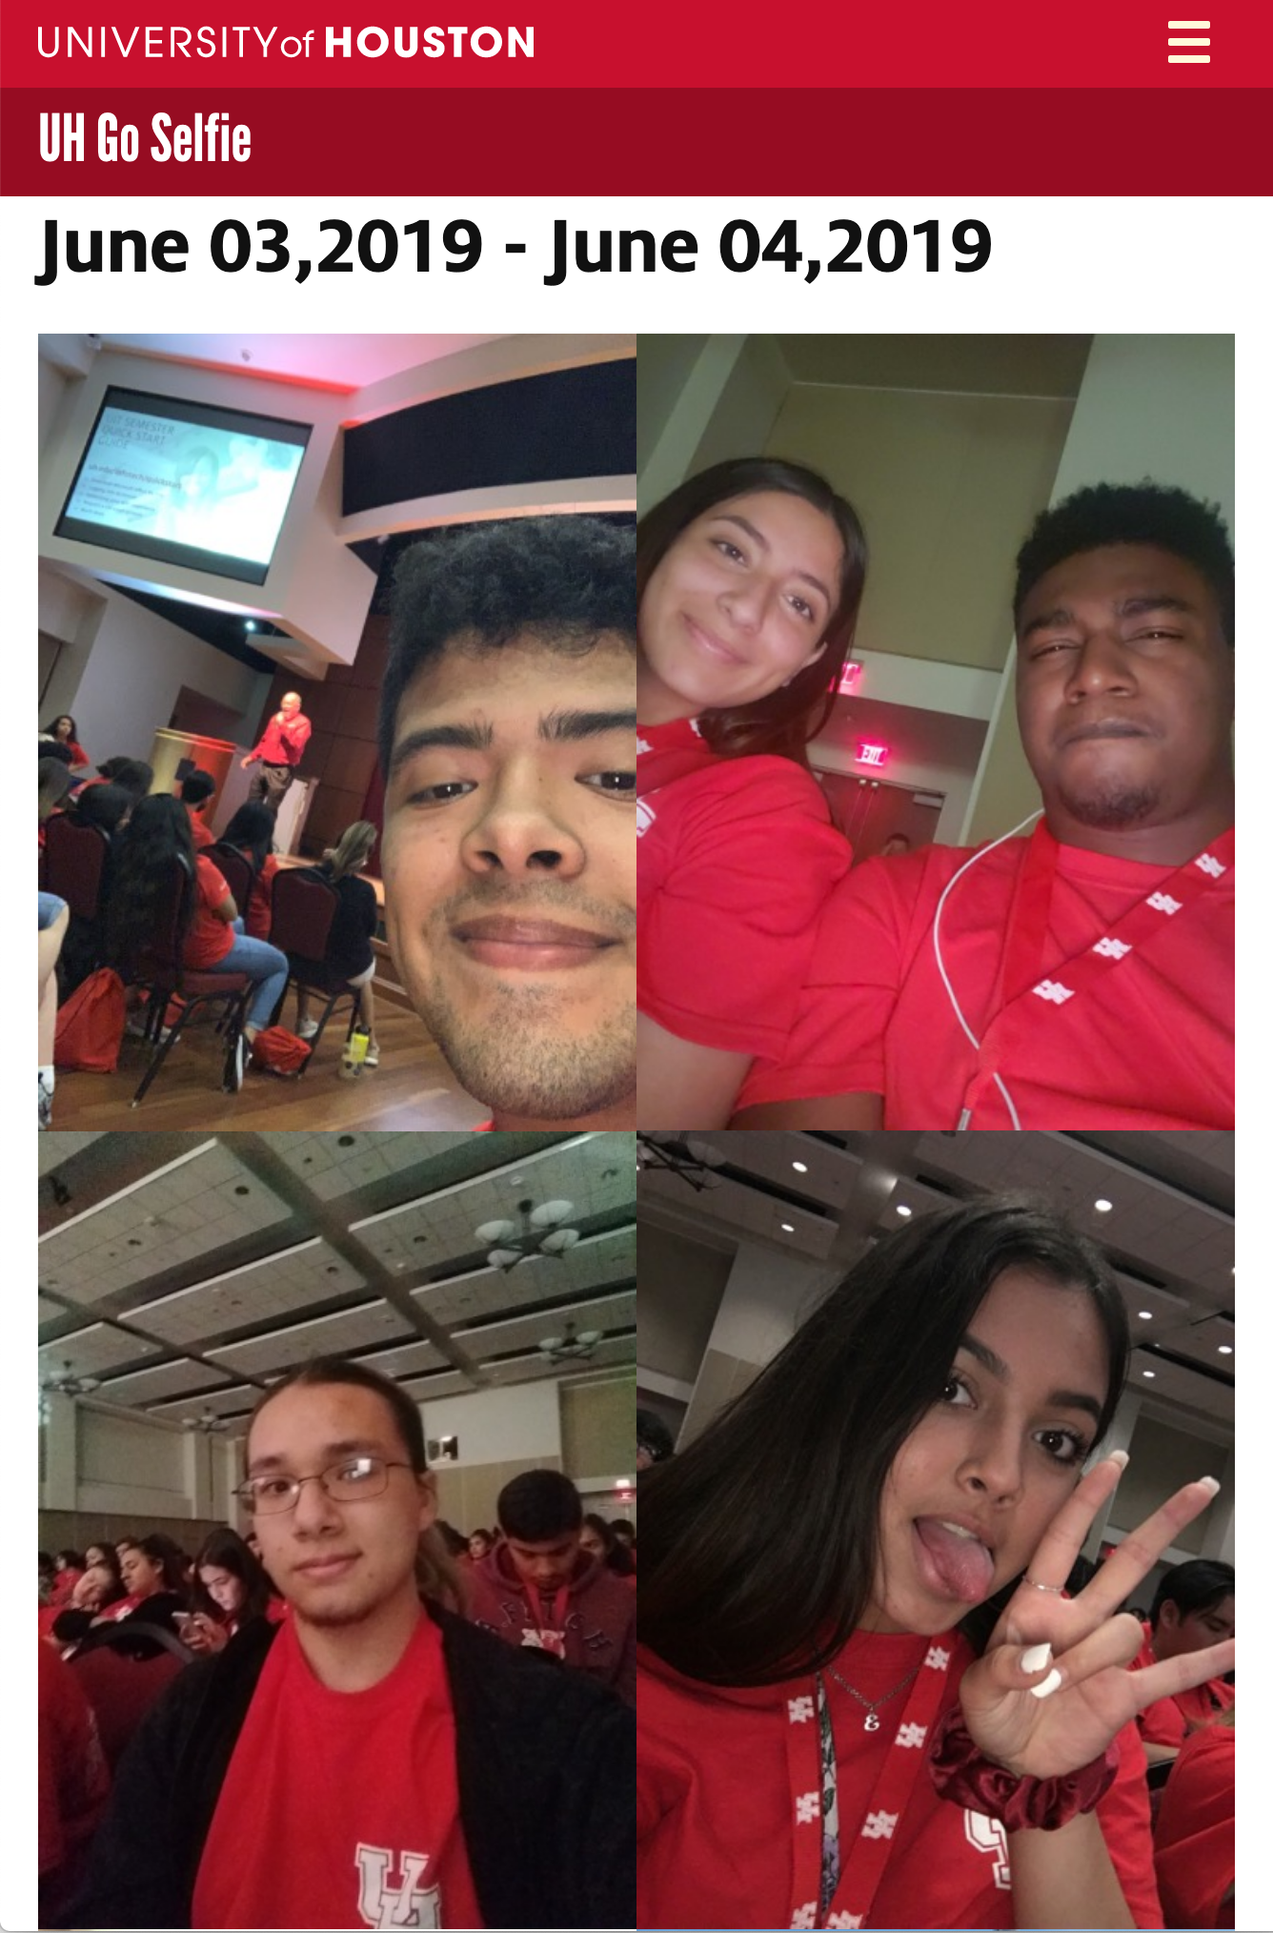
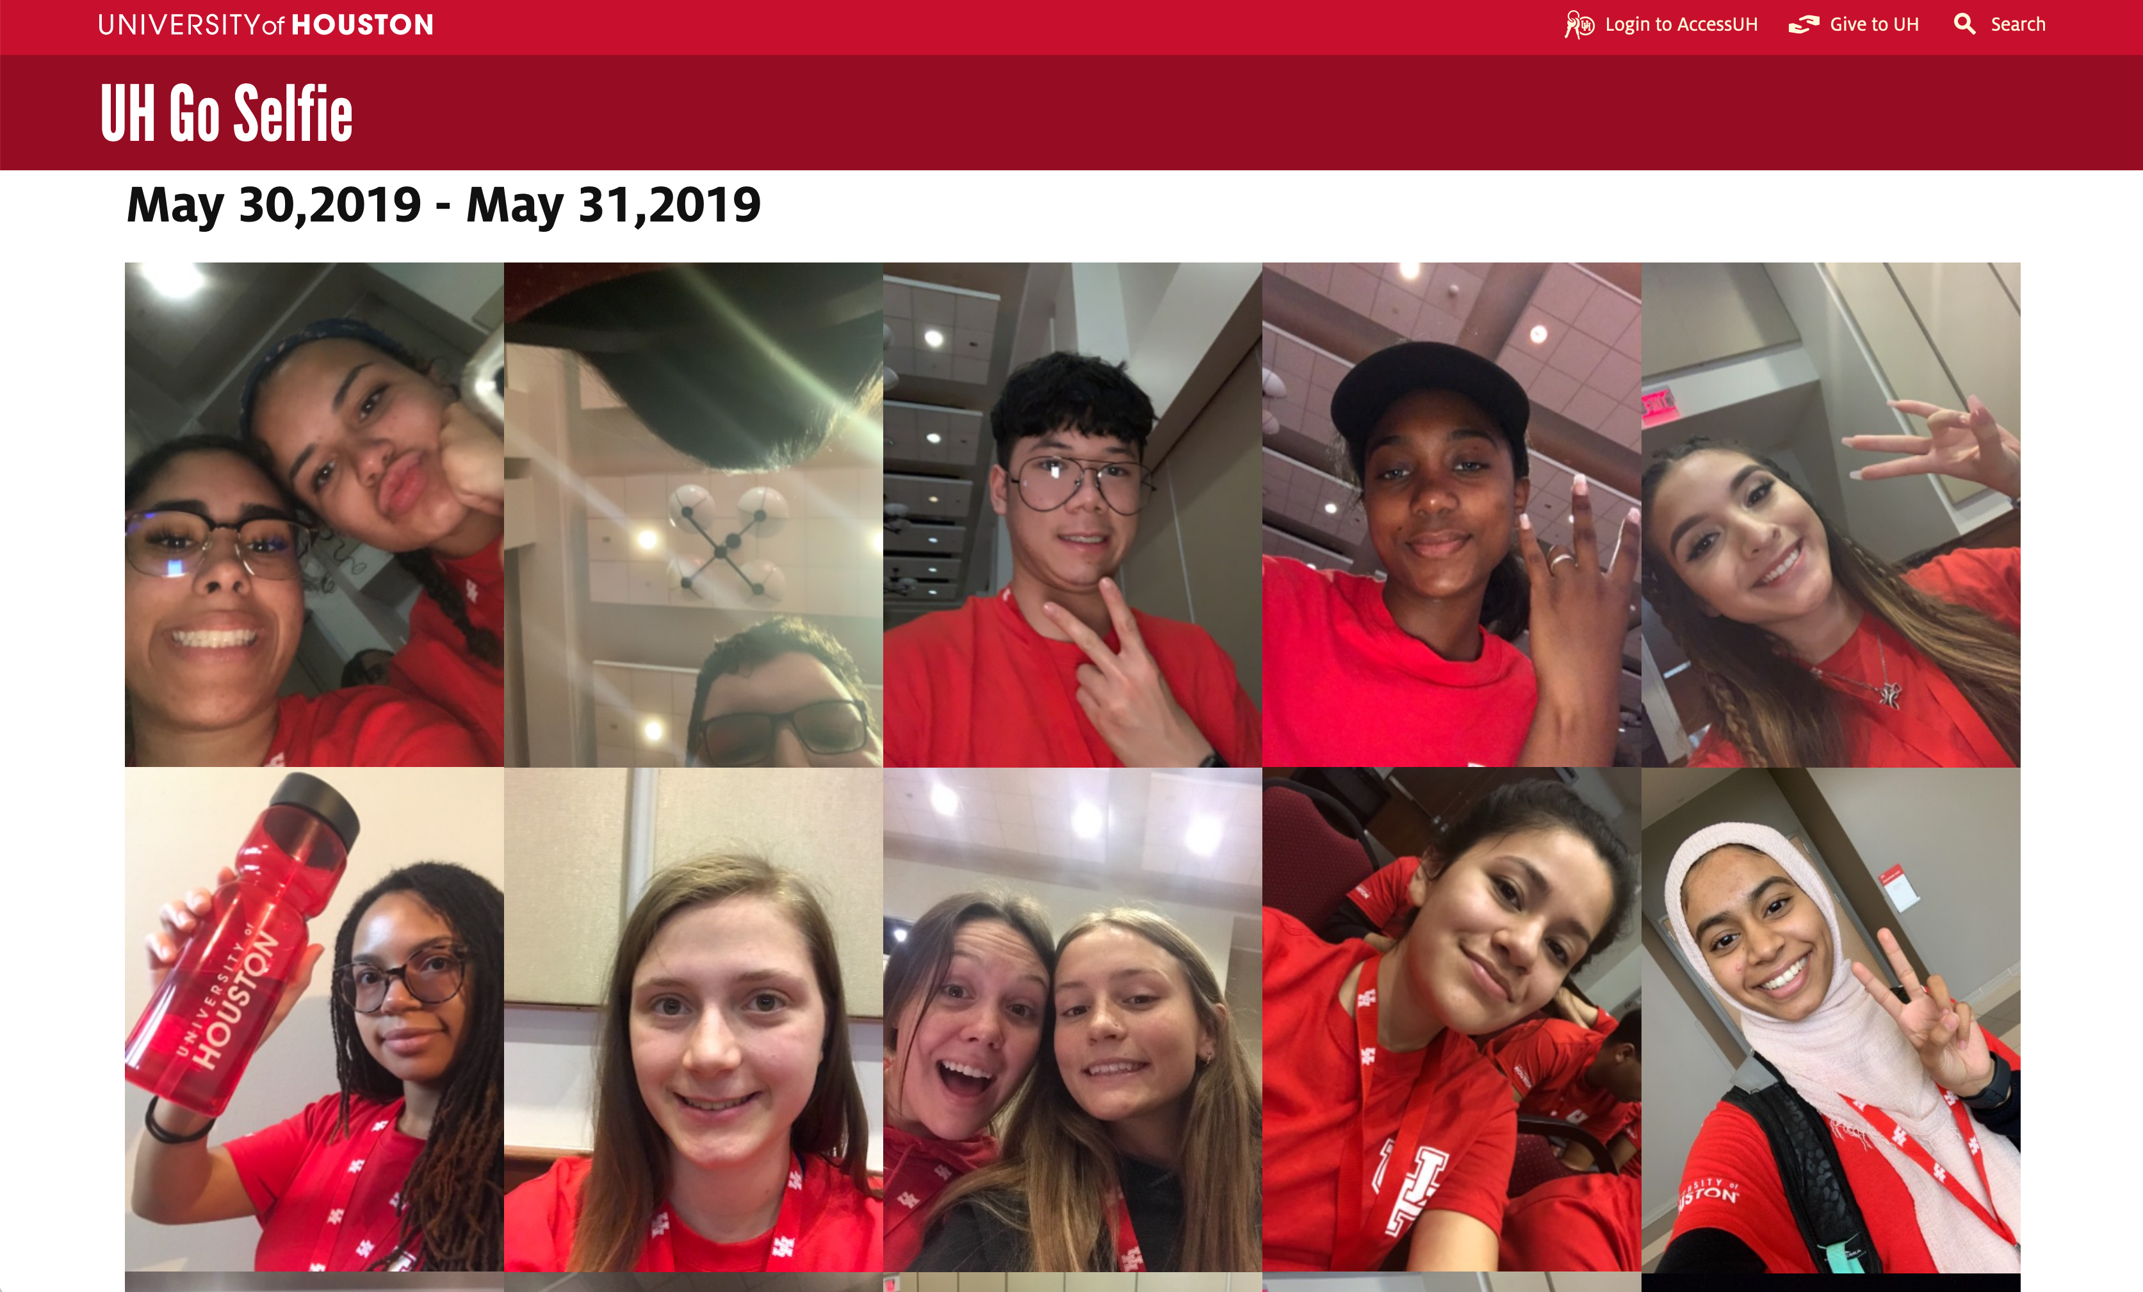

Slide 18
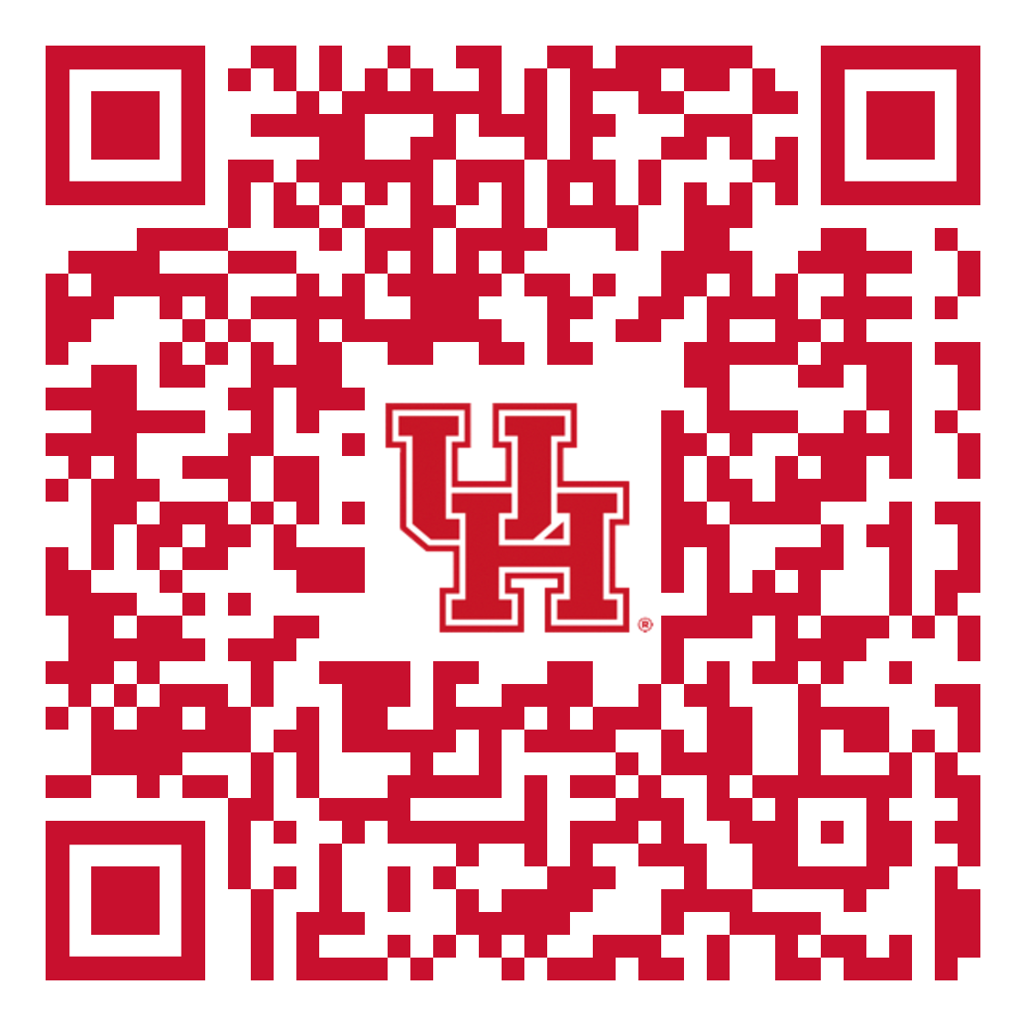
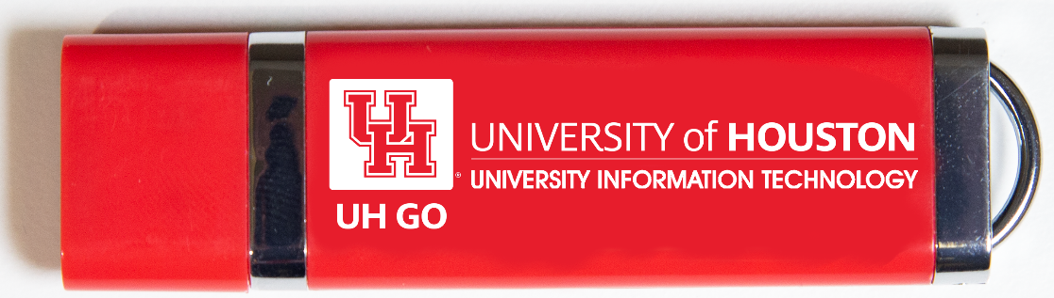
Available on the flash drive:
Sample Project plan
Sample integration plan
Etc.

