Slide 1
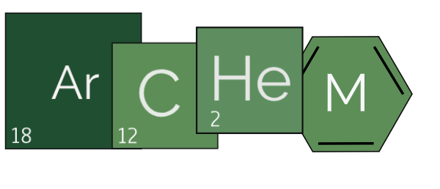
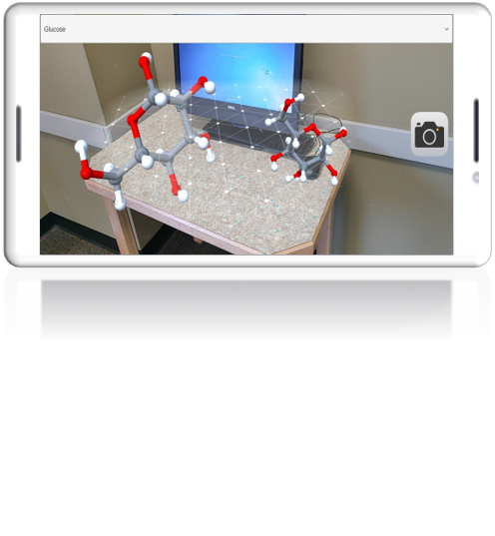
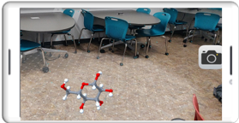
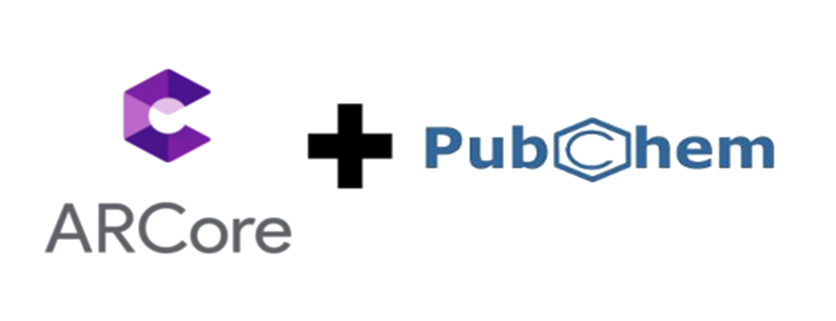
Shared Augmented Reality Experience of 3D Molecules for Chemistry Students
Ayesha Shaik, Jeremiah Anderson, Richard Smith
Georgia Gwinnett College, Lawrenceville, GA, 30043
Abstract: Augmented Reality (AR) and Artificial Intelligence (AI) can be harnessed inside of a smart phone to enhance the education experience. The purpose of this project is to create a shared AR experience that allows users to manipulate 3D representations of molecules, using only their mobile devices. The mobile application was created using Google’s ARCore software to provide an AR baseline environment and Unity 3D editing software to build the application. It allows students to take concepts from the real world that are metaphysical in nature and give them an on-screen 3D model to visualize and maneuver in a virtual environment mirroring their own. The mobile application is meant to be a tool for students to improve their chemistry content knowledge using the phones in their pockets inside the classroom, and on the go.
.
What’s The Problem?
High failure rate in Chemistry.
Understanding the sub microscopic when interpreting macroscopic level¹
Limitations of current physical model kits
What are the Benefits of AR?
Increased interest, collaboration, speed of results²
No specialized equipment
More accurate models
Content quality improvement
What’s a Solution?
Launch App
Mapping Environment
Double tap to place
Grant Camera Permission
Choose from Dropdown
Scene A
Google Sign-In
Scene B
Classification
Capture Molecule
Double tap to place
Send image
Insert
App Development
Challenges
Third-party SDK compatibility issues
Android vs iOS development
Stability issues
Software versions
Hardware availability
References
“Developing and using models: From macroscopic to sub-microscopic", Royal Society of Chemistry, https://www.rsc.org/cpd/resource/RES00001450/from-macroscopic-to-sub-microscopic/RES00001448#!cmpid=CMP00003565, Accessed 22 Feb. 2019
“Augmented Reality in Education: The Hottest EdTech Trend 2018 and How to Apply It to Your Business.” Eastern Peak, 24 Apr. 2018, easternpeak.com/blog/augmented-reality-in-education-the-hottest-edtech-trend-2018-and-how-to-apply-it-to-your-business/
Future Work
Shared environment for multi-users/devices
Data persistence for single user
Want More Info?
Derek Behmke
dbehmke@ggc.edu
Robert Lutz
rlutz@ggc.edu

