Slide 1
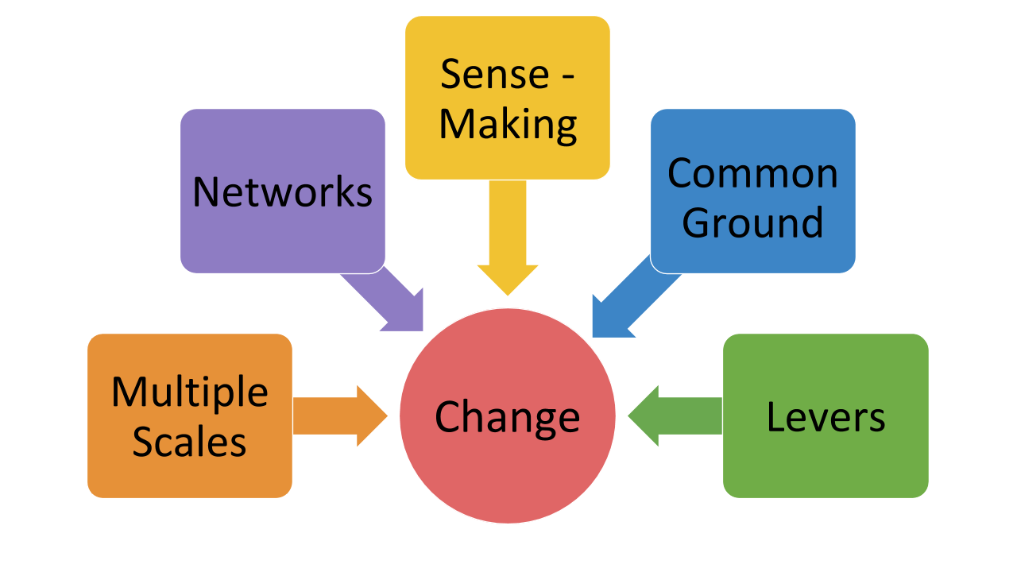
Educational Developers: Leading Change from the Middle
S. Raj Chaudhury, schaudhury@southalabama.edu Executive Director, Innovation in Learning Center & USAonline University of South Alabama
IT concerns are central to the modern higher education teaching and learning landscape. Depending on institutional structures, IT can stand for ‘information technologies’ or ‘instructional technologies’ or both. Often, “IT folks” become educational developers - guiding users to the most appropriate uses of technology for enhancing their teaching, learning or scholarship. This session will be valuable to all those engaged in change initiatives from the ‘middle’ - i.e. not faculty nor upper administration and offer insights into how they can become leaders of these processes. The unique perspective of educational developers, whether IT focused or not, allows them to contribute to the success of institutional initiatives such as expansion of online learning or design and operation of active learning classrooms.
Case Description: You direct a campus Center for Teaching and Learning (CTL). The Physics department on your campus has established an active learning classroom along the lines of the SCALE-UP (North Carolina State) model. This transition in physics pedagogy has largely been a departmental effort, through a funding initiative related to raising the profile of the School of Engineering on campus. SCALE-UP has been shown to close the achievement gaps for underserved students in the calculus-based physics course, an often problematic prerequisite for engineering majors. All new faculty hired in the Physics department cycle through teaching in the SCALE-UP room where all introductory course sections are taught. The department is quite content with their own curricular reform and do not view themselves as having a faculty professional development role in being active outside their own discipline-based educational research boundaries.
Global Option:
Local Option:
Your institution is establishing an overseas branch campus in Eastern Europe, in a country with a proud Soviet-era tradition of excellence in the sciences, but still very much emerging from those times. The university has traditional lecture halls and traditional pedagogy.
Classroom renovations have been approved at this new campus and your Provost has asked you to be sure that 30% of the new classroom space is modeled after the SCALE-UP type of active learning spaces.
You will work with the local Office of Building Management to accomplish renovations but they have a traditional view of what classroom furniture looks like. Purchase requisitions that don’t fit their view are likely to be ignored.
Faculty development related to teaching has been non-existent at this university.
The new campus opens in 1 year.
The Board of Regents has decreed that your university will ‘absorb’ another smaller, struggling institution 20 miles down the interstate.
While the median home prices in the zipcode of your institution are closer to $1 Million, the new branch campus is in an area with a median family income of $60K.
The student demographics of the branch campus are distinct in a number of ways as well: a majority of first generation attendees and a majority Latino population versus predominantly White at your current campus.
The Provost has asked your Center to assist with the restructuring of physics education for engineers at the new location to reflect best practices on the home campus.
You will work with the Office of Academic Affairs at the new branch campus on any faculty development programs.
The merger and name change are 6 months away.
Acknowledgements: Amy Mulnix, Elly Vandegrift and Jennifer Yates for our workshop on this topic presented at 2018 POD Network Conference

