Slide 1
Scaling Up to an Active Learning Building
Bringing the Anteater Learning Pavilion (ALP)
to campus, and the campus to the building

Slide 3
LINKS
alp.uci.edu
Anteater Learning Pavilion building details
classrooms.uci.edu
Info on all UCI general assignment classrooms & technology
dtei.uci.edu
Includes sections on learning environments, faculty development, the Active Learning Institute, etc.

Slide 4
LINKS
ovptl.uci.edu
UCI’s Office of the Vice Provost of Teaching & Learning incorporates Undergraduate Education, Assessment & Research, Teaching Excellence & Innovation, etc.
oit.uci.edu
The Office of Information Technology covers classroom and lab support groups, LMS support, IT infrastructure, desktop support, email and calendaring, security, etc.

Slide 5
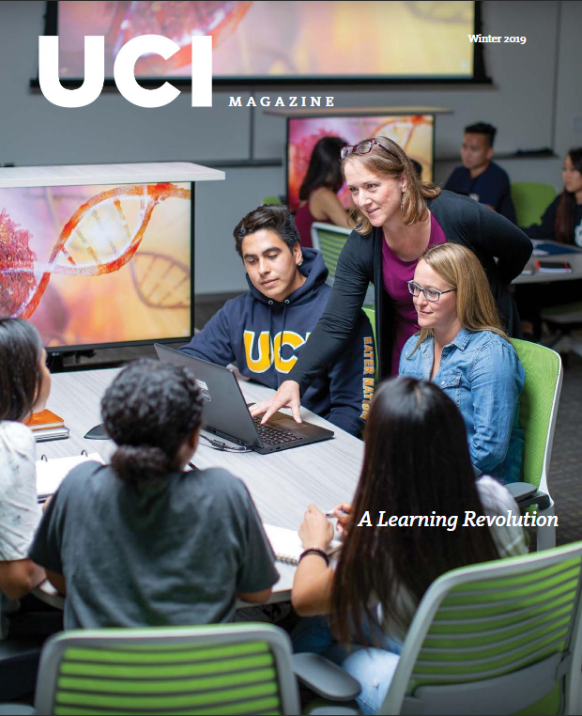
LINKS
issuu.com/ucimagazine/docs/uci19_winter_mag
Pages 16-27 cover the active learning models used in the Anteater Learning Pavilion, the Active Learning Institute, and assessment efforts.

Slide 6
Planning of the Anteater Learning Pavilion (ALP)
VISION / DEVELOPMENT
Based on course data and enrollments, the university had a need for additional large lecture hall space. We also needed to replace a number of 30-60 seat general assignment classrooms that had been lost to other departmental use.
Instead of building using the same stale classroom and lecture hall models, ALP provided an opportunity to create new types of classroom spaces that could help shape the direction of teaching and learning at UCI.

Slide 7
A building advisory committee was created. We collaborated with faculty, administrative units, and IT units, and had support from senior campus leadership.
The decision was made to optimize classrooms for active & collaborative learning, but also to accommodate faculty who are only beginning to incorporate these methods.
This took a lot of consulting. We looked at what others had done with similar spaces, evaluated our own prior ALC renovation, attended Educause ELI courses, and ultimately determined UCI’s specific needs and desires.

Slide 8
Opportunities & Challenges
More classroom spaces to meet demand
Additional collaborative learning spaces outside of the classroom
Ability to designate more area per student in new construction versus renovated spaces
Elevation of the discussion around teaching and learning on campus
Added value placed on learner-centric instruction
Preparing students and faculty for the change, including outreach and training
Staffing concerns for both training and ongoing support
Campus methodology changes for room reservations
Building management
Design, technology, and furniture decision making
Assessment of spaces and faculty

Slide 9
Alignment with UCI Strategic Plan
PILLAR 2: FIRST IN CLASS
Elevating the Student Experience to Prepare Future Leaders
We will embrace innovations in pedagogy that improve the quality of learning and provide the support necessary to ensure outstanding outcomes for all students.
Their experiences inside and outside the classroom will connect them to the UCI community for life, enrich their minds and spirits, prepare them for productive lives, and empower them to make the strongest possible contributions to our world.

Slide 10
Alignment with UCI Strategic Plan
Goal 2.3: Utilize modern technological tools to create the most effective learning environments
UCI embraces a technologically enhanced education strategy that goes beyond online courses and leverages all forms of innovation to enhance student experiences. We will develop a comprehensive plan for deploying technology in a way that best supports our diverse internal and external constituencies.
Their experiences inside and outside the classroom will connect them to the UCI community for life, enrich their minds and spirits, prepare them for productive lives, and empower them to make the strongest
possible contributions to our world.

Slide 11
Alignment with UCI Strategic Plan
Goal 2.4: Integrate student life with educational experiences
Our university has a fundamental role in supporting the intellectual, personal, social, and professional development of all students.
Support the development of students’ 21st-century literacy proficiencies (information, data, visual/image literacy, and global competencies) by providing instructional space integrated with library support and assessing undergraduate learning outcomes.

Slide 12
DESIGN / TECHNOLOGY
● Classroom features should support a wide variety of instructional approaches and activities while minimizing the time and effort required to switch between them
● Rooms should support and promote student-instructor and student- student interaction
● Technologies should be available to those who wish to use them without creating unnecessary barriers for those who do not
● Rooms should be clean, comfortable, and well-lit

Slide 13
DESIGN / TECHNOLOGY
● Flexible seating
● More square-feet per student, wider aisles
● Shared student notation space (whiteboards and/or shared PCs)
The building would draw lots of students, and if we were going to start asking students to do group work in class, we wanted to give them formal and informal group study spaces outside of class.
We began by evaluating a prior ALC renovation.

Slide 14
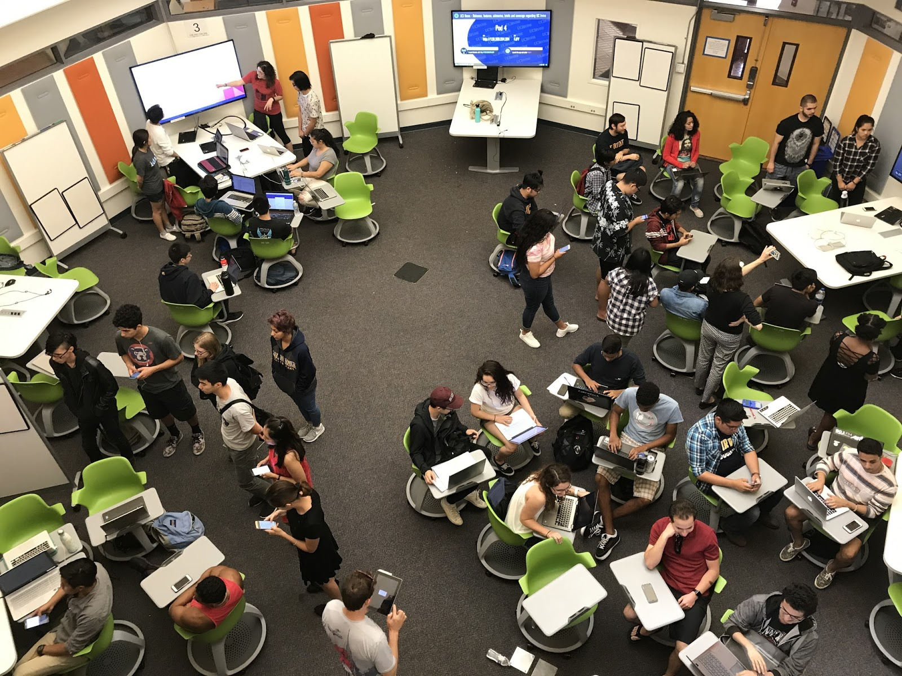
UCI’s only previous ALC renovation was in an octagonal room.
We learned that new spaces should still have a defined “front of room.”

Slide 15
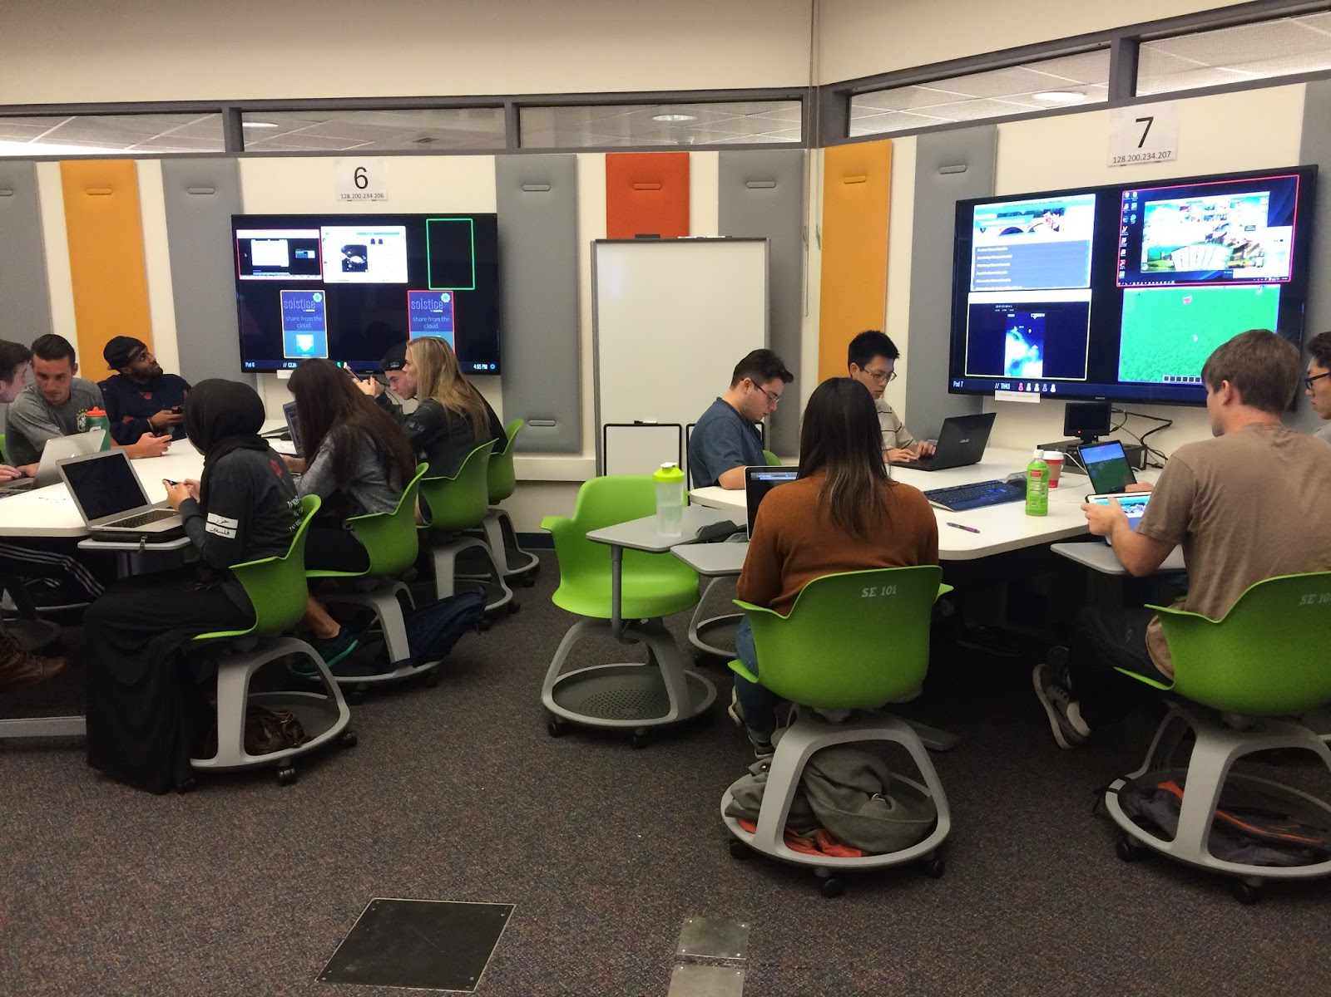
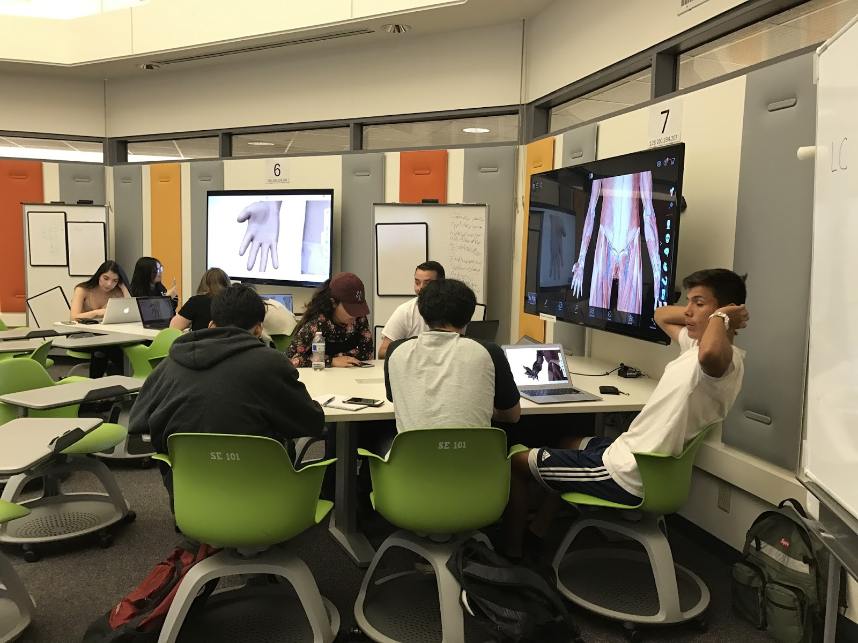
Many other elements were relatively well received, but were
modified or expanded upon when designing the new building.

Slide 16
Final design criteria included:
Rooms can be used in both traditional and active learning modes
Rooms must be spacious enough to accommodate student interaction and instructor movement
Groupings of 6 students should be the standard
Lecture halls should have 2 rows per tier, with seating allowing 180+ degree movement for collaboration with the row behind
Power should be available at virtually every seat
Instructors should have a podium with room for technology & materials
Low-tech options like whiteboards must be available for instructors and all student groups
Screens and whiteboards should be able to be used simultaneously
Incorporate natural light
Utilize flexible furnishings to allow as much mobility as possible
Have informal spaces for student interaction along with formal space

Slide 17
As much as possible, we tried to design these features into all spaces:
Lecture halls
Active learning classrooms w/ standard technology
Active learning classrooms w/enhanced technology
Computer classrooms
Tutorial rooms
Reservable group study rooms
Informal study and lounge areas

Slide 18
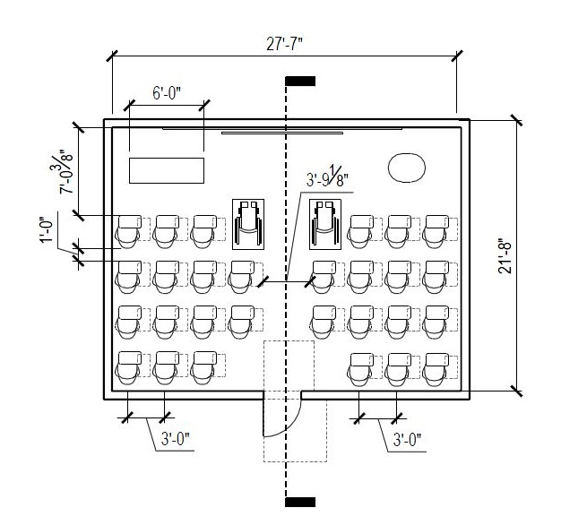
ANTEATER LEARNING PAVILION
Design phase – Small ALC
Notes:
4 Rooms (6 or 10 seats)
Available 8am - 10pm M-F
Scheduled 86% of available hours
DUE Academic Support Programs
School/Department Based Tutoring
Supplemental Course Session

Slide 19
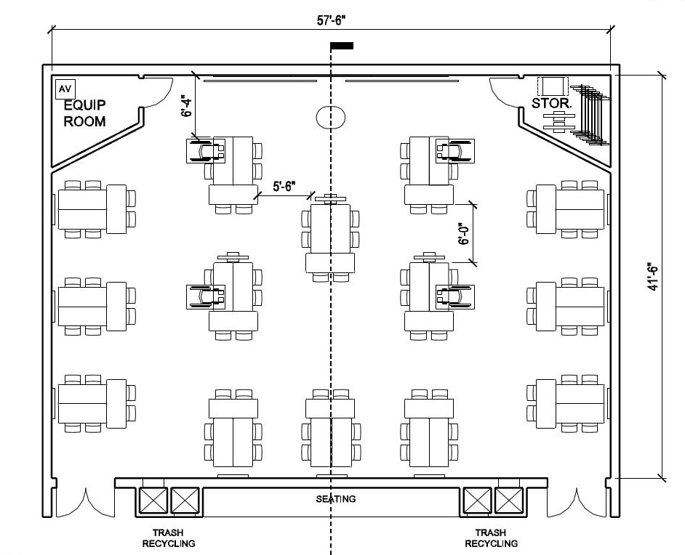
ANTEATER LEARNING PAVILION
Design phase – Large ALC
Notes:
4 Rooms (6 or 10 seats)
Available 8am - 10pm M-F
Scheduled 86% of available hours
DUE Academic Support Programs
School/Department Based Tutoring
Supplemental Course Session

Slide 20
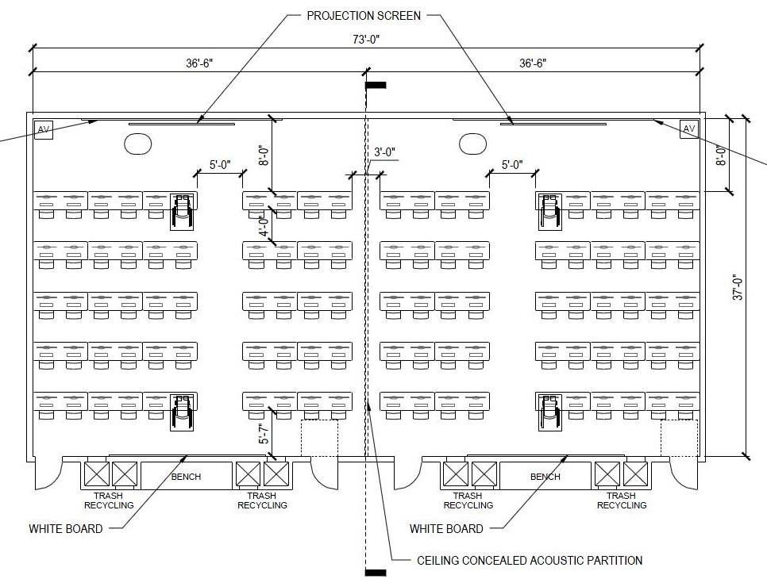
ANTEATER LEARNING PAVILION
Design phase – Computer classroom
Notes:
4 Rooms (6 or 10 seats)
Available 8am - 10pm M-F
Scheduled 86% of available hours
DUE Academic Support Programs
School/Department Based Tutoring
Supplemental Course Session

Slide 21
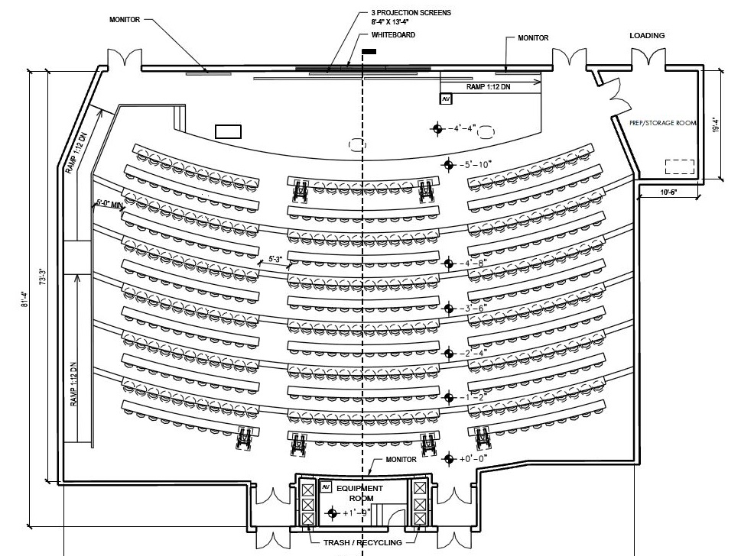
ANTEATER LEARNING PAVILION
Design phase – Lecture hall
Notes:
4 Rooms (6 or 10 seats)
Available 8am - 10pm M-F
Scheduled 86% of available hours
DUE Academic Support Programs
School/Department Based Tutoring
Supplemental Course Session

Slide 22
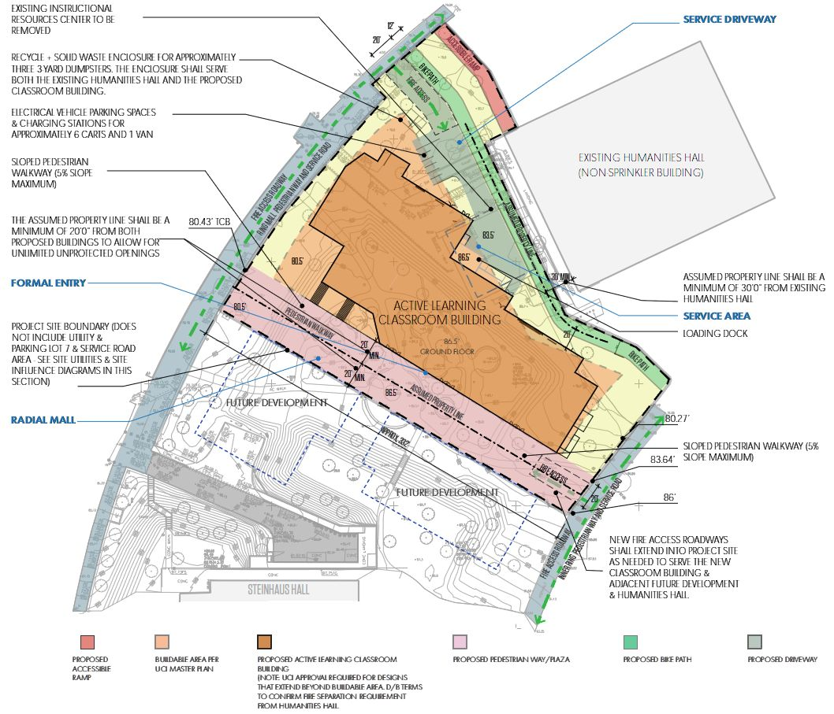
ANTEATER LEARNING PAVILION
Design phase – Building layout
Notes:
4 Rooms (6 or 10 seats)
Available 8am - 10pm M-F
Scheduled 86% of available hours
DUE Academic Support Programs
School/Department Based Tutoring
Supplemental Course Session

Slide 23
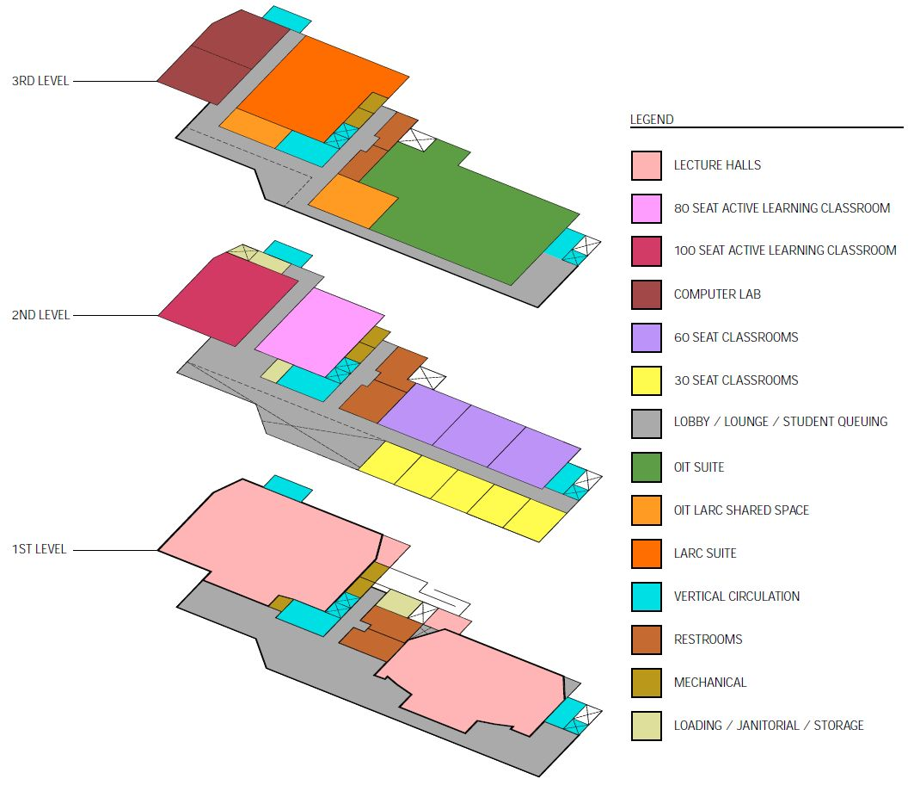
ANTEATER LEARNING PAVILION
Design phase – Building layout
Notes:
4 Rooms (6 or 10 seats)
Available 8am - 10pm M-F
Scheduled 86% of available hours
DUE Academic Support Programs
School/Department Based Tutoring
Supplemental Course Session

Slide 24
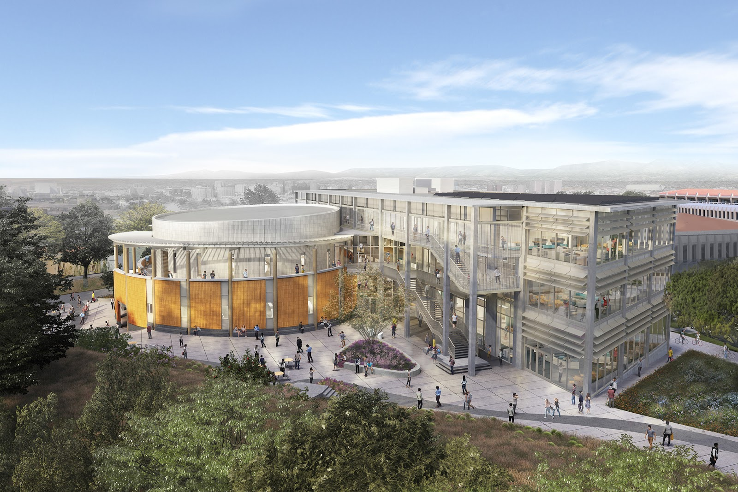
ANTEATER LEARNING PAVILION
Final plan renderings
Notes:
4 Rooms (6 or 10 seats)
Available 8am - 10pm M-F
Scheduled 86% of available hours
DUE Academic Support Programs
School/Department Based Tutoring
Supplemental Course Session

Slide 25
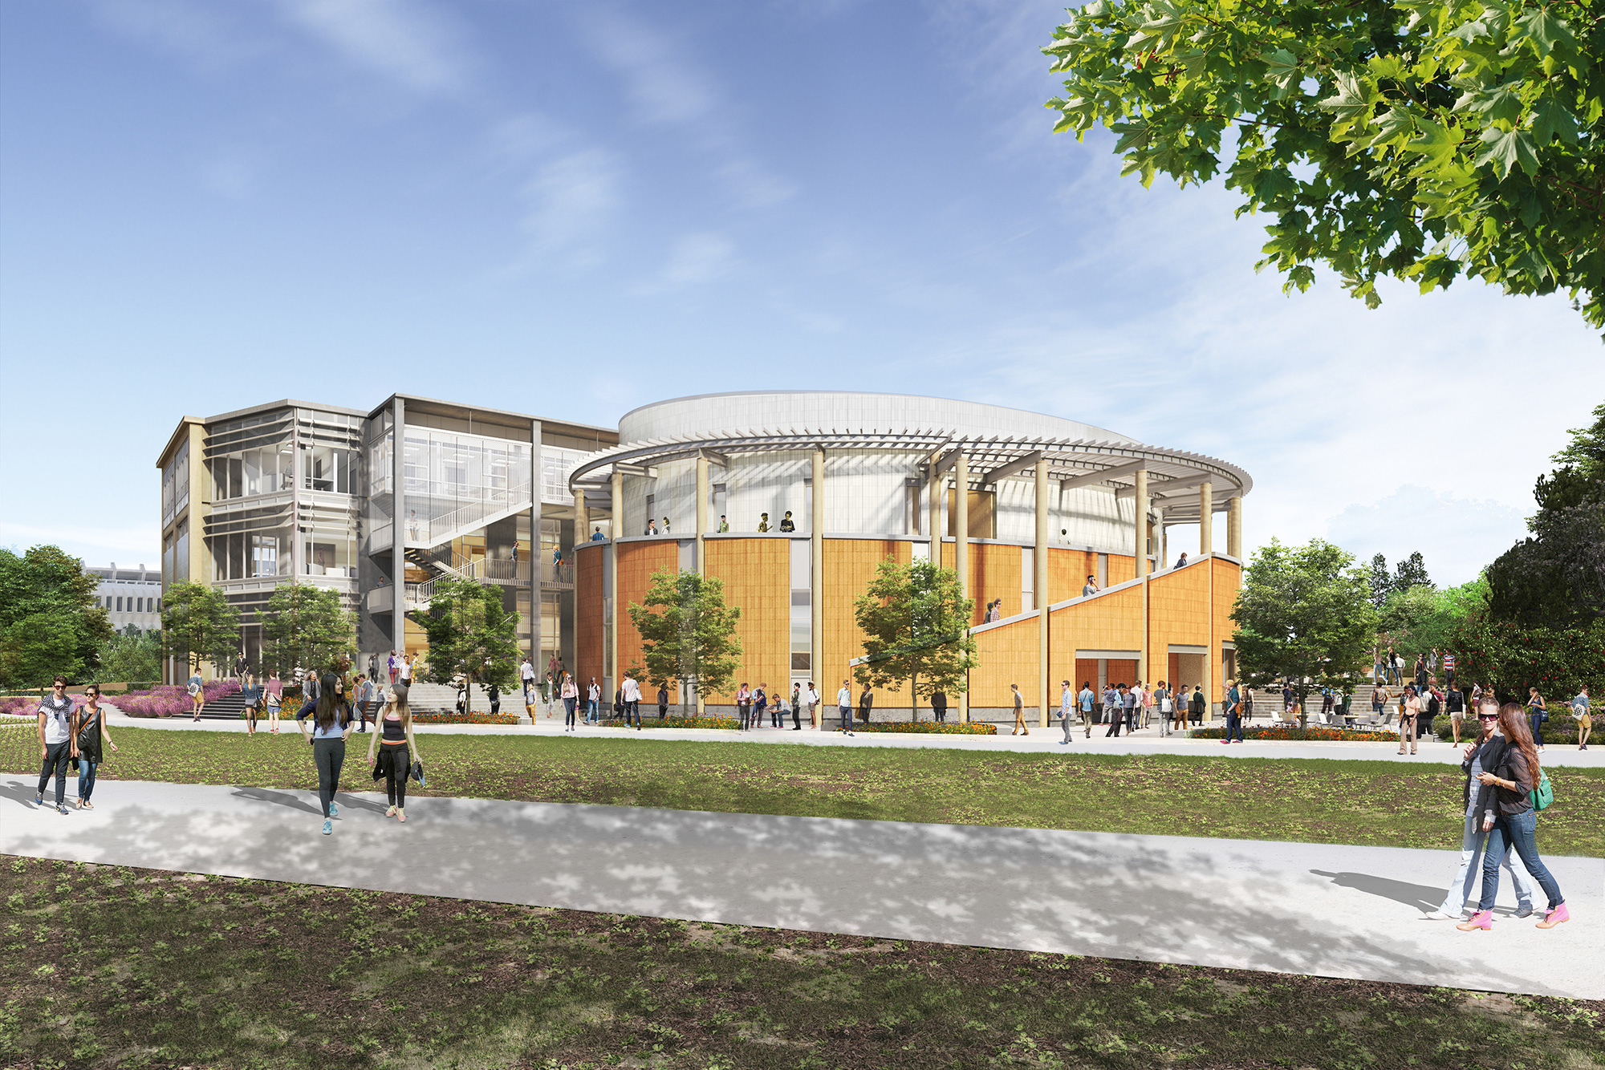
ANTEATER LEARNING PAVILION
Final plan renderings
Notes:
4 Rooms (6 or 10 seats)
Available 8am - 10pm M-F
Scheduled 86% of available hours
DUE Academic Support Programs
School/Department Based Tutoring
Supplemental Course Session

Slide 26
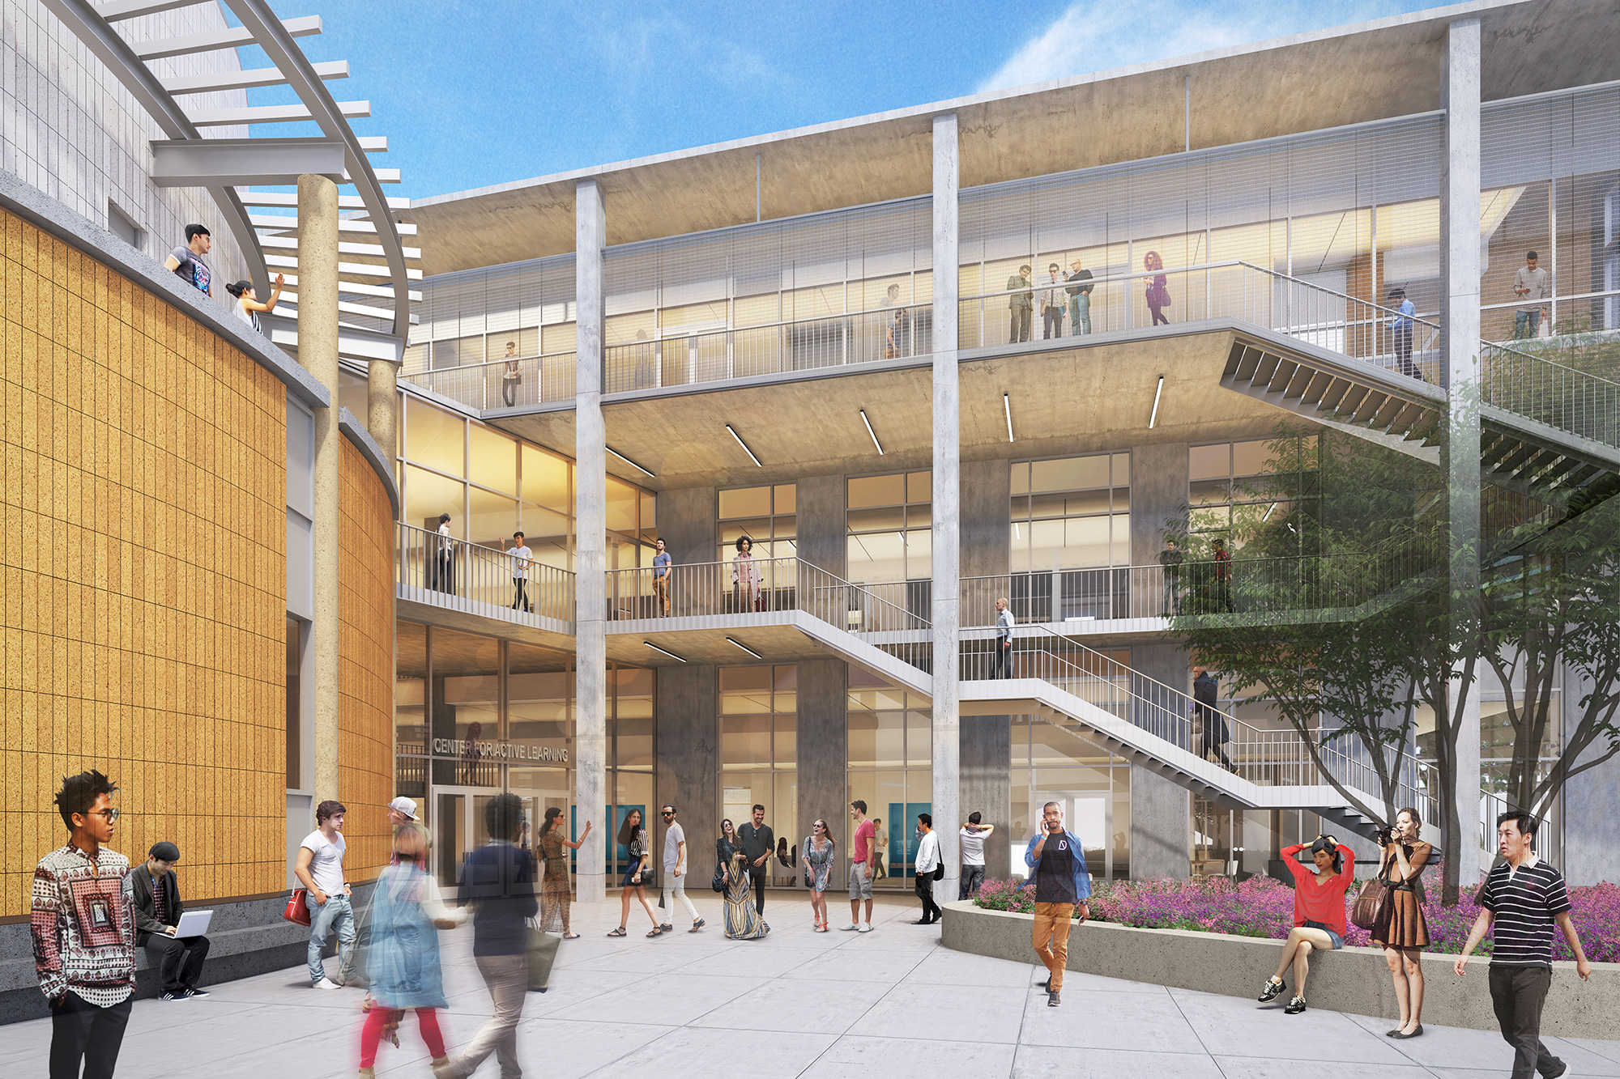
ANTEATER LEARNING PAVILION
Final plan renderings
Notes:
4 Rooms (6 or 10 seats)
Available 8am - 10pm M-F
Scheduled 86% of available hours
DUE Academic Support Programs
School/Department Based Tutoring
Supplemental Course Session

Slide 27
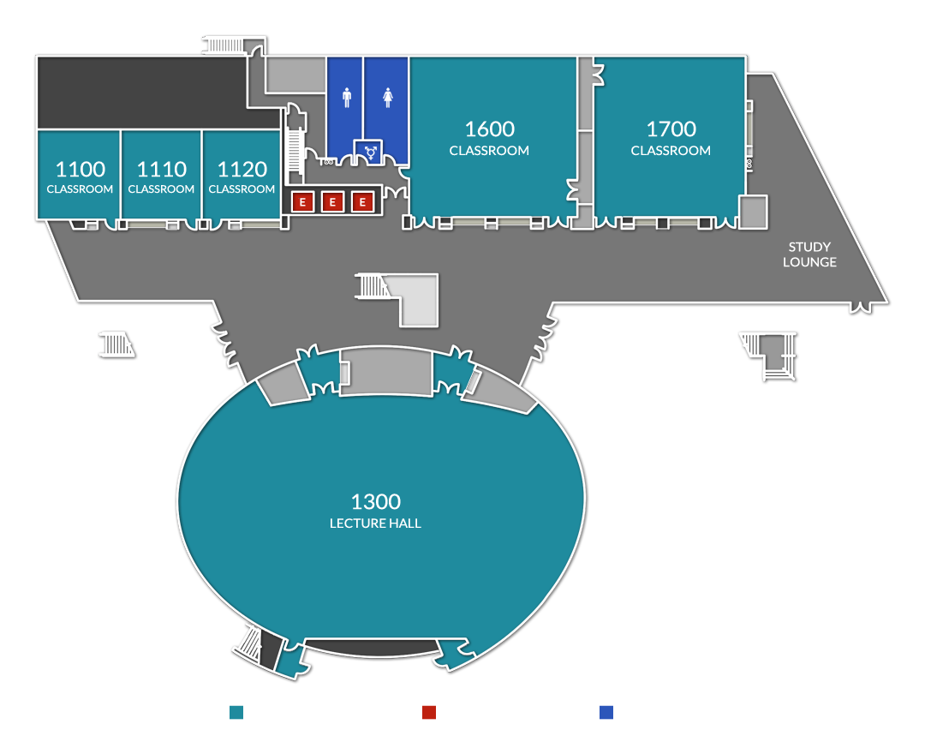
ANTEATER LEARNING PAVILION
Final plan - Level 1

Slide 28
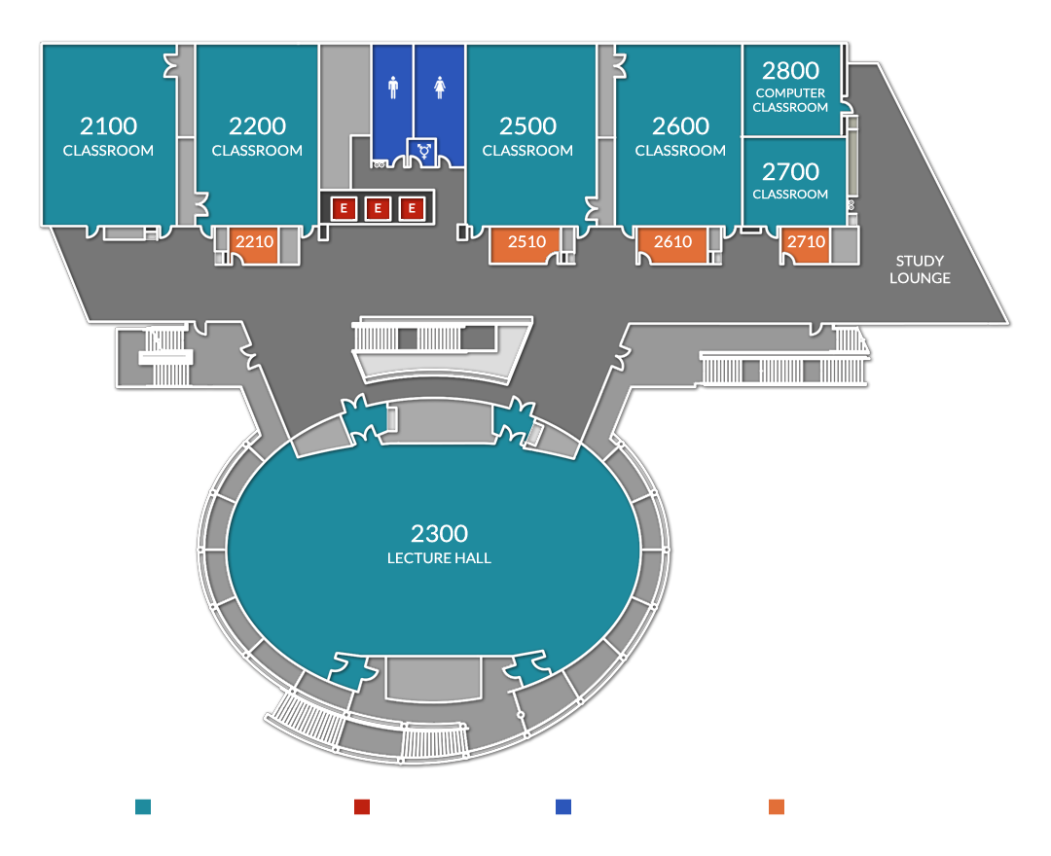
ANTEATER LEARNING PAVILION
Final plan - Level 2

Slide 29
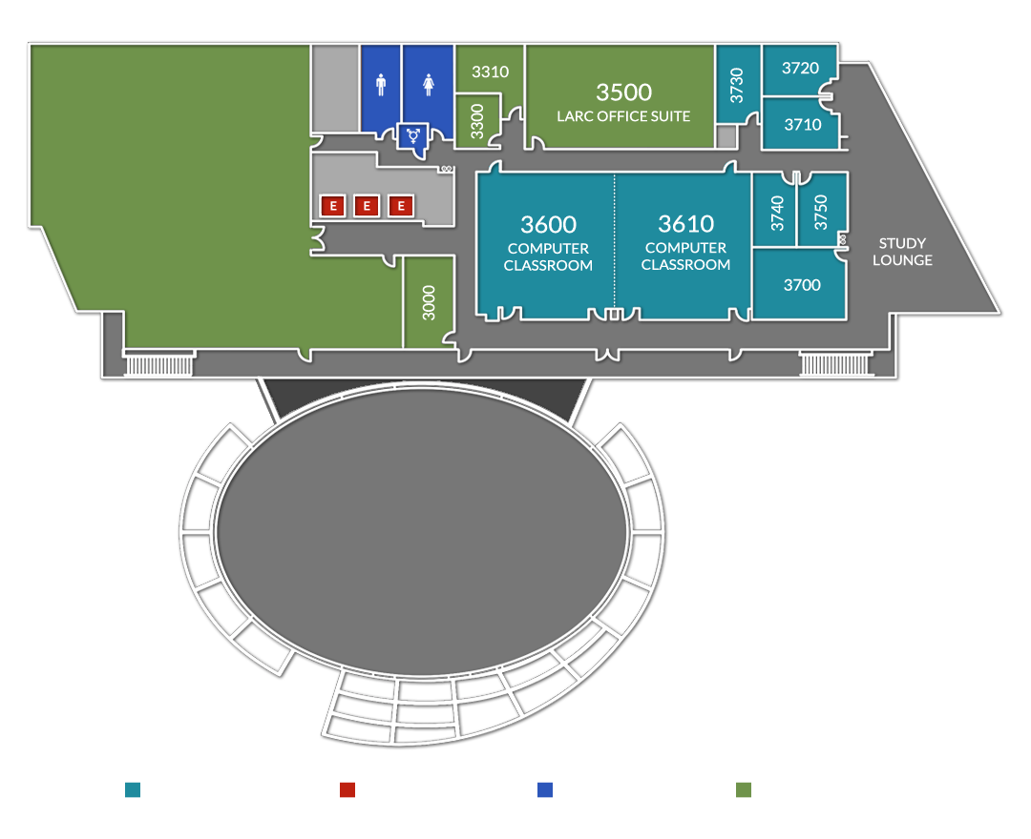
ANTEATER LEARNING PAVILION
Final plan - Level 3

Slide 30
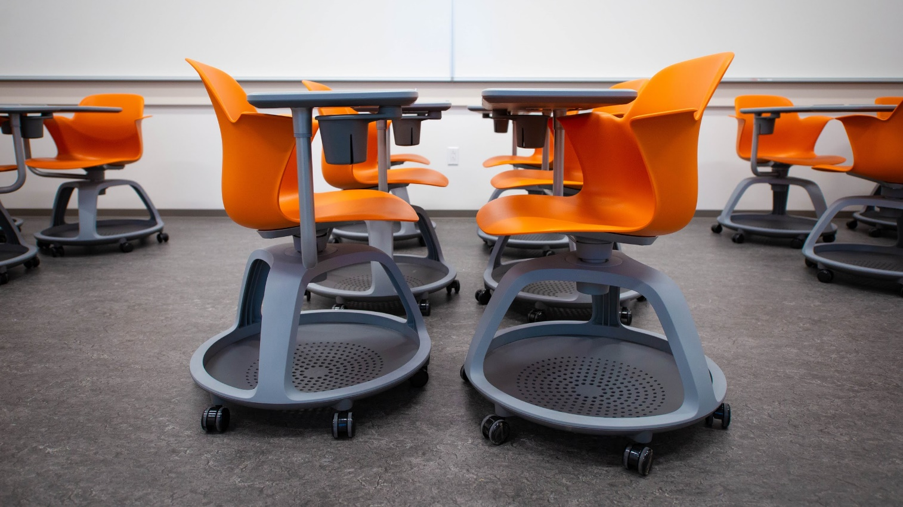
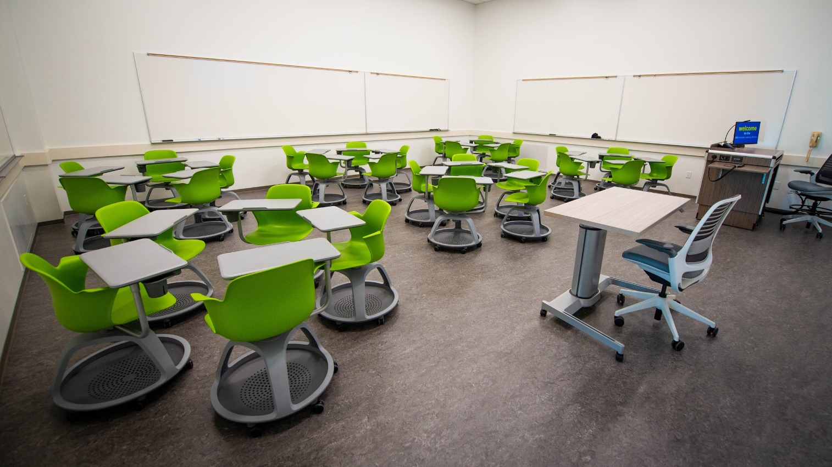
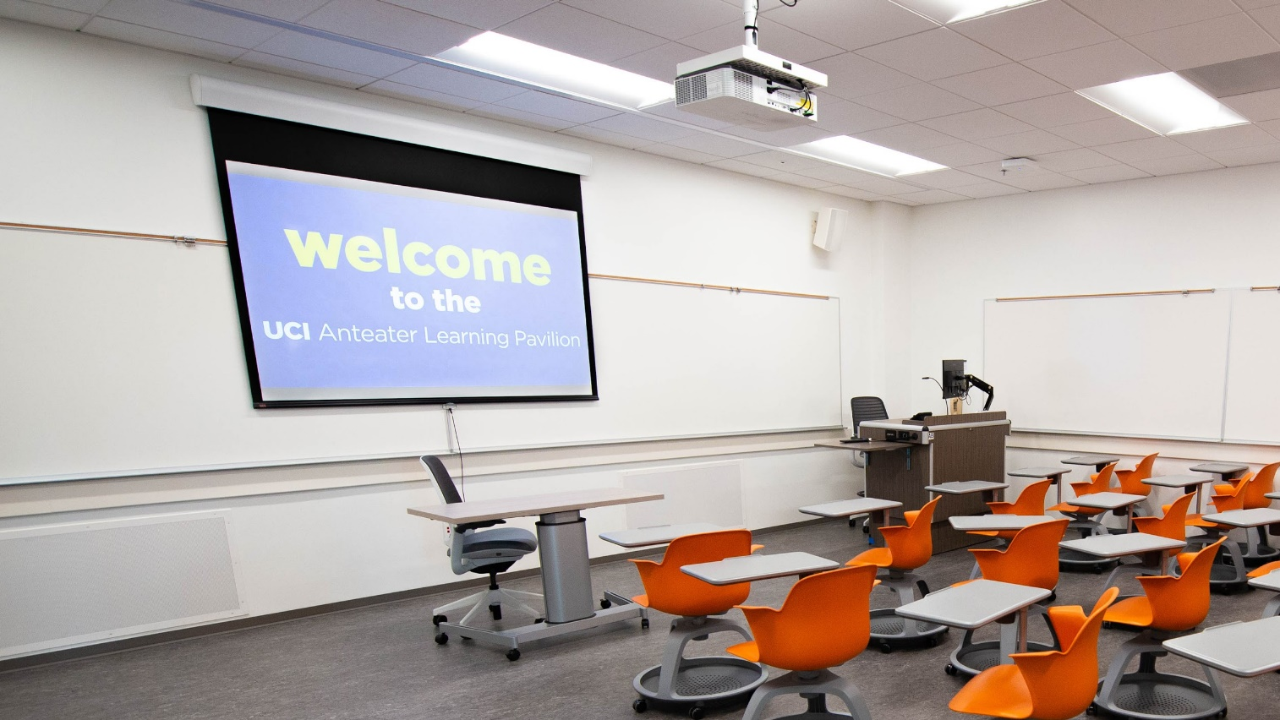
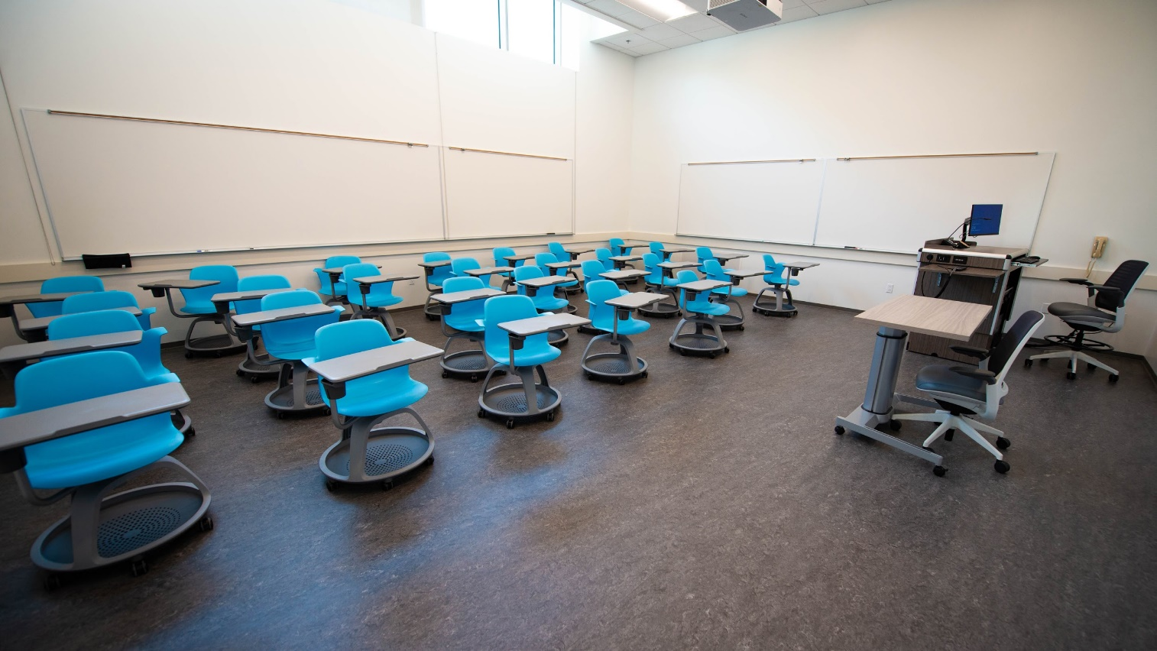
ANTEATER LEARNING PAVILION
Small active learning classrooms
Flexible Seating Layouts
More Space Per Student
Wireless Projection
Whiteboards Everywhere

Slide 31
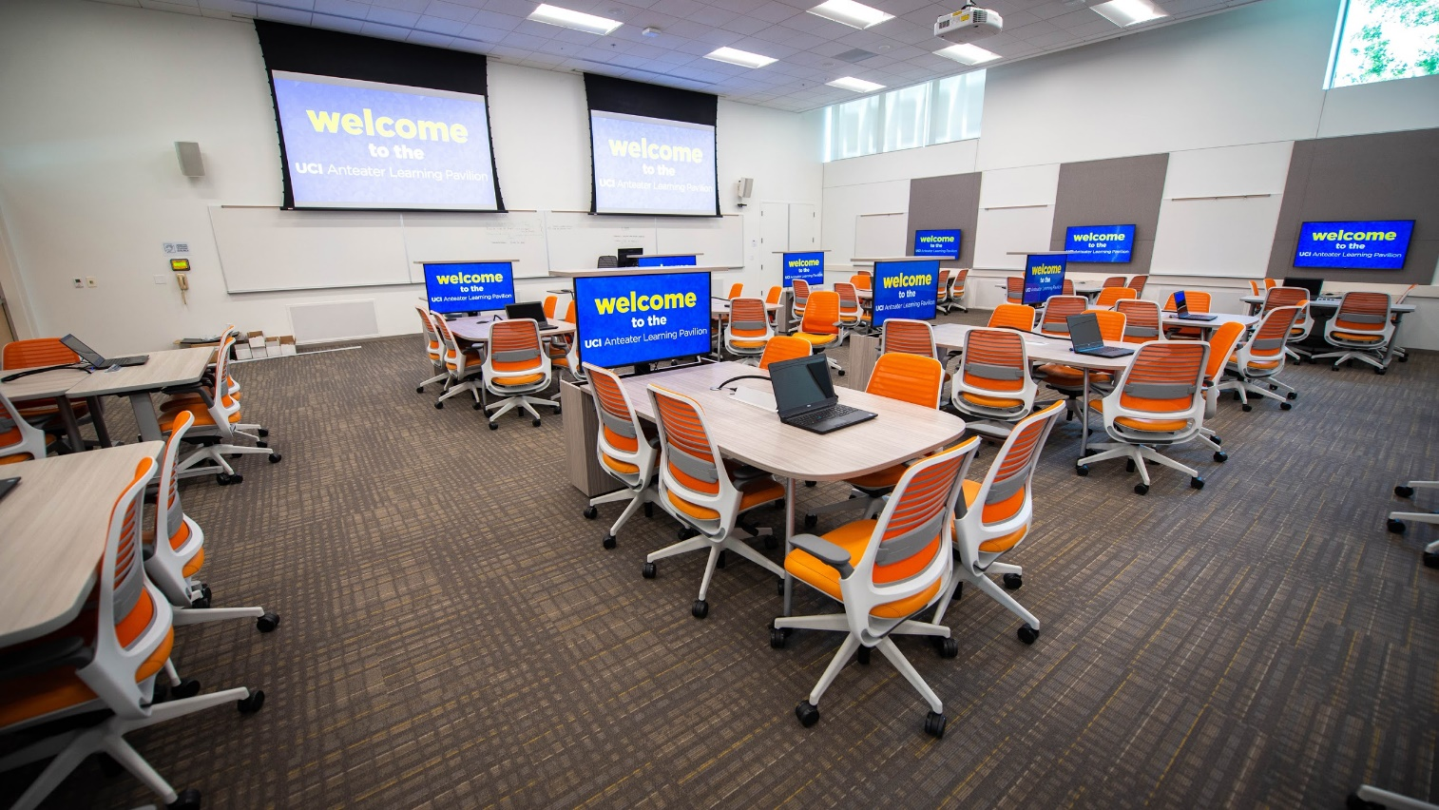
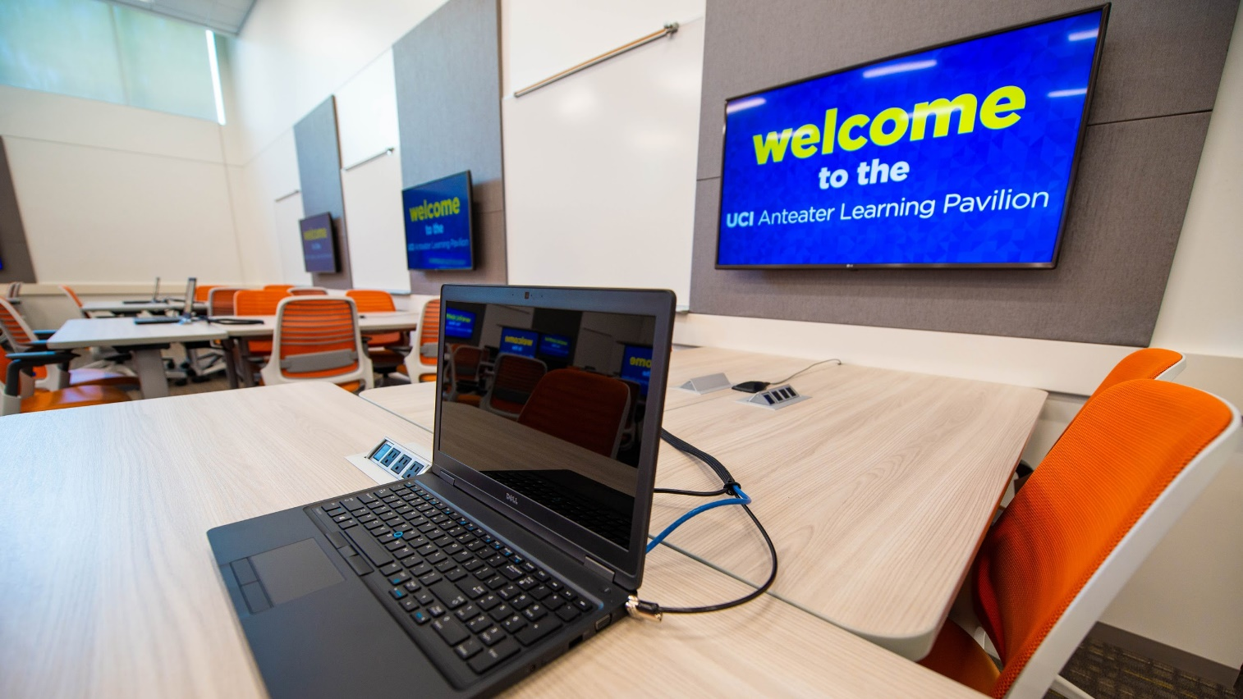
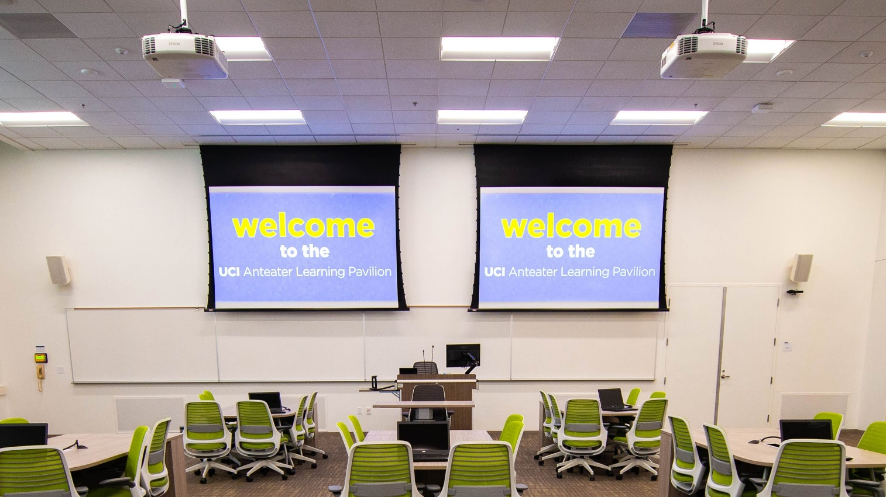
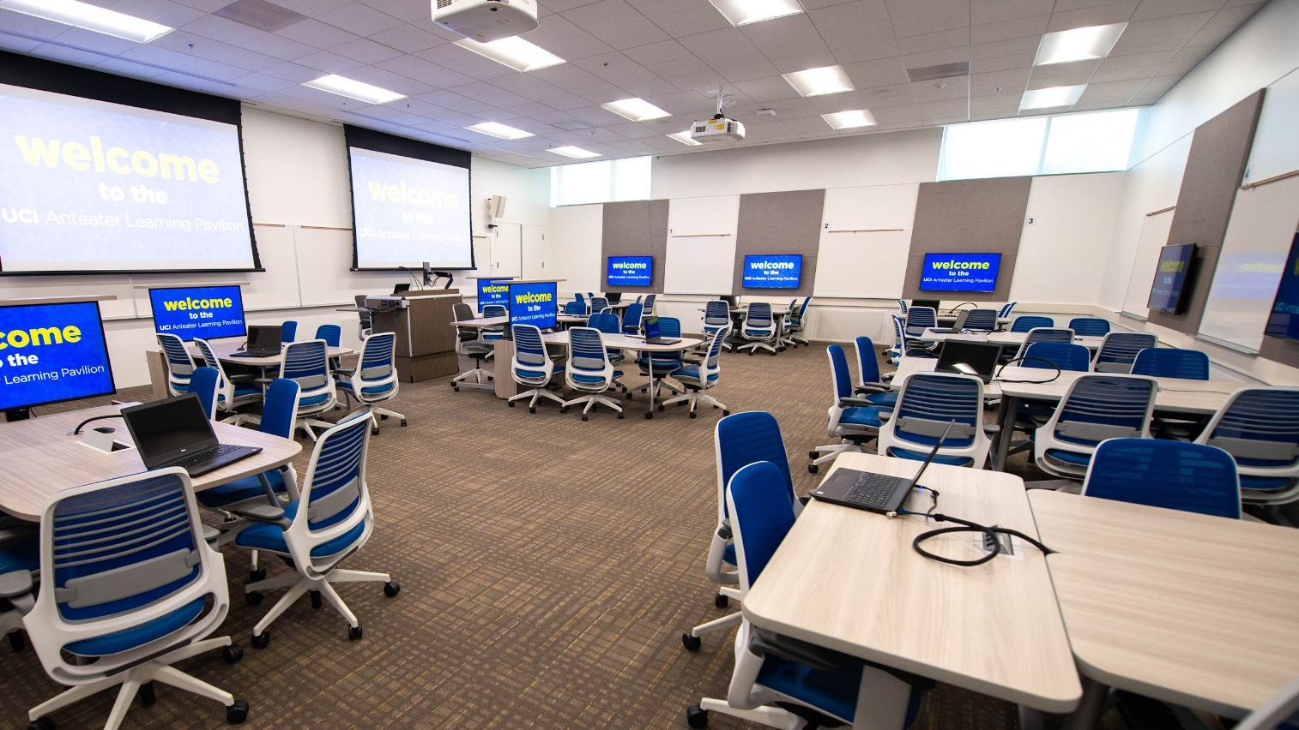
ANTEATER LEARNING PAVILION
Large active learning classrooms
Pod Seating Layout
Student Collaboration Displays
Wireless Projection
Whiteboards Everywhere

Slide 32
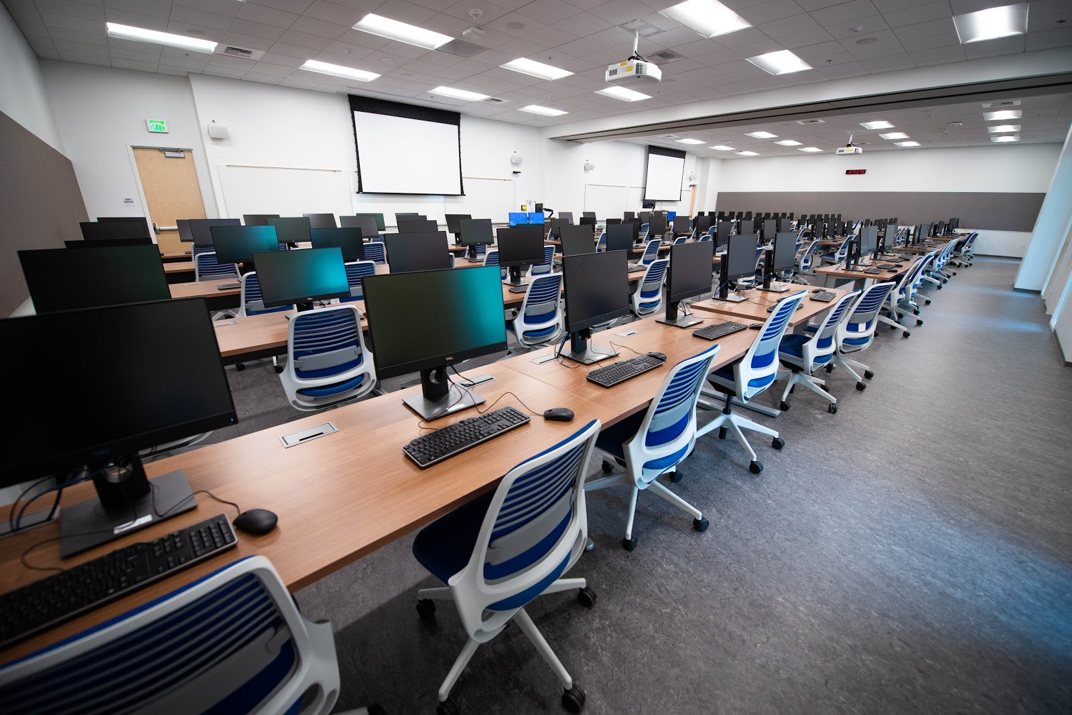
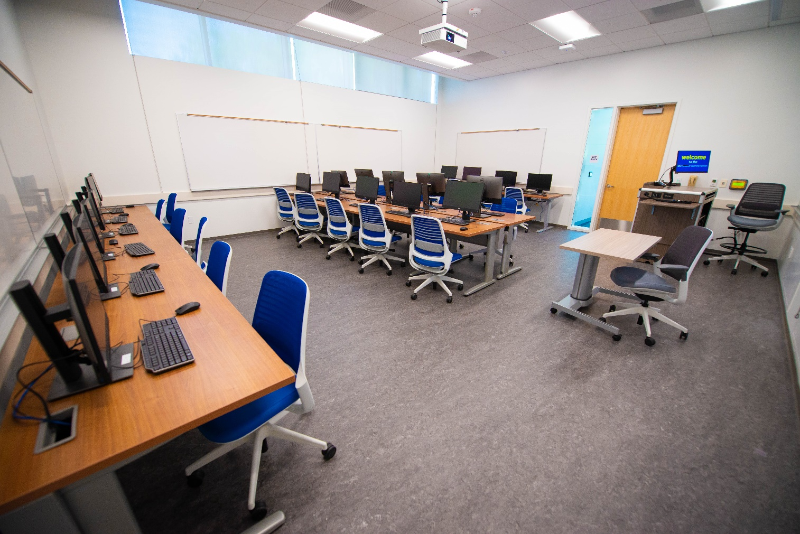
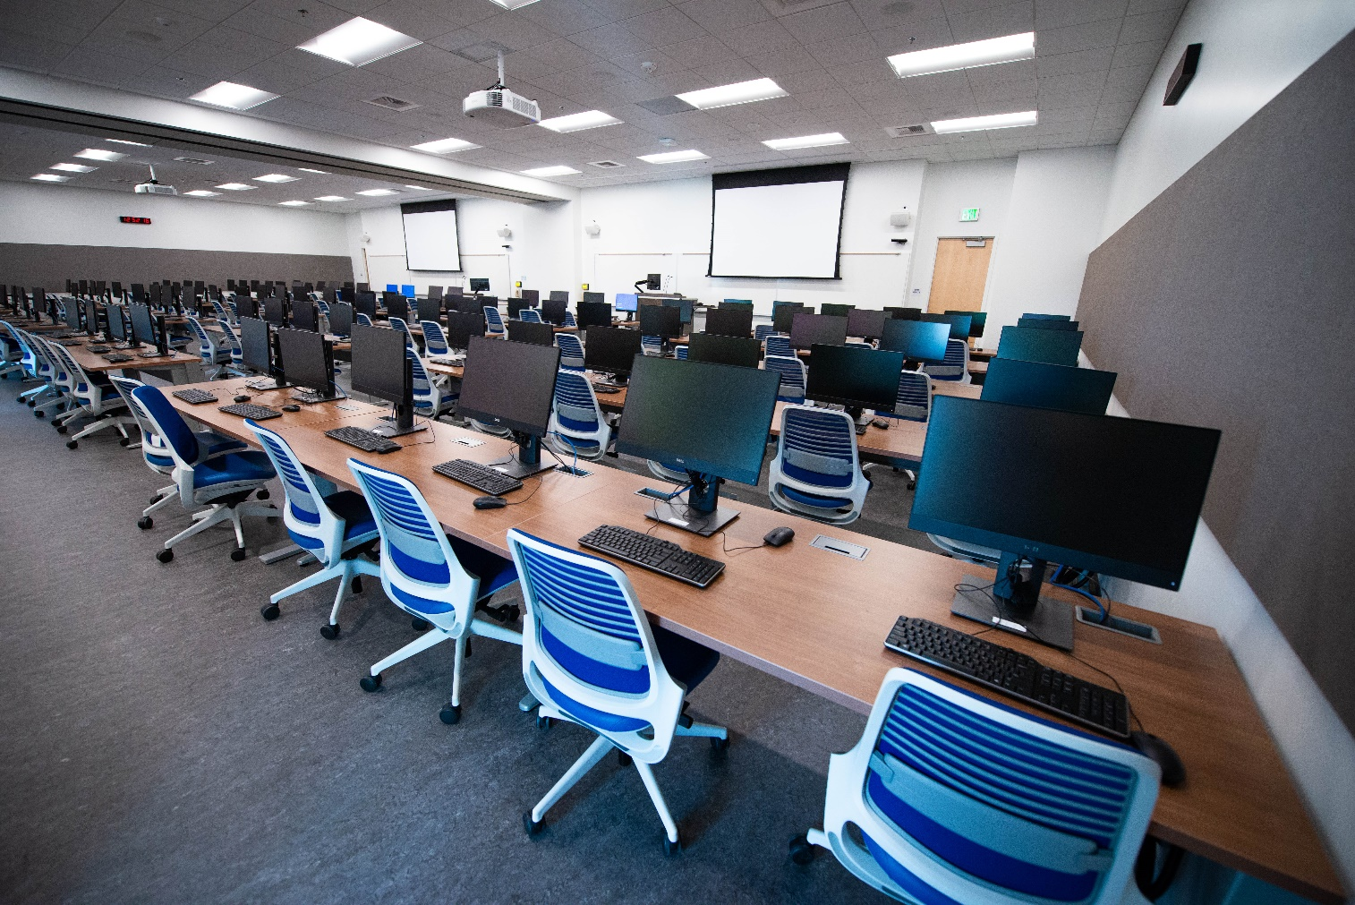
ANTEATER LEARNING PAVILION
Computer classrooms
30” Deep Tables
Defined Instructor Stations
Divisible Room w/ Skyfold Partition

Slide 33
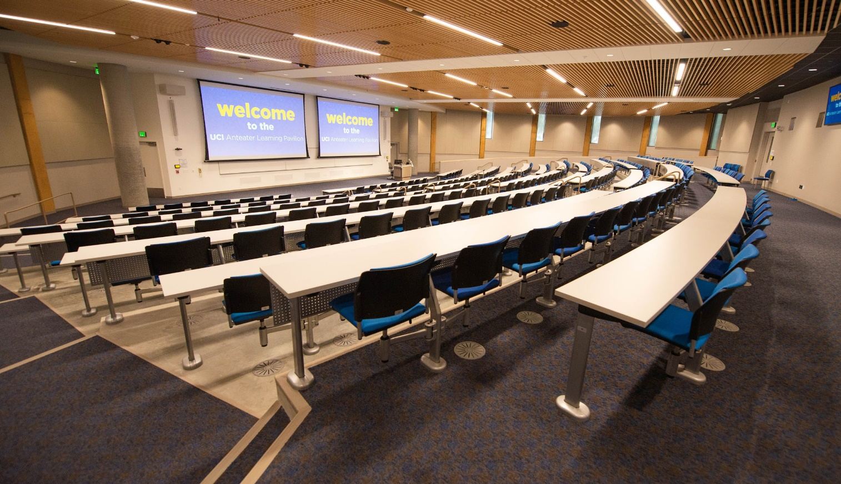
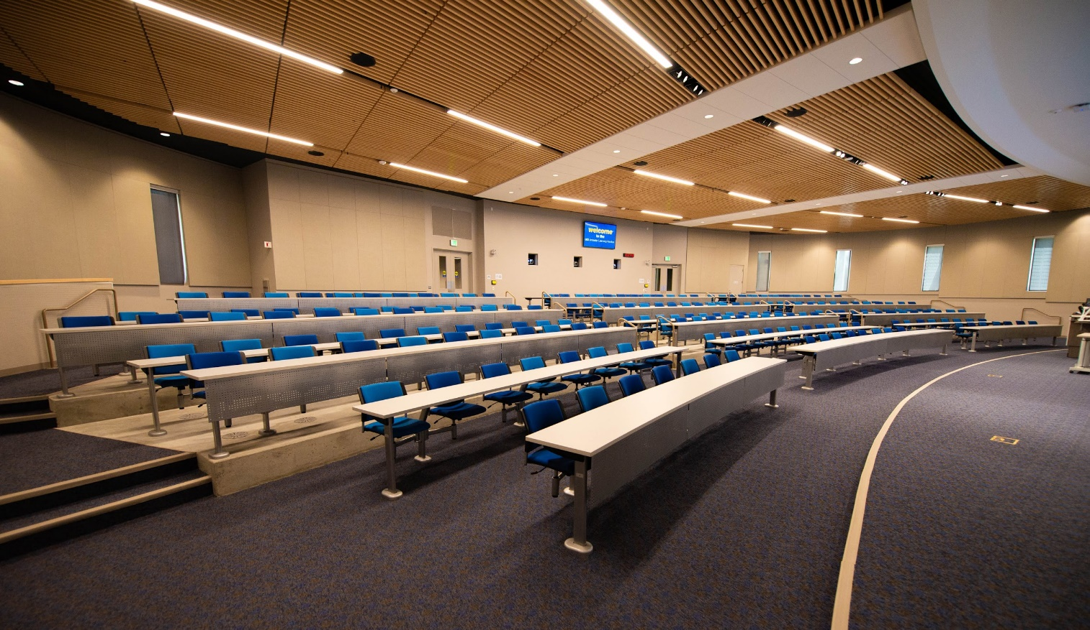
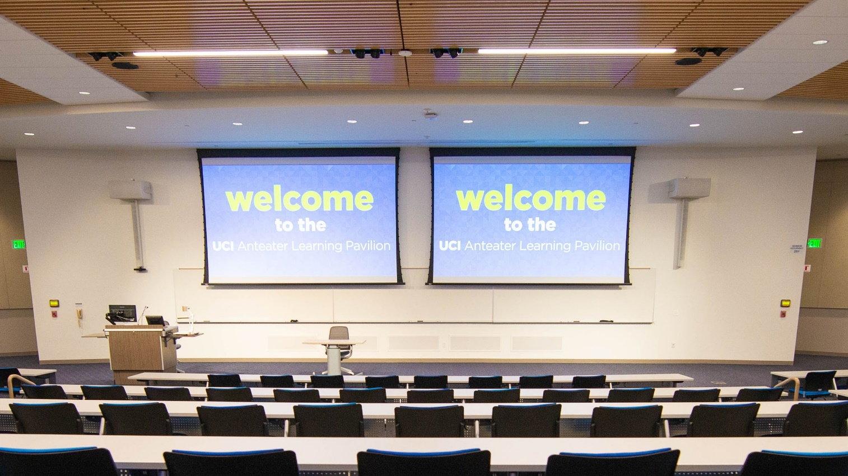
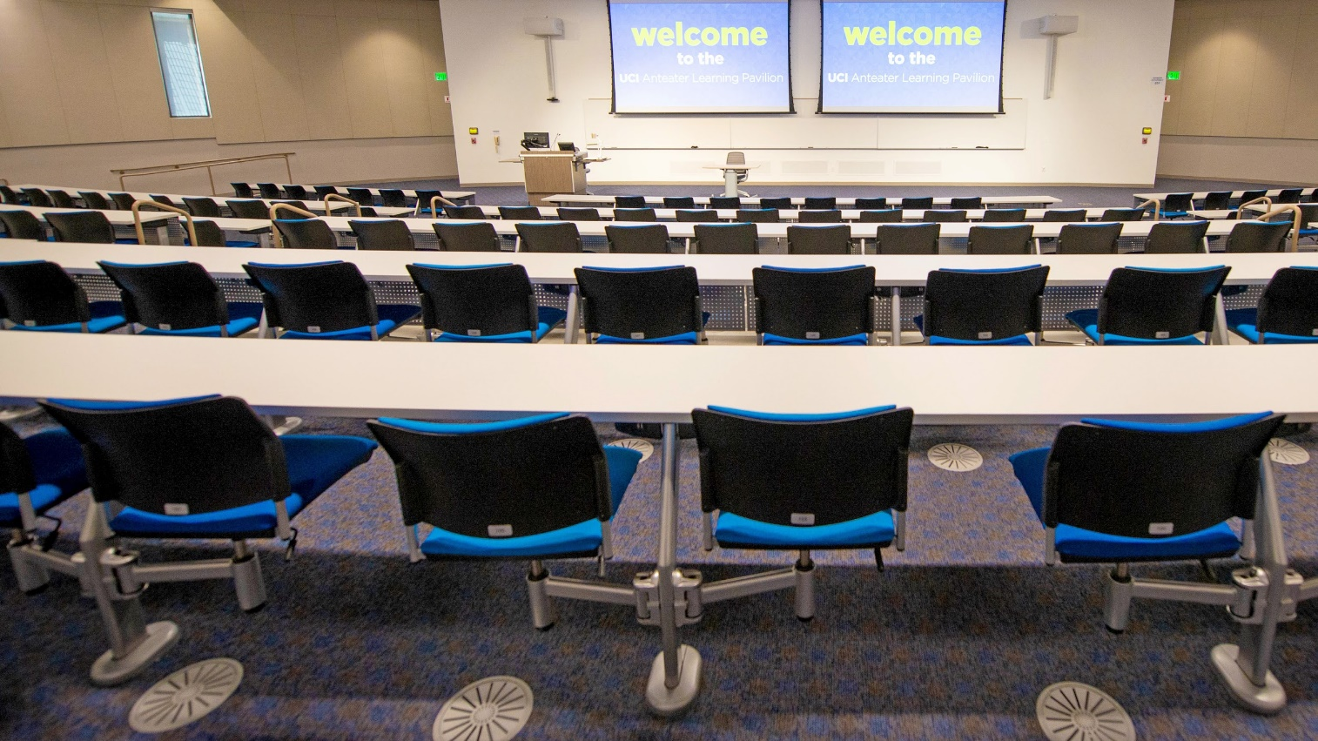
ANTEATER LEARNING PAVILION
Active learning lecture halls
Swiveling Seats
Wider Aisles
Wireless Projection
Power at Every Seat

Slide 34
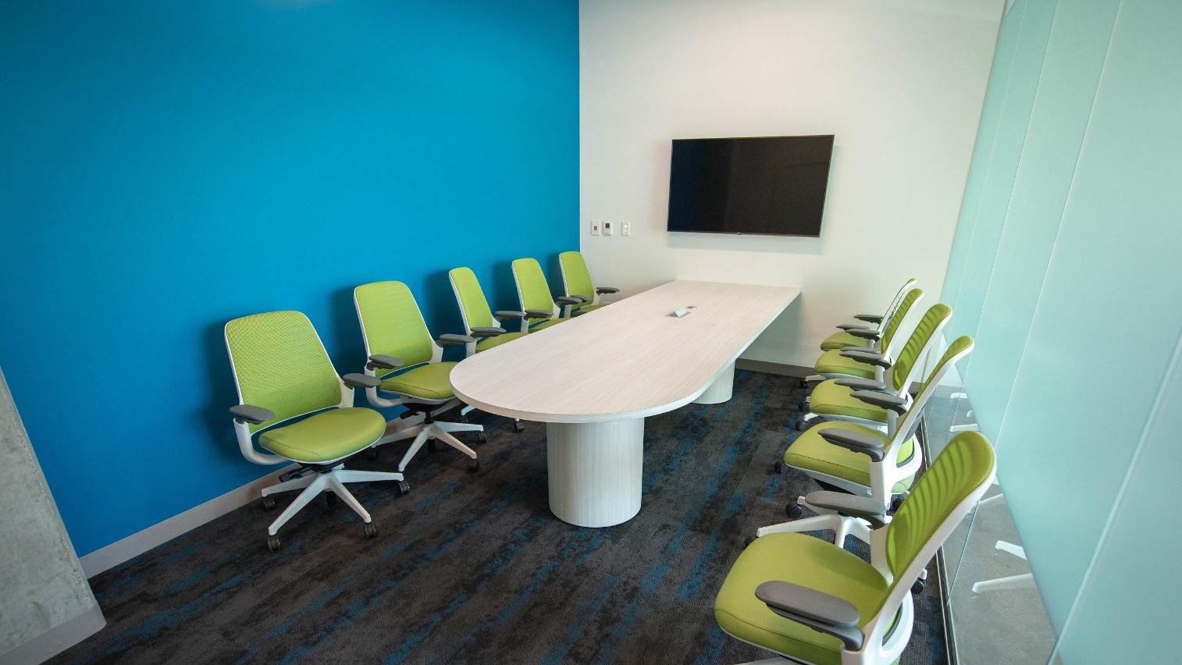
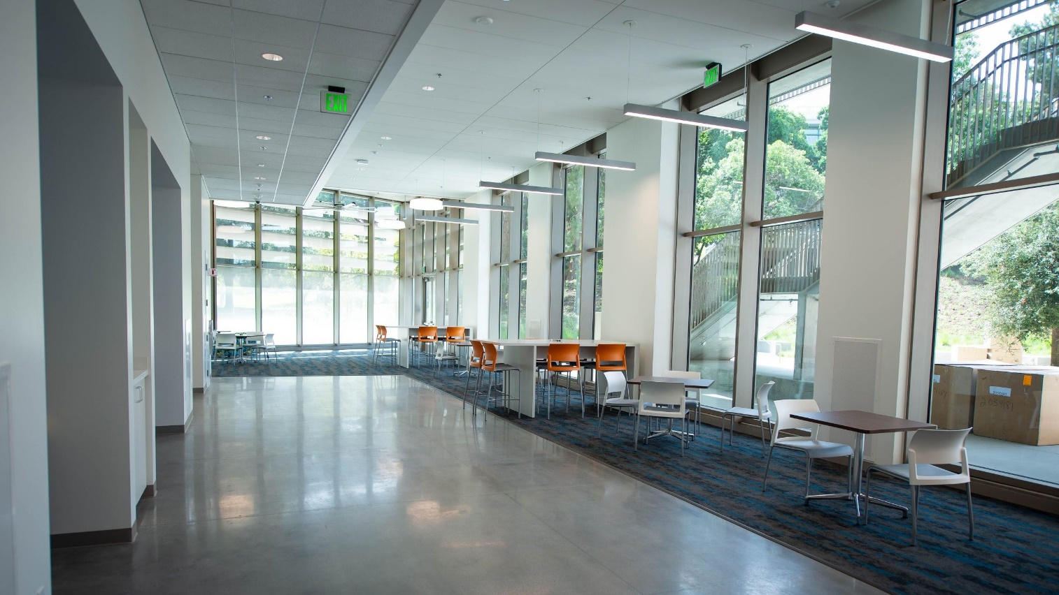
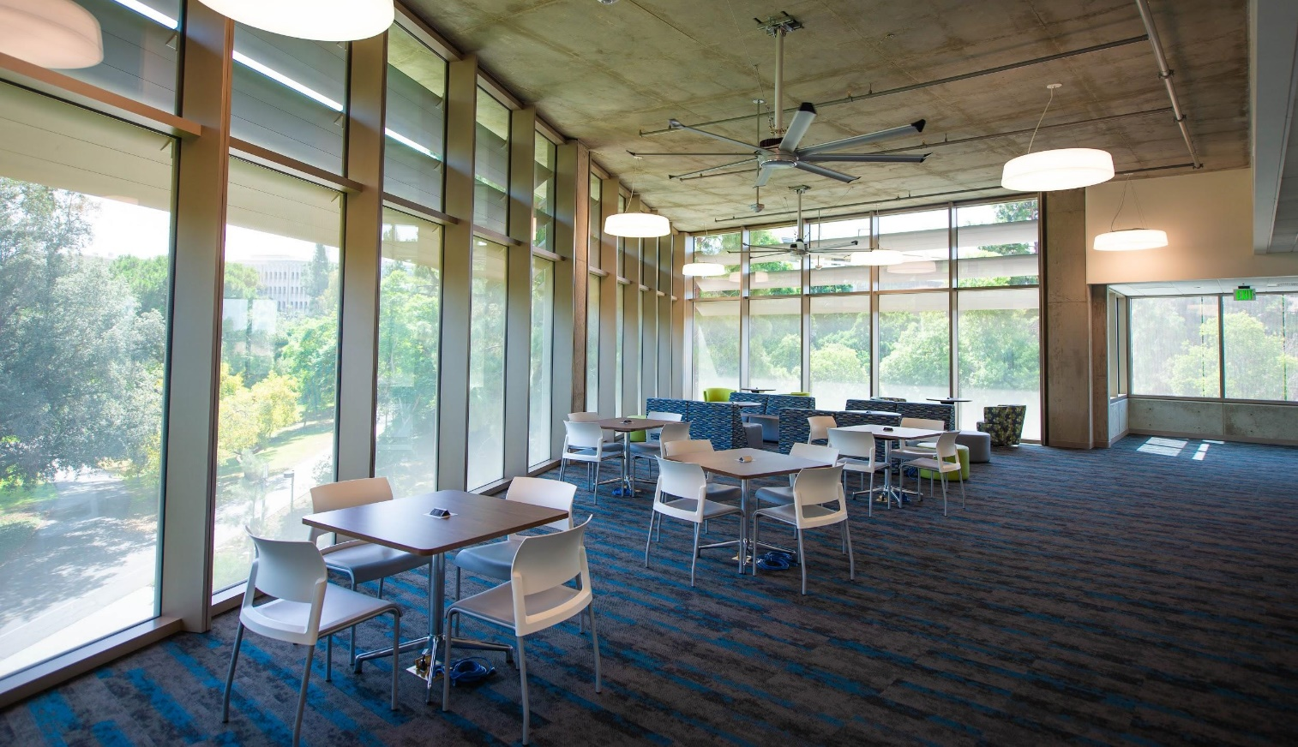
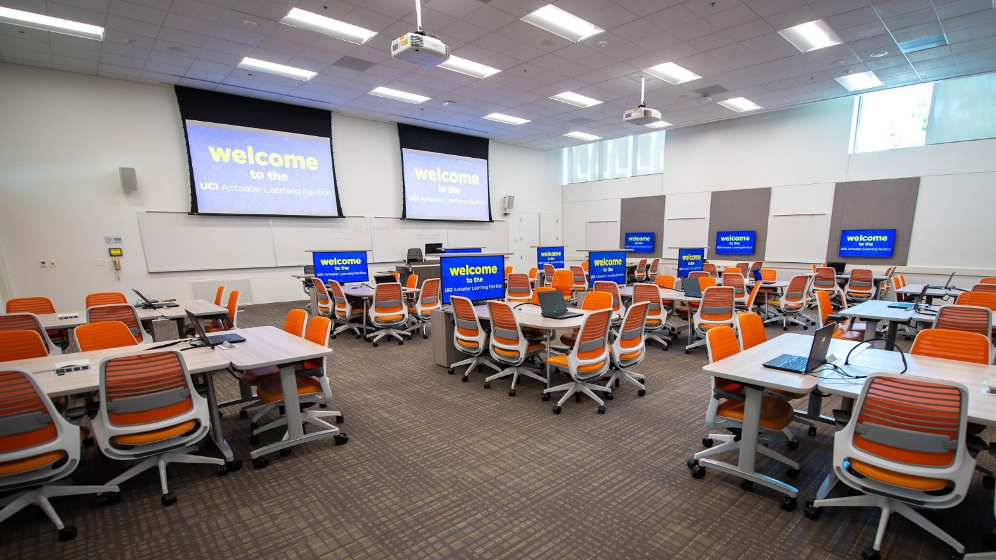
ANTEATER LEARNING PAVILION
Beyond classes
AntCAVES
Large Lobbies & Corridors
Study Lounges
Evening Classroom Use
Notes:
4 Rooms (6 or 10 seats)
Available 8am - 10pm M-F
Scheduled 86% of available hours
DUE Academic Support Programs
School/Department Based Tutoring
Supplemental Course Session

Slide 35
Technology
AV was put under the GC scope (and electrical subcontractor)due to coordination needed between infrastructure and design
*This was a huge challenge and resulted in conflicts over budget and specific technology required for proper IT support
Wireless network intensive throughout the building
Note that technology in the classrooms is only there to support instruction when called upon. We specifically did not require the use of technology in order to teach in these spaces.

Slide 36
Tech Specs
Projectors:
(27) total laser projectors
(1) Sony VPL-PHZ10 (5,000 lumen, WUXGA) laser projectors in each small classroom/lab (7 total)
(2) Epson Pro L 1300U (8,000 lumen, WUXGA) laser projectors in each 60-102 seat active learning classroom, and (1) each in the two 50-seat computer labs (14 total)
(3) Epson Pro L 1500U (12,000 lumen, WUXGA) laser projectors in each lecture hall (6 total)

Slide 37
Tech Specs
Screens:
One screen for each projector
Draper Access XL V electric screens in 396-seat lecture hall: 255” diagonals (135”x216”)
Draper Access V electric screens in all other rooms 50-seats and above: 137” diagonals (72.5”x116”) in 50-102 seat rooms, 198” diagonals (105”x168”) in 250-seat lecture hall
Draper Silhouette M manual screens in 30-seat rooms and under: 94” diagonals (50”x80”)

Slide 38
Tech Specs
Displays:
• More than (75) flat-panel displays with 43”-84” diagonals
• (26) LG 43SE3KD 43” displays located inside Steelcase Verb Active Media Tables (these are used for the center student groupings, not up against a wall, in the active learning classrooms)
• (35) LG 49LV340C 49” displays on wall-mounts for student groupings in active learning classrooms
• (4) LG 55LV340C 55” displays on wall mounts in the group study rooms
• (2) Panasonic TH-84EF1U 84” displays as confidence monitors in the lecture halls
• (16) additional Planar PCT2435 24” diagonal touchscreen displays on instructor lecterns – these act as the local monitor for PCs and all video sources

Slide 39
Tech Specs
Computers:
• More than 140 Dell desktop computers deployed for the classrooms, labs, and public areas
• 65 Dell Mobile Precision 3520 student laptops deployed for active learning classrooms (1 for each group of 6) and study rooms
Wireless Presentation Devices:
• (90) Mersive Solstice Pods throughout the building
• (1) in every classroom/lecture hall/group study room
• An additional (1) for every group of 6 students in active learning rooms

Slide 40
Tech Specs
Control Systems & Switching:
• Extron controllers – either Extron IPCP Pro 350 or IPCP Pro 550 depending on the room
• Extron switchers – Extron IN1608SA in 50-seat and under rooms, Crosspoint 84 4k in all active learning rooms, XTP II 1600 custom matrix switchers in both lecture halls and 60-seat active learning classrooms, and XTP II 3200 custom matrix switchers in 84-seat and 102-seat active learning rooms
• Extron touchpanels – Extron TLP Pro 320M in rooms 50-seats and under, TLP Pro 1025T in active learning rooms, TLP Pro 1220TG in lecture halls
• Extron wallplate controllers – Extron MLC 62 RS D MediaLink controllers in group study rooms & conference rooms

Slide 41
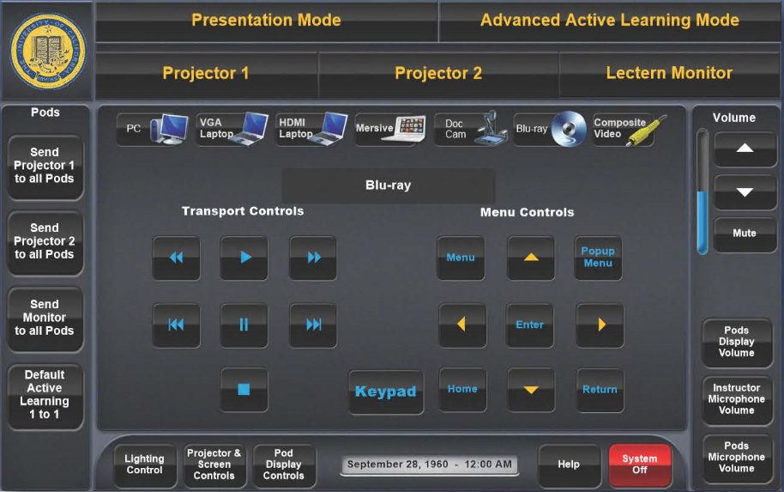
Tech Specs
Control Systems & Switching:
• Matrix switching allows sharing of any instructor or student device to any/all projectors and displays
Easy switching between presentation mode, default active learning mode (each group working on their own local display), and advanced active learning mode

Slide 42
Tech Specs
Wireless Microphones:
• (18) Shure QLXD wireless mic systems – (1) in each 50-seat computer lab, (2) in each active learning classroom and lecture hall 60-seats or larger
Document Cameras:
• (14) Elmo MX-1 – (1) in every room other than the lecture halls
• (2) Elmo P30HD – (1) in each lecture hall

Slide 43
Tech Specs
Lecture Capture:
• (2) YuJa Hardware Hub capture devices (1 in each lecture hall) to record/stream audio, images sent to projector, and camera video
• (4) Vaddio RoboSHOT 30 cameras (2 in each lecture hall) to capture the instructor & stage
Room Scheduling Displays:
• (29) Extron TLS Pro 520M scheduling displays – integrated with Exchange calendars; 25Live registrar class data and Springshare LibCal for group study room bookings

Slide 44
Tech Specs
Wireless Network Infrastructure:
• (100) Cisco 3800 Series wireless access points for the building interior
• (7) Cisco 1560 Series wireless access points for the exterior

Slide 45
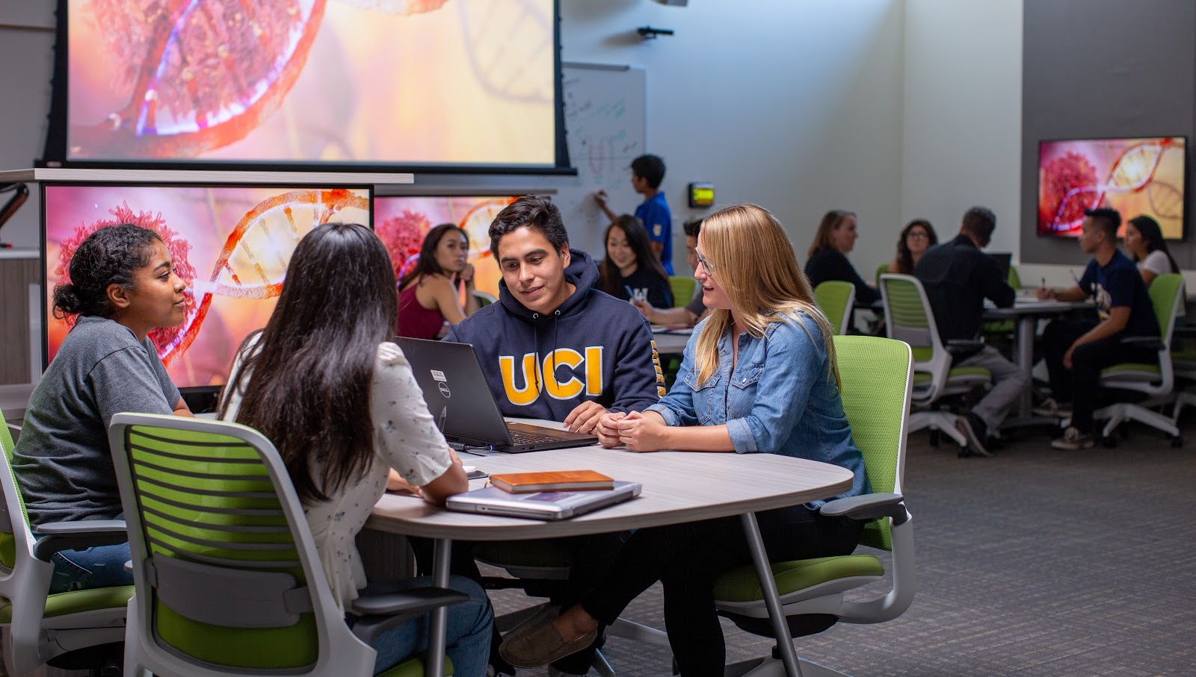
Photo by Steve Zylius/UCI

Slide 46
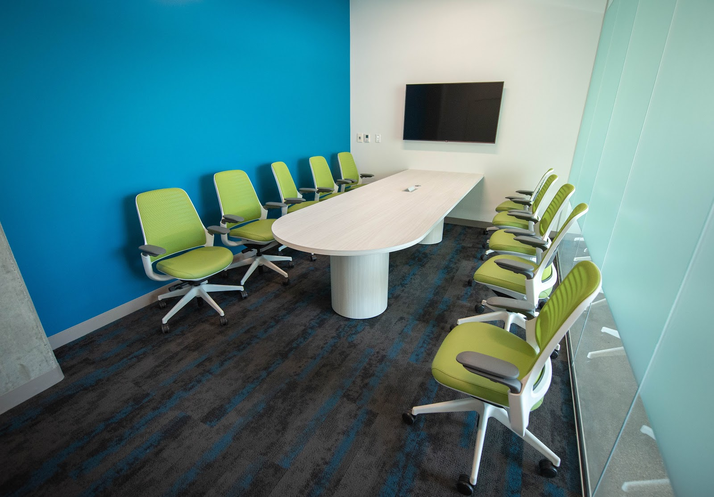
Photo by Will Alvarez/UCI

Slide 47
Furniture
We used Tangram Interiors almost exclusively
After a long, unsuccessful search for height adjustable display carts we liked, we went with Steelcase Verb active media tables for our center of the room student groupings
Every student group has personal and/or group whiteboards
Node chairs in 30-seat rooms & Series 1 chairs in larger classrooms and group study rooms
Sedia seating in lecture halls

Slide 48
Furniture
Campfire tables for informal 6-person groupings in lounge
Other 2, 4, and 6 person informal group tables
Benches and counters for pre and post class waiting, prep, individual work, or discussion
Exterior patio tables and loveseat groupings
We’re still not 100% done! After the building opened, we had to reassess the usage of public area furniture

Slide 49
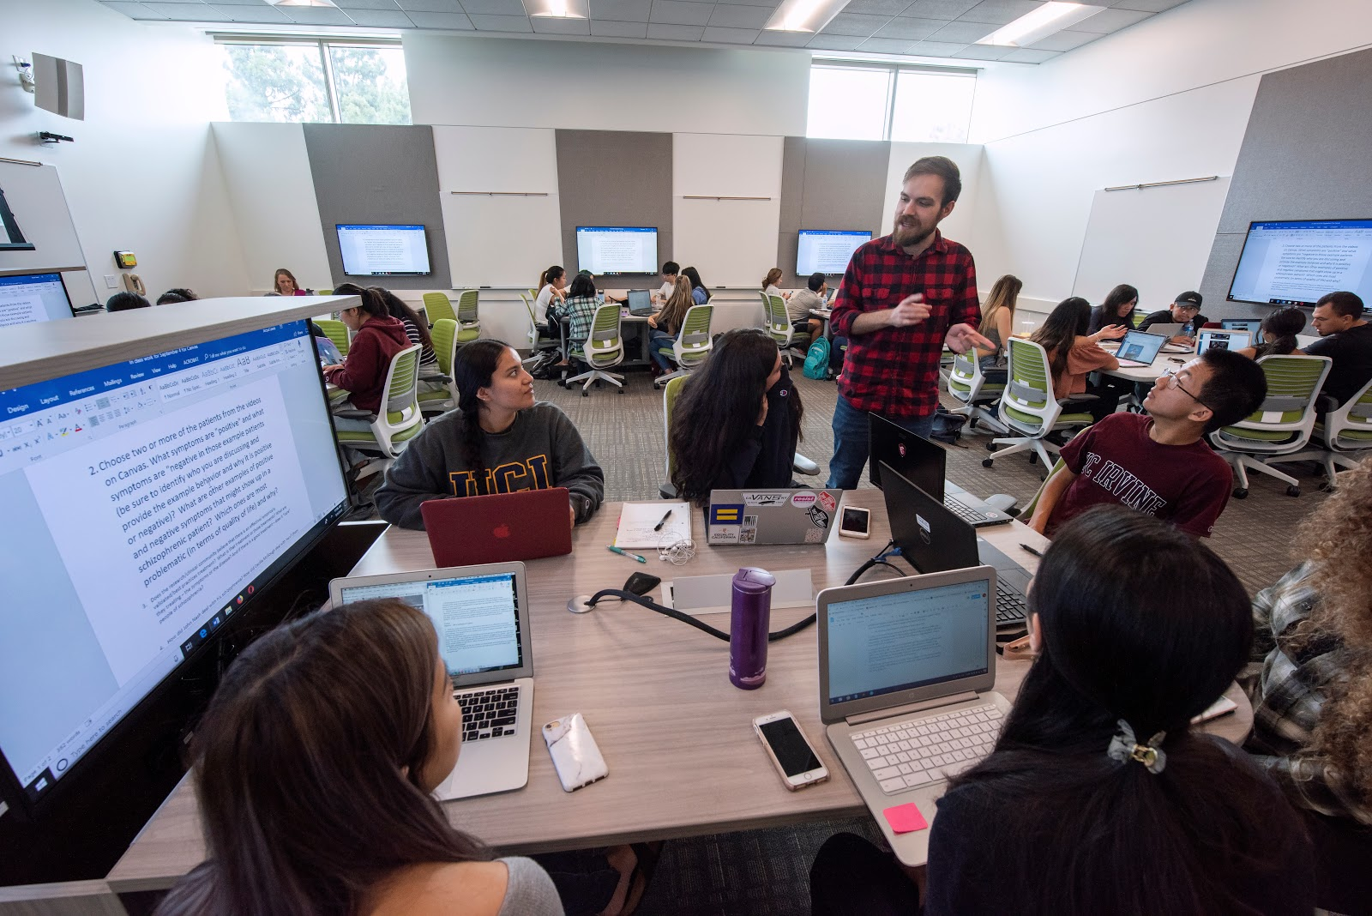
Photo by Steve Zylius/UCI

Slide 50
Photo by Steve Zylius/UCI

Slide 51
SUPPORT / STRUCTURAL CHANGE
Changes were required to some established campus practices, including:
Development of a specific communication & outreach plan
Formation of UCI’s Active Learning Institute to support and encourage faculty to utilize active learning techniques
Working with the University Registrar to establish a new form of priority room scheduling
Staffing adjustments to support new spaces and room users (including IT, administration, building management, custodial)
Creation of peer learning assistants

Slide 52
Communication & Outreach
We started more than a year in advance of opening w/ plan development, review, marketing, ALI workshops, scheduling discussions, etc.
Mass communication:
Website
Email
Social media
Print
Faculty Outreach & Development:
Room scheduling refinement Active Learning Institute & certification process Video tips from instructors Open forums
Individual consultations
Department meetings
Practice hours
TA training
Peer learning assistant training
Student Outreach:
Coordinate with Undergraduate Education & Student Affairs
Email
Social media
In-room orientations
Student tours
After hours & group study room reservations

Slide 53
Faculty Development
Active Learning Institute – a multi-week faculty institute offered several times a year
Focused on self-reflection, making small changes, assessing impact
Driven by faculty interests and experience
Personalized, with no mandates
Recognize and reward faculty already using active learning techniques
Connects faculty with their colleagues and helps develop informal networks that persist after the institute
Includes strategies to help support students’ transition to active learning – after all, this can be new for them, too

Slide 54
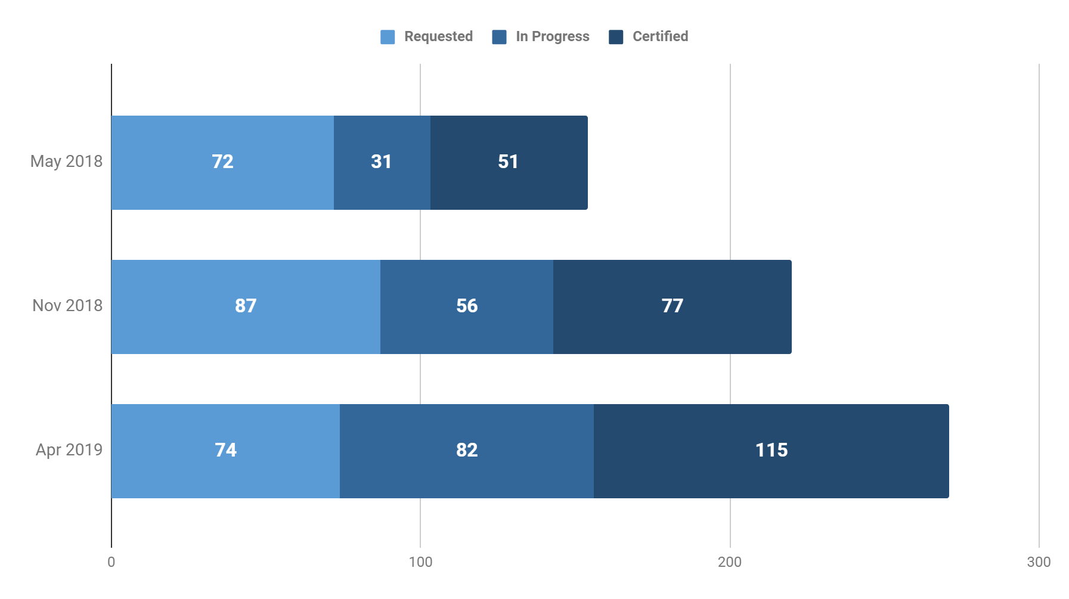
Active Learning Certification Growth
154
220
271

Slide 55
Faculty Development
To be certified, not all faculty had to attend the multi-week ALI.
If instructors were already teaching using active learning methodologies, they simply needed to be observed by members of UCI’s Division of Teaching Excellence & Innovation (DTEI), who would then provide individual feedback and consultation.
There are currently more than 300 certified faculty at UCI from all disciplines and ranks.

Slide 56
Priority Room Scheduling
ALI participants and other faculty who have demonstrated regular use of active learning are given priority in Anteater Learning Pavilion classrooms and other ALCs on campus.
This program was developed and piloted well in advance
The Registrar keeps a database of certified/approved faculty
This went against the normal process where schools or departments had priority in certain rooms at certain times
ALP classrooms and group study rooms can also be reserved for faculty office hours or pre-arranged reviews, tutoring, or other academic support

Slide 57
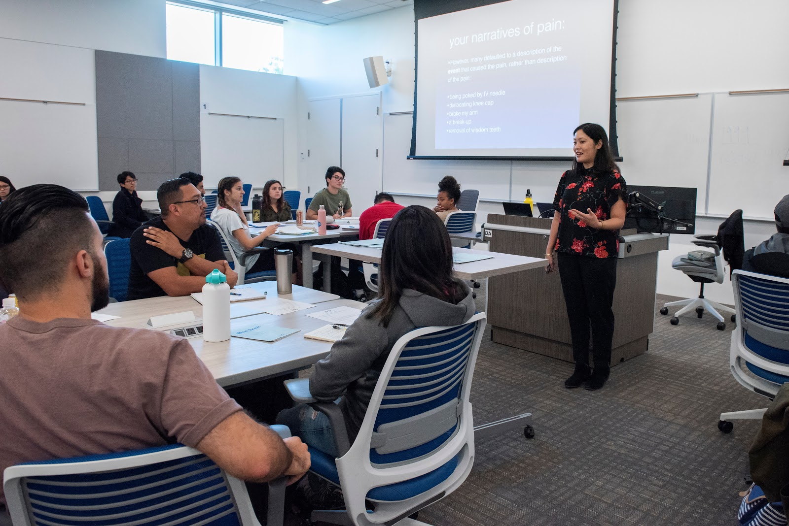
Photo by Steve Zylius/UCI

Slide 58
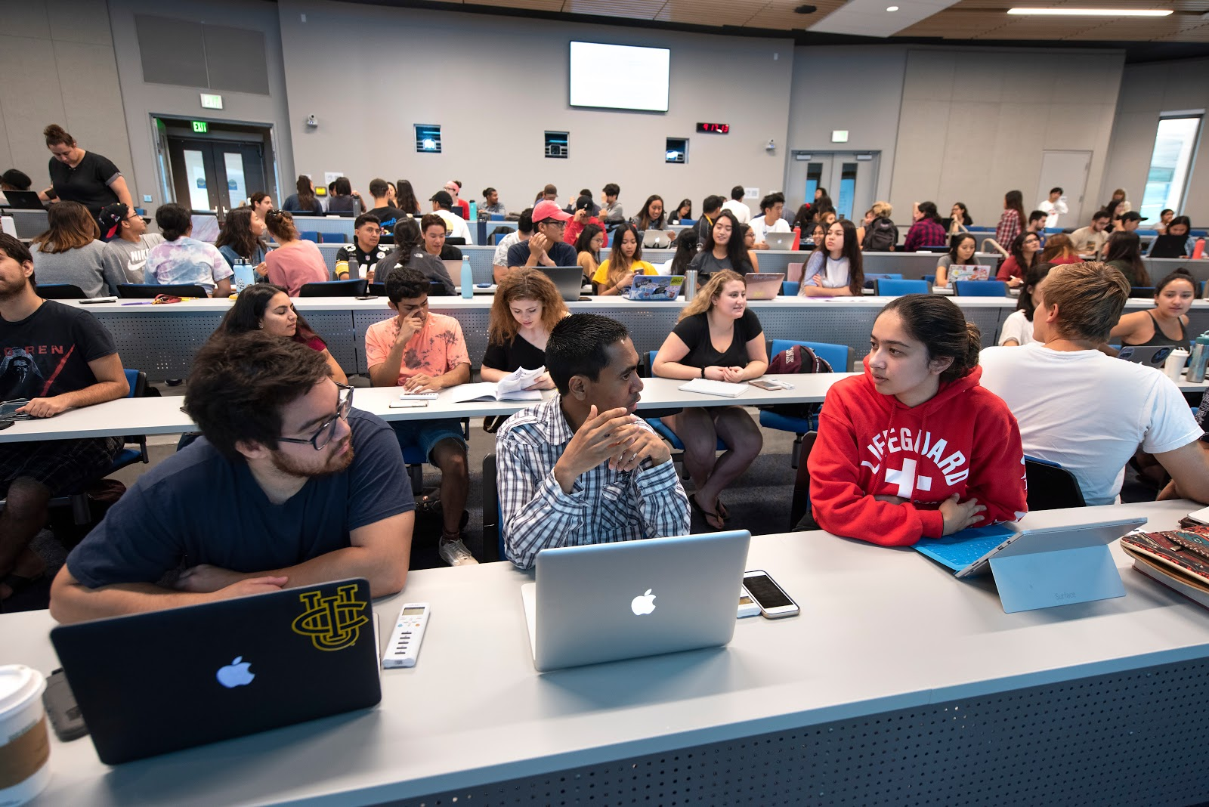
Photo by Steve Zylius/UCI

Slide 59
Support
The new ALP spaces required a very different level of support than the “regular” general assignment classrooms
The Classroom Technologies group was located in the building, knowing there would be increased and more complex levels of technology
An additional full time staff member and several additional student employees were hired
The number of ALCs had skyrocketed, and there were
going to be far more faculty and students in need
of help.

Slide 60
Growth in ALCs at UC Irvine
 |  | 2016-2017 | 2017-2018 | 2018-2019
Active Learning Classrooms w/ Enhanced Technology | Rooms | 1 | 1 | 6
 | Seats | 56 | 56 | 422
 | Max. Courses/Term* | 23 | 23 | 138
Active Learning Classrooms w/ Standard Technology | Rooms |  | 4 | 9
 | Seats |  | 232 | 412
 | Max. Courses/Term* |  | 92 | 207
Active Learning Lecture Halls | Rooms |  |  | 2
 | Seats |  |  | 650
 | Max. Courses/Term* |  |  | 46

Slide 61
Support Areas
Building management
Expanded custodial services
Maintenance and warranty coordination
Door unlock/lock scheduling
Scheduling display panels
Digital signage
Furniture maintenance
AntCAVE group study room reservations
Emergency management
Event support
Training and evaluations

Slide 62
ASSESSMENT / RESULTS
The following is a look at where we stand through one year of course use in the Anteater Learning Pavilion

Slide 63
Course Sections in ALP 2018/2019
299
F18
305
W19
314
S19
918
Notes:
Excludes computer labs and LARC tutorial session. Cross-listed courses counted as 1

Slide 64
Course Enrollments in ALP 2018/2019
16,515
F18
17,797
W19
16,149
S19
50,461
Notes:
Excludes computer labs and LARC tutorial session. Cross-listed courses counted as 1

Slide 65
Evaluations
We want to know:
How are ALCs being used?
To what extent do faculty feel supported and prepared to use AL techniques in ALCs?
How are students experiencing AL in ALCs?
What needs aren’t being met?
So that we can:
Regularly improve ALCs and related programs and services
Prioritize, and pace future renovations/construction
Develop and submit funding requests
Contribute back to the community

Slide 66
Assessing Active Learning Classrooms
Do ALC’s work?
Promote active and collaborative learning?
Change in teaching practices?
Change in student attitudes and approaches to learning?
When do they work and for who?
Do some strategies or designs work better than others?
Does impact differ by student or course characteristics?
How do they work?
How do the specific features and affordances of the room support teaching and learning?
How are they being used?
Are they cost effective?
How does the effectiveness and usage of specific features compare to the costs?

Slide 67
ALP Assessment Analysis
 |  | Scheduling Data | Faculty Interviews | Class Observations | Student Survey | Faculty Survey | Course Outcomes
1 | ALP Utilization | ✔
2 | Student & Faculty Experiences |  | ✔ |  | ✔ | ✔
3 | Level of Active Learning |  | ✔ | ✔ | ✔ | ✔
4 | Student Engagement |  |  | ✔ | ✔ | ✔
5 | Student Outcomes |  |  |  | ✔ |  | ✔

Slide 68
ALP Assessment Participation (# of Courses)
Room Type | F18 | W19 | S19 | Total
ALP ALC (60+ Seats) | 11 | 16 | 4 | 31
ALP Lecture Hall | 10 | 13 | 16 | 39
Traditional | 0 | 13 | 10 | 23
Total | 21 | 42 | 30 | 93

Slide 69
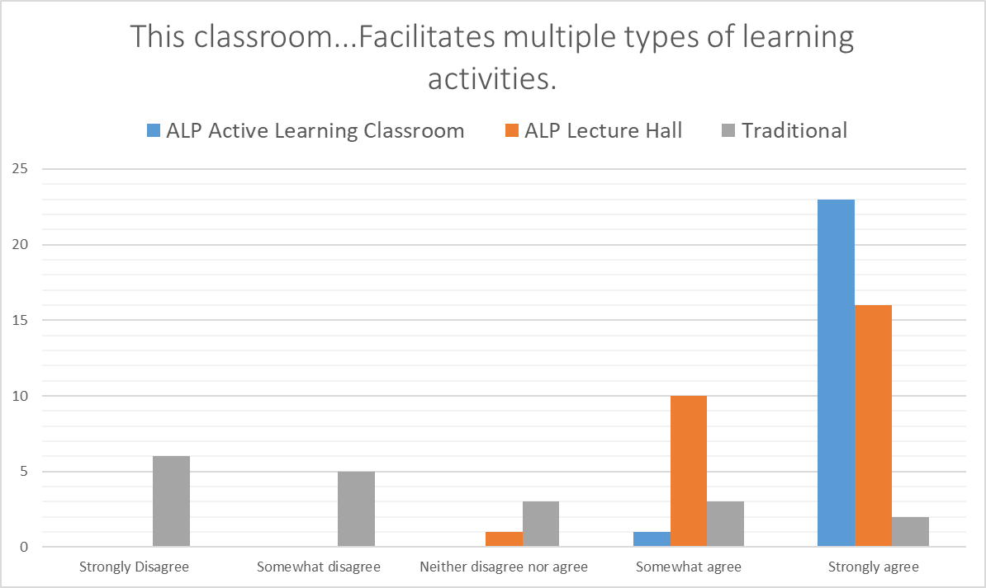

Slide 70
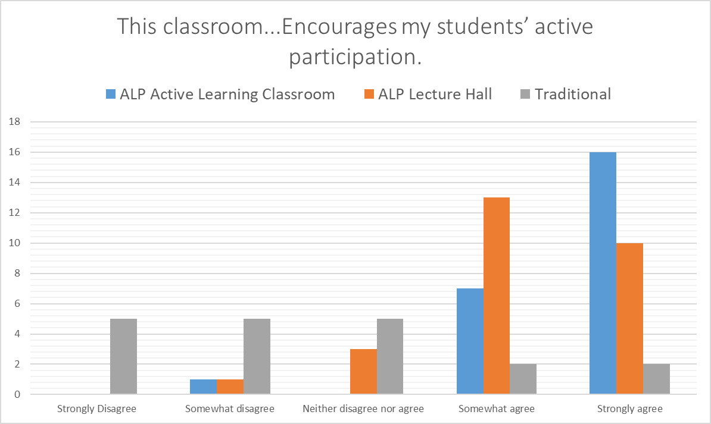

Slide 71
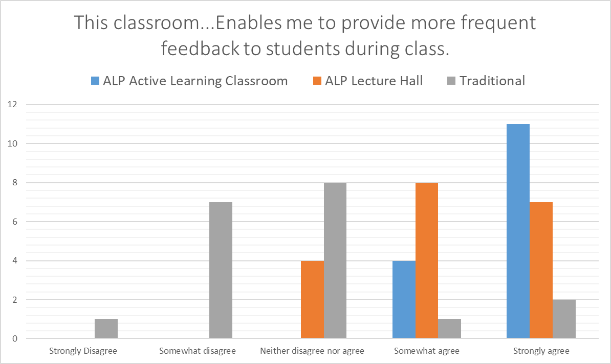

Slide 72
“ALP is no longer a classroom, but a tool for teaching. The technology and configuration of the room definitely facilitates different active learning strategies.”
ALP Faculty
Quotes

Slide 73
I thoroughly enjoy the set up of ALP because I feel the center and focus directly involves every student. We are not hiding in a line somewhere in an auditorium. We are all invited to participate, we face each other in our groups, and we all have equal access to the material being presented. I wish nearly all the buildings on campus were this engaging and comfortable.
ALP Student

Slide 74
“I had organized this quarter’s lecture notes to write on the board…That's how I did it last time, and this time that didn't materialize because the room is not made for that…It's not a lecture room at all, really. It’s an activity room.”
Dr. Oliver – non-active learning certified, research faculty

Slide 75
I would encourage more courses to involve collaboration with peers because it is helpful when learning difficult concepts in class since everyone understands things differently and it is always good to get someone else to try to explain things to you. In addition, you make good connections with people in your class that can possibly be struggling like you and can form a study group.
ALP Student

Slide 76
“I think it signals that…this model of teaching versus lecturing, is important, that the institution is investing in that, signaling to the students that their skills and interests and what they're taking away and getting out of their degree matters.”
Dr. Hannah – active learning certified, research faculty

Slide 77
“Being able to move between rows of seats and speak with all of the students in my large (400-student class) was extremely helpful and encouraged me to use more in-class activities. Previously I could only speak to students at the ends of rows which limited my ability to set more challenging in-class assignments.”
ALP Faculty

Slide 78
Outcomes
This is not a full look at our assessment outcomes, as there are a few people in the process of publishing this data. However, what we have seen is:
A fully utilized array of classroom spaces for the diverse group of course offerings, students, and supplemental learning opportunities available at UCI.
Positive student and faculty experiences in active learning classrooms.
Increased active learning instruction in ALP.
Increased student engagement in active learning for those in ALP.
Improved or differential student outcomes, both cognitive and non-cognitive, for those enrolled in classes held in ALP.

Slide 79
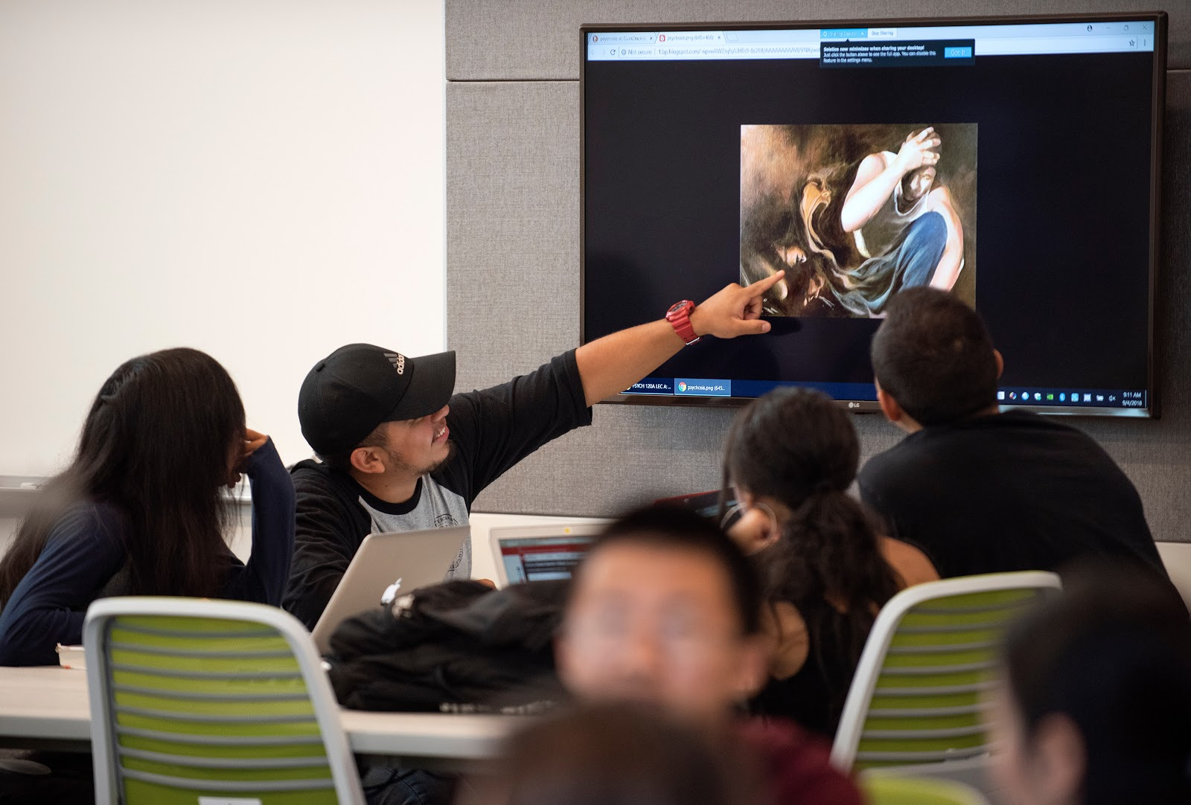
Photo by Steve Zylius/UCI

Slide 80
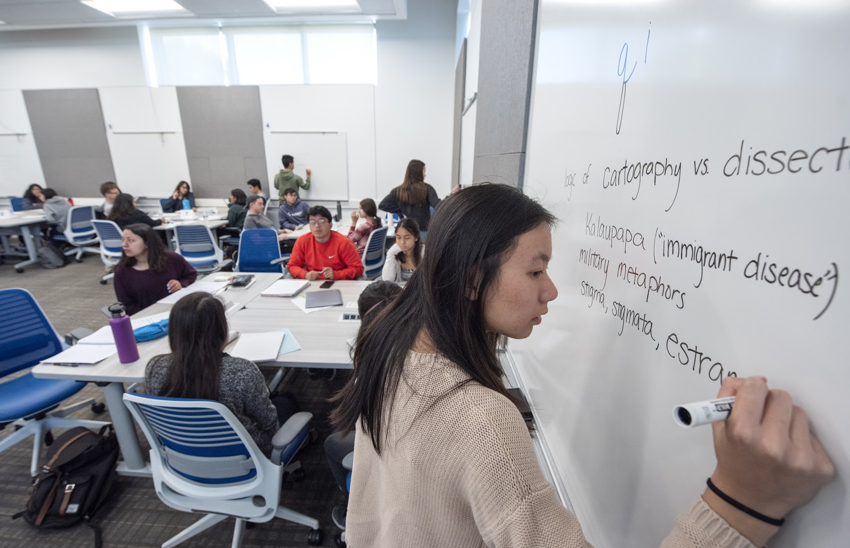
Photo by Steve Zylius/UCI

Slide 81
TAKEAWAYS / SURPRISES
Bring relevant stakeholders into the process early
Determine key drivers of timeline (e.g. course scheduling)
Use multiple formats for outreach, development, and training
Ask what it means for ALCs to “work”
The building has changed campus culture
It has led to investment in additional classroom renovation projects
It is almost too successful
- How do you support the facility for events, after hours requests?
- Some faculty have adapted their teaching style to the rooms,
but now are having trouble getting courses booked there

Slide 82
Campus Culture
The building immediately became a strong campus symbol and has impacted campus culture
It’s a showpiece building focused on our core teaching mission
It provides multi-discipline accessibility
It has become a marketing/development/recruiting tool
It brings students to the building for more than just classes
- Learning & Academic Resource Center – tutoring & workshops
- It’s inviting w/ natural light and lounge & study areas
with exterior views
It brings a sense of pride

Slide 83
Surprises
Lounge and study furniture was used (and moved around) immediately
We are still making adjustments to equipment and furniture
It has been in high demand for special events, and we’ve had to manage expectations regarding support
Building management without a true, dedicated facilities manager is an extra challenge
We’ll have to start preparing for refreshing this building-funded technology in only a few years.
When you rely on students using mobile devices, there’s a lot of mobile device support required
Only supporting 5 GHz WiFi causes problems

Slide 84
Surprises
Managing old pipes, ground cover, and social media
On Superbowl Sunday we had a pipe rupture a few hundred feet outside of the 1st floor lecture hall. Mulch from the new landscaping immediately clogged the drains, and water flowed into and over the stage and first rows of seats. Classes were moved or canceled for a week while the clean up took place. Crews responded quickly, but not before some students dubbed the new building the Anteater Learning Pool.

Slide 85
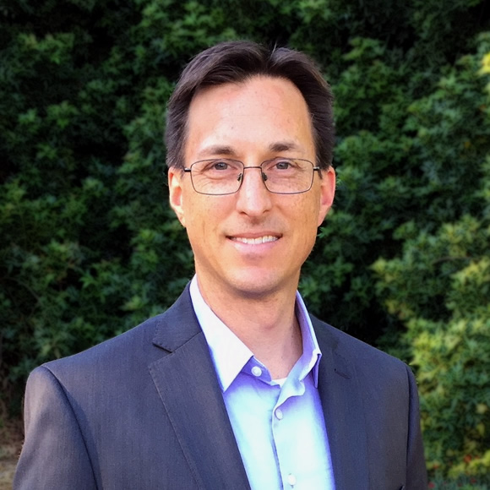
Contact Information
Presenter
Eric Rupp
Planning and Outreach Manager,
OIT Classroom Technologies
949.824.6962
erupp@uci.edu
University of California, Irvine
3228 Anteater Learning Pavilion
605 Humanities Quad
Irvine, CA 92697-5665
NOTE: This presentation leaves copyright of the content to the presenter. Unless otherwise noted in the materials, uploaded content carries the Creative Commons Attribution 4.0 International (CC BY 4.0), which grants usage to the general public, with appropriate credit to the author.

Slide 86
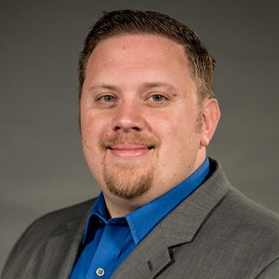
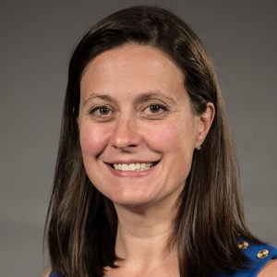
Contact Information
Pedagogy
Mathew Williams, Ed.D.
Principal Analyst for Learning Environments
Division of Teaching Excellence & Innovation
949.824.3717
mathew.williams@uci.edu
Andrea Aebersold, Ph.D.
Director, Faculty Instructional Development
Division of Teaching Excellence & Innovation
949.824.0347
andrea.aebersold@uci.edu
NOTE: This presentation leaves copyright of the content to the presenter. Unless otherwise noted in the materials, uploaded content carries the Creative Commons Attribution 4.0 International (CC BY 4.0), which grants usage to the general public, with appropriate credit to the author.

Slide 87
Contact Information
Technology
OIT Classroom Technologies Helpdesk
949.824.8833
smartclassrooms@uci.edu
Kelsey Layos
Classroom Technology Liaison & Application Support Specialist
OIT Classroom Technologies
949.824.9459
kelsey.layos@uci.edu
NOTE: This presentation leaves copyright of the content to the presenter. Unless otherwise noted in the materials, uploaded content carries the Creative Commons Attribution 4.0 International (CC BY 4.0), which grants usage to the general public, with appropriate credit to the author.

Slide 88
Photo by Steve Zylius/UCI

Slide 89
Photo by Steve Zylius/UCI

Slide 90
Photo by Steve Zylius/UCI

Slide 91
Photo by Steve Zylius/UCI

