Slide 1
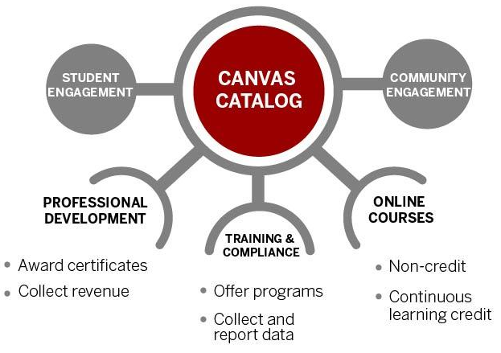
A 2-University Implementation of Canvas Catalog Through Campus Partnerships
David Long, University of Iowa Jessica Sowalsky, Ph.D., University of Maryland
What is Canvas Catalog?
Who is the Audience for Canvas Catalog?
Canvas Catalog is a storefront that enables people to self-enroll in courses. Once enrolled, the student is placed in a Canvas course.
The use case for this service comes from the universities’ need to offer non-credit courses. This service offers an easy way for students to select and enroll in courses that are free or fee based. In addition, administrators of these courses can track student enrollments and course completions.
Upon completion of a course, students can print a transcript of the courses they completed, or print an optional certificate of completion.
Continuing Education Units (CEUs):
College of Education: K-12 Teachers
College of Nursing: Hospital Nurses
Internal to the University:
Office of Student Conduct: Academic Integrity training
University Human Resources: Security Awareness
Specific External Communities:
College of Agriculture and Natural Resources: Master Gardeners
Iowa Geriatric Education Center: Caregiver training
National Consortium for the Study of Terrorism and Responses to Terrorism: Federal and State Government workers
High school students considering college
Student
Canvas Catalog storefront
Course offerings listed
Registration and account creation
Payment
Transcript & certificate
Image Credit: Indiana University
Canvas LMS
Course content, discussions, grades, etc
Challenges and Opportunities:
Usage Data:
Where Are We Headed?
Challenges:
Competing against other non-credit courses from other areas
Navigating University financial requirements
Not all integrations licensed for use
Staff to create and maintain courses
University branding initiatives
Opportunities:
Delivery platform for grant funded projects
Find new sources of funds
Market and advertise your brand
New ways to offer outreach and engagement
Offer certificates of completion, unofficial transcripts
Professional development courses
Iowa
https://learn.uiowa.edu
12 departments / units
116 courses
1,507 enrollments
367 completions
Maryland
https://umd.catalog.instructure.com
13 departments / units
87 courses
12,782 enrollments
8,076 completions
Maryland:
Strengthen partnership with the Office of Extended Studies
Iowa:
Advertise this service more internally
Service Delivery Model | Iowa | Maryland
Who can use Canvas Catalog to deliver courses? | Departments and schools across campus | Departments and schools across campus
Who maintains the service? | Central IT unit | Central IT unit
Who approves the courses to be launched? | Instructors or their unit | Office of Extended Studies
How does course payment work? | Colleges have own payment gateway | Office of Extended Studies manages payment gateway
Who is the audience for courses in Canvas Catalog? | External users, potential students | External users, potential students
Who provides support for students who sign up for courses? | The group offering the course | The group offering the service
Cohort 2
Cohort 2

