Slide 1
Why Micro-Credentialing?
Education Design Lab

Slide 2
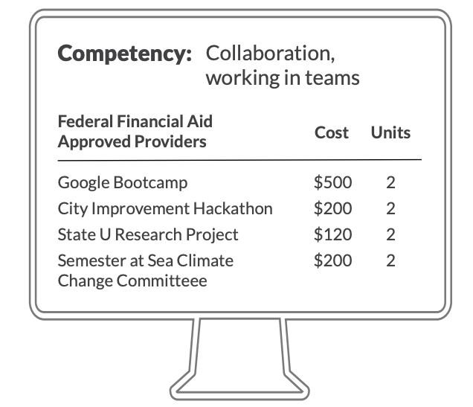
The Learner Revolution
in the future learners will pick and choose from a menu of experiences, courses, badges, certificates and pathways from multiple providers that are potentially endorsed—or even offered—by employers or other respected validators...
Learner Revolution, Kathleen deLaski, 2019
@eddesignlab
#LearnerRevolution
eddesignlab.org/learnerrevolution
Education Design Lab

Slide 3
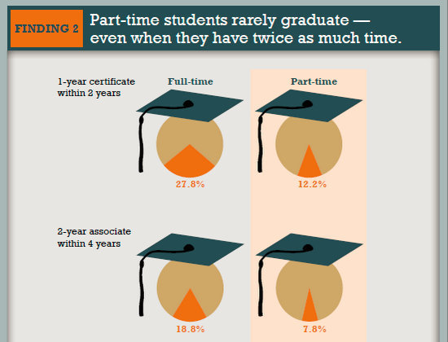
It is a moral imperative to redesign the system so it works for more students
Despite their growing numbers, part-time learners often struggle to earn a degree or credential. Just one in five part-time students finishes a degree in six years.
@completecollege
#EDU19
Education Design Lab

Slide 4
New Majority Learners require smaller more affordable learning experiences
The Lab, along with many others in the field of Lifelong Learning, have termed the 3/4s of learners being served by higher ed today as the New Majority Learner. The New Majority Learner represents a group formerly considered ‘non-traditional’ students (i.e., not 18-22-year residential students), only more specific. Examples of New Majority Learners are incumbent workers, single mothers, individuals from low-income households, etc.
@NPR_ED
#NewMajorityLearner
Nadworny, Elissa (2019). NPR.
Education Design Lab

Slide 5
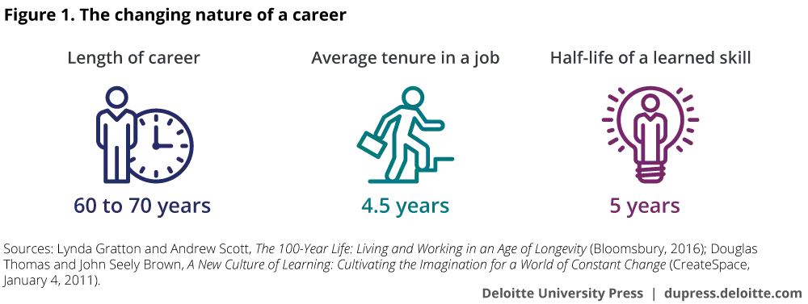
Changing Nature of Careers calls for shorter form credentials
@DeloitteInsight
#FutureOfWork
Gratton and Scott. The 100-Year Life. (2016)
Education Design Lab

Slide 6
Who are you likely to interview first?
@D2L
#FutureOfWork
D2L + CLO Micro-Credentialing Webinar
Education Design Lab

Slide 7
Micro-Credentialing
Case Studies
Education Design Lab

Slide 8
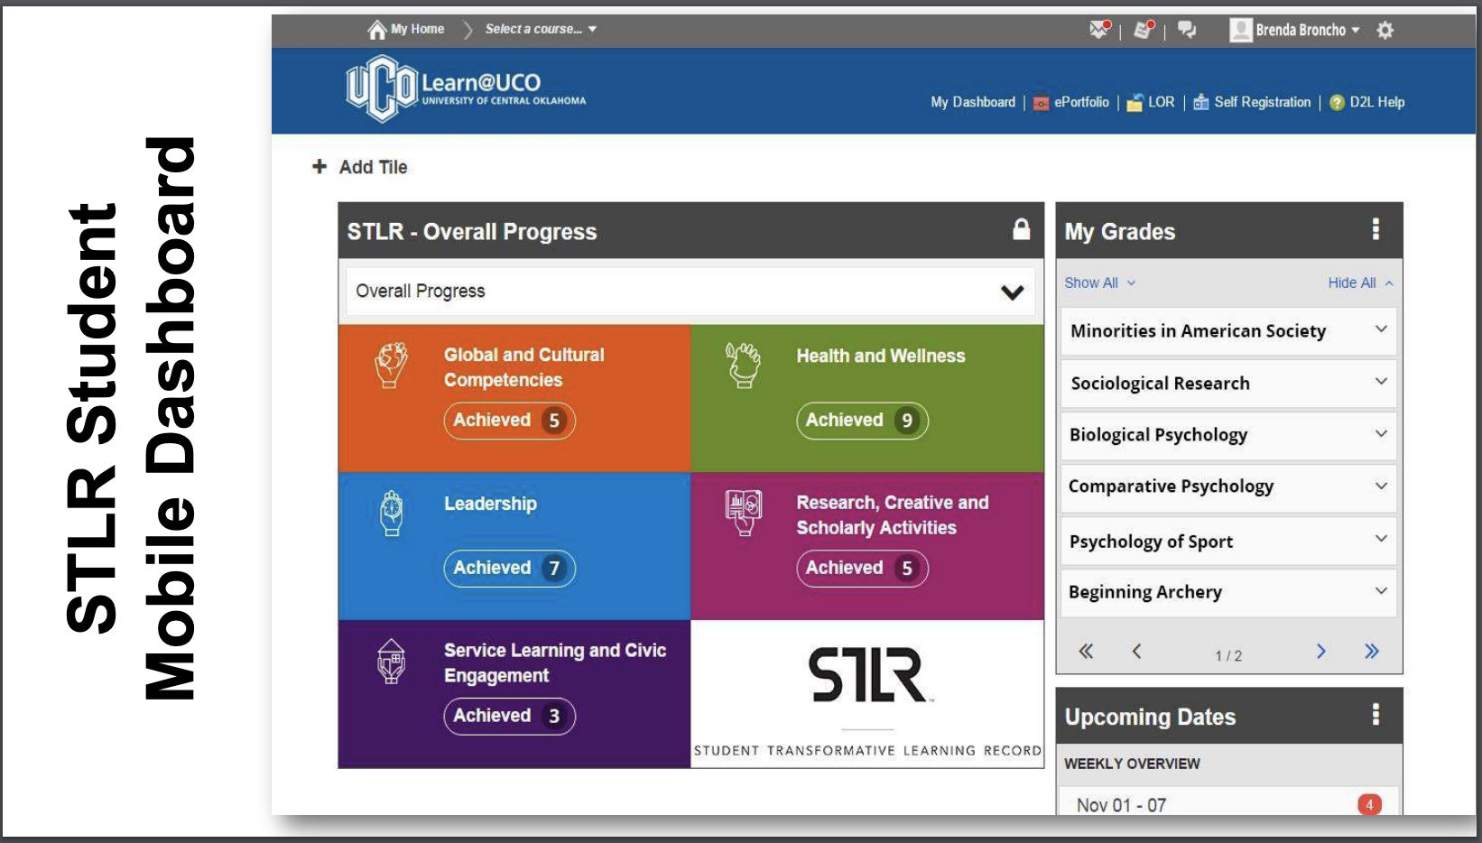
University of Central Oklahoma Badging Dashboard
@UCOSTLR
@AACRAO
Gratton and Scott. The 100-Year Life. (2016)
Education Design Lab

Slide 9
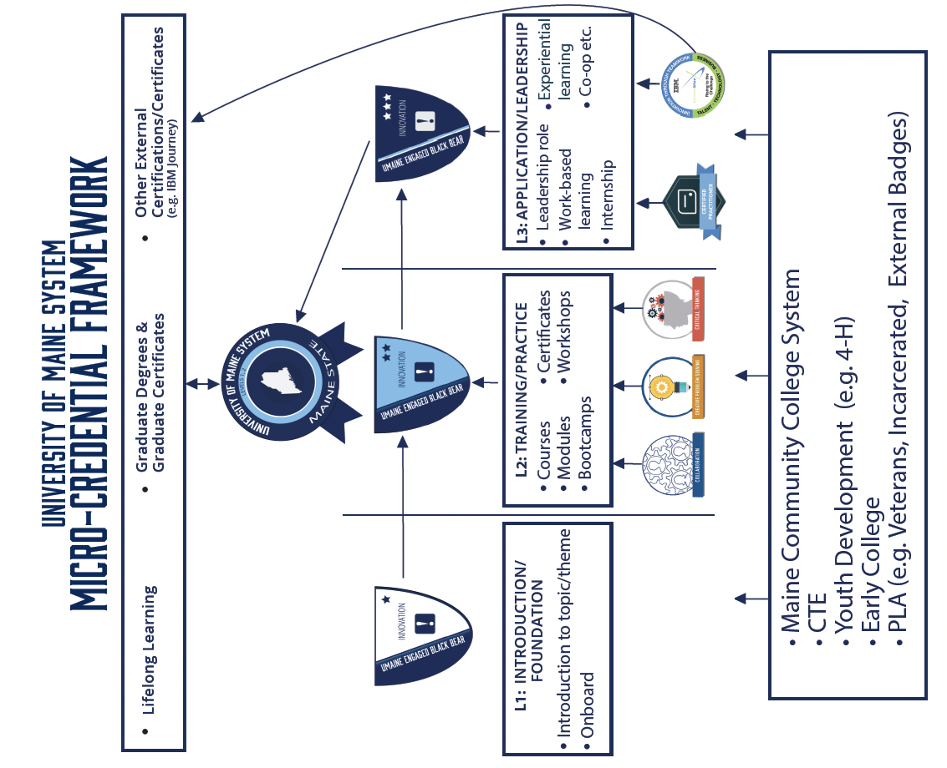
#EngagedBlackBear
@UMaine
University of Maine System Framework
Education Design Lab

Slide 10
SUNY Micro-Credentialing Implementation Groups
@SUNY
#stackablecredentials
https://system.suny.edu/academic-affairs/microcredentials/
Education Design Lab

Slide 11
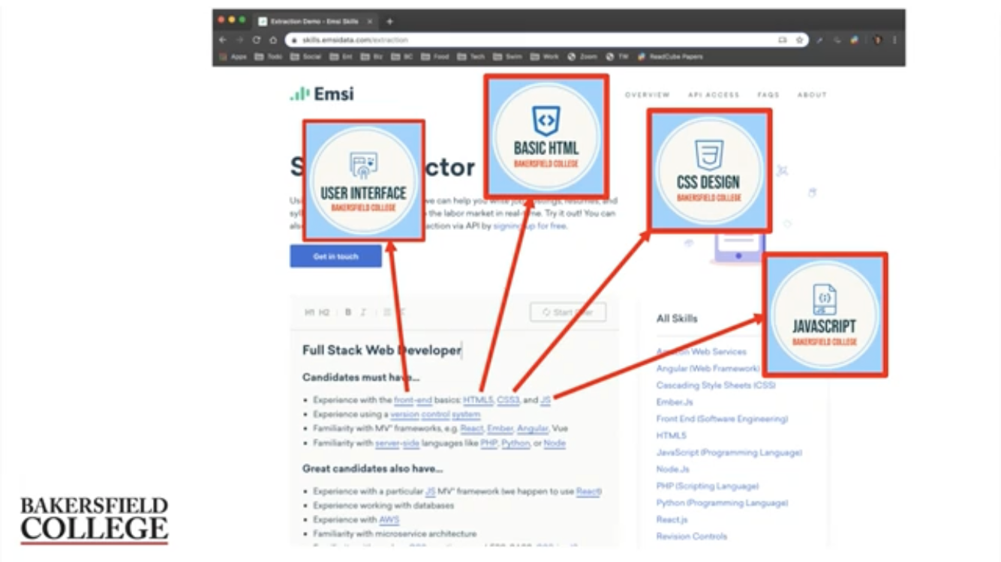
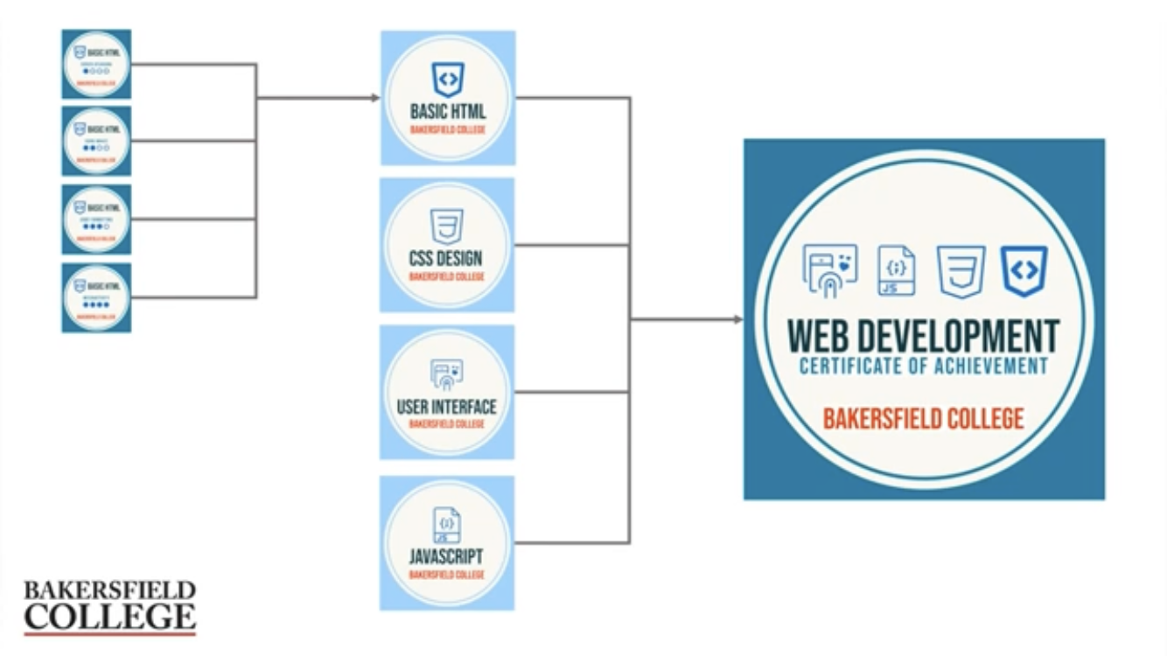
Bakersfield College Maps Micro-Credential Competencies to Job Postings
@BAKCollege
#OpenPathways
https://www.youtube.com/watch?v=tz1EcC4H2JY
Education Design Lab

Slide 12
8 things IBM Learned through their
Badging Program
@David_Leaser
#NewCollar
https://www.ibm.com/services/learning
Education Design Lab

Slide 13
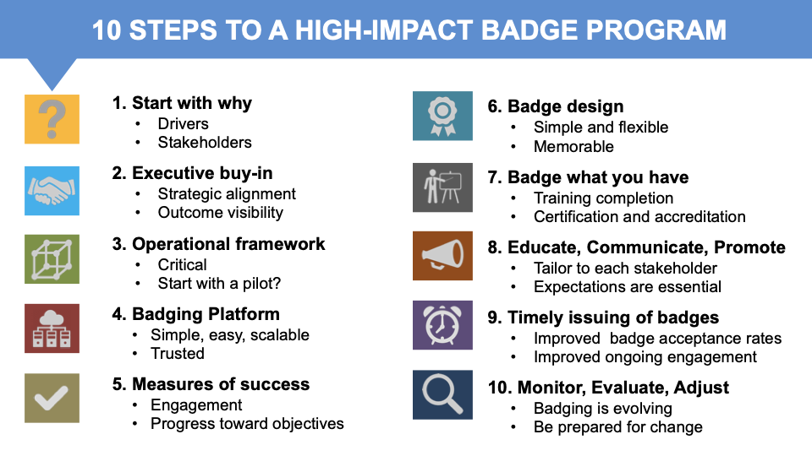
@David_Leaser
#NewCollar
https://www.ibm.com/services/learning
Education Design Lab

Slide 14
Overview
1
2
3
Standalone
academic offering
IREX
Pakistan University of Management
Course Integrated
embedded in course
Minnesota State System Johnston
Community College
Learning Community
co-curricular experience
George Mason University San Jose State University
G.o.A.L Program
Education Design Lab
@eddesignlab
#BadgedToHire
eddesignlab.org/badgedtohire

Slide 15
Standalone
academic offering
1
learner experience
badge sub-competency development
badge awarded
line of visibility
facilitator experience
badge facilitator training
sub-competency assessment
issue badges
Education Design Lab
@eddesignlab
#BadgedToHire
eddesignlab.org/badgedtohire

Slide 16
1
IREX
badge(s): oral communication
badge offered asynchronously online via canvas for 8 weeks to all IREX UGRAD alumni, facilitators were 3 IREX associates
Pakistan University of Management badge(s): suite of eight
badges are mandatory part of first year experience for every university student offered in Moodle
skin in the game application process (i.e. limited cohort, tell us why you’d like to participate)
students work through modules independently online; STAIR (student techno- logical and instructional resource center) is available for 1:1 consultations and periodic check-ins
Education Design Lab

Slide 17
“
I am grateful that I was
able to learn, practice and improve my oral communication skills throughout this course and experience e-learning for the first time.
Imane Larousni, Morocco IREX Alumni
”
Education Design Lab
@eddesignlab
#BadgedToHire
eddesignlab.org/badgedtohire

Slide 18
Course Integrated
embedded in for-credit course
2
course curricula milestones
course completion
learner experience
badge sub-competency development ^{badge awarded}
line of visibility
syllabus language +
curriculum crosswalk
facilitate curriculum as usual
facilitator experience
badge facilitator training
sub-competency assessment
issue badges
Education Design Lab
@eddesignlab
#BadgedToHire
eddesignlab.org/badgedtohire

Slide 19
Course Integrated
embedded in for-credit course
2
Minnesota State System
badge(s): oral communication,
initiative, and collaboration
ready-to-use badge modules with IT workplace scenarios have been created and distributed in D2L
Johnston Community College
badge(s): critical thinking, resilience,
and intercultural fluency
cohort of three faculty from business and applied technologies volunteered to embed one badge in their course (cultural immersion, accounting, and criminal law)
faculty from around the state have pulled them into their courses to improve ‘career readiness’
Education Design Lab
each faculty was responsible for incorporating badge content into course syllabus and facilitation

Slide 20
“
It was seamless to incorporate the Collaboration and Teamwork Module into my course. Once the Module was imported it took little effort to customize
to my course layout. After completing the Module, the students seemed to have a greater level of empathy and respect for
each other.
”
Janet Johnson, IT / Cybersecurity Faculty,
MN State Community and Technical College, Wadena
@ITinMN
#BadgingFellows
https://mnstateitcoe.org/career-readiness-
curriculum/
Education Design Lab

Slide 21
Learning Community
co-curricular experience
3
co-curricular milestones
experience completed
learner experience
practice
product: capstone/internship/ presentation
badge sub-competency development
badge awarded
line of visibility
crosswalk activities +
update schedule
facilitate activities as usual
facilitator experience
badge facilitator training
sub-competency assessment
issue badges
Education Design Lab
@eddesignlab
#BadgedToHire
eddesignlab.org/badgedtohire

Slide 22
Learning Community
co-curricular experience
3
RESILIENCE
George Mason University
badge(s): resilience
the resilience badge is a 5 week hybrid workshop open to any student at George Mason
San Jose State University
G.o.A.L Program
badge(s): creative problem solving
the GOAL program is a leadership institute that has layered the initiative badge on-top of the co-curricular curriculum
students work through materials independently online, and join once each week in-person for a meaning making session
the participants complete the micro-credential in addition to the program curriculum to get recognition for the skills being developed in this program
Education Design Lab

Slide 23
Employer Enthusiasm
Education Design Lab

Slide 24
“
At Enterprise, we like to see a candidate balance academics with such soft skills as work ethic, communication and teamwork.
These mobility micro-credentials provide students an opportunity to build on and articulate these skills.
”
Casey Porter Talent Acquisition Manager, Enterprise
@Enterprise
#BadgedToHire
Education Design Lab
Notes:
Has anyone ever heard of Enterprise Car rental? Here’s what a hiring manager for lot’s of entry-level talent (college grads) say they’re looking for in new candidates...

Slide 25
“
This resilience badge is really interesting, this is something I would not be able to see
looking at a resume or cover letter. The badge is one more way we’re able to better vet our candidates before they even come through the door.
”
Desy Osunsade
Senior Director Culture and Talent, Arabella Advisors
Education Design Lab
@MasonULife
#Resiliency
https://ulife.gmu.edu/wellbeing-landing-page/resilience/

Slide 26
“
Just having a degree is not going to be good enough. So, [micro-]credentialing is really important in terms of those people who really want to be successful professionally. This is a way for them to demonstrate it early on.
”
David Pease
Director of Talent + Diversity
Bangor Savings Bank
Education Design Lab
@BangorSavings
#BadgedToHire

Slide 27
“
[the digital badge helps] hiring managers with identifying the skills that these students have rather than having to sift through resumes. The digital badge easily identifies and separates them from other potential applicants.
”
Joanna Morrison
Director of Talent Acquisition
Northern Light Health
Education Design Lab
@NorthernLightH
#BadgedToHire

Slide 28
“
We’re going to have a better pool of the workforce that has those intangibles that you can use and you can baseline them against other people coming in that don’t necessarily have them
”
Sam Hatchell
Corporate Quality Manager
Jaynes Corporation
Education Design Lab
@JaynesCorp
#BadgedToHire

Slide 29
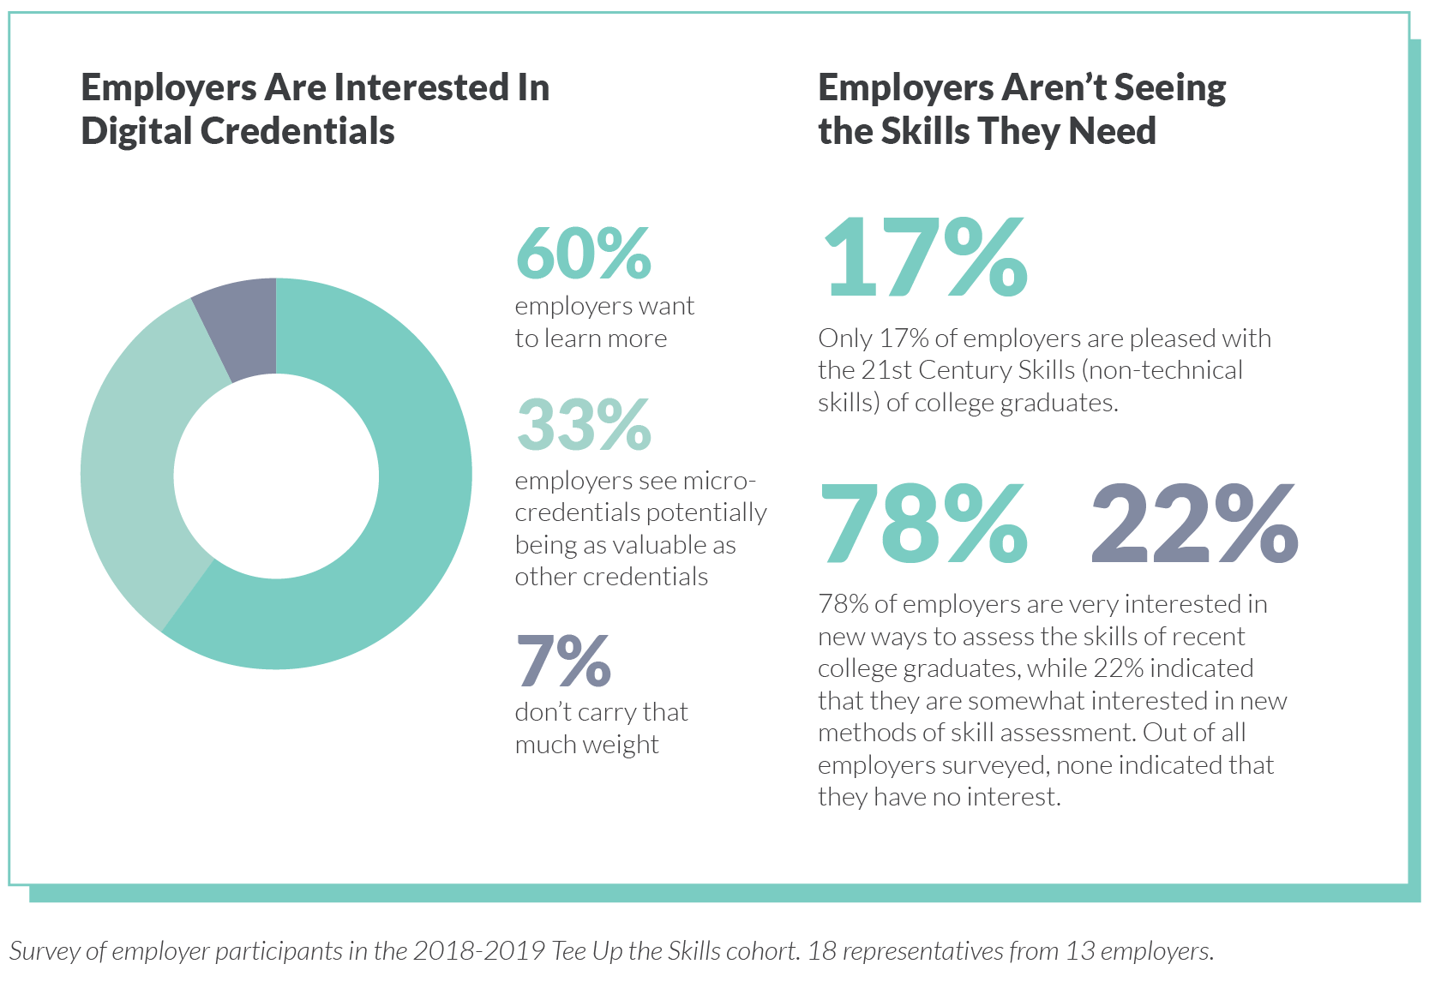
Education Design Lab
@eddesignlab
#TeeUpTheSkills
eddesignlab.org/teeup

Slide 30
Micro-Credentialing
Technologies
Education Design Lab

Slide 31
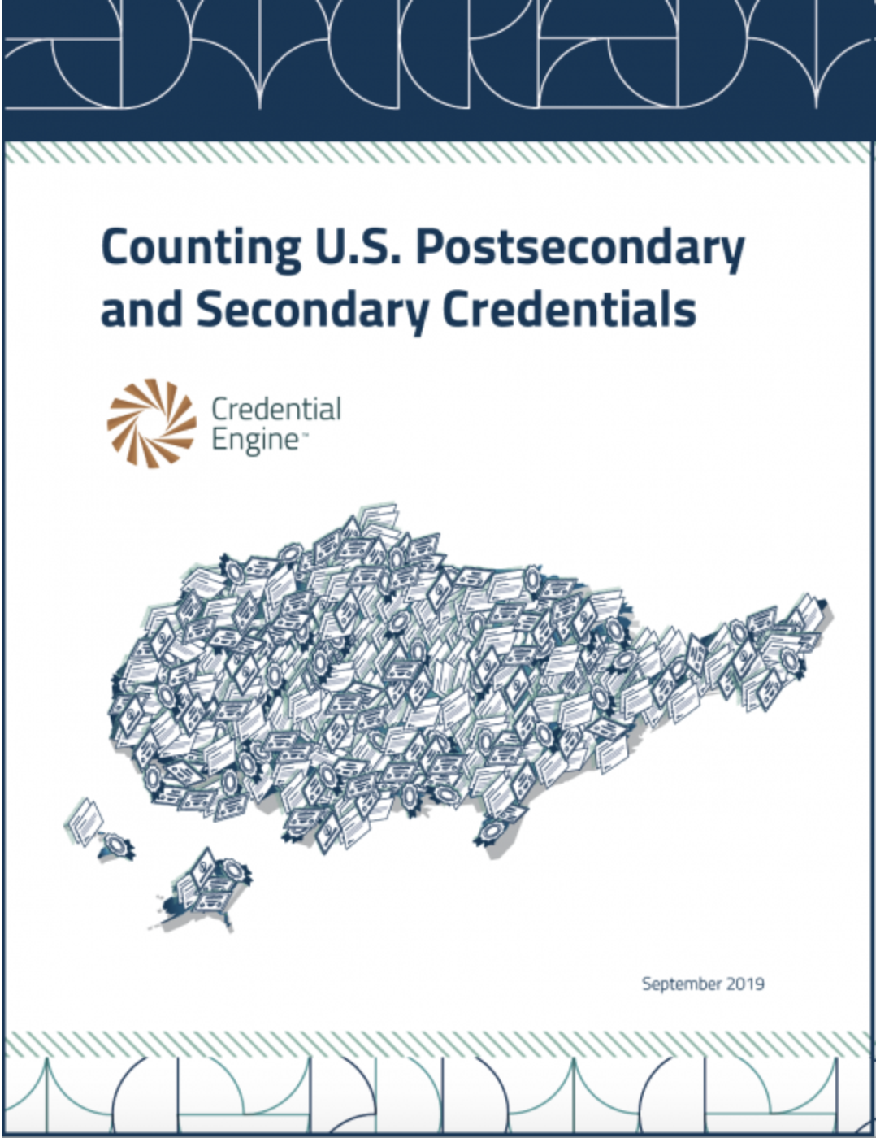
Credential Engine Aims to Publish Comprehensive Data on ALL Credentials
the United States has at least 738,428 unique credentials across 17 separate subcategories.
@credengine
#CountingCredentials2019
credentialengine.com
Education Design Lab

Slide 32
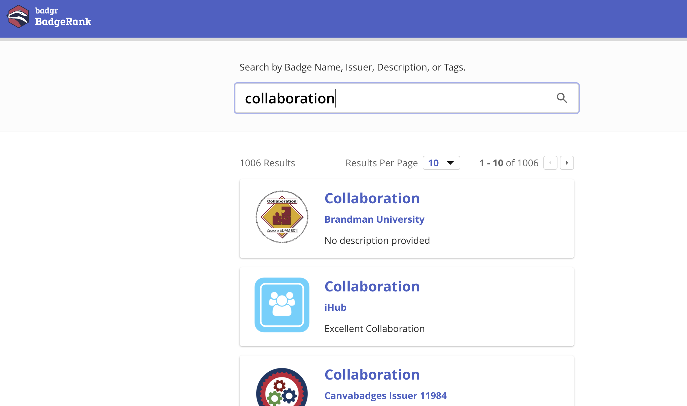
Scan BadgeRank to see what Badges other Institutions are Offering
BadgeRank is a free search engine designed to index and rank Open Badges from the badging platforms of the world. You can use BadgeRank to search for a wide variety of badges as well as explore the criteria under which they are issued.
@badgrteam
#digitalbadges
badgerank.org
Education Design Lab

Slide 33
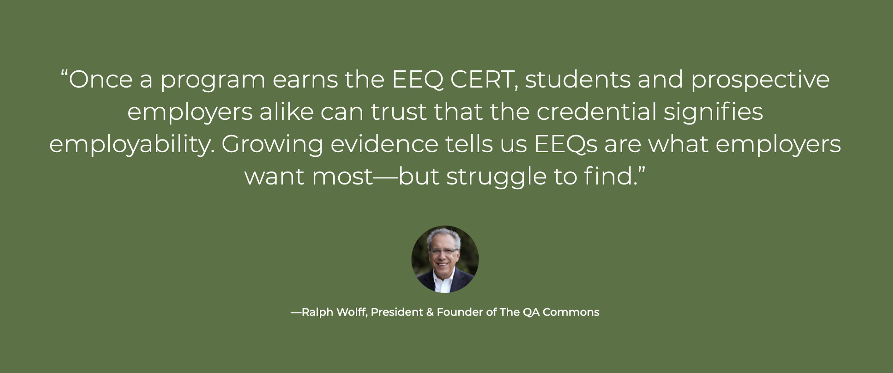
QA Commons wants to validate your credential as ‘employer-verified’
@rawolff
#QACommons
theQAcommons.org
Education Design Lab

Slide 34
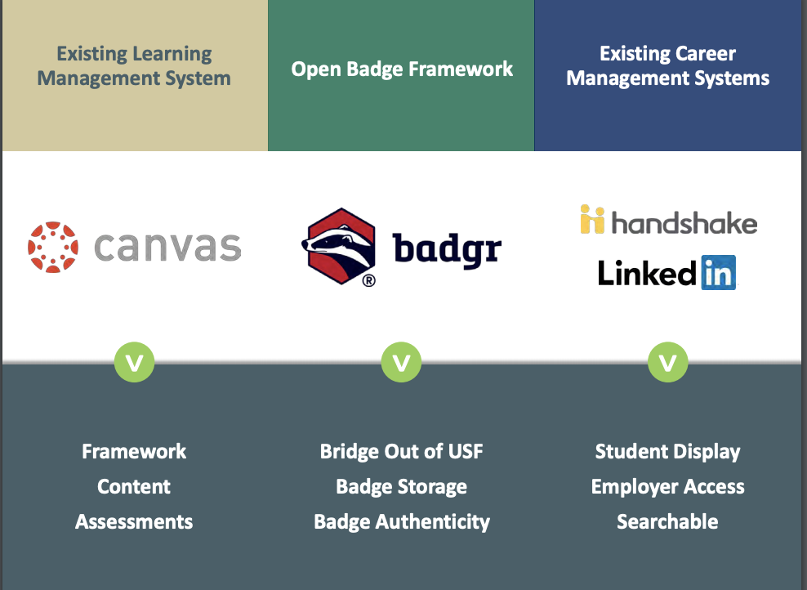
University of South Florida Career Readiness Badging Tech Stack
@pthorsett
@USFCareerServ
https://www.usf.edu/career-services/career-ready/
Education Design Lab

Slide 35
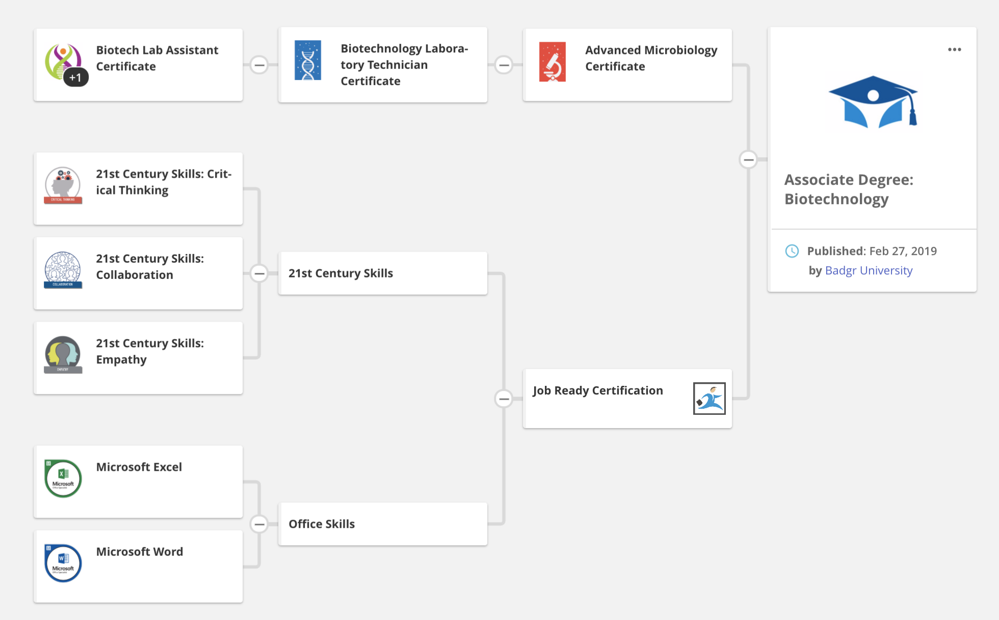
Open Pathways: A Curation of Interoperable ‘Badge Stacks’
@badgrteam
#openpathways
pathways.badgr.io
Education Design Lab

Slide 36
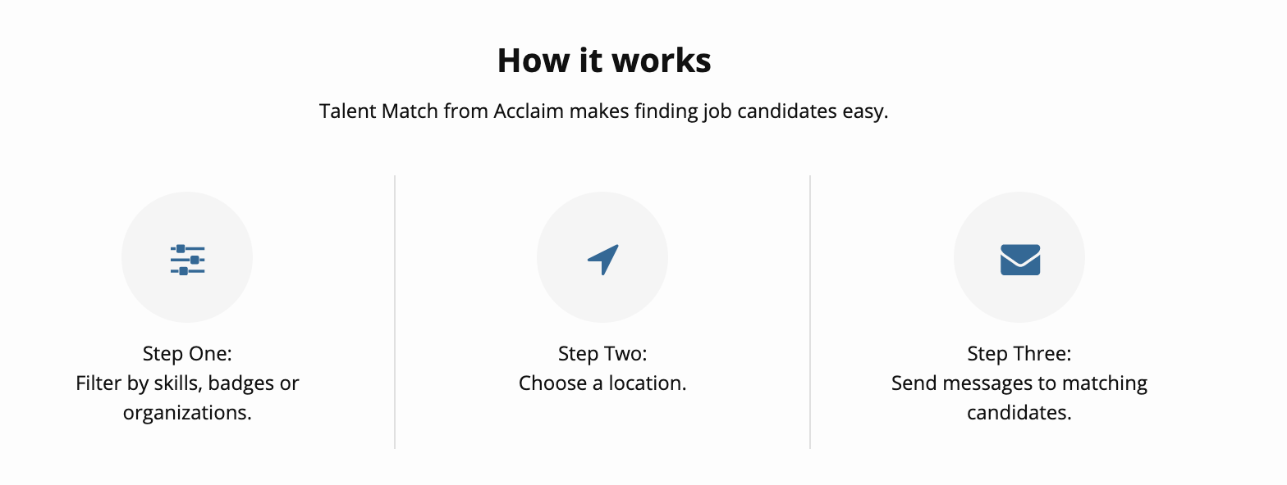
Talent Match Allows Employers to Search Candidates by Badged Competencies
@credly
#talentmatch
https://www.youracclaim.com/talent-match
Education Design Lab

Slide 37
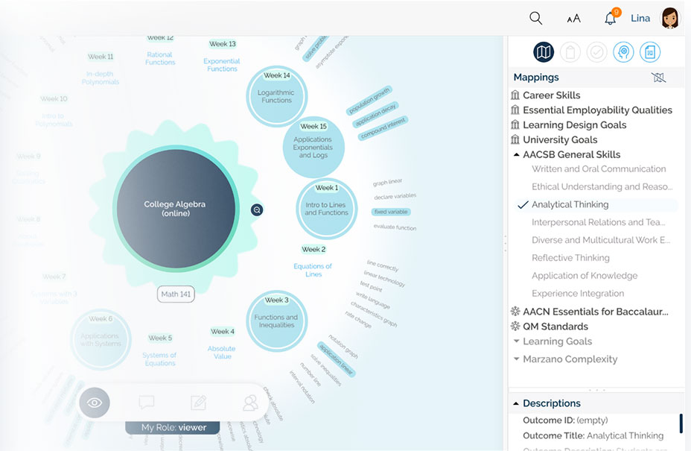
Coursetune creates curriculum maps that make it easy to see where competencies occur across programs
@busynessgirl
#coursetune
coursetune.com
Education Design Lab

Slide 38
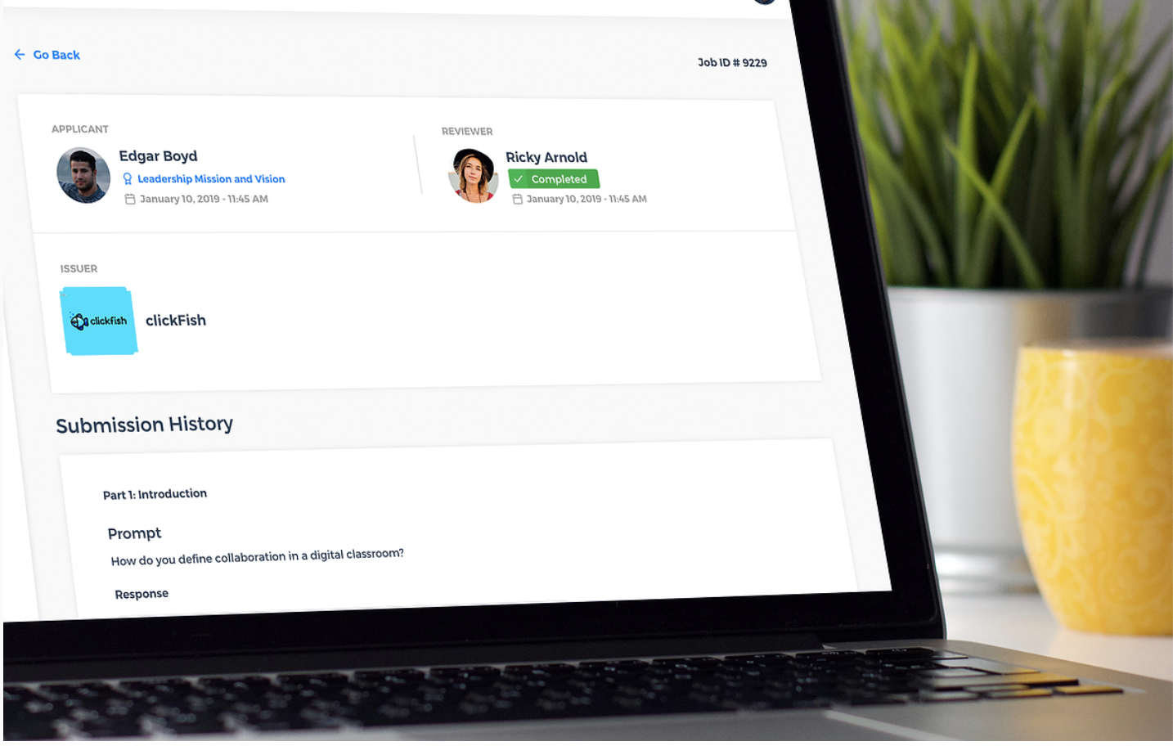
WonderCert helps you access, manage, and train pools of on-demand reviewers
@MichiganVirtual
wondercert.com
Education Design Lab

Slide 39
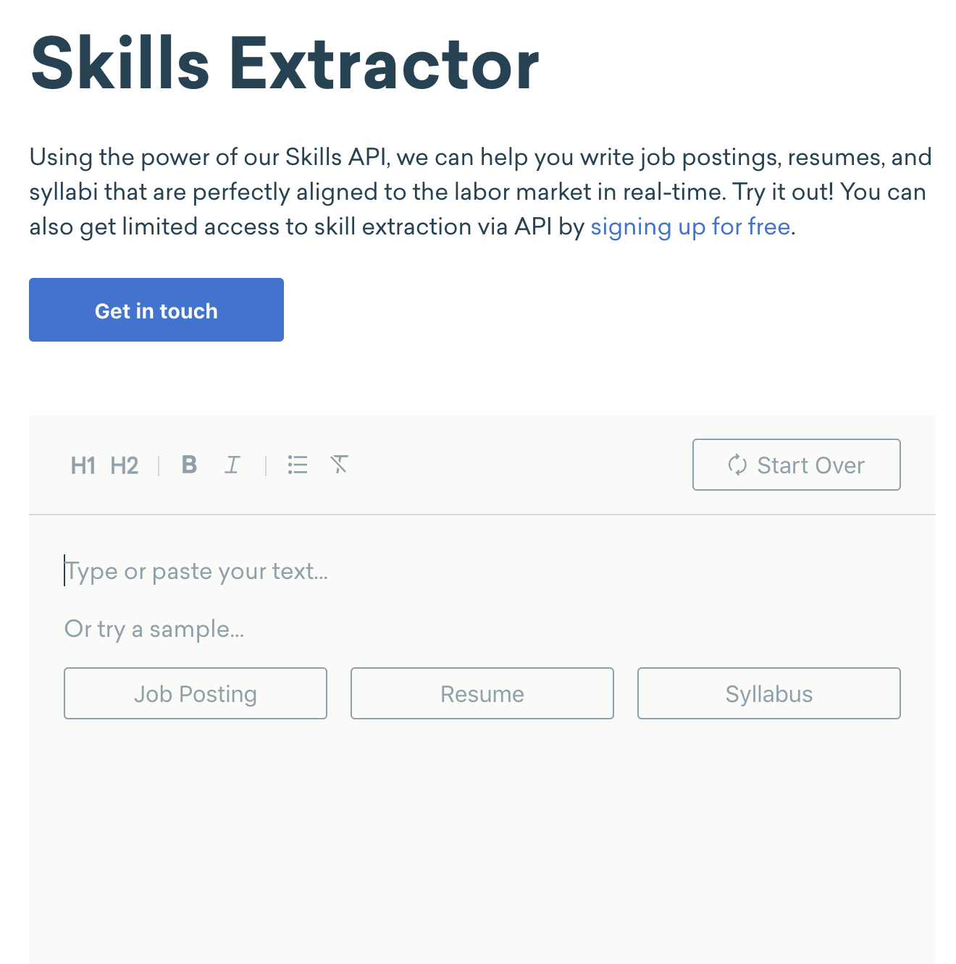
Emsi skills library: nearly 30,000 skills to help educators, industry + job seekers speak the same language
Emsi pulls and updates the skills from real-world resumes, professional profiles, and job postings.
@Emsidata
#Emsidata
economicmodeling.com
Education Design Lab

Slide 40
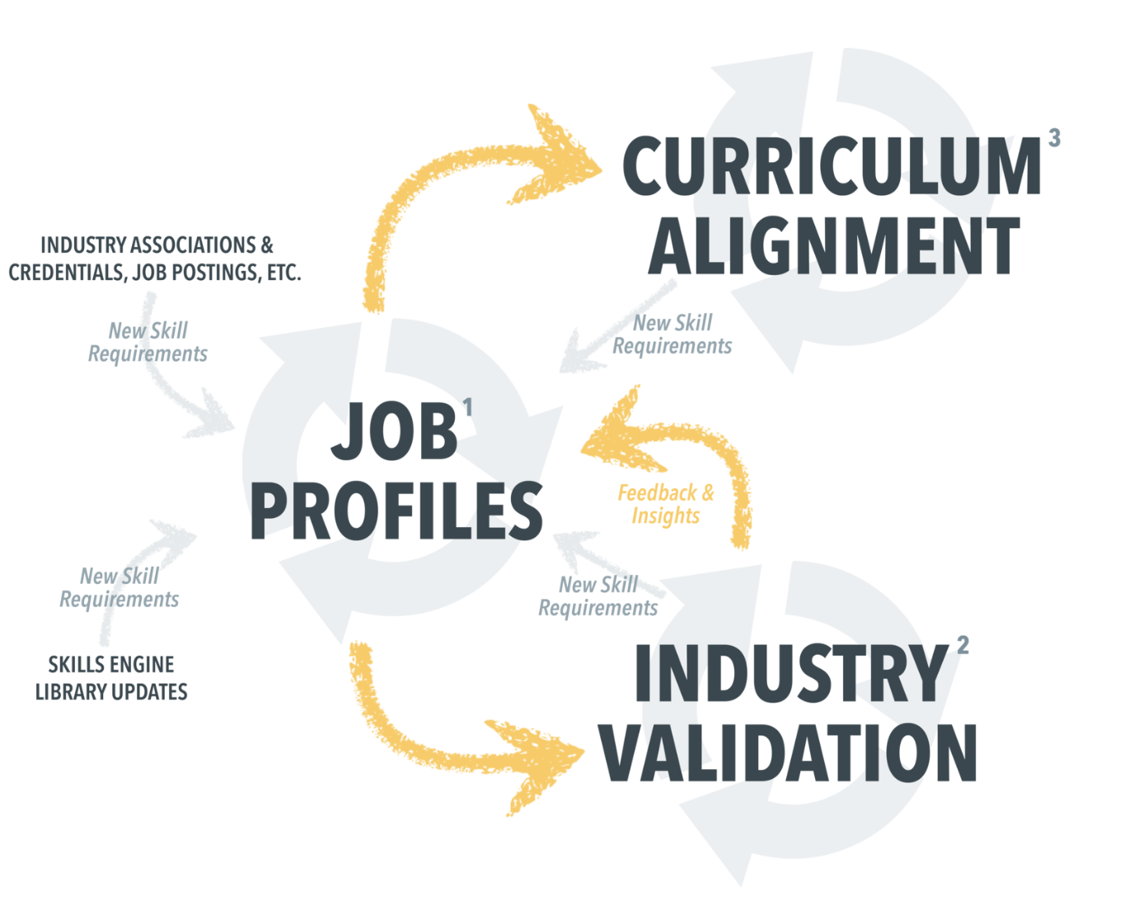
SkillsEngine will review your course and tag the workforce relevant skills
@bettersworth
#SkillsEngine
skillsengine.com
Education Design Lab

Slide 41
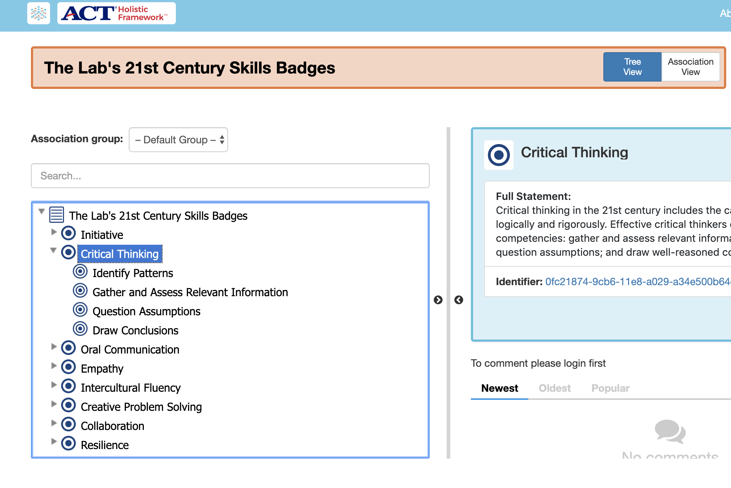
CASE Standards align badges to a skill taxonomy in a machine readable format
@LearningImpact
#EDU19
https://www.imsglobal.org/activity/case
Education Design Lab

Slide 42
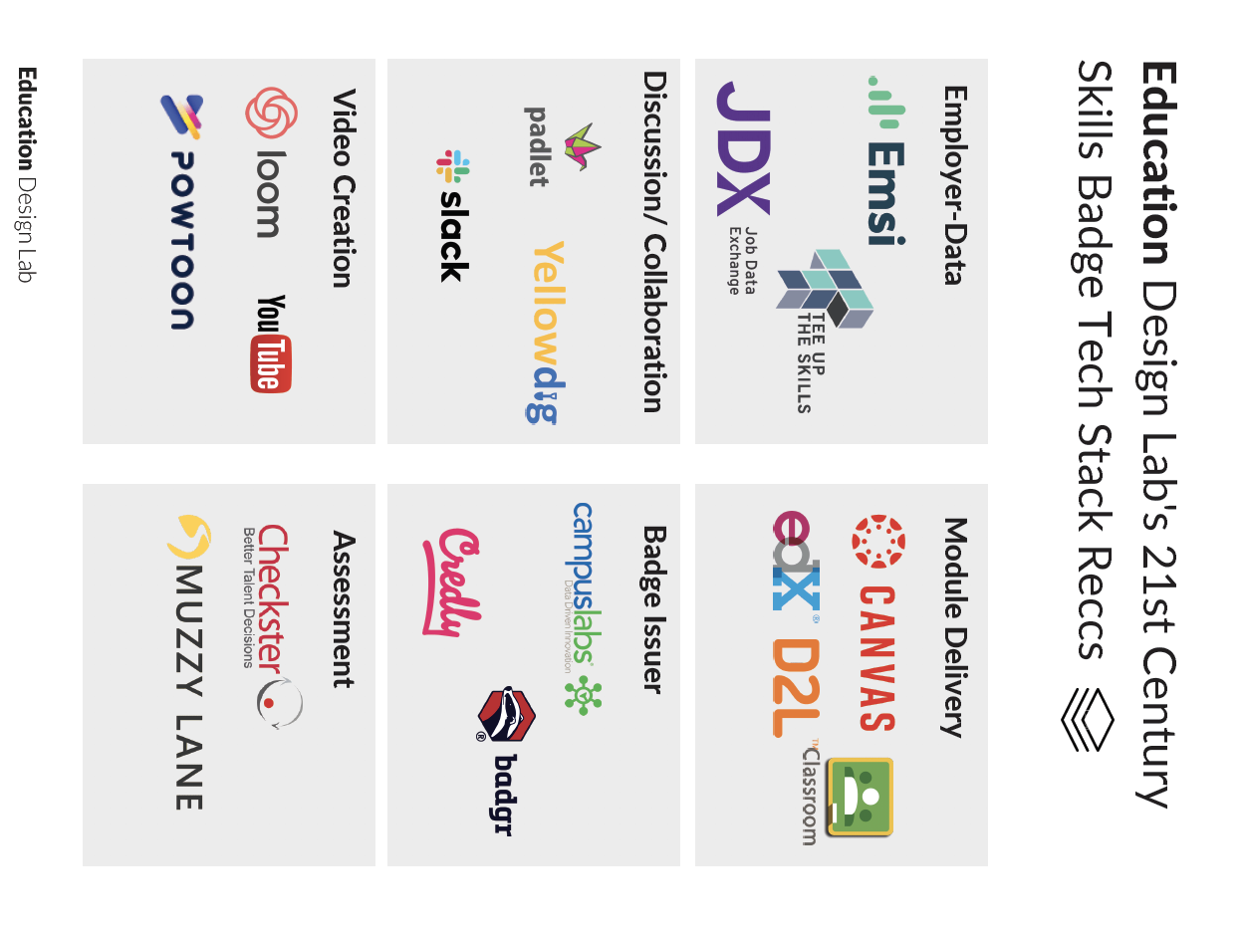

Slide 43
Micro-Credentialing
Trends
Education Design Lab

Slide 44
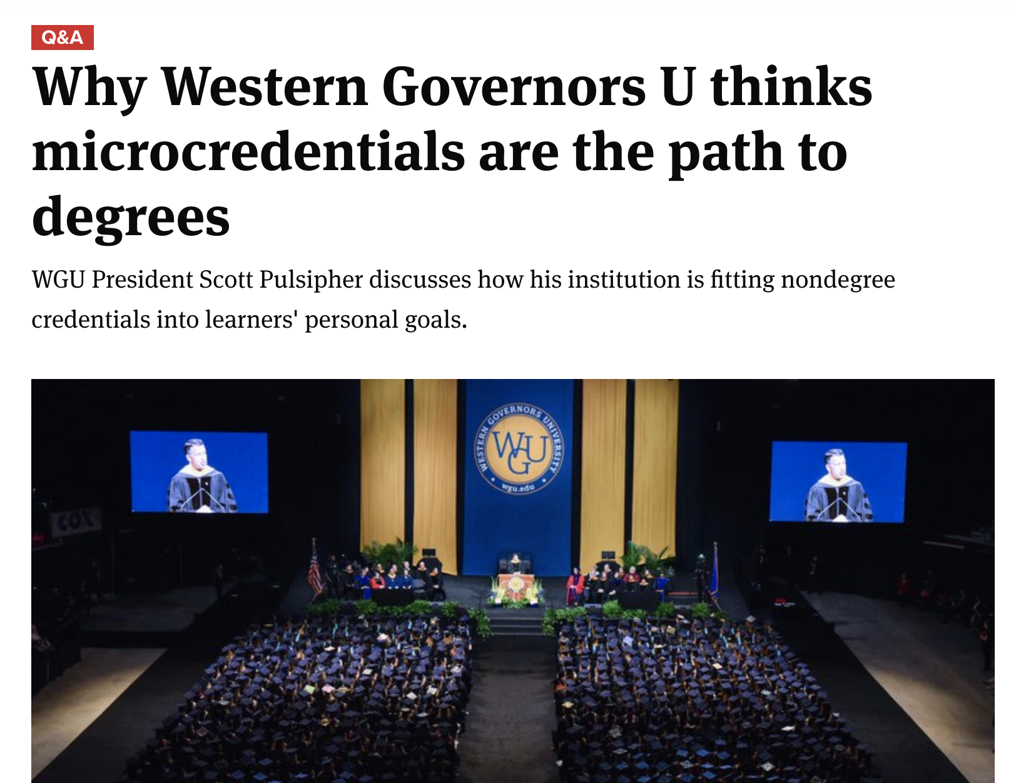
“The degree is not the be-all-end-all of employer’s hiring plans”
@pulsipher_WGU
#InnovationWins
Education Design Lab

Slide 45
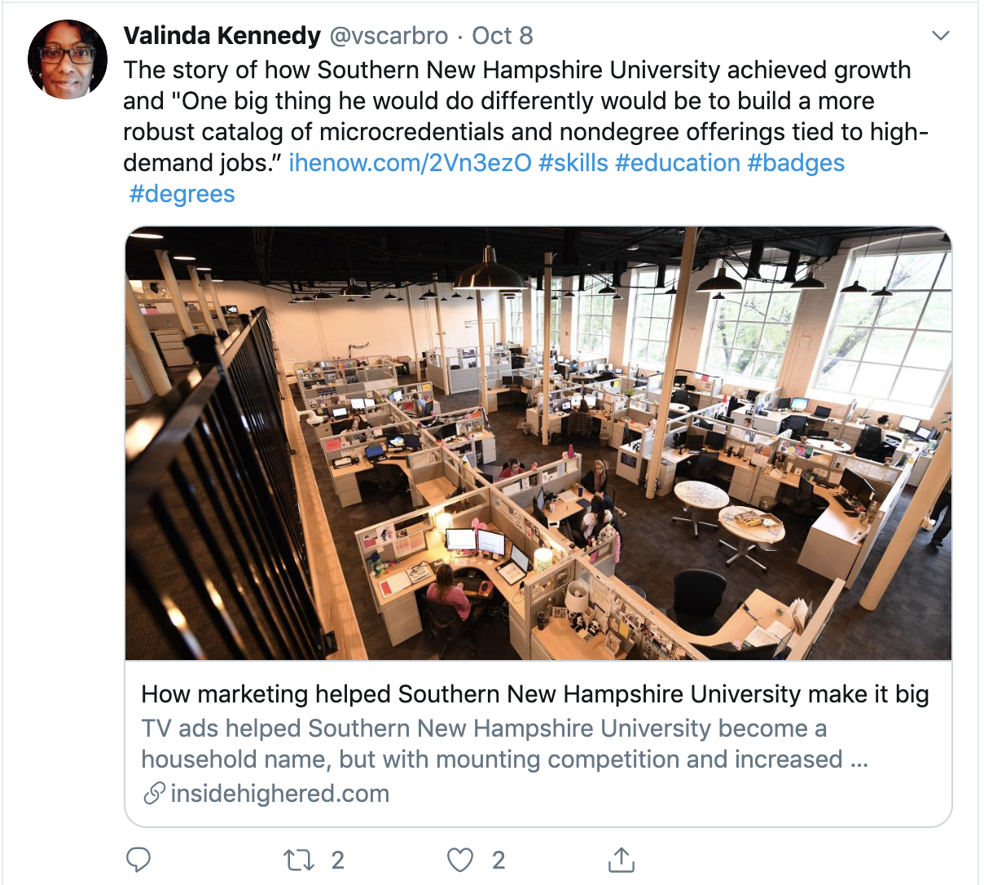
SNHU continues to evolve with micro-credentials
@snhuprez
#disruption
http://www.sandboxcollaborative.org/
Education Design Lab

Slide 46
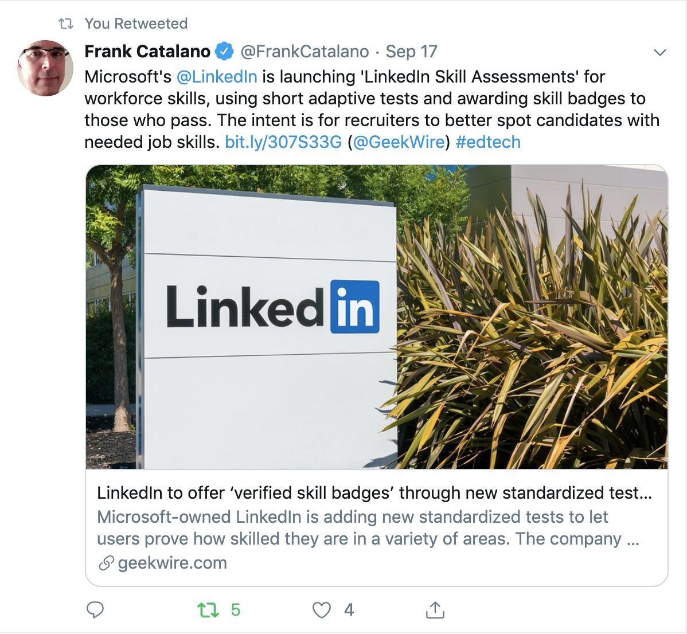
Linkedin launches skills assessments
@linkedin
#EDU19
Education Design Lab

Slide 47
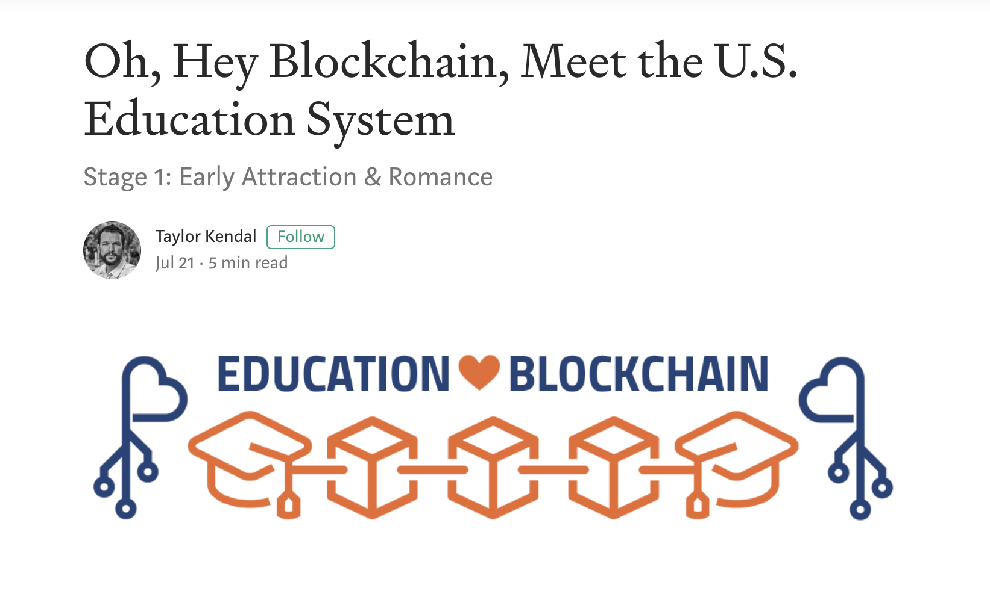
US Department of Education launches Education Blockchain Action Network
With a clear focus on open, interoperable standards related to digital credentials and identity.
@taykendesign
@OfficeOfEdTech
https://usedgov.github.io/blockchain/
Education Design Lab

Slide 48
Converging Industry Knowledge to College Credit
IBM employees, customers, and members of the public can now use IBM issued badge credentials toward three Northeastern professional master’s degree programs—data analytics, project management, and portfolio management
IBM + Northeastern, David Leaser, 2017
@HiEdStrat
#LifeLongLearner
Gratton and Scott. The 100-Year Life. (2016)
Education Design Lab | K12 PBL Micro-credential

