Slide 1
Jump-Starting your Institution’s Badging Initiative
University of Maine System + Education Design Lab

Slide 2
who we are
Don Fraser
Director of Micro-Credentialing
Education Design Lab
Claire Sullivan
Assistant Vice Chancellor for Digital Badging + Micro-Credentialing
University of Maine System
Tara Baumgarten
Associate Education Designer
Education Design Lab

Slide 3
session at a glance
Introductions and Overview
Gallery Walk (Case Studies, Trends, Innovations)
Build Empathy for our User
Value Proposition
Who are your key stakeholders?
What competencies will you badge?
Visualize the Learner’s Experience
Key Considerations
Pathway to Scale

Slide 4
Intro to the Lab + Design Thinking

Slide 5
Why Use Human-Centered Design?
Human-centered design is a systemic approach to problem solving and is anchored in three core beliefs.
empathy
establish a deep understanding of human needs
invention
discover new possibilities
iteration
use initial solutions as stepping stones to greater impact

Slide 6
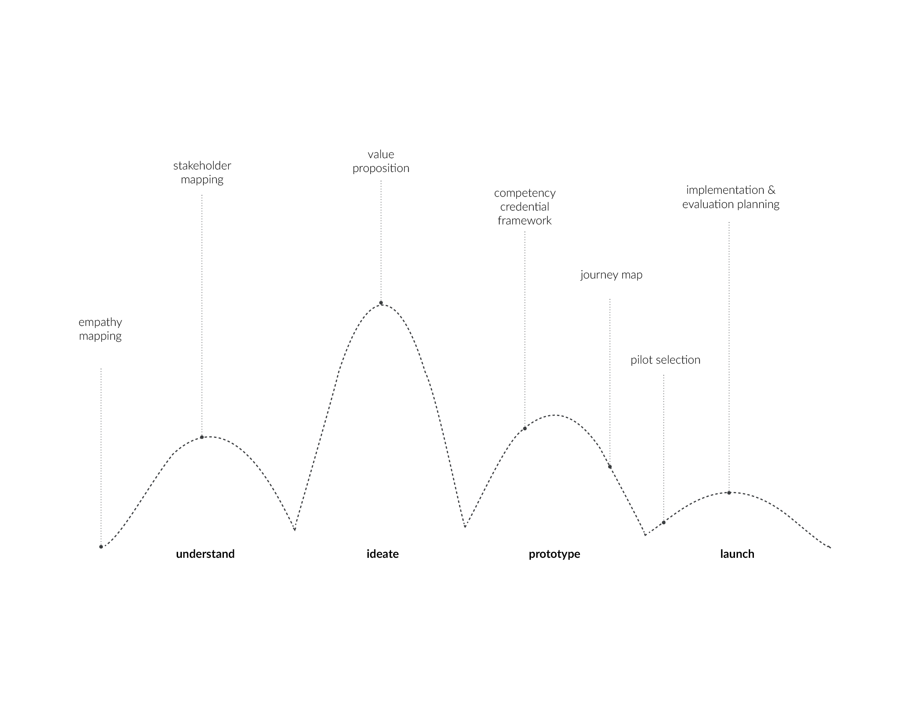
The Human-Centered Design Process

Slide 7
Design Mindset
Balance a design process that could be somewhat unfamiliar or even uncomfortable for some.
Let go of the “traditional” mental models of education.
Suspend what we think we know about how to solve this problem and explore possibilities.
| Design Process + Design Mindset

Slide 8
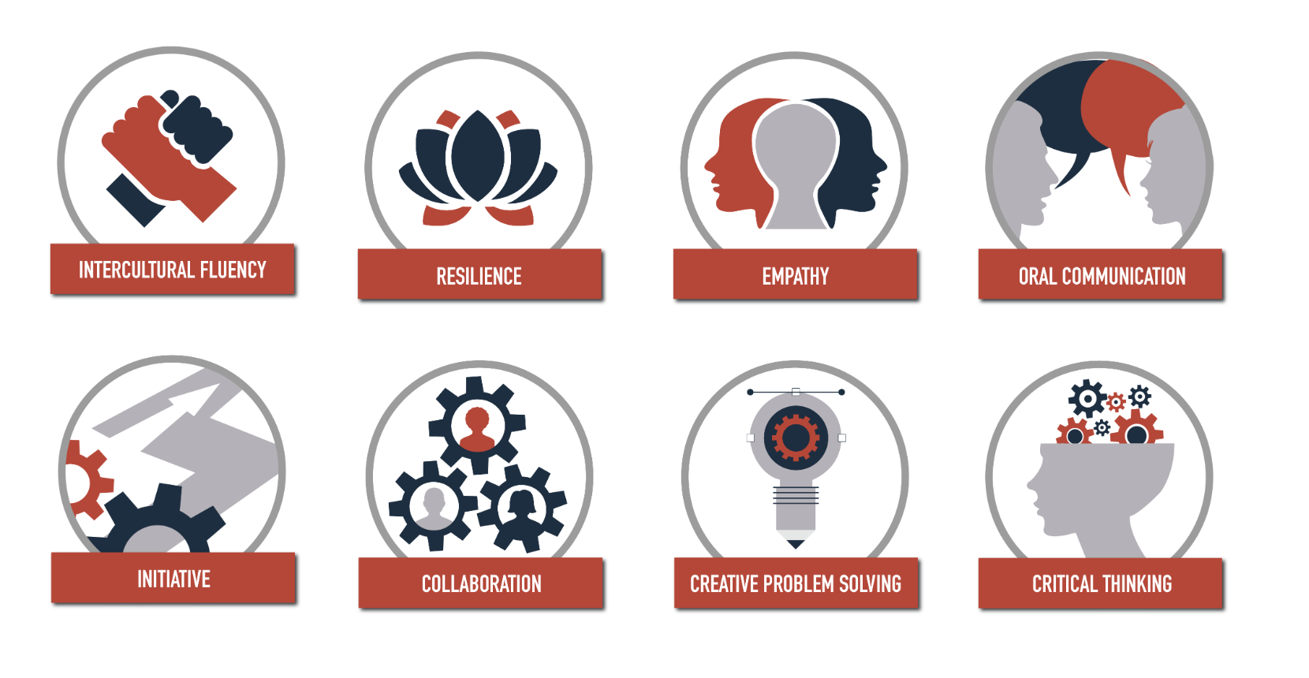
The Lab’s 21st Century Skills

Slide 9
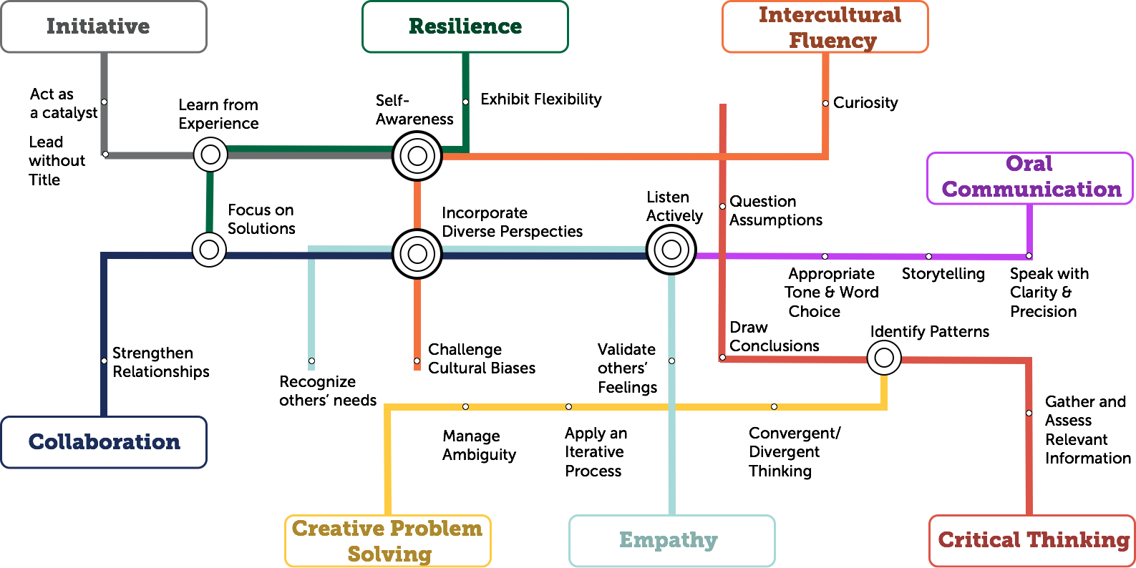
Sub-Competency Map

Slide 10
Stories from the Field

Slide 11
Stories From the Field: Engaged Black Bear Initiative
Notes:
CLAIRE

Slide 12
National, State and Local Initiatives
Notes:
CLAIRE

Slide 13
The Lab’s 21st Century Skills

Slide 14
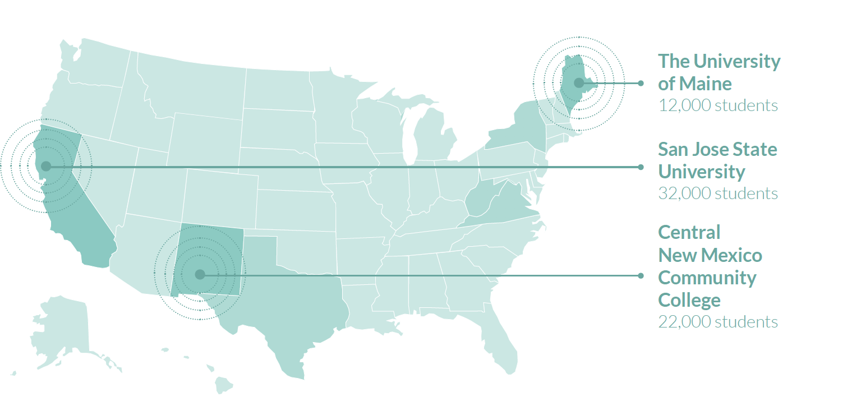
#BadgedToHire Cohort

Slide 15
Gallery Walk

Slide 16
Gallery Walk
Gallery Walks are a collection of artifacts and ideas produced to unify insights or themes synthesized across a variety of ‘data’ sources and formats
insights What trends + case studies stood out to you?
questions What lingering questions arise as you browse the gallery?
Notes:
TARA

Slide 17
Gallery Reflections
What stands out?
What’s new or different?
What elements would we like to borrow from these programs?

Slide 18
PEOPLE: Faculty, Learners + Employers
Notes:
DON

Slide 19
Build Empathy for our Users
Notes:
TARA

Slide 20
Meet Tim
Residential 4-Year Learner
Sophomore
Age 19
Interested in getting an internship next year
Participates in intramural sports

Slide 21
Meet Lana
Commuting 2-Year Learner
2nd year
Age 26
Part-time job in retail
Commutes from home to save money
Pursuing cybersecurity certificate
Not planning on seeking Bachelor’s

Slide 22
Meet Kimberly
Online learner
1st year
Age 38
Wants to be a Registered Nurse
Works full-time job
Has two young children
Previously attempted college, completed one semester

Slide 23
Meet Miguel
Continuing Ed learner
Age 28
Recently lost full-time job
English is his second language
Hoping to earn advanced manufacturing certificate
Can afford to take one class per semester

Slide 24
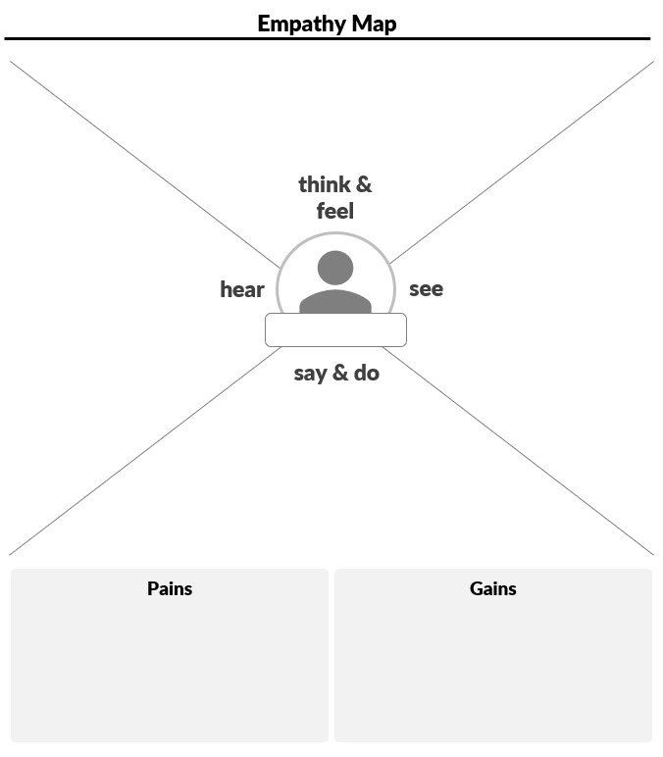
Empathy Mapping
An Empathy Map is a collaborative tool teams can use to gain a deeper insight into their stakeholders.
1
Group at an Empathy Map template by your organization. Brainstorm in the following categories:
Think & Feel; See; Hear; Say & Do (3 min each)
Write one (1) idea per sticky note and place them on your empathy map.
2
3
Swap Empathy Maps, discuss similarities and differences between student experiences.

Slide 25
Empathy Mapping
Think and Feel:
What are their motivations & inspirations?
What are their loves, fears, desires, or needs?
What are important to them?
See:
Home, neighborhood, city
Friends, family, other
Service offerings
Hear:
Voices of family, friends, community, coworkers
Influences and their effects
Media influence and channels
Say and Do:
Public face and behavior
Things told to others/you
Workarounds or quick fixes

Slide 26
Value Proposition
Notes:
DON

Slide 27
Value
What will you badge? Noise?
Added Value, Benefits, and Currency
Target Population and Access
Employer Need and Involvement
Learning Outcomes and Standards
Evidence: What is acceptable? Who says so?
Competency-based? Mastery? Authentic Assessment?
Notes:
CLAIRE

Slide 28
What is a Value Proposition?
A value proposition is the one unique and compelling reason your customer(s) will value—and choose—your offering over that of your competitor(s).
Notes:
CLAIRE

Slide 29
A Value Proposition is
•specific and clear
•competitively distinct
•highly relevant and motivating to our audience(s)
•credible and believable, coming from us
•a clear guide for decision making and growth, now and in the future
Notes:
CLAIRE

Slide 30
Why must you have a value proposition?
INTERNALLY
Guides your decision making
Empowers colleagues to know what they are a part of and working toward
EXTERNALLY
Guides your students’ decision making
Differentiates you in a competitive marketplace
Notes:
CLAIRE

Slide 31
Why must you have a value proposition?
INTERNALLY AND EXTERNALLY
Provides understanding and cohesive
expression about what you offer and why
Notes:
CLAIRE

Slide 32
Why must you have a value proposition?
Create and deliver focus: You must understand how your offering is unique and valuable in the marketplace so you are able to promise and deliver that valuable offering to your students.
Curriculum
development
Admissions
Strategic Planning
Operations
Marketing
Fundraising
Alumni Relations
Events
Research
Notes:
CLAIRE

Slide 33
What is your value proposition?
We plan to offer badges so that learners can _______________________
key strength/benefit
to help them ___________________________
address this need(s)
and unlike______________________________
this competitor(s)
we____________________________________.
unique benefit to student
Notes:
CLAIRE

Slide 34
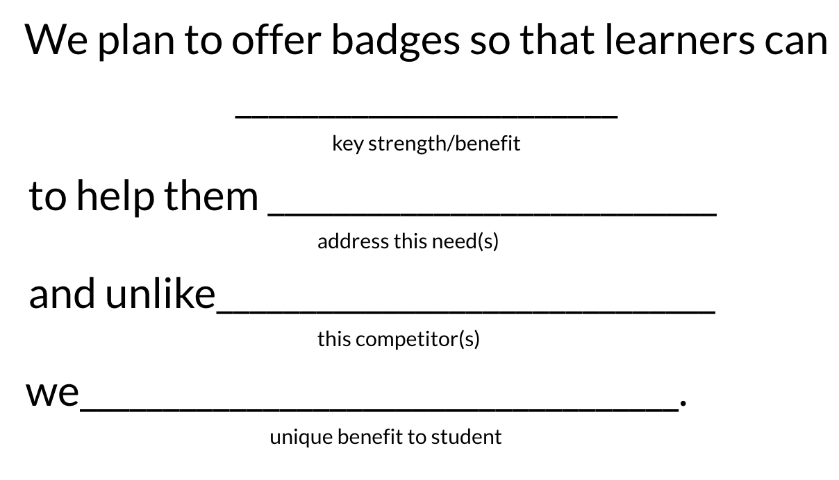
What is your value proposition?
Craft your value proposition (5 minutes)
Share with a neighbor + get feedback (10 minutes)
Revisit your value proposition + make any changes necessary (2 minutes)
Notes:
CLAIRE

Slide 35
Stakeholder Mapping

Slide 36
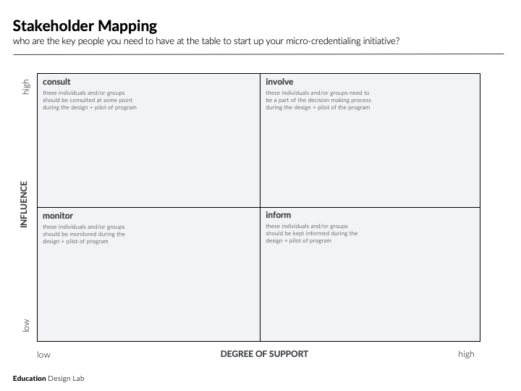
Stakeholder Mapping

Slide 37
Stakeholder Mapping: Directions

Slide 38
BREAK

Slide 39
PROGRAM
Notes:
DON

Slide 40
What Competencies will you Badge?
Notes:
DON

Slide 41
21st Century Skill Badges
“Micro-Badges” within the new University of Maine System Framework
For-Credit Courses
Within Co-Curricular through EBB, including internships
Within Campus Clubs (AMA)
Non-credit course or extra-credit
Delivery:
Online, hybrid, and classroom are all possibilities
Notes:
CLAIRE

Slide 42
Badging new competencies
The Lab’s Badge Facilitator Micro-Credential
Identify badge delivery model for your environment
Align existing course content with the competency framework
Utilize the Lab’s Proving Ground rubrics to give feedback
Apply 21st century skills in a scenario or context related to your field of work
Provide direction to learners on how to claim and share their badge (UMS will also provide system-wide support for this)

Slide 43
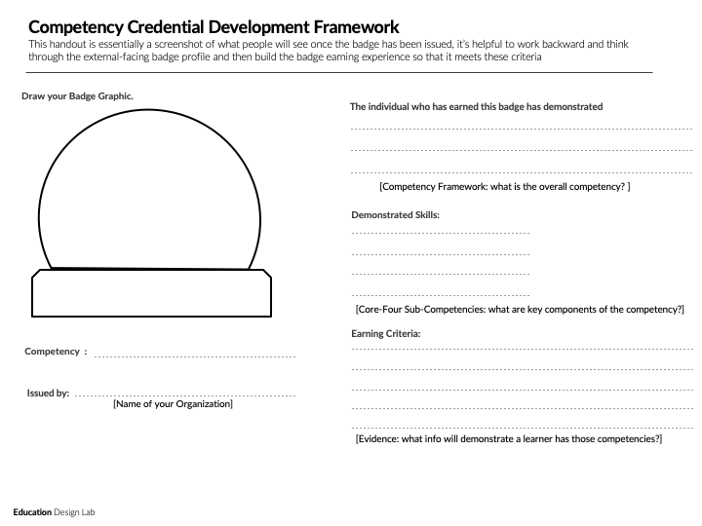
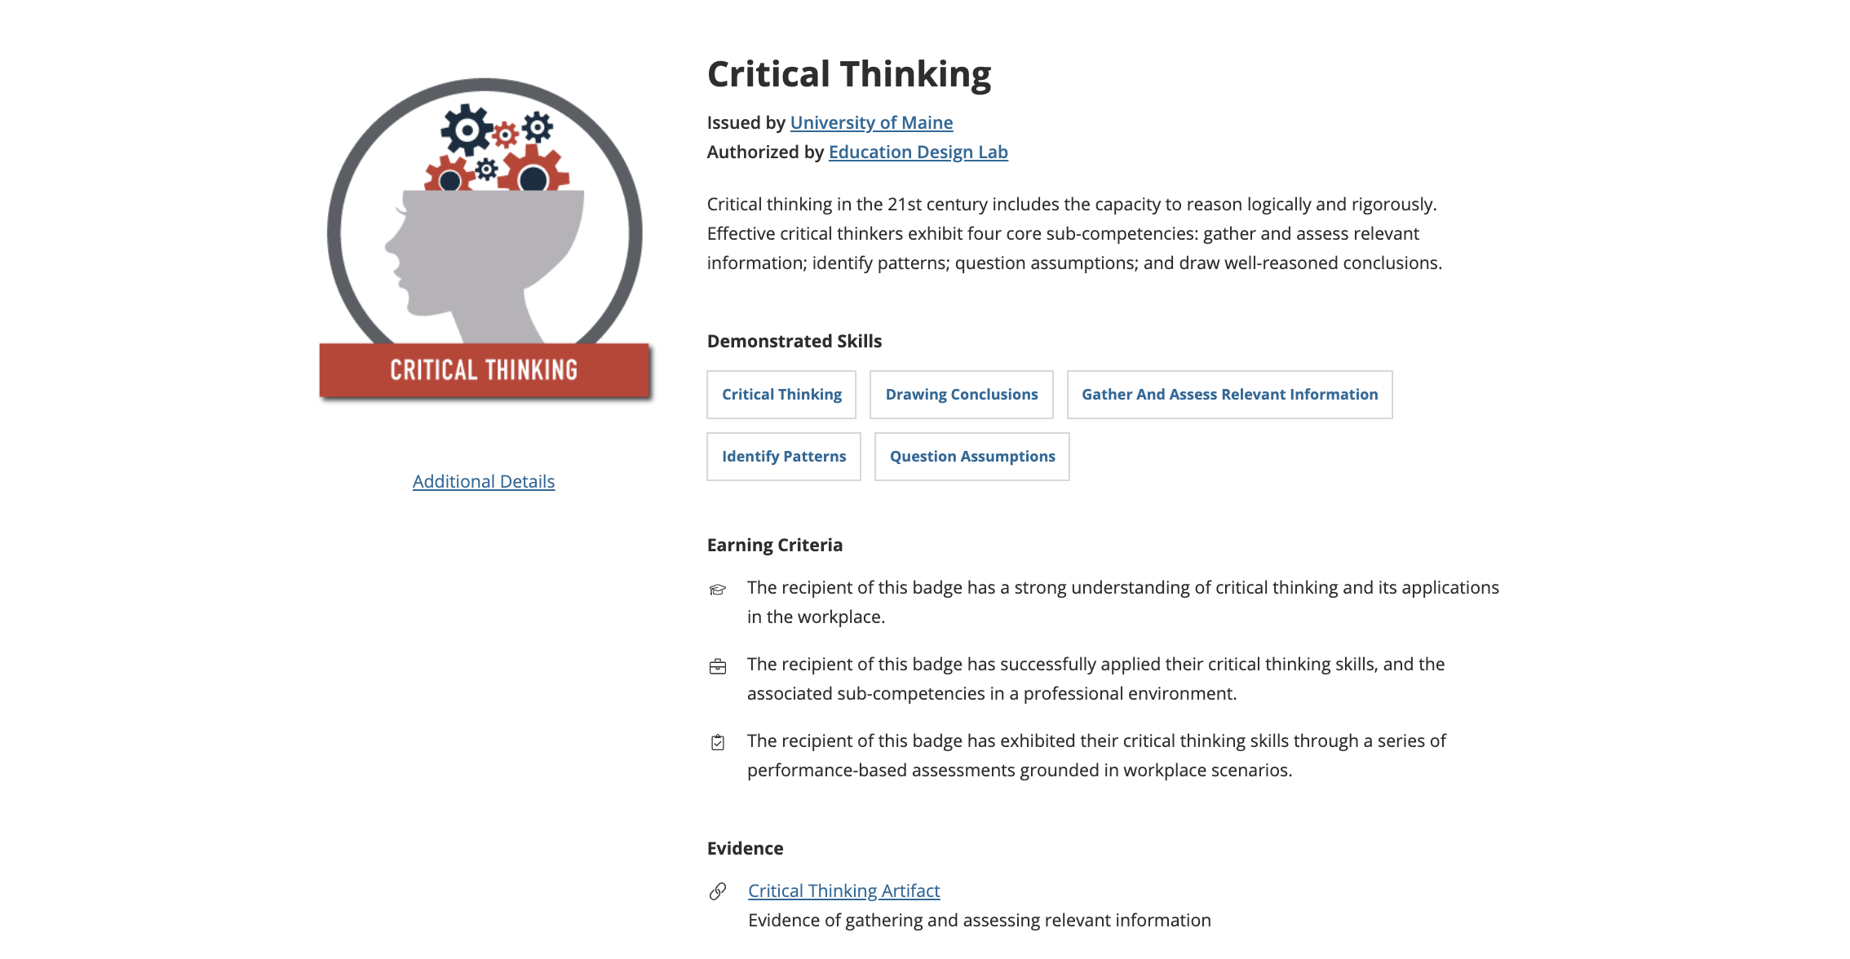
Competency Credential Development Framework
Notes:
TARA

Slide 44
Visualize the Learner’s Experience
Notes:
DON

Slide 45
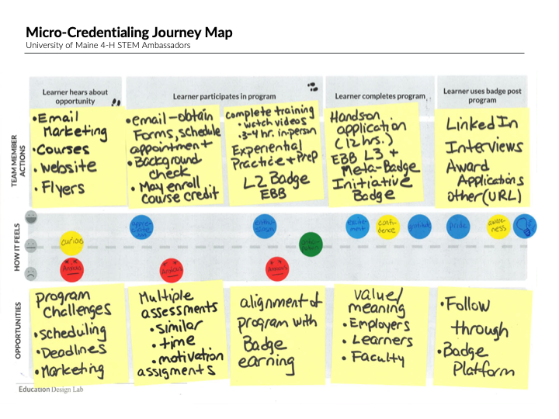
Journey Mapping
A Journey Map is a graphic representation of a stakeholder’s experience as he or she works to accomplish something of importance to him or her.
Brings to life the stakeholder’s experiences and touchpoints
Helps cross-functional teams gain insights about highs and lows
Helps us build and imagine an ideal state
Can be used to build consensus for the ideal state
Can be used to document or record synthesized research
Notes:
CLAIRE

Slide 46
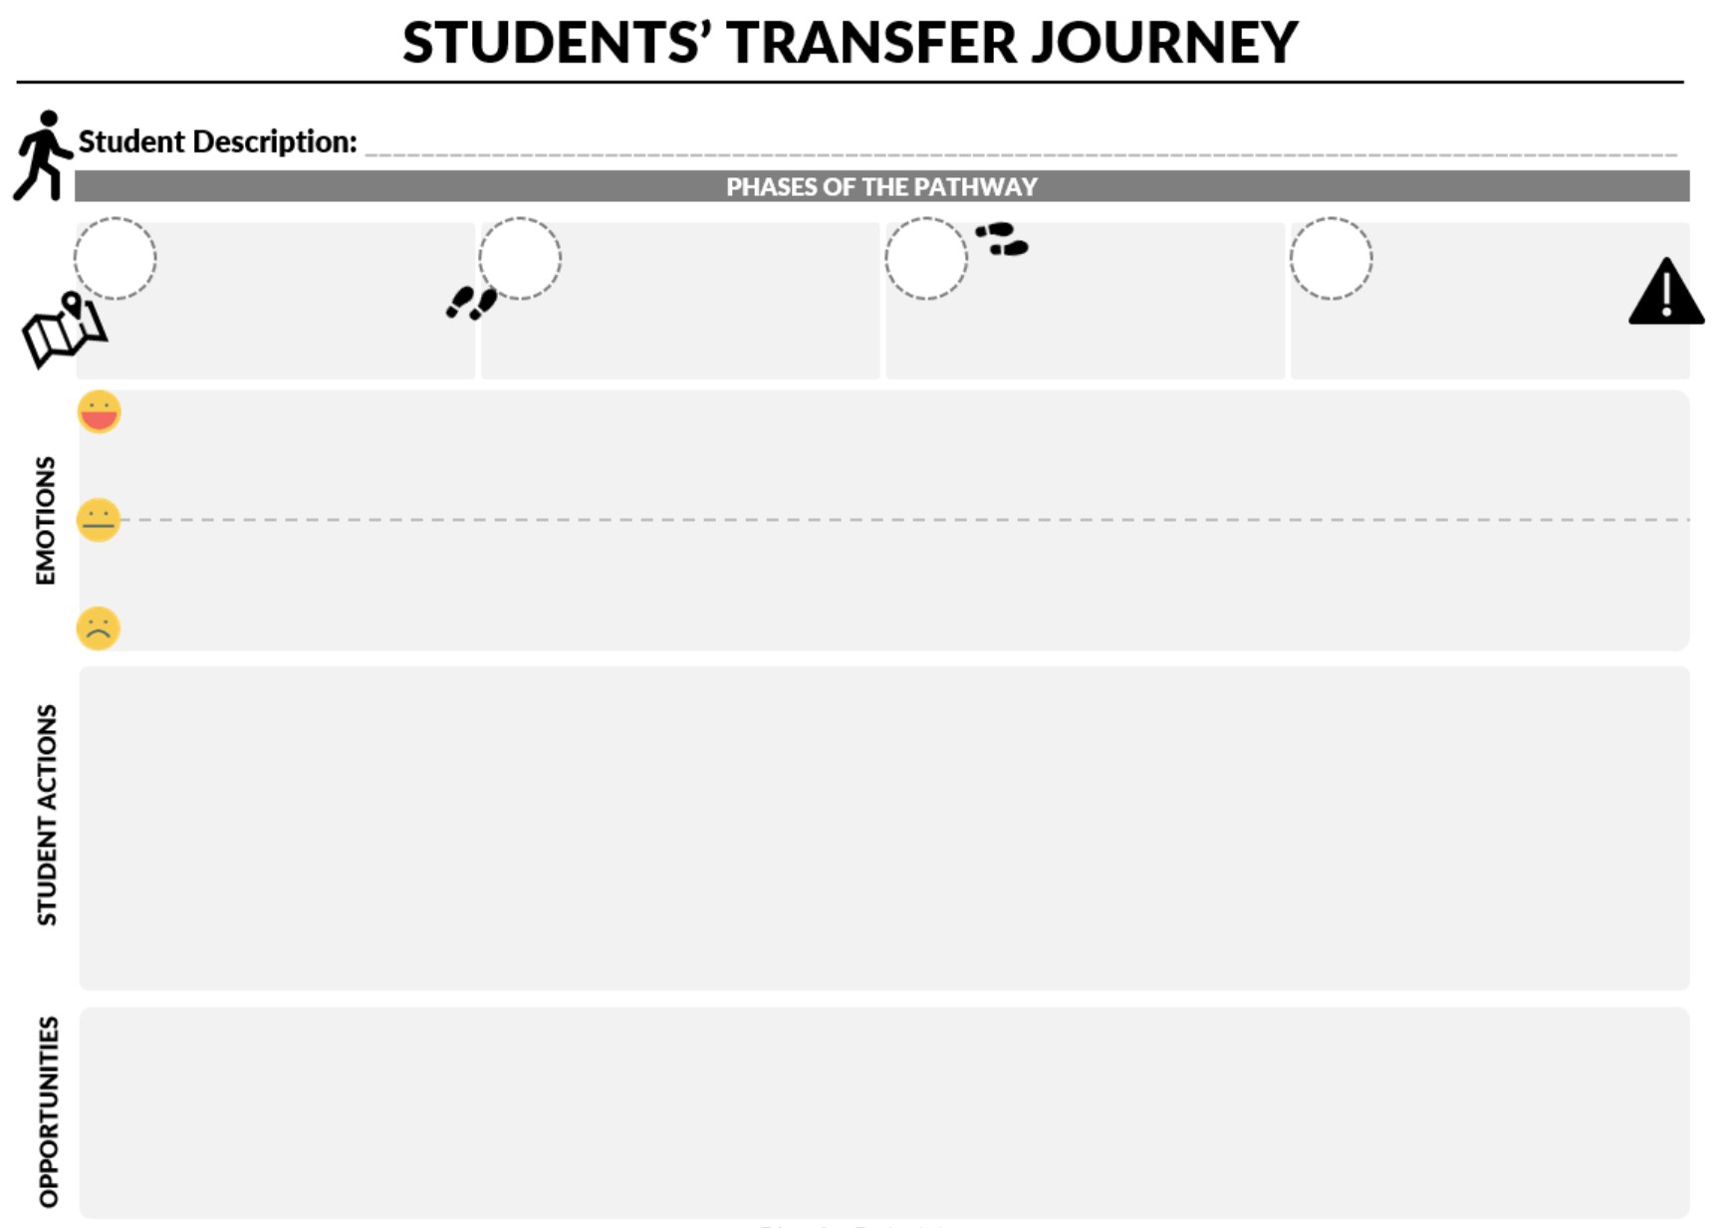
Your Student’s Journey
1
We have briefly described the “typical” pathway milestones when earning a badge
A
learner hears about opportunity
B
C
G
Pre-Test
School Visit
2
Identify Student Actions taken through the Journey (min 2-3 / Milestone)
Notes:
TARA

Slide 47
Your Student’s Journey
For each major Action, identify the Emotional State of your student and use the round “Smiley” sticker, mapping it on your poster.
A
learner hears about opportunity
B
C
G
3
Pre-Test
School Visit
For each major Action, identify the potential opportunities: this could be bringing in other partners, technology, etc.
Asst. w/ Entry Forms
4
Notes:
TARA

Slide 48
Key Considerations

Slide 49
Successes
Challenges
Notes:
CLAIRE

Slide 50
Pathways to Scale

Slide 51
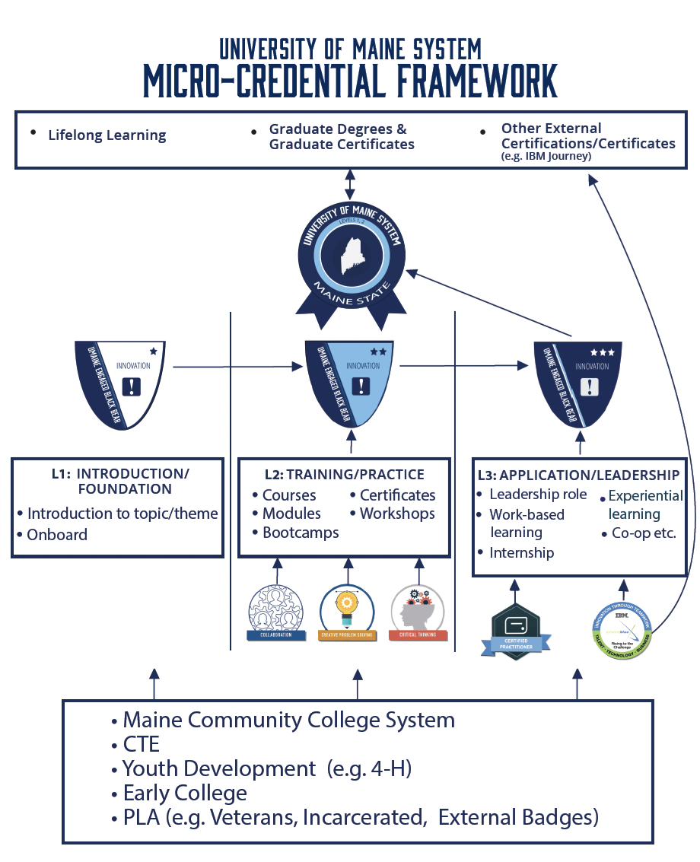

Slide 52
Statewide Initiative: 60% of adults ages 25+ holding a post-secondary credential of value by 2025 (Adopted Maine State Legislature, 2018)

Slide 53
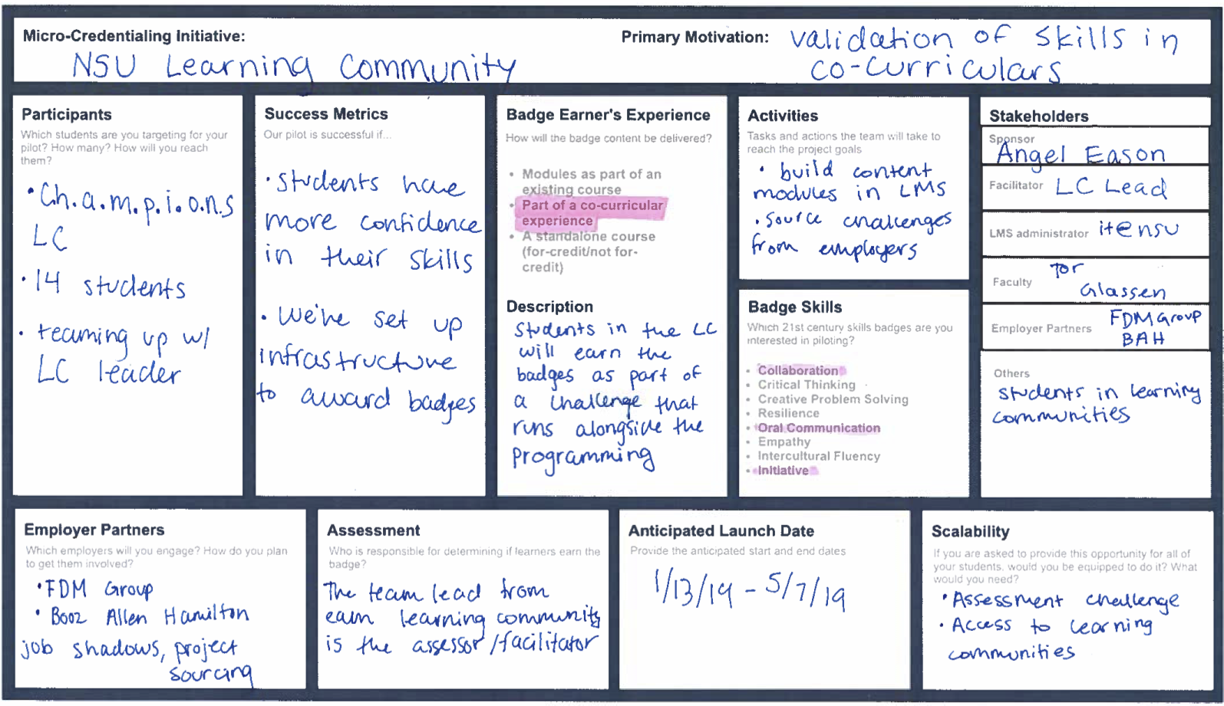
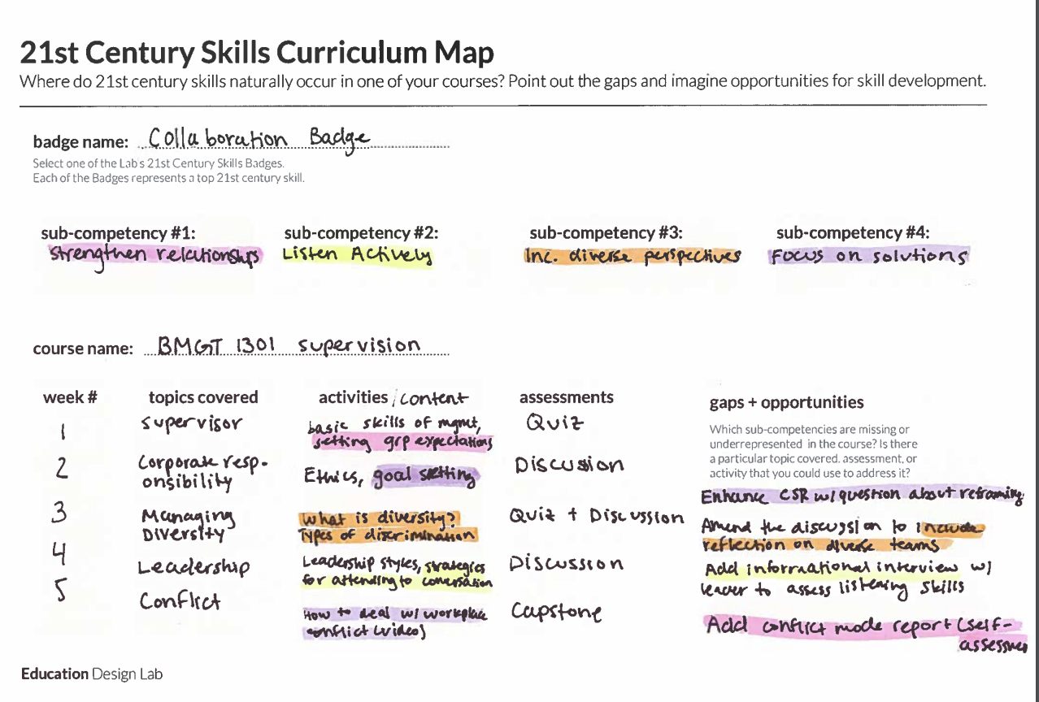
Other Resources
Notes:
TARA

Slide 54
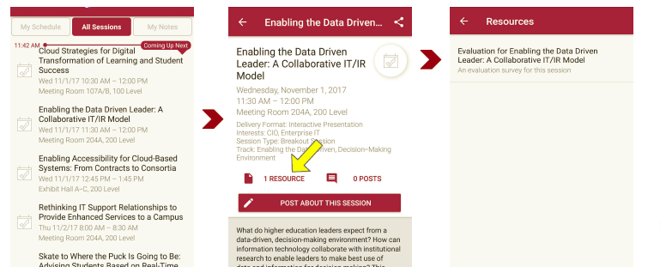
Session Evaluations There are two ways to access the session and presenter evaluations:
1
2
In the online agenda, click on the “Evaluate Session” link
From the mobile app, click on the session you want from the schedule > then scroll down or click on the associated resources > and the evaluation will pop up in the list

Slide 55
Contact Information
Education Design Lab:
microcreds@eddesignlab.org
Claire Sullivan:
claires@maine.edu
NOTE: This presentation leaves copyright of the content to the presenter. Unless otherwise noted in the materials, uploaded content carries the Creative Commons Attribution 4.0 International (CC BY 4.0), which grants usage to the general public, with appropriate credit to the author.

