Slide 1

Positioning IT to Lead Strategic Change
Tom Andriola
VP & CIO
University of California System
CIO, UC Health
Advisor, Calit2, UCSD/UCI
Advisor, CDI2, UC Health
Senior Advisor, IIFH, UC Davis
tom.andriola@ucop.edu
@Andriola_UC

Slide 2
My Career Journey
IT Executive
Intrapreneur/GM
General Manager
Business Transformation Leader
CIO
Practice Leader
Alliances
Consultant
Project Manager
Analyst
2
@Andriola_UC

Slide 3
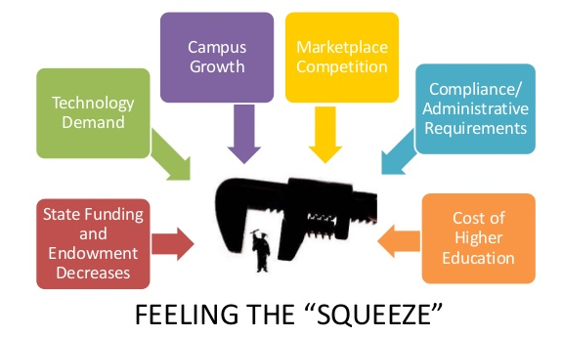
Pressures on Higher Education

Slide 4
Today’s Agenda
The evolving role of IT and the IT leader
“Stop hitting yourself”
Four core competencies all IT leaders must master
(How) are you creating value?
Being relevant
Wrap up: “The Bottom Line”

Slide 5
Evolving Role of the IT Leader
a.k.a., What the heck does a CIO do?
a.k.a., What value does CIO create/contribute to an organization?

Slide 6
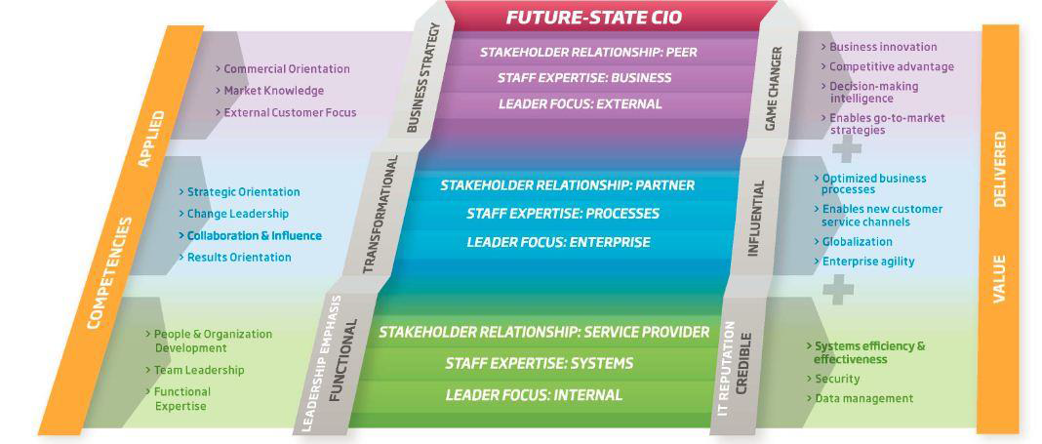
There are so many CIO models out there

Slide 7
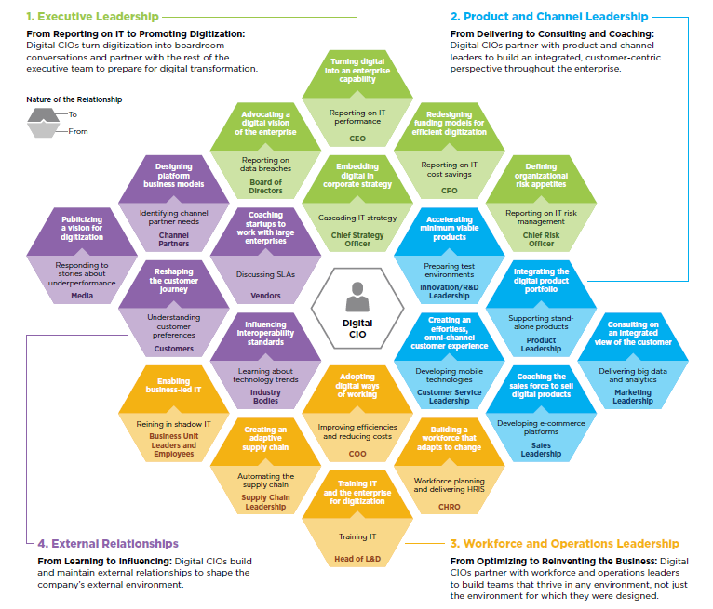
There are so many CIO models out there

Slide 8
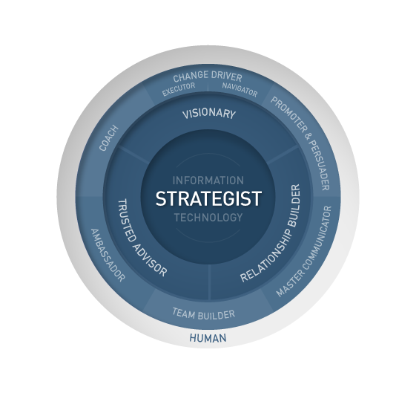
There are so many CIO models out there

Slide 9
TMI

Slide 11
“Stop hitting yourself; stop hitting yourself”
a.k.a., we are our own worst enemy

Slide 12

Hi, I work in IT and I’ll be ready to engage with you as soon as I finish this email that has a whole bunch of jargon in it that you wouldn’t understand

Slide 13




“Hi, we’re with IT: We put the NO in innovation”

Slide 14

“This is what it feels like with the tools we get from you”

Slide 15
Why do we behave this way?

Slide 16
Goldsmith, Marshall (2006)
What Got You Here Won’t Get You There: How Successful People Become Even More Successful

Slide 17
Four Critical Competencies for IT Leaders
  Can you be an effective leader?
  In your environment, can you drive-coordinate-facilitate effective collaboration (completing work across boundaries)?
  Can you help the organization, business unit, department innovate and change (bend the curve)?
  Can you create value for your organization’s mission and goals?
  Are you relevant?

Slide 18
What does it mean to be an “effective leader?”

Slide 19
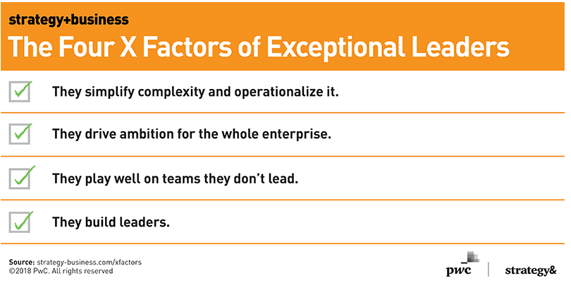
What does it mean to be an “effective leader?”
  “X-factor leaders create a clear worldview — nimble constructs and operational narratives — that everyone buys into. They win by setting the right priorities, building effective teams, and helping the organization step outside its silos to act as one.”

Slide 20
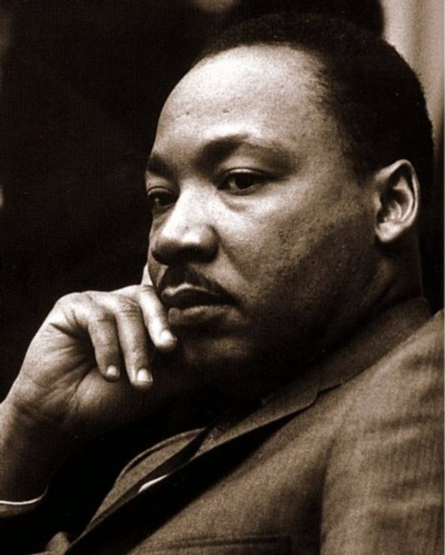
Other great statements on ‘leadership”
Kevin Connelly, CEO Spencer Stuart
Martin Luther King
  “The most effective leaders actively seek out new ideas and contrasting perspectives, challenging their own biases and assumptions, recognizing the need for and build new organizational capabilities and help create a culture that enables today’s increasingly diverse, global workforce to change and adapt to new business priorities”
  “Simply put, leadership is the ability to inspire others to achieve shared objectives, and I think the most important word there by far is ‘inspire,”
  - Jeff Weiner, CEO of LinkedIn
“A genuine leader is not a searcher of consensus but a molder of consensus”

Slide 21
Take your break

Slide 22
Why is collaboration important for our University and our contribution to mission?

Slide 23
Why is collaboration important for our University and our contribution to mission?
  None of us is as smart as all of us
  Speed & agility are metric we should care more about
  There is something inherently satisfying about helping another person
  Collaboration can yield better solutions
  It just seems like the right behavior for our environment

Slide 24
Types of collaboration at our University
Collaboration is both mission-critical and mission-aligned. Universities are open & collaborative environments; sharing is both common and somewhat sensitive.
  Share to give you my perspective
  Share with intent to use & incorporate
  Deliberate approach up front to define, link & synergize activities
“If there is one last lesson I take away from shared services, it is the profound impact they have on culture and leadership style. To work, shared services require a new and different level of trust and interdependency. Our organization is still grappling with those concepts at both local and system-wide levels; they require a new level of dialogue, shared understanding, and commitment.”
- Tom Andriola, in EDUCAUSE Online, August 2014

Slide 25
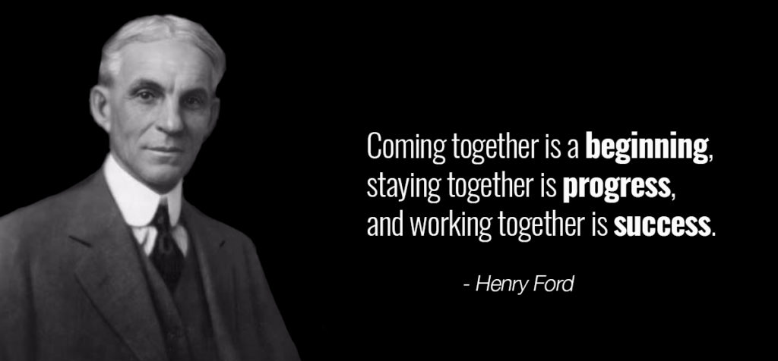
Collaboration

Slide 26

TEAM UC
Together
Everyone
Achieves
More

Slide 27
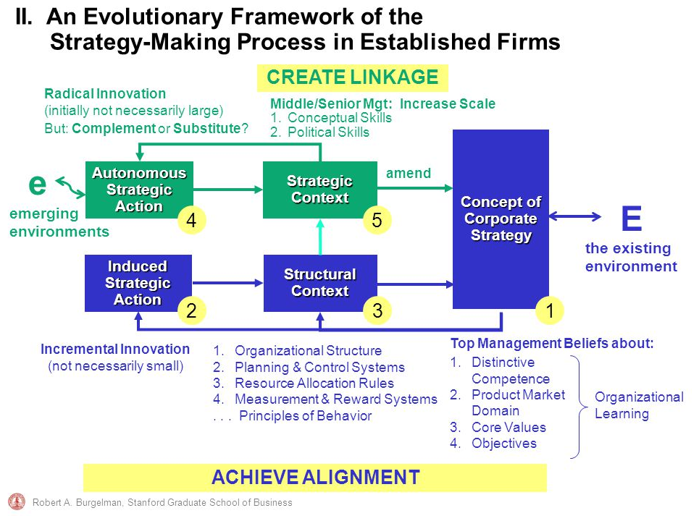
Innovation

Slide 28

Innovation
Product / Service Innovation
Process Innovation
Business Model Innovation

Slide 29
Innovation
Nice to Have
Must Have
Shadow Cost
Hard to Sell Easy to Sell
Product / Service Innovation
Process Innovation
Business Model Innovation
Easy to Copy Hard to Copy

Slide 30
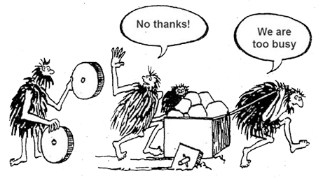
When Collaboration & Innovation both get ignored

Slide 31
Managing Change

Slide 32
Managing Change
Product / Service Innovation
Process Innovation
Business Model Innovation
Implementing technology; lighter change
Managing significant people change
Managing strategic change; multiple levels

Slide 33
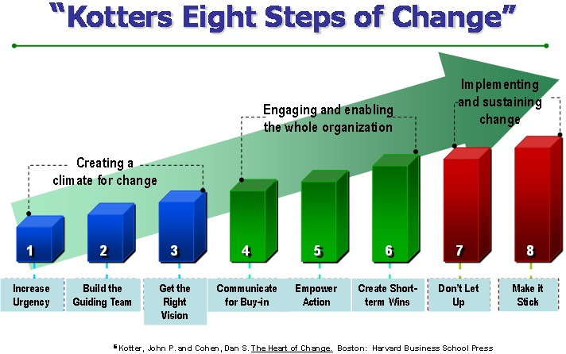

Slide 34
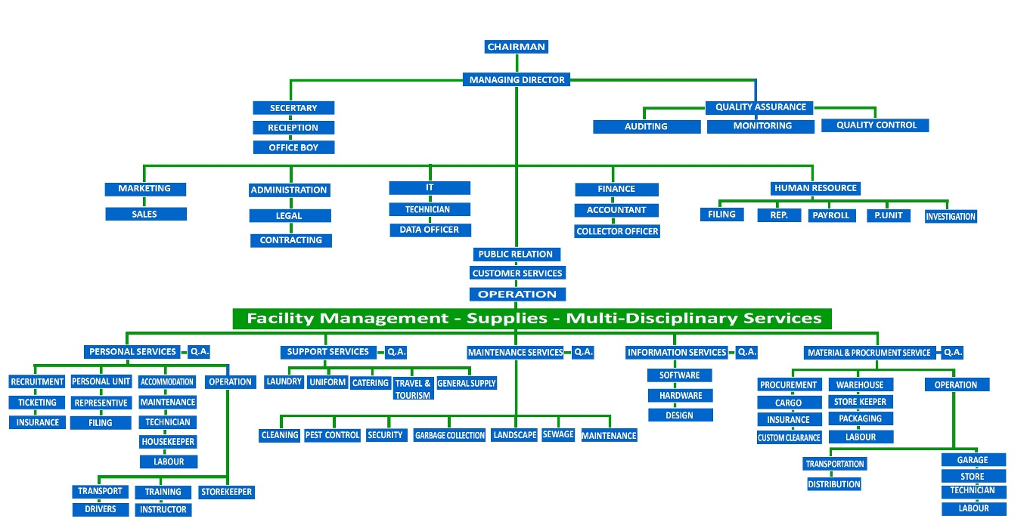

Managing Change

Slide 35
The Trust Equation
Credibility
Reliability
Intimacy
Trust
Self-
Orientation

Slide 36
Elements of the Trust Equation
Credibility | Relevant expertise/experience built from similar and analogous situations Analytical or problem solving (including asking the right questions) Perspective on how to move the process forward |  | Can I help others understand, think through and solve the problems they are facing?
Reliability | Consistency between what is said and body language Consistent and dependable behavior Repeated linking of promise to delivery |  | Do I keep promises (deadlines, appointments, etc.) to others and follow through with action?
Intimacy | Empathy and willingness to talk about difficult agendas Emotional closeness with the issues at hand Ability to go from the professional to the personal agenda where appropriate |  | Am willing to explore the boundaries of emotional intimacy with others?
Self-orientation | Degree of focus on self and own agenda rather than on other Willingness to truly understand the other person Ability to be generous and give and take |  | To what extent is this relationship about me, or about others?

Slide 37
Typical trust profile in IT
Credibility
Reliability
Intimacy
Self-orientation
Weakest
dimension
Strongest dimension

Slide 38
Four Critical Competencies for IT Leaders
(“The bottom line”)
  Can you be an effective leader?
  In your environment, can you drive-coordinate-facilitate effective collaboration (completing work across boundaries)?
  Can you help the organization, business unit, department innovate and change (bend the curve)?
  Can you create value for your organization’s mission and goals?
  Are you relevant?

Slide 39
Creating “value”

Slide 40
Tool: Value Proposition House
For (target customer)
who (statement of customer need)
The (product/service)
Is a (recognized product category)
That (statement of customer benefit).
Unlike (competitive alternative)
Our product (statement of differentiation)

Slide 41
Q: What does it mean to be relevant?

Slide 42
Mistake: Confusing a bigger budget with being strategic
(e.g., $15m increase to my budget for upgrading the data center)

Slide 43
Getting to the retreat doesn’t make you relevant

Slide 44
A few of my strategies to be relevant

Slide 45

A few of my strategies to be relevant

Slide 46
A few of my strategies to be relevant
  What healthcare CEOs is worrying about
  Financial challenges
  Healthcare reform implementation
  Governmental mandates (MACRA)
  Patient safety and quality
  Care for the uninsured/underinsured
  Patient satisfaction
  Physician-hospital relations
  Population health management
  Technology
  Personnel shortages
  Top Provost concerns
  What are the sustainable business models for colleges moving forward?
  What are the right metrics to monitor, and how can I get a clearer understanding of the progress on critical initiatives?
  How do we align the institution around student success by creating accountability for student retention and graduation?
  Making the right investments in next-generation learning

Slide 47

A few of my strategies to be relevant
CEO
A bit
more
focus
here
CIO
A bit
less
focus
here
GLOBAL Comparison between Gartner 2015 CEO and CIO surveys

Slide 48

What Executives Think About IT
Am I spending the right amount on IT?
Am I spending that money on the right IT?
Run the business
Advance the strategic agenda
Notes:
Which question is the most important?
Which question is raised most often in your enterprise?
The second question is more important than the first, because it gets to the issue of strategic outcomes for the enterprise. The first question is about careful management of resources, i.e. about efficiency and waste; the second is about the future of the enterprise, i.e. about strategy. Value in the first question is represented by careful management of cost and wastes; value in the second question is represented by achievement of enterprise goals.
In general, most enterprise IT organizations see more executive interest in the first outcome (spending the “right amount”, which in most cases means the minimum spend necessary to support enterprise operations at a given level of performance), less in the second, possibly because most enterprises lack a coherent strategy, and it’s tough to answer the second question in the absence of a strategy. Because perceived value delivered by IT is closely associated with clarity and coherent execution of strategy, it’s important for CIOs to push hard for both.

Slide 49
Q: How do I make an effective presentation to my top executives?

Slide 50
Q: How do I make an effective presentation to my top executives? (BONUS)
  Enterprise priorities (I know what the game is)
  What IT is contributing to these priorities (IT is playing in that very game)
  What IT is doing to improve its own performance (We know how to play, and we’re working hard to get better)
  Issues that require executive attention (We need to address things that may impede “our” success; “our” = enterprise)
  Thank you. It’s an honor to work with this team.

Slide 51
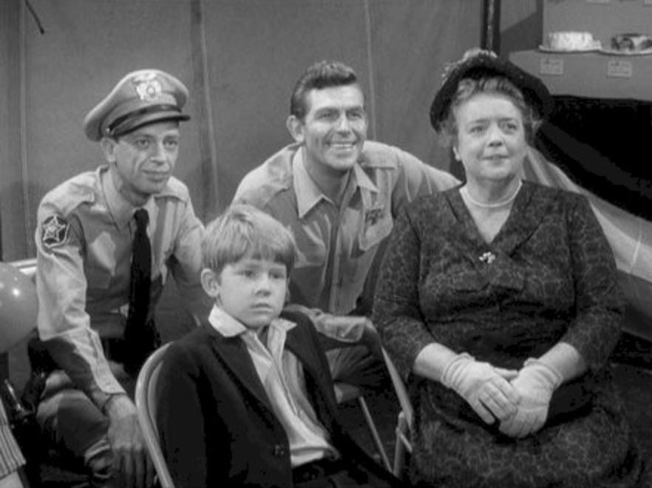

Slide 52


Slide 53
There has never been a time when technology and data has been so relevant and strategic to the success of our institutions

Slide 54
“The bottom line”
  Can you be an effective leader?
  In your environment, can you drive-coordinate-facilitate effective collaboration (completing work across boundaries)?
  Can you help the organization, business unit, department innovate and change (bend the curve)?
  Can you create value for your organization’s mission and goals?
  Are you relevant?

Slide 55
Thank you
Tom Andriola
VP & CIO
University of California System
CIO, UC Health
Advisor, Calit2, UCSD/UCI
Advisor, CDI2, UC Health
Senior Advisor, IIFH, UC Davis
tom.andriola@ucop.edu
@Andriola_UC

Slide 56
UC’s IT Leadership Academy Program

Slide 57
What the heck does a CIO do? (your comments)
Connect the dots
Direct the orchestra
Set the culture & tone (everyone is watching)
Understand the institution’s values & communication them
Remove roadblocks
Professional development
Thought leadership

Slide 58
What value does a CIO create or contribute?
(your comments)
Be the voice of IT
Bridge the gap
Empower staff
Influence the culture
Create vision & alignment
Balance running operations & innovation
Foster collaboration
Be a change agent
Identify internal disconnects & enable new pathways

Slide 59
Why do we “keep hitting ourselves?” (your comments)
Heavy workloads lead to “no”
Protectionary behavior
Burden of understanding complexity
Internal IT culture, e.g., “the ticketing system made me do it”
Saying “yes” to faculty catches up with us

Slide 60
Effective Leaders (your comments)
Help us not just with the what but also the how
Build effective teams
Bridge builders
Help resolve conflict
Are good salespeople
Reflective listeners
Willing to fail, be challenged, be wrong (vulnerable)

Slide 61
Effective Leaders (your comments)
Empathy
Accessibility
Transparency
Motivating & inspiring
Sense of curiosity
Provide “air cover”
Support failing fast
Authenticity
Comfortable with ambiguity

Slide 62
Collaboration (your comments)
Shared value
Faster
More effective & focused efforts (Open . . . Narrow . . . Close)
Sustainability
Generates buy-in, sense of ownership
Learn more about the overall environment
Allow us to see a bigger picture

Slide 63
Creating Value (your comments)
Value is “in the eye of the beholder”
  How are we measuring it?
  How is it aligned to the institution’s goals?
  How is it solving their biggest problems?
  How is it making their life better?
Common mistakes by IT
  We don’t ask the question in the beginning about what value are we creating & for whom?
  We tend to measure the wrong thing – choose for the thing we can measure in IT and not what matters to our stakeholder
  We get to focused on measurement in the form of a number or statistic versus understanding that value many times comes from the heart

Slide 64
Being relevant (your comments)
Invited in
Have something to say
What we say or think is acknowledged
Respected
Able to influence
Add value to what they care about

Slide 65
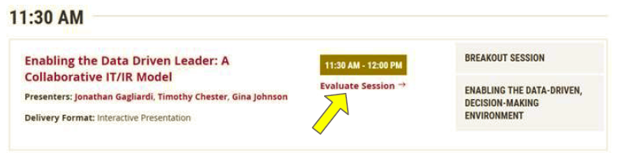
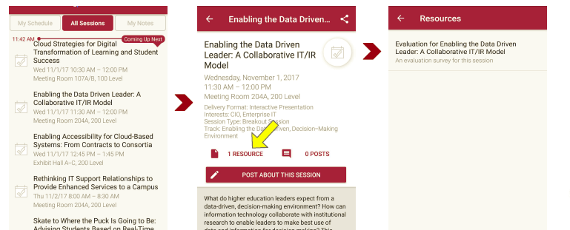
Session Evaluations
There are two ways to access the session and presenter evaluations:
1
2
In the online agenda, click on the “Evaluate Session” link
From the mobile app, click on the session you want from the schedule > then scroll down or click on the associated resources > and the evaluation will pop up in the list

Slide 66
Contact Information
Tom Andriola
VP & CIO
University of California System
CIO, UC Health
Advisor, Calit2, UCSD/UCI
Advisor, CDI2, UC Health
Senior Advisor, IIFH, UC Davis
tom.andriola@ucop.edu
@Andriola_UC
NOTE: This presentation leaves copyright of the content to the presenter. Unless otherwise noted in the materials, uploaded content carries the Creative Commons Attribution 4.0 International (CC BY 4.0), which grants usage to the general public, with appropriate credit to the author.

