Slide 1

What’s the Problem?

Slide 2
Setting
Expectations
level set
Notes:
Opening
Irene
Participants
Setting expectations
Communication and Clarity
9 AM 5 minutes

Slide 3
What we will cover today
Writing
Requirements
Problem
Statements
Root
Cause tools
Customer
needs

Slide 4
Warm-up
prep for the real work
Notes:
20 minutes
9 AM 5 minutes

Slide 5
Identifying the full process & its touch points
A SIPOC map facilitates breaking down processes into manageable segments while keeping the customer front and center for every process step.
Notes:
15 minutes total
9:10 AM 5 minutes

Slide 6
Identifying customer’s needs and wants
Process
Customer
WASTE Tasks
WANTS
Non-VALUE-ADDED Tasks
NEEDS
VALUE-ADDED Tasks
Customer’s perceived value of a product’s Quality, Cost, and all relevant User Experiences
should equal or exceed process costs
© 2015|The Mauch Group LLC
Notes:
9:05 AM 5 minutes

Slide 7
Drill deeper
understand the cause of a problem
Notes:
9 AM 5 minutes

Slide 8
Practicing root cause analysis techniques
A3
5 Why’s
4 Lens
Fishbone diagramming
Questionstorming

Slide 9
Step-up
deliver targeted solutions
Notes:
8 minutes
9 AM 5 minutes

Slide 10
Stating the problem
Concise description of the current condition
Who and what is impacted right now
What is the result of inaction
What is the motivation? moving away from a condition or moving toward
A problem statement is not a narrative
Notes:
8 minutes
9 AM 5 minutes

Slide 11
Constructing requirement statements
Based on 3 level questioning
Based on a need assessment
Notes:
8 minutes
9 AM 5 minutes

Slide 12
Cool down
summarize the experience
Notes:
9 AM 5 minutes

Slide 13
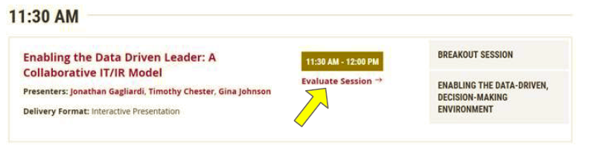
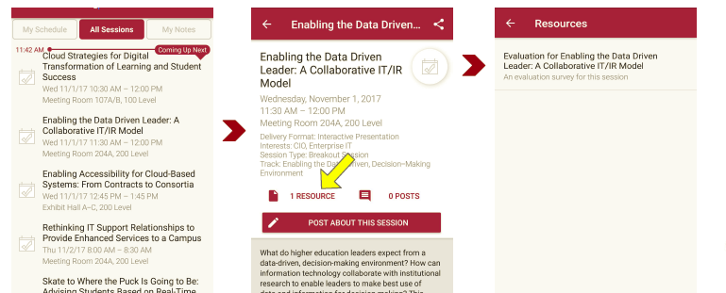
There are two ways to access the session and presenter evaluations:
Session evaluation
1
2
In the online agenda, click on the “Evaluate Session” link
From the mobile app, click on the session you want from the schedule > then scroll down or click on the associated resources > and the evaluation will pop up in the list

Slide 14
Thank you
a resource to help as you define “What’s the problem?”
Irene Mauch: irene@mauchgroup.com
NOTE: This presentation leaves copyright of the content to the presenter. Unless otherwise noted in the materials, uploaded content carries the Creative Commons Attribution 4.0 International (CC BY 4.0), which grants usage to the general public, with appropriate credit to the author.
Notes:
9:30 AM

