Slide 1
Creating a Digitally Accessible Campus: The Illinois Experience
Lawrence Angrave
Jon Gunderson
Tim Offenstein
Marc Thompson

Slide 2
Agenda
The Experience of Disability
How Universal Design Benefits Everyone
- Break -
Campus Policy Development and Implementation
Standards and Open Source Tools
- Break -
Course Design and Training
Next Steps Activity
Resources

Slide 3
The Experience of Disability
Jon Gunderson

Slide 4
The Illinois Experience of Disability Inclusion
Link to slides on the Illinois Experience of Disability Inclusion

Slide 5
How Universal Design Benefits Everyone
Marc Thompson, Lawrence Angrave

Slide 6
An Inclusive Framework: Universal Design for Learning (UDL)

Slide 7
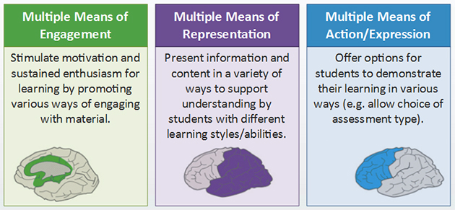
Universal Design for Learning (UDL)
Engagement → Why we learn
Representation → What we learn
Action & Expression → How we learn
Notes:
To summarize quickly, UDL provides three major principles based on specific brain networks and inclusive learning considerations that govern what, how, and why we learn. The three principles are provide multiple means of representation, the first principle focused on what we learn; provide multiple means of action and expression, the second principle focused on how we learn; and provide multiple means of engagement, the third principle focused on why we learn. Let’s take a quick look at each of these three UDL principles and some examples of how they can be implemented in instruction. Many of the examples provided are from the CAST Center for Applied Special Technology.

Slide 8
Multiple Means of Representation
Offer ways of customizing the display of information
Offer alternatives for auditory information
Offer alternatives for visual information
Notes:
In providing multiple means of representation, we offer inclusive learning opportunities by giving learners ways of customizing the way their information is displayed: for example, when we allow learners to control the playback or playback speed of video or the size of text and other visual content. In offering alternatives for auditory information, we can provide text equivalents using captions; and diagrams, charts, or notation with music or sound. For visual information, we can offer alternative text or spoken descriptions for images, animations, and video. These are just a few examples of how we can create a more inclusive learning experience by providing multiple means of representation.

Slide 9
Multiple Means of Action & Expression
Illustrate through multiple media
Clarify vocabulary, syntax and structure
Support decoding text, mathematical notation, and symbols
Promote understanding across languages
Notes:
In providing multiple means of action and expression, we offer inclusive learning opportunities by giving learners different ways of constructing knowledge and expressing what they learn. Some examples include facilitating learning by providing clear explanations for key terms and symbols, connecting new concepts and ideas with learners’ prior knowledge and experience, providing digital text notation like MathML so that math expressions can be rendered audibly, or through Braille in tactile form. Other examples include providing captioning for students who are deaf, which also benefits students for whom English is a second language, as well as some students with learning disabilities. Providing multiple means of expression might involve creating an assignment that allows students to choose one of several ways of demonstrating their learning. For example, an assignment focused on public health campaigns, might invite students to write an essay, or create an infographic, or a video presentation to fulfill the learning objectives of the assignment.

Slide 10
Multiple Means of Engagement
Activate or supply background knowledge
Highlight patterns, major ideas, and relationships
Guide information processing, visualization, and manipulation
Maximize transfer and generalization
Notes:
In providing multiple means of engagement, we offer inclusive learning through different ways of stimulating students’ interests and motivation for learning. Some examples include chunking content into smaller units that facilitate practice and review, and providing low stakes, repeatable learning checks to help reinforce key concepts and ideas during the learning process. Another example of engagement involves activating students’ prior knowledge early in a lesson by inviting them to relate a concept or topic to current events, their personal experience, or to another concept or topic they learned about previously in the course. For larger projects, you can provide multi-stage assignments that allow students to build on their accumulated learning in the course. Yet another means of engagement involves providing opportunities for collaborative student work. This might include activities like role playing, case studies, debates, or group presentations, or leveraging tools like wikis or social media to facilitate collaborative authoring. Overall, providing multiple means of engagement is all about optimizing the learning experience of students through a variety of delivery methods and assessment strategies that guide and stimulate learning in multiple ways.

Slide 11
Summary - UDL
All students benefit from design practices that:
Provide full access to content
Enable different abilities and learning styles
Allow compatibility with a wide range of technologies
Notes:
By adopting universal design principles for learning, you improve the academic experience and make the learning environment and instructional materials more accessible and usable to all students, including students with disabilities. By following UDL principles you ensure that learning content is accessible for a wide range of students with different abilities and learning styles. UDL will also make learning content compatible with a wider range of technologies and allow people to view and interact with content in ways that are best suited to their individual learning strategies. Ultimately, all students benefit from having full access to content and being able to interact with it effectively, regardless of how they access the learning material or what their individual abilities are.

Slide 12
MS Office Features for Accessible Authoring

Slide 13
Accessible Authoring Basics
Styles in MS Word
Slide Layout templates in PowerPoint
Selection Pane for Reading Order in PowerPoint
Accessibility Checker

Slide 14
New MS Office Automated Tools
Proactive Real-time Accessibility Checker
Automatic AI-generated alt-text for images in Word & PowerPoint
Learning Tools Add-in for Dyslexia
PowerPoint Presentation Translator
Outlook MailTip pre-emptively checks mail content for accessibility
See Microsoft’s Digital Accessibility at Universities for more information
Notes:
https://www.microsoft.com/en-us/microsoft-365/blog/2018/05/16/reimagine-accessibility-and-foster-inclusion-in-the-modern-workplace/
https://www.microsoft.com/en-us/microsoft-365/blog/wp-content/uploads/sites/2/2016/12/New-to-Office-365-in-December-2-2.png
https://www.microsoft.com/en-us/garage/profiles/presentation-translator/
Live subtitling: Speak in any of the 10 supported speech languages – Arabic, Chinese (Mandarin), English, French, German, Italian, Japanese, Portuguese, Russian and Spanish – and subtitle into any one of the 60+ text translation languages.

Slide 15
Accessibility Checker: Recommended Actions

Slide 16
MS MailTip in Action
Notes:
https://www.microsoft.com/en-us/microsoft-365/blog/wp-content/uploads/sites/2/2016/12/Whats-new-December-2.gif

Slide 17
eText@Illinois A New Reading Experience
Fully Accessible Content
Multimodal
Interactive

Slide 18
Video Clip: eText Accessibility
Notes:
https://etext.illinois.edu/
1:45 - 4:00 (2 mins. 15 secs)

Slide 19
eText: Accessible Reading Features
HyperFocus Mode
ReadAloud Mode with Synchronous Text Highlighting
OpenDyslexic Font Option
Adjustable letter and line spacing

Slide 20
HyperFocus with ReadAloud

Slide 21
Reader Settings

Slide 22
eText: Video Highlights
HTML5 Player
Captioning
Editable Automatic Speech Recognition (ASR)
Accessible Player Controls

Slide 23
eText: Additional Features
All events based on keyboard focus, rather than mouse clicks
Image Enlargement with Focus Enhancement
SVG Math Images with LaTex to alt text via EquatIO
2013 Commendation from National Federation of the Blind

Slide 24
ClassTranscribe at Illinois

Slide 25
ClassTranscribe
Analytics: Research & encourage successful student learning behaviors
Accessible
Searchable lectures
Useful Transcriptions and Captioning
Translations

Slide 26
History
2015 Crowd-sourced prototype
2018 v1 Automated Transcriptions
2019/1 Multiple courses Learning analytics
2019/9 v2 Admin & instructor UI Translations Scalable

Slide 27
Software

Slide 28
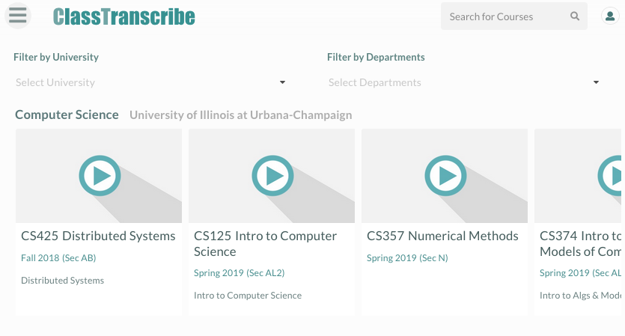
Course Select

Slide 29
Multi-stream Video

Slide 30
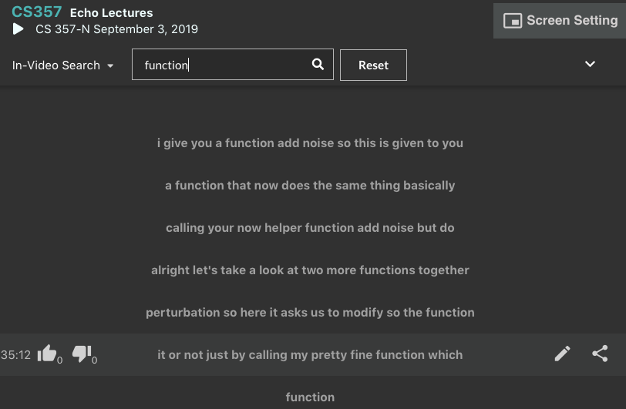
In-video Search

Slide 31
Learning Outcomes

Slide 32
ClassTranscribe Learning Outcomes
SP19 CS241, N=271 students
ClassTranscribe searchable videos
No in-person lectures
All previous semesters : MWF lectures – also on echo360.com

Slide 33
Events

Slide 34
Universal Design for Learning
Multiple pathways for success

Slide 35
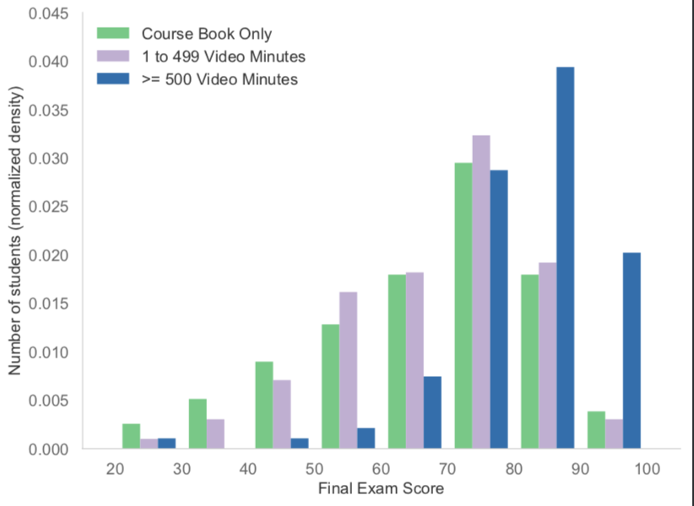
Exam scores

Slide 36
Who benefits? 1 of 2
"The prevalence of significant hearing impairment at speech frequencies in the U.S. for adults aged 20-29 is 2.2% ​[11]​. In a recent study ​[12]​ at the University of Wisconsin, only 26.2% of students who reported a disability in the survey disclosed their disability to the University. Recognizing the limitation that the reported fraction of unreported disabilities is for all disabilities, out of a typical class of 200 students, there will be an expected average of three students with non-disclosed hearing impairments. "

Slide 37
Who benefits? 2 of 2
Consider class quartiles by course score excluding final exam
Does use of CT affect learning?

Slide 38
Previous Semesters
Statistic | 2015 N=195 | 2016 N=325 | 2018 N=247 | 2019 N=271
Q1 | 60.1 | 58.7 | 60.0 | 63.6
Q2 | 68.1 | 69.6 | 71.1 | 72.7
Q3 | 76.6 | 78.3 | 80.0 | 83.3
Q4 | 16.5 | 19.6 | 20.0 | 19.7

Slide 39
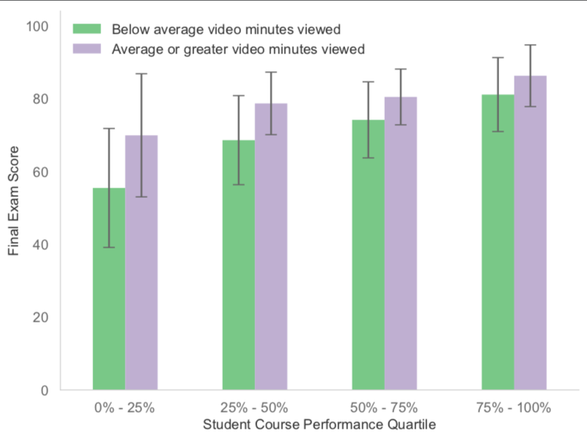
Video Minutes

Slide 40
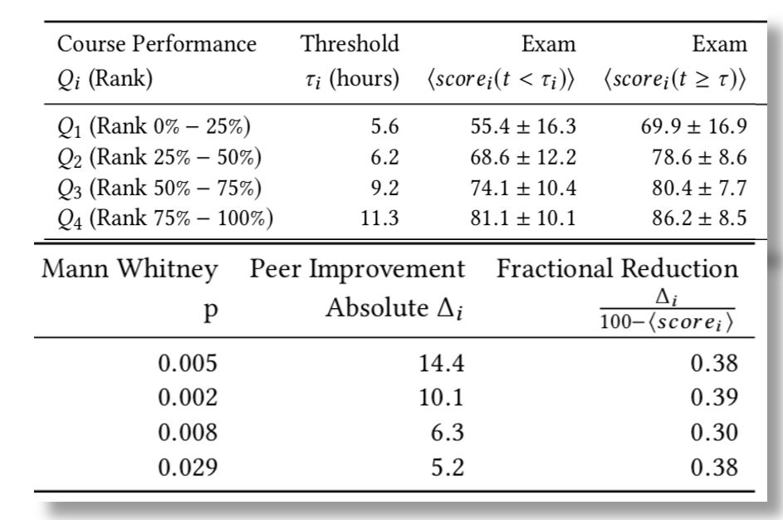
Course Performance

Slide 41
Implications?
Data point: effective learning course design & delivery in University courses and use of lecture space resources?
New class of competency models

Slide 42
Interest
ClassTranscribe for your courses?
email: classtranscribe@Illinois.edu

Slide 43
Campus Policy Development and Implementation at Illinois
Tim Offenstein

Slide 44
Campus Policy Development and Implementation
April 2017 – Official Office of Civil Rights complaint letter
No policy in place
Disconnected accessibility efforts
Vulnerable
Dodged the bullet, others not so lucky.

Slide 45
Campus Policy Development
Effort began in 2014
Multiple leadership changes
OCR complaint woke things up
October 2018 – Official policy inducted into Campus Administrative Manual

Slide 46
Policy Goals
Many policies lost in obscurity
A policy with teeth
Backed by Chancellor Jones and Vice Chancellor
A policy that solves problems (resources)
A flexible policy that stays current
A policy with an implementation component

Slide 47
Implementation Plan
Policy provides high level overview
Implementation Plan deals with:
Changing standards
Changing campus environment
Encourage Best practices
Formation of an empowered committee
Exception process review
Champion for campus efforts
Creation of IT Accessibility Liaisons (ITAL)

Slide 48
Changing Landscape
2017/2018 – Section 508 Refresh
Illinois Information Technology Accessibility Act (IITAA) harmonizes with 508
VPAT 2.0
June 2018 – WCAG 2.1
August 2019 - WAI-ARIA 1.1
Lawsuits triple in 2018/19

Slide 49
Outreach
Participation with the Big Ten Academic Association (BTAA)
IT Accessibility Group
BTAA CIO collaboration
Hiring new ADA Director
Hiring new ADA Technology Director
Hiring new Coordinator of Education, Training and Outreach

Slide 50
Standards and Open Source
Jon Gunderson

Slide 51
Web Accessibility Standards and Open Source Tools
Link to slide on Web Accessibility Standards and Open Source Tools

Slide 52
Course Design and Training
Marc Thompson, Lawrence Angrave, Jon Gunderson, Tim Offenstein

Slide 53
Overview: Course Design & Training
Fundamental Design Considerations
Onboarding Training for Instructional Designers
Faculty Training for DIY Online Courses
Compliance Checking for Online Courses

Slide 54
Fundamental Design Considerations
Headings, lists, tables to organize information
Color contrast considerations
Alt text for informational graphics
Captioning for all video content
Font, line spacing for readability
Keyboard navigability within the LMS
Electronic Documents & Third-Party Content
Course templates

Slide 55
Onboarding
Audience: New Instructional Design Staff (Instructional Designers, Quality Control Specialists, Student workers)
More internal staff exposed to accessibility issues in course design
Diffusion of knowledge
Reduce "bus factor" and individual workload
Challenge keeping staff exposed to accessibility projects

Slide 56
Faculty Training
Audience: Instructors and eLearning professionals
Increased awareness of accessibility among many stakeholders
Trainees become trainers to other staff
Discipline-specific: content samples to better target workshop to faculty needs

Slide 57
Compliance Checking
Audience: Instructors developing online courses without full CITL instructional design support
Fewer overall accessibility issues in courses
More satisfied students with variety of needs
Increased faculty awareness of accessibility

Slide 58
Microsoft Lighthouse Fellowship Program (Lawrence)
Focus on actions to improving digital accessibility across all departments
2 Graduate Fellows
Interdisciplinary Steering Committee
Created Faculty Awareness Survey
2-5 minute "mini-presentations“
Assist with ClassTranscribe development

Slide 59
Badging Program (Jon)

Slide 60
Information Accessibility Design & Policy (IADP) (Tim)
3 eight-week courses comprising
Accessible Word/PowerPoint
Universal Design
Disability education
Evaluation procedures
Accessible HTML/CSS
Usability
ARIA
Professional Certification
http://iadp.ahs.illinois.edu/

Slide 61
IAAP Certification
IADP is excellent preparation for IAAP
3 levels of certification
The IAAP Certified Professional in Accessibility Core Competencies (CPACC)
The IAAP Web Accessibility Specialist (WAS)
Certified Professional in Web Accessibility (CPWA)
Proctored exams available
Preparation materials very helpful
www.accessibilityassociation.org/certification

Slide 62
ITAL Liaison Program, 1 of 2
Important component of EIT Accessibility Policy
3 Goals
Honor and recognize accessibility work that’s already being done,
Equip our staff through training, networking and community building,
Scale our accessibility outreach by providing a knowledgeable person(s) within each campus unit.

Slide 63
ITAL Liaison Program, 2 of 2
Inaugural year
70 liaisons, 35 units, 10% coverage
Hiring dedicated staff to grow and oversee the program
Technical/non-technical/managerial roster
Monthly meetings, homework
Subject matter experts, guest speakers
https://itaccessibility.illinois.edu/accessibility-liaisons

Slide 64
Next Steps Activity
Jon Gunderson

Slide 65
Next Steps Instructions
Break up into small groups
Discuss priorities for your campus next steps on IT accessibility
Identify 3 priorities to share from your group
Connecting with other people at the workshop

Slide 66
Resources
Resources from Digitally Accessible Campus Pre-Conference Workshop

