Slide 1
5G and Beyond: 5 Considerations for Next-Gen Wireless Networks Oct 13,2019

Slide 2
5 Considerations for Next-Gen Wireless Networks:
1 Universities and the demand
2 User behavior driving demand
3 5G Drivers
4 Near-term 5G technologies
5 Infrastructure options to support 5G
6 Other considerations and technologies

Slide 3
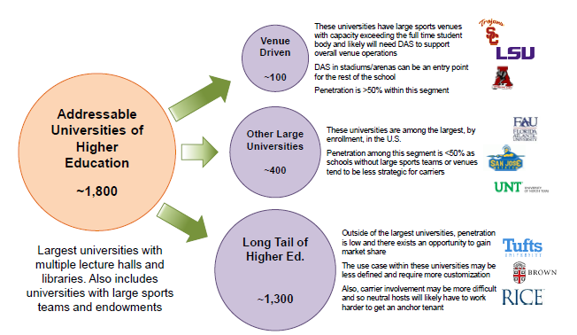

Slide 5
University of Iowa: Kinnick Stadium

Slide 6
User Behavior Driving The Demand

Slide 7
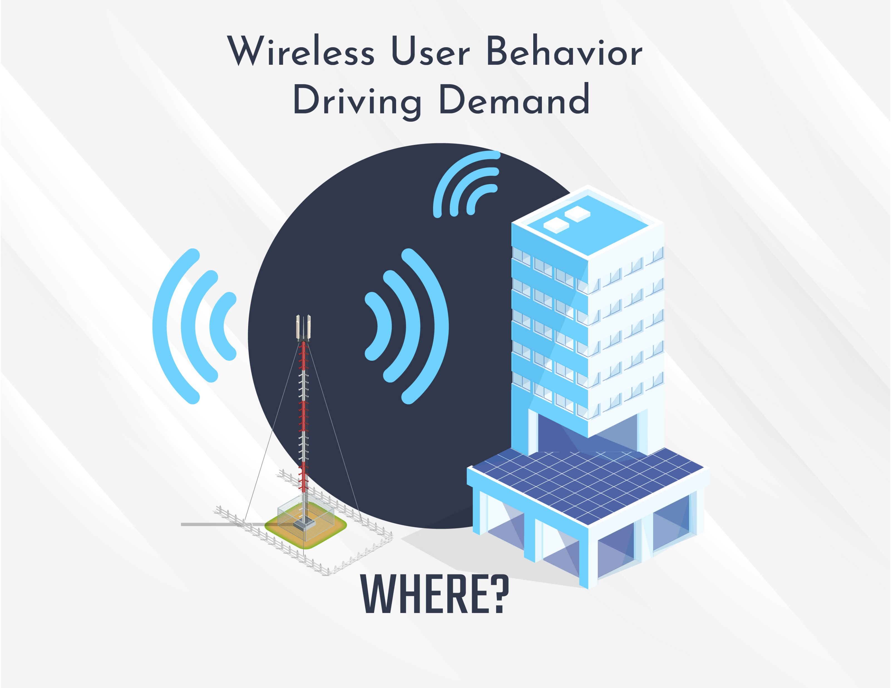
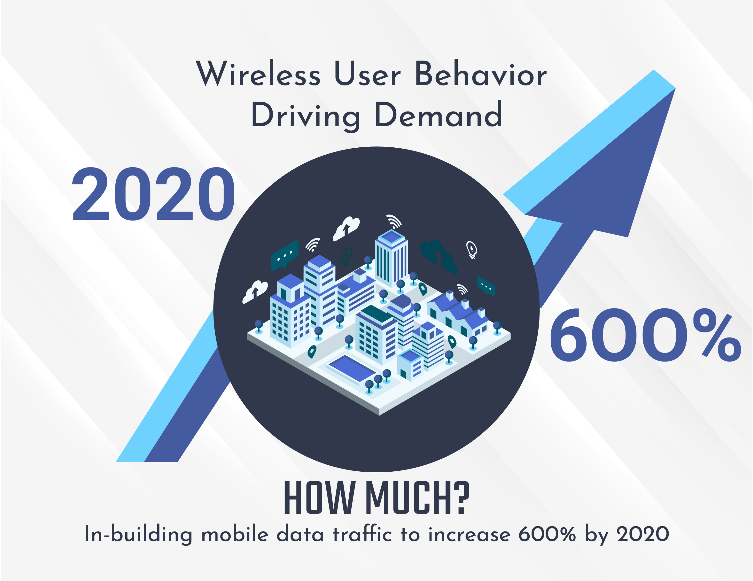
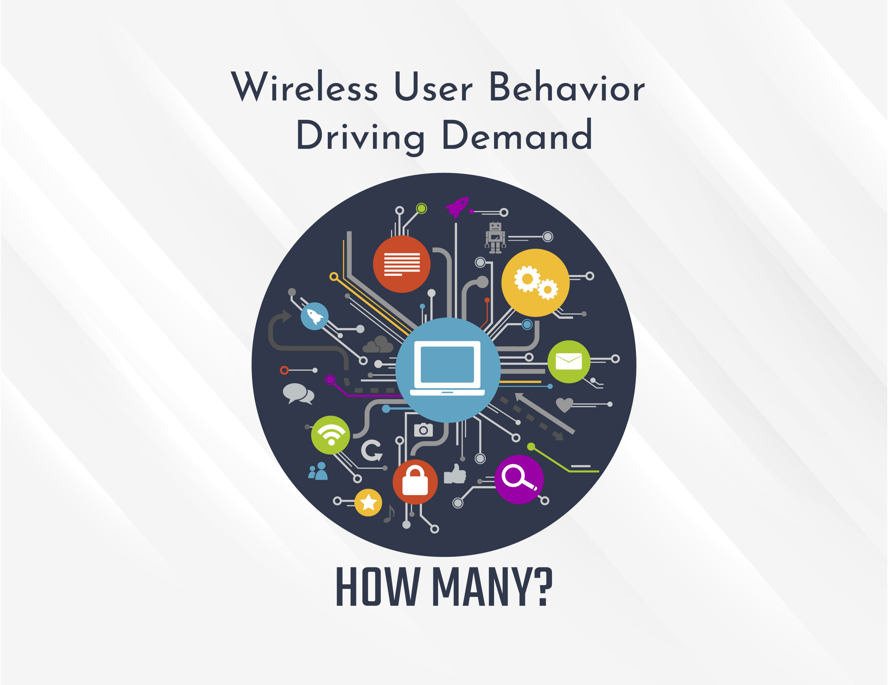
Notes:
Perhaps the stats that roughly 80% of the commercial buildings in US suffer from lack of coverage, capacity, or both

Slide 8
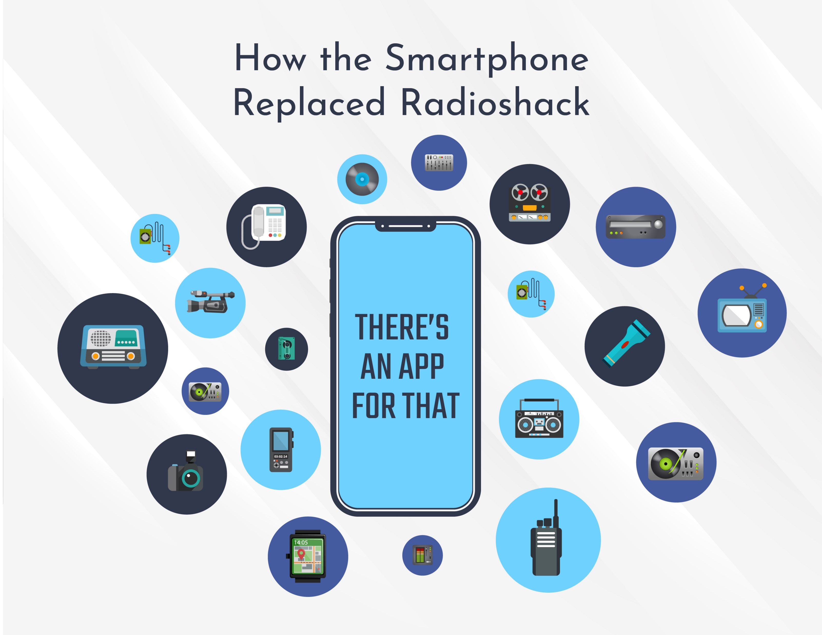

Slide 9
5G Drivers

Slide 11
Near-Term 5G Technologies

Slide 12
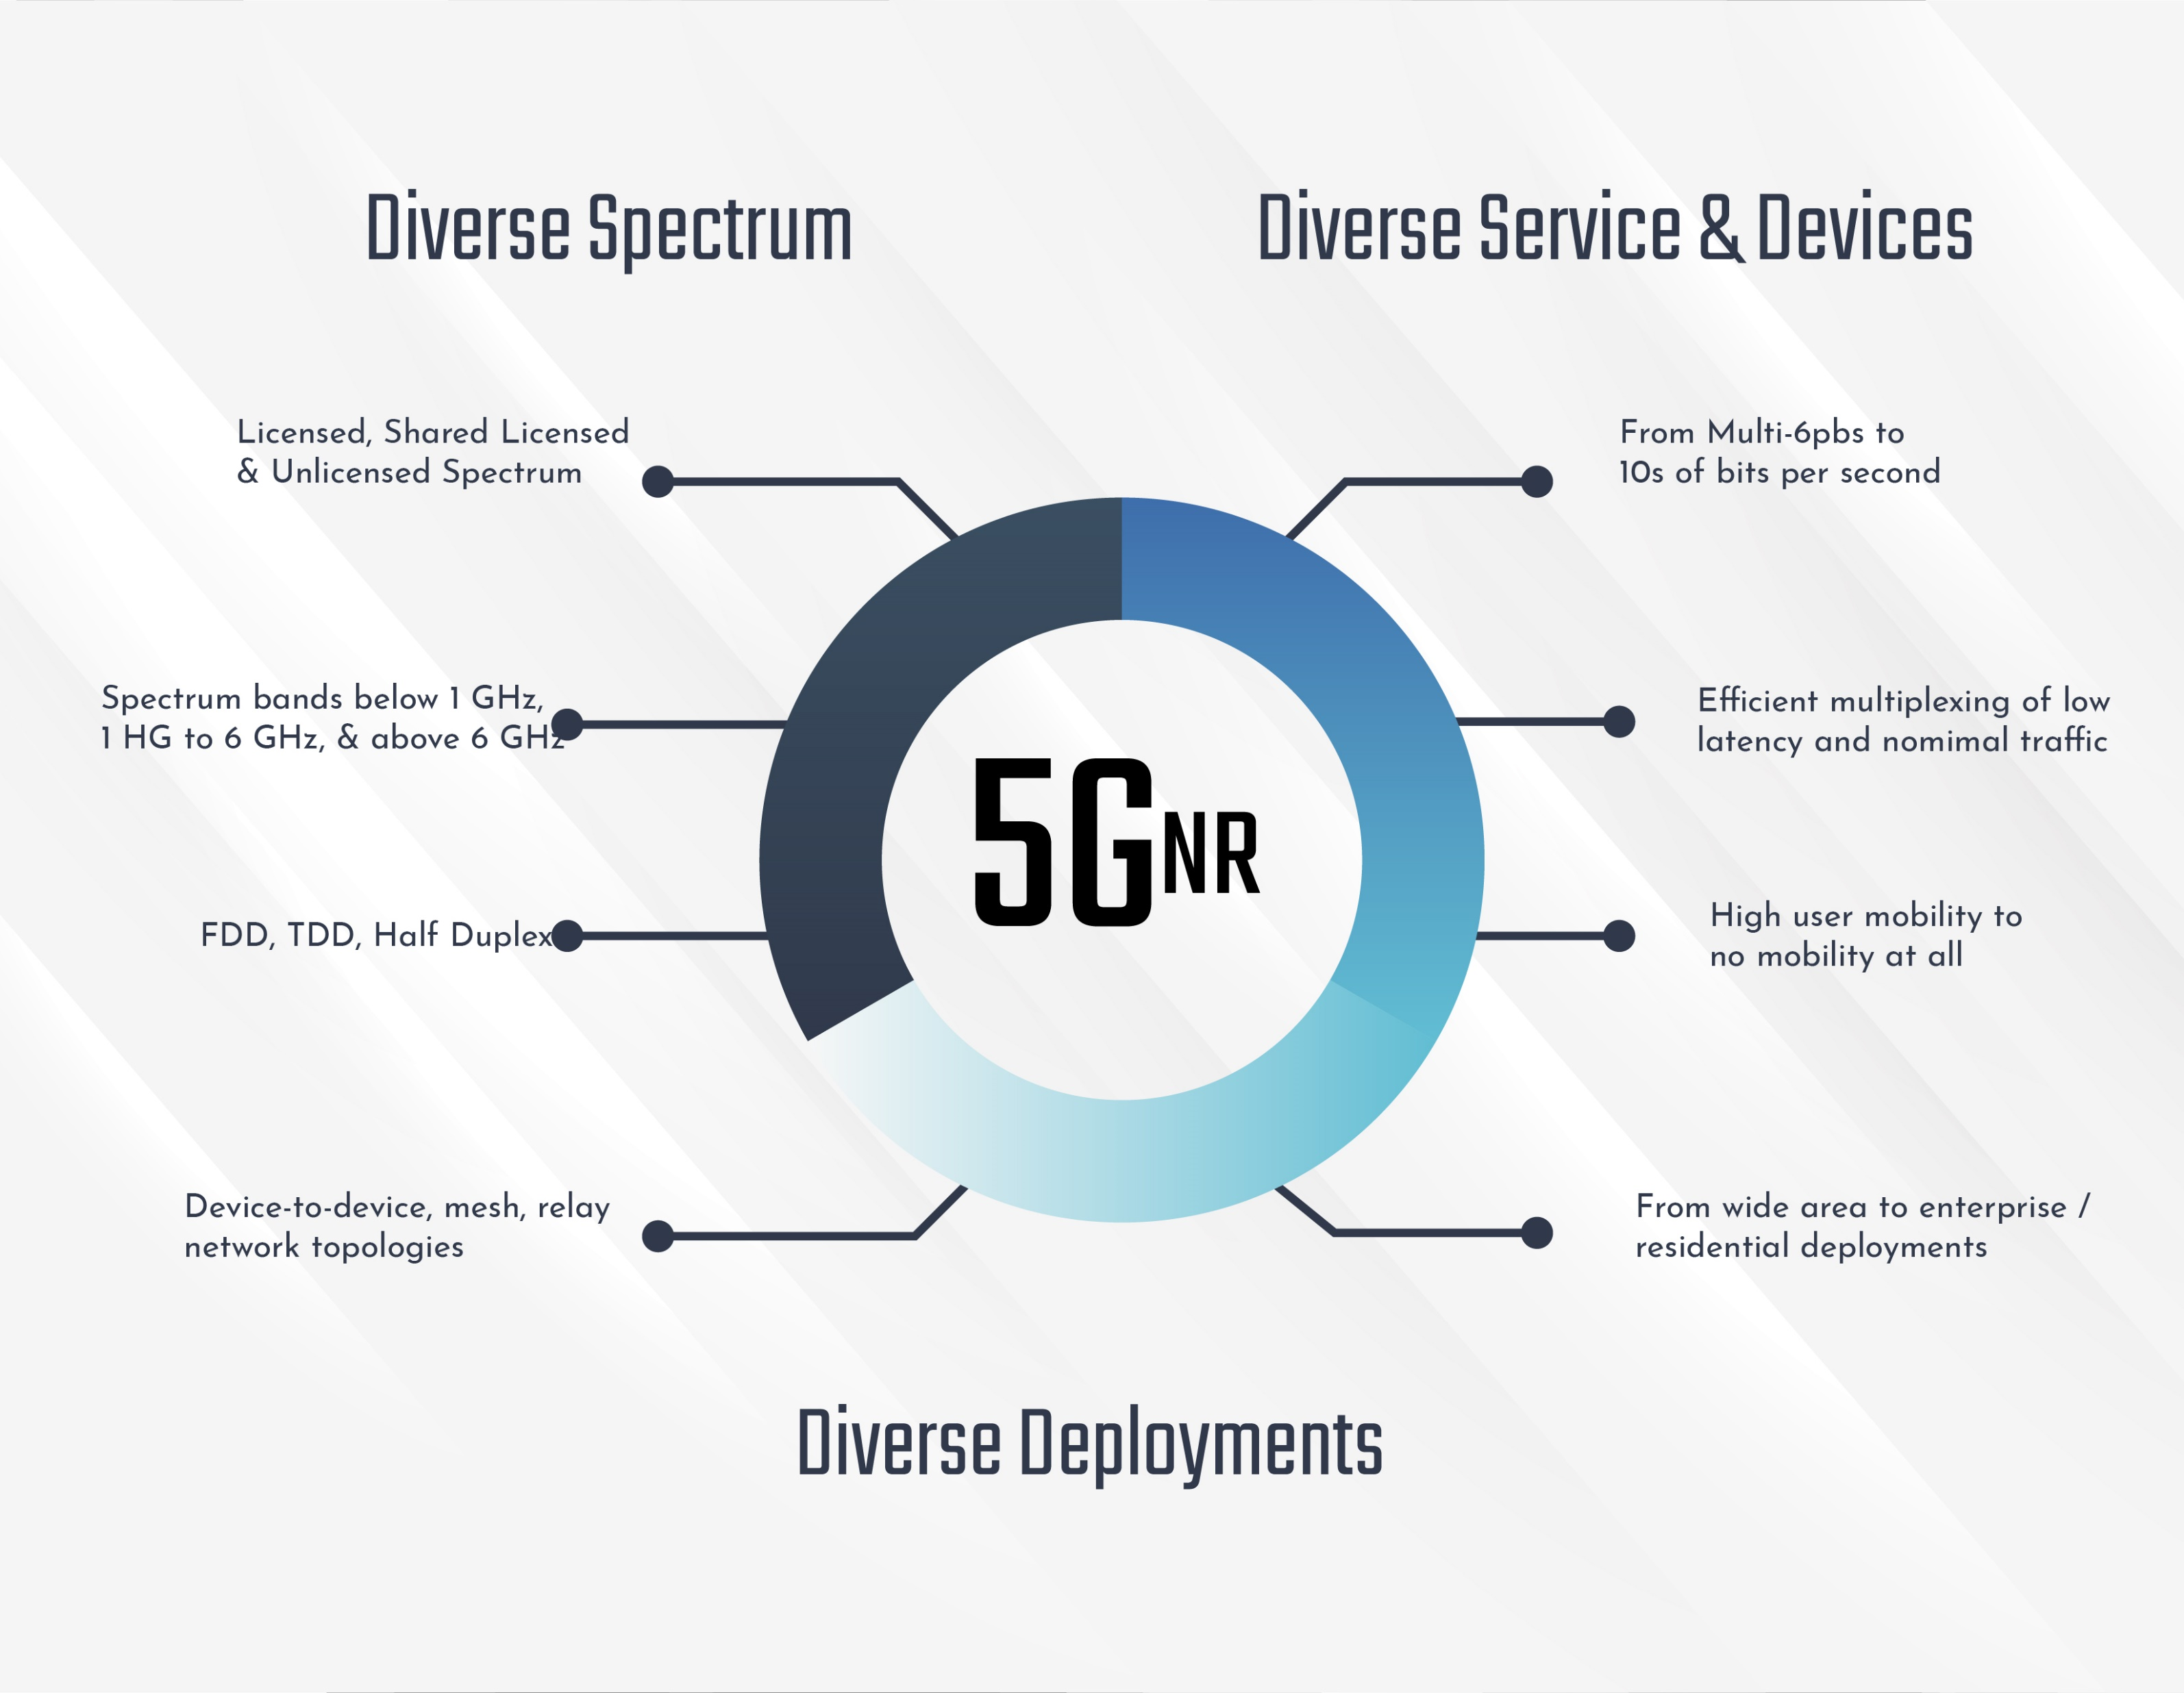
Operates in licensed and shared licensed & unlicensed spectrum
Multi-6pbs to 10s of bits per second
Wide frequency range (Sub-6 GHz and above 6 GHz)
Provides optimal multiplexing for low latency and nominal traffic
5GNR (new radios)
D-RAN
Beamforming
Supports FDD, TDD, and Half Duplex technologies
Efficient support for high user traffic, as well as low user traffic
Flexible network topologies
Ideal for enterprises as well as residential deployments

Slide 13
Infrastructure Options to Support 5G

Slide 14
Usability of current coaxial and fiber DAS architectures
Cat-5E and Cat-6 not sufficient: Cat-6A is minimum
4x4 MIMO
Fiber to the “X”
The fiber backhaul challenge

Slide 15
Other Considerations &Technologies

Slide 16
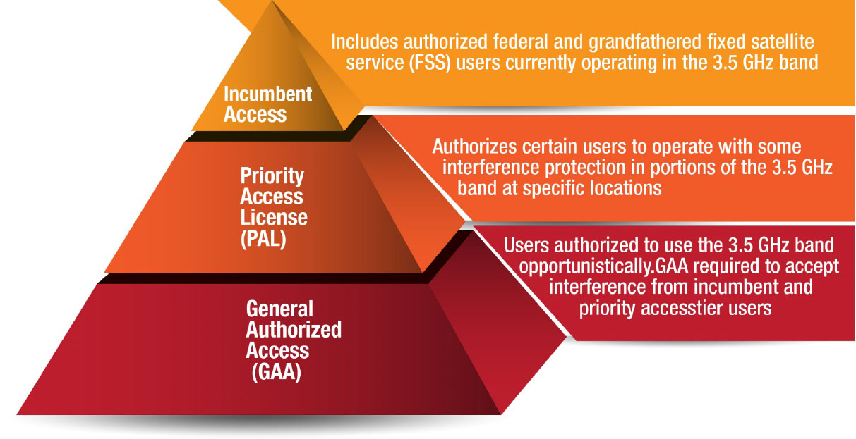
Incumbent users
PAL (Priority Access License)
GAA (General Authorized Access

Slide 17
LTE-based technology solely in unlicensed spectrum
Targets small-cells in unlicensed spectrum bands such as the global 5GHz band
Harmoniously coexists with Wi-Fi and LTE U/LAA
Enhanced signal range and capacity
Operates solely in unlicensed spectrum (e.g. 5 GHz)
Seamless handover and improved quality of experience
Simple, independent network architecture
Hyper-dense, self-optimizing deployments
Suitable for neutral-host deployments

Slide 18
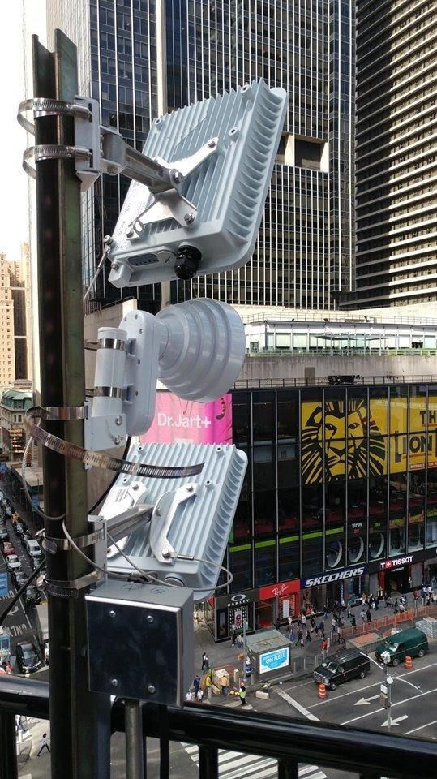
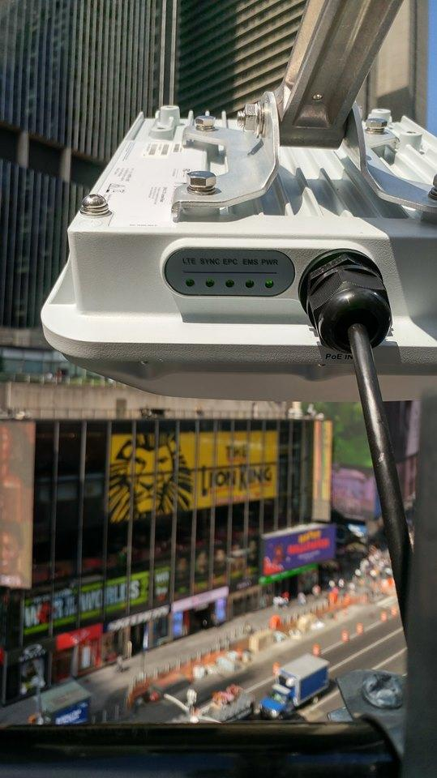
CBRS Trials – Times Square and Angels Stadium

Slide 19
Use Cases - Examples
Handsets
Use Case Description: Prove the use of handsets with the CBRS system.
Components: Handsets (Essential, iPhone11), SIM cards for the devices
Push to Talk
Use Case Description: Prove the use of push to talk radios with the CBRS system.
Components: Two Motorola SLN1000 radios, SIM cards for the devices
CBRS Laptop
Use Case Description: Prove a laptop can be connected to internet via a CBRS dongle
Component: Any laptop with Ethernet port (RJ45), Sierra Wireless RV55 CPE, SIM card for the CPE
Wifi Backhaul
Use Case Description: Prove a WiFi AP can use CBRS as backhaul
Components: an AP with Ethernet port (RJ45) and power cable, RV55 CPE, SIM card for the CPE
CBRS Digital Signage
Use Case Description: Prove a digital sign can be connected to internet via a CBRS dongle
Components: any digital sign with Ethernet port (RJ45), Sierra Wireless RV55 CPE, SIM card for the CPE
CBRS CPE Router
Use Case Description: Prove CBRS routers can be used to provide Ethernet and WiFi service
Components; any laptop with Ethernet port (RJ45), Sierra Wireless RV55 CPE, SIM card for the CPE, one AER2200 CBRS router, and a camera/base unit

Slide 20
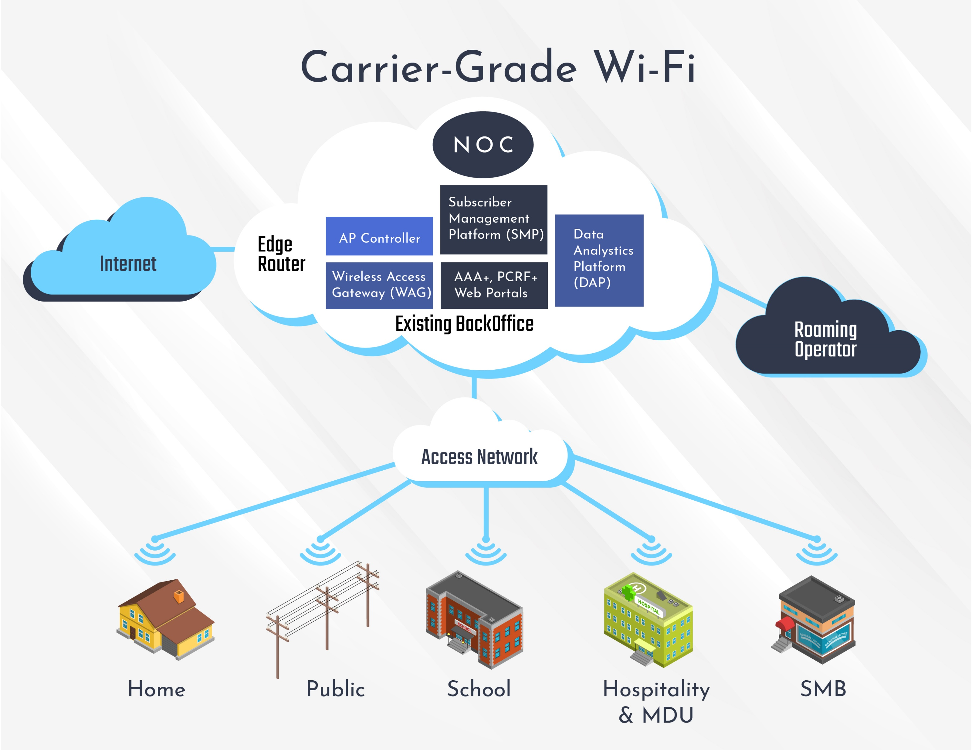

Slide 21
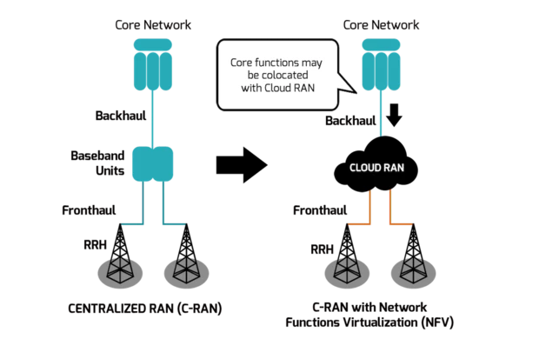

Slide 22
Takeaways

Slide 24
- Thank you -
Questions?
Bryce Bregen
|| Senior Vice President
bbregen@connectivitywireless.com
(602) 321-6555

Slide 25
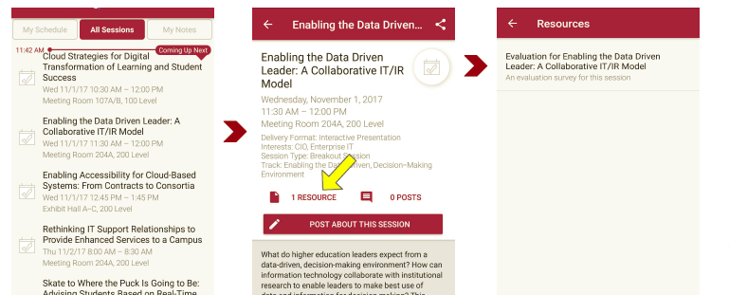
Session Evaluations There are two ways to access the session and presenter evaluations:
1
2
In the online agenda, click on the “Evaluate Session” link
From the mobile app, click on the session you want from the schedule > then scroll down or click on the associated resources > and the evaluation will pop up in the list

