Slide 1
IT Service Management
For Communications and Collaboration Services

Slide 2
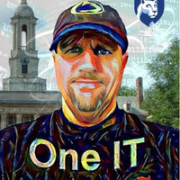
Introductions
Mark Katsouros, Penn State
Deborah McDaniel, Rutgers

Slide 3
What Common IT Challenges Do You Face?
Let’s have some fun!
Take out your phones
Go to slido.com
Type in the event code #ITSM-CC

Slide 4
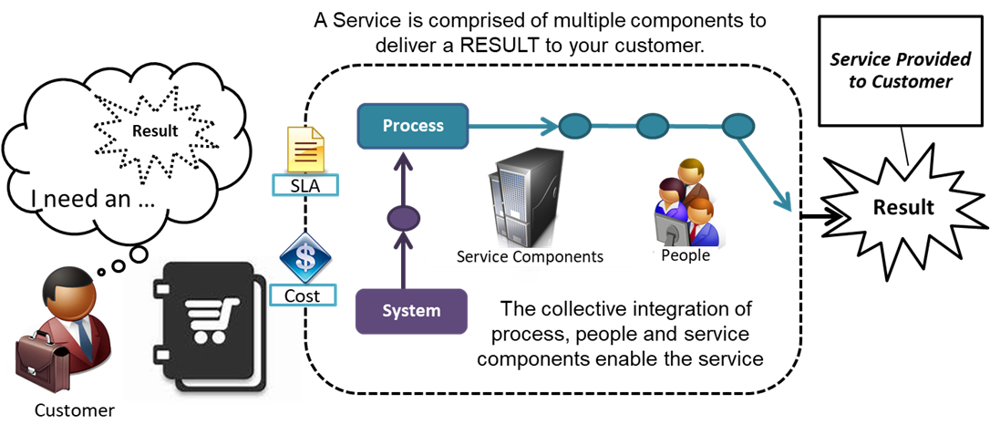
What is IT Service Management?

Slide 5
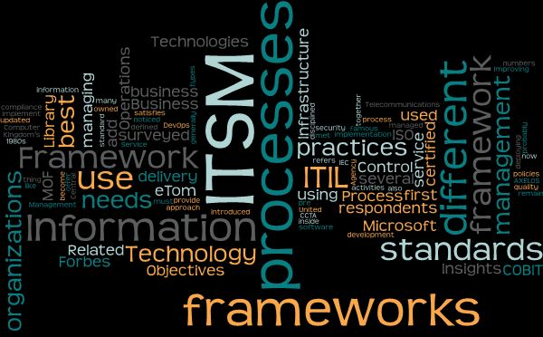
The Alphabet Soup of ITSM Frameworks

Slide 6
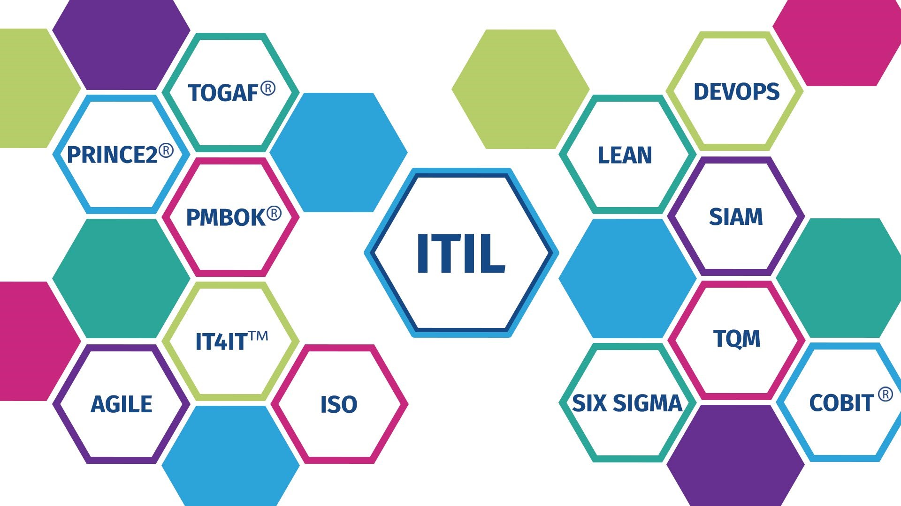
ITIL 4 – An Integration Framework
COBIT® is a trademark of ISACA® registered in the United States and other countries. TOGAF® and IT4IT™ are registered trademarks of The Open Group in the United States and other countries. PMBOK® is a trademark of the Project Management Institute, Inc., which is registered in the United States and other nations. PRINCE2® is a registered trade mark of AXELOS Limited.

Slide 7
Speaking of integration…

Slide 8
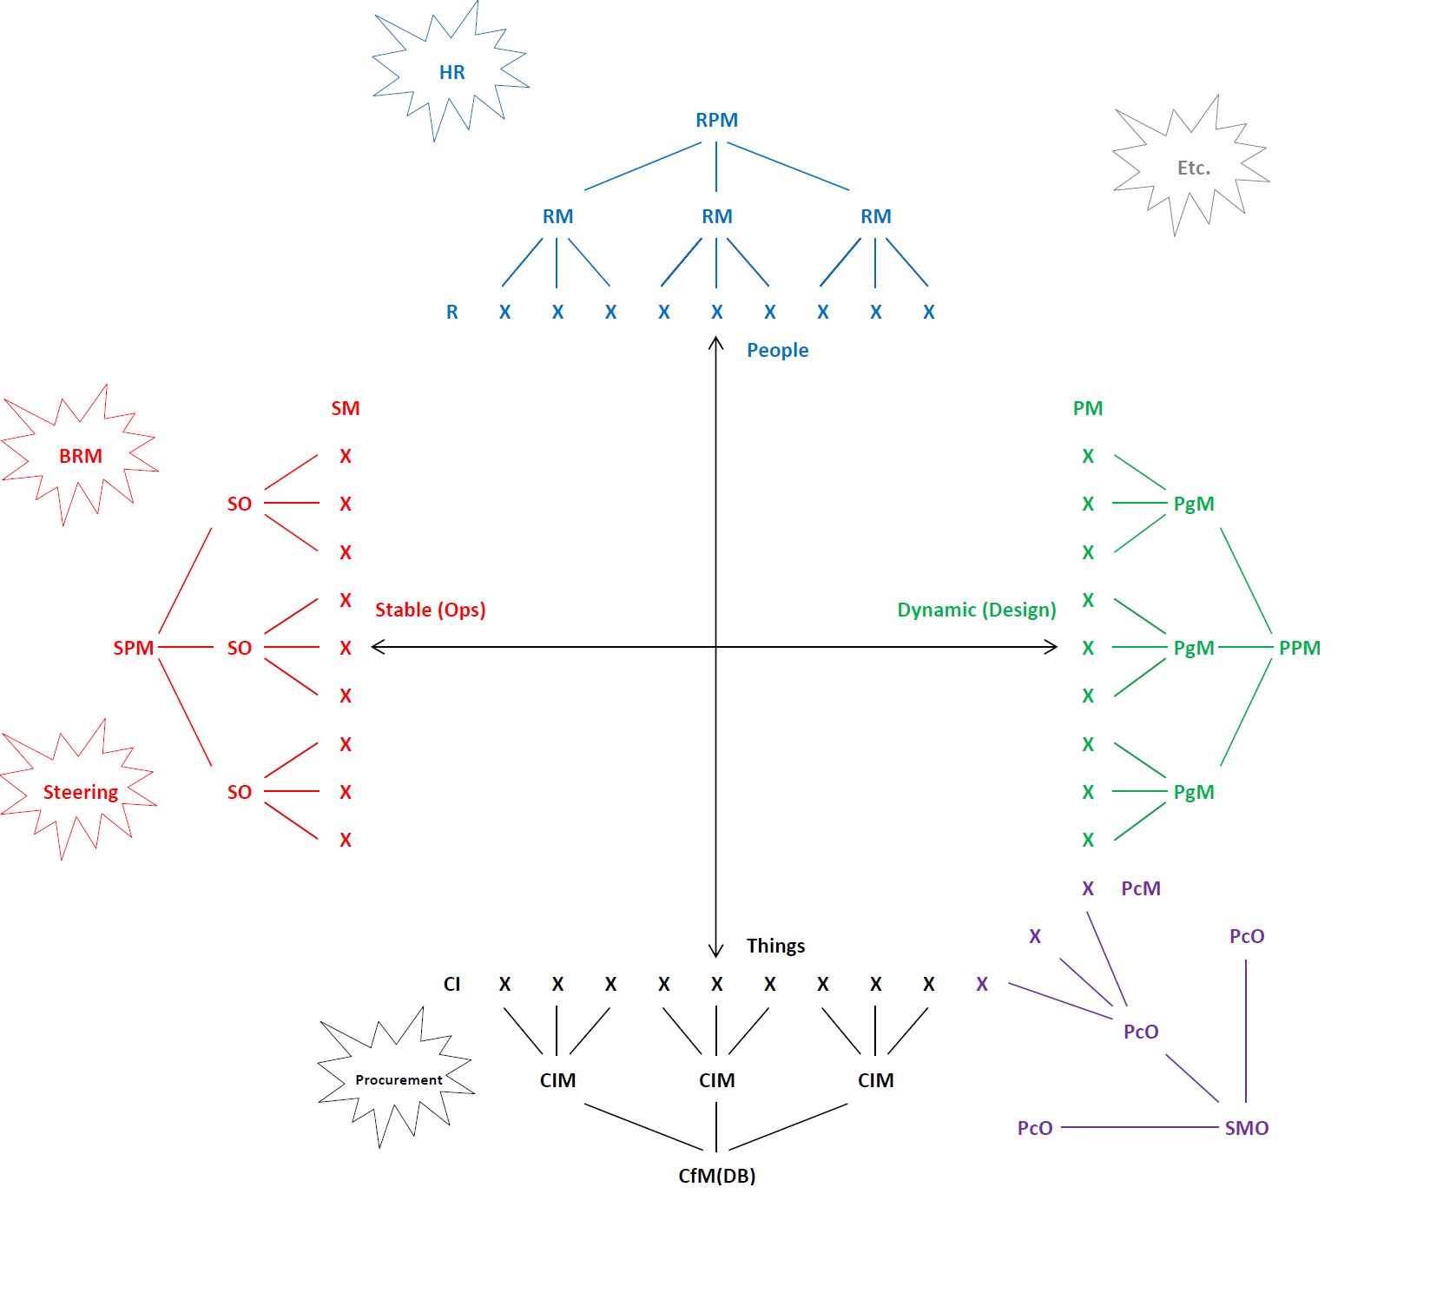

Slide 9
Who? Roles and Responsibilities
Notes:
Mark will do this section (~15 minutes)

Slide 10
ITIL Roles
Service Owners (SOs) – Service evolution/strategy
Service Managers (SMs) – Service operations / Customer-facing
Service Engineers – Technical design
Service Analysts – Financial models/sustainability
Process Owners – Enterprise-level
Process Managers – Unit-level
Process Liaisons – Subunit-level
Configuration Item Managers – App managers, product owners, sys admins, etc. (responsible for granular technical pieces)
Portfolio Managers – Business strategy & resource prioritization)
Project Managers (& Project Sponsors, Project Team Members, Program Managers/Sponsors, Stakeholders, SME’s, etc., all from PMBOK)
Business Relationship Managers – “Translators” b/w IT service providers and customers
Customer Relationship Managers – Customer satisfaction/retention

Slide 11
ITIL Roles
Service Owners (SOs) – Service evolution/strategy
Service Managers (SMs) – Service operations / Customer-facing
Service Engineers – Technical design
Service Analysts – Financial models/sustainability
Process Owners – Enterprise-level
Process Managers – Unit-level
Process Liaisons – Subunit-level
Configuration Item Managers – App managers, product owners, sys admins, etc. (responsible for granular technical pieces)
Portfolio Managers – Business strategy & resource prioritization)
Project Managers (& Project Sponsors, Project Team Members, Program Managers/Sponsors, Stakeholders, SME’s, etc., all from PMBOK)
Business Relationship Managers – “Translators” b/w IT service providers and customers
Customer Relationship Managers – Customer satisfaction/retention

Slide 12
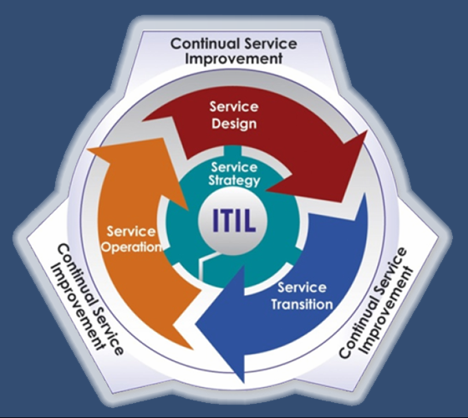
Service Roles and Lifecycle
(Business) Service Owner – SO
Service Strategy
Service Design
Service (Offering) Manager – SM
Service Transition
Service Operation
Continual Service Improvement

Slide 13
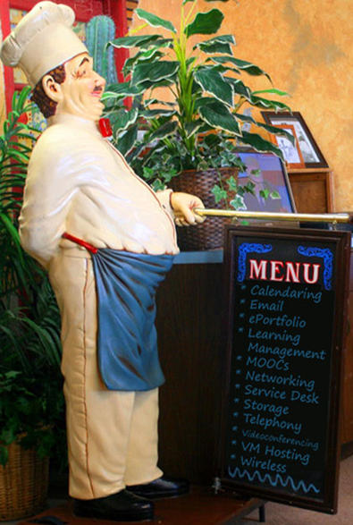
The IT Service Catalog

Slide 14
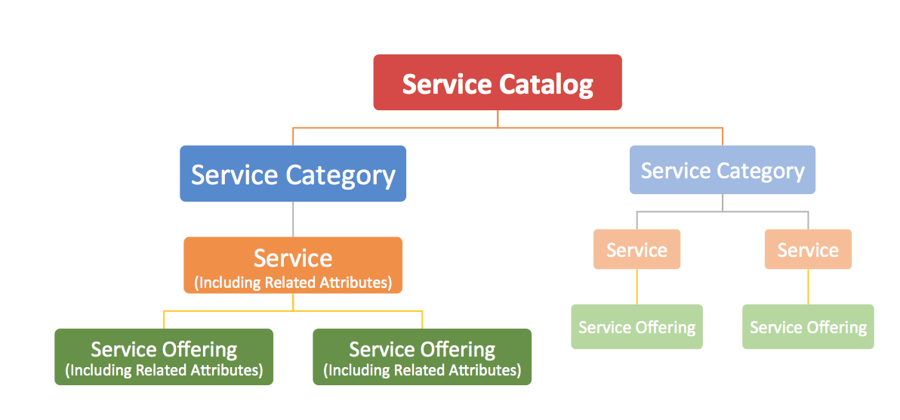
Service Hierarchies
Service Portfolio
Service Pipeline
Retired Services

Slide 15
Service Categories
Administrative and Business
Communication and Collaboration
End-Point Computing
Infrastructure
IT Professional Services
Research
Security
Teaching and Learning
Services
Application Development
Consulting/Advising
Continuity/Disaster Recovery
Enterprise Licensing
IT Service Management
Portfolio/Project Management
Training

Slide 16
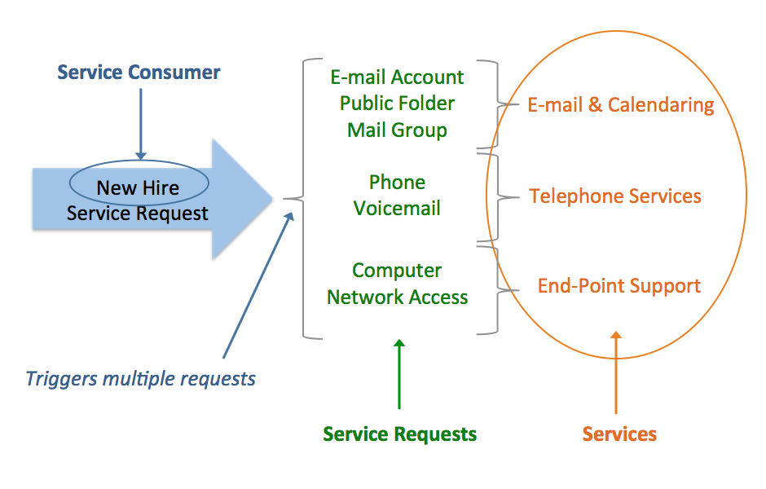
How Service Requests Relate to Services
-The Higher Ed IT Service Catalog: A Working Model for Comparison and Collaboration

Slide 17
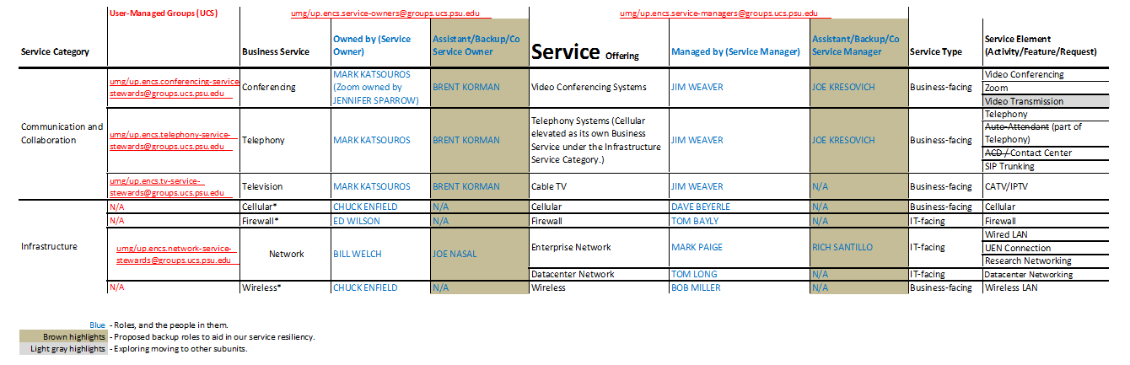
Enterprise Networking and Communication Services in the PSU IT Service Catalog

Slide 18
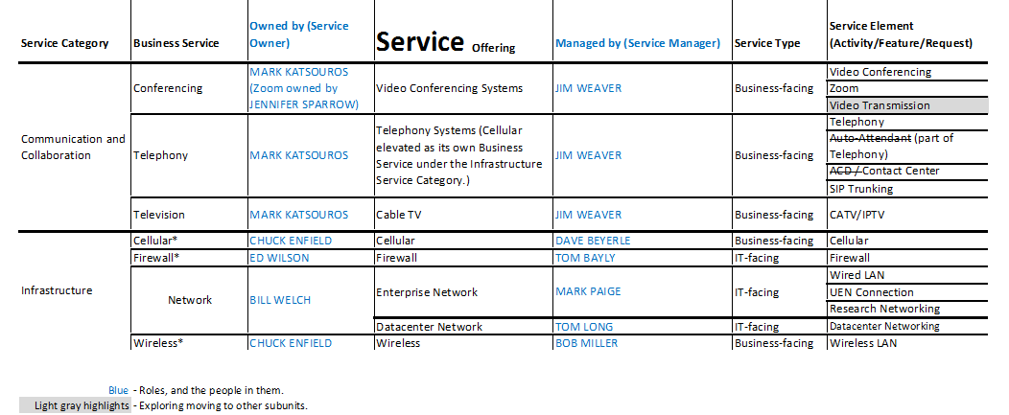
Enterprise Networking and Communication Services in the PSU IT Service Catalog (Distilled)

Slide 19
Enterprise Networking and Communication Services in the PSU IT Service Catalog (Distilled)

Slide 20
Enterprise Networking and Communication Services in the PSU IT Service Catalog (Distilled)

Slide 21
Change Management

Slide 22
Three Contexts of “Change Management”
Organizational Culture, structure, leadership, etc.
Service (evolution) Service design, feature changes, wholly new services, etc.
Operational “Reboots,” upgrades, updates, service outages in general, etc.

Slide 23
Service Change Management
RFC (Request For Change)
ITSSC (IT Services Steering Committee)
SDCP (Service Design Change Package)
SDP (Service Design Package)

Slide 24
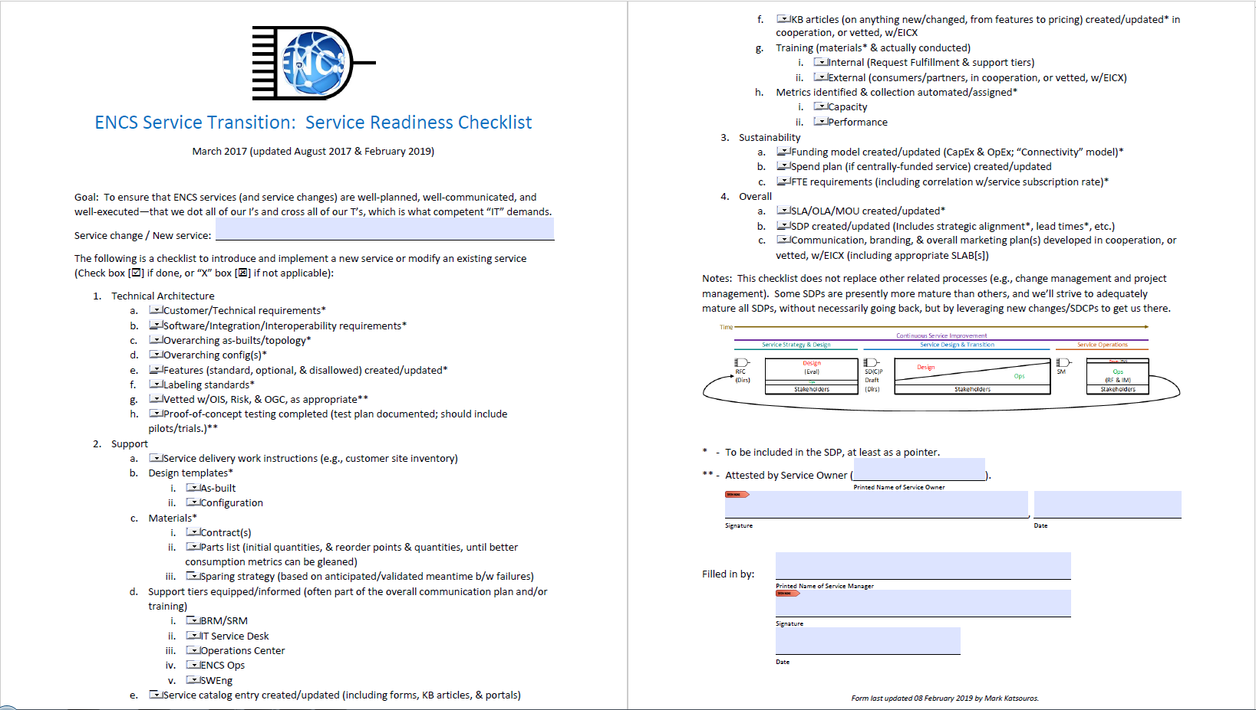

Slide 25
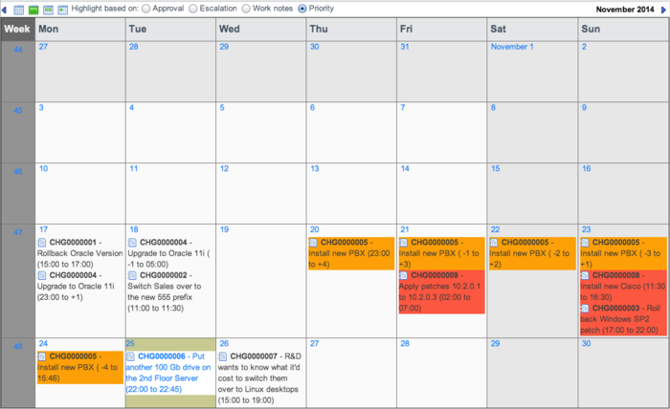
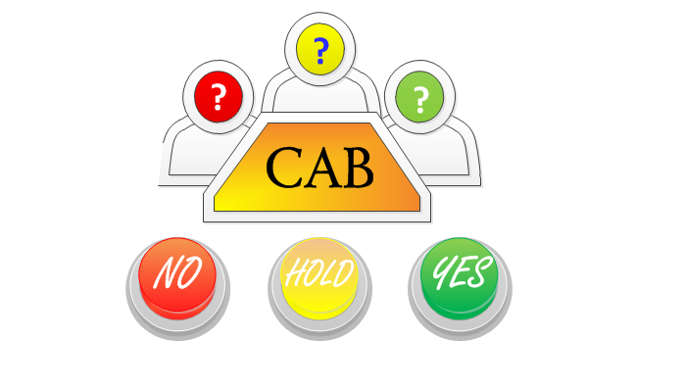
Operational Change Management
Change calendar
Collision avoidance
Incident forensics
CAB (Change Advisory Board)
Communication/Notification

Slide 26
Successes, Failures, & Lessons Learned
Get executive sponsorship, which greatly increases your chances for success.
Get plenty of your folks trained in ITSM/ITIL and consider hiring an ITSM consultant to help you define your goals/requirements and procure an enterprise ITSM tool.
Start with the service catalog and Service Catalog Management process.
Utilize the ECAR Higher Ed IT Service Catalog Model: https://library.educause.edu/resources/2015/4/the-higher-education-it-service-catalog-a-working-model-for-comparison-and-collaboration

Slide 27
Successes, Failures, & Lessons Learned
Assign process and service stewardship roles (process owners, service managers, etc.)
Don’t let politics get in the way of service ownership.
Form a Service Management Office (SMO) to provide operational support to all ITSM subscribers.
SMO should provide federated governance (facilitate vs. dictate decisions).
Don’t stop short of the holy grails (more on that below).
Minimize customization of your core tools (e.g., ServiceNow).

Slide 28
Holy Grails 1. Managing the Nuts & Bolts 2. Prioritization & Strategy
Notes:
Mark (~5 minutes)

Slide 29
The ITSM Process Continuum

Slide 30
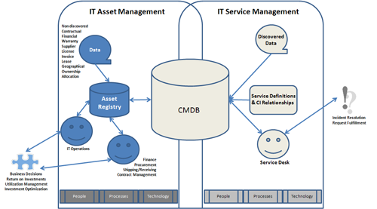
=
1

Slide 31
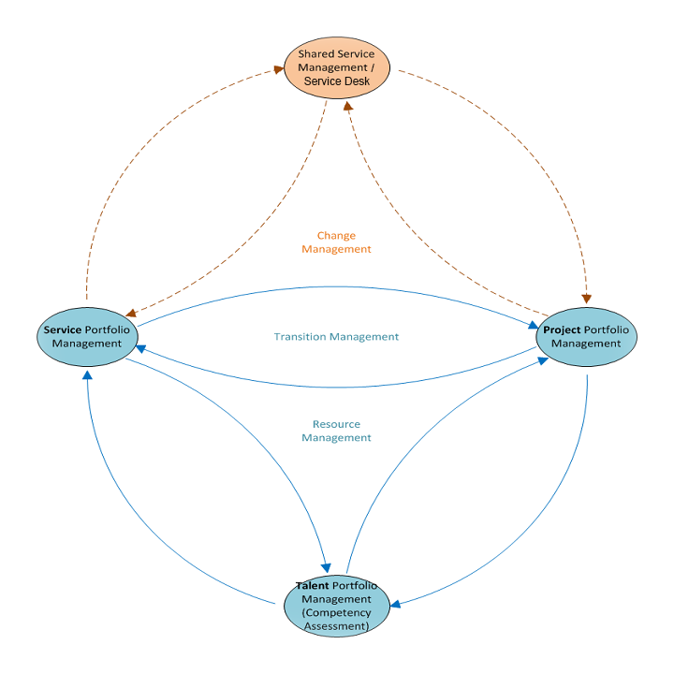
=
2

Slide 32
What’s New in ITIL 4?
ITIL 3
ITIL 4
4 Ps
Service Lifecycle
26 Processes and 4 Functions
9 Guiding Principles
4 Dimensions
Service Value System
34 Practices across 3 Domains
7 Guiding Principles

Slide 33
ITIL 4 – What’s In It for Us?
Integration with DevOps, Agile, TOGAF, and others
Strong focus on value co-creation
More customizable and flexible
More holistic view of IT and IT Service Management
Refreshed approach to modern IT challenges

Slide 34
ITIL 4 – Start Where You Are

Slide 35
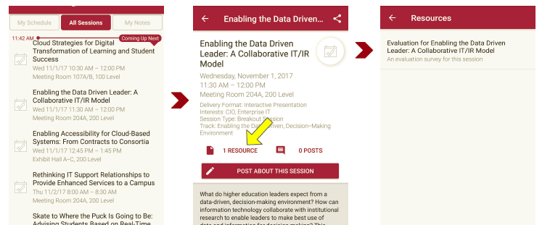
Session Evaluations There are two ways to access the session and presenter evaluations:
1
2
In the online agenda, click on the “Evaluate Session” link
From the mobile app, click on the session you want from the schedule > then scroll down or click on the associated resources > and the evaluation will pop up in the list

Slide 36
Contact Information
Mark Katsouros
Director, Voice & Video
mark1@psu.edu
814-867-4738
https://www.linkedin.com/in/katsouros
Deborah McDaniel
Associate Director, IT Service Management
deborah.mcdaniel@rutgers.edu
848-445-1753
https://www.linkedin.com/in/dlmcdaniel
Questions?
NOTE: This presentation leaves copyright of the content to the presenters. Unless otherwise noted in the materials, uploaded content carries the Creative Commons Attribution 4.0 International (CC BY 4.0), which grants usage to the general public, with appropriate credit to the author.

Slide 37
Resources
EDUCAUSE ITSM Constituent Group https://www.educause.edu/discuss/it-service-management-itsm-constituent-group
IT Service Metrics 101 https://er.educause.edu/articles/2013/1/it-service-metrics-101
The Unified IT Service Catalog: Your One-Stop Shop https://er.educause.edu/articles/2014/8/the-unified-it-service-catalog-your-onestop-shop
The Higher Education IT Service Catalog: A Working Model for Comparison and Collaboration https://library.educause.edu/resources/2015/4/the-higher-education-it-service-catalog-a-working-model-for-comparison-and-collaboration
Demonstrating Value Through IT Service Management in Higher Education https://library.educause.edu/resources/2016/8/demonstrating-value-through-it-service-management-in-higher-education

