Slide 1
Higher Ed and IT Policy, 2019: Developments and Directions
Jarret Cummings and Katie Branson
October 16, 2019

Slide 2
Your Tour Guides Through the Land of Oz
Jarret Cummings, Senior Advisor for Policy and Government Relations, EDUCAUSE
Katie Branson, Senior Associate, Ulman Public Policy (EDUCAUSE consultants)
https://commons.wikimedia.org/w/index.php?curid=854090

Slide 3
What We’ll See On Today’s Tour
First, the policy climate (“…, there’s a storm blowin’ up, a whopper!”)
Our key issues this year
Federal Trade Commission (FTC) proposed Safeguards Rule changes
Dept. of Education (ED)/Federal Student Aid (FSA) information security
Accessible instructional materials bill
Late entry: Network neutrality
https://commons.wikimedia.org/w/index.php?curid=10889976

Slide 4
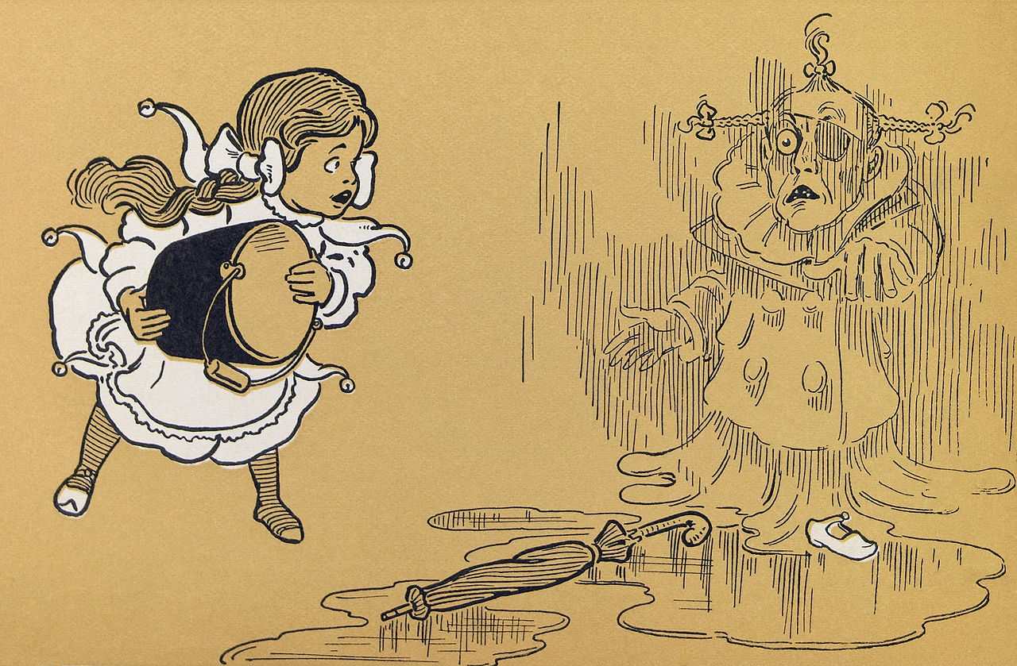
The Policy Climate
Legislative activity already “melting” early due to early “splash” of 2020 campaign season
Now, impeachment = paralysis
Early ‘19 deal on budget caps/ debt ceiling = okay ‘til July ‘21
No FY20 agency funding yet; continuing resolution until Nov. 21, probably longer
No HEA reauthorization ‘til 2021 at earliest
https://commons.wikimedia.org/w/index.php?curid=7499859

Slide 5
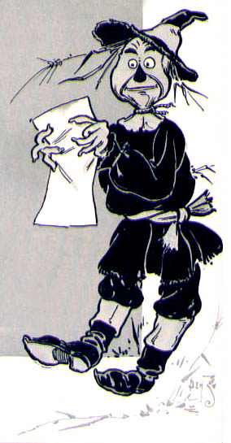
FTC Safeguards Rule?
Established by Federal Trade Commission (FTC) in 2003; FTC’s main information security regulation
Implements oversight responsibilities under Gramm-Leach-Bliley Act (GLBA)
Focus on protecting “customer information” of “financial institutions”
We’re covered because of student aid role
Image Attribution:
https://commons.wikimedia.org/w/index.php?curid=3470850

Slide 6
Safeguards Rule Changes?
Spring ‘19 FTC notice on new rule-making
Proposed new requirements include:
CISO (with or without the title)
Encryption of customer data in transit and at rest
Security testing of all apps handling customer data
Continuous monitoring or annual pen. testing w/ biannual vulnerability assessments
Much, much more…
Image Attribution:
https://commons.wikimedia.org/w/index.php?curid=7275119

Slide 7
Safeguards Rule Changes = Higher Ed Concerns
Proposed 6-month compliance deadline
“Small institution” definition for key exceptions doesn’t match higher ed
Many requirements not clearly tied to “customer information” (scope creep?)
Many provisions don’t account for cloud services (potential compliance barriers)
Many, many more…
https://commons.wikimedia.org/w/index.php?curid=69520776

Slide 8
Higher Ed Recommendations on Rule Changes
EDUCAUSE on joint comments highlighting concerns
We recommended:
Two years to comply (plan done within one year)
“Small institution” defined by Carnegie classification
Reference “customer information” consistently across provisions to limit scope
Edit provisions to reflect limited control and information available to institutions using cloud services

Slide 9
ED/FSA Information Security Compliance
Positive dialogue on security/ breach issues continues
Member group developing ideas for ED/FSA consideration
ED/FSA may discuss collaborative model at FSA’s December conf.
Safeguards Rule audit objective in place for FY19
https://commons.wikimedia.org/w/index.php?curid=10894206

Slide 10
Still Aiming for the AIM HIGH Act
Bill to develop voluntary guidelines for accessible instructional materials/related technologies
Higher ed associations, NFB, AAP, and SIIA worked together to create proposal
Introduced in both chambers last Congress; working to reintroduce in both this Congress
Main change: Ineffective safe harbors out, voluntary guidelines for pilot testing in

Slide 11
Net Neutrality: There’s No Place Like Court…
Fed. appeals court finally ruled Oct. 1
FCC repeal of its 2015 rules upheld
Blanket preemption of states was NOT
FCC can challenge state laws case-by-case, but can’t block outright
E.g., CA’s strong rules will apply unless more appeals delay or FCC sues/wins
https://commons.wikimedia.org/w/index.php?curid=3481797

Slide 12
Somewhere Over the Rainbow…
The FTC will agree with all of our Safeguards Rule recommendations!
We will reach a shared understanding on information security with ED!
AIM HIGH will clear the bar and become law!
The states will finish what the FCC could not and lock in net neutrality!
https://commons.wikimedia.org/w/index.php?curid=69520775

Slide 13
Just remember—dreams really do come true, and thanks for listening!
jcummings@educause.edu
kathryn@ulmanpolicy.com
Read the EDUCAUSE Policy Spotlight for more:
https://er.educause.edu/columns/policy-spotlight
NOTE: This presentation leaves copyright of the content to the presenter. Unless otherwise noted in the materials, uploaded content carries the Creative Commons Attribution 4.0 International (CC BY 4.0), which grants usage to the general public, with appropriate credit to the author.

Slide 14
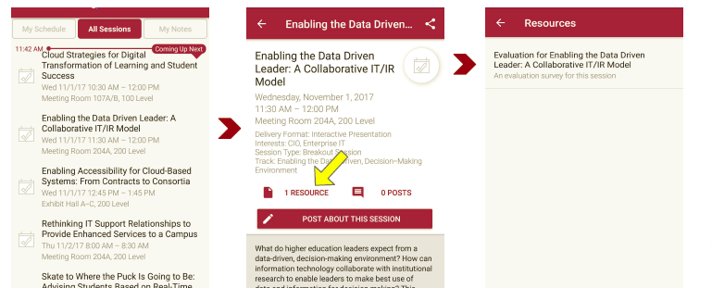
Session Evaluations There are two ways to access the session and presenter evaluations:
1
2
In the online agenda, click on the “Evaluate Session” link
From the mobile app, click on the session you want from the schedule > then scroll down or click on the associated resources > and the evaluation will pop up in the list

