Slide 1
Where to Start with Student Success Initiatives
Leah Lang
D. Christopher Brooks
Kathe Pelletier

Slide 2
Let’s talk about…
What’s the buzz about student success initiatives?
A brief tour of data and definitions
Student success maturity and technology deployment mashup
Let’s look at some of the end users: students and advisors
Takeaways and lessons from the field

Slide 3
Are student success initiatives worth it?

Slide 5
What do the headlines say?

Slide 6
Let’s unpack this a bit
THIS IS HUMAN
WORK.

Slide 7
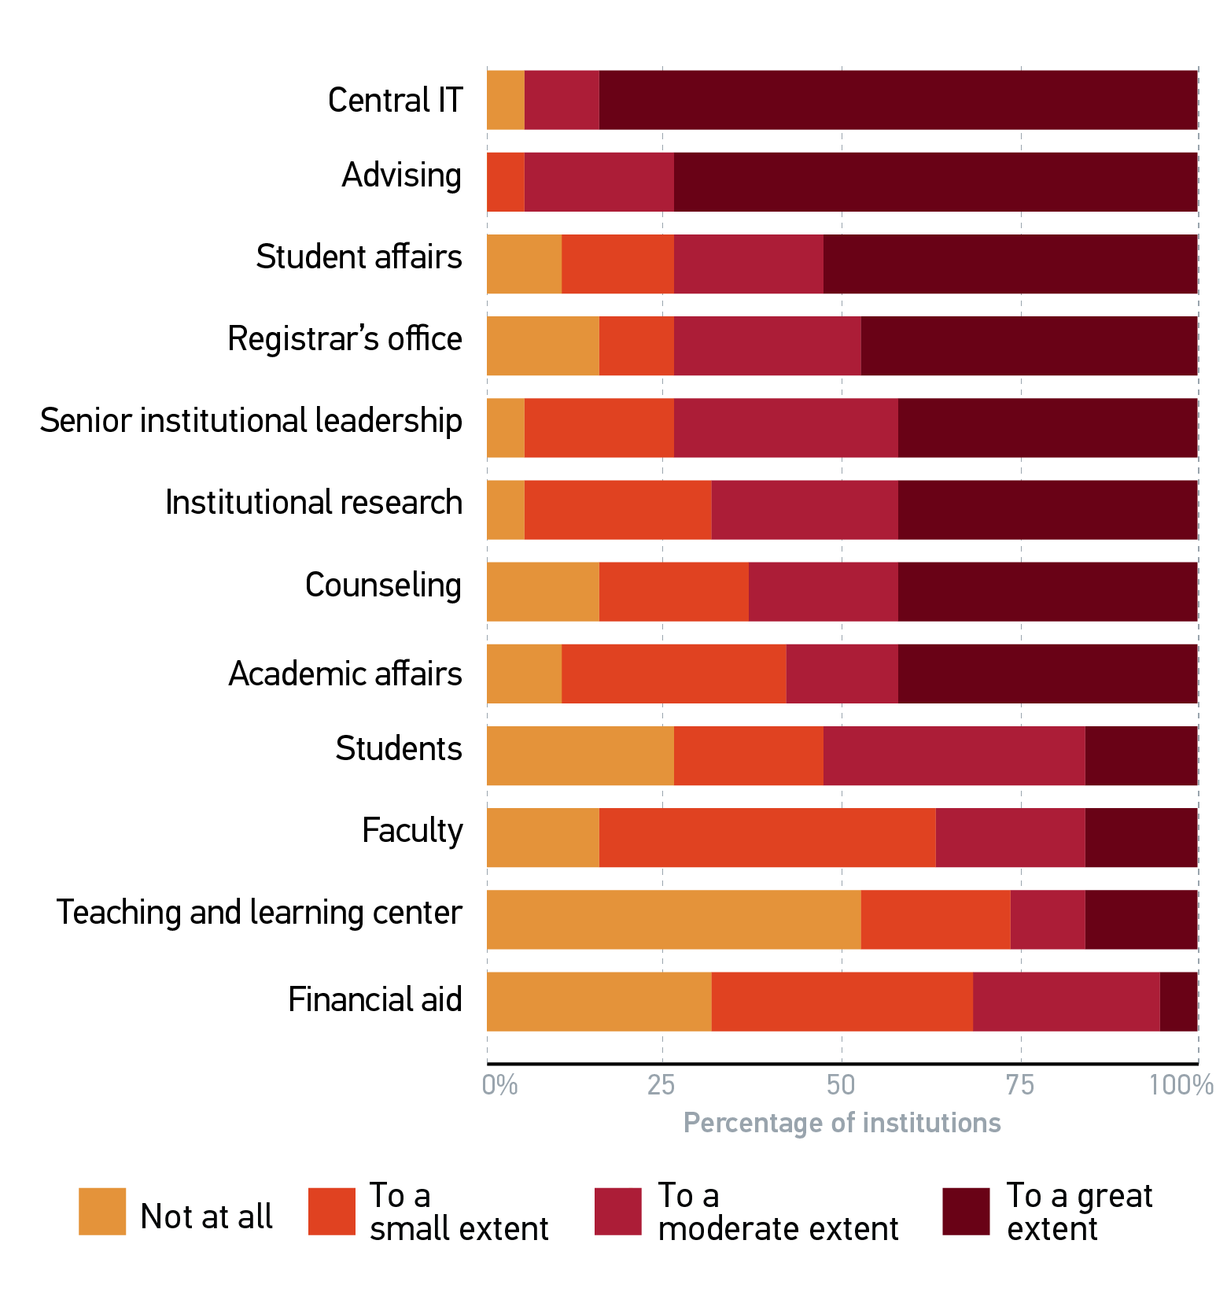
Student success (IPAS) change-management involvement
SOURCE: D. Christopher Brooks, IPAS Implementation Handbook, research report, (Louisville, CO: ECAR, October 2014), p. 17. Available from http://www.educause.edu/ecar.

Slide 8
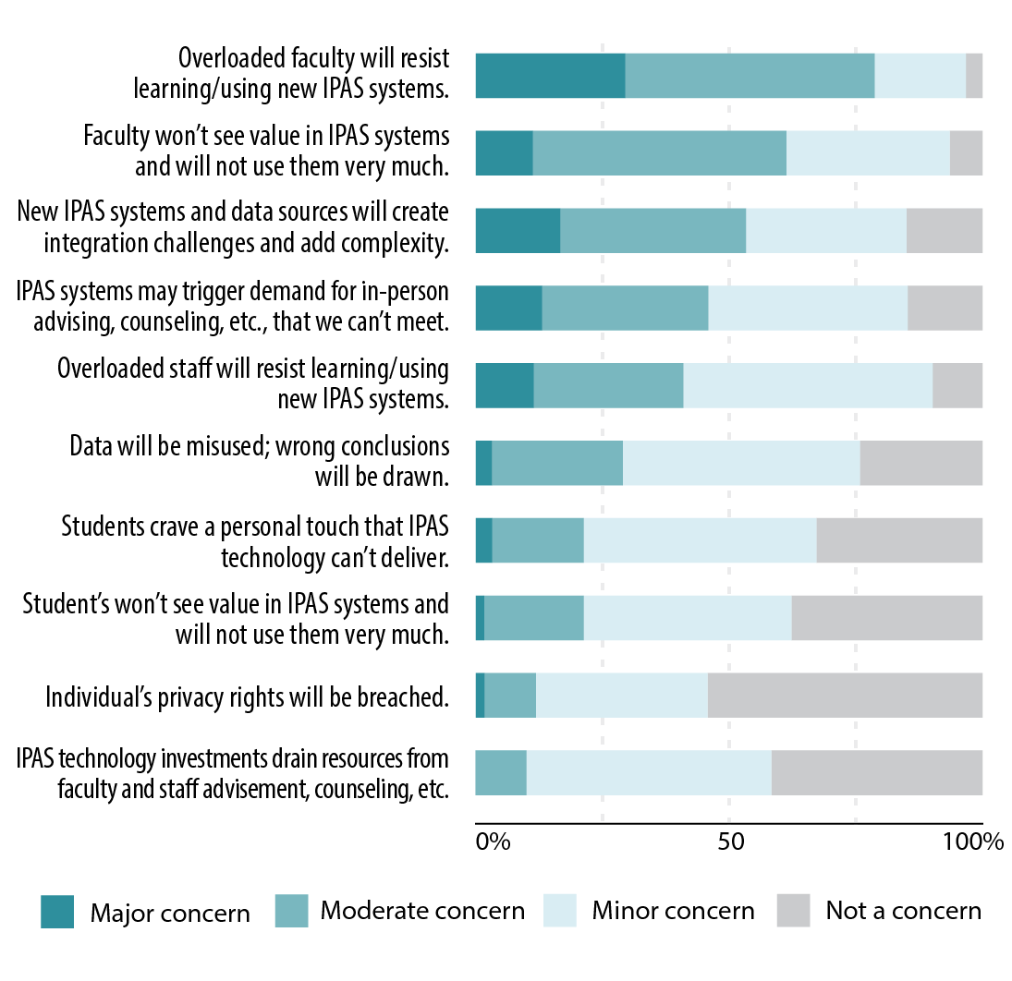
Concerns about the growing use of student success tools
SOURCE: D. Christopher Brooks, IPAS Implementation Issues: Data and Systems Integration, research report (Louisville, CO: ECAR, 2014), p. 20. Available from http://www.educause.edu/ecar.

Slide 9
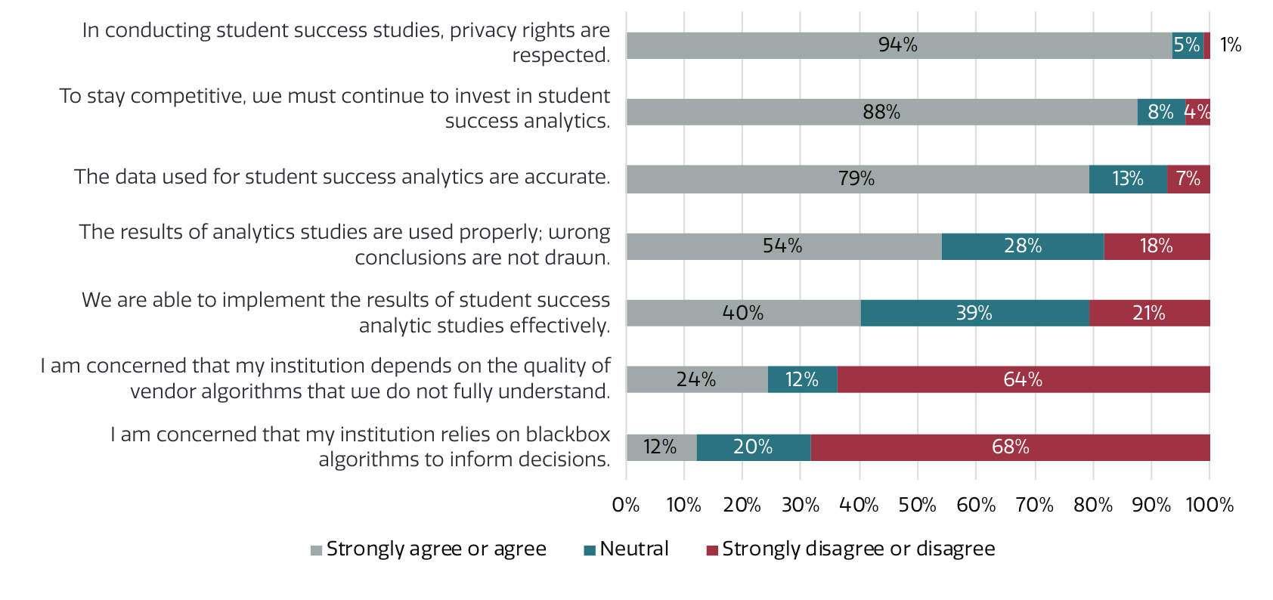
Student affairs, institutional research, and IT professionals’ agreement with statements on data and analytics
SOURCE: Parnell, Jones, Wesaw, and Brooks, Institutions’ Use of Data and Analytics for Student Success: Results from a National Landscape Analysis, research report (Washington, DC: NASPA, 2018), p. 12. Available from http://www.educause.edu/ecar.

Slide 10
Today’s mashup
Gathers data on:
IT service maturity
Technology deployment
…and much, much, more
Gathers data on:
Student impressions of technology
Student use of technology
www.educause.edu/coredata
www.educause.edu/etrac
Notes:
describe our data sources and how the mashup works.
Take wording/phrases from rubric for SSMI

Slide 11
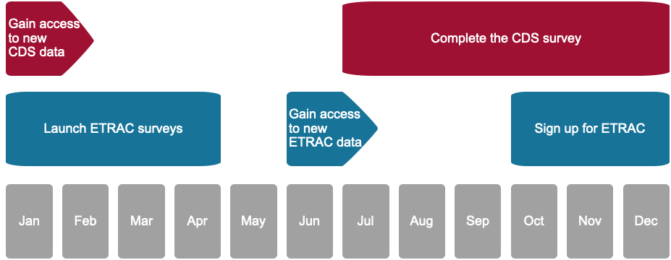
Dates to remember
You are here

Slide 12
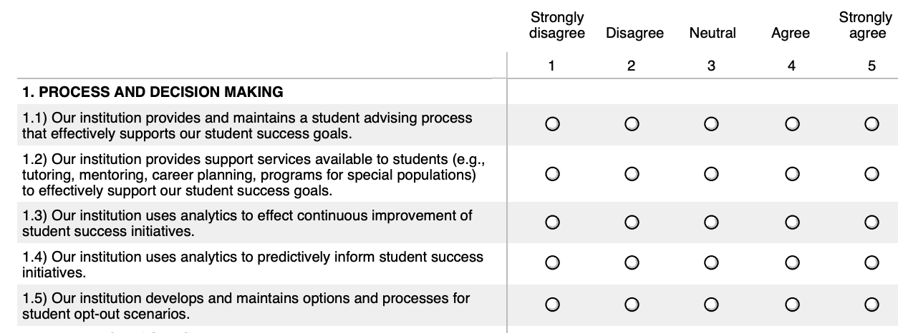
What is Student Success Technologies Maturity?
https://er.educause.edu/blogs/2019/9/making-the-sausage-or-how-cds-establishes-maturity-index-validity
Notes:
describe our data sources and how the mashup works.
Take wording/phrases from rubric for SSMI

Slide 13
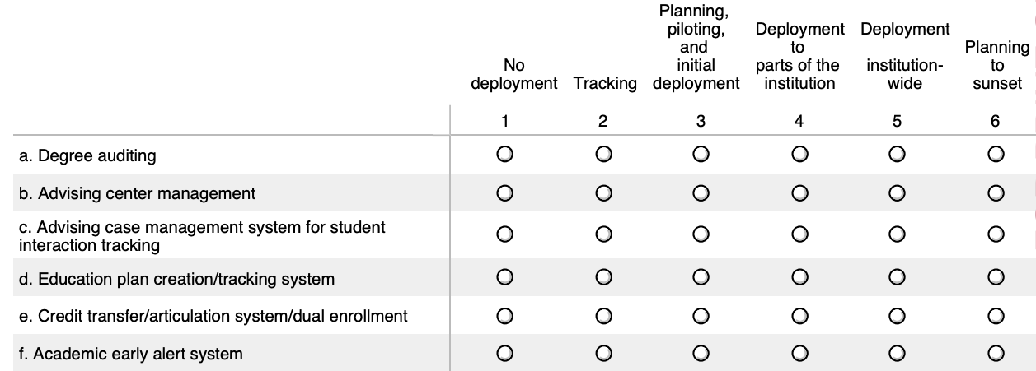
What is Student Success Technologies Deployment?
Notes:
describe our data sources and how the mashup works.
Take wording/phrases from rubric for SSMI

Slide 14
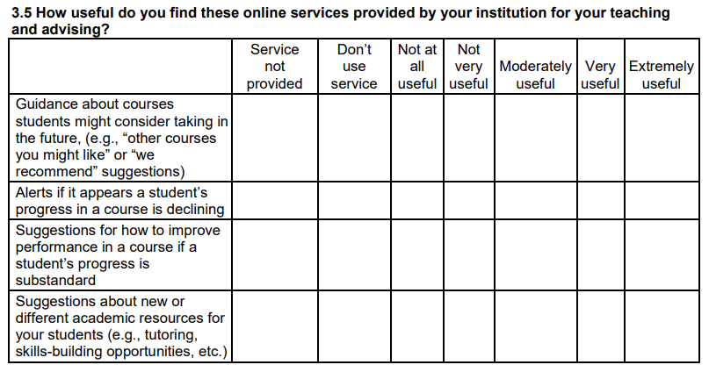
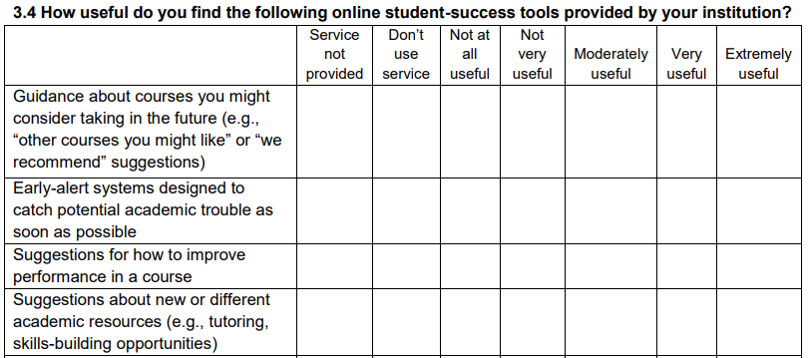
Student and Faculty Impressions of Student Success Technologies
FACULTY
STUDENT
Notes:
describe our data sources and how the mashup works.
Take wording/phrases from rubric for SSMI

Slide 15
Student Success: Maturity Index (2018)
https://library.educause.edu/~/media/files/library/2017/7/studentsuccrubric.pdf
Notes:
revision of MI:
Pearlman’s blog: https://er.educause.edu/blogs/2019/9/making-the-sausage-or-how-cds-establishes-maturity-index-validity
involved more people aspects of this than just getting the technology down.
⅓ of items are tech; the remainder are human-related
::::::::::::::::::::::
Technology maturity is correlated with student awareness, use, and usefulness ratings
>right kinds of data - shared and safe data
>right technology
>faculty training in technology
Collaboration and culture maturity is correlated with correlated with faculty finding tools useful
>goals are accepted
>stakeholder involvement
the more inclusive you can be on the front end with tech selection, the better the implementation
Leslie’s blog - did the shift in MI slant to more human

Slide 16
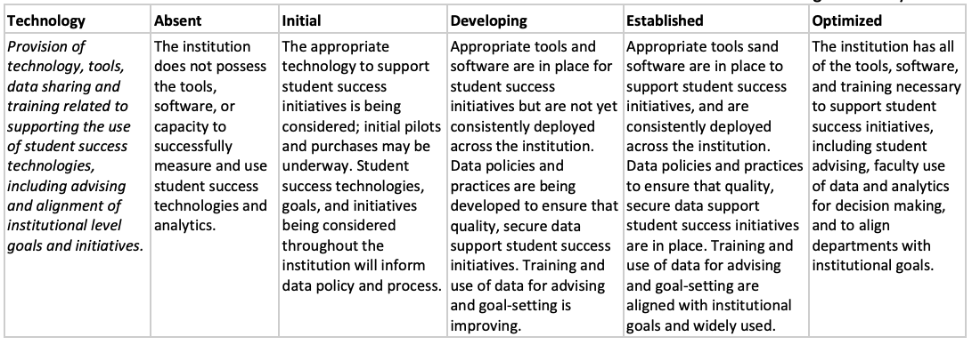
Student Success: Maturity Index (2018)
https://library.educause.edu/~/media/files/library/2017/7/studentsuccrubric.pdf
Notes:
revision of MI:
Pearlman’s blog: https://er.educause.edu/blogs/2019/9/making-the-sausage-or-how-cds-establishes-maturity-index-validity
involved more people aspects of this than just getting the technology down.
⅓ of items are tech; the remainder are human-related
::::::::::::::::::::::
Technology maturity is correlated with student awareness, use, and usefulness ratings
>right kinds of data - shared and safe data
>right technology
>faculty training in technology
Collaboration and culture maturity is correlated with correlated with faculty finding tools useful
>goals are accepted
>stakeholder involvement
the more inclusive you can be on the front end with tech selection, the better the implementation
Leslie’s blog - did the shift in MI slant to more human

Slide 17
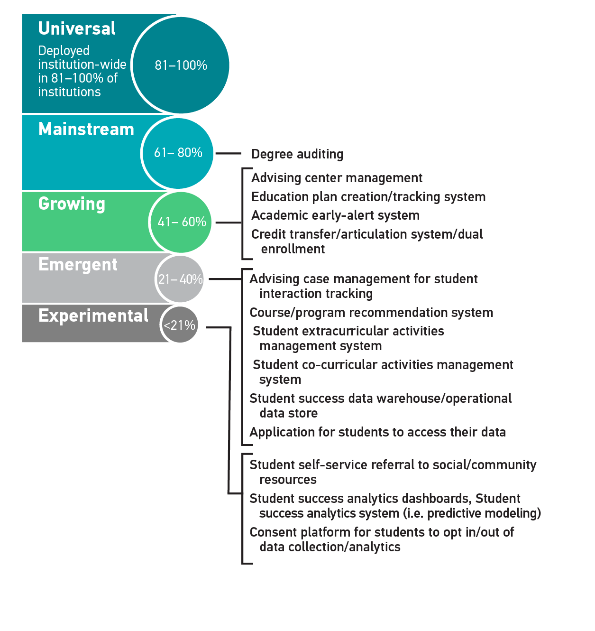
Student Success Technologies: Deployment Index (2018)
Notes:
level of difficulty vs. how long technologies have been in the field vs. end-users and how much buy-in you need across the institution
Tech at the higher end of the scale is in support of student as a student in their academic career.

Slide 18
Student Success: Deployment Index

Slide 19
Student Success: Deployment Index

Slide 20
Student Success: Deployment Index
Notes:
Technologies at this end of the scale are more in support of student as a citizen.

Slide 21
Student Success: Deployment Index

Slide 22
Key end-users of student success tools
Advising and Student Affairs
Students
Faculty
Institutional Research and Leadership

Slide 23
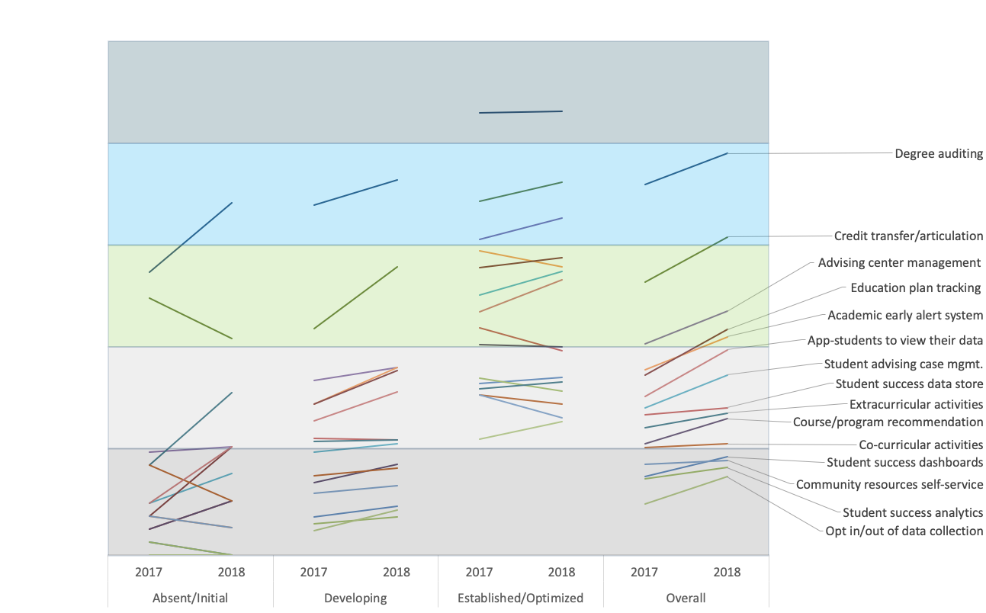
Maturity & Deployment
Notes:
Maturity and technology deployment are correlated
We’ve seen an increase in institution-wide adoption in all areas of SST
level of difficulty vs. how long technologies have been in the field vs. end-users and how much buy-in you need across the institution

Slide 24
Technologies for students

Slide 25
Advising and Student Affairs
Students
Education plan tracking
App-students to view their data
Community resources self-service
Opt in/out of data collection
Credit transfer/ articulation
Course/program recommendation
Co-curricular activities
Degree audit
Extracurricular activities
Faculty
Institutional Research and Leadership

Slide 26
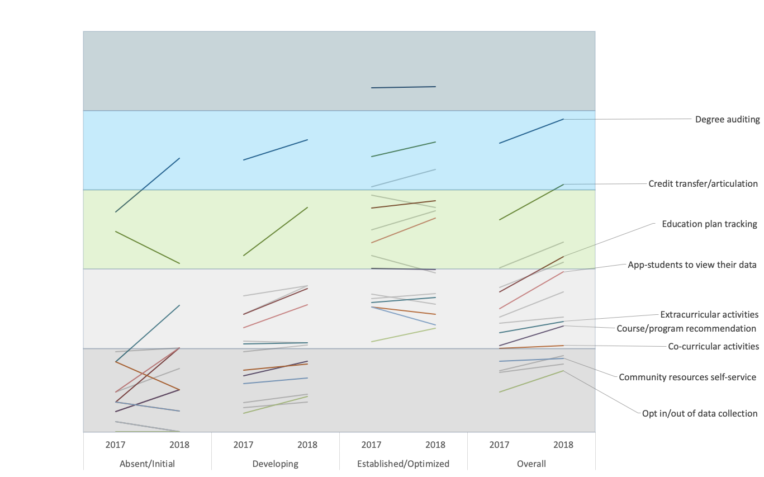
Students

Slide 27
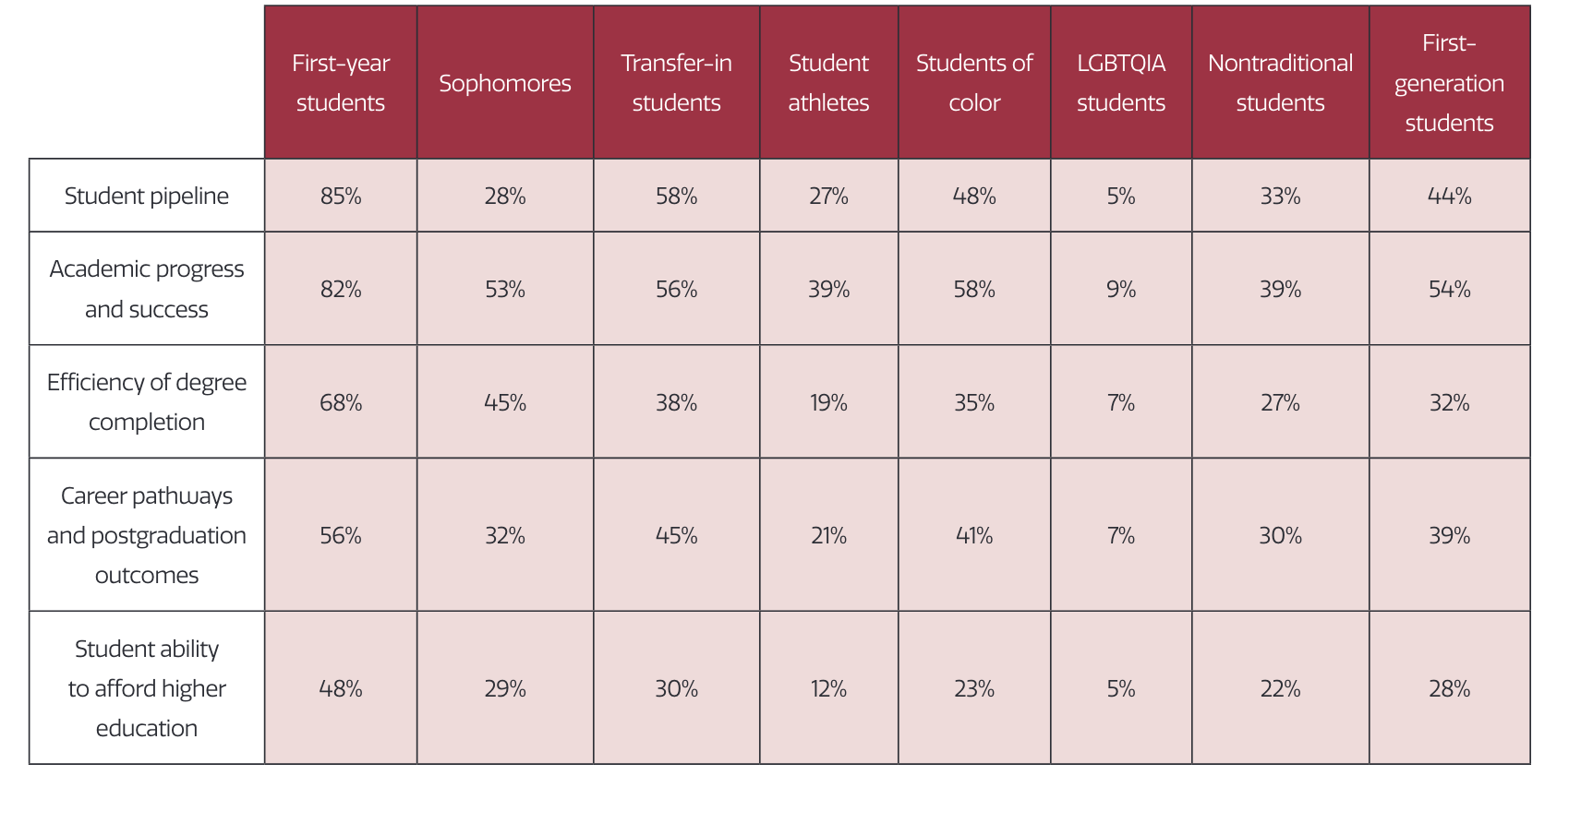
Focus of initiatives in support of student success
SOURCE: Parnell, Jones, Wesaw, and Brooks, Institutions’ Use of Data and Analytics for Student Success: Results from a National Landscape Analysis, research report (Washington, DC: NASPA, 2018), p. 6. Available from http://www.educause.edu/ecar.

Slide 28
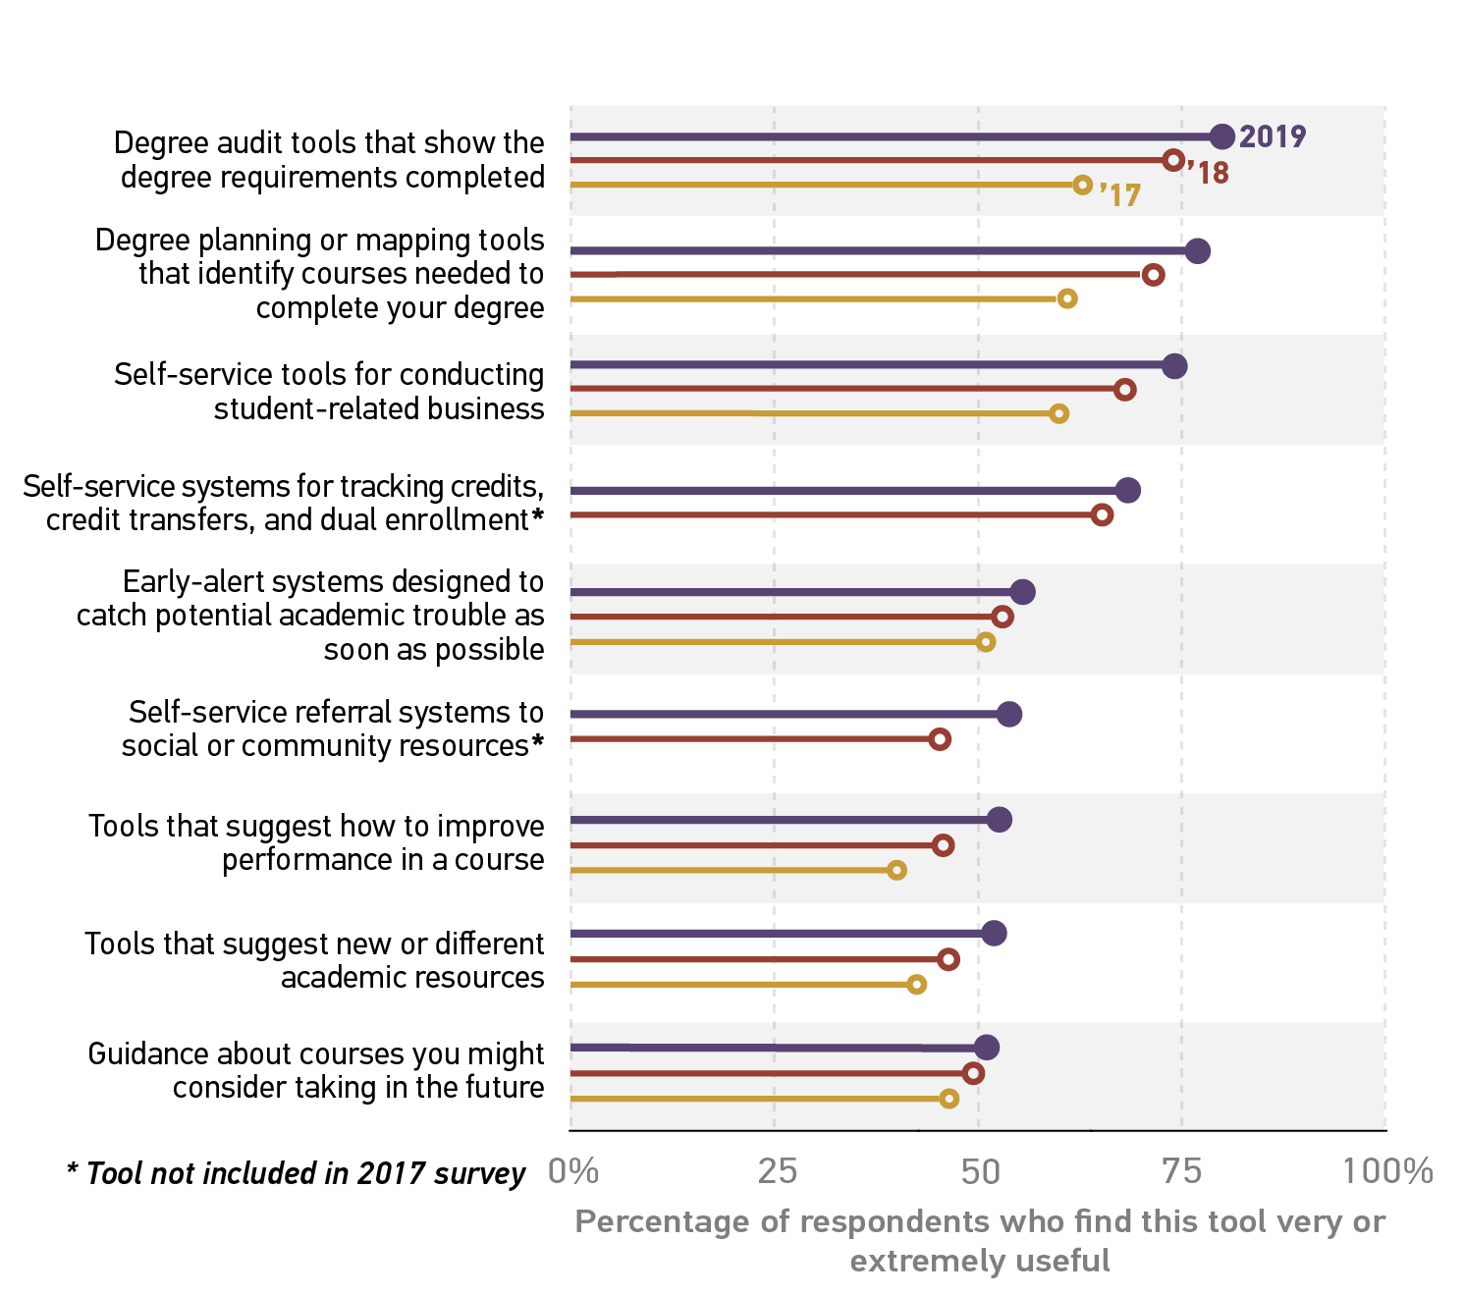
Positive ratings of the usefulness of online student success tools, 2017-2019
SOURCE: Dana C. Gierdowski, ECAR Study of Undergraduate Students and Information Technology, 2019, research report (Louisville, CO: ECAR, Forthcoming 2019).

Slide 29
Technologies for Advising and Student Affairs

Slide 30
Advising and Student Affairs
Students
Student advising case mgmt.
Credit transfer/ articulation
Academic early alert system
Course/program recommendation
Co-curricular activities
Degree audit
Extracurricular activities
Faculty
Advising center mgmt.
Institutional Research and Leadership

Slide 31
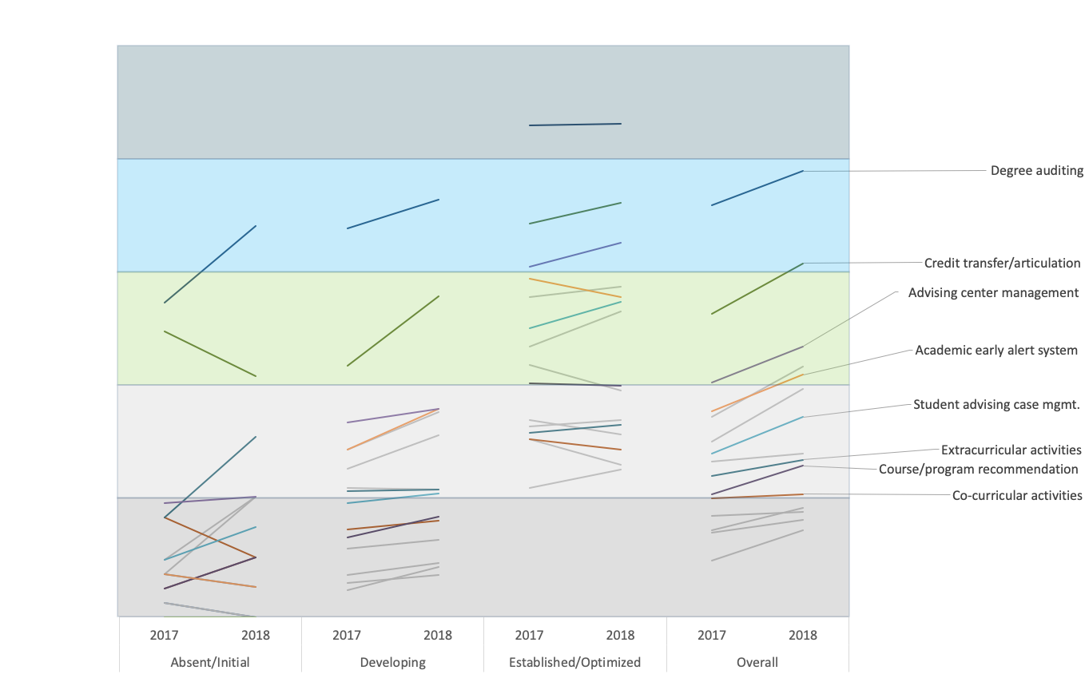
Advising and Student Affairs

Slide 32
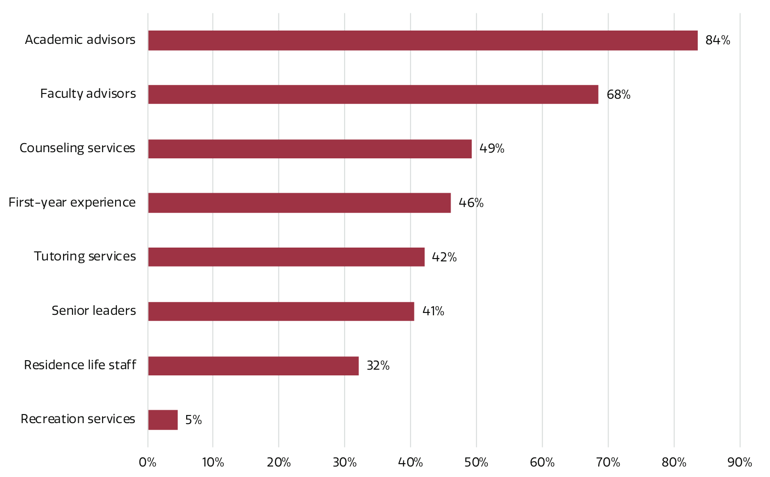
Staff with access to student-level data from institutions’ early-alert systems
SOURCE: Parnell, Jones, Wesaw, and Brooks, Institutions’ Use of Data and Analytics for Student Success: Results from a National Landscape Analysis, research report (Washington, DC: NASPA, 2018), p. 18. Available from http://www.educause.edu/ecar.

Slide 33
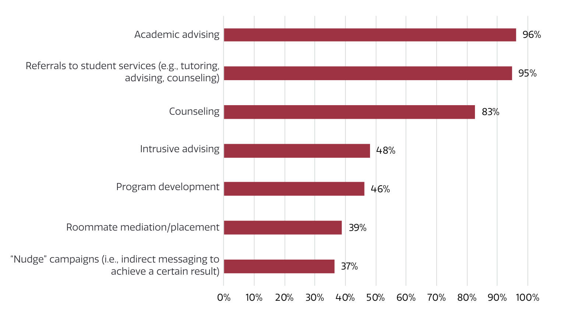
Interventions in use at institutions to improve student success
SOURCE: Parnell, Jones, Wesaw, and Brooks, Institutions’ Use of Data and Analytics for Student Success: Results from a National Landscape Analysis, research report (Washington, DC: NASPA, 2018), p. 19. Available from http://www.educause.edu/ecar.

Slide 34
Takeaways and lessons from the field

Slide 35
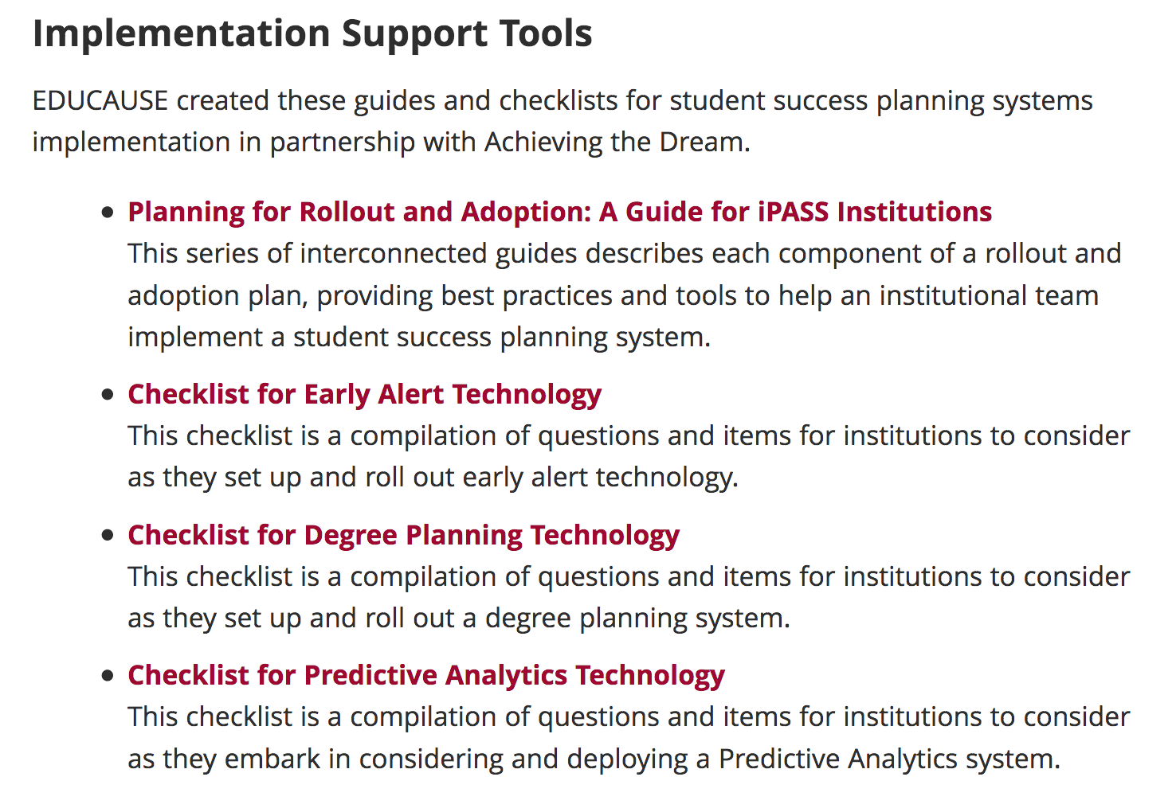
Implementation Support Tools
https://library.educause.edu/topics/information-technology-management-and-leadership/integrated-planning-and-advising-for-student-success-ipass
Notes:
https://library.educause.edu/topics/information-technology-management-and-leadership/integrated-planning-and-advising-for-student-success-ipass
Could also reference reports linked earlier
iPASS lessons from the field
Turning More Tassels
Tyton Driving Toward a Degree
CCRC July 2019
CCRC August 2019

Slide 36
Lessons from the field
Technology is a tool that enables meaningful interaction between humans.
A data-informed culture of hypothesis testing that leverages leading indicators can identify and maximize and celebrate momentum points, or drive iteration for improvement.
Diverse and visible leadership and engaged faculty, advisors, and other front-line staff are enablers of success.
A proactive approach to ethics and equity is critical to dismantle systemic bias and racism.
Deployment and adoption are not the same thing.
THIS IS HUMAN WORK.
Recent reports:
iPASS lessons from the field
Turning More Tassels
Tyton Driving Toward a Degree
CCRC July 2019
CCRC August 2019
Notes:
Straw man - this is what we saw recently; we have some other thoughts
CCRC July 2019: Not seeing substantial impact to retention yet but starting to see impact on leading indicators like % students meeting with advisors and other changes to student experience
CCRC August 2019: Four case studies. Lessons learned -
diverse leadership,
engage faculty,
tech is complex,
expect iteration
What do we know about the field?
iPASS lessons from the field: Lessons learned:
shift in advisor.student relationship from transactional to transformational, professionalization of advisor role,
shift in focus from technology to advisors,
coordination of care - holistic view of the student (ETC)
Turning More Tassels (webpage here) Jan 2019: return on investment of broad-based advising reforms—those that affect all students in a particular class. The study focused on Florida State University, Georgia State University, Montgomery County Community College, and the University of Texas at Austin. Findings:
Investment in personnel vs investment in tech.
Drivers of ROI: simplifying path to degree w maps and increasing right-time access to advisors.
Enablers: cross-functional team, selective use of data/analytics to drive actions, and use of software tools to inform the creation of simplified paths and keep students on track
Tyton Driving Toward a Degree:
Institutional perspectives:
Increasing coordination of care - integration of supports to serve whole student
Integrated student supports - lead to higher retention rates
Increasing adoption of guided pathways (up 9% since 2017) - but retention rates the same. Models are diverse. Lack of integration at guided pathways institutions.
Tech perspectives
Techs and services market related to advising is largest segment and 7% increase since 2017
Across 12 product categories related to advising, only academic planning/audit has institutional adoption rate greater than 50%
⅔ of administrators believe in the effectiveness of tech to improve advising
Caseload management; diagnostics; alerts, signals, and notifications; and performance management positively correlated with ideal advising situation
Competitive market; consolidated spend among top suppliers despite new entrants to the market.

Slide 37
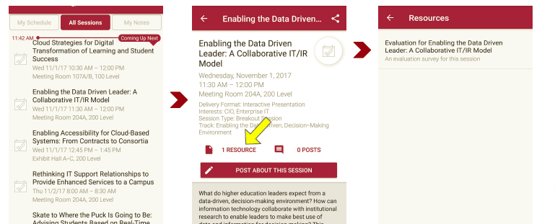
Session Evaluations There are two ways to access the session and presenter evaluations:
1
2
In the online agenda, click on the “Evaluate Session” link
From the mobile app, click on the session you want from the schedule > then scroll down or click on the associated resources > and the evaluation will pop up in the list

Slide 38
Contact Information
Kathe Pelletier
kpelletier@educause.edu
Christopher Brooks
cbrooks@educause.edu
Leah Lang
llang@educause.edu
NOTE: This presentation leaves copyright of the content to the presenter. Unless otherwise noted in the materials, uploaded content carries the Creative Commons Attribution 4.0 International (CC BY 4.0), which grants usage to the general public, with appropriate credit to the author.

