Slide 1
You’ve Been Hacked! A Data Breach Response Exercise
Matt Johnson
October 2019
attorney advertisement
Copyright © Cooley LLP, 3175 Hanover Street, Palo Alto, CA 94304. The content of this packet is an introduction to Cooley LLP’s capabilities and is not intended, by itself, to provide legal advice or create an attorney-client relationship. Prior results do not guarantee future outcome.

Slide 2
Agenda
Scenario 1 (3:20-3:40)
Scenario 2 (3:40-3:50)
Takeaways and Q&A (3:50-4:00)
Fine print disclaimer: This presentation is not legal advice.

Slide 3
Scenario 1

Slide 4
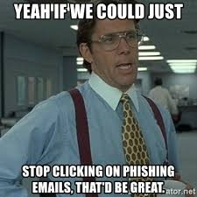
Scenario 1: Dave
The University receives a call from the FBI that student and employee sensitive information (including SSNs) is available on the dark web. The information is not public.
Forensics analysis with IT support determines that an administrator account (Dave from financial aid) accessed and downloaded numerous sensitive files.
Forensics determines that Dave was victim to a phishing attack infecting the system with malware.
No instances of identity theft or unauthorized use of personal information is known to-date.

Slide 5
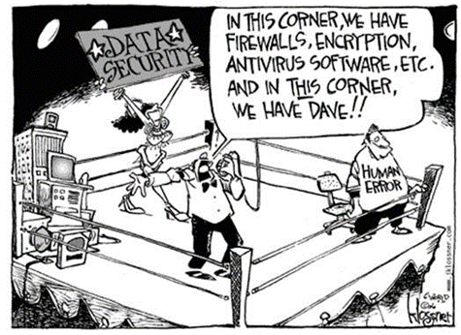
Scenario 1: Dave
Training
Account restrictions
Anti-malware software
Incident Response Plan
Law Enforcement Comms
Public (and Employee) Comms
Breach Notification & Remediation
Insurance

Slide 6
Scenario 2

Slide 7
Scenario 2: Bitcoin Blackmail
At 7 am on the first day of the Fall Term, you are woken up by multiple emails and calls that all University systems are down.
Initial investigation confirms that University is the victim of a ransomware attack. Attackers are threatening to permanently destroy all locked data unless paid $5M in crypto within 48 hours.
In the meantime, University resources are inundated with calls from students.

Slide 8
Scenario 2: Bitcoin Blackmail
Prevention
Forensics
Incident Response
Backup and Disaster Recovery
Comms (Again)
Law Enforcement?
Pay Ransom?

Slide 9
Takeaways and Q&A

Slide 10
Takeaways
Calm and measured response is critical
Preparation is key to being calm and measured.
Conduct risk assessments
Data mapping
Review and update policies and practices
Review vendor commitments
Create a response team
Develop incident response procedures (internal & external)
Employee training & awareness
Monitor Effectiveness

Slide 11
Thank you for attending! Questions? Matt Johnson: mjohnson@cooley.com

