Slide 1
Transform Your Campus
With Student-Centered Decision Making
Robert Bramucci, Ph.D. Vice-Chancellor, Technology & Learning Services
Jim Gaston, IT Director
Sandi Pope, SIS Support Manager
Yen Kwan, Business Analyst
Student Design Team
Tony Bautista
Bita Gheibi
Kelsey Lillie
Sam Seifollahi

Slide 2
Agenda
Introductions
Who you are
What you do
Why you are here
Background on SOCCCD District IT
Student Design Team
SmartSchedule Project

Slide 3
SOCCCD Custom Student Information System (SIS)

Slide 4
SOCCCD Student Success Systems
MAP
Sherpa
Predictive
Analytics
Student Success
Dashboard
Progress Report
(Early Alert)
SmartSchedule

Slide 5
Student Design Team

Slide 7
Student Design Team Primary Tasks
Weekly Meetings with IT Director and staff
Participate on project design teams
Provide direct feedback on system development
Help facilitate focus groups to get broader student input
Create help videos for new systems

Slide 8
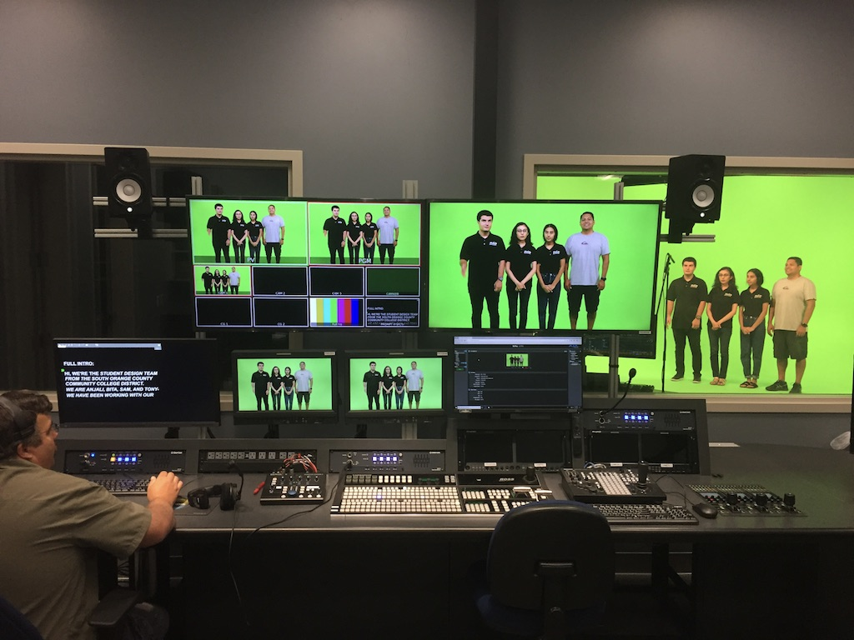
Help Videos

Slide 10
Advice From Our Students for Creating a Team
Start somewhere
Leverage existing groups to get feedback
Don’t use students as just a figurehead
Get them involved early in the process and include them in every stage
Let them talk directly to the people empowered to make decisions
Pick students who will be assertive and encourage it – even if you don’t like what they say
Get a broader view
Larger design teams – students opinions should be equal with others
Focus groups – use design team to help facilitate them
Surveys

Slide 11
Benefits to the students on the team
Real world experience in a professional setting
Great addition to their resumes
Develops understanding of how the colleges work
Builds confidence

Slide 12
Logistics
Application Process
Hiring
Communication
Meetings

Slide 13
SmartSchedule Project

Slide 14
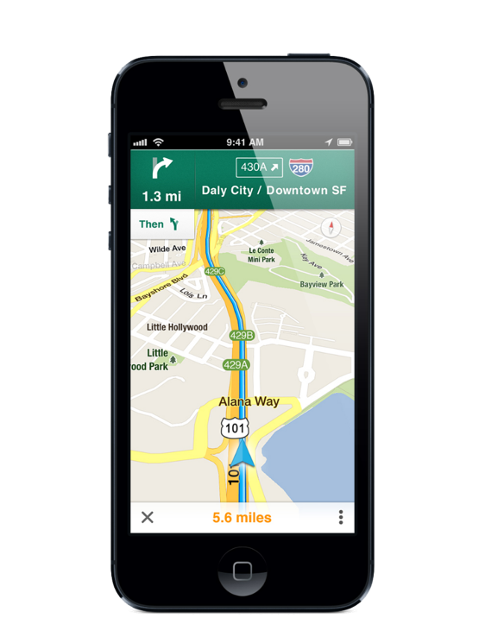
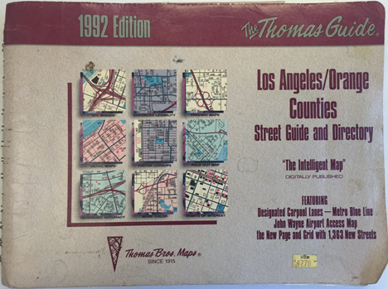
SmartSchedule Goal

Slide 15
Choice Architecture
Index vs. Search
Summary vs. Detail
Generic vs. Customized
Aggregation
Terminology
Sorting
The Power of the Default

Slide 16
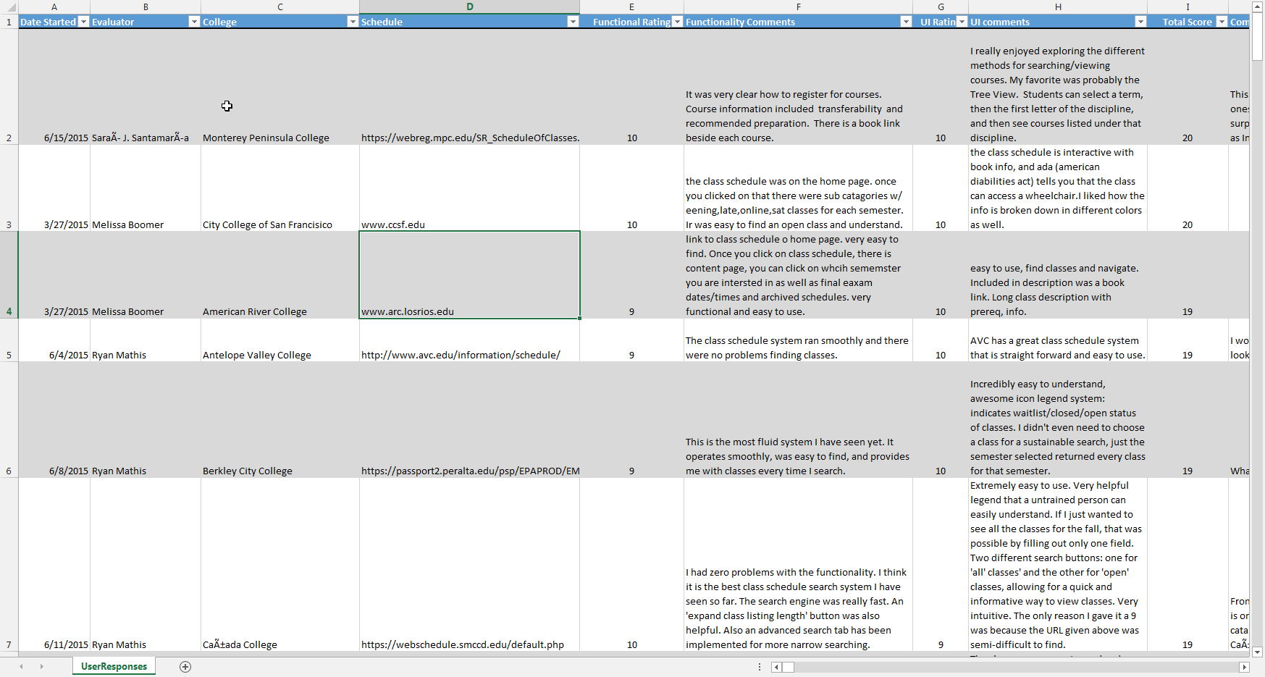
Student Review of Class Schedules

Slide 17
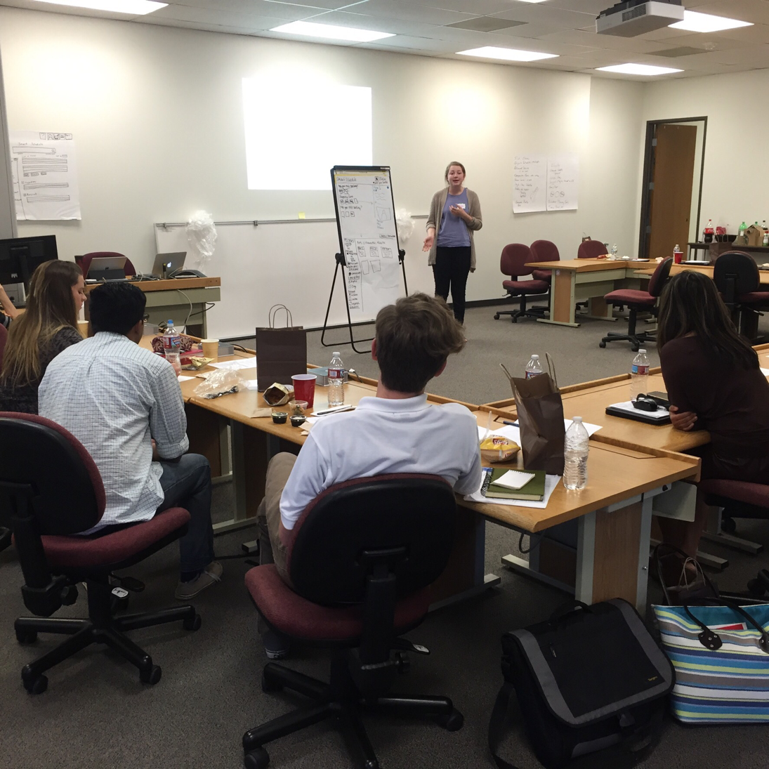
Design Work - Brainstorming

Slide 18
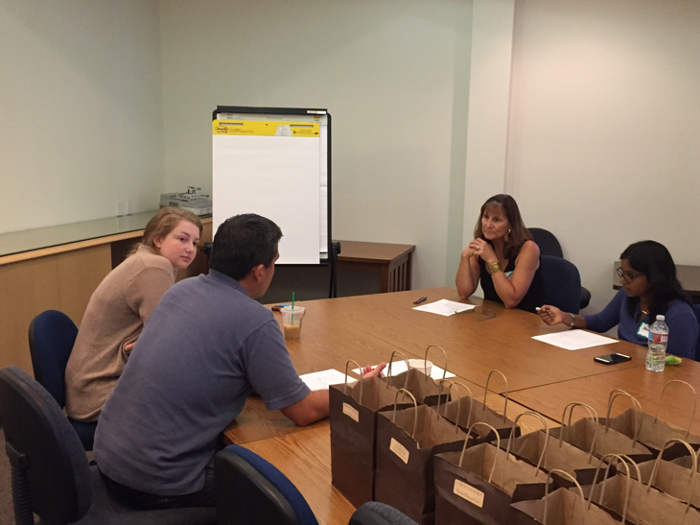
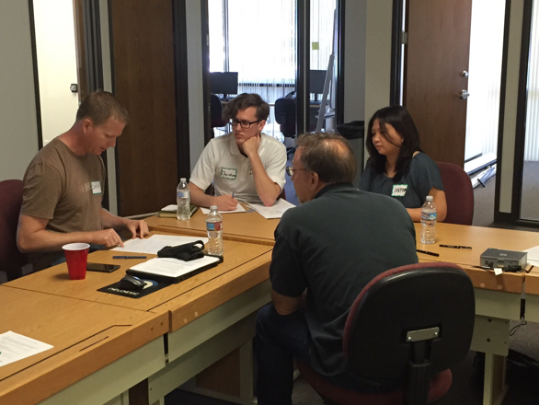
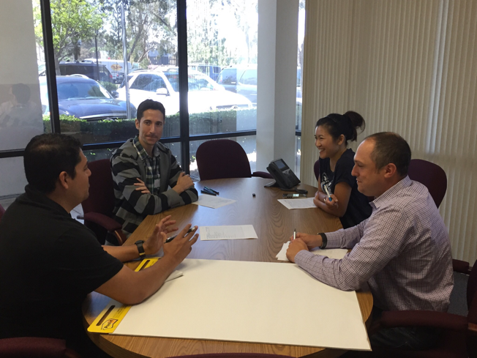
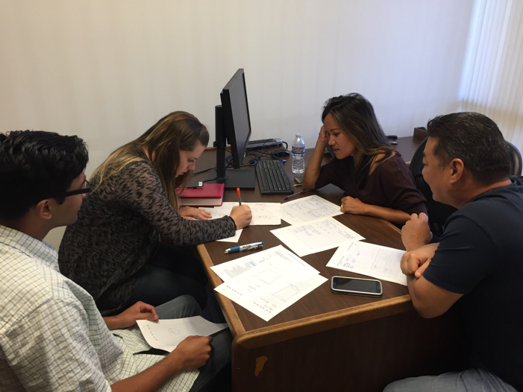
Detailed Design Work with Development Team

Slide 19
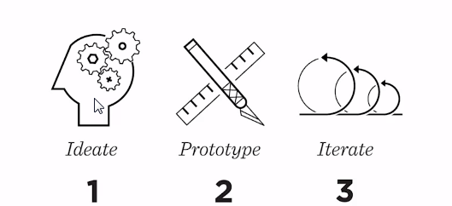
Design Process

Slide 20
Persona Based Design
Olivia the Overachiever
Uri the Undecided
Abby the Adult Learner
Ed the Emeritus Student
Ivan the International Student
Harry the High School Student

Slide 21
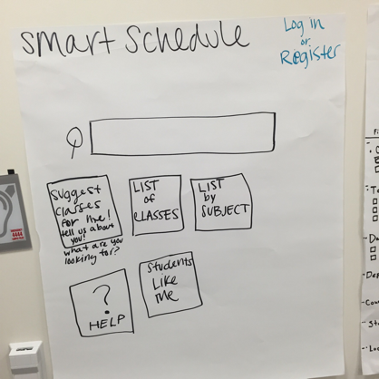
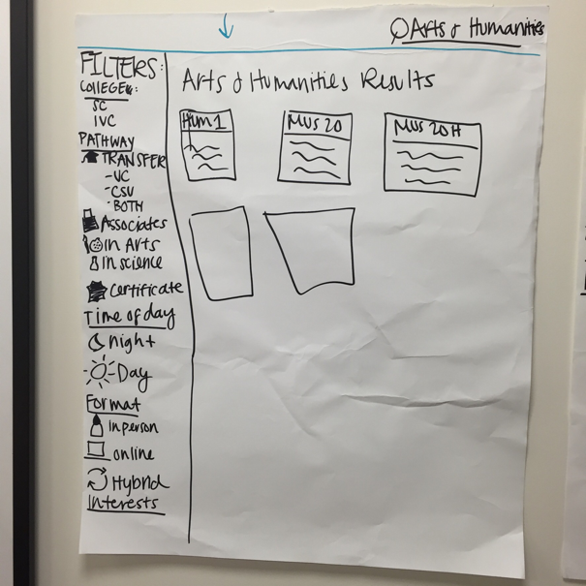
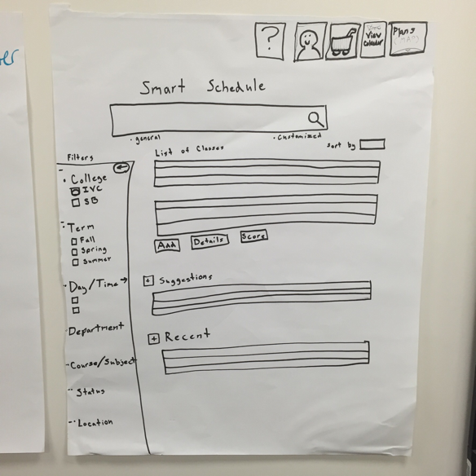
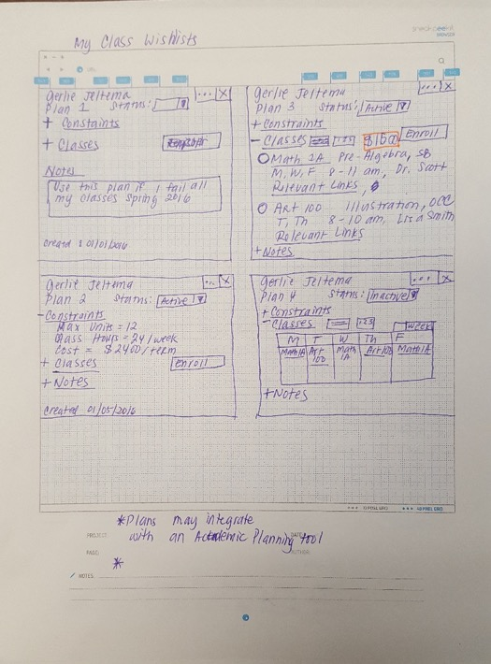
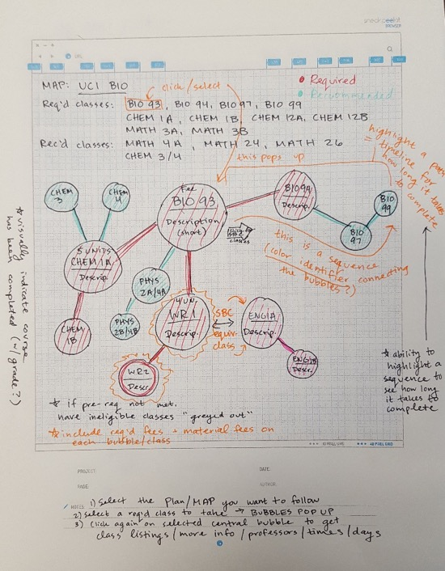
Rough Sketches

Slide 22
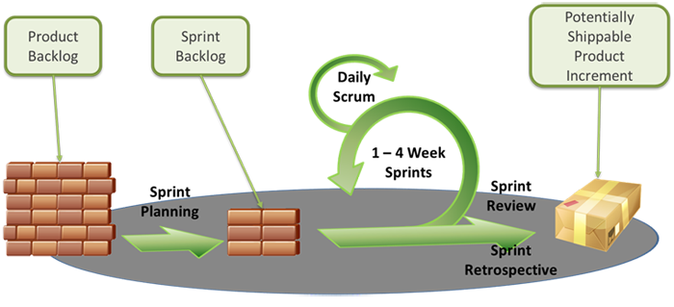
Development Process

Slide 23
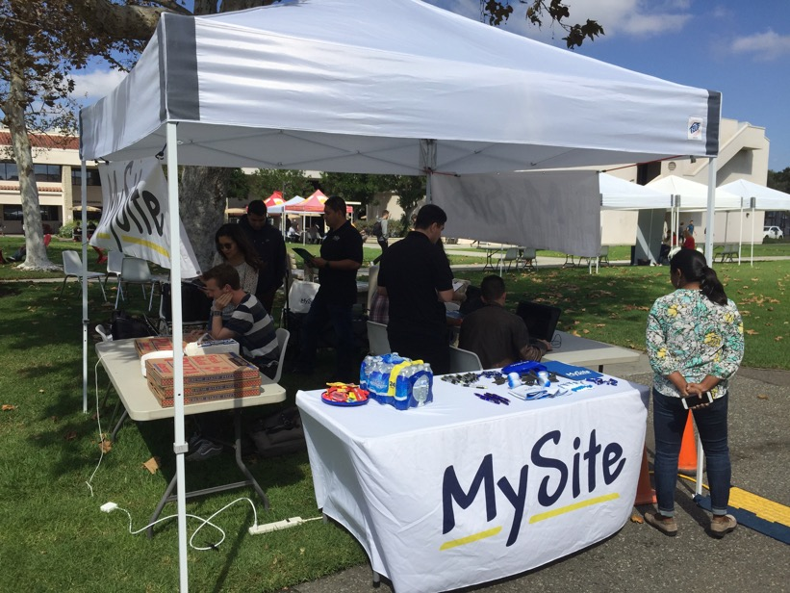
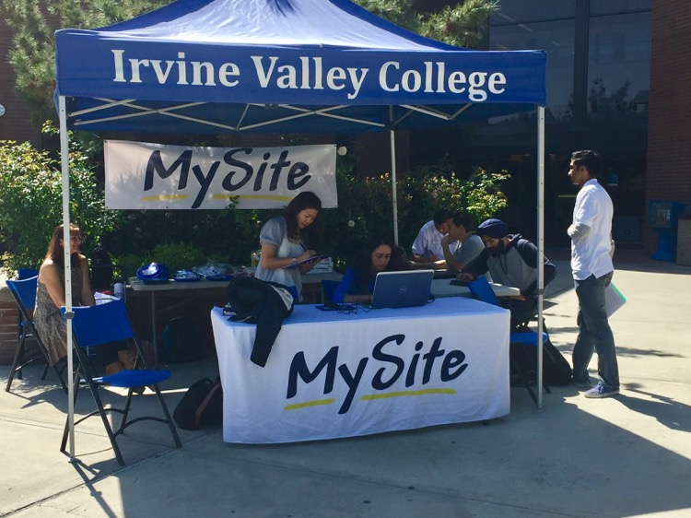
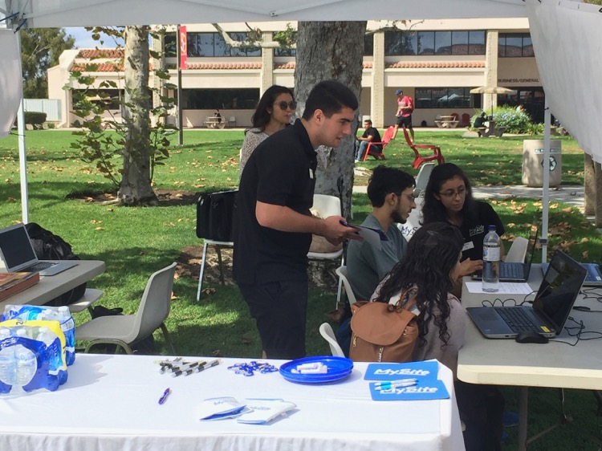
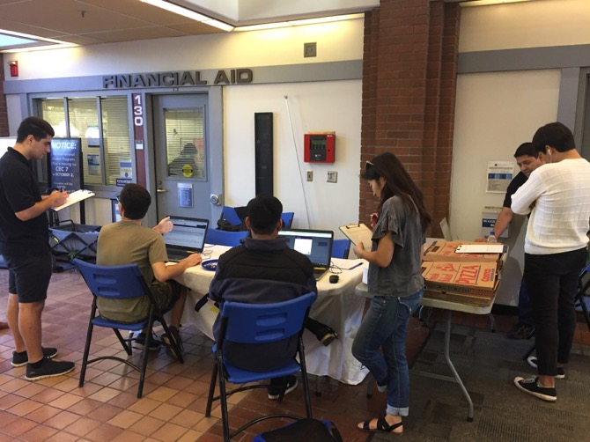
Focus Groups - Informal

Slide 24
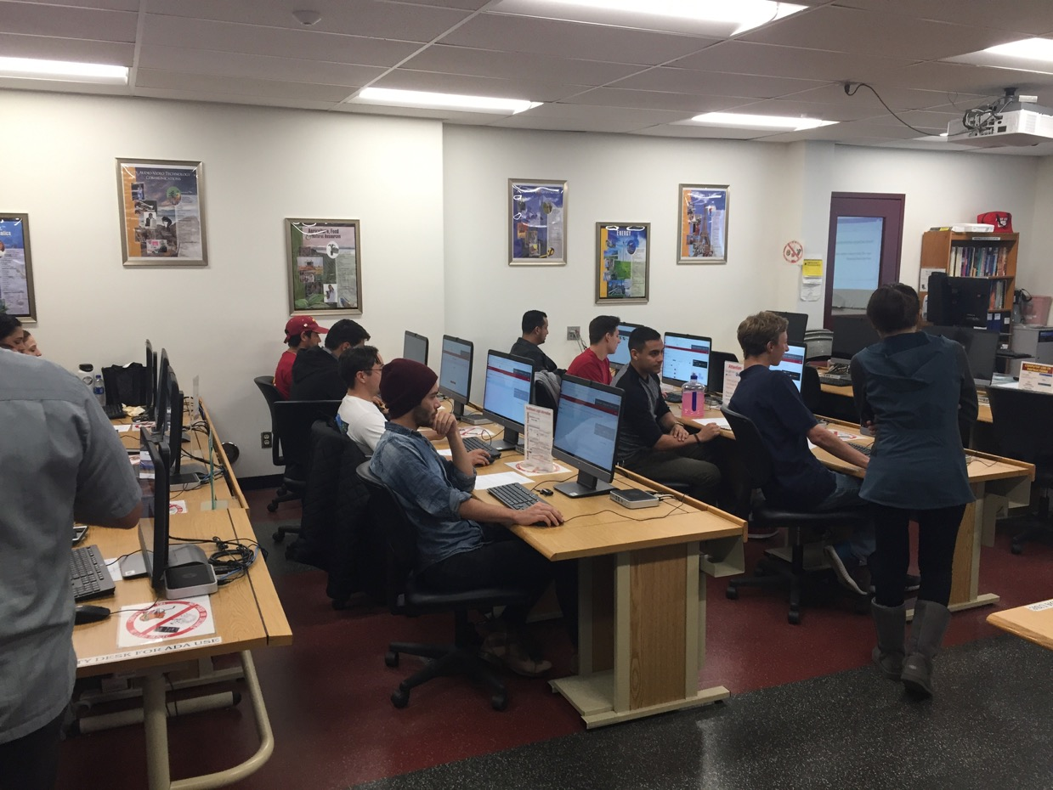
Focus Groups - Formal

Slide 25
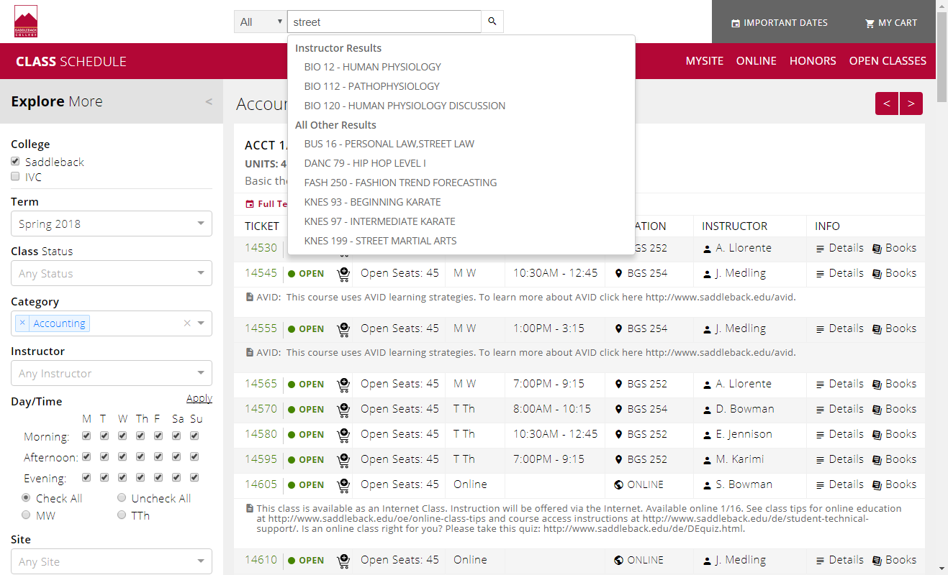
SmartSchedule Demonstration

Slide 26
Questions?
Robert Bramucci: rbramucci@socccd.edu
Jim Gaston: jgaston@socccd.edu
Notes:
`

