Slide 1


Time for Class: Digital Courseware Adoption in Higher Education
October 2019

Slide 2
Today’s Learning Outcomes
Understand key market dynamics and supply and demand-side trends in the digital courseware space
Learn about and share tools, strategies and resources to support faculty and administrators making decisions about selecting courseware.
Contribute to closing gaps in our knowledge base, with a focus on student experiences, needs and preferences for courseware.

Slide 3
What perspectives are represented today?
What best describes your role?
Faculty at institution
Administrator at institution
Publisher
Other
PollEv.com/kristenfox450

Slide 4
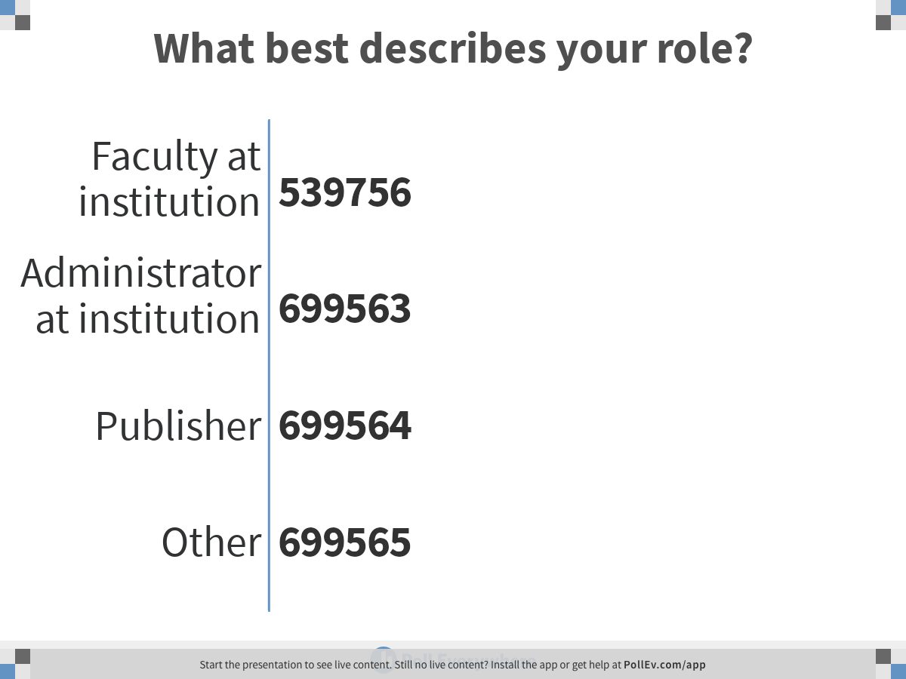
Notes:
What best describes your role?
https://www.polleverywhere.com/multiple_choice_polls/hiaES82frf4yB94g43BpA

Slide 5



Our conversation today is focused on instructional content and courseware as part of broader “digital learning” ecosystem
 |  | Digital Learning* Supplier Ecosystem
Value Proposition | Core Teaching & Learning
 | Efficiency and Productivity
 |  |  | Faculty |  |  | Enterprise
 |  |  | Primary Decision-Maker
Category | Definition
Instructional Material “IM” | Content (print or digital) used for core or supplemental teaching and learning purposes; Includes new, used, rental, and OER materials e.g. McGraw-Hill, OpenStax
Courseware “CW” | Learning platform + instructional content that delivers instructional material via integrated digital learning experience; can be content-led or platform-led e.g. Cengage MindTap, ALEKS
Instructional Tools “IT” | Supplementary tools that facilitate the process of learning within a course or program e.g. ConnectYard, Piazza, iClicker
Online Program Management “OPM” | Services designed to scale, grow, and drive success of online learning through outsourced management of non-academic functions e.g. 2U, Wiley Education Services
Learning Management Systems “LMS” | Software applications and platforms for the administration and delivery of educational programs e.g. Canvas, Blackboard
I. Instructional content and courseware
IV. Enterprise online learning platforms
IM
CW
CW
LMS
IT
OPM
II. Collaboration and supplemental tools
III. Institution-wide delivery platforms
*Digital learning can take place in online, face-to-face, or hybrid environments

Slide 6
Courseware can be a powerful tool to transform learning, especially in large introductory classes
Courseware is a digital instruction tool that includes content and assessment; it is scoped and sequenced to support an entire course. Courseware enables full-course digital content delivery and assessment and is not a learning management system (LMS).
The emerging evidence base around courseware shows potential to improve outcomes, increase access, increase engagement, and decrease costs for students.
Courseware is used to achieve outcomes across four broad categories—outcomes, engagement, access, and affordability.
However, courseware is an ends to a means, and is only effective in achieving these outcomes when high quality solutions are implemented well and with sufficient support for faculty.

Slide 7
Time for Class is an annual longitudinal study that tracks courseware & a broader digital learning ecosystem
Overview
Topics Covered
Time for Class Time for Class is a comprehensive longitudinal survey of 4,000+ higher education faculty and administrators, fielded since 2014 by Tyton Partners and the Babson Survey Research Group and underwritten by the Bill & Melinda Gates Foundation.
Work conducted in partnership with Every Learner Everywhere, incl. Educause.
Results inform a comprehensive fact base on the postsecondary digital courseware landscape, in the service of making this diverse and complex market easier to navigate for institutions and education professionals.
Online surveys deployed December 2018 – January 2019 to administrators and faculty at postsecondary institutions
Digital Learning
  Digital learning in strategic plan and progress towards ideal
  Attitudes towards digital learning
  Decision-making and information sources
  Barriers and enablers of digital learning, incl. professional development
Courseware and Digital Tools
  Awareness, current use and planned future use
  Perceived value
  Adoption dynamics – types of courses adopted in; use cases; feature set preferences,
  Decision-making and motivation for use
  Distribution and inclusive access

Slide 8
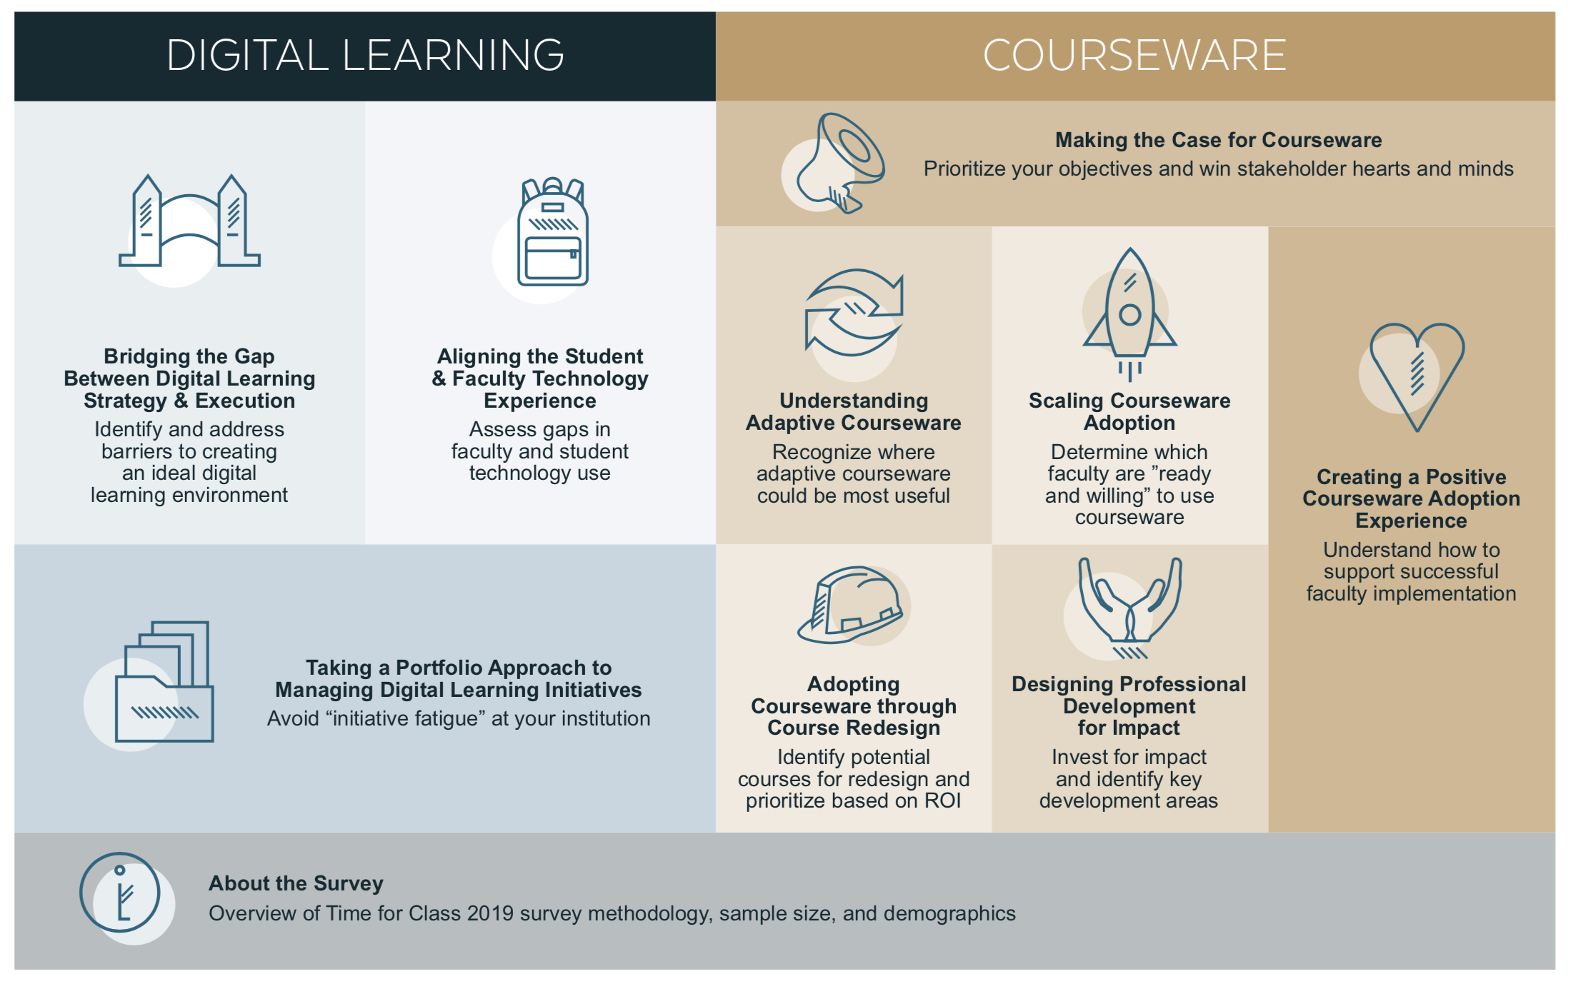
2019 work culminated in nine user-focused action briefs which can be accessed via the link below
https://www.everylearnereverywhere.org/time-for-class-toolkit

Slide 9
01
Market Dynamics

Slide 10
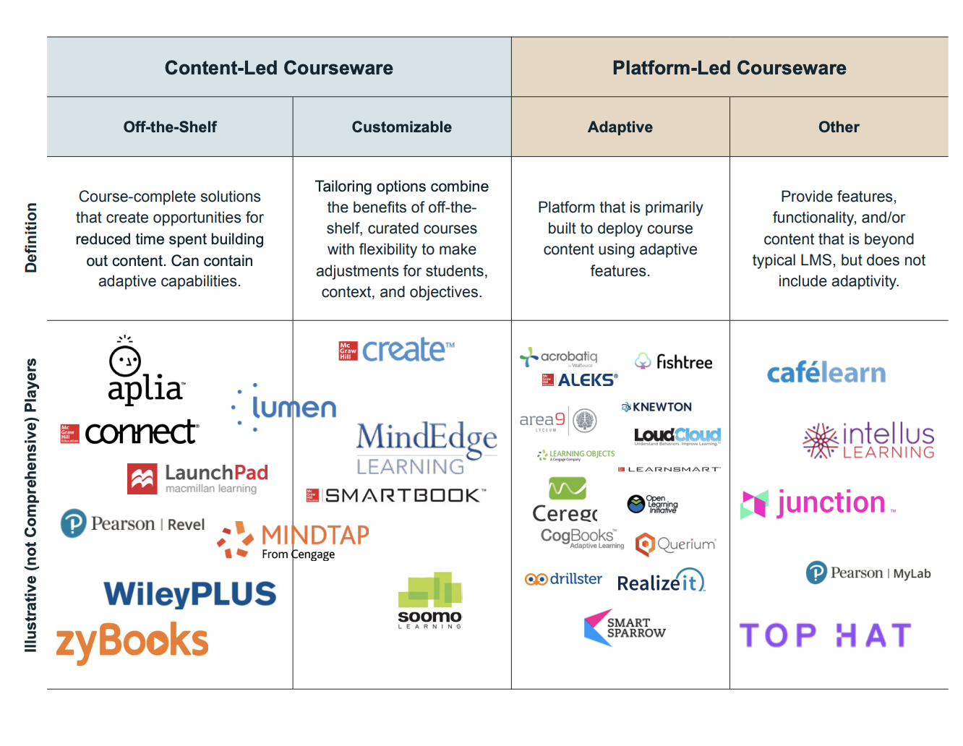
Courseware ranges from content to platform led
*Now owned by Wiley
Source: Tyton Partners analysis

Slide 11
Institutional adoption has been reported by 50%+ of administrators; primary goal is improving student outcomes
Administrator courseware usage across institution types
Is courseware used in your institution?
Not used
Why was courseware adopted at your institution? Select your top 3 reasons
Improve student outcomes – 66% Reduce the time and effort it takes to maintain content– 51% Standardize instructional quality– 49%
67%
66%
53%
58%
58%
50%
41%
Used at my
institution
Overall
2-year
Low
2-year
High
4-year
Public
Low
4-year
Public
High
4-year
Private
Low
4-year
Private
High
N = 1,578
Left Question: Please tell us about your awareness and use of the following digital learning offerings
Sources: Time for Class 2019; Tyton Partners analysis

Slide 12
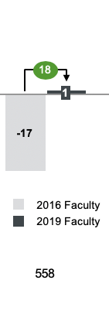
Faculty courseware adoption is higher in 2019 than 2016; Satisfaction with existing products is also higher
Faculty courseware adoption shifts from 2016 to 2019
Faculty Net Promoter Score for Courseware Currently in Use
2016 | 2019
2016 | 2019
2016 | 2019
Not Adopted
33%
34%
36%
N =
Adopted
25%
21%
27%
Overall
2-year
4-year
2016 N = 2,322
2019 N = 2,347
2016 Question: Which description below best describes the use of courseware at your institution: primarily used among individual faculty, used at the department or college level; used institution wide
2019 Question: Please tell us about your awareness and use of the following digital learning offerings: Aware of courseware and I currently use; Aware of courseware and have used but am not currently using
Sources: Time for Class 2016 and 2019; Tyton Partners and Babson Survey Research Group analysis
Notes:
How do you use courseware in your class?
For graded homework – 67%
For active learning – 60%
For additional reference – 51%

Slide 13























Courseware providers fall along the adaptive spectrum - and highly adaptive products have low use
45%
Faculty: Select all courseware products you used or have used
40%
35%
30%
25%
Faculty Use (%)
20%
15%
10%
5%
0%
Degree of Alignment with CWiC Adaptive Elements

Slide 14
Adaptive products compose 90% of primary adoption
Faculty: Which courseware product do you use in the highest enrollment course you teach?
494
Non-Adaptive Products
10%
Adaptive Other*
16%
Cengage Mindtap
11%
Macmillan LaunchPad 5%
Adaptive Courseware Products
McGraw-Hill Connect
16%
Pearson MyLab
30%
Cengage Learning Objects 6%
WileyPLUS 7%
Question: Which of the following courseware products do you use?
* Adaptive Other includes Acrobatiq, Aplia, Café Learn, Cerego, Knewton, Loudcloud, ALEKS, LearnSmart, Smartbook, MindEdge Learning, RealizeIt, Sapling, SmartSparrow, zyBooks ** Non-Adaptive Other includes Candela, Chegg Math Solver, Intellus Learning, Waymaker
Sources: Time for Class 2019; Tyton Partners analysis

Slide 15
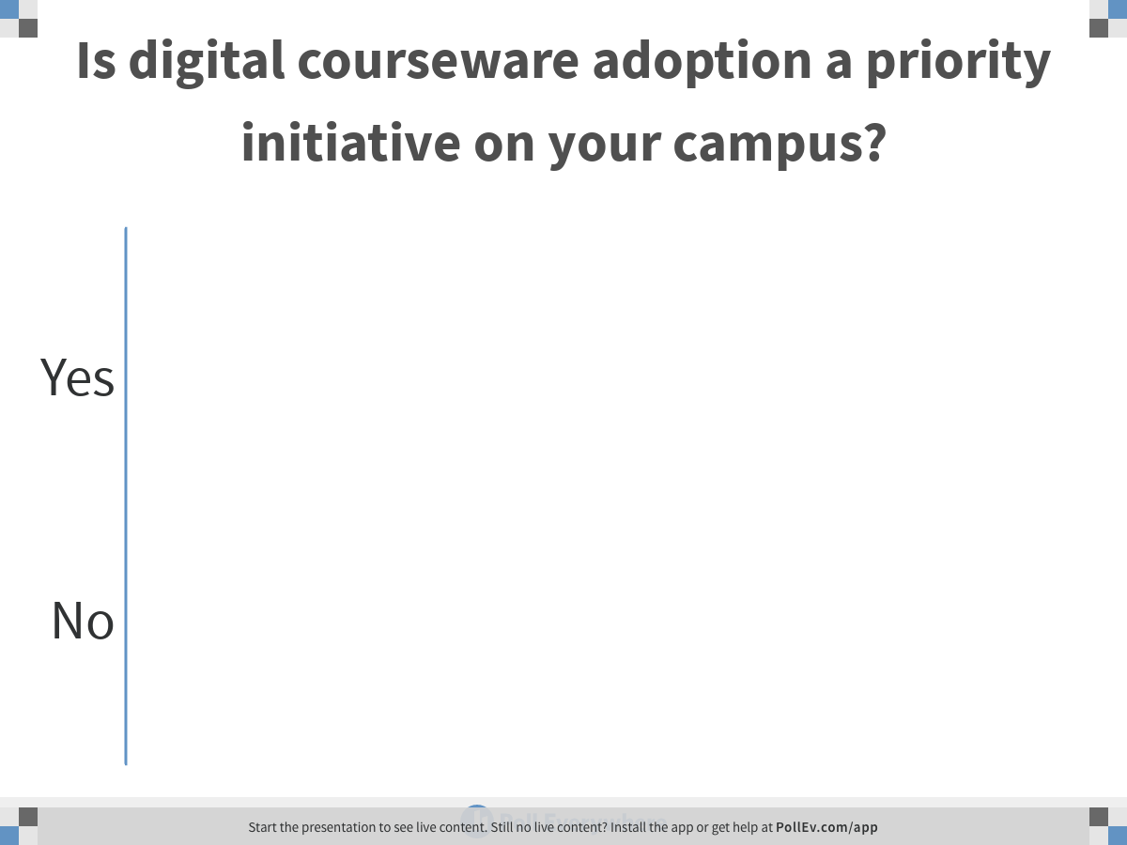
PollEv.com/kristenfox450
Notes:
Is digital courseware adoption a priority initiative on your campus?
https://www.polleverywhere.com/multiple_choice_polls/hnC7Le821A8C5gffs9zkL

Slide 16
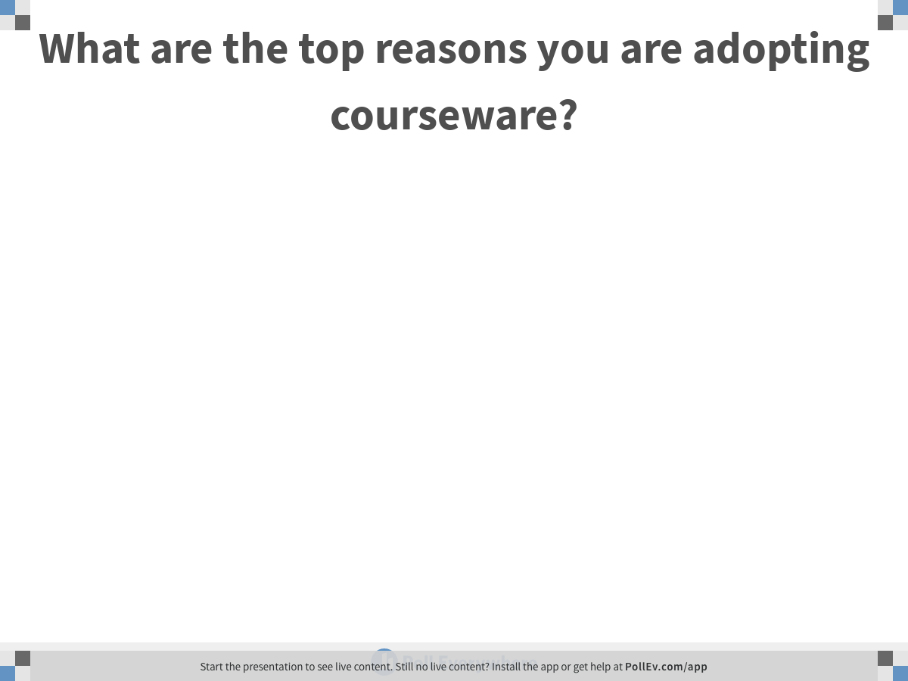
PollEv.com/kristenfox450
Notes:
What are the top reasons you are adopting courseware?
https://www.polleverywhere.com/free_text_polls/urm9ciltjAeH07pFlKRNQ

Slide 17
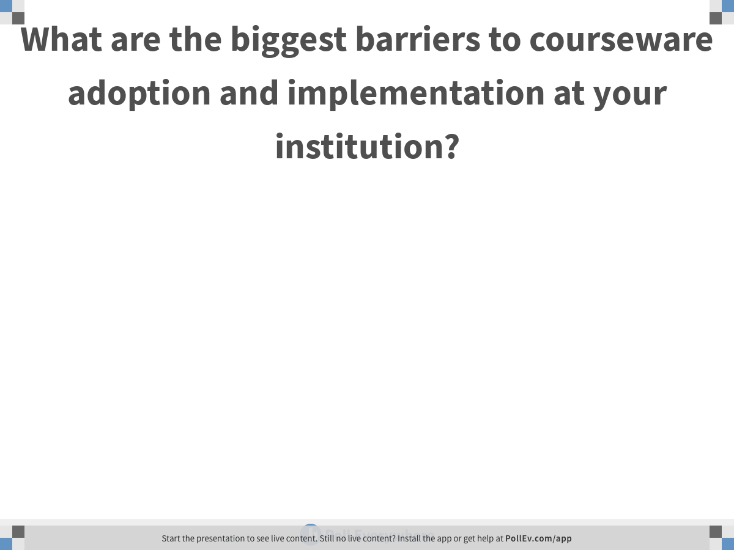
PollEv.com/kristenfox450
Notes:
What are the biggest barriers to courseware adoption and implementation at your institution?
https://www.polleverywhere.com/free_text_polls/nz3Iy5jwhKgu5K9XtMvD7

Slide 18
Per student spend on instructional materials is down; major publisher share increasing with shifts to digital
Publisher Revenue, Market Share and Average Student Spend on Instructional Materials 2015-2017*
$7B
$650
$602
$600
$6B
$5.8B
$484
$500
$5B
Other
$1.8B
(31%)
$4.1B
$400
$4B
Wiley $0.3B (5%)
Publisher Revenue**
McGraw-Hill
$0.8B
(14%)
Other $0.7B (18%)
Average Student Spend on Course Materials
$3B
Wiley $0.3B (6%)
$300
Cengage
$1.1B
(19%)
McGraw-Hill
$0.7B (18%)
$2B
Cengage
$0.8B
(21%)
$200
$.5B
Pearson
$1.8B
(32%)
Pearson
$1.5B
(37%)
$100
$0B
$0
2015
2017
Δ%
Student Spend
CAGR 2015-2017 | Pearson | Cengage | McGraw-Hill | Wiley |  | Other
 | -9% | -12% | -7% | -4% | -16% | -24%
Total Market
*Note: Percentages may not add to 100% due to rounding
**Note: Revenue takes into account both print and digital materials
Sources: Company Annual Reports and Investor Filings; NACS.org; Tyton Partners analysis
Notes:
All publishers are seeing decreased revenue due to fundamental industry headwinds
Declining enrollment - 2018 marks seventh year in a row where fewer students in the U.S. attended college than the year prior according to NSC Research Center
- Growth of Print Textbook Rental Market - All major publishers note this as a business risk in their annual reports
Movement from Print to Digital
Tyton Partners estimates that 46% of instructional materials revenue is from digital in 2017
Adoption of Open Educational Resources - 34% of faculty reported having used OER, according to Tyton Partners analysis
Decreased Student Spend - National Association of College Stores noted a 20% decline in per student spend from 2015-2017
24% decrease in student spend
Pearson -9%, Cengage -12%, MHE -7%, Wiley-4%, total market -16%

Slide 19
Inclusive access is continuing to experience rapid institutional adoption
27% of administrators report having Inclusive Access agreements in place
69% of those who are aware plan to maintain or increase use in the future
Current Awareness and Use*
Anticipated Future Use**
1,431
682
Unsure
15%
NA/Don't Know
25%
What is Inclusive Access?
Negotiated institutional deals for “day 1” digital delivery of instructional content. This is positioned as a strategy to provide lower cost access to students with higher sell-through for publishers.
Not
aware
24%
Not Use, 4%
Decrease Use, 2%
Use at
same levels
24%
Aware,
not used
at institution
35%
Increase Use
45%
Aware, used
at institution
27%
*Please pick what best describes your awareness and institutional use of Inclusive Access.
**How would you describe your institution’s use of inclusive access in the next three years?
Survey Definition: “Inclusive Access (also known as digital direct or immediate access) is where publishers such as Pearson, Cengage, McGraw Hill, or Wiley may partner with organizations such as Vital Source, RedShelf, Verba, Follett and Barnes & Noble to provide digital access to all students in a class on a subscription basis.”
Sources: Time for Class 2019; Tyton Partners / Babson Survey Research Group analysis
Notes:
Less choice, no long term access for faculty and students
Loss of bookstore recv
More barriers to entry for independenta
Products, roles and power structures will continue to shift
Students/Faculty
Choosing between owning and renting
Choosing print and/or digital
Leveraging more tools for price comparison
Publishers
Managing their own secondary markets
Attempting to lock in more, bigger deals
Building a business around OER
Institutions
Experimenting with new digital learning tools
Using buying power strategically
Balancing student savings and faculty freedom

Slide 20
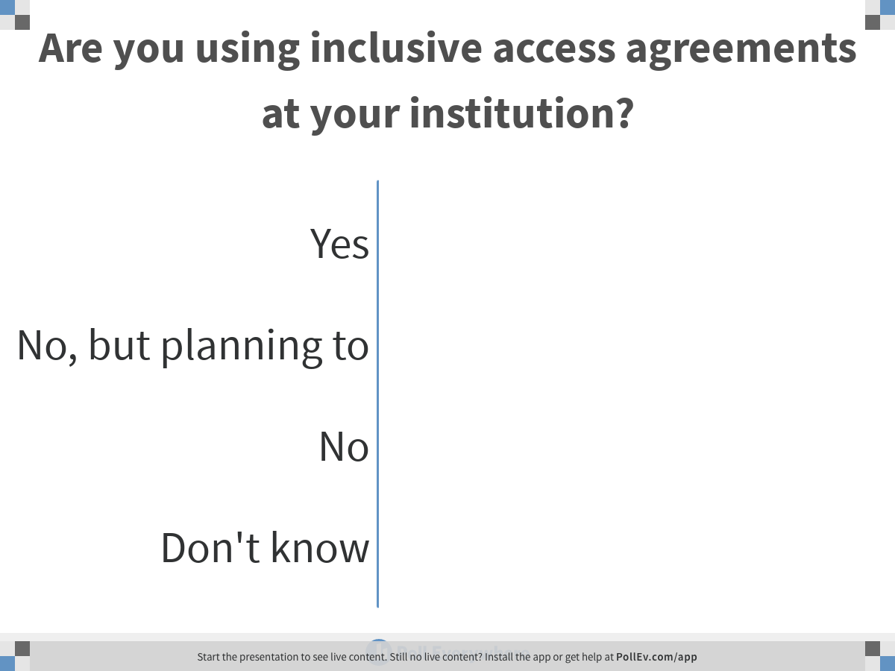
PollEv.com/kristenfox450
Notes:
Are you using inclusive access agreements at your institution?
https://www.polleverywhere.com/multiple_choice_polls/Igrdast07KzzS5jI3whWO

Slide 21
02
The Faculty Perspective

Slide 22
Administrators and faculty agree on key barriers to digital learning implementation – time and effort required
What factors have contributed most negatively towards the implementation of digital learning?
Time necessary to
adopt and implement
48%
56%
Faculty time / effort required
59%
52%
Competing priorities
42%
38%
Limited support staff
41%
29%
Institutional budget
and related policies
26%
22%
7%
Faculty more likely to be concerned about cost to students
Additional cost to students
19%
Concern over efficacy in
improving learning outcomes
19%
Efficacy concerns are only a barrier for less than 20% of faculty and administrators
19%
Technical integration challenges
15%
16%
14%
Administrator
Awareness of relevant tools
15%
Faculty
Technology is not yet mature
6%
5%
Admin N = 1,583 Faculty N = 2,357
Note: Select up to three answer options
Note: Efficacy concern as barrier down from 26% in 2014 Survey
Sources: Time for Class 2019; Tyton Partners analysis

Slide 23
PD is seen as the most important enabler of digital learning by both faculty and administrators
What factors have contributed most positively towards the implementation of digital learning?
Support for faculty PD
52%
53%
Access to instructional designers /
avail. of instructional design resources
46%
38%
Important enablers but less uniform agreement
A center for distance education and / or
a center for teaching and learning
39%
43%
Supportive institutional culture
40%
47%
Supportive institutional budget
and related policies
24%
23%
25%
Administrator
Time off and / or stipends for faculty
21%
Faculty
Opportunities for faculty promotion,
recognition, awards
8%
8%
Admin N = 1,453 Faculty N = 2,089
Note: Select up to three answer options
Sources: Time for Class 2019; Tyton Partners analysis

Slide 24
Courseware features sought most often by faculty are usability and customization – adaptivity in the middle of pack
Faculty: Top ranked capabilities
when selecting courseware
Usability
66%
Customization
65%
Depth of Interaction
63%
Faculty: Top Uses for Courseware
Measurement and Structure
58%
How do you use courseware in your class?
For graded homework – 67% For active learning – 60% For additional reference – 51%
Feedback
53%
Scaffolding
51%
Adaptivity
50%
Collaboration
41%
Packaged Content
36%
Learner Autonomy
34%
Other
4%
N = 632
Question: Please indicate which of the following capabilities are important to you in selecting courseware? Please select all that apply.
Sources: Time for Class 2019; Tyton Partners analysis
Notes:
High distance
Feedback
Usability
Content
4-year
Learner autonomy
2-year
Customization

Slide 25
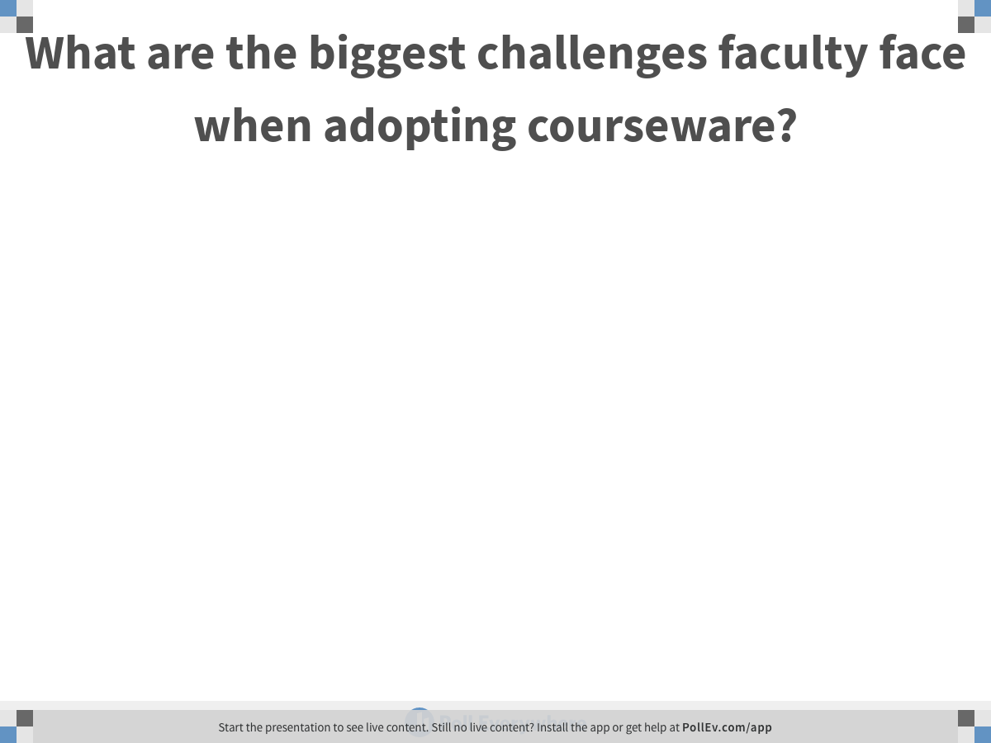
PollEv.com/kristenfox450
Notes:
What are the biggest challenges faculty face when adopting courseware?
https://www.polleverywhere.com/free_text_polls/L1Aqb6Vnbkwb8zd41JW58

Slide 26
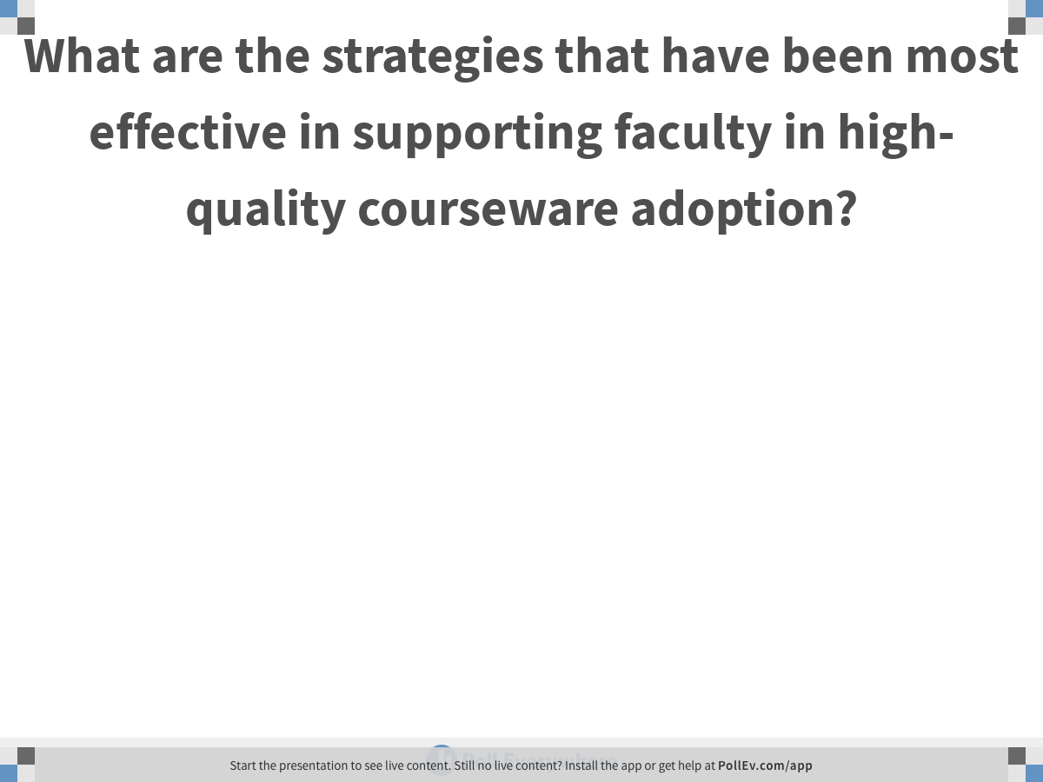
PollEv.com/kristenfox450
Notes:
What are the strategies that have been most effective in supporting faculty in high-quality courseware adoption?
https://www.polleverywhere.com/free_text_polls/PPf3gPHj29wztQV8xxJUP

Slide 27
03
What About the Student?

Slide 28
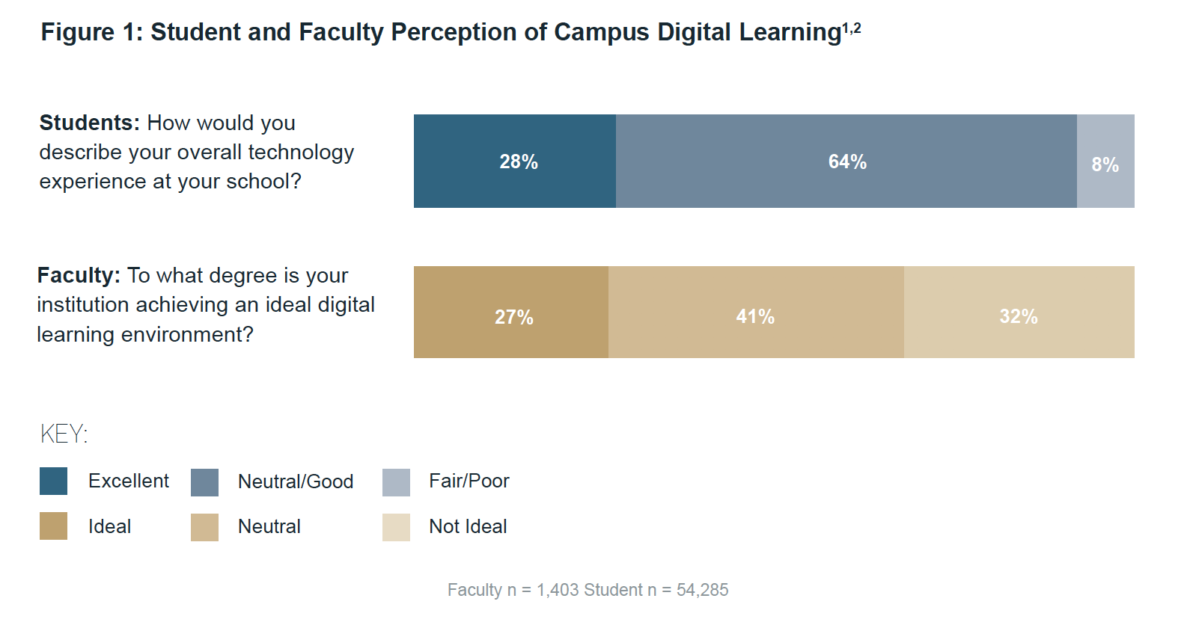
Students generally have a more positive view of instructional technology than faculty do
1EDUCAUSE’s ECAR Study of Undergraduate Students and Information Technology, 2018 collected responses from approximately 50,000 students across the United States. These students represent both public and private institutions as well as two-year and four-year institutions. 2Student question: “How would you describe your overall technology experience at your school?” Faculty question: “To what degree is your institution achieving an ideal digital learning environment?”

Slide 29
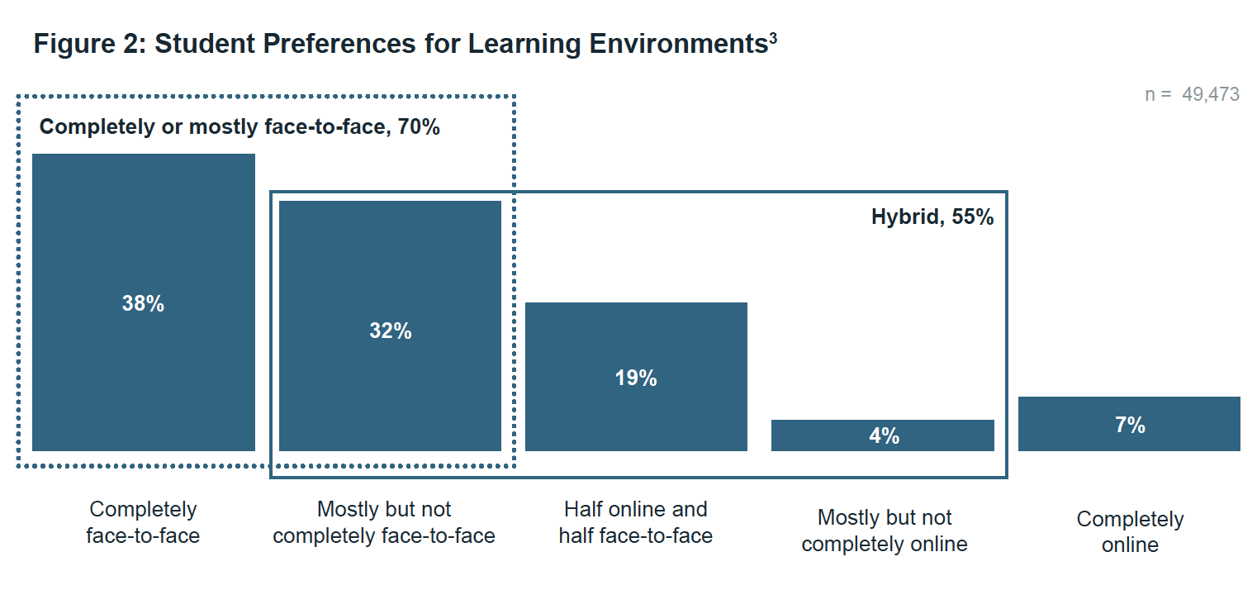
The majority of students prefer hybrid learning experiences that blend face-to-face and online instruction

Slide 30
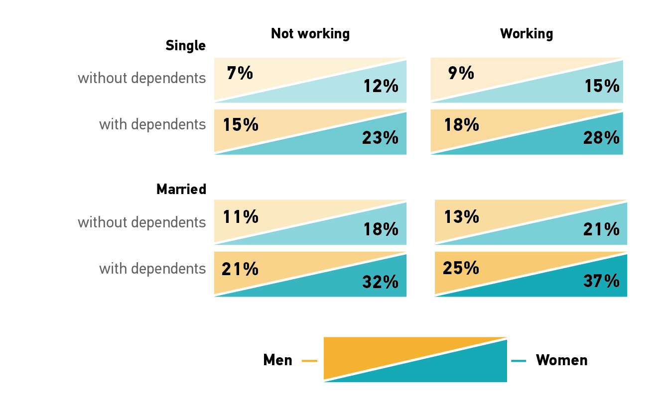
Community college student preferences for mostly to fully online courses are dependent on key demographics
SOURCE: Dana C. Gierdowski and D. Christopher Brooks, “Whatever It Takes,” Data Bytes, EDUCAUSE Review (11 October 2019). Data from EDUCAUSE 2018 ETRAC Student Survey.
Notes:
DCB

Slide 31
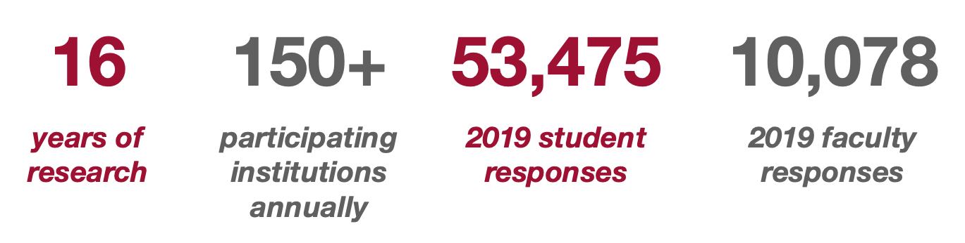
EDUCAUSE Technology Research in the Academic Community (ETRAC)
by the numbers

Slide 32
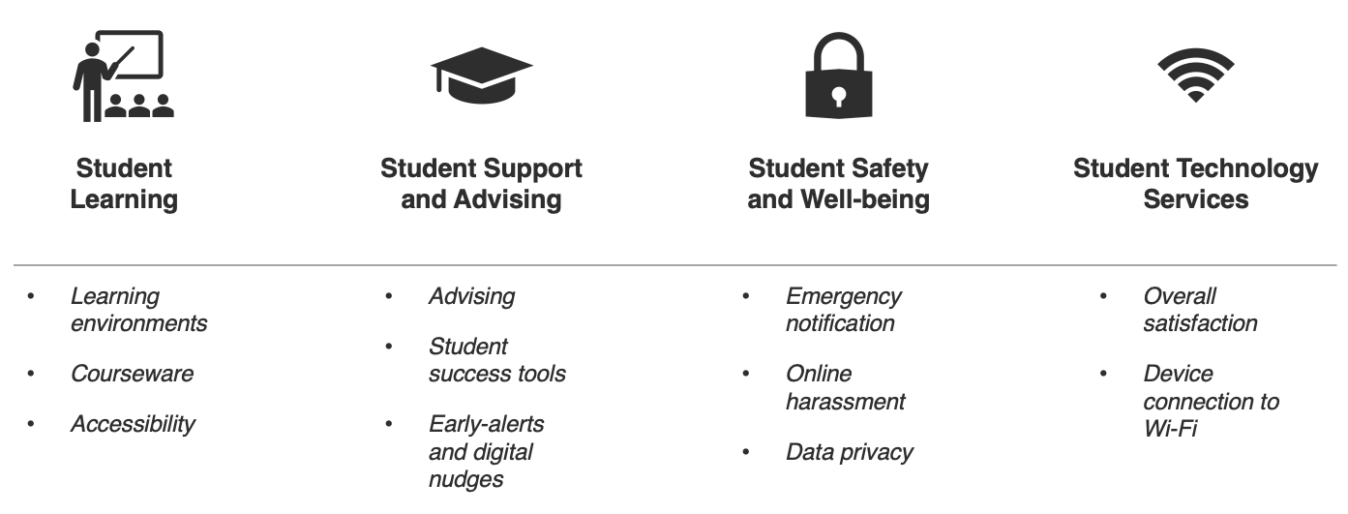
EDUCAUSE Technology Research in the Academic Community (ETRAC)
topics

Slide 33
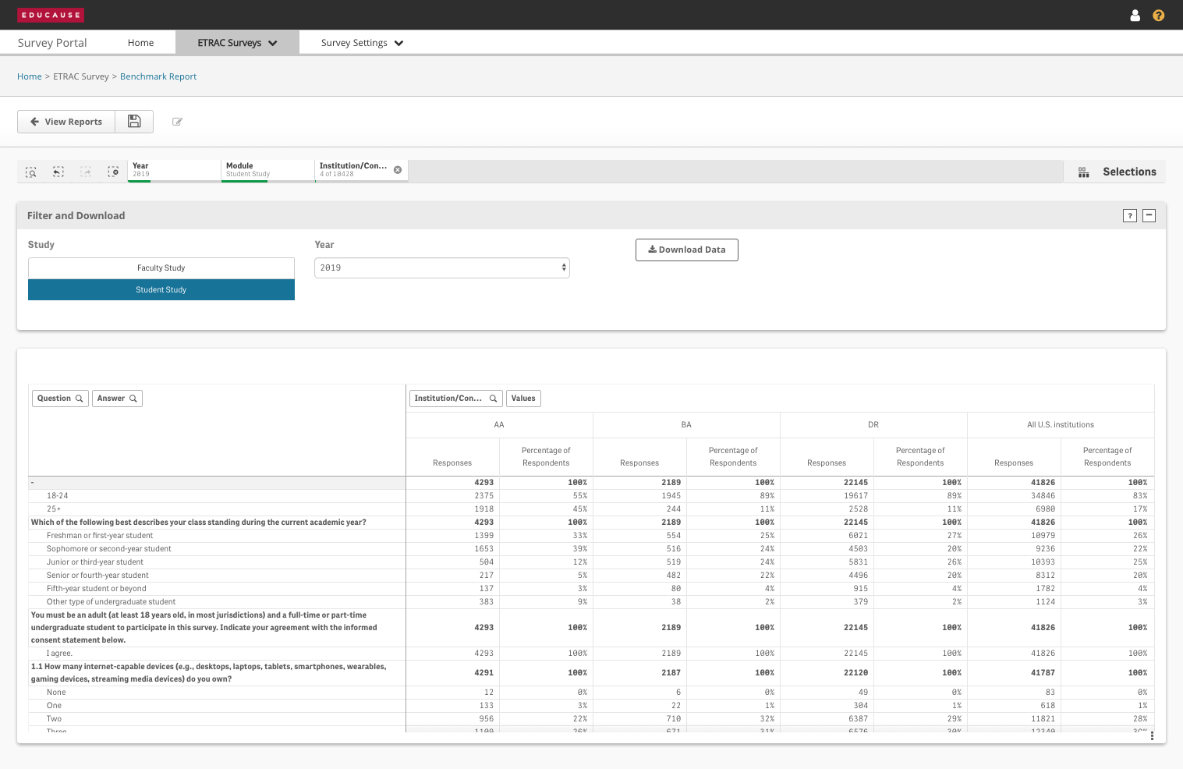
EDUCAUSE Technology Research in the Academic Community (ETRAC)
benchmarking

Slide 34
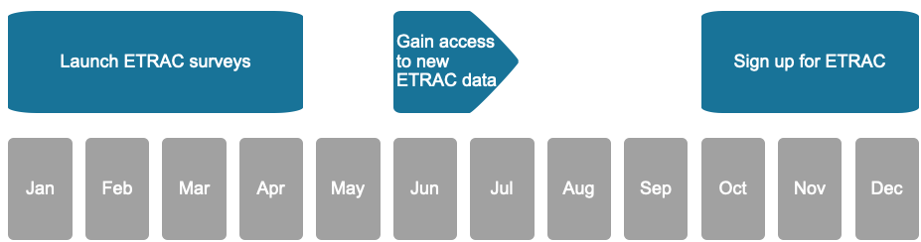
EDUCAUSE Technology Research in the Academic Community (ETRAC)
dates to remember
You are here
www.educause.edu/etrac
Notes:
Think about what cases will you need to make in the future and target potential data sources for those stories.
There is some time sensitivity to getting access to some of this data – CDS, ETRAC, MISO, and some CUPA HR surveys all run on a cycle – even if you don’t need the data now, you might in the future, so it is good to prepare w/ participation

Slide 35
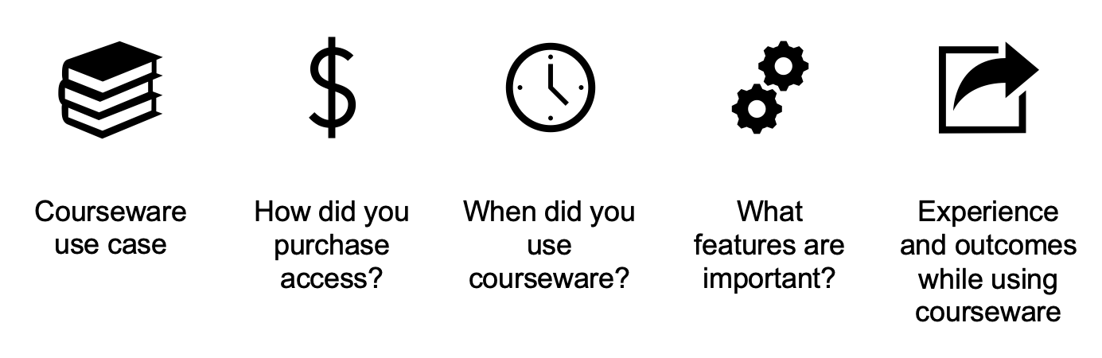
Courseware topics in ETRAC 2020

Slide 36
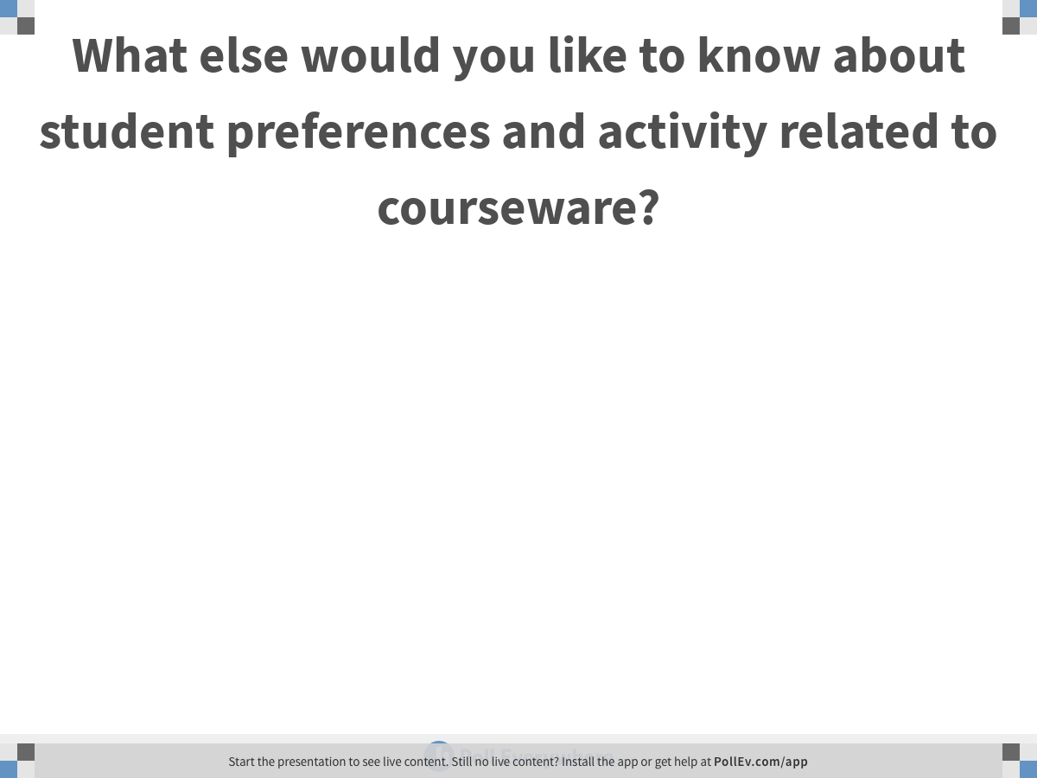
PollEv.com/kristenfox450
Notes:
What else would you like to know about student preferences and activity related to courseware?
https://www.polleverywhere.com/free_text_polls/i9tuZPUvyEdbBNJBbga8k

Slide 37
04
Other Resources

Slide 38
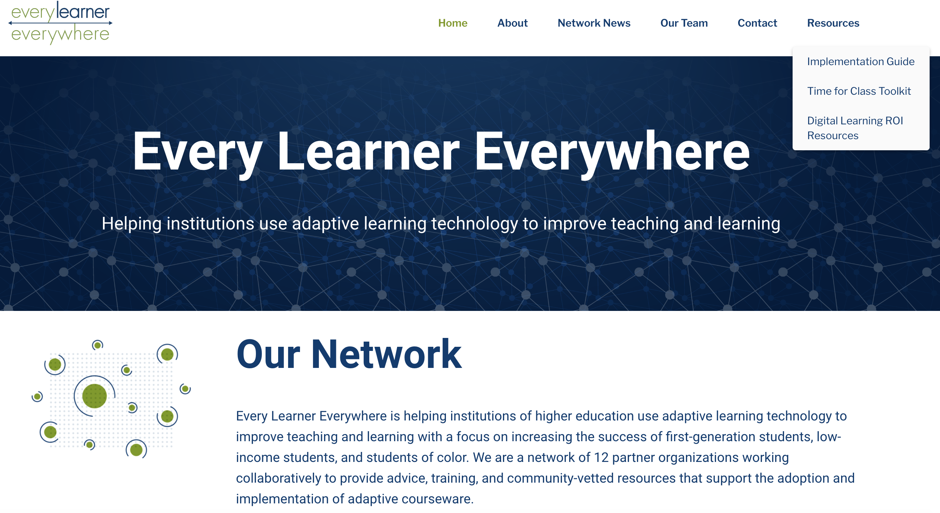
Questions? Go to ELE to access various materials that support decision-making and quality adoption
https://www.everylearnereverywhere.org

Slide 39
05
Appendix

Slide 40
Overview of Survey Respondents
Overview of Faculty Survey Respondents
100%
2,171
2,164
2,167
2,438
2,441
2,066
1,912
Under 35
9%
1 to 3, 7%
90%
Part-time
24%
Private
4-Year
24%
Adjunct
24%
4 to 7
17%
Not
tenure
track
37%
80%
35 - 44
21%
Other
55%
70%
8 to 12,
19%
60%
45 - 54
28%
Tenure
track, not
tenured
16%
50%
13 to 20
22%
Public
4-Year
57%
40%
Full-time
76%
Not
Adjunct
76%
30%
55+
43%
BMGF
Focus
45%
Tenured
47%
20%
20+
35%
10%
2-Year
18%
0%
Employment Status
Age
Experience (Years)
Sector
BMGF
Classification
Teaching Status
Tenure Status
Sources: Time for Class 2019

Slide 41
Overview of Survey Respondents
Overview of Administrator Survey Respondents
100%
1,420
1,390
1,575
1,589
1,251
Under 35, 4%
90%
35 - 44
14%
1 to 3
19%
Other
24%
80%
Private
4-Year
43%
Online Learning 3%
70%
45 - 54
31%
4 to 7
28%
Center for T&L 3%
Inst. Designer 6%
60%
Other
81%
Provost / VPAA
10%
50%
Dean
15%
8 to 12
18%
Public
4-Year
38%
40%
30%
55+
51%
13 to 20
18%
20%
Chairperson
39%
10%
20+
17%
2-Year
20%
BMGF Focus
19%
0%
Age
Experience (Years)
Sector
BMGF Classification
Position
Sources: Time for Class 2019

