Slide 1
Digitalization Needs a Change in the IT Mindset

Slide 2
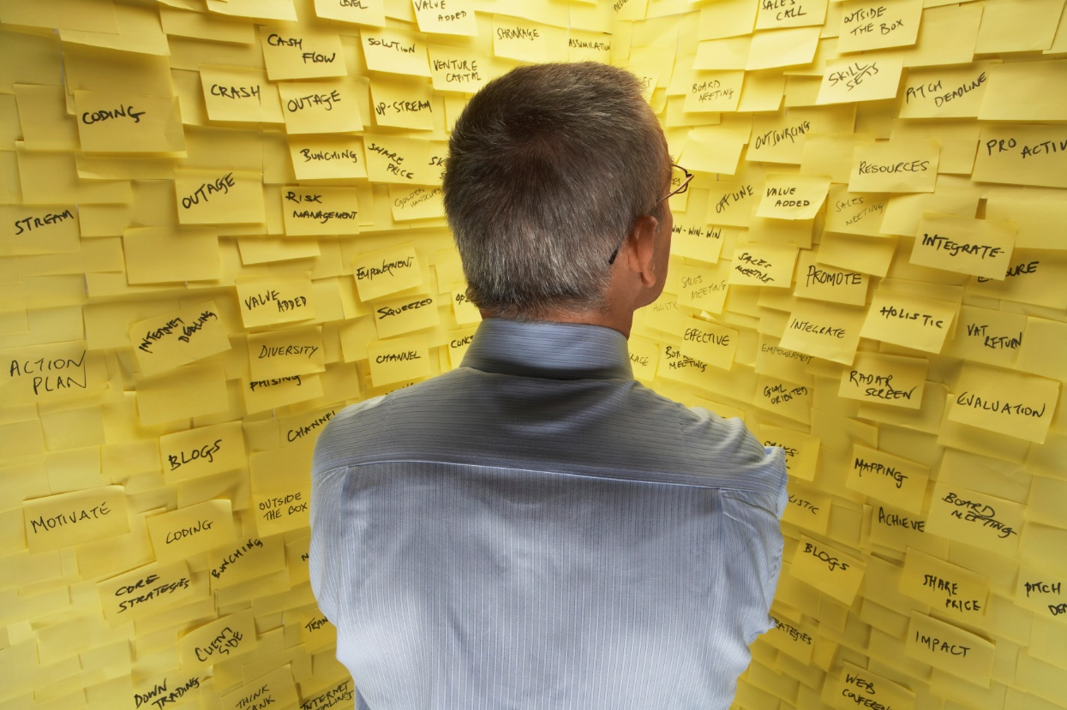
Why Change ??
100+ small & large IT projects
Siloed IT departments
Fragmented Governance
Over customized ERPs
Significant new ERP implementations costs
Burnt out IT teams
Diminishing ROI
No way to answer to new demands and speed
No view or input into the “IT Black Box”
Clients demanding ‘faster’, ‘more agile’ 'DIGITALIZATION OF THE BUSINESS'

Slide 3
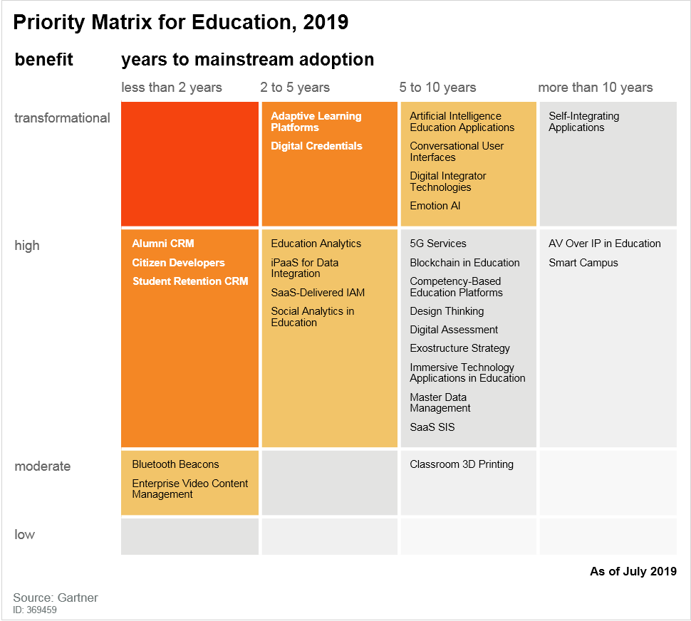
Digitalization -- Its already here !!
Digitalization is the use of digital technologies to change a business model and provide new revenue and value-producing opportunities. It is the process of moving to a digital business.
Ability to capture and act on "digital moments"

Slide 4
We need a new IT mindset
Lazer focus on client outcome
Scale and sustain innovative practices
Break down IT silos
Create platforms for transformation
Rapidly deliver value-producing products NOT individual projects
Hire and reward a growth mindset

Slide 5
Eternal learning: Agile
Do you remember?...

Slide 6
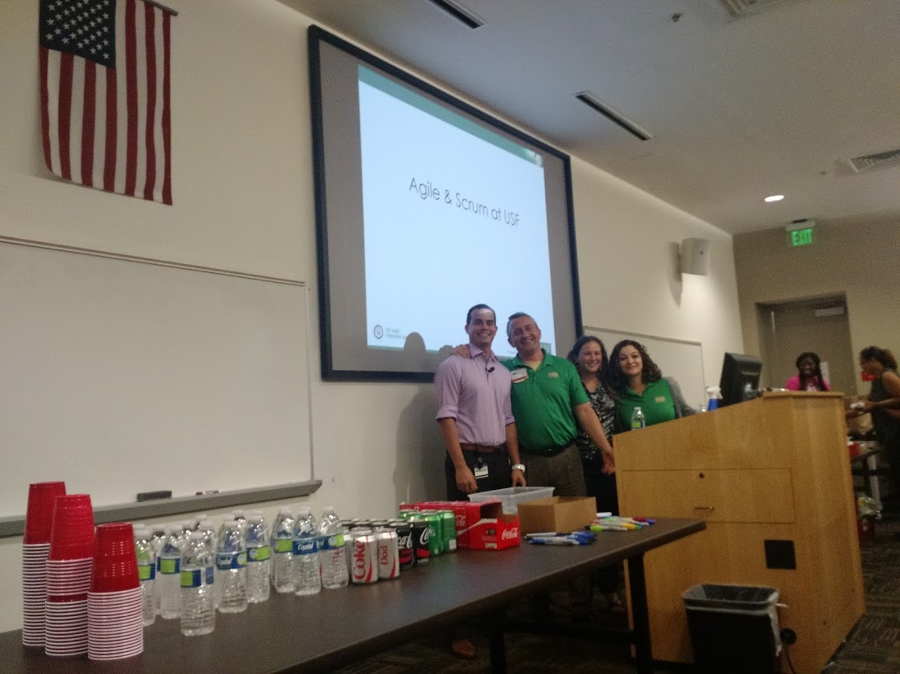
Go back to basics
Reset Team Norms
Define roles and responsibilities of a
Product Owner
Scrum Master
Dev Team
Testing
Stakeholder(s)
Writing good User Stories workshops
Good Definition of Done/Acceptance criteria
Allocating time for backlog grooming/refining sessions
Train your stakeholders!
Attend planning and reviews!

Slide 7
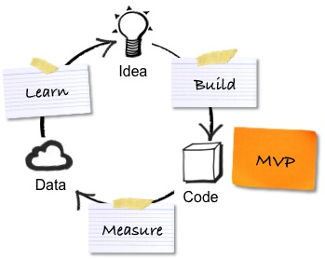
Eternal learning: Agile
OVERCONFIDENCE

Slide 8
Embrace new technology
easy + powerful + unified
…to build …to use
…to change
works on all devices
scalable & secure
always current
a single environment across applications
for agile digital business transformation

Slide 9
Scalability challenges

Slide 10
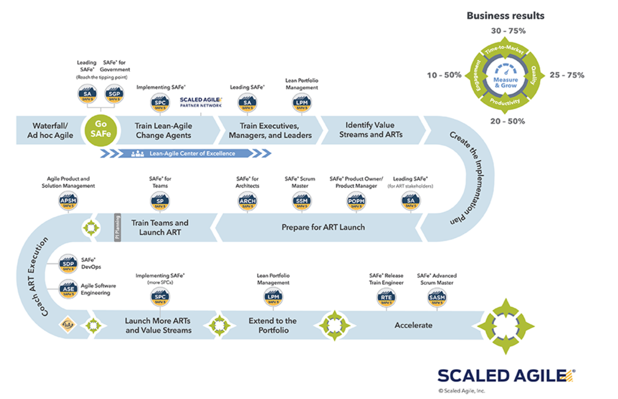
Scalability roadmap

Slide 11
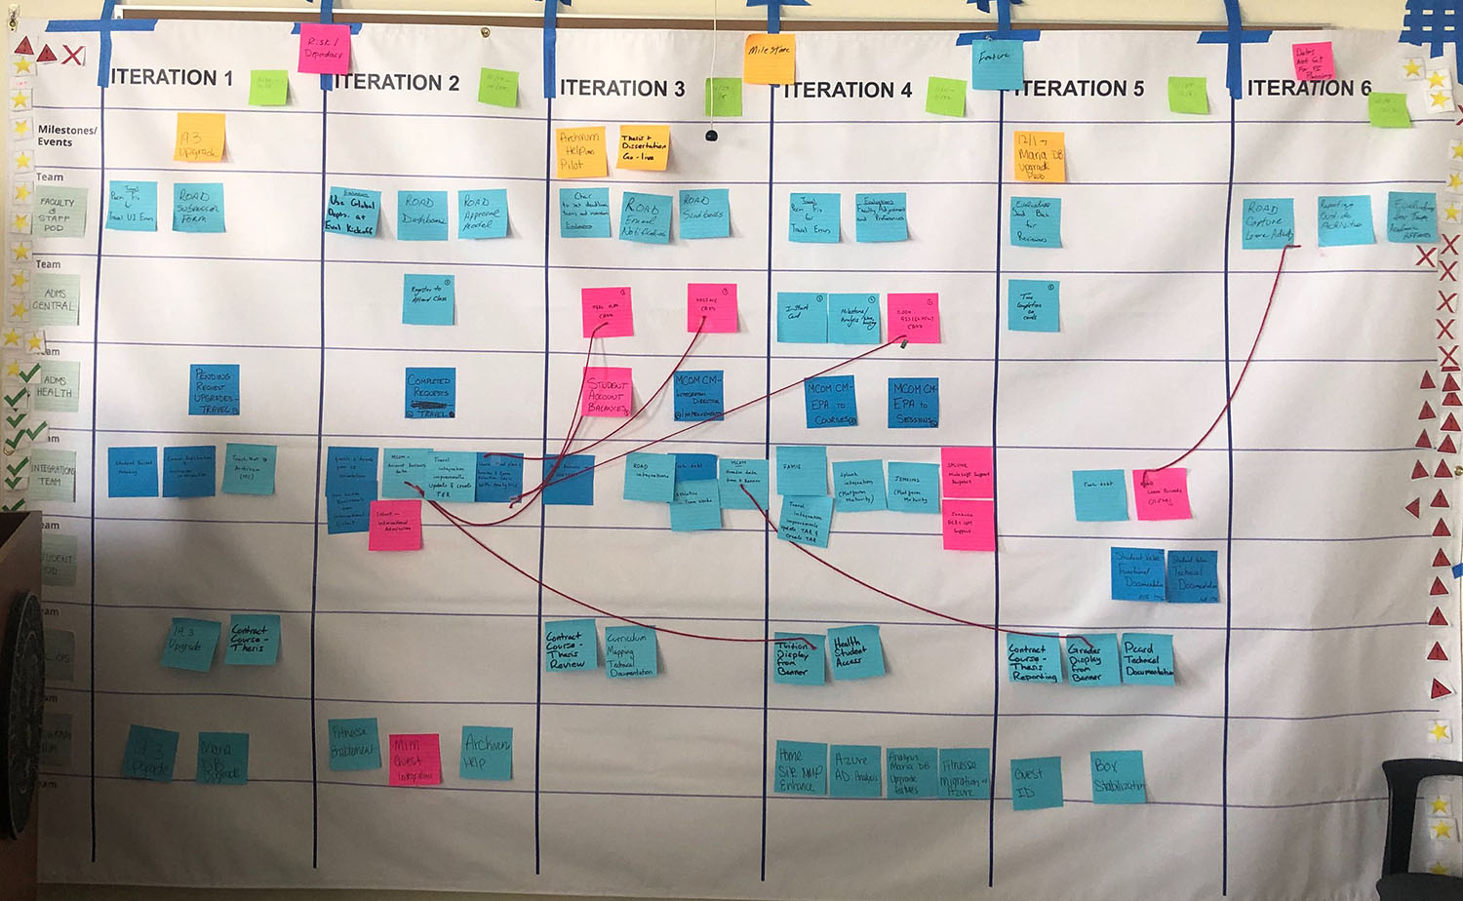
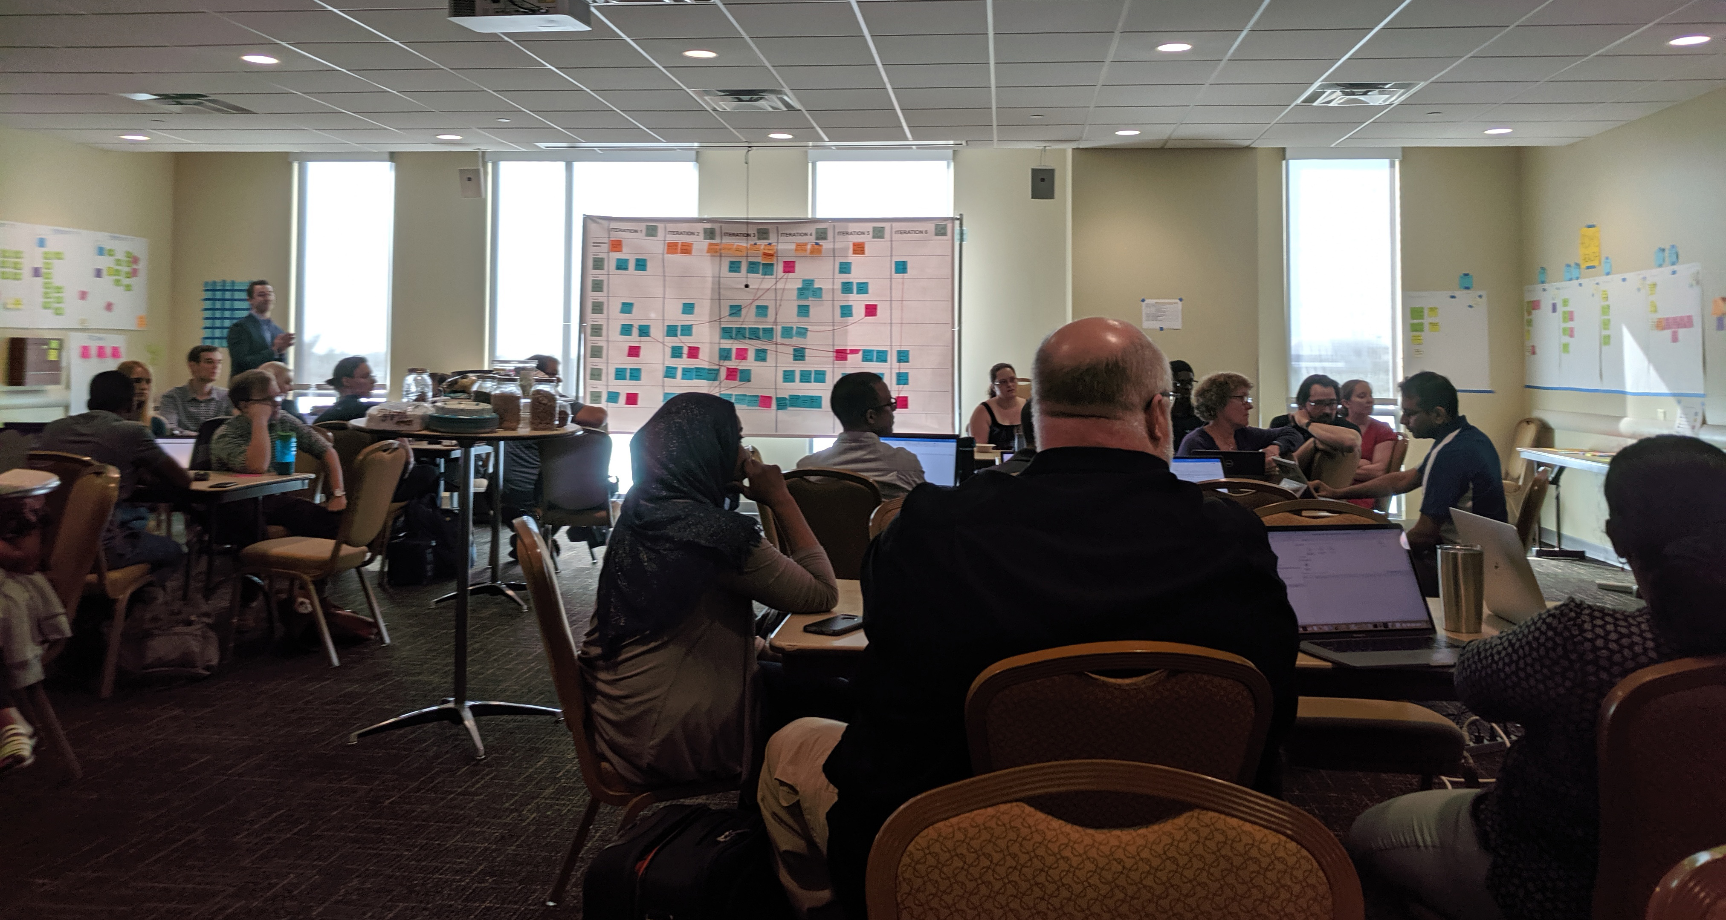
Scalability @ USF

Slide 12
Infrastructure as a Product, let's go to the cloud!
What the product isn't:
SANS
Servers virtual or physical
What it is for us:
azure cloud services
Enablement / shift left

Slide 13
Why you can't trust dev teams in the cloud
Wrong
Wrong

Slide 14
How Infrastructure Teams Transition to Enablement
Self service (shifting left) cloud services
Enabled by traditional I&O
Do not underestimate the power of culture
Respond to : “I must protect the organization from itself.”
Transition from security by denial, to security through enablement
Transition cost management from minimal resource allocation, to budget allocation

Slide 15
Infrastructure as a Product, beyond IaaS, PaaS, SaaS
Infrastructure teams changing mindset
Enablement of fellow IT product teams
Product deployment direct to clients
Enable of clients to directly consume services
Exposure to clients
Direct interaction
indirect feedback example surveys
Shift away from “devs can't be trusted”
Shift to tooling (cloud services and other platform services)
Defaulting more to open (where possible)
Be a conductor not a gate keeper

Slide 16
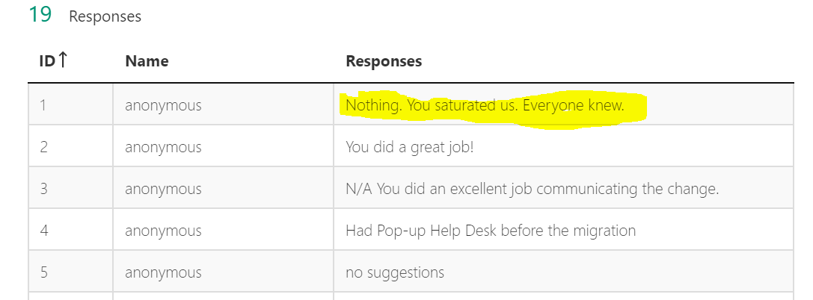
Example feedback and effect
1st client wave
2nd client wave

Slide 17
Security
Embed patching within the services provided
SaaS
PaaS
IaaS + automations
Enforced policy through containerization
Empowered and educated devs, building security throughout OSI model

Slide 18
Cost
Shift as close to the customer as possible
Charge back (direct)
Researchers / specific departments with unique needs (IT is broker)
Charge back (internal – IT)
Allows product teams to self optimize their product line
They can answer the question themselves:
Is it more important to optimize this application to scale up / down as needed? Or throw more resources at it?
Is it worth throwing development hours at backing up infrastructure as ‘software’ vs. keeping idle cycles available for DR?
Show back
Include all infrastructure (DR / Backup) – Align to your product suites

Slide 19
Data & Analytics – Familiar Challenges
Reporting as an after-thought
Data Quality, Gaps, Data Capture Challenges
No clear understanding of “Why”
“Now What”?
“What Next?”
Insatiable appetites for data
Varied client-base
Subject Matter Expertise
Strategic vs Tactical
Technical Proficiencies
Readiness
Disparate technologies – no one size fits all

Slide 20
Data & Analytics – Systems Thinking
Holistic Awareness
Techology
- Trends
- Technology Core Competencies
- Integrations
- Road-maps
Organizational
- Goals and context
- Initiatives
- Needs and Challenges
- Interconnectedness
- Decisions and Actions
- Impact
- Outcomes

Slide 21
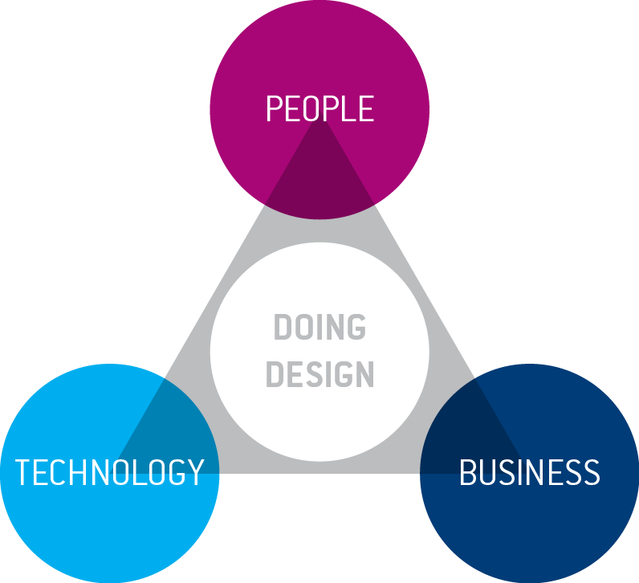
Data & Analytics – Systems Thinking
Holistic Alignment
Goals
Strategy – processes, decisioning, action plans, outcome measurement, ROI, feedback and refinement
Planning, funding, execution and on-going support
Roles, Responsibilities and Accountability
Supporting Structures
Feedback Loops
Governance – Intake, Product, Data and Information
Change Management
Data Literacy
Security/Compliance
Adoption Management

Slide 22
Data & Analytics – Culture and Mindset
Growth mindset - Training and expansion of skillsets
Adoption and Evangelization
Decentralization and democratization
Self Service Infrastructure and Enablement
Integration and Embedding
Data Literacy – Training, Data Catalogs, Trusted Datasets, Glossaries and Metadata
Information Governance
Competency Centers and related mechanisms
Knowledge sharing and crowd-sourcing via guilds
Cross-functional teams and joint ownerships
(Re)alignment of resources
Planning cycles
Value Streams
Client-base
Enablement

Slide 23
How we work today
https://vimeo.com/347375384

Slide 24
Contact Information
Swapna Chackravarthy
(AVP Analytics and Data Management Solutions) – schackra@usf.edu
Patrick Gall
(Chief Technology Officer) gallpw@usf.edu
Alice Wei
Senior Director Digital Innovation and Transformation wwei@usf.edu
Sidney Fernandes
VP Information Technology/CIO sfernand@usf.edu
NOTE: This presentation leaves copyright of the content to the presenter. Unless otherwise noted in the materials, uploaded content carries the Creative Commons Attribution 4.0 International (CC BY 4.0), which grants usage to the general public, with appropriate credit to the author.

