Slide 1
Increasing Technology Literacy within a Liberal Arts Education
Michael Boyles, Tenzer Technology Director
Carol L. Smith, Chief Information Officer
DePauw University

Slide 2
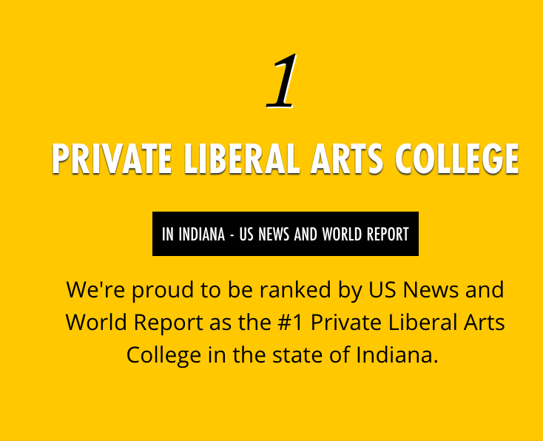
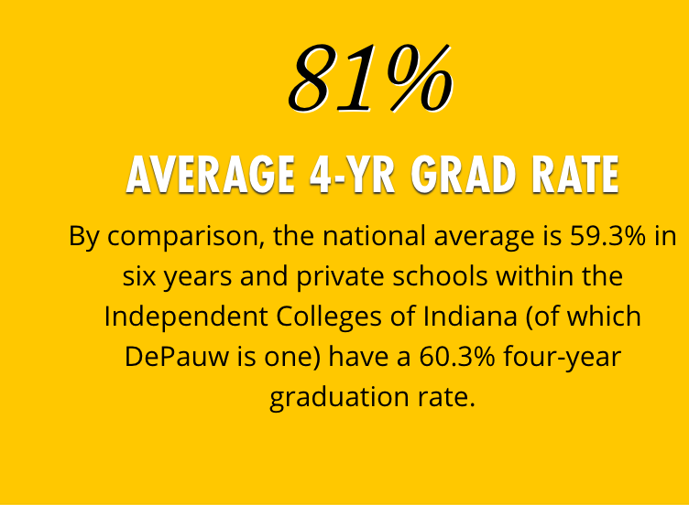
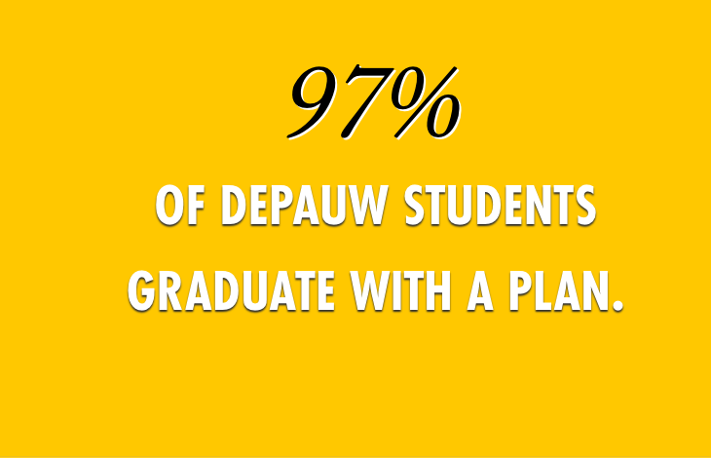
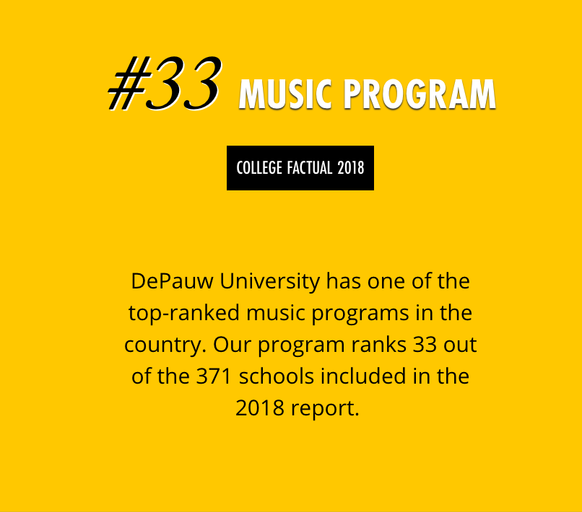
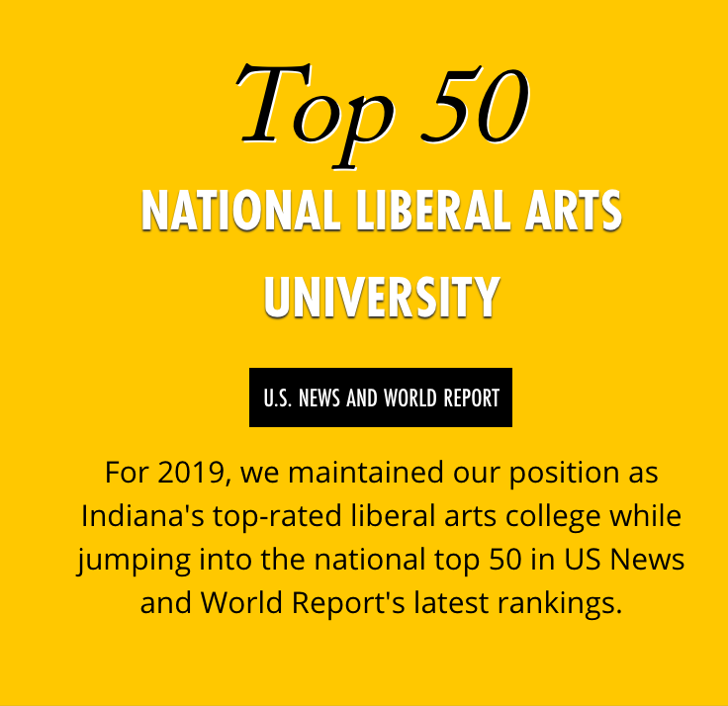
DePauw University
Greencastle, Indiana
Private Liberal Arts University
School of Music
2,000 FTE
28 Areas of Study, School of Music
40+ Majors/Minors

Slide 3
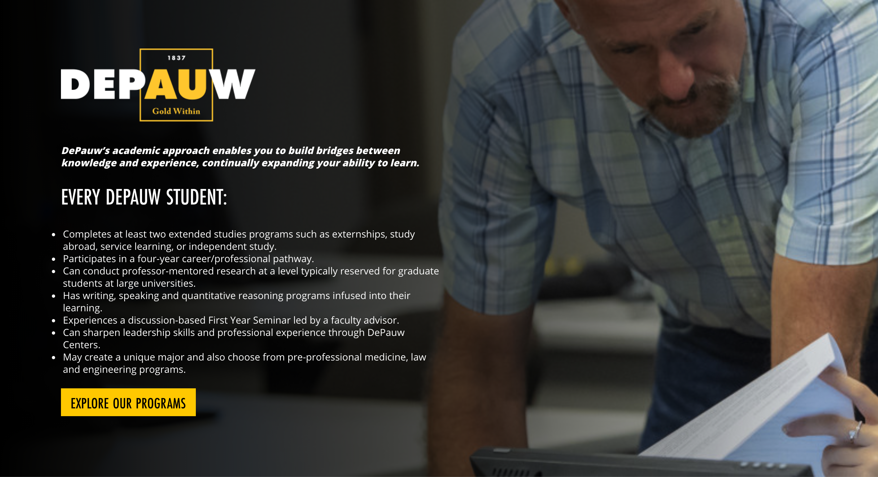

Slide 4
Technology in Teaching & Learning at DePauw
FITS
ITAP
Faculty Instructional Technology Support
Teaching and learning using technology in the classroom
Information Technology Associates Program
Internship experiences that include using technology

Slide 5
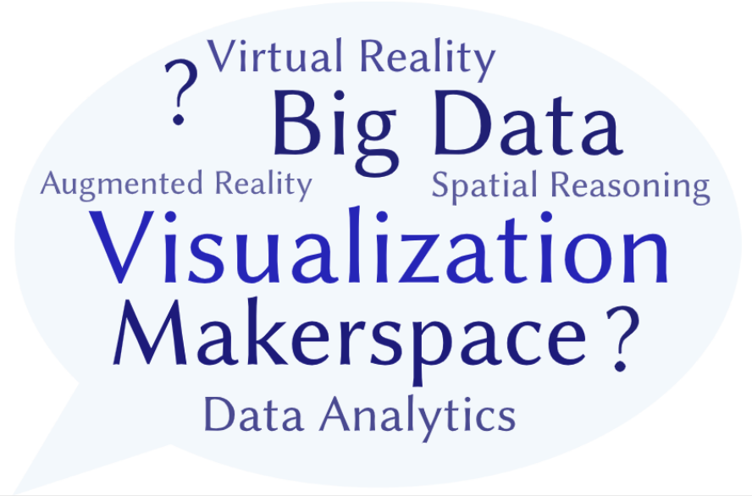

Technology in Teaching & Learning at DePauw
What’s Next?
All students graduate
with technology fluency
FITS
ITAP
Faculty Instructional Technology Support
Teaching and learning using technology in the classroom
Information Technology Associates Program
Internship experiences that include using technology

Slide 6
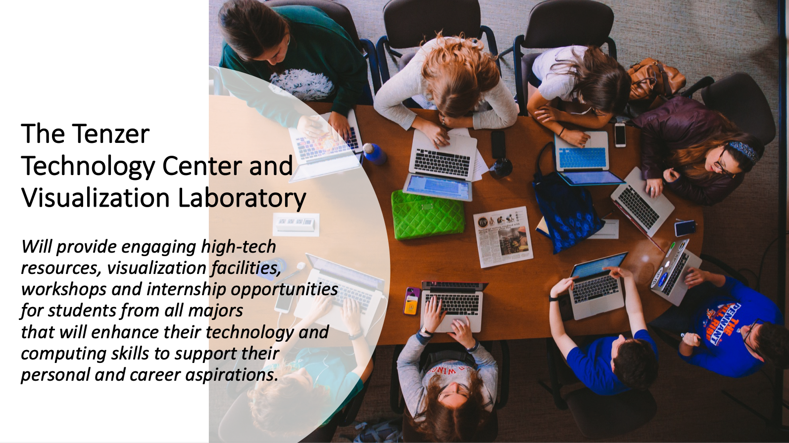

Slide 7
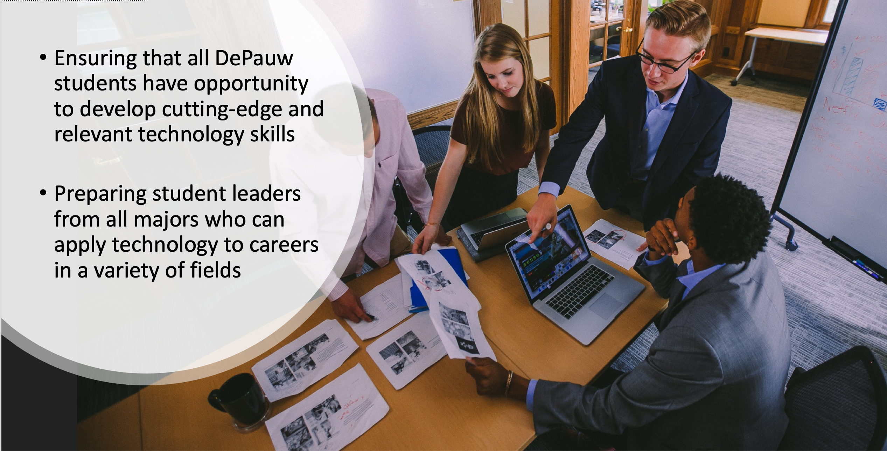

Slide 8
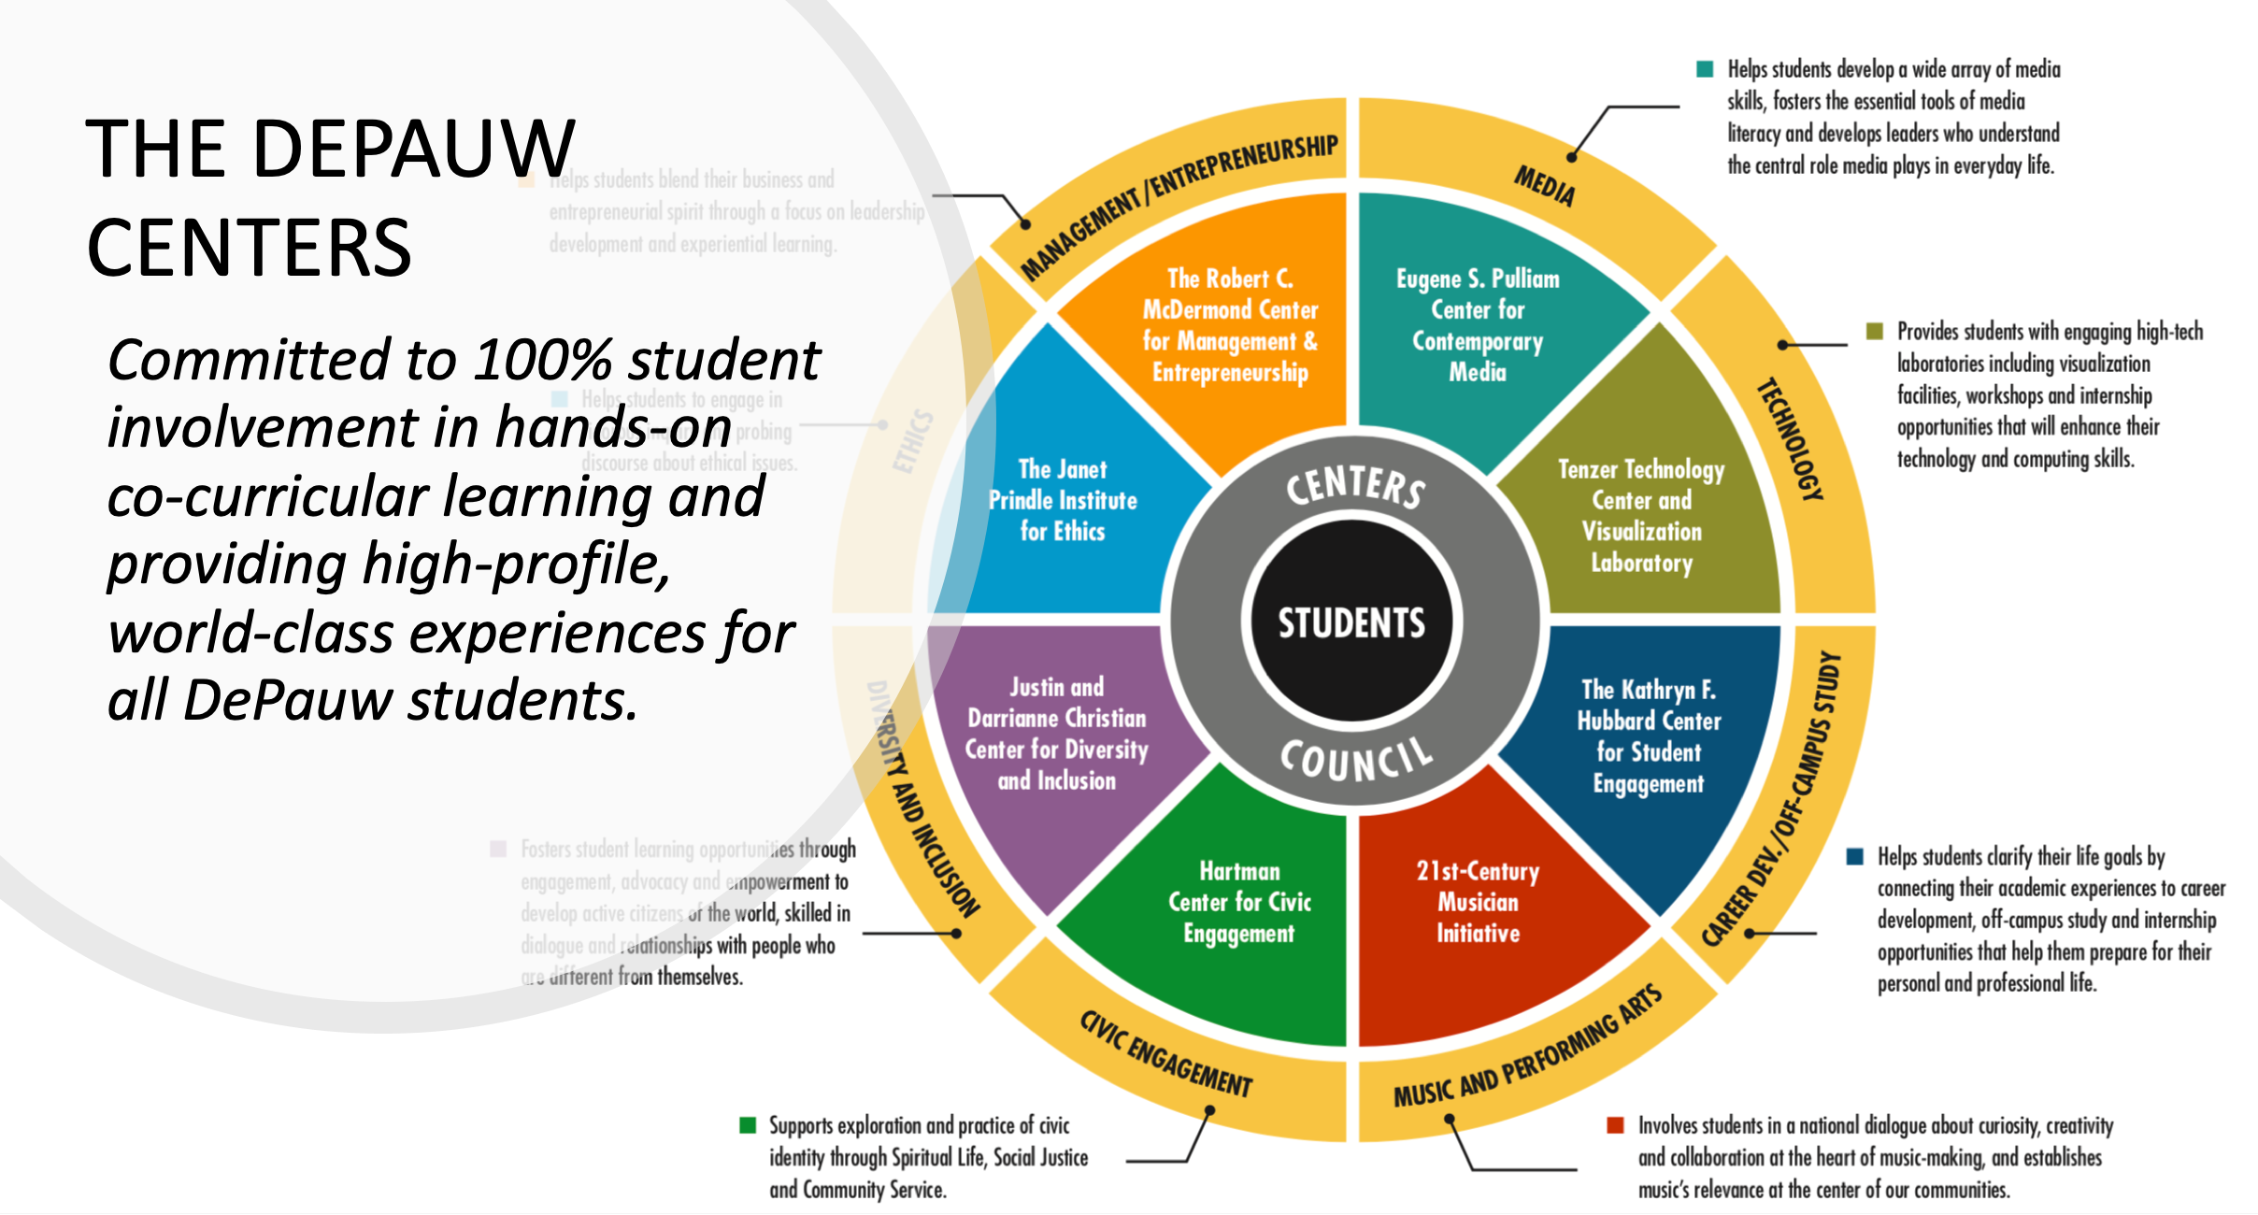

Slide 9
Tenzer Technology Initiative
STUDENTS
TECHNOLOGY
All majors
All skill levels
Includes both technical & non-technical students
Broad definition of “technology”, but leading with visualization technologies
Broadly applicable
Low barrier to entry
Immediately and recognizably impactful

Slide 10
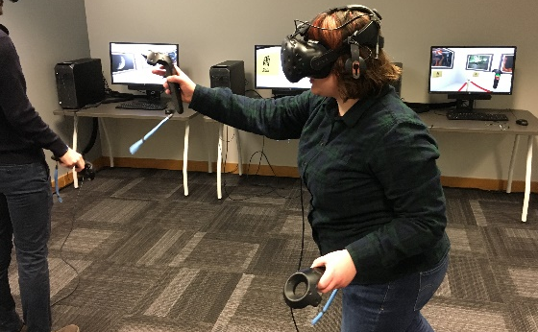
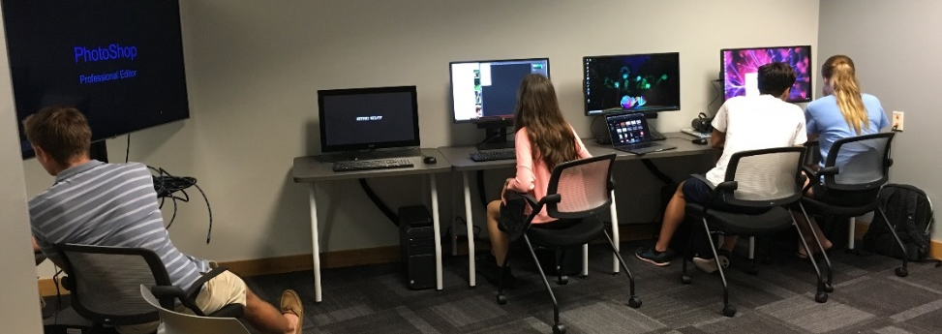
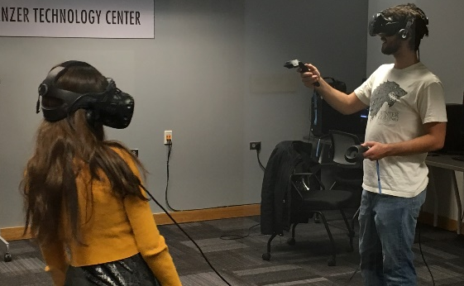
Levels of Engagement
Exposure
Competence
Sophisticated
vocab and general awareness; decreasing the level of anxiety; using or employing
more sophisticated use cases; applying your own data or creating your own experiences
creatively applying a set of technologies (perhaps in a new way) to solve a problem; building novel software or hardware systems

Slide 12
to scale this effort, we must impact the curriculum

Slide 13
For each Use Case
How widely applicable?
How easy to use? What is barrier to entry?
How interesting, engaging, exciting?
Which skill level (exposure, competence, sophisticated)?
Cost?
  Financially
  Faculty time investment/commitment
  Other support personnel time investment/commitment

Slide 14
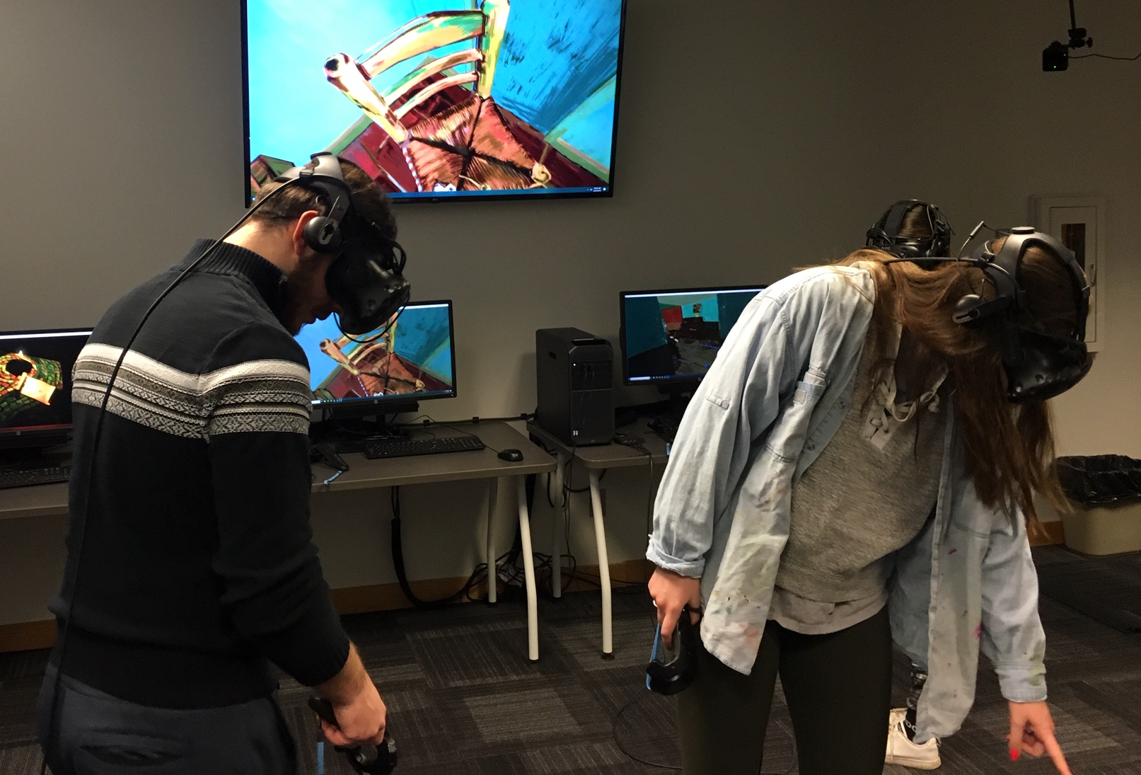
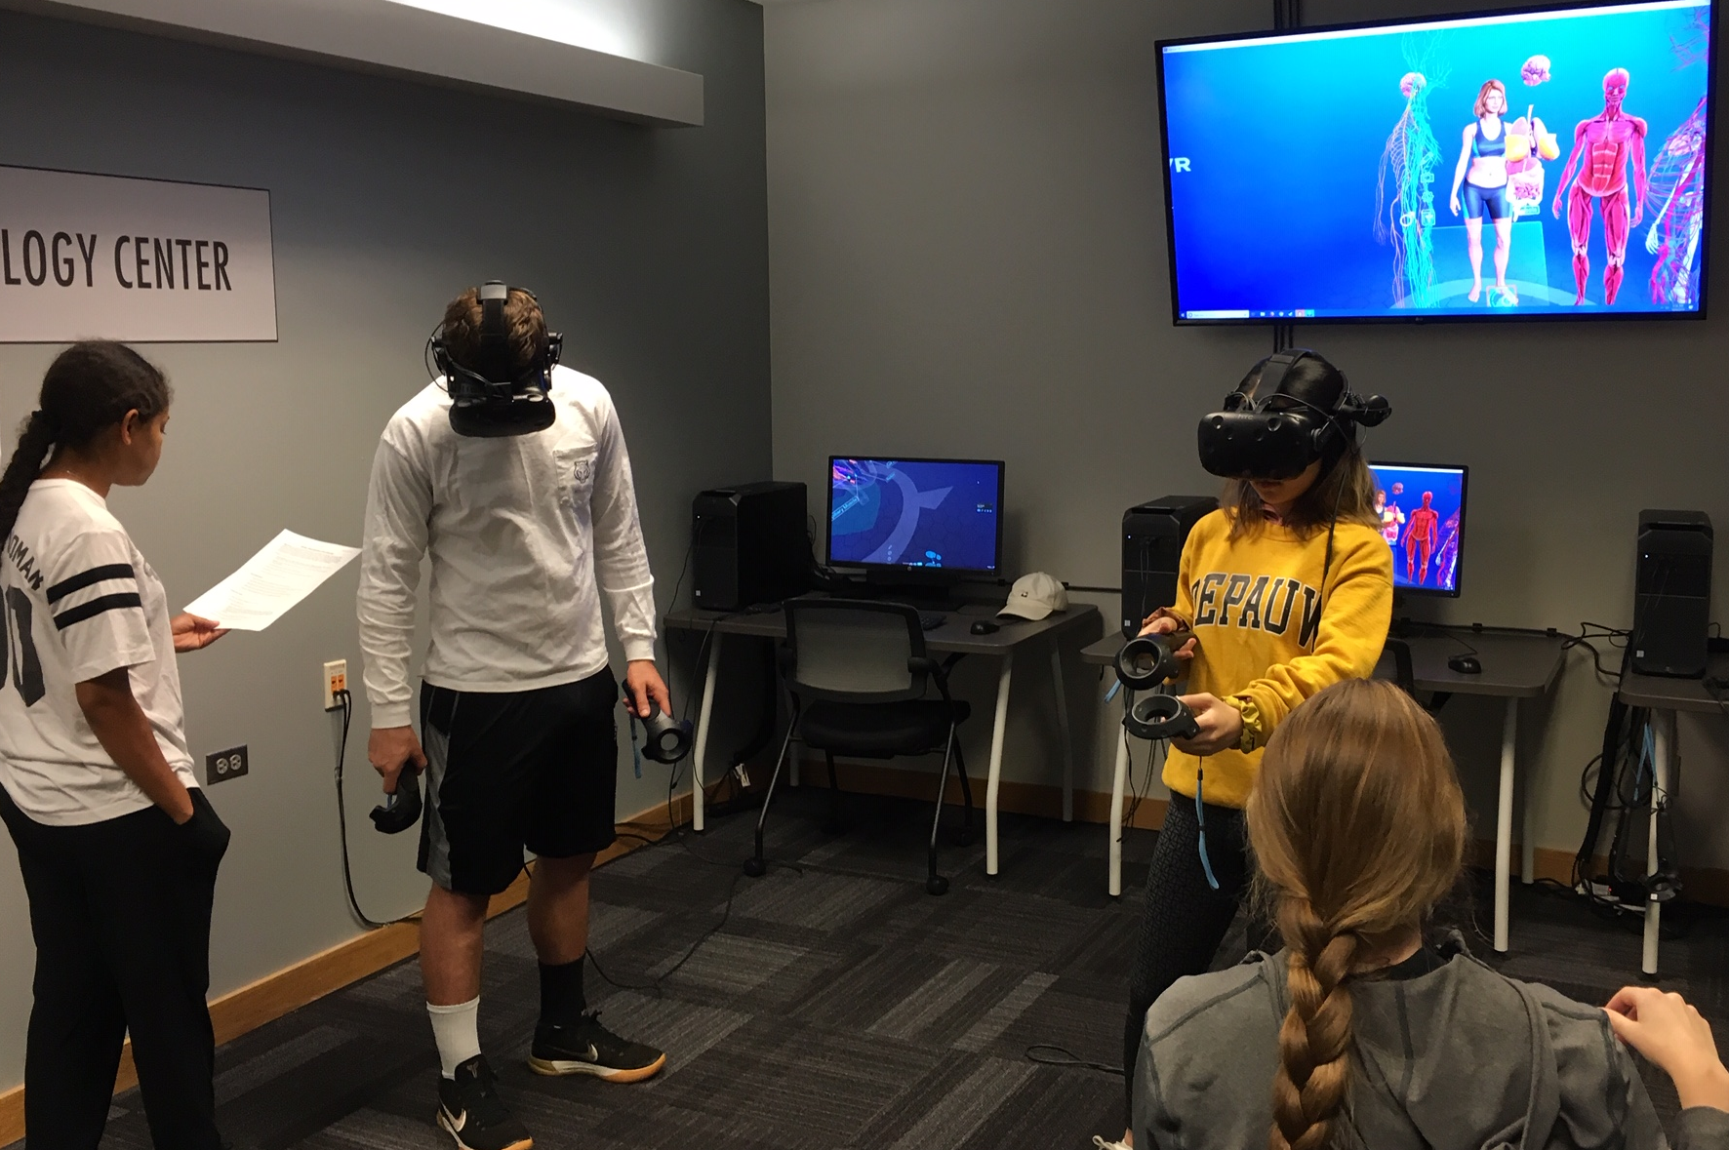
Use Case: Leverage Existing VR Apps
Tilt Brush – Art (Spring 2019)
Sharecare VR – Biology (Fall 2019)

Slide 15
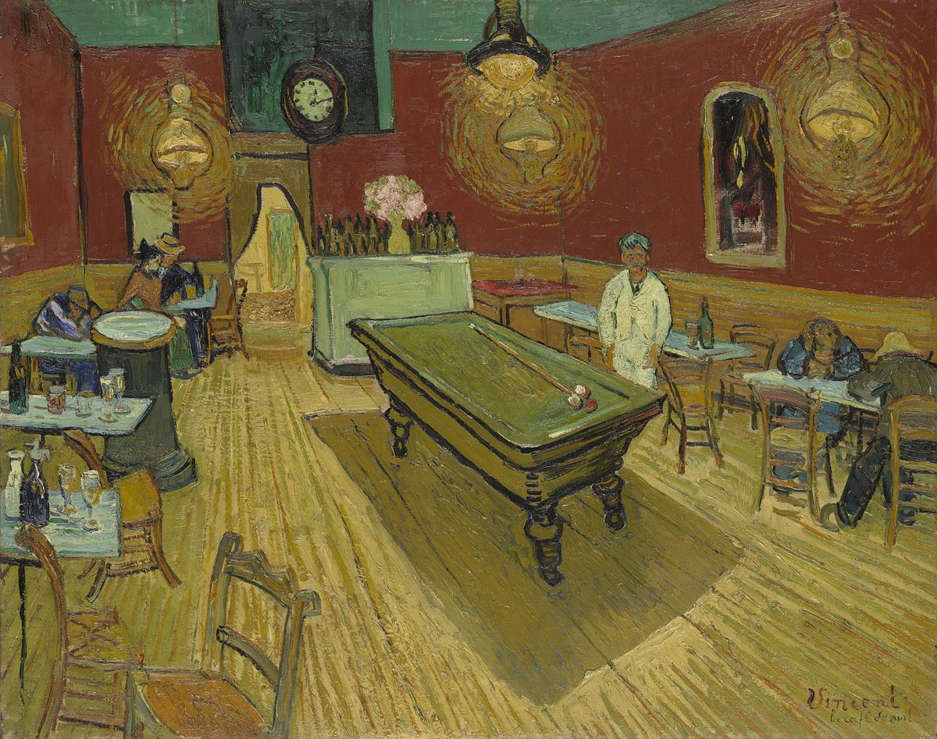
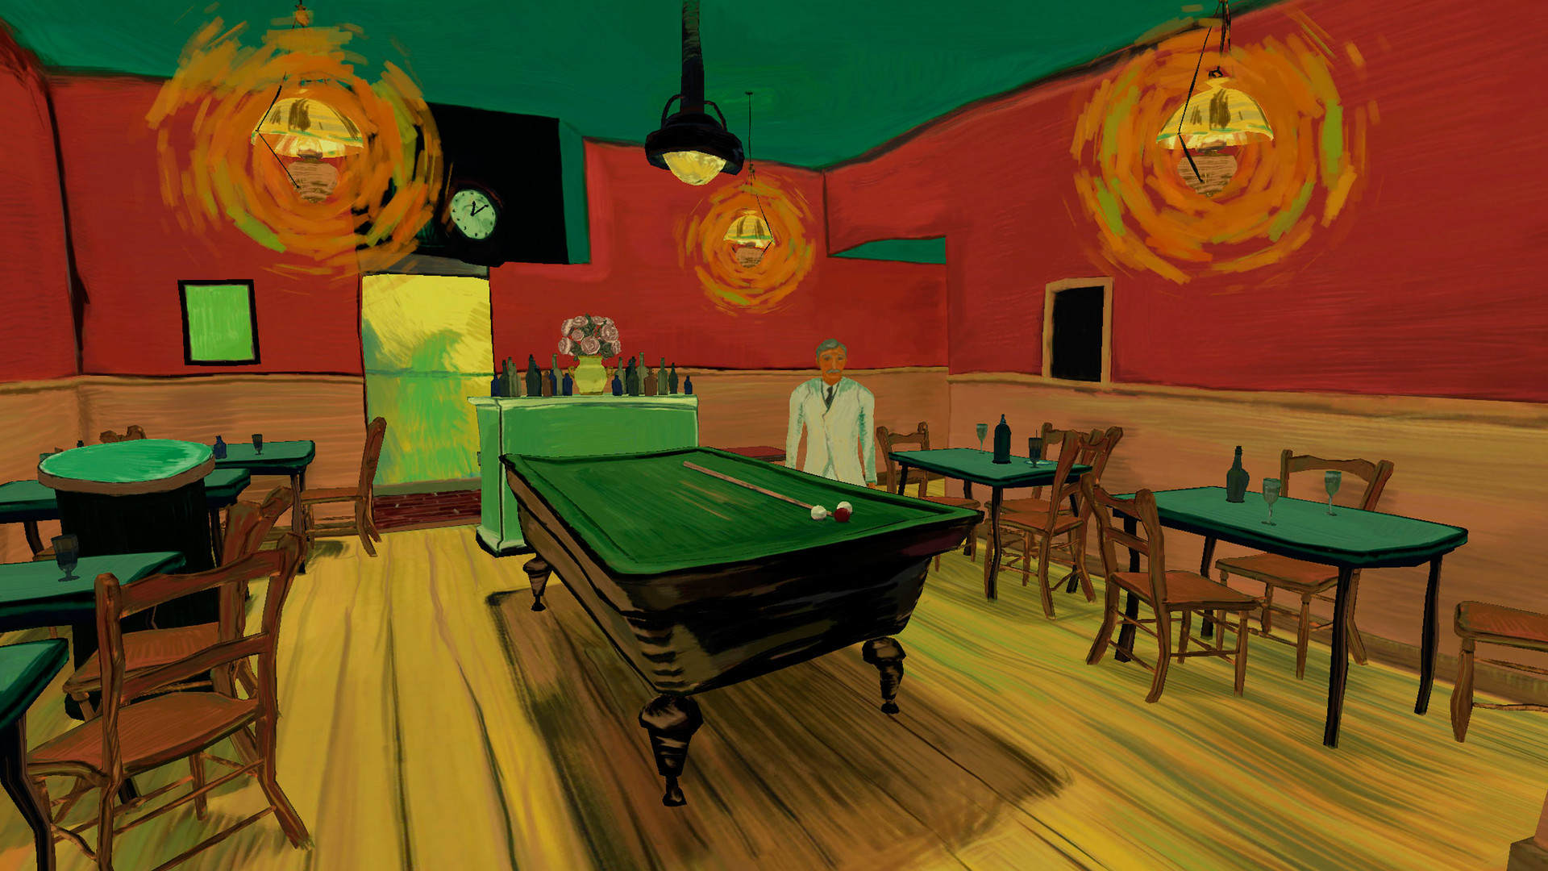
The Night Café – Art History (Spring 2019)
Original oil and canvas version, 1888
Source URL
Recreated for virtual reality, 2015
Source URL

Slide 16
Use Case: Role-Play as a Data Analyst
Communication and Theatre course (Fall 2019)
… explores representations of social identity, culture, and ideology in live performance and film with special emphasis on issues of race, gender, class, and sexual identity. The course also explores the role of the audience, historical performance, and strategies for recognizing, reinforcing, or subverting conventional depictions of power and ideology.
a Privilege, Power and Diversity course
Explore the Early American Actress Dataset

Slide 17
Use Case: Create 360 Virtual Tours
Winter Term in Europe (Jan 2019)
Others
  May Term in Cuba (May 2019)
  DePauw Farmhouse (Fall 2018)
  Tenzer Center (Fall 2018)
  Ullem Farm (Summer 2019)

Slide 18
Use Case: Build Informational Maps
Intro to Economics course (Fall 2019)
  3 assignments progressively building technical skills
  Using (free) educational version of Tableau Desktop
Assignment #1 – International Trade
Assignment #2 – State Taxes
Assignment #3 – Unemployment (coming soon)

Slide 19
Strategies for Engaging Faculty
Focus on augmenting their existing courses
  Preserve the faculty’s vision; not trying to re-make their course
    If telling stories, utilize tech that enables storytelling
  Learn a bit about what they’re teaching first then ideate
    Even if suggestions are a bit off-base, it keeps conversation going and demonstrates that we care about their course and the content they want to teach
  Not trying to take them (too far) out of their element
    Embrace the liberal arts and bend and mold tech experiences accordingly

Slide 20
Strategies for Engaging Faculty
Build examples and let them speak for themselves
  Seek faculty colleagues to share their success stories; host faculty development talks/workshops/roundtables
Recognize this isn’t for all faculty and all courses
  No need to push too hard or too fast; do not overwhelm; do not get defensive
Been pleasantly surprised how many faculty have reached out proactively
  This is professional development for faculty

Slide 21
Support Resources for Faculty
Stipends for faculty development and/or professional support
Offer interns who can be allocated to faculty to help them identify/test the suitability of a particular tech; can also help faculty prepare lessons and run labs

Slide 22
Contact Information
Michael Boyles, Tenzer Technology Director – MichaelBoyles@depauw.edu
Carol L. Smith, Chief Information Officer – clsmith@depauw.edu
  Tenzer Technology Center
  www.depauw.edu/academics/centers/tenzercenter
  Information Technology Associates Program (ITAP)
  www.depauw.edu/it/itap/
  DePauw Information Information Services
  www.depauw.edu/it
NOTE: This presentation leaves copyright of the content to the presenter. Unless otherwise noted in the materials, uploaded content carries the Creative Commons Attribution 4.0 International (CC BY 4.0), which grants usage to the general public, with appropriate credit to the author.

Slide 23
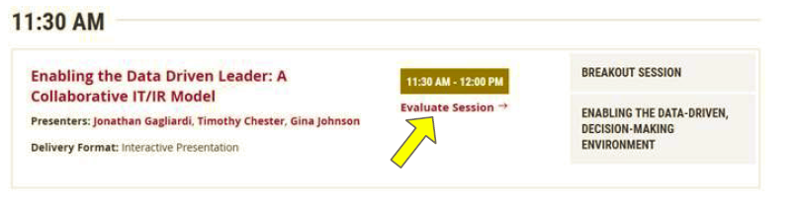
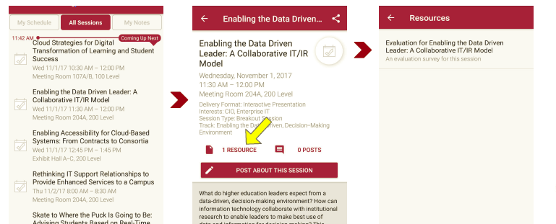
Session Evaluations
There are two ways to access the session and presenter evaluations:
1
2
In the online agenda, click on the “Evaluate Session” link
From the mobile app, click on the session you want from the schedule > then scroll down or click on the associated resources > and the evaluation will pop up in the list

