Slide 1
Anywhere but in the Lab Exploring Applications for VR
Kendra Ketchum, Vice President, Information Management & Technology
Vanessa Hammler Kenon, Ed.D., Associate Vice President, Information Management & Technology
Trevor Nash, UTS Training and Marketing Manager
Jessica Abel, Ph.D., UTS Project Coordinator
Nicholas Mello, Labster Customer Success Manager

Slide 2
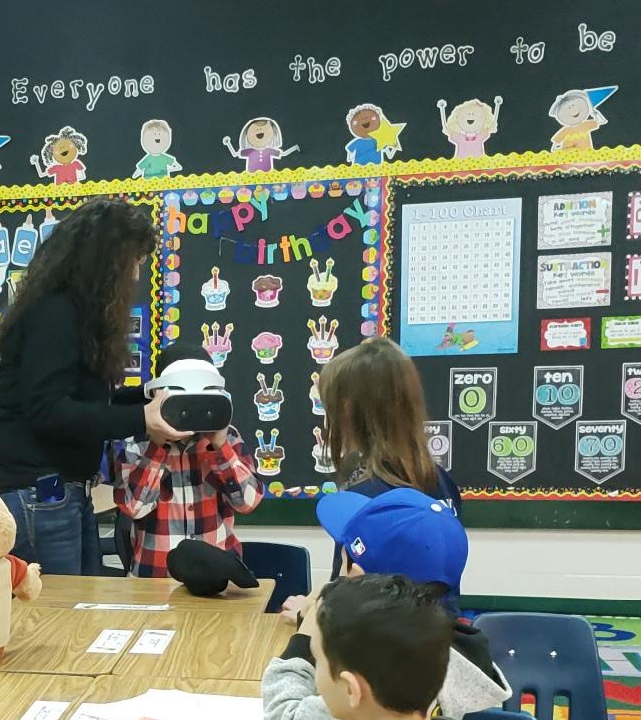
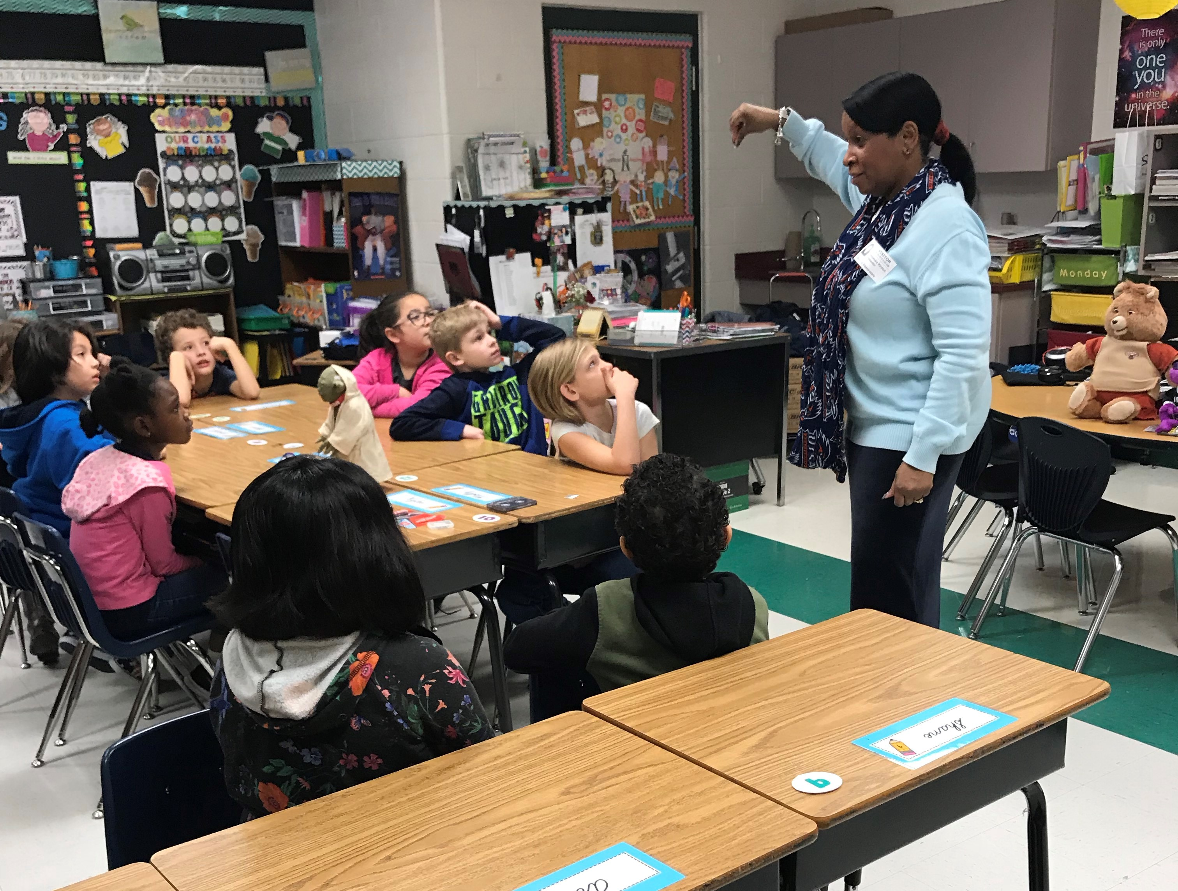
Facilitator: Vanessa Kenon, Ed.D

Slide 3
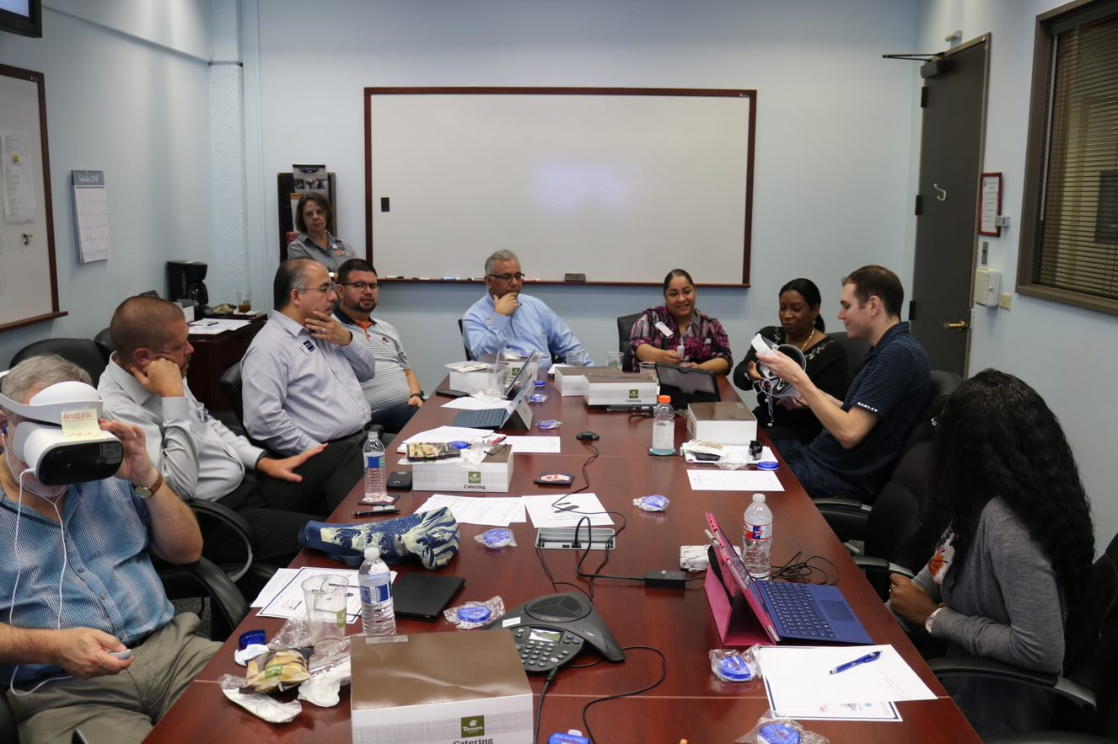
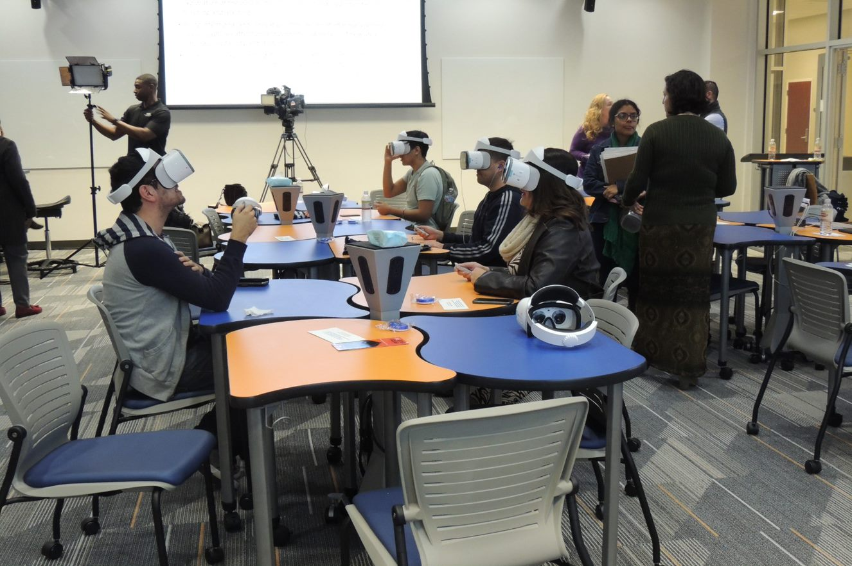
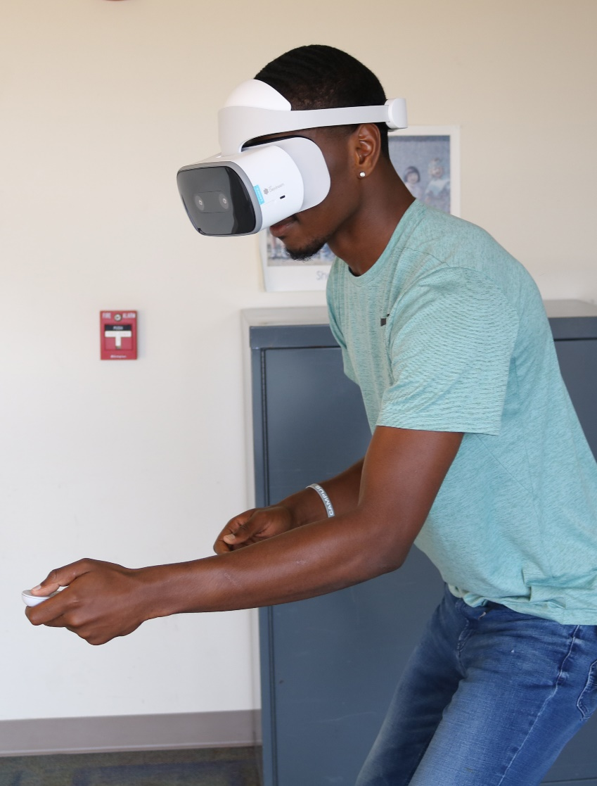
Utilizing labs as a teaching classroom

Slide 4
Evolution to a Service Management Catalog
Importance of strong IT Infrastructure to support emerging technologies such as Virtual Reality
Working with students, faculty, and staff directly to understand and appreciate academic innovation
Responding to the call of the surrounding community outside of the University walls to provide SMEs on this technology
Working with vendor partners to provide VR solutions at affordable VR solutions

Slide 5
Talking points from a CIO
Ushering in a new era of collaboration in innovative pedagogy, because UTS is now a solutions provider and strategic partner in the university’s vision.
In that vein, we are building and strengthening our collaborative work in the service of student learning, in partnership with departments like Academic Affairs. The only way we can move forward is together. In bold partnerships, innovation can grow.
Particular excitement for these VR projects, because they show how we are taking learning outside of the lab and putting the future of learning into hands of students. Projects like these really highlight the urgency and value of the work we do in higher ed IT.

Slide 6
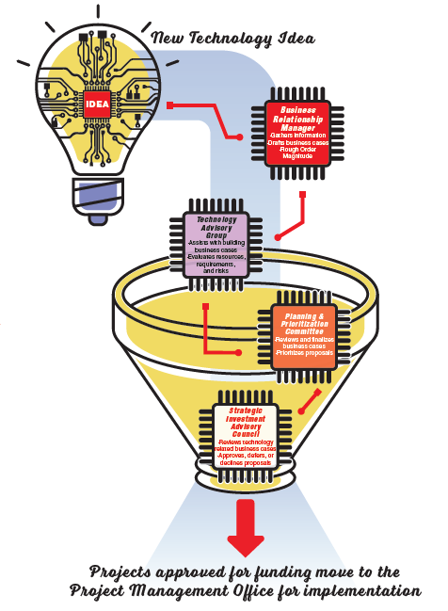
University Technology Solutions Community Engagement

Slide 7
Exploring Applications for VR Trevor Nash

Slide 8
Communications and Marketing Jessica Abel, Ph.D.

Slide 9
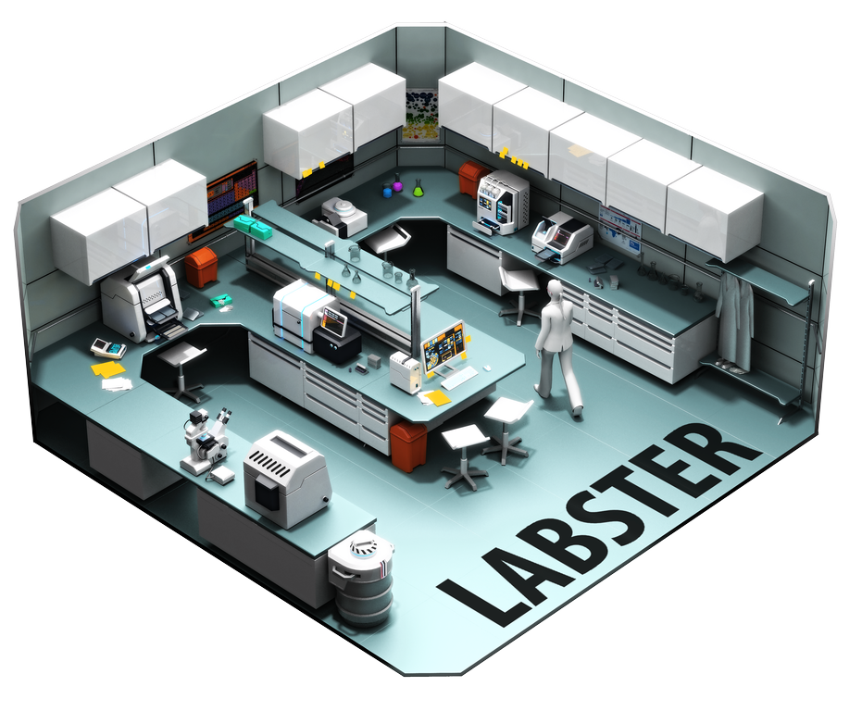
Labster
Jes

Slide 10
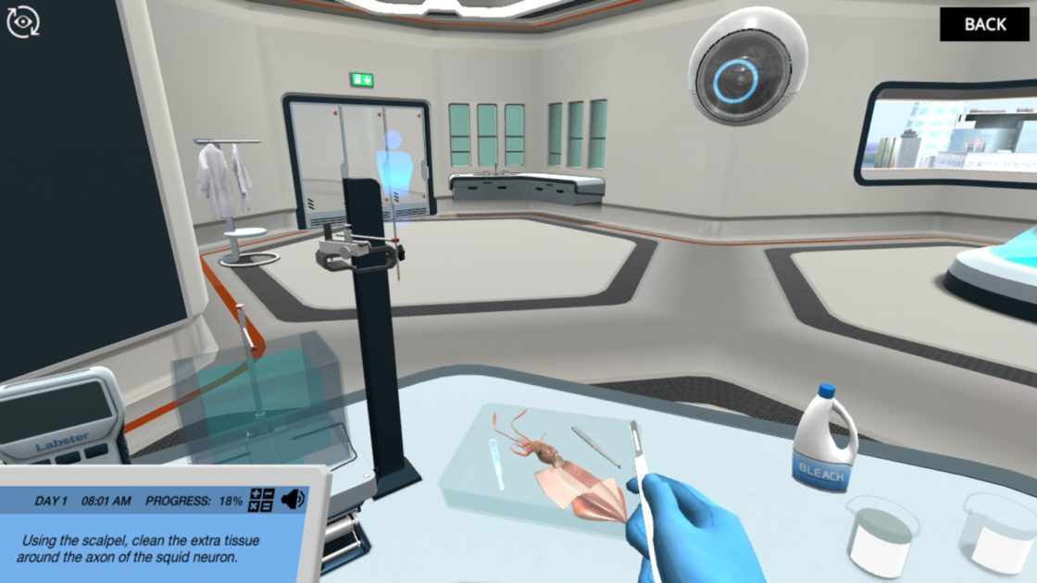
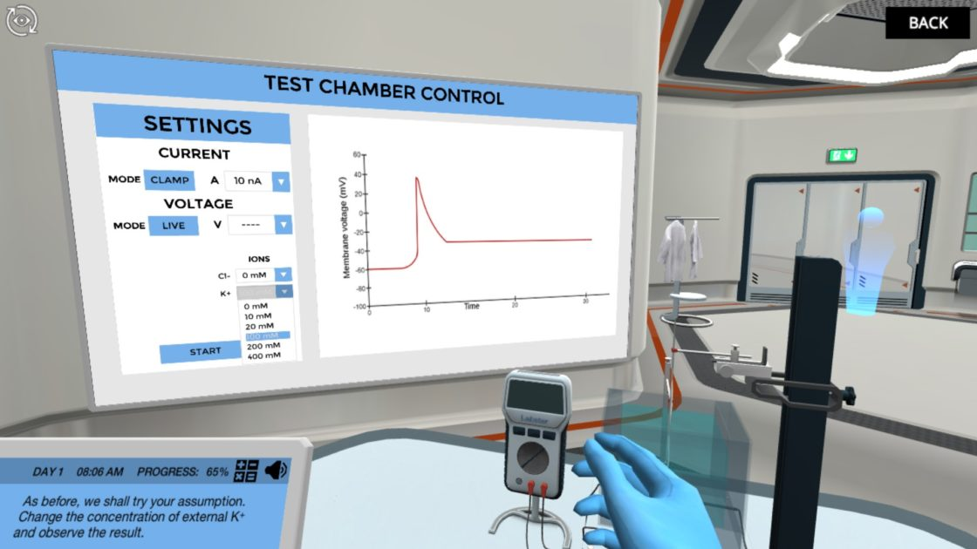
Introduction to Labster VR Technology Nicholas Mello, Labster Student Success Manager

Slide 11
Q & A Session

Slide 12
Contact Information
Kendra Ketchum, Vice President of Information Management & Technology
Kendra.ketchum@utsa.edu
Vanessa Hammler Kenon, Ed.D., Associate Vice President of Information Management & Technology
Vanessa.kenon@utsa.edu
Trevor Nash, UTS Training and Marketing Manager
Trevor.nash@utsa.edu
Jessica Abel, Ph.D., UTS Project Coordinator
Jessica.abel@utsa.edu
Nicholas Mello, Labster Student Success Manager
Nicholas@labster.com

