Slide 1


Building the AI
Network of the Future
A CIO Perspective

Slide 2
Liberal Arts
at the Core
Scholars Who
Love to Teach
A fusion of a renowned liberal arts college and a robust research university where we partner to take on the world’s great challenges.
Adventuresome
Spirit
Profound
Sense of Place
Base Camp to
The World
2

Slide 3

Innovation
New Decision Cycles
Amplitude
Decision Cycles
Increased Speed of Change
Old Decision Cycles
Frequency
Decision Cycles
“Wisdom means knowing what you know and knowing what your don’t know” - Plato
3

Slide 4
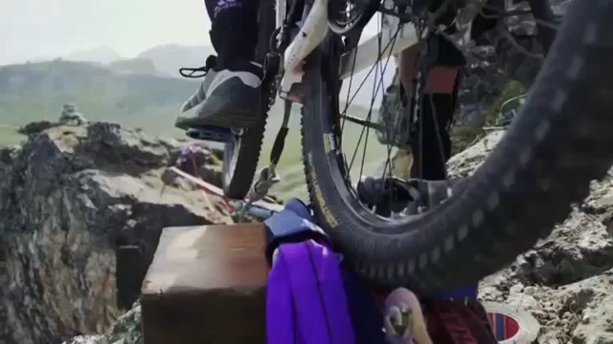
Balance
Risk
Leadership

Slide 5
T
We value “T-shaped” people.
That is, people who are both generalists (highly skilled at a broad set of valuable things—the top of the T) and also experts (among the best in their field within a narrow discipline— the vertical leg of the T).
Operational Learning
Maintaining depth of expertise and growing your breadth of knowledge.
Professional Growth
Career learning or training to advance one into a new role or job.
Breadth of Knowledge
Depth of Expertise
Learning Today
I am still Learning - Michelangelo, Age 87
5

Slide 6
E
We value "E-shaped” people.
That is, people who are both generalists (highly skilled at a broad set of valuable things—the top of the E) and also experts (among the best in their field within a number of narrow discipline— the vertical legs of the E).
Operational Learning
Constantly maintaining depth of expertise and developing your breadth of knowledge.
Professional Growth
Career learning and training to advance one into a number of possible new roles or jobs.
Breadth of Knowledge
Depth of Expertise
Learning Tomorrow
I am still Learning - Michelangelo, Age 87
6

Slide 7
Why AI for Information, Technology and Consulting ?
Don’t have enough IT people
84%
Don’t have the right IT skills
75%
Don’t have enough capacity of technical infrastructure
72%
Can’t implement fast enough to meet business goals
69%
Don’t offer innovative, business-relevant ideas
63%

Slide 8
The Access Network must adapt to changing times
Assurance
critical services require more predictable, reliable, and measurable networks
Insight
“Up” is not the same as “good”
Aware as well as there
Key trends:
Wireless First
Mobile First
Tenet Services – individual space on the net
Automation
Network configure machines
Complexity Resolved
Relevance
Deliver personalized experiences based on user location; Integration with IoT
New Client Centered Wireless Solution
PPSK – limit 7,000 user on any network.

Slide 9
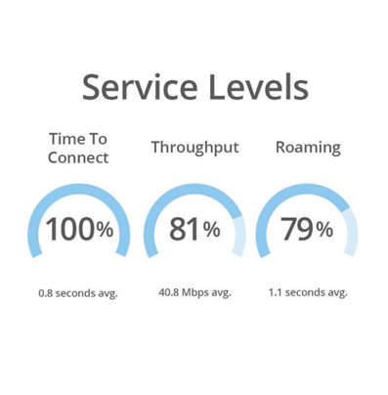
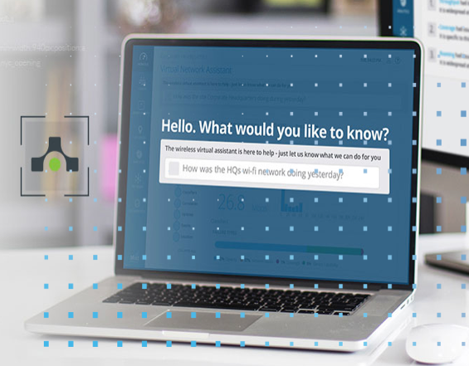

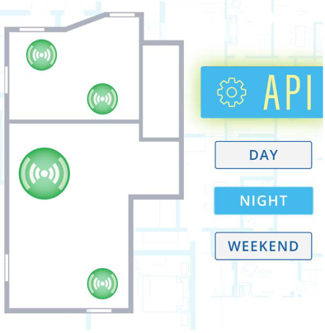
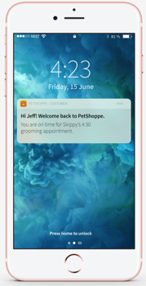
Why move to AI and the Cloud
Client level visibility
AI-driven operations and support
Microservices cloud for agility
Digital Engagement with virtual BLE
3
Of the Fortune 10 have standardized on a Cloud based AI managed network
25+
Of the Fortune 500 have chosen an AI driven network
10
Of the Top 50 retailers have switched
5
Of the top 20 service providers are running wireless managed services with an AI to provide a better client experience and reduce management cost.
9

Slide 10
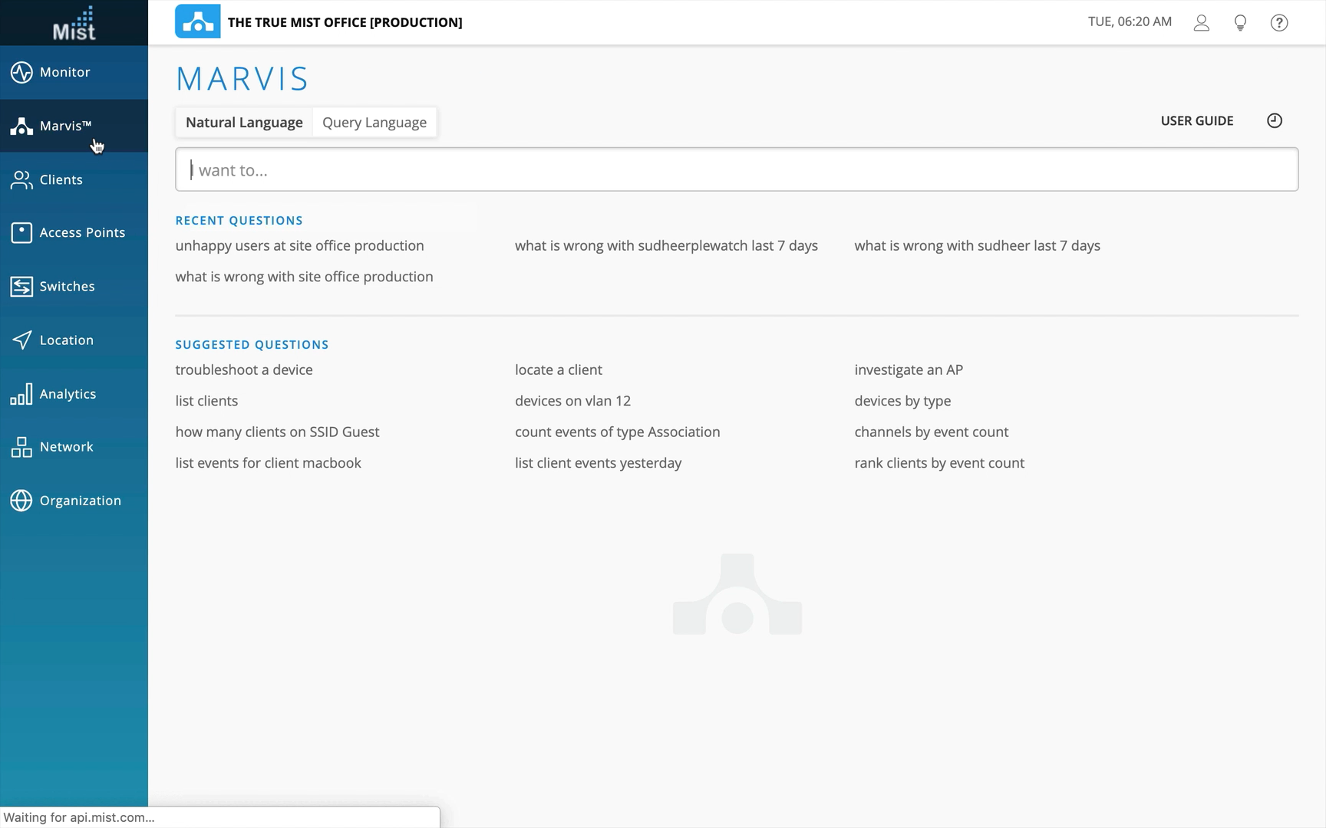
MARVIS

Slide 11
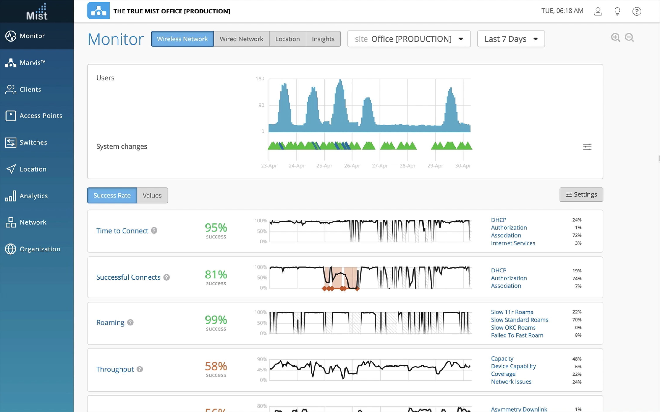
AI-Driven

Slide 12
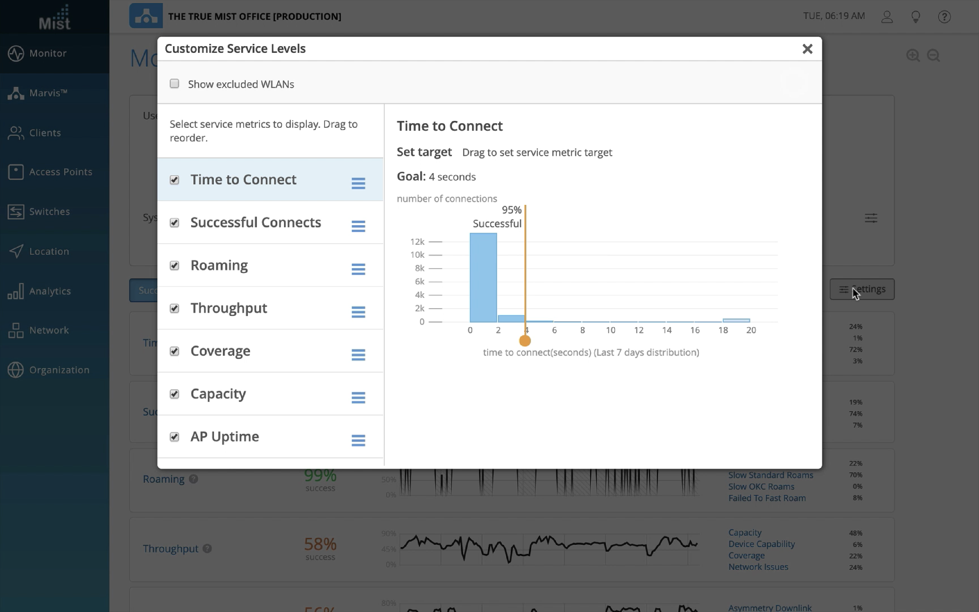
AI-Driven in action

Slide 13
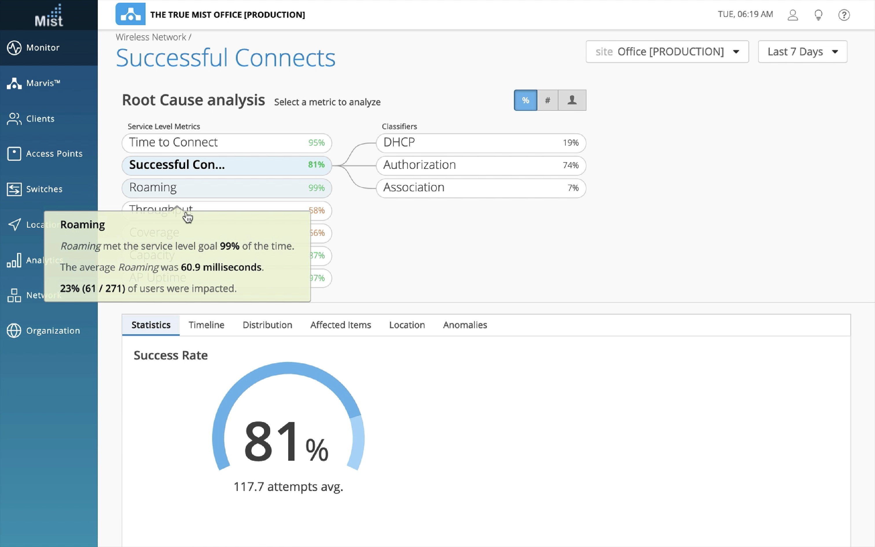
AI-Driven in action

Slide 14
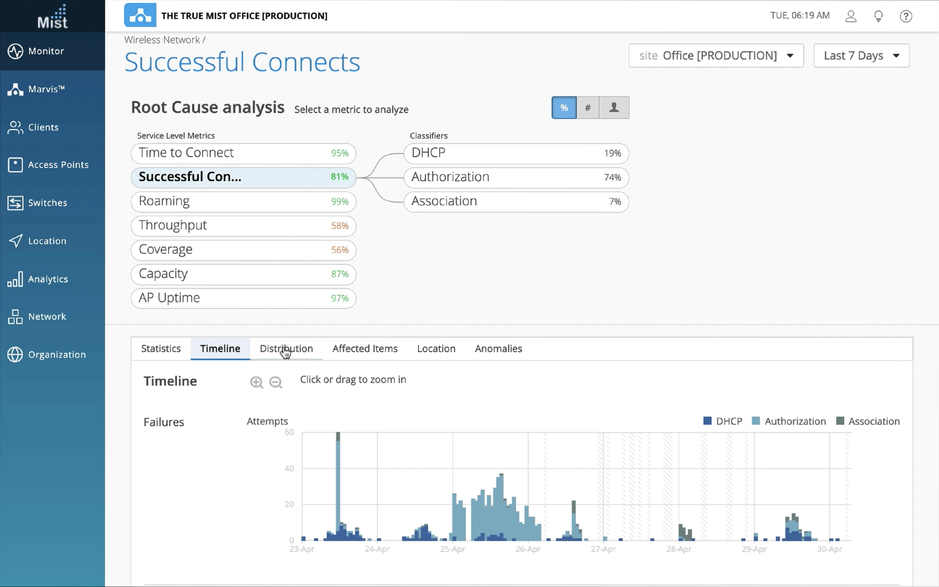
AI-Driven in action

Slide 15
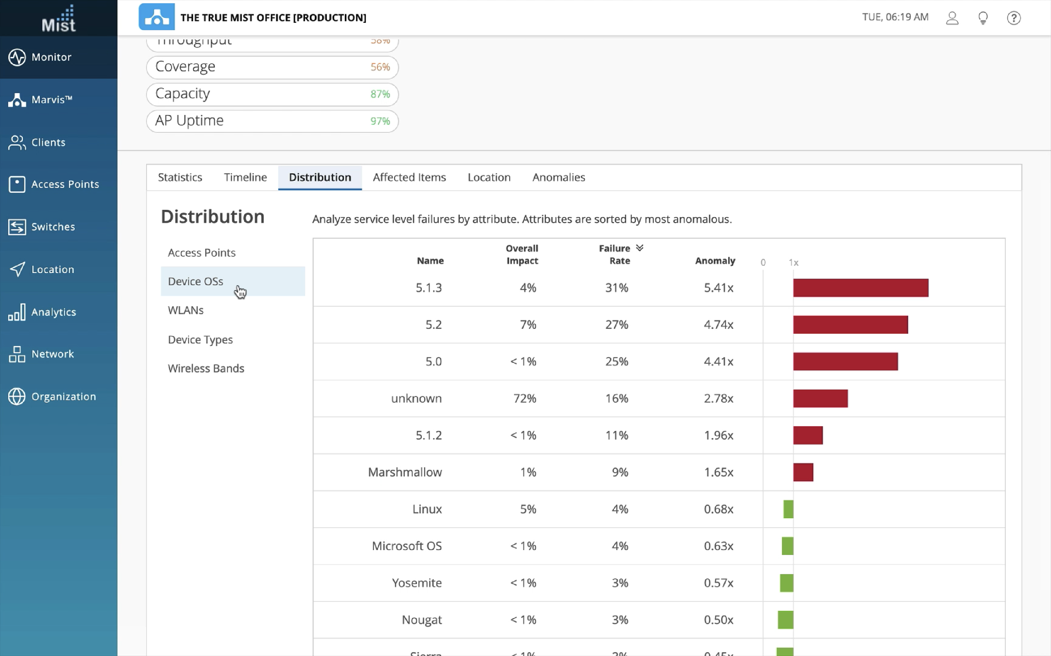
AI-Driven in action

Slide 16
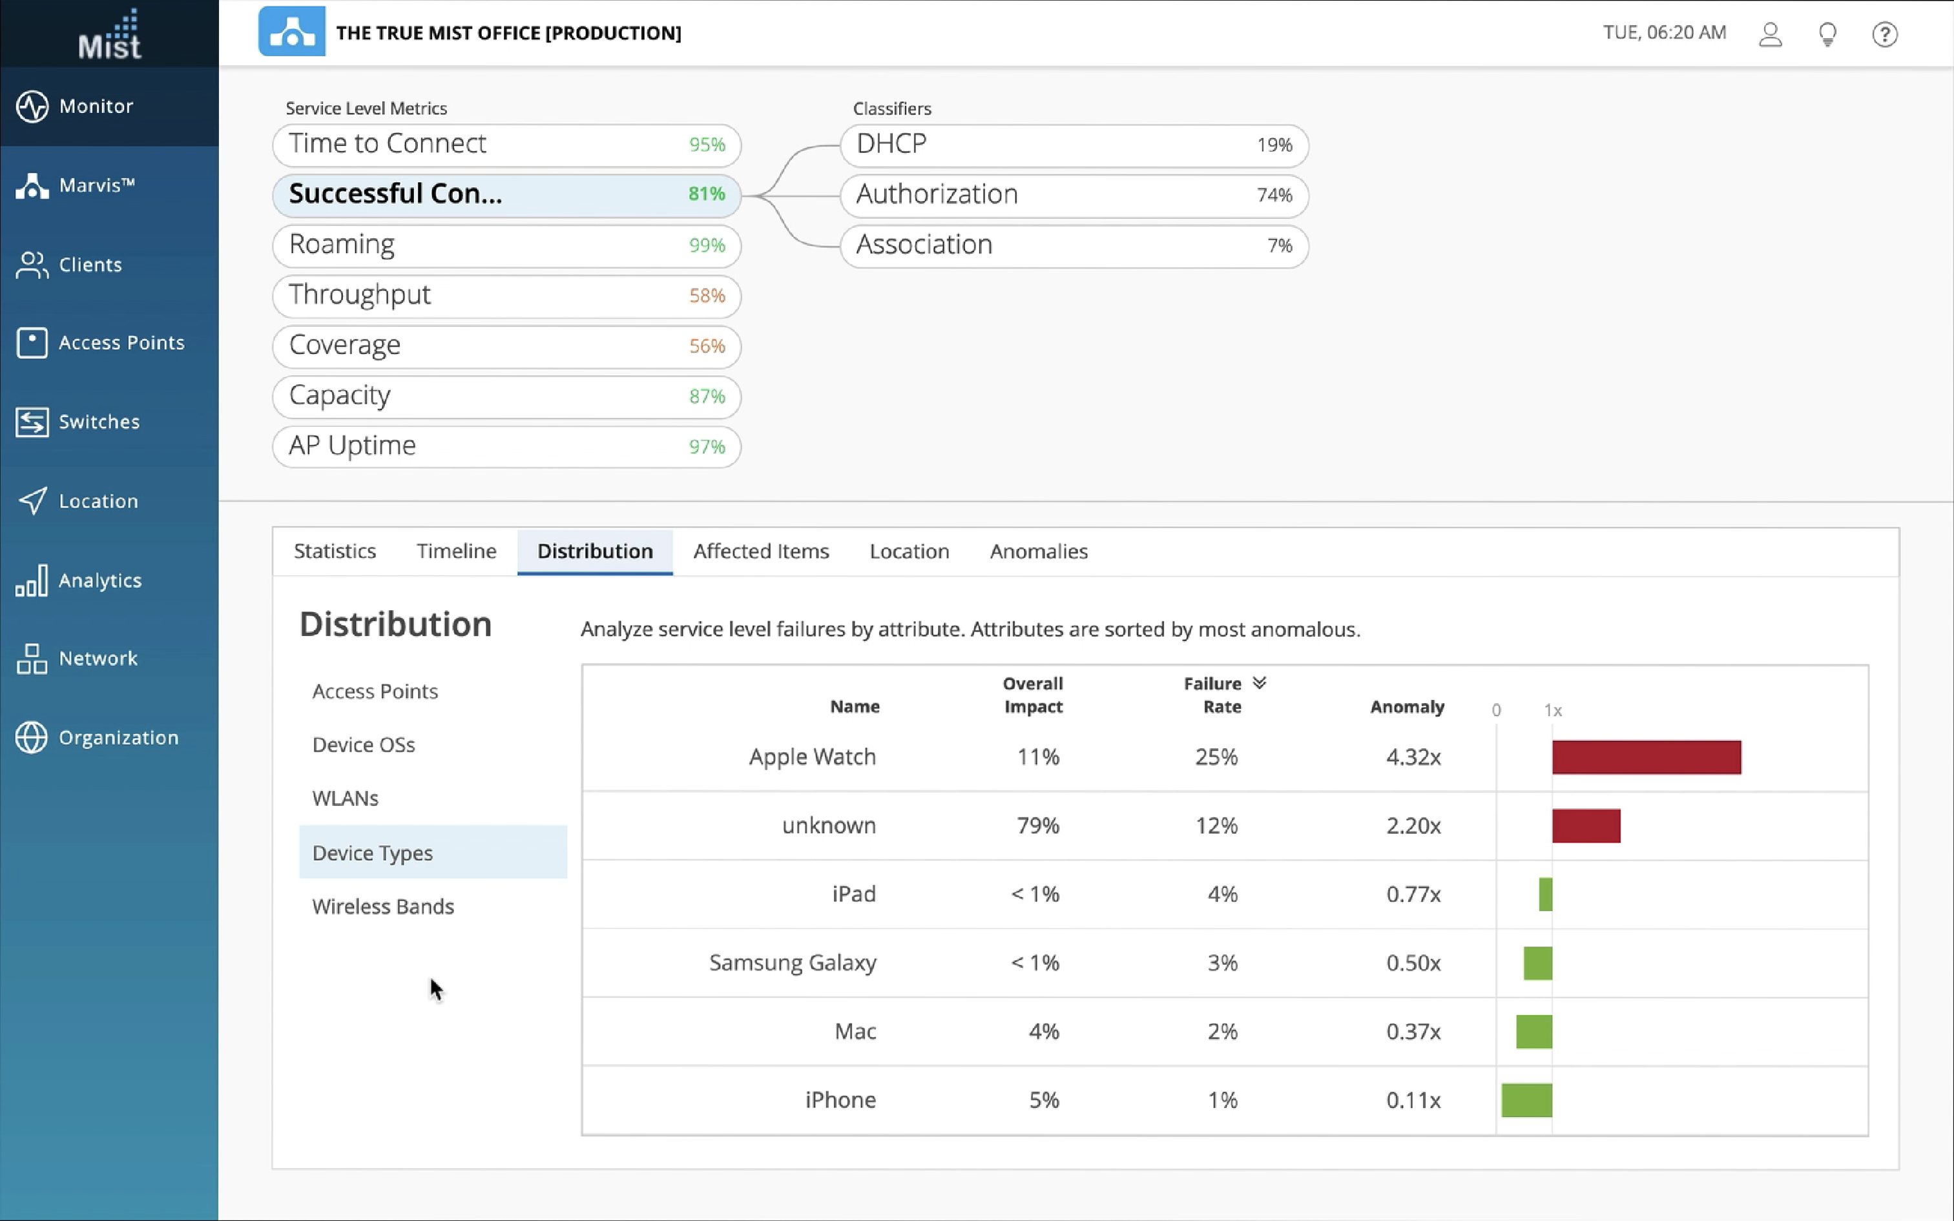
AI-Driven in action

Slide 17





Access networks have not changed much…over the years
Wi-Fi Gen 1
Wi-Fi Gen 2
No modern
wireless architectures
AI-driven
networks
2003
2007
2016

Slide 18


Clean out the unplanned work
AI-Driven Cloud
Each of the functions
is a micro-service in the Cloud

Slide 19







The AI-driven enterprise:
Automation and insight across the stack
High Quality Of Data
High Efficacy AI Engine (Marvis)
Modern Cloud (100% Programmability with Microservices)
Robust Product Portfolio (Wired/Wireless/Security)
Wireless
Wired
Security
WAN
API
AI Engine
Visibility and Policy Control

Slide 20
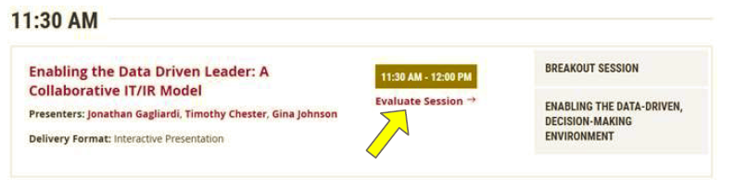
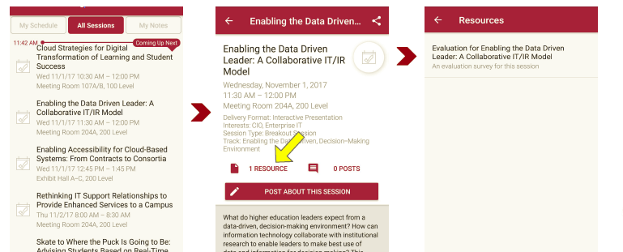
Session Evaluations
There are two ways to access the session and presenter evaluations:
1
2
In the online agenda, click on the “Evaluate Session” link
From the mobile app, click on the session you want from the schedule > then scroll down or click on the associated resources > and the evaluation will pop up in the list

Slide 21
Contact Information
Mitch Davis
Vice President and Chief Information Officer
Information, Technology and Consulting
Dartmouth College
4 Currier Place, Suite 101, Rm 211
Hanover, NH 03755
LinkedIn
M 603.727.8136
O 603-646-8620
Heather D. Woolbert
Administrative Assistant
Phone: (603) 646-4081
Heather.D.Woolbert@Dartmouth.edu
NOTE: This presentation leaves copyright of the content to the presenter. Unless otherwise noted in the materials, uploaded content carries the Creative Commons Attribution 4.0 International (CC BY 4.0), which grants usage to the general public, with appropriate credit to the author.

