Slide 1
Welcome! While you are waiting for the session to begin, please think about what worries you most about supporting enterprise applications at your institution.

Slide 2
How to Reduce THE BURDEN OF INFORMATION SHARING
Building Capacity to Meet Data Sharing Demands Using Integration Tools
Fran Dykstra

Slide 3
About Me
Associate Vice Chancellor Enterprise Applications – Retired in September 2019
University of North Carolina – Chapel Hill
Responsible for the ERP, student information systems, and other administrative applications including Facilities, Parking and Environmental Health and Safety
Currently Service Delivery Model Consultant
Washington University in St. Louis Workday Project
45 Years in Higher Education Administration
Brown University
University of Virginia
Yale University
Stony Brook University
University of North Carolina at Chapel Hill
Washington University in St. Louis

Slide 4
Who are you?
University IT Leaders and Staff
Vendors
Others

Slide 5
Topics
What do you worry about the most?
A Descriptive Model
What does this look like?
What is the cost?
Building capacity
Product selection
Tool Adoption
Preliminary results

Slide 6
What do you worry about the most?
Information Security
Managing Demand
Hiring and Retaining Staff
Data Analytics
Others

Slide 7
A Descriptive Model

Slide 8
Gartner’s Pace Layer Model: Three Types of Systems
Systems of Record Administrative and transaction processing systems. Typically a suite of integrated applications. Example: An ERP
Systems of Differentiation
Unique to an industry. Provide competitive advantage. Choose Best of Breed.
Example: Slate
Rayner, Nigel, and John E. Van Decker, “Use Gartner’s Pace Layers Model to Better Manage Your Financial Management Application Portfolio, Gartner Research paper Number GO0213657, 24 June 2011.
Systems of Innovation
Built quickly to support new innovative activities. Usually not deployed at the enterprise level.
Example: Departmental Productivity Applications (workflow)

Slide 9
UNC’s Systems
PeopleSoft 9.2 Campus Solutions, Finance, and Human Resources/Payroll
ConnectCarolina Logins in FY 2019 8,690,170
Help and Service Requests Resolved in FY 2017 29,092
~100 Other enterprise applications supported – A Mix of
Homegrown Java applications
Vendor On Premises applications
Software as a Service
A myriad of other systems supported by Schools, the College, and other Administrative Units
Total in- and out-bound interfaces 730

Slide 10
What Holds the “Layers” Together?
Connective Tissue
Workflow
Master Data Management
Data Warehouse
Data Integration

Slide 11
What does this look like at your institution?
Ad Hoc
Semi-Organized
Consistent, Standard Approach

Slide 12
What does this typically look like?

Slide 13
What is the cost of your approach?

Slide 14
The Cost
Estimated time to build an integration (flat file or web service) 4 weeks
Estimated additional time to coordinate testing 2 weeks
Average cost of a developer (salary, benefits, non-payroll expenses) $125,000
The cost of a single integration $14,400
The number of integrations one developer can complete in a year 8
The cost of establishing 80 interfaces in one year $1,250,000
The number of developers needed 10
Reputation Loss: IT can’t get things done!

Slide 15
How can you build capacity?

Slide 16
What does this look like at your institution?
More staff
Charge Customers
Ration access to data
Use New Tools

Slide 17
How can you build capacity?
Using integration tools to build capacity
Modern integration tools like Dell Boomi, Mulesoft, Informatica and other
Allow the creation of standard objects
Enables the objects to be dragged and dropped to create an integration
Providing the capability for
Data transformation
Scheduling
Error monitoring
Notifications
Emailed results
Cuts development time in half

Slide 18
Product Selection
Evaluating the Products: Recommended Practices
Engage your best/lead developers in the product selection process
Ask them to list the features they need
Identify and research products
Consult with your peers
Ask Gartner and Forrester
Select 3 or 4 products for evaluation
Work with vendors to establish a sandbox
Ask developers to recreate an existing integration on each tool
Evaluate the results
This takes time!!!

Slide 19
Do you experience difficulties with tool adoption? How do you tackle this hurdle?

Slide 20
Tool Adoption
The Biggest Challenges
Conquering the learning curve
Getting traction
Some Strategies
Find one or more champions
Reward early successes
Engage your over-achievers
Create a buddy system to allow developers to help each other
Don’t limit tool training and use to developers; business analysts can use these tools too.
Establish design planning sessions to help developers select the most efficient approach
TIP: THE DEVELOPERS WHO PARTICIPATED IN PRODUCT EVALUATIONS MAY BECOME YOUR TOOL EXPERTS AND CHAMPIONS!!!

Slide 21
Preliminary Results at UNC
The first integrations were completed within 2 months of purchasing the tool
A third of team members have completed training and created integrations
Integration projects are taking half the time of traditional development methods
The product pays for itself in terms of productivity improvements
80 new interfaces in the first year

Slide 22
Representative Projects
30 new web services built to enable UNC Chapel Hill to participate in a University of North Carolina system online course initiative
Data feeds to Teamworks enable class and tutoring schedules to be uploaded to an application that manages student athlete’s schedules.
A medical school request for data feeds to a new budgeting system was completed two months ahead of schedule

Slide 23
What strategies have worked for you?

Slide 24
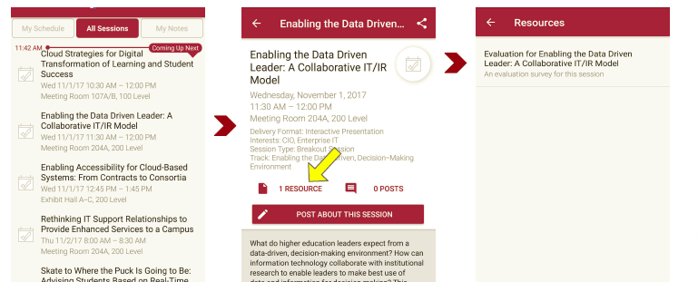
Session Evaluations There are two ways to access the session and presenter evaluations:
1
2
In the online agenda, click on the “Evaluate Session” link
From the mobile app, click on the session you want from the schedule > then scroll down or click on the associated resources > and the evaluation will pop up in the list

Slide 25
Contact Information
Fran Dykstra
Consultant
Washington University
St. Louis, MO
EMAIL: frandykstra@gmail.com
NOTE: This presentation leaves copyright of the content to the presenter. Unless otherwise noted in the materials, uploaded content carries the Creative Commons Attribution 4.0 International (CC BY 4.0), which grants usage to the general public, with appropriate credit to the author.

