Slide 1
Answering the Call for Better Student Data

Slide 2
Michelle Blackwell
Manager Data Partnerships
National Student Clearinghouse Research Center
Laurie Heacock
Senior Advisor of Data and Analytics
Achieving the Dream
Eric Godin Associate Vice President
State Higher Education Executive Officers

Slide 3
Agenda
Who, What, When, Why and How of the Postsecondary Data Partnership (PDP)
IT as a Strategic Partner of the PDP
Activity: Bridging Campus Needs and Technology Solutions

Slide 6
Who are the Postsecondary Data Partnership (PDP) Partners?

Slide 7
Funders Managing Organization
Bill & Melinda Gates Foundation
Lumina Foundation

Slide 8
Participating Organizational Data Partners?

Slide 10
Who are the Data Partners?
Institutions
Campus Reporting
Data-enabled leaders
Board
President’s cabinet
Administrators
Full-time faculty
Adjunct faculty
Academic Affairs
Student Services
Four-Year Universities
Community Colleges
Districts
Systems
IT
IR
Registrar’s office
System office

Slide 11
What is the Postsecondary Data Partnership (PDP)?

Slide 12
Answers the call for better data by partnering to:
Build alignment in the field around a new metrics framework drawn on lessons from the field over the past decade
Help institutions better understand how they are performing related to student access, progress, completion and post-college outcomes
Gain insights on equity measures to include all students, including those underserved who may have been invisible in other data collections

Slide 13
Answers the call for better data by partnering to:
Improve data quality, transparency and use
Reduce reporting burden
Provide meaningful benchmarks

Slide 14
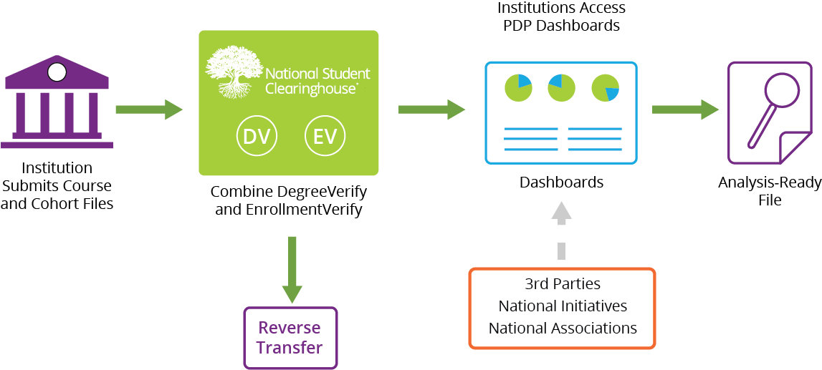
PDP Process – Building on Our Existing Institutional Relationships and Reporting

Slide 15
Postsecondary Data Partnership Dashboards
Filter by:
Cohort
Cohort Term
Credential Type Sought
Age
Race/Ethnicity
Gender
Enrollment Type
Attendance
Dual/summer Enrollment
Pell
First Generation
GPA
Math Prepared
English Prepared

Slide 16
Analysis-Ready File
Data from course file, cohort file, and NSC enrollment/degree data
Derived metrics such as:
Retention/Persistence
Year of last degree/enrollment
Time to credential
Student level identified for institution;
Can be used for granular analysis, making KPI metric data actionable

Slide 17
When can you start submitting data to the PDP?
New institutions can begin reporting at any time.
Current institutions report twice yearly for the previous semester
Institutions are encouraged to report 3-5 years years of data in their first reporting submission

Slide 18
Why Should We Join the Postsecondary Data Partnership (PDP)?

Slide 19
To promote success by helping you:
Reduce reporting burden, freeing up more time for data usage
Access leading indicators that are predictive of completion such as:
Credit accumulation first term and first year
Credit completion ratio
Successful completion of gateway Math and English in the first year
Term to term persistence
Disaggregate data by ethnicity, gender, age, Pell status, first generation status to identify equity gaps

Slide 20
To promote success by helping you:
Evaluate impact of co-requisites, embedded supports and other pathways reforms
Benchmark by Carnegie classification
Democratize data and break down silos through use of interactive Tableau dashboards including executive summary dashboards
Convene faculty and student services staff to discuss data and how to redesign the student experience to increase early momentum

Slide 22
How to Join the Postsecondary Data Partnership (PDP)?

Slide 23
Postsecondary Data Partnership Process
Data sharing agreements
4-8 weeks
Legal Contracts
Program to pull data
Typically 1 full week of work (40 hours) 5 years of historical and current year.
Data Programming
First time approximately 1-2 weeks of passing validations and troubleshooting
Subsequent less than one week
Submit
Data

Slide 24
This process time frame will vary over the next year due to continued enhancements. Availability of dashboards will depend on when data has completed validations.
Additional data quality validations
May result in resubmissions
Data
Quality
Clearinghouse matches to Degree and Enrollment Data
Process
Data
Interactive Dashboards
Analysis Ready File
Dashboards and Analysis Ready File

Slide 25
Report Two Additional Files to NSC
Cohort File
Course File
Pell status
Program Intent (degree type, transfer)
GPA (term, cumulative)
Course name, number, CIP, type, delivery method
Course credits, grade, etc.
Gateway Math & English
Degree type sought
Reverse Transfer information
Entry status
High school completion & GPA
First-generation status
Race/ethnicity
Dual enrollment
Number credits attempted & transferred
Math & English readiness

Slide 26
Where is your institution on the analytics curve?

Slide 30
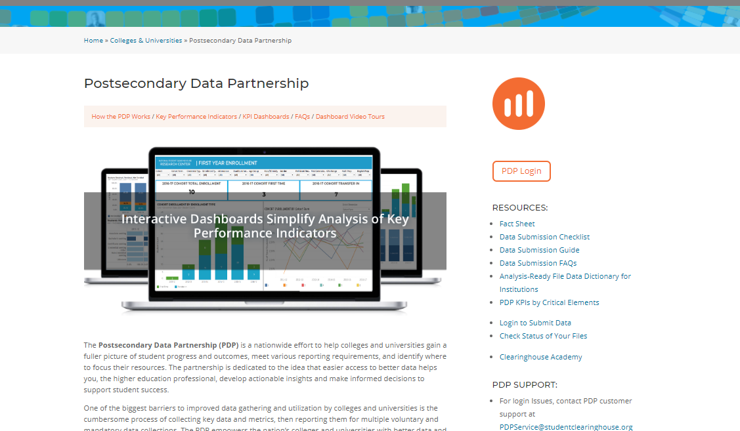
Learn More at PDP Website

Slide 31
SHEEO Supporting the PDP
PDP Convenings (JFF – July), (CCA – October)
Technical Support (Data Upload & Data Analysis)
Webinars
Case Studies
Data Analysis Examples
Technical Briefs
Blog Posts
Research Papers

Slide 32
Join a Future Learning Event
NSC & Partner hosted webinars
Watch for us at a conference near you.

Slide 33
Contact us at:
mblackwell@studentclearinghouse.org
lheacock@achievingthedream.org
egodin@sheeo.org
Visit the PDP Website: https://studentclearinghouse.org/colleges/pdp/

Slide 34
Q & A

