Slide 1
Hacking Your Way to Student Success
Orlando Leon
Chief Information Officer
California State University - Fresno

Slide 2
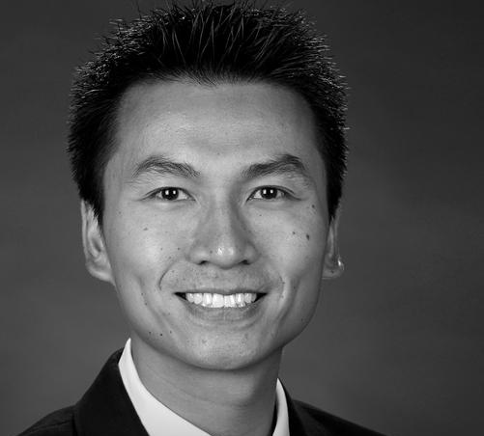
Introduction
ORLANDO
LEON
Chief Information Officer
Fresno State

Slide 3
Learning Objectives
Understand why Fresno State invested in a hackathon and how one supports student success and a culture of innovation
Understand lessons learned in starting a hackathon from scratch
Consider key ingredients for success and how to apply to your campus

Slide 4
Fresno State Demographics
Central Valley, Agricultural-Focus, Lowest Per-Capita Median Income in CA, Division I Athletics
24,995 Students Enrolled in Fall 2018
Bachelors/Masters/Doctoral-Granting Institution
AANAPISI/HSI
70% First Generation to College Student/70% Pell Grant Recipients
102 FTE in Central IT (includes some Academic Technology, does not include IR/Library/Advancement/Aux IT)
80+ student employees/volunteers
8 MPPs

Slide 5
Notes:
Who has a hackathon on campus?
https://www.polleverywhere.com/multiple_choice_polls/7a63yaC4fJTLd68y7ozti

Slide 6
Notes:
For those who have a hackathon on campus, is the Central IT team involved?
https://www.polleverywhere.com/multiple_choice_polls/RQb7yJi37sJ6x9crCkYYr

Slide 9
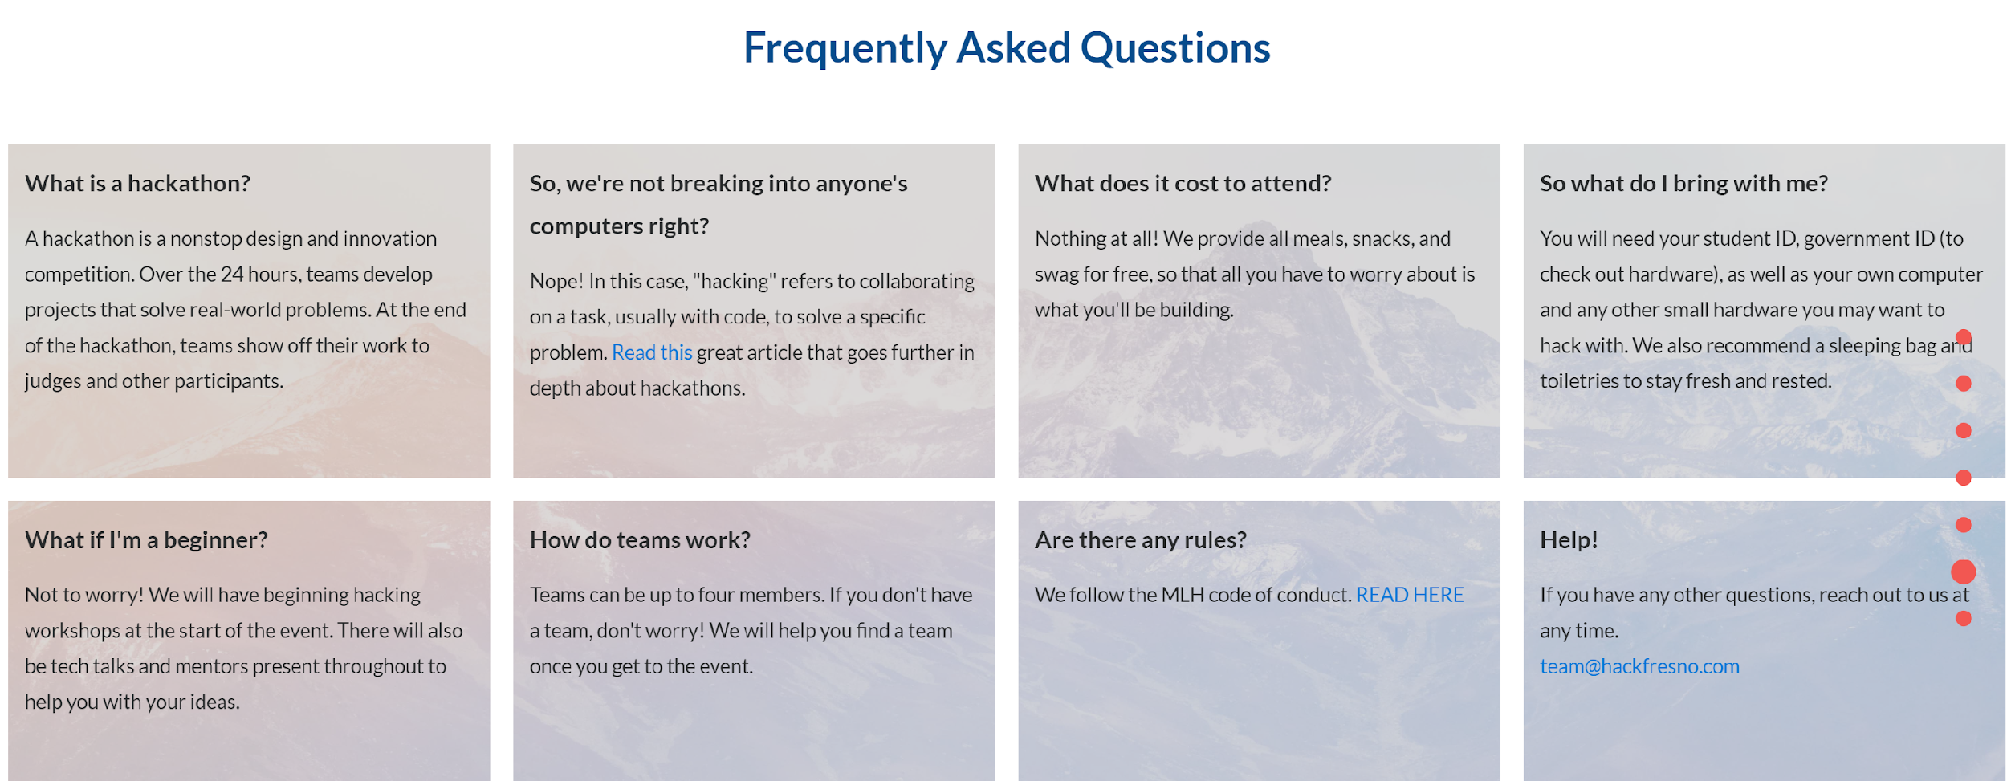

Slide 10
Why Hackathons?
Hands-on, Group-based, Project-based, Interdisciplinary Learning
Theory 🡺 Practice
Exposure to the Outside World
Potential for Partnerships
A Great Resume-Builder
Build Excitement, Interest, and Brand
Economic Development, Digital Literacy, Social Mobility, Digital Awareness, Building Tomorrow’s Workforce
Innovation and Transformation
Diversity, Equity, Inclusion

Slide 11
Elements of Design and Execution
Vision
Facilities
Marketing
Finances
Event Coordination
Food
Equipment/Infrastructure
Judging
Sponsors

Slide 12
Elements of Design and Execution
Students
☺

Slide 14
Measuring Success
Just getting through the 24 or 36 hours!
Feedback from Students
Feedback from Sponsors
Feedback from Faculty/Staff
Excitement of Students

Slide 15
Sustaining
Student Club
Transition Team
Recruiting Students
Maintaining Relationships with Sponsors
Planning Ahead
Partnering with Faculty
Integrating with Other Innovation Efforts

Slide 16
Lessons Learned - So What? Now What?
Book a Venue ASAP!
Don’t Forget Those Food Waivers!
Students will be Students…
Sponsors, Sponsors, Sponsors…
The First Year will be the Hardest

Slide 17
Questions

Slide 18
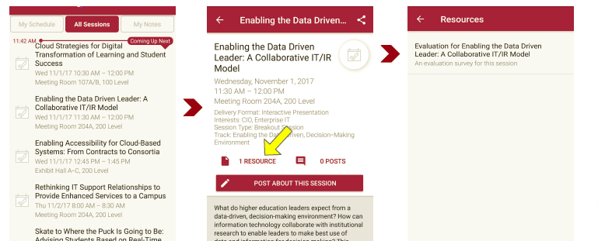
Session Evaluations There are two ways to access the session and presenter evaluations:
1
2
In the online agenda, click on the “Evaluate Session” link
From the mobile app, click on the session you want from the schedule > then scroll down or click on the associated resources > and the evaluation will pop up in the list

Slide 19
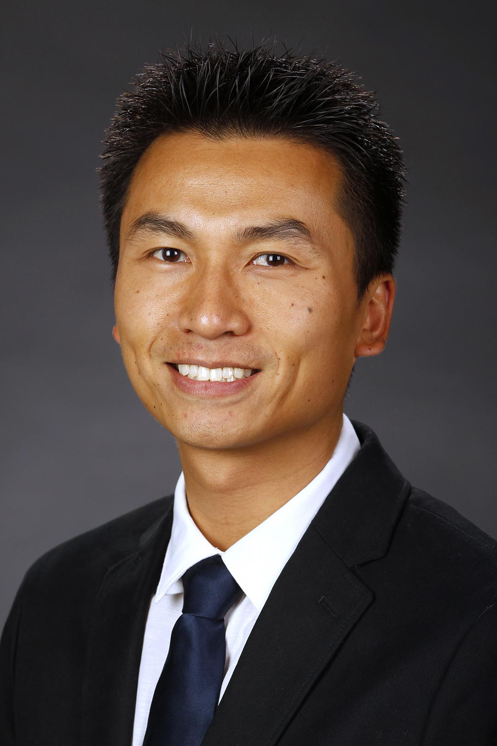
Contact Information
Orlando Leon - Fresno State
oleon@csufresno.edu
@OrlandoWLeon
NOTE: This presentation leaves copyright of the content to the presenter. Unless otherwise noted in the materials, uploaded content carries the Creative Commons Attribution 4.0 International (CC BY 4.0), which grants usage to the general public, with appropriate credit to the author.

Slide 20
Thank You!

