Slide 1
Digital Transformation: Ideas Are Easy, Execution Is Hard

Slide 2
Digital Transformation: Ideas Are Easy, Execution Is Hard
Jennifer Casey
Director, Digital Transformation Office
Simon Fraser University
Mark Roman
Chief Information Officer
Simon Fraser University
Brian Stewart
Deputy CIO
University of Alberta
Josie DeBaere
Director, Technology Architecture
Boston University

Slide 3
Brian Stewart
Deputy Chief Information Officer
University of Alberta – Edmonton, AB Canada

Slide 4
My role in Digital Transformation (DX)
Personal
Develop a digital consciousness and create momentum
Identify areas of weakness
Iterate a roadmap to adopt DX
CIO
Create Digital gravity
Advocate and initiate change
Seek DX opportunities and demonstrate the effectiveness of DX
Lead the IT department and the Institution into DX – eyes wide open
IT Department
Adopt DX –people, process, technology
Fill knowledge gaps and learn new skills and approaches
Develop sustainable technology models for campus adoption

Slide 5
My intent in Digital Transformation (DX)
Create fascinating learning experiences
Enhance student experience and success
Increase graduation rates
Reduce graduation times
Reduce administrative load on faculty
Reduce cost of education – optimize resource utilization
Create a Learning organization – use data to iterate the future

Slide 6
What I’m doing in Digital Transformation (DX)
Learning, learning, learning
Digital momentum - initiatives
Robotic Process Automation – automate routine functions
Chat Bots – increased hours and disintermediation of services
Screen overlays – intuitive interfaces for existing applications
Service Reviews – focus on uncovering client values
Learning Analytics – using Moodle and SIS data
IoT – classroom utilization using Wifi Internet Access Points
Data management – Governance, quality, availability and protection
Staff leadership and skills development
Putting data at the heart of what IT does

Slide 7
Mark Roman
Chief Information Office
Simon Fraser University – Vancouver, BC Canada

Slide 8
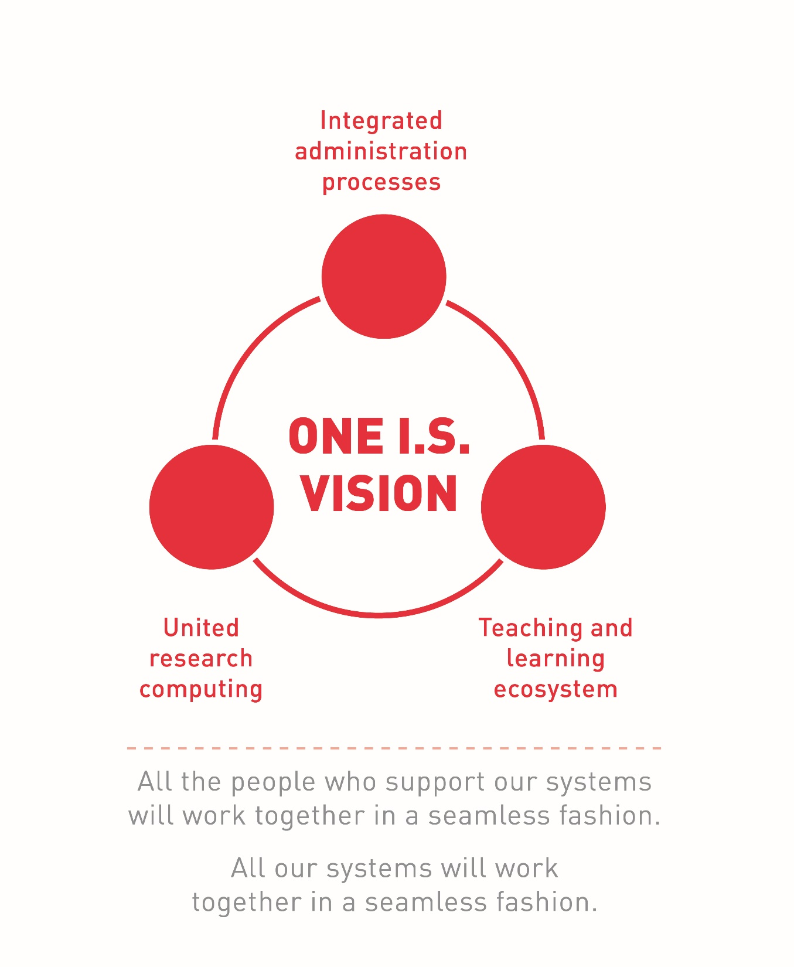
Role: One I.S. Vision
All of our systems will work in a seamless fashion, and all of our staff will work together in a seamless fashion.
External
Internal
Digital Transformation
“Should IT continue to exist?”
“Are we pushing IT
too hard?”
“Every SFU project is an IT project!”
Focii
Client service
Leadership
Project process
Technology deficit
Stewardship
Organization
Deliverables
Focii
SFU operational model changes
IT pivots without friction
Focii
People development
Cultural evolution
Collaboration model
Operations improvement
Today
Time

Slide 9
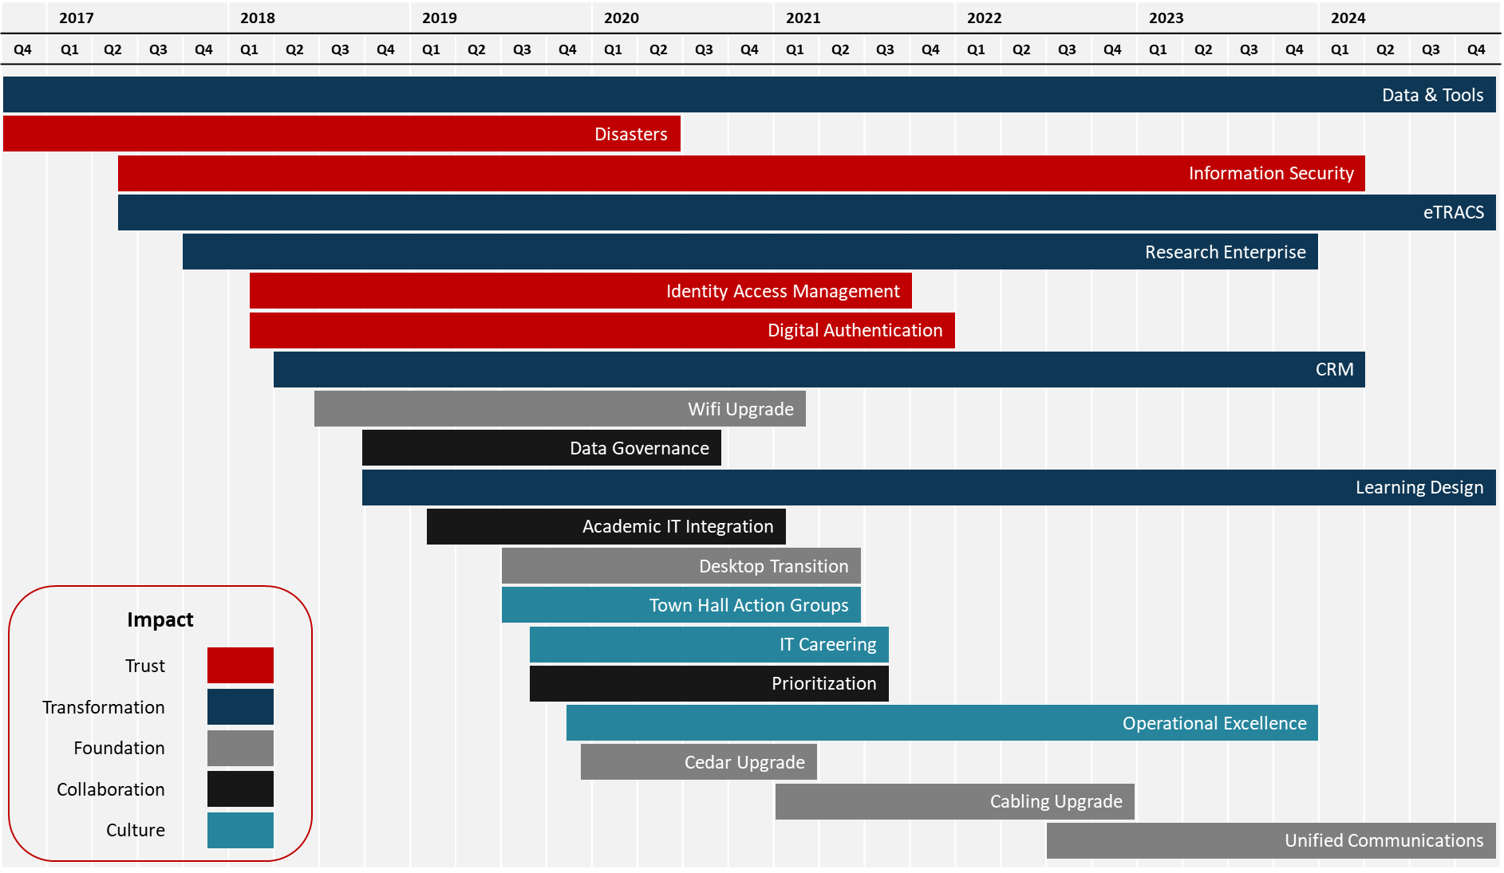
Intent: Dx Roadmap

Slide 10
Doing:
High Attention
Clear Way Forward
Hard to Explain
Table Stakes

Slide 11
Jennifer Casey
Director, Digital Transformation
Simon Fraser University - Vancouver, BC Canada

Slide 12
My role in Digital Transformation (DX)
Socialize & Educate
Identify
Assess
Support
Notes:
I see my role focused across these 4 areas:
Socialize / Educate, my team, my IT department / my institution about what DX means, what it looks like, and how we might lead / execute and support it. Creating a buzz to gain interest and prompt discussion
Identify: Ear to the ground to be able to identify problems that we need to solve or what opportunities we could vs should be taking advantage of. The more you listen and learn the better situation you are in to predict and plan.
Assess: current gaps / functionality of our departmental tools and processes / impact of change on the community to prevent fatigue / technology decisions
Support: multi-dimensional change (people / process / data / tech)

Slide 13
My intent in Digital Transformation (DX)
People
DX
User Centric
Digital Value
Integrate
Mindset
Capability
Agility
Data Driven
New Skills
Process
Technology
Data
Notes:
My intent is to look at DX as a 4 way split between People / Process / Data & Technology
Starting at 12 o’clock, the focus should be centered on the users and what their team / departments capability is in order to successfully create effective tools & processes. We can’t do this without embracing agility and approaching our knowledge and change more iteratively to ensure we are working on the right things.
Understanding what and where data is needed to support the effective process creation then forms digital value as we start to look at data as a currency. These means we must move towards a more technology integrated approach to move information to the places its most valued.
Finally we anticipate the new skills that are needed with the onset of new technology and tools to support successful DX change.
Which results in DX becoming more of a mindset than a theory or individual tactic.

Slide 14
What I’m doing in Digital Transformation (DX)
Defining
Creating
Trying
Measuring
Learning
DX project success
New tools, tactics and templates
New activities to support DX
Qualitative & quantitative results
Mixed methodology
Design Life-cycle
User centric
DX Advisory committee
Client, colleague & partner feedback
Lessons learned review
Definition of Done
Project Classification
Notes:
My approach is very much to work continuously and iteratively across a few different areas:
While I am Defining what project success in DX looks like, I am also Creating: new methods and templates for DX projects to support quality based outcomes. Which then leads us into Trying – we are testing out new methodologies and concepts such as conducting a User Journey Mapping exercise with our MFA pilot users to better understand the viability and desirability of a proposed solution.
We naturally go into a continuous measurement cycle, but focusing on both quantitative and qualitative results with both project metrics and community feedback to see how things are going and finally Learning: , I have established a DX Advisory Committee to discuss learnings from our trying stages as well as any feedback or nuggets that our teams are identifying on the ground.

Slide 15
Why should we believe that Digital Transformation is not just another fad? What’s different this time?
Go to sli.do
Enter code H312
Type in your thoughts to share with the room:
Why should we believe that Digital Transformation is not just another fad? What’s different this time?
Notes:
We’ve talked some about how our panelists view DX and what they’re doing at their institutions.
At this point, we’d like to hear from all of you by using SLI.DO
Why should we believe that Digital Transformation is not just another fad? What’s different this time?
Here’s a question on; go to SLI.DO on your phone or laptop
And type your thoughts
---
12:00-12:06: panelists discuss
Brian
Jennifer
Mark

Slide 16
Ideas are easy; execution is hard …
Processes and Data:
What changes pave way for digital transformation? What are the challenges?
What is the role of data in digital transformation?
How do we engage with faculty, staff and students to make these changes?
Notes:
12:06-12:12 Let’s start with processes and data:
Mark
Jennifer
Brian

Slide 17
Ideas are easy; execution is hard …
Culture:
How does the culture of an organization factor into digital transformation?
Is it realistic to expect tradition-based institutions to embrace digital transformation?
Notes:
12:12-12:18
Brian,
Jennifer
Mark

Slide 18
Ideas are easy; execution is hard …
Digital Transformation:
What’s your one key takeaway?
Notes:
12:18-12:21
Jennifer
Mark
Brian

Slide 19
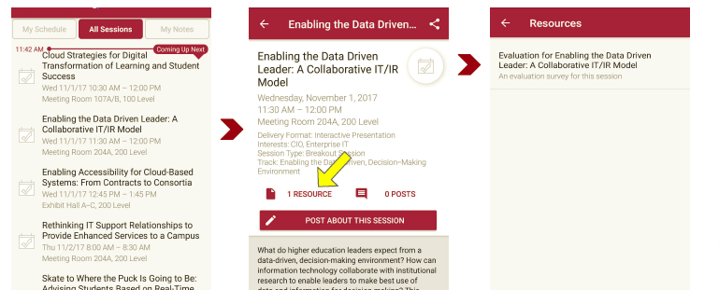
Session Evaluations There are two ways to access the session and presenter evaluations:
1
2
In the online agenda, click on the “Evaluate Session” link
From the mobile app, click on the session you want from the schedule > then scroll down or click on the associated resources > and the evaluation will pop up in the list

Slide 20
Contact Information
Jennifer Casey
Director, Digital Transformation Office
Simon Fraser University
jcasey@sfu.ca
Mark Roman
Chief Information Officer
Simon Fraser University
mark_roman@sfu.ca
Brian Stewart
Deputy CIO
University of Alberta
brstewar@ualberta.ca
Josie DeBaere
Director, Technology Architecture
Boston University
jdebaere@bu.edu
NOTE: This presentation leaves copyright of the content to the presenter. Unless otherwise noted in the materials, uploaded content carries the Creative Commons Attribution 4.0 International (CC BY 4.0), which grants usage to the general public, with appropriate credit to the author.

