Slide 1
Empowering the Campus Community to Own Tech Transformation:
CRM Case Study
October 17, 2019
9:30 am – 10:15 am
Notes:
Description: Come learn how your institution can facilitate effective stakeholder engagement strategies to achieve enterprise-wide collaboration and prepare for the cultural, technical, and tactical implications of deploying CRM university-wide. Gonzaga's IT leadership will share insights from their journey of uniting departments across the student life cycle that you can apply to your own technology transformation.
Outcomes:
Learn strategies for building enterprise-wide buy-in and support of IT initiatives
Review tactical examples of effective stakeholder engagement
Gain an understanding of the potential for IT to gauge change readiness and prepare for the cultural aspects of technology transformation

Slide 2
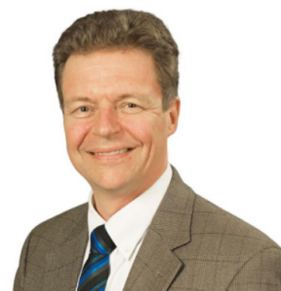
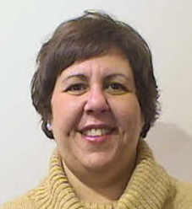

Introductions
Borre Ulrichsen
Chief Information Officer
Gonzaga University
Stephanie Schut
Director, IT PMO
Gonzaga University
Alex Faklis
Director
Huron Consulting Group
Notes:
3 minutes

Slide 3

Gonzaga University: Overview
Gonzaga University
Spokane, WA
Private, Jesuit, liberal-arts institution with Division I Athletic Programs
Ranked in top 20% among national universities
Through artful teaching from expert professors, a proud Jesuit liberal arts tradition, and a supportive, yet challenging community, we help students realize immense possibilities. At Gonzaga, students become the innovative, compassionate, and courageous people the world needs most.
Gonzaga’s total enrollment for 2018-19 is 7,566 and GU offers 18 undergraduate degrees through 56 majors, 61 minors and 50 concentrations; 16 master's programs and five doctorate degrees.
94% of first-year students stay on at Gonzaga and 86% of undergraduate students graduate in six years¹
¹ U.S. News & World Report, 2020
Notes:
2 min – Gonzaga overview slide
Sources: https://www.gonzaga.edu/about/at-a-glance/national-rankings; https://www.gonzaga.edu/about/at-a-glance; https://www.gonzaga.edu/about/at-a-glance/facts-and-figures; https://www.gonzaga.edu/about/our-mission-jesuit-values/mission-statement-and-values

Slide 4
Huron Student Lifecycle Solutions
A Holistic Approach
Huron offers services across strategy, technology, and business and organizational transformation to align institutional processes to the student journey and improve student outcomes.
Strategy
Business & Organizational Transformation
Technology
Notes:
3 min – Huron overview slide
Alex

Slide 5
Today’s Session: Learning Objectives
Fostering Collaboration
Measuring Success
Building Buy-In
Strategy-first approach
Enterprise-wide support of IT initiatives
Examples of effective stakeholder engagement
"Units uniting"
Importance of quantifiable metrics for continued success
Gonzaga’s Enterprise CRM Objective
Aggregate, share, and utilize information across the University to deepen relationships and improve the experiences constituents have with Gonzaga, no matter what stage of the lifecycle they are in.
Notes:
3 minutes
Borre
Talking Points
Today, Gonzaga University’s IT leadership will share insights from their journey of uniting departments across the student lifecycle to own technology transformation
Learn about a strategy-first approach for building enterprise-wide buy-in and support of IT initiatives
See examples of effective stakeholder engagement and collaboration
Understand the importance of quantifiable metrics for measuring continued success
Description: Come learn how your institution can facilitate effective stakeholder engagement strategies to achieve enterprise-wide collaboration and prepare for the cultural, technical, and tactical implications of deploying CRM university-wide. Gonzaga's IT leadership will share insights from their journey of uniting departments across the student life cycle that you can apply to your own technology transformation.
Outcomes:
Learn strategies for building enterprise-wide buy-in and support of IT initiatives
Review tactical examples of effective stakeholder engagement
Gain an understanding of the potential for IT to gauge change readiness and prepare for the cultural aspects of technology transformation

Slide 6
Questions
With a show of hands, how many of you are currently planning for or in-the-midst of an enterprise-wide technology initiative? If you’re in one currently, at what stage?
What word or phrase comes to mind when you think of enterprise-wide technology initiatives?
What are critical success factors of enterprise-wide technology initiatives?
Notes:
Borre
5 minutes – Slido poll(s)
Talking Points
Gonzaga sought to implement a tool to maintain the high-touch, personalized culture of Gonzaga to improve stakeholder engagement
This enterprise-wide initiative requires IT support

Slide 7
Strategy-First Approach
Board of Trustees
GU
Strategic Plan
Strategic Objectives
for CRM
TITLE
CRM Project Steering Committee and Core Functional Team
Guiding Principles
for CRM Selection
CRM Functional and Technical Requirements
TITLE
CRM System Selection
Notes:
Borre
3 minutes
Talking Points
Visual conveys GU’s strategy-first approach to enterprise-wide buy in (top-down push and bottom-up pull)
The impetus for this project was Gonzaga’s revamped Strategic Plan
The project Steering Committee and Core Functional Team then co-created strategic objectives and guiding principles for the CRM project
These objectives and principles informed the system assessment and selection process

Slide 8
Governance Approach
Selection and Planning
Implementation
Executive Steering Committee 12 members including representatives from central units, schools, IT, and the President's Chief of Staff
Core Project Team 20 members representing units across campus ranging from Admissions through Advancement
Cross-Unit Stakeholders Conducted interviews with 100+ stakeholders, including students
Executive Steering Committee
Supported by Gonzaga’s IT PMO, CRM Vendor Implementation Teams, and Huron’s Consulting Team
Supported by Gonzaga’s IT PMO and Huron’s Consulting Team
Program Management Team
Core Functional Team
Technical Team
Customer Support
Training Team
Power Users / Testing Team
Data Stewardship Team
Architecture and Developer Team
Notes:
Borre
3 minutes
Talking Points
Project Governance was thoughtfully created to ensure impacted units had voiced representation at the Steering Committee and Core Functional Team level
The integrated nature of these teams sparked collaboration across units that were previously siloed, paving the way for enhanced partnerships and data sharing in the future state with CRM
GU’s IT team was actively engaged throughout the entire CRM assessment, selection, and implementation process
The IT team made the intentional and strategic decision to act as a facilitator, not a decision maker
To achieve enterprise-wide buy-in and adoption, functional units drove the assessment and selection process
“Its your tool and your selection.”
For example, requirements gathering included interviews with 100+ stakeholders (the ultimate end users within each business unit) across the University
All the core team members had a vote and that there was not consensus, but we did achieve agreement.

Slide 9
Diverse Perspective on Technology Value
“If we want to remember to send a follow-up email to students, we put a note on our calendars…we hand-count appointment totals”
“Tracking our work in one system would allow us to be more thoughtful… staff are in at least 6+ systems each day and things are inefficient”
“Email and phone requests are hand-typed…there’s a lot of room for error”
“We’d like more control of the communications we can send out…we’d like to pull lists more quickly and reduce reliance on others”
“Right now, someone goes into the system and sends the emails one-at-a-time. They spend an entire day pushing out emails”
“A major value add of CRM would be case management – to promote collaboration and keep notes in a central place”
Notes:
Stephanie
2 minutes
Talking Points
Quotes listed on the slide are excerpted from the 100+ stakeholder interviews conducted at the onset of the engagement
Gonzaga community members understood that their voice mattered in the process
The interviews provided the basis for Gonzaga’s CRM requirements gathering process, which ultimately informed the RFP

Slide 10
CRM Objectives Aligned with GU Strategic Plan
Gonzaga University Strategic Plan: Strategic Commitments |  | Primary Strategic Priorities for CRM
Commitment 1: Foster Responsibility for Shared Mission |  | Utilize a central platform across multiple communication channels
Commitment 2: Animate Academic Excellence Across the Institution |  | Deploy targeted messaging to segmented constituent groups
Commitment 3: Provide an Integrative Jesuit Educational Experience for our Students |  | Deliver a 360-degree view of students, alumni, and other constituencies
Commitment 4: Optimize Institutional Stewardship and Sustainability |  | Enhance reporting and analytics to enable improved leveraging of engagement data and deliver workflow and automation
Notes:
Stephanie
3 minutes
Talking Points
Since the impetus for this project was Gonzaga’s revamped Strategic Plan (which already had university-wide buy-in), it was important to ground and link the CRM strategic priorities back to the Strategic Plan
This drove a “strategy-first” approach to enterprise-wide buy in that guided the assessment and selection process and continues to guide the implementation process
Leadership set the tone that the project outcome was for the betterment of Gonzaga University as a whole, and all discussions centered around this core understanding
During CRM-related discussions, GU referred back to the Strategic Priorities to ground itself and inform the decision-making process

Slide 11
Effective Stakeholder Engagement
In addition to defining the priorities for CRM, aligned with Gonzaga’s Strategic Plan, Core Project Team members led the requirements definition and vendor selection process. Gonzaga utilized the Guiding Principles for selection articulated below.
Gonzaga University will select a CRM solution that best serves the institution’s enterprise-wide priorities.
Gonzaga University will adopt a CRM solution with an accessible and intuitive user interface, allowing for reasonable user adoption.
1
5
Gonzaga University will adopt a CRM solution that has a proven track record of success at other higher education institutions.
Gonzaga University will implement a CRM solution that integrates with other core University technologies and data sources while upholding data privacy standards and meeting data compliance requirements.
2
6
Gonzaga University will implement a CRM solution that is compatible with GU’s ability to invest in its implementation.
Gonzaga University will partner with CRM solution vendors that exhibit values that align with GU’s mission and vendors that have demonstrated strong partnerships with other organizations.
3
7
Gonzaga University will consider CRM solutions that are built on scalable platforms that will evolve to continually meet the needs of the University.
Through its CRM solution adoption, Gonzaga will work to achieve measurable impacts and objectives as outlined in its Strategic Plan.
4
8
Notes:
Alex
3 minutes
Talking Points
Similar to the Strategic Priorities, the Guiding Principles were co-created by the Core Functional Team and Steering Committee and shaped the CRM assessment and selection process
During CRM-related discussions, GU referred back to the Guiding Principles to ground itself and inform the decision-making process

Slide 12
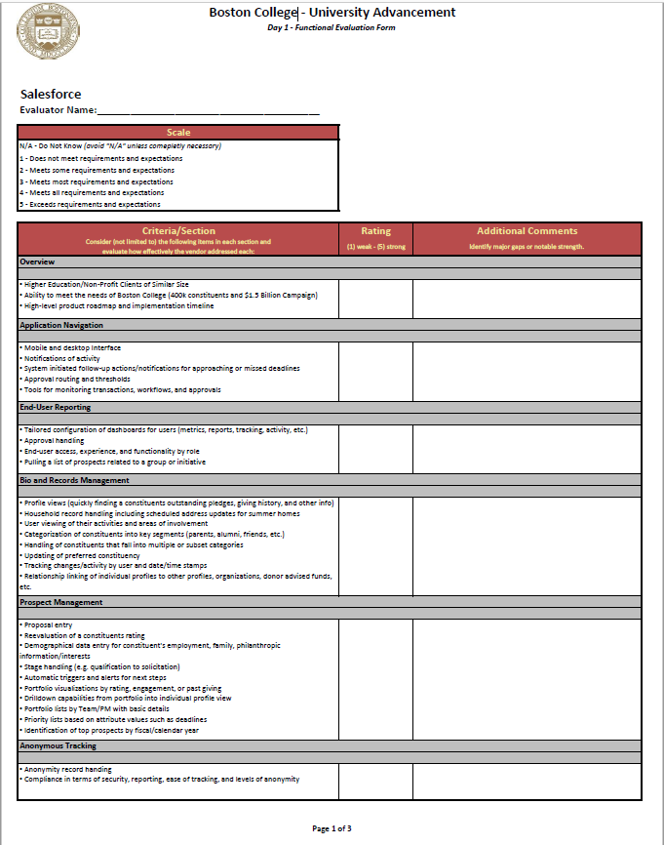
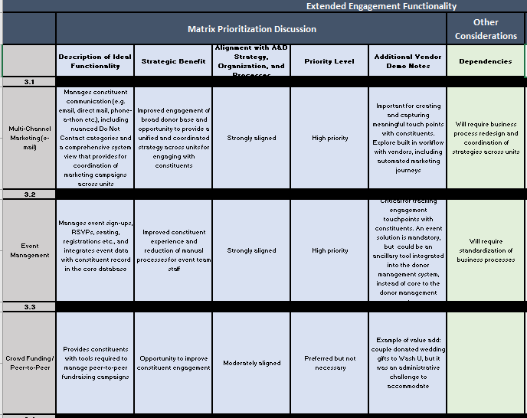
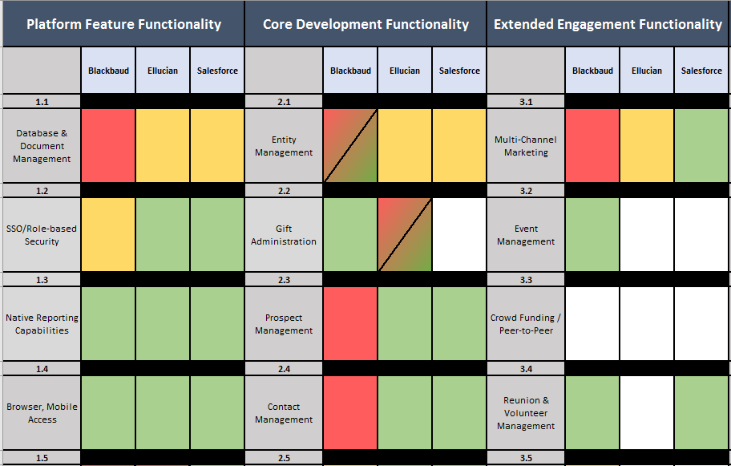
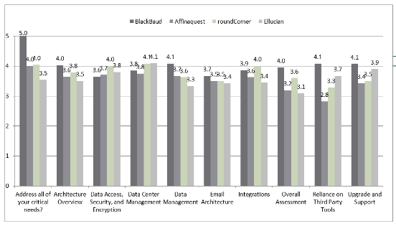
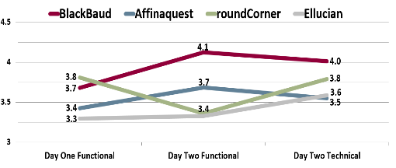
Effective Stakeholder Engagement
Gonzaga University facilitated a transparent, data-driven vendor selection process, with representative stakeholders across units.
Stakeholder-developed use cases
Vendor scorecards, with distributed results
Vendor matrix of core capabilities
Fit/Gap analysis of GU’s prioritized functionalities against vendor capabilities
Stakeholder vetting of peer references
Image 1: Vendor Scoring
Image 2: Vendor Matrix and Fit/Gap
Notes:
Alex
2 minutes
Talking Points
Stakeholders from across the institution (i.e., the Core Functional Team) were actively engaged throughout the process.
1) Refined business requirements which informed strategic objectives and guiding principles for CRM
2) Developed scripts for structured vendor demonstrations, attended and participated in multiple rounds of vendor demo’s, and assessed CRM functionality via vendor scorecards
3) Reviewed and assessed vendor RFP responses and supplemental materials to inform a fit/gap analysis
Part of the RFP response evaluation was how closely each vendor fulfilled the Strategic Priorities and Guiding Principles
4) Used the vendor demos, RFP responses, and a variety of other inputs (including a robust peer review process) to rank CRM vendors for review by the Steering Committee

Slide 13
Effective Stakeholder Engagement
According to the Center for Creative Leadership, “66-75% of all public and private change initiatives fail. A resistant organizational culture was the chief culprit the majority of the time.”
ALIGNMENT &
COMMUNICATION
ORGANIZATIONAL
DEVELOPMENT
SOLUTION SUSTAINABILITY
Visible leadership alignment to ensure high priority across the enterprise
Guidance to move organization from simple awareness to commitment
Reduced employee fear and change resistance
Greater efficiency through increased user adoption
Ongoing role-based training to maximize return on investment
Organizational goals tied to individual employee development
Structured process for ongoing solution adoption and availability
Feedback mechanism to identify potential enhancements
Governance process to meet evolving business requirements
Questions
Does your organization consistently employ formal change management efforts for technology initiatives (yes/no)?
Reflecting on past technology initiatives, what might have you done differently from a change management perspective?
Notes:
Stephanie
2 minutes
Talking Points
If you don’t have good sponsorship and leadership, it will be difficult for enterprise-wide initiatives to be successful
ZRM had Presidential (and BoT) approval and buy-in from the beginning, and that point was frequently reiterated
The Steering Committee and Core Functional Team knew ZRM was a strategic priority relative to other university-wide initiatives, therefore it received the necessary support required to progress successfully

Slide 14



Effective Stakeholder Engagement
Results
What is the plan to implement the solution?
Commitment
Will we need new processes, policies, and procedures?
What does the solution look like?
How will I execute my new role & responsibilities?
What is our situation/ issue today?
Organizational
How is my role changing?
What is in it for me and my department?
Individual
Notes:
Stephanie
2 minutes
Talking Points
The anticipated level and impact of change from ZRM encouraged GU to develop a true change management plan (previous approach to enterprise-wide initiatives focused on project management vs. change management)
This change management plan was grounded in the fact that changes are happening at the organizational and individual level and any concerns related to either need to be addressed in a proactive and timely manner

Slide 15
Quantifiable Metrics for Continued Success
Categories of ROI (Return on Investment)
Direct ROI:
Realizing defined Key Performance Indicators (KPIs) and metrics
  Examples: Increase number of international students, increase number of retained donors
Replacing duplicative tools and technology systems
Enabling gains in efficiency and a reallocation of time to high-impact practices by automating time-intensive, manual processes
Indirect ROI:
Supporting the achievement of strategic plan commitments and related strategic objectives, like:
  Measuring interactions to improve cultivation, enhance engagement, and strengthen relationships with constituents
  Developing “in demand” reports for the Board of Regents, Board of Trustees, and President's Cabinet
  Elevating Gonzaga’s brand awareness (e.g., the cost of not deploying a CRM relative to competitors)
Notes:
Stephanie
2 minutes
Talking Points
This is part of the change management – why it’s important to GU.
The establishment of KPIs to track future-state engagement success and the identification of duplicative technologies to sunset post-CRM, both underscored ROI opportunities to drive the “why” of ZRM

Slide 16
Quantifiable Metrics for Continued Success
Value of Business Process Mapping
Current and future-state Business Process Mapping identified many opportunities for improved efficiency and effectiveness. An example of ROI derived from this exercise includes:
Undergraduate Admissions: Visit Office
Current State
Future State
Registered visitors receive one confirmation email
Scheduling class visits, faculty meetings, and Admissions Counselor meetings requires manual back-and-forth between systems
Registration will trigger an automated and strategic communication plan
Datapoints aggregated in real time will save staff time spent pulling information from various systems
ROI Realized via Deployment of CRM
On August 14, 2019, GU’s Undergraduate Admissions launched its first Communication Plan via the CRM to over 50,000 people ​
This single Communication Plan will save up to 15 hours a week through automation of formerly manual tasks ​
Notes:
Stephanie
2 minutes
Talking Points
This is part of the change management – why it’s important to GU.
The establishment of KPIs to track future-state engagement success and the identification of duplicative technologies to sunset post-CRM, both underscored ROI opportunities to drive the “why” of ZRM

Slide 17
Lessons Learned Throughout Implementation
Areas of Continued Focus
Human Resource Constraints
  Staff backfill during the project
  New or redeployed staff to support long-term system development and longevity
  Engage with partners, but begin with independence / ownership in mind
Change Management
  Executive leadership / sponsorship is key; show continued enthusiasm
  Brand the project and / or system
  Highlight the recent wins; focus on benefits to individual staff and faculty
  Assess lessons learned at each stage and reapply them
Data Governance
  Data definitions, cleansing, and sharing
Communication protocols
Integration
Notes:
Stephanie
5 minutes
Talking Points
Provide brief progress update on implementation, post-selection (where is GU now in the process)
Considerations for a broader enterprise initiative
Data cleansing
Human side; resource impact and constraints and the human resources first. One of the first things we did is planned for backfill. We planned for the longevity of product deployment beyond the initial implementation by having the right staff in place to support from an operational perspective. New staff are part of the journey.
The Program Management piece. Strong organizational and change management (reiterating how ZRM will help)
Partnering with third parties where appropriate. Short term need fulfilled but then the ownership needs to go back to the GU internal team. Partners that help you get to a place where you can own it.
Another key is branding. ZRM logo, continual place of where to go to get information
Continual lessons learned and reapplying and pausing to celebrate and build excitement along the way

Slide 18
Q & A

Slide 19
Thank You

Slide 20
Contact Information
Borre Ulrichsen
Gonzaga University
Chief Information Officer
ulrichsen@gonzaga.edu
Stephanie Schut
Gonzaga University
Director, IT PMO
schut@gonzaga.edu
Alex Faklis
Huron
Director, Student Lifecycle Solutions
afaklis@huronconsultinggroup.com
NOTE: This presentation leaves copyright of the content to the presenter. Unless otherwise noted in the materials, uploaded content carries the Creative Commons Attribution 4.0 International (CC BY 4.0), which grants usage to the general public, with appropriate credit to the author.

Slide 21
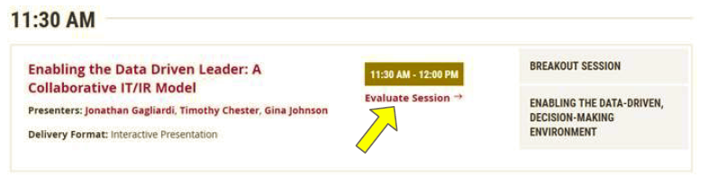
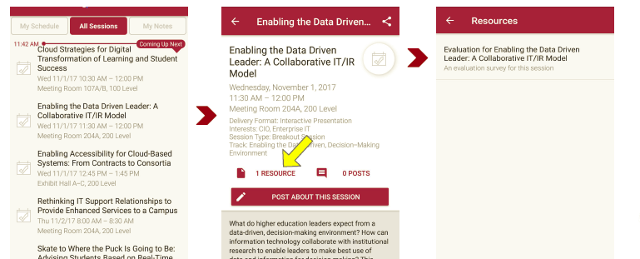
Session Evaluations
There are two ways to access the session and presenter evaluations:
1
2
In the online agenda, click on the “Evaluate Session” link
From the mobile app, click on the session you want from the schedule > then scroll down or click on the associated resources > and the evaluation will pop up in the list

