Slide 1
Seeing our work through the Lens of Innovation
Jamey Hansen
Director of LATIS
CIO for the College of Liberal Arts
University of Minnesota
Presentation materials at
z.umn.edu/innovationsupport
Notes:
Supporting the innovative work of faculty, students, and staff.
Disclaimer:
Fostering a culture of innovation is aspirational and an ongoing effort. We have a lot of work to do—in LATIS and in CLA.
Ideas presented here today are a work in progress. We seek new ideas and want to work and learn with others along the way.
“Our” = IT people

Slide 2
My goals for today:
Define and highlight “Innovation Support”
Leave you with practical ideas you can use
Gather ideas from you that I can use

Slide 3
Who’s in the room today? (raise of hands)
What kind of role do you have?
Leadership role (control over resources)
Individual contributor (influence others)
What kind of unit are you a part of?
Central unit
College/department (distributed) unit
If you attended other innovation sessions, what themes did you hear?

Slide 4
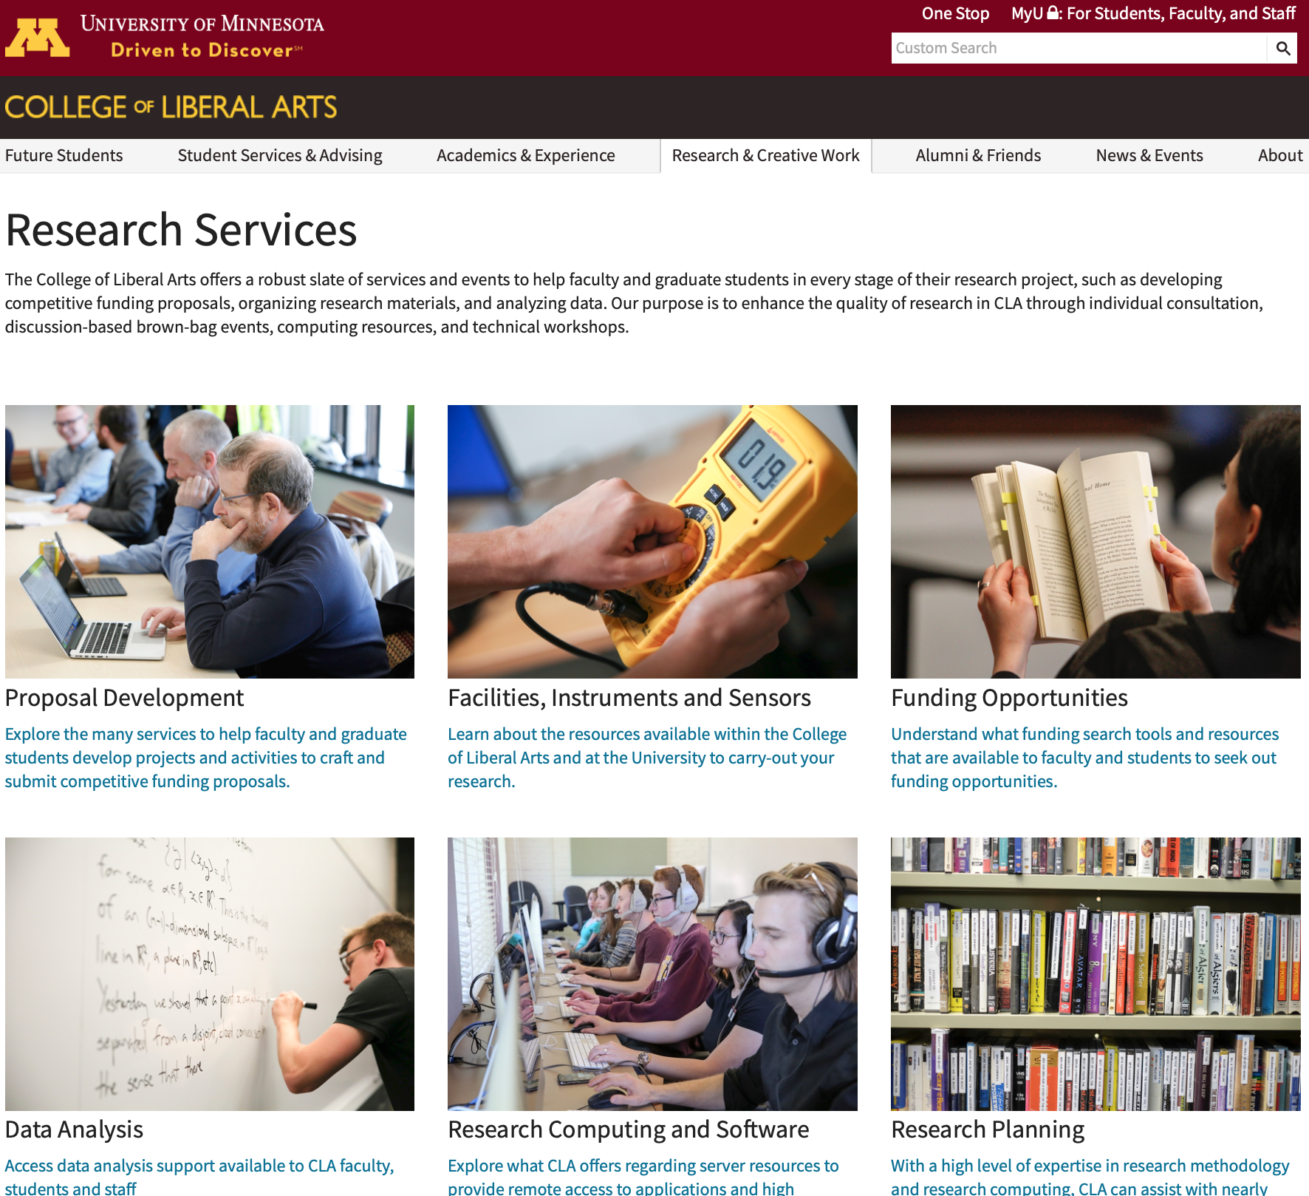
CLA
College of Liberal Arts
University of Minnesota
A large distributed college
in a large distributed university
Notes:
What if CLA was a box?

Slide 5
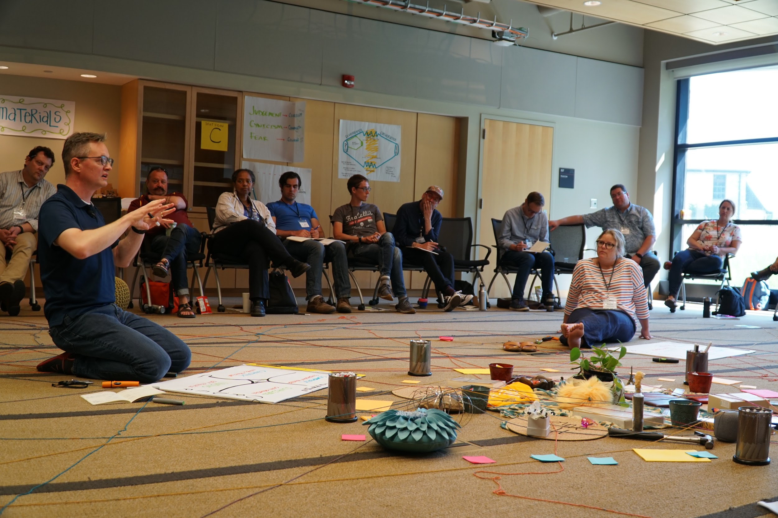
LATIS
Liberal Arts Technologies and Innovation Services
LATIS
Liberal Arts Technologies and Innovation Services
Formerly CLA OIT with many IT, AT, and Research services | Desktop support was moved to central IT; cut 12 FTE ($1 mil) | LATIS is mission driven: research, teaching, engagement | Higher-level analysts, designers, consultants, discipline experts
Notes:
In general, we’ve been “moving up the value chain” for over 5 years.

Slide 6
LATIS
Goal &
Strategies
What we do (unit names)
Partner with college leaders to transform CLA into a “destination college.”
Clearly align LATIS efforts to goals set by CLA leadership
Invest in relationships with faculty, students, and staff
Foster a culture of innovation in the liberal arts
enhancing
Learning
advancing
Research
improving
Process
Notes:
We are also exploring a new branch of Strengthening Engagement.
“Destination College” is part of the Dean’s strategic vision.

Slide 7
My definitions
Innovation:
Taking ideas (or problems)
and turning them into…
Innovation support:
Things we do to help
faculty, students, and staff
turn their (or our) ideas into...
... results and solutions that advance the mission.
Notes:
IT staff can:
Pursue innovative work by ourselves (on our own initiative or by request)
Participate in innovative work with others, or
Support the innovative work of faculty, students, and staff
Not everyone has to be innovative, but we can all see ourselves supporting innovation.
Techniques for being good at either are very similar.

Slide 8
Innovation Lens Framework
Invest in Innovation
Get to the Table
Translate Strengths
Link and Extend
Handout: z.umn.edu/innovationsupport
Notes:
Innovation is collaborative. Rarely does innovation happen alone.
Whether you are innovating yourself or supporting the innovative work of others, there are many things to you can do to

Slide 9
Invest in Innovation
Actions to take
Make time and space for exploring
Reward those who take initiative
Expose yourself to different ideas
Start with “Yes”
Allow and watch for emergence
Values to promote
Attitude of abundance
Diverse and inclusive teams
Sharing: services, resources, & time
Be OK with messy
Trust first
Don’t fear failure—or success.
Don’t wait for permission.

Slide 10
Get to the Table
Find Opportunities
Be present when problems, ideas, barriers, and plans are discussed
Act like an anthropologist, observe and understand the “why”
Many tables: leadership, faculty, students, community, more…
And create your own tables and invite others
Build Relationships
Build a reputation beyond IT
Attend events, meetings when you are not on the agenda
Volunteer

Slide 11
Translate Strengths
Know your resources and your non-technical capabilities
Use strengths to support People
Matchmaking/brokering
Connect people to resources
Champion innovative programs
Use strengths to support Projects
Help prepare project proposals
Incubate and Prototype
Provide project management
Run seed funding programs
Use strengths to support Planning
Facilitate participatory meetings
Consulting
Data and Trend analysis
Notes:
You already support innovation.
Recognize it.

Slide 12
Link & Extend
Think bigger picture
Ask “What else?”
Ask “Who else?”
Actions to take
Build and invest in networks (people, not data)
Create tools and processes with sharing in mind
Speak up, share your stories, talk about your efforts
Take advantage of opportunities

Slide 13
If we have time...

Slide 14
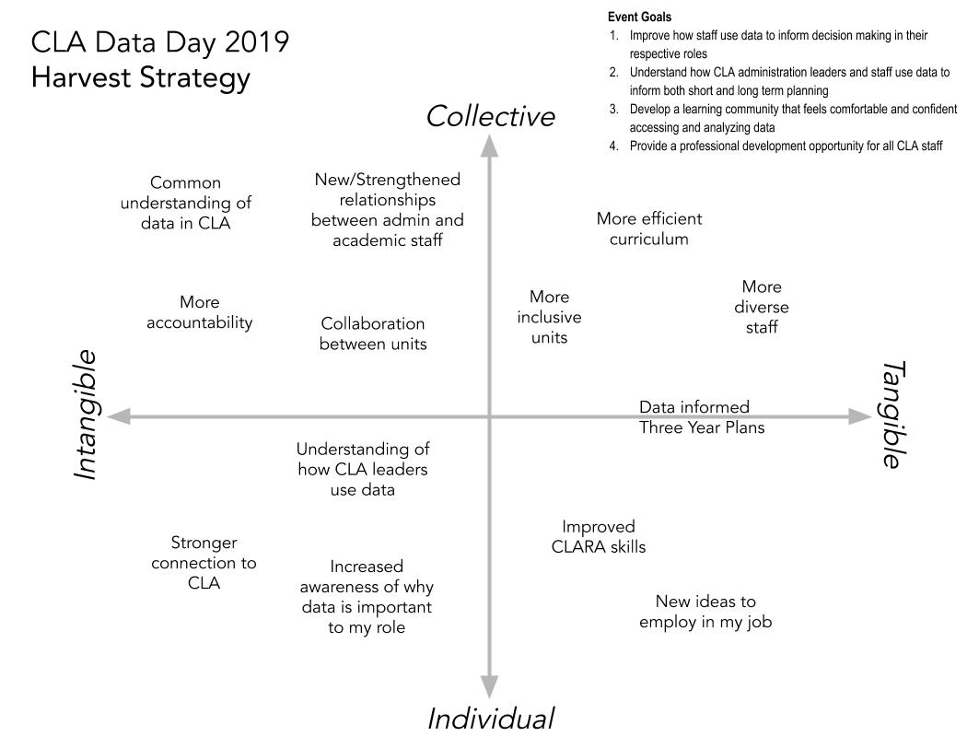
Harvest Strategy
Think about what you are “harvesting” from a meeting, event, or initiative.
Sometimes the intangibles are more important than the tangibles. There are both group and individual outcomes you can harvest.
From the work of Monica Nissen and the Art of Hosting community.

Slide 15
Innovation Support: Different methods for different situations
Complex
Probe • Sense • Respond
Unknown unknowns | Emergent Practice | No right answer
Relationship building
Fostering a culture of innovation
Discovering promising projects
Ideating and brainstorming
Designing participatory processes
Facilitating participatory processes
Strategic planning
Step into the unknown with others
Complicated
Sense • Analyze • Respond
Known unknowns | Good Practice | Range of right answers
Matchmaking & brokering
Project management
Knowledge management
Manage seed funding programs
Preparing project proposals
Trend & data analysis
Packaging results for others to use
Get things done
Disorder
don’t know where you are
Chaotic or Disruptive
Act • Sense • Respond
Instinct | Novel Practice | No answers
Prototyping
Incubating/sheltering projects
Creating opportunities to explore & play
Take initiative and try something
Known or Obvious
Sense • Categorize • Respond
Known knowns | Best Practice | One right answer
Connecting people to resources
Identifying funding sources
Sharing prepared/defined knowledge
Share what you know
Based on the Cynefin Framework by David Snowden
Notes:
I am a fan of the Cynefin Framework by David Snowden. It informs much of my thinking and work.
Very quickly:
What is it that IT people are good at? Ordered things. Ordered thinking. Solving problems. Complicated stuff that requires our expertise. Systems.
What do we find that we are experiencing? Unorded, complexity, People.
First, understand where you are.
Then know what you can do in each situation.
This is my effort to map Innovation Services to different types of situations.

Slide 16
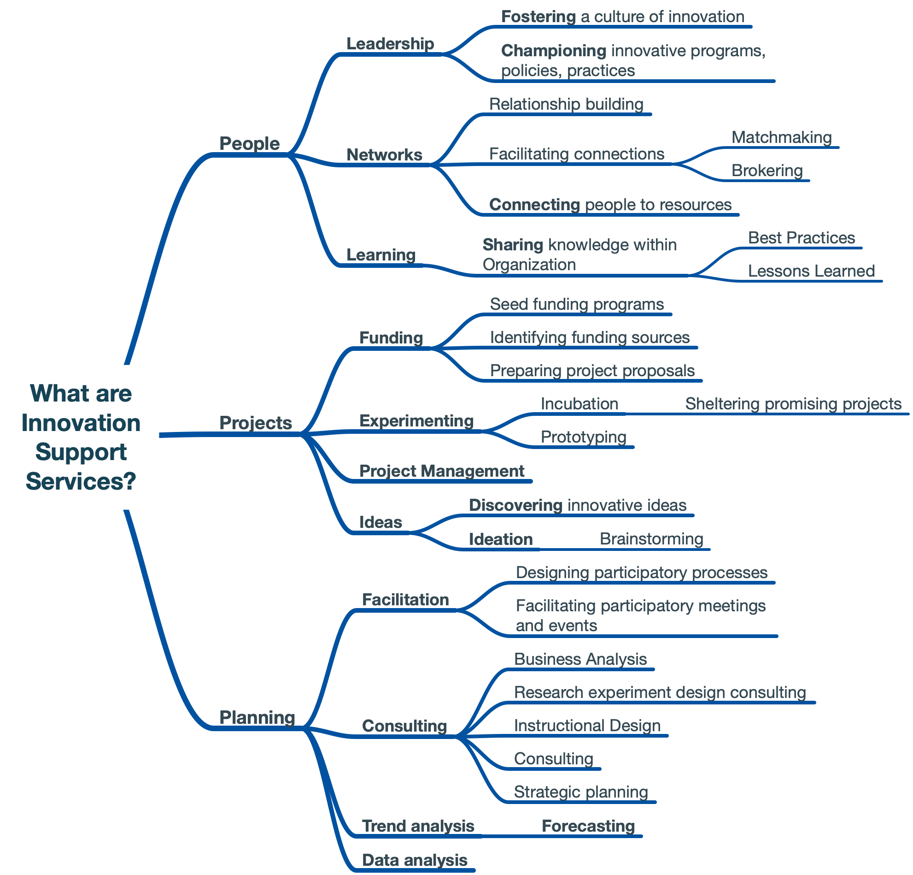
People
Projects
Planning
Innovation support is about:
Notes:
Trying to organize and categorize innovation services.

Slide 17
The Ten Faces of Innovation
The Anthropologist
The Experimenter
The Cross-Pollinator
The Hurdler
The Collaborator
The Director
The Experience Architect
The Set Designer
The Storyteller
The Caregiver
Tom Kelley, IDEO
Notes:
Everyone can be an innovator.
Successful innovation takes many roles.
Good source of ideas.
Helps describe the ways in which people can be an innovator and an innovation supporter.
You’ll likely see yourself and many of your staff in these descriptions.

Slide 18
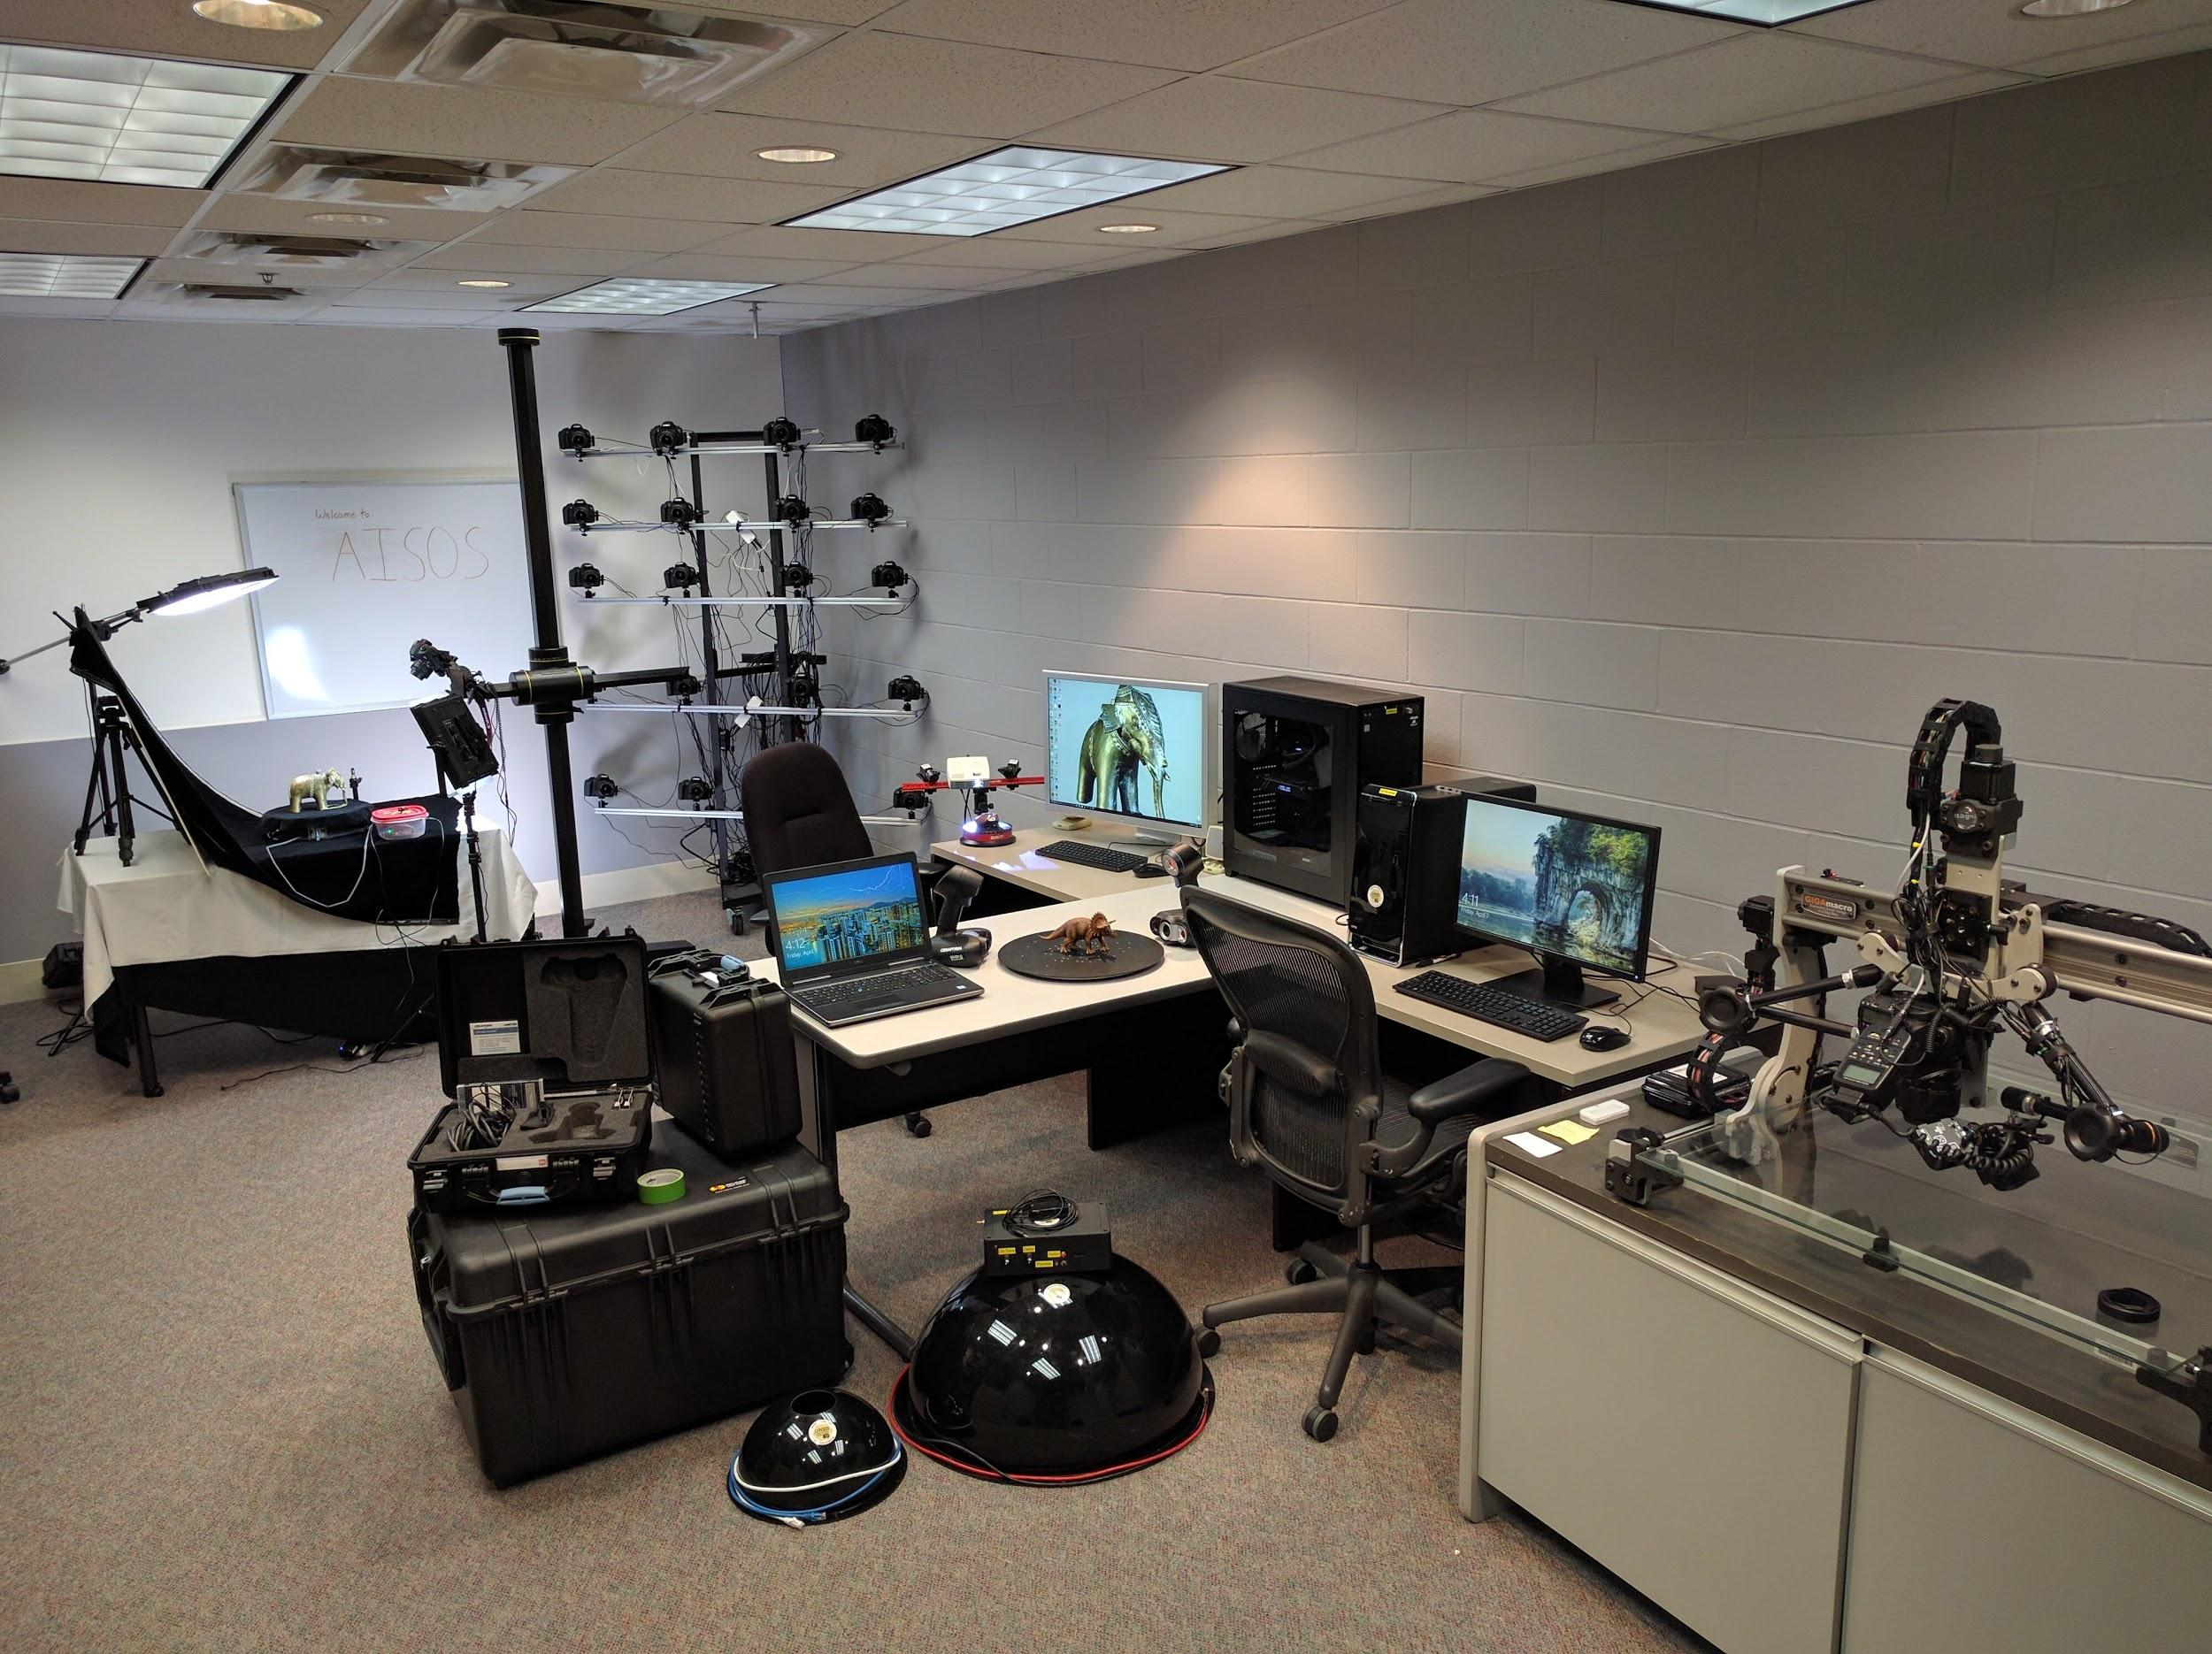
A real world example: AISOS
Notes:
AISOS (aisos.umn.edu)
We didn’t build AISOS because Educause said to, or because the Horizon Report said that it was the future ..
Dr. Dan Griffin approached us because he’d heard we were the kind of folks you could bounce technical ideas off, even if it wasn’t on a list of “service offerings”
Meanwhile … we knew other folks were experimenting in “advanced imaging”. Anthropology had some awesome grad students 3d scanning stone cores.
We didn’t actually know anything about this, but we had a sense that even those who knew “a lot” were still mostly experimenting.
We launched AISOS, which meant we could start scanning tree cores. Which was cool.
But because we have an innovation mindset, we were able to say “ok that’s cool, but …”
Custom workflow and stitching software
Hired an undergrad and managed them
Fully digital analysis and archival process
Totally blowing minds in the dendro field. And all open source.
AISOS is open to everyone. You only need to come with an idea, we support you, and you take that innovation back to your field because innovation begets innovation. We build custom hardware and software to experiment. And sometimes we say “well, we’re not there yet”

Slide 19
Contact Information
Jamey Hansen
CIO for the College of Liberal Arts
University of Minnesota
hansenj@umn.edu
latis.umn.edu
z.umn.edu/innovationsupport
NOTE: This presentation leaves copyright of the content to the presenter. Unless otherwise noted in the materials, uploaded content carries the Creative Commons Attribution 4.0 International (CC BY 4.0), which grants usage to the general public, with appropriate credit to the author.

