Slide 1
Virtual Exchange:
Connecting Students Across Cultures
Amy Gillett

Slide 2
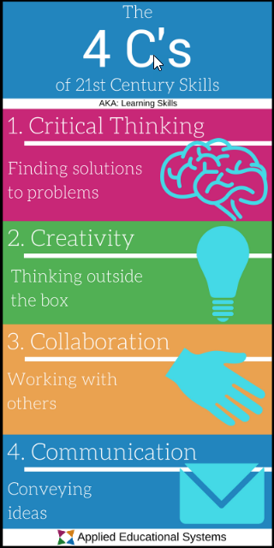
Today’s students …
need 21st century skills
live in a global economy
digitally savvy
love experiential learning
Notes:
They want hands-on, experiential learning!

Slide 3
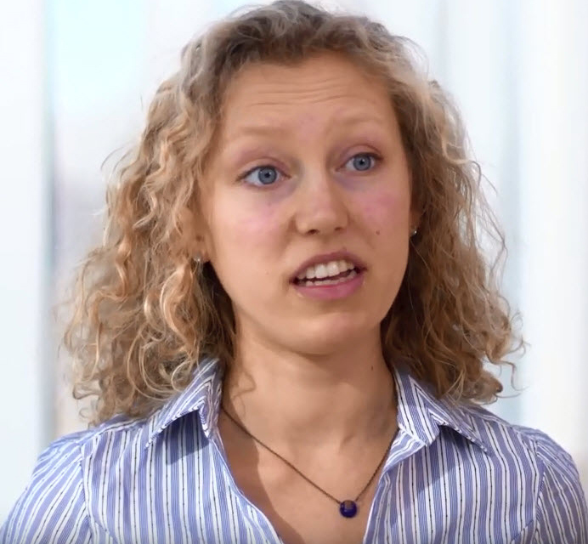
Meet Jackie …
Sophomore business major at the University of Michigan
Grew up in small town
Minimal opportunities to meet people from outside the USA
Hasn’t studied abroad
Plans to join Peace Corps & then work in int’l business

Slide 4
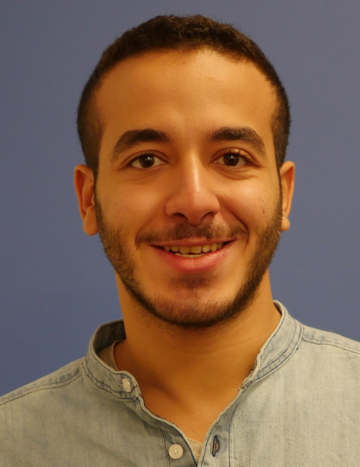
Meet Omar …
Architecture student in Cairo
Interested in sustainable urban development & climate change
Designed & built a community center in an underprivileged community by Cairo
He has visited nearly every city in Egypt but had never been in the USA

Slide 5
Let’s create a life-changing experience for them!

Slide 6
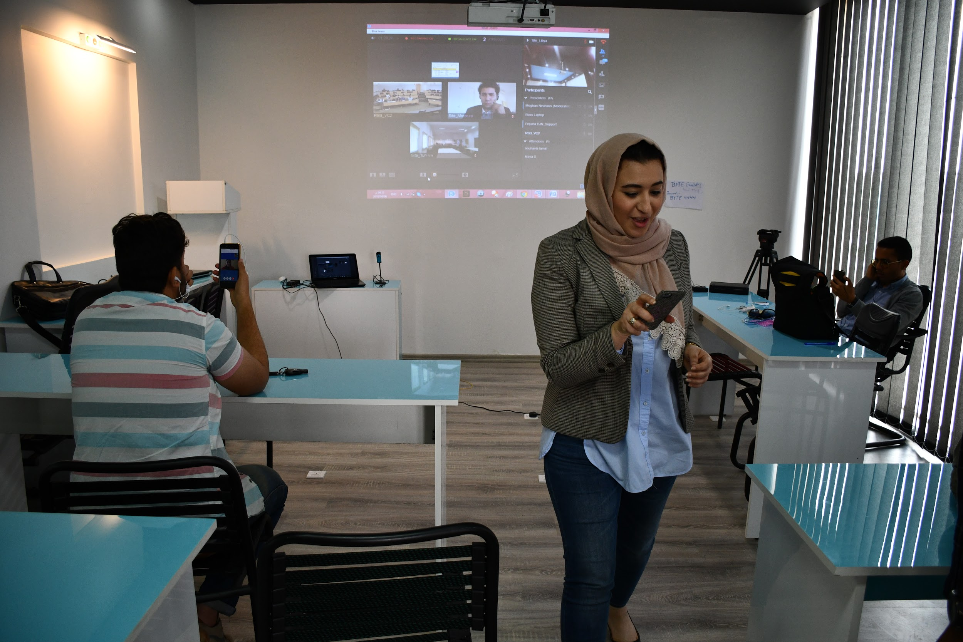
VIRTUAL + EXCHANGE
Notes:
What is virtual exchange? Connect students via technology to learn and collaborate together.

Slide 8
Under the hood …

Slide 9
Participant feedback
M²GATE participants say they gained:
excitement for entrepreneurship
global perspective
network & lifelong friends
empowerment
Notes:
51% of participants say they will use what they learn to start a social enterprise

Slide 10
Finding international partners
Managing large # of students virtually
Time zone differences
Varying levels of Internet access
Notes:
51% of participants say they will use what they learn to start a social enterprise

Slide 11
How do I run a virtual exchange?
Try WDI’s Virtual Exchange Roadmap The 9 I’s of Innovative Program Design
Notes:
51% of participants say they will use what they learn to start a social enterprise

Slide 12
Virtual Exchange Roadmap: Step 1
Ideate
Program idea?
Target audience?
Desired learning outcomes?
Notes:
51% of participants say they will use what they learn to start a social enterprise

Slide 13
Virtual Exchange Roadmap: Step 2
Identify
Who will you partner with?
What do they bring to the table?
Notes:
51% of participants say they will use what they learn to start a social enterprise

Slide 14
Virtual Exchange Roadmap: Step 3
Invite
Who’s on the delivery team?
Instructors
Staff
IT support

Slide 15
Virtual Exchange Roadmap: Step 4
Integrate
What technology do we already have?
Existing subscriptions | Free tools
Notes:
51% of participants say they will use what they learn to start a social enterprise

Slide 16
Virtual Exchange Roadmap: Step 5
Innovate
What technology do we need to invent or adopt?
Notes:
51% of participants say they will use what they learn to start a social enterprise

Slide 17
Virtual Exchange Roadmap: Steps 6 - 9
6: Implement
7: Investigate
8: Iterate
9: Inspire
Notes:
51% of participants say they will use what they learn to start a social enterprise

Slide 18
Back to Jackie & Omar …
Team of 7 created social enterprise: “EcoMENA”
Zabaleen community recycles 2/3 of waste in Cairo
Create an e-commerce website:
sell plastics, other raw products
sell goods made out of recycled materials
tell their stories – gives them voice
Notes:
Not unionized, not taxed – operate in informal sector
government is outsourcing to Italy and France – ends up in landfill – Zabeleen is green
Community stories online – hear their story

Slide 19
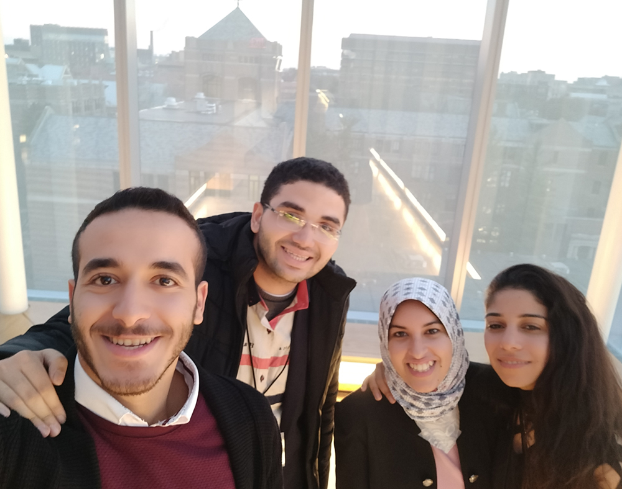
Back to Jackie & Omar
Their pitch video won in their cohort – beat out 25 other teams
Omar & teammates invited to Ann Arbor for live pitch competition …

Slide 20
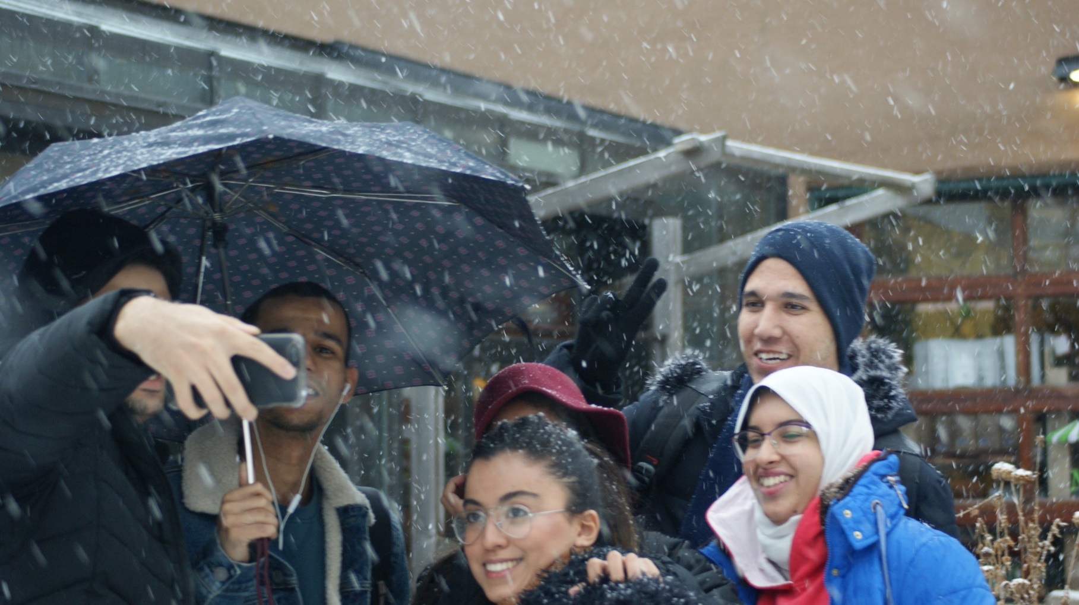
We successfully order a blizzard for their visit …

Slide 21
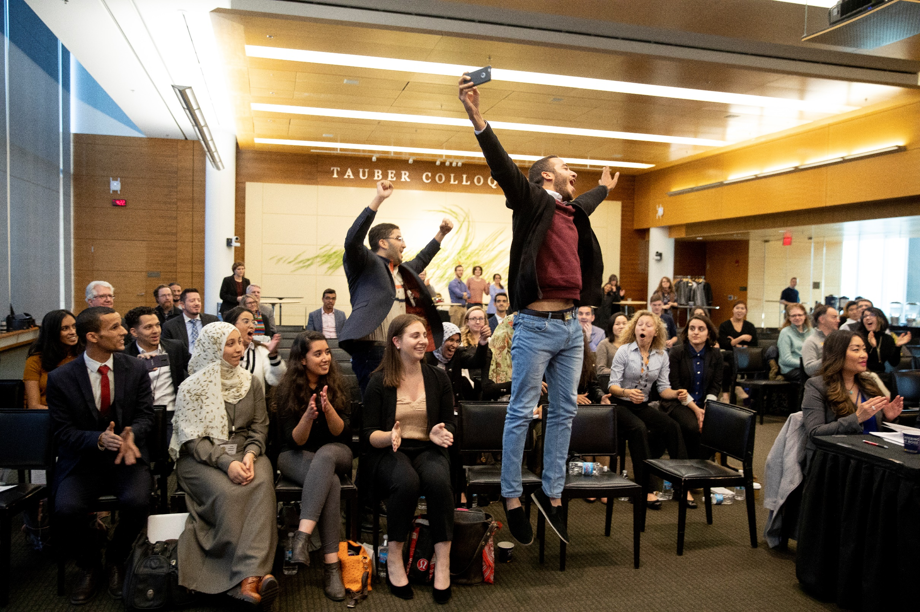
… and they win the entire competition!
Notes:
51% of participants say they will use what they learn to start a social enterprise

Slide 22
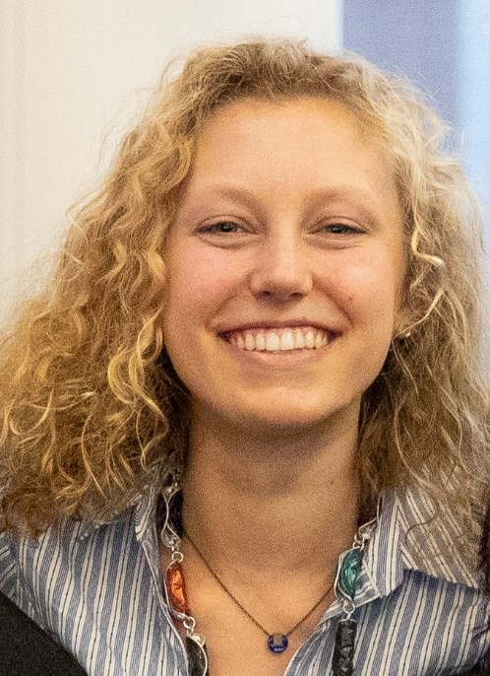
The Power of Virtual Exchange
I learned a lot about Egyptian culture. There are small cultural differences but I realized how similar we are. I was energized by how motivated, brilliant and kind my teammates were.

Slide 23
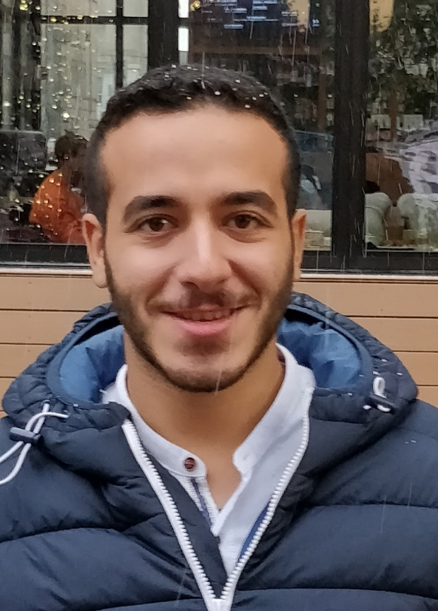
The Power of Virtual Exchange
Jackie is talking about a community she’s never seen, but she feels the community in Egypt … she could describe it, attach people to a community that lacks dignity, create empathy in the room in Ann Arbor.
Notes:
Jackie – learn about Egyptian culture – It’s not as different as we think – small cultural differences but I realized how similar we are. Energized by how motivated, brilliant and kind teammates were. Language barrier. She was worried they wouldn’t be able to communicate but they made it work.
Omar – learn about American – language barrier but we are the end we are human. Jackie is talking about a community she’s never seen, but she feels the community in Egypt. She could describe it, create empathy in the room in Ann Arbor, attach people to the story of a community that lacks dignity.
Build bridges –

Slide 24
Virtual Exchange Resources
BizEd article on Virtual Exchange (July/Aug issue - online)
WDI’s Global Virtual Learning Center for more resources
http://bit.ly/virtXchange

Slide 25
Contact Information
Amy Gillett
William Davidson Institute at the University of Michigan
Gilletta@umich.edu
 734-763-5928
NOTE: This presentation leaves copyright of the content to the presenter. Unless otherwise noted in the materials, uploaded content carries the Creative Commons Attribution 4.0 International (CC BY 4.0), which grants usage to the general public, with appropriate credit to the author.

Slide 26
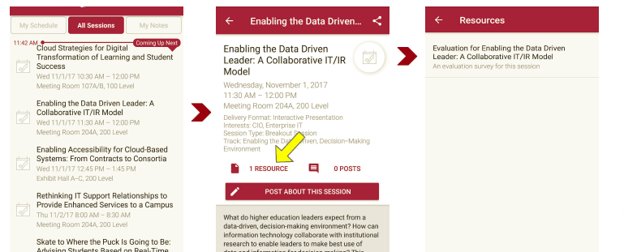
Session Evaluations There are two ways to access the session and presenter evaluations:
1
2
In the online agenda, click on the “Evaluate Session” link
From the mobile app, click on the session you want from the schedule > then scroll down or click on the associated resources > and the evaluation will pop up in the list

