Slide 1
REBUILD YOUR INSTITUTION’S IT CULTURE INTO AN ADAPTABLE POWERHOUSE

Slide 2
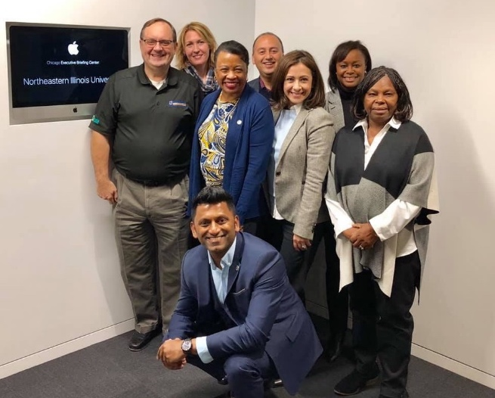
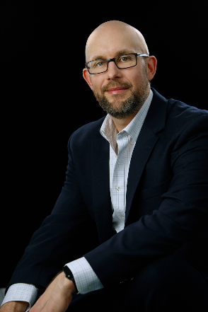
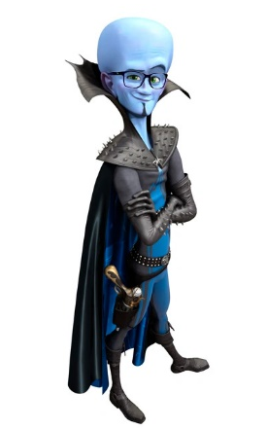
Who we are
Sam Kann
CIO at NEIU
Wayne Geils
Technology Evangelist at SCTG
Notes:
How to overcome the internal cultural challenges associated with large shifts in technology
Balancing internal control with vendor lock-in
How to right-size your organization across a hybrid technology spectrum, including ERP, third-party, and legacy applications
The bitter cost of not understanding the importance of IT governance in a services model
How to achieve internal buy-in across departments during a shift to cloud
How NEIU is future-proofing its technology landscape

Slide 3
What’s happening in higher education and its impact on NEIU
The public compact
The student experience
Research and academic life
Business model
Student success
Notes:
The Public Compact:
Lawmakers and outside groups have always criticized higher education, but this moment is different.
Higher ed’s detractors are embracing new, more aggressive approaches. Through legislation, lawsuits, and even public-records requests, they are taking aim at colleges’ autonomy and attempting to set campus policy.
Free-speech clashes have grabbed the spotlight and spurred legislative action. But these controversies are really just illuminating broader public discontent with colleges.
In the past, much of the criticism has come from the right, and current dissatisfaction with higher education does run deeper with conservatives. But legislators from both sides of the aisle are looking over colleges’ shoulder.
College leaders must find ways to better communicate with lawmakers and the public.
Research and Academic Life
Though initiatives to make published research more freely available have for years poked at the publishing industry’s armor, these efforts — known as the open-access movement — have not toppled the norms of how academic work is distributed and read.
Student Success
they’ve tried compressing it, breaking it into bite-size chunks, computerizing it, even making it optional. But the traditional, prerequisite remedial course that generations of underprepared students have been funneled into before they can start college-level courses remains an insurmountable barrier for too many students. Increasingly, it is being ditched altogether.
Business Model
Rise of the mega university
The Student Experience
After the legal demise of in loco parentis, in the 1960s, colleges went in the opposite direction, viewing their role more as bystanders. Now they seem to have found a middle ground.
The new in loco parentis is driven by tuition-payers’ expectations, colleges’ concerns about legal liability, shifting cultural and social norms, and an evolving understanding of human development.
Increasing competitive pressure on colleges is encouraging them to exercise their supervisory and decision-making roles more aggressively.
You can see that in many forms, including more-intrusive advising and crackdowns on fraternities and sororities.

Slide 4
Modernizing NEIU UTS
Notes:
Banner EPR and Banner DB’s EOL and out of support

Slide 5
NEIU’s IT Environmental Scan
NEIU University Technology Services (UTS) Environmental Scan
Function | Departmental risk assessment Utilize the risk assessment template to formulate the department risks
Function | Departmental project management Utilize the PM template to generate a high level project list for each area
Function | Budget review process Perform a thorough budget analysis for each area
Function | Resource management and other matters Review job description, resource allocations, salary, Univ governance for each area
Function | Vendor management Review/assess and renew/consolidate VM for each area
Notes:
Departmental risk – understanding the operation of IT and its associated risks
Projects – All the projects on UTS’s plate
Over 80+ vendors

Slide 6
Two parallels…
Operations
Labor
Notes:
Sam
Operations – needs analysis of IT ops. Identify what was really needed
Labor went from 17 depts to 4 dept to focus on core services (2017 Budget Impass) caused a 20% headcount reduction)
Administrative computing (app stack)
Network, Systems, telco
Users services - Help Desk/media services
IT budgets

Slide 7
Challenges & measurable steps
What is Cloud?
What’s a Managed Cloud Services Provider (MSP)?
Are they the same?
Notes:
Strategy - Implement an end to end cloud computing solution with a focus on student experience and convenience.

Slide 8
Why does cloud matter?
Fluid enrollment number
Student experience requires right-sized environments
Seasonal workloads
While some workloads seem constant, there is variation
Ever-reducing budgets
“Do more with less” will be on our tombstones
Notes:
Wayne

Slide 9
The CIO asks the BOT for $1 million in funding

Slide 10
Strategic IT planning in an era of digital disruption
Advocacy
To succeed, you must win over many groups
The most powerful tool in advocacy is listening
Strategy
Building a long-term strategy that fits with the school’s strategy
Be more forward-looking than you might be comfortable with

Slide 11
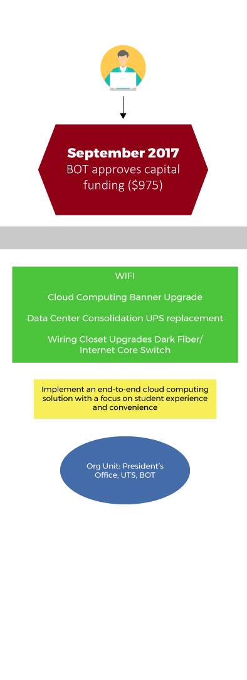
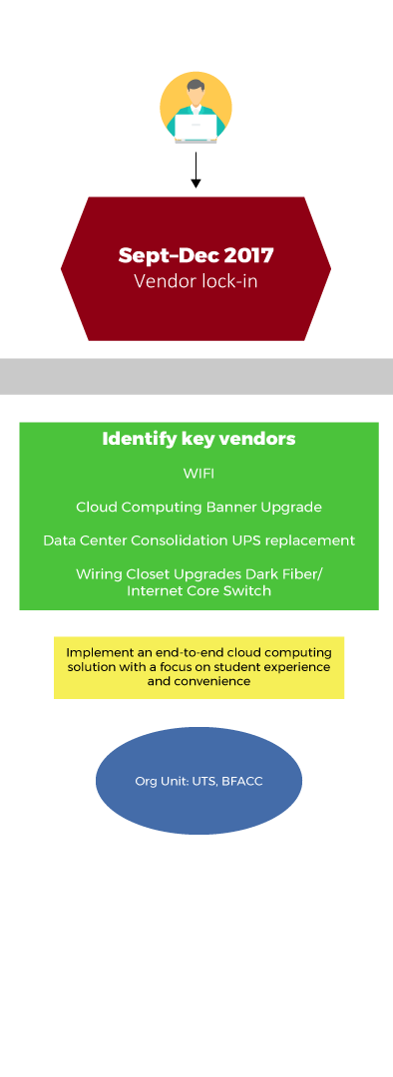
Approval time & vendor selection

Slide 12
With cloud, it’s more marriage than dating
This technology evolution is as confusing and impactful to providers as it is to you. They just hide it a little better.
Do they share your long-term strategy and view on technology?
Do they have the right kind of culture, do the teams play together?
Where does their expertise come from and how do they maintain it?
Beyond the solutions, what else do they bring to the table?
Notes:
Wayne

Slide 13
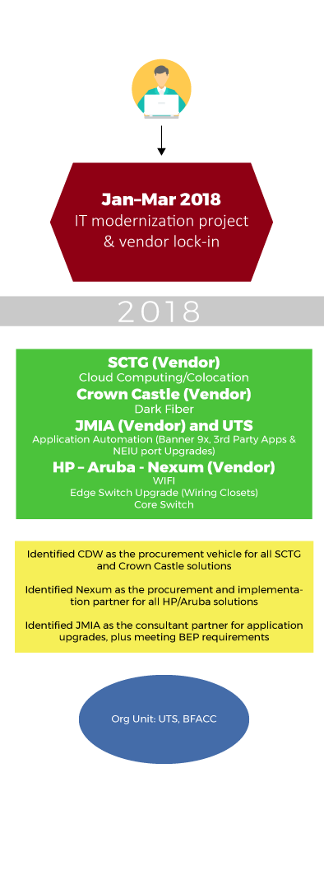
Contracts, procurement, & planning

Slide 14
Pay attention to the details
What is an SLA really worth?
Path to purchase (AKA why can’t I just buy what we need?)
The how and why of breaking up and assigning PMO responsibilities
As the overall champion, we must own and define what success looks like
Stay agile under constraints
Notes:
Wayne

Slide 15
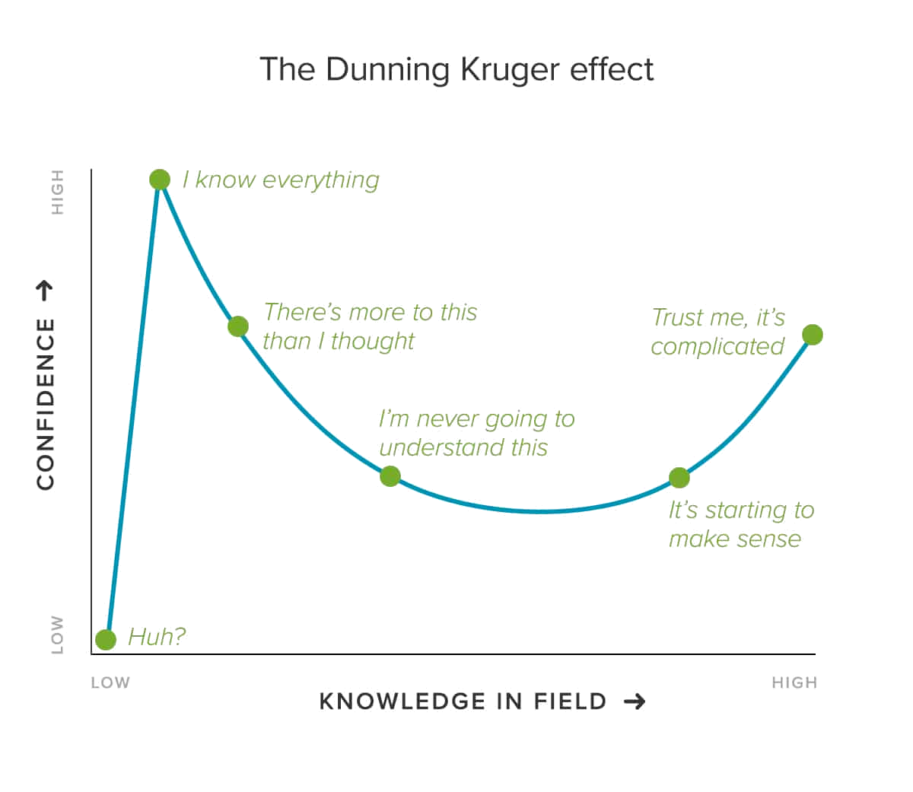
Enable your teams, but urge caution
It’s human to overestimate our abilities
Encourage your teams to want to grow, but rely on experience when committing to a path
Notes:
Wayne

Slide 16
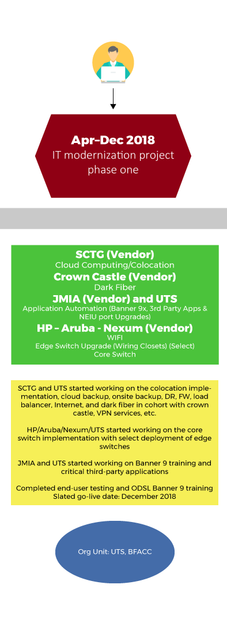
Implementation

Slide 17
What we built
Linked NEIU with 2 world class data centers via multi-channel dark fiber ring
Allows multiple Tb capacities with no Telco involvement
Upgraded campus internet from single 1-Gb AT&T service to 10-Gb+ service provided via 5 Tier 1 carriers
NEIU is now a single cross connect away from 100s of providers
Provisioned a native VMware cloud solution for NEIU’s Banner move
Cloud resources are completely granular
Implemented a BC/DR service protecting all of NEIU’s critical data in Chicago, IL
DR housed in Ashburn, VA
Notes:
Wayne

Slide 18
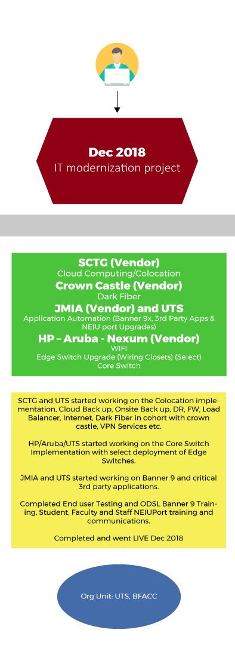
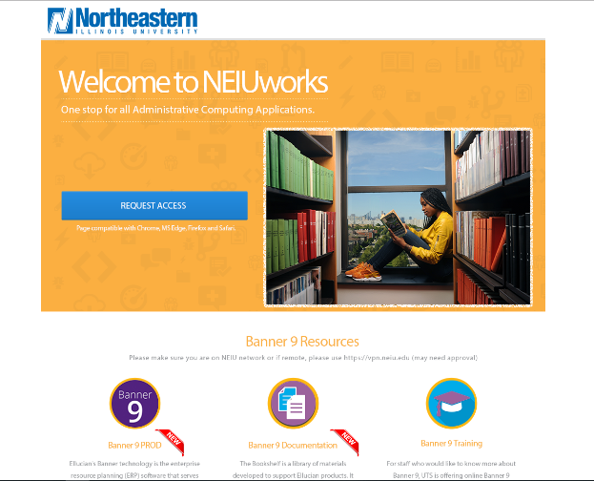
The agile approach to everything

Slide 19
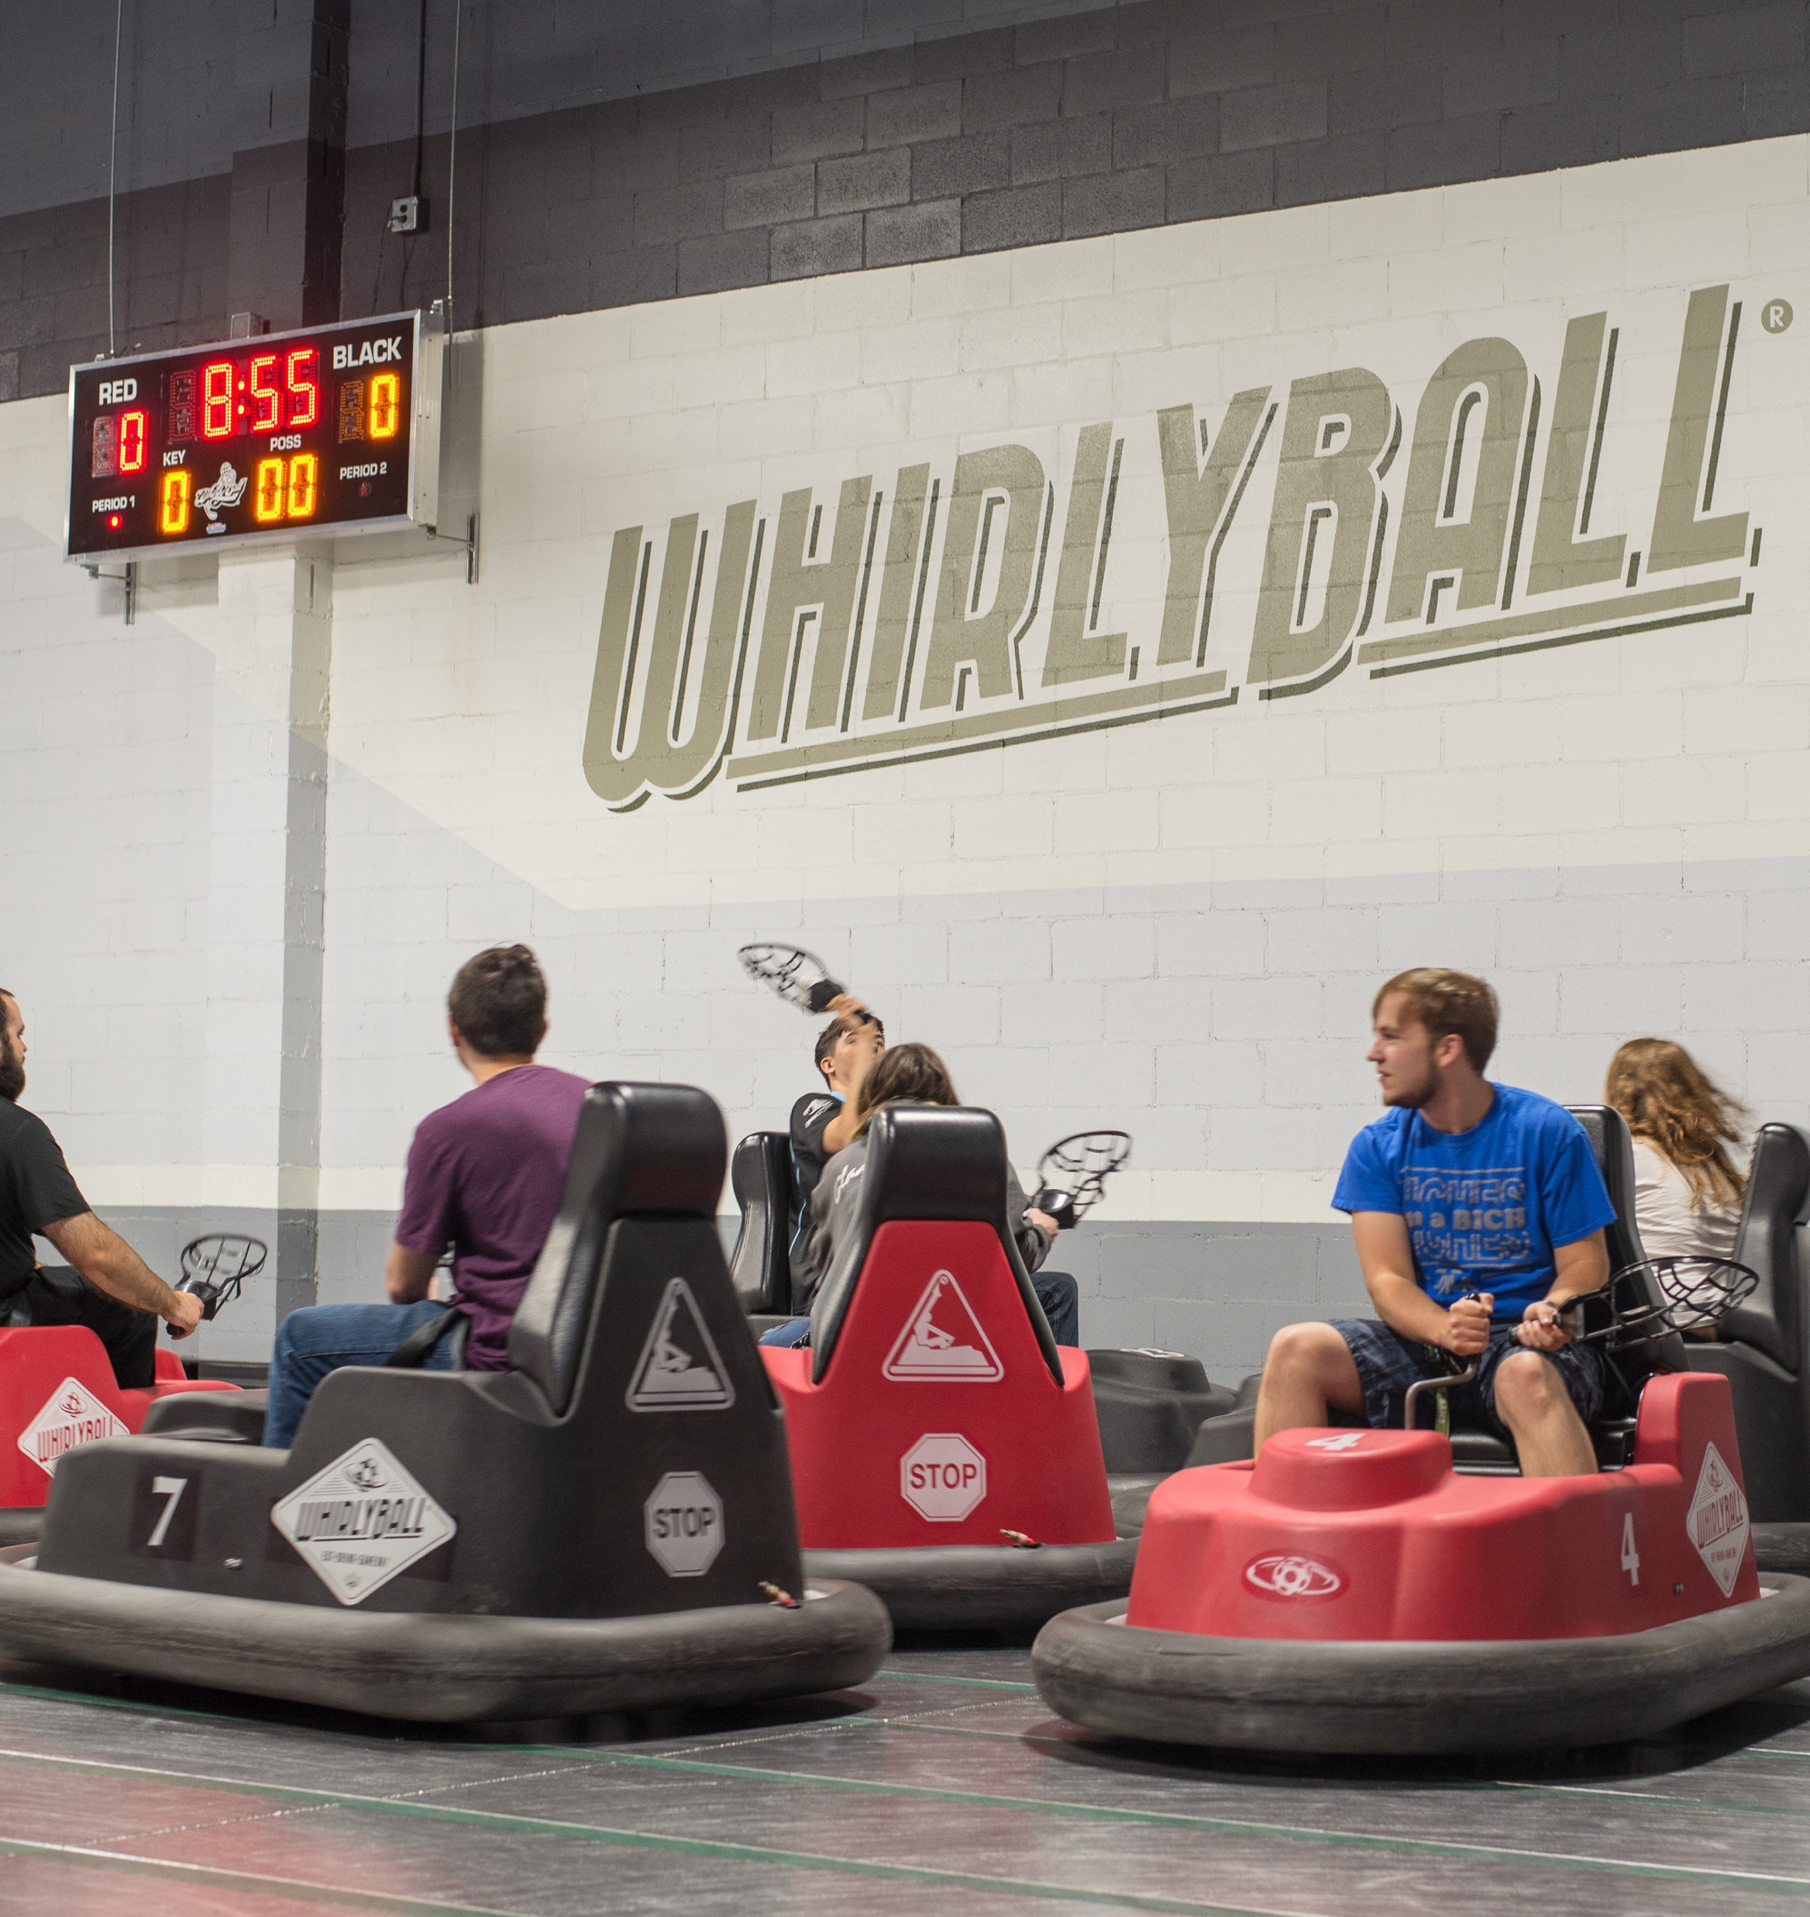
Celebrate and recognize the team
Ongoing partnership, include all parties
Many of the silos and barriers that divide teams can be greatly reduced
In-person or remote
Notes:
Wayne & Sam

Slide 20
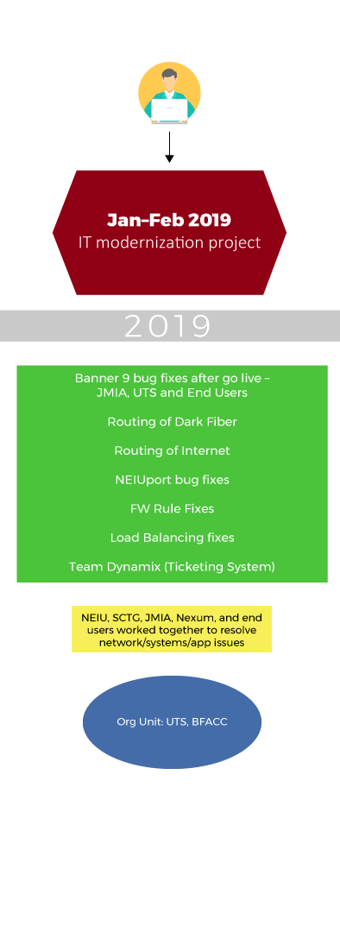
Post Go-Live

Slide 21
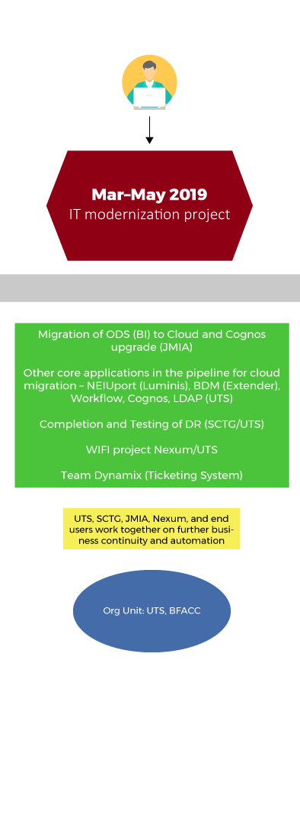
After the launch

Slide 22
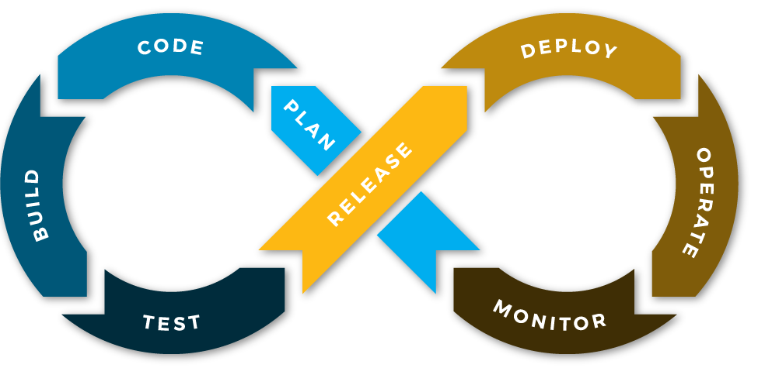
Cloud = DevOps?
Notes:
Wayne

Slide 23
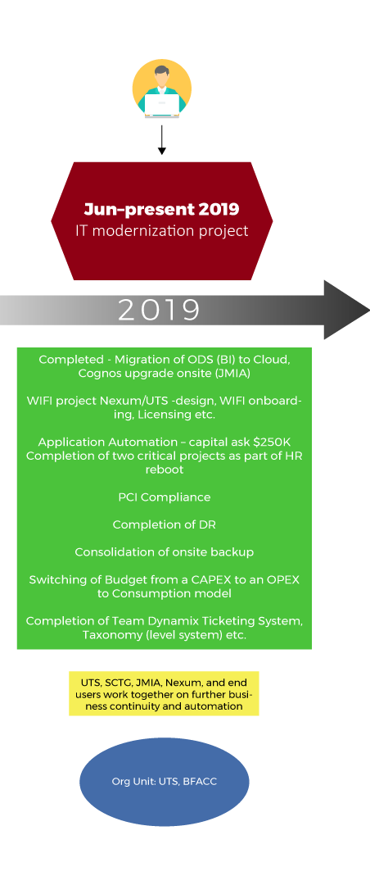
Business continuity and automation

Slide 24
Now the door is open…
“Tremendous things are in store for you! Many wonderful surprises await you!”
-Roald Dahl
Look for new ways to innovate
Time to look at costs and silos
Get your governance right
Notes:
Wayne

Slide 25
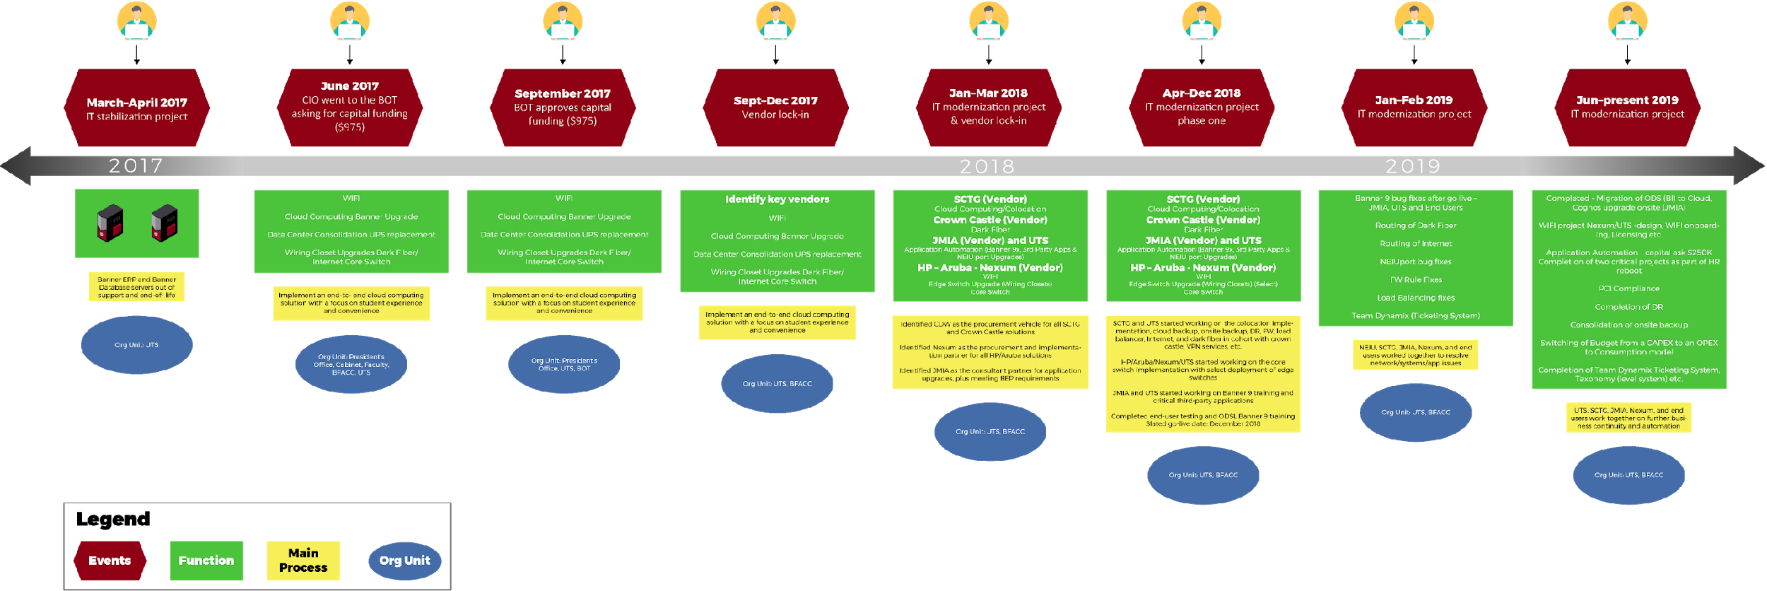
IT modernization project timeline March 2017–December 2018
Go Live

Slide 26
NEIU’s pathway to “smart” solutions
+
+
Instrumented
Interconnected
Intelligent
Event capture and filtering for timely response
Any-to-any linkage of people, process, and systems
Deep discovery, analysis, and forecasting
= Smart
Notes:
Sam
Place holder - What does the future hold
A field tested technology eco-system
Consumption model (capex – opex – consumption)
Ready to scale up or down
Expected mainstream technology – Horizon Report…

Slide 27
Contact Information
Sam Kann
LinedIn – https://www.linkedin.com/in/skann
Ph – 1(407)-592-7365
Wayne Geils
LinkedIn – https://www.linkedin.com/in/wayne-geils/
Ph – 1(312)-545-0000
NOTE: This presentation leaves copyright of the content to the presenter. Unless otherwise noted in the materials, uploaded content carries the Creative Commons Attribution 4.0 International (CC BY 4.0), which grants usage to the general public, with appropriate credit to the author.

Slide 28
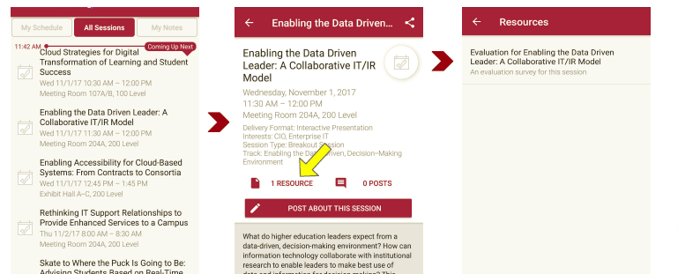
Session Evaluations There are two ways to access the session and presenter evaluations:
1
2
In the online agenda, click on the “Evaluate Session” link
From the mobile app, click on the session you want from the schedule > then scroll down or click on the associated resources > and the evaluation will pop up in the list

