Slide 1
REBUILD YOUR INSTITUTION’S IT CULTURE INTO AN ADAPTABLE POWERHOUSE

Slide 2


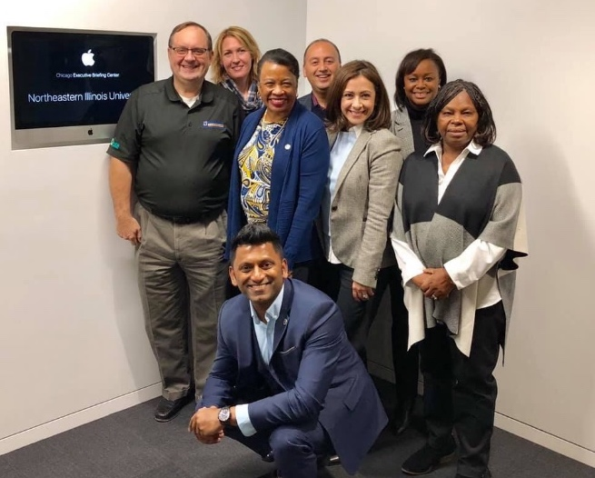


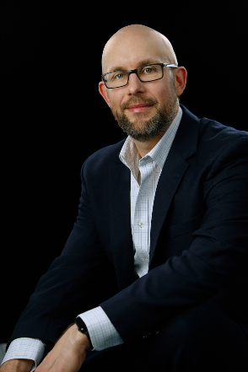
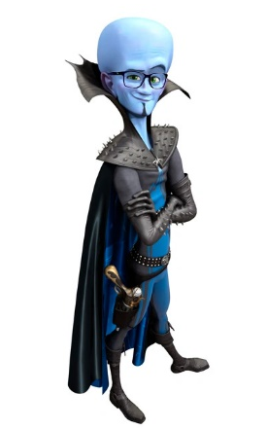
Who we are
Sam Kann
CIO at NEIU
Wayne Geils
Technology Evangelist at SCTG
Notes:
How to overcome the internal cultural challenges associated with large shifts in technology
Balancing internal control with vendor lock-in
How to right-size your organization across a hybrid technology spectrum, including ERP, third-party, and legacy applications
The bitter cost of not understanding the importance of IT governance in a services model
How to achieve internal buy-in across departments during a shift to cloud
How NEIU is future-proofing its technology landscape

Slide 3
What’s happening in higher education and its impact on NEIU
The public compact
Research and academic life
Student success
Business model
The student experience
Notes:
Sam
Place holder - What is happening to IT in higher ed? Cultural
Demographic
Economic forces
are changing the world around and on campuses, challenging long-held beliefs and upending traditions. ttps://youtu.be/q3e1vGQ0fOg

Slide 4
NEIU’s IT Environmental Scan
NEIU University Technology Services (UTS) Environmental Scan
Function | Departmental risk assessment Utilize the risk assessment template to formulate the department risks
Function | Departmental project management Utilize the PM template to generate a high level project list for each area
Function | Budget review process Perform a thorough budget analysis for each area
Function | Resource management and other matters Review job description, resource allocations, salary, Univ governance for each area
Function | Vendor management Review/assess and renew/consolidate VM for each area
Notes:
Sam
Place holder - Triage & assess your environment <WG&SK>
How to triage <WG>
Have your priorities clear
What is your mandate from the BOT?
How are your priorities different from the previous’ leaders?
What is the ranking of your priorities?
Maybe use this model? https://medium.com/shapeshifters/strategy-triage-how-to-prioritise-your-business-tasks-and-decisions-795259e94755
Inventory all the assets you have
People, money, time, non-standard resources
Network, partnerships and vendors
Now plan what can be done with the resources/time you have
Is this enough? Do you need to secure more?
The methods to assess your technology and team <SK>
How NEIU applied these <SK>

Slide 5
Two parallels…
Operations
Labor
Notes:
Sam

Slide 6
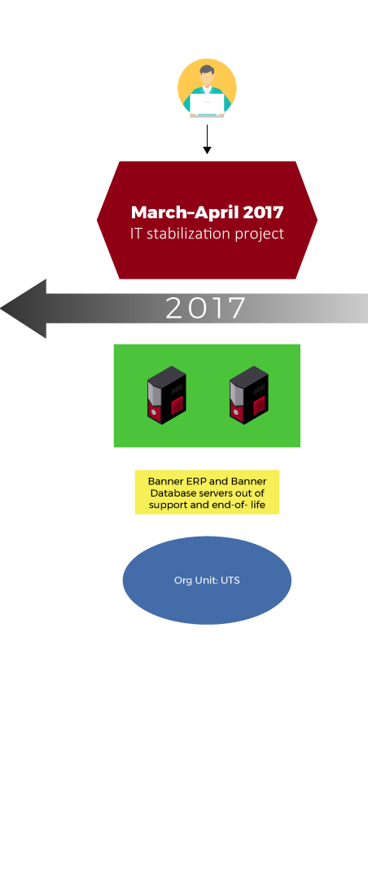
Modernizing NEIU UTS

Slide 7
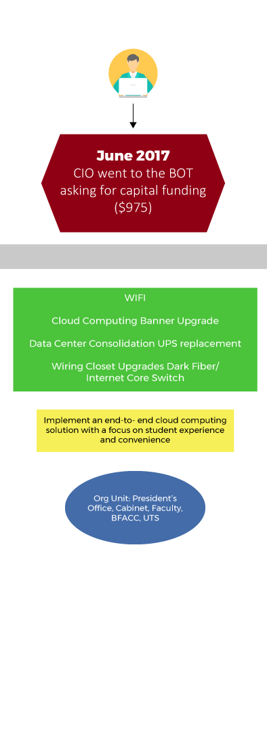
Challenges & measurable steps
What is Cloud?
What’s a Managed Cloud Services Provider (MSP)?
Are they the same?
Notes:
Sam

Slide 8
Why does cloud matter?
Fluid enrollment number
  Student experience requires right-sized environments
Seasonal workloads
  While some workloads seem constant, there is variation
Ever-reducing budgets
  “Do more with less” will be on our tombstones
Notes:
Wayne

Slide 9
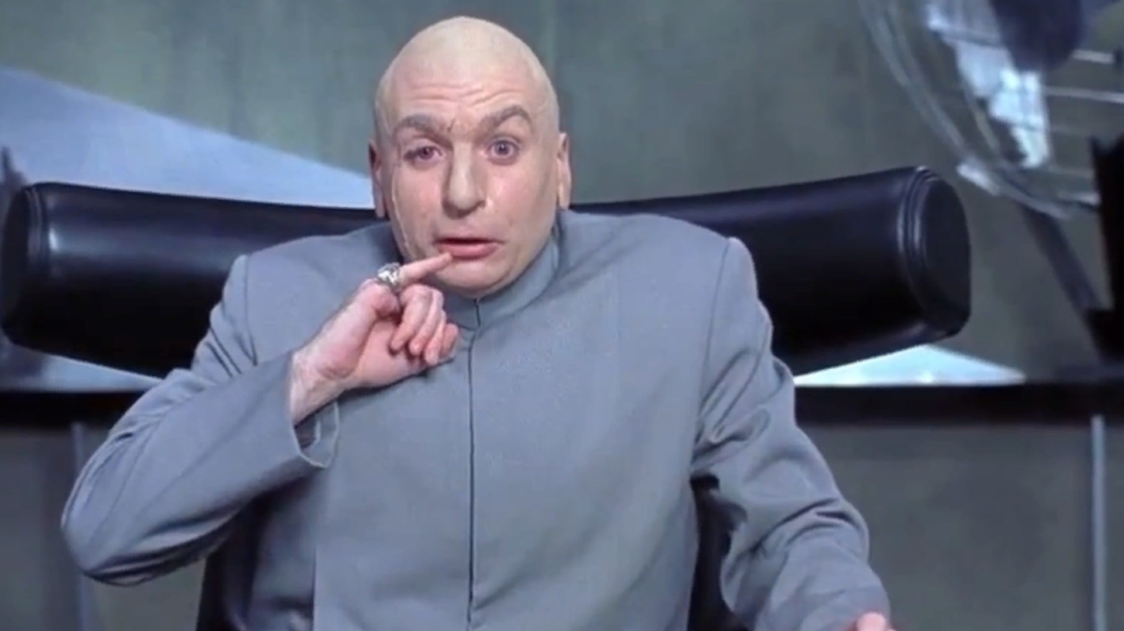
The CIO asks the BOT for $1 million in funding

Slide 10
Strategic IT planning in an era of digital disruption
Advocacy
  To succeed, you must win over many groups
  The most powerful tool in advocacy is listening
Strategy
  Building a long-term strategy that fits with the school’s strategy
  Be more forward-looking than you might be comfortable with

Slide 11
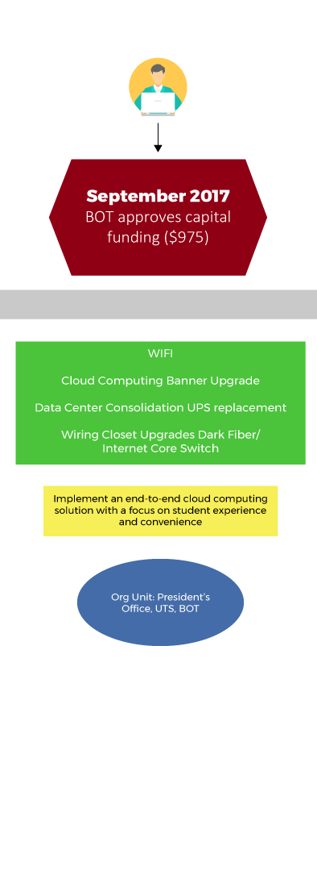
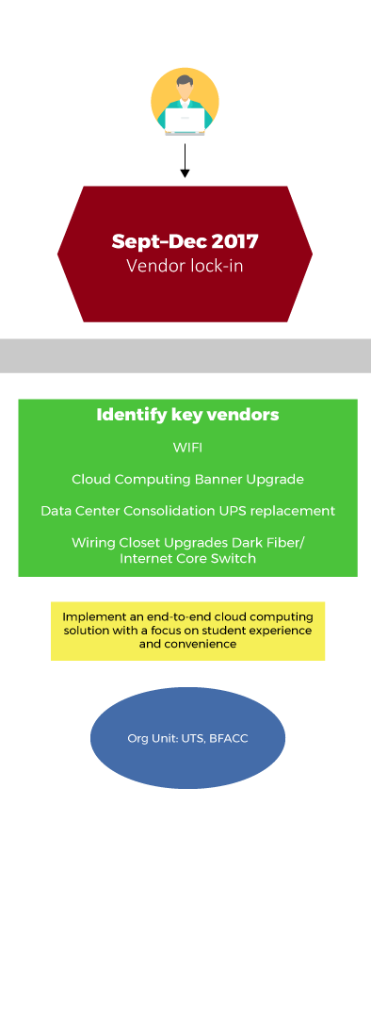
Approval time & vendor selection

Slide 12

With cloud, it’s more marriage than dating
  This technology evolution is as confusing and impactful to providers as it is to you. They just hide it a little better.
  Do they share your long-term strategy and view on technology?
  Do they have the right kind of culture, do the teams play together?
  Where does their expertise come from and how do they maintain it?
  Beyond the solutions, what else do they bring to the table?
Notes:
Wayne

Slide 13
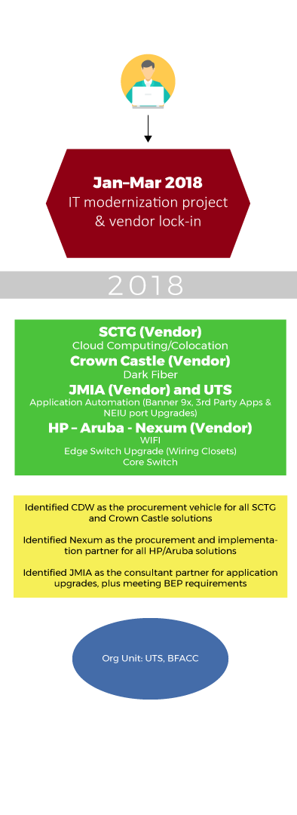
Contracts, procurement, & planning

Slide 14
Pay attention to the details
  What is an SLA really worth?
  Path to purchase (AKA why can’t I just buy what we need?)
  The how and why of breaking up and assigning PMO responsibilities
  As the overall champion, we must own and define what success looks like
  Stay agile under constraints
Notes:
Wayne

Slide 15
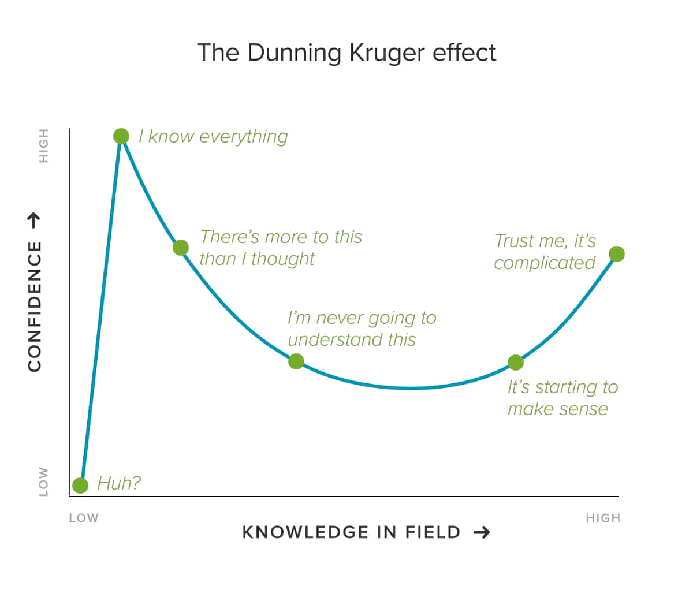
Enable your teams, but urge caution
It’s human to overestimate our abilities
Encourage your teams to want to grow, but rely on experience when committing to a path
Notes:
Wayne

Slide 16
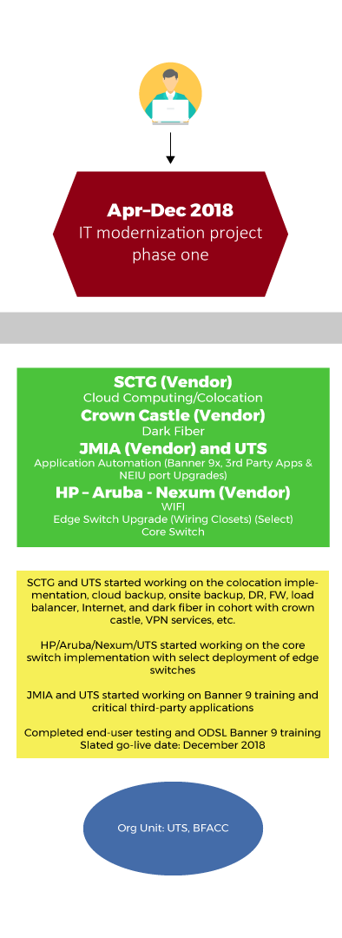
Implementation

Slide 17
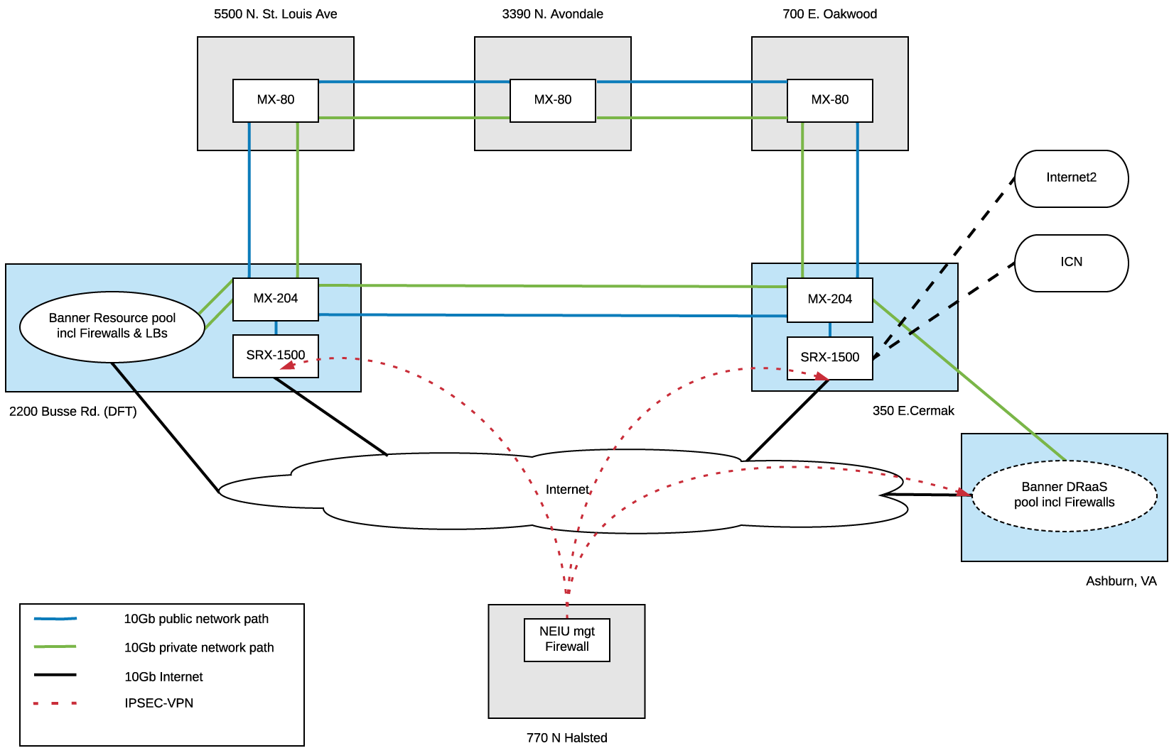
What we built
Linked NEIU with 2 world class data centers via multi-channel dark fiber ring
  Allows multiple Tb capacities with no Telco involvement
Upgraded campus internet from single 1-Gb AT&T service to 10-Gb+ service provided via 5 Tier 1 carriers
  NEIU is now a single cross connect away from 100s of providers
Provisioned a native VMware cloud solution for NEIU’s Banner move
  Cloud resources are completely granular
Implemented a BC/DR service protecting all of NEIU’s critical data in Chicago, IL
  DR housed in Ashburn, VA
Notes:
Wayne

Slide 18
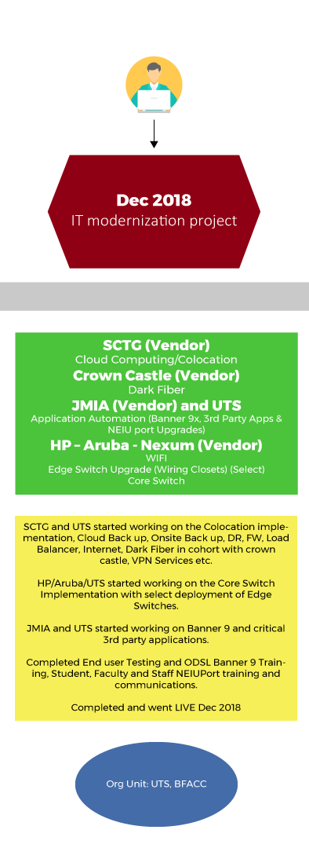
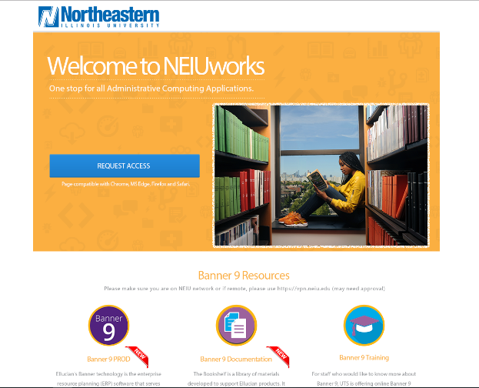
The agile approach to everything

Slide 19
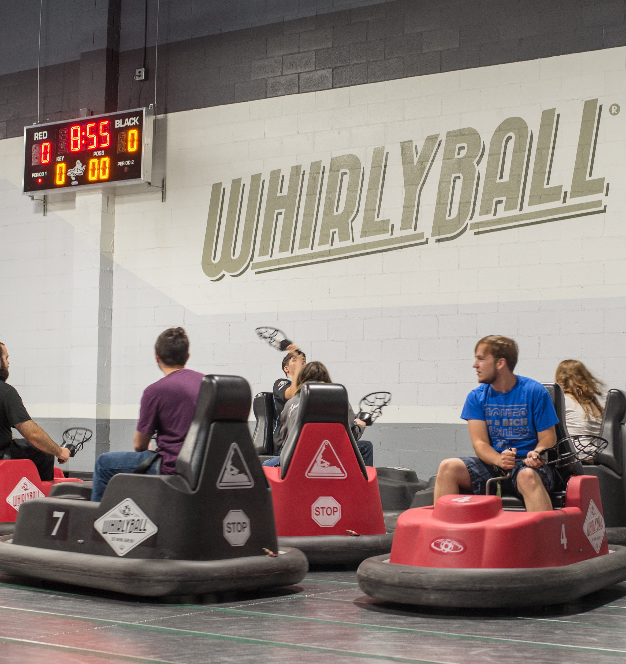
Celebrate and recognize the team
Ongoing partnership, include all parties
Many of the silos and barriers that divide teams can be greatly reduced
In-person or remote
Notes:
Wayne & Sam

Slide 20
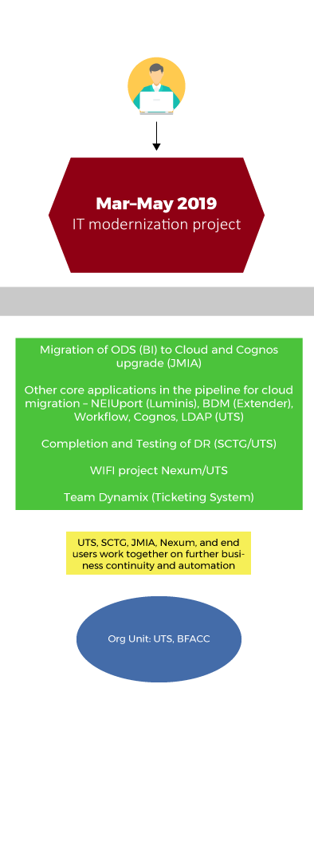
After the launch

Slide 21
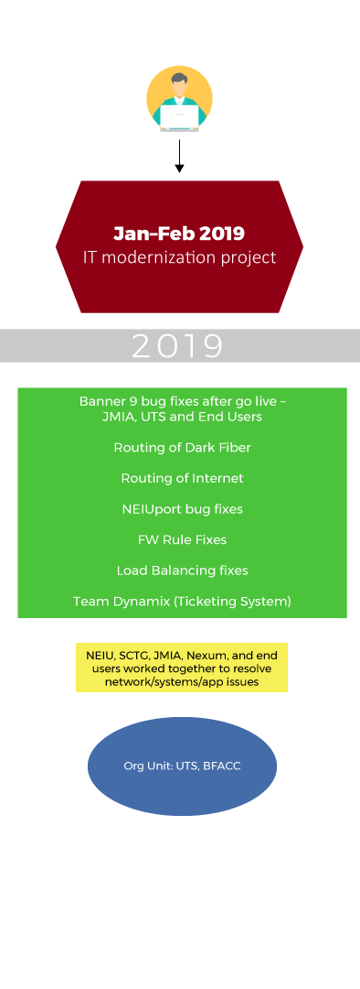
Post Go-Live

Slide 22
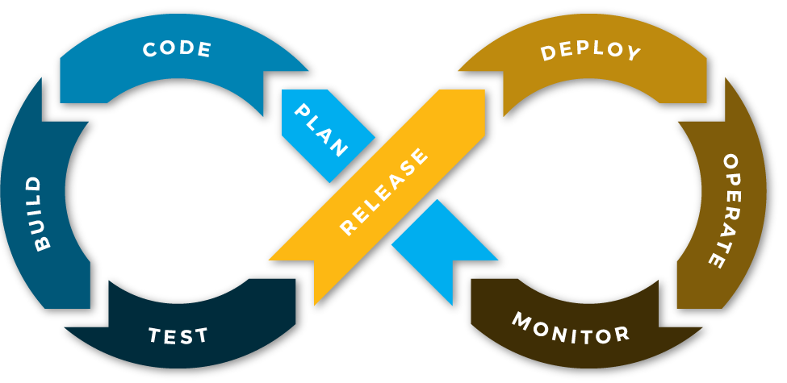
Cloud = DevOps?
Notes:
Wayne

Slide 23
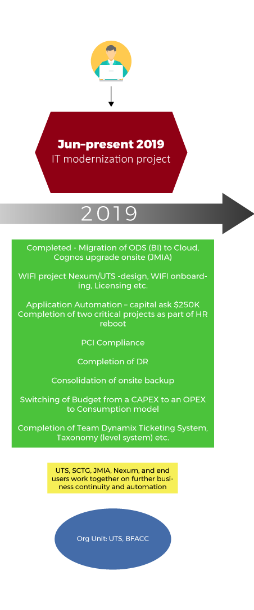
Business continuity and automation

Slide 24

Now the door is open…
“Tremendous things are in store for you! Many wonderful surprises await you!”
-Roald Dahl
Look for new ways to innovate
Time to look at costs and silos
Get your governance right
Notes:
Wayne

Slide 25
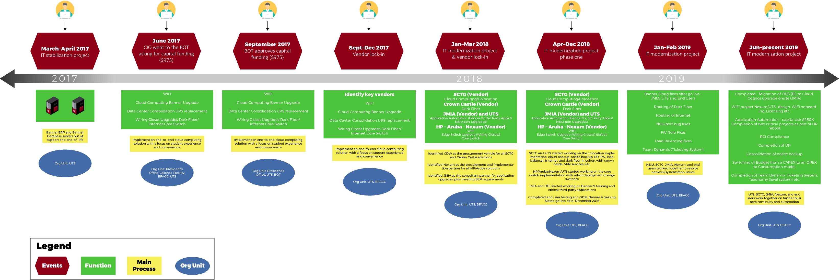
IT modernization project timeline
March 2017–December 2018

Slide 26




NEIU’s pathway to “smart” solutions
+
+
Instrumented
Interconnected
Intelligent
Event capture and filtering for timely response
Any-to-any linkage of people, process, and systems
Deep discovery, analysis,
and forecasting
= Smart
Notes:
Sam
Place holder - What does the future hold
A field tested technology eco-system
Consumption model (capex – opex – consumption)
Ready to scale up or down
Expected mainstream technology – Horizon Report…

Slide 27
Contact Information
Sam Kann
LinedIn – https://www.linkedin.com/in/skann
Ph – 1(407)-592-7365
Wayne Geils
LinkedIn – https://www.linkedin.com/in/wayne-geils/
Ph – 1(312)-545-0000
NOTE: This presentation leaves copyright of the content to the presenter. Unless otherwise noted in the materials, uploaded content carries the Creative Commons Attribution 4.0 International (CC BY 4.0), which grants usage to the general public, with appropriate credit to the author.

Slide 28
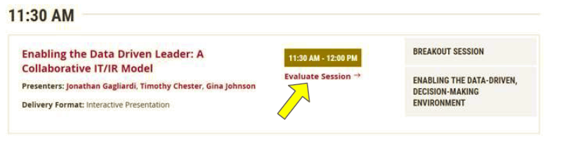
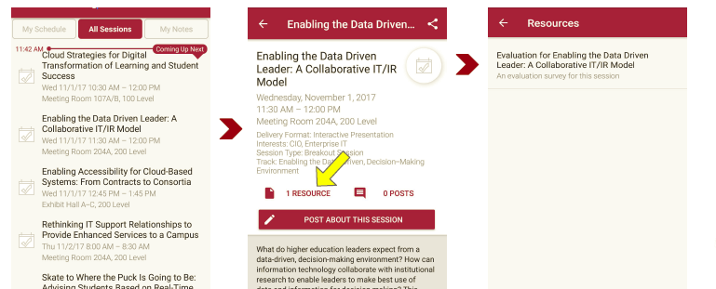
Session Evaluations
There are two ways to access the session and presenter evaluations:
1
2
In the online agenda, click on the “Evaluate Session” link
From the mobile app, click on the session you want from the schedule > then scroll down or click on the associated resources > and the evaluation will pop up in the list

