Slide 1
PRIVACY PERSPECTIVES Student Data Analytics How much is too much?
Holly Drake, Chief Privacy Officer
Marcia Ham, PhD Candidate, Learning Analytics Consultant

Slide 2
What is privacy and why does it matter?
Privacy:
surveillance
be left alone
analytic
Transparency
Matters:
ethical
choice
regulatory
expectation
equity
Notes:
Marcia’s Slide
When we are out talking with our faculty, staff and students about privacy and the ethical use of personal information, we often start presentations with

Slide 3
Privacy Perspectives
Everyone who visits, studies, works, heals, researches, and plays at Ohio State brings their own unique privacy perspective.

Slide 4
Buddy up!

Slide 5
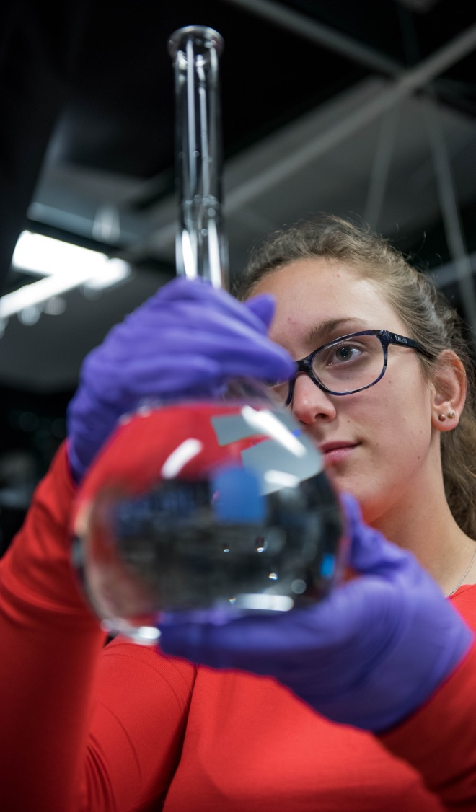
We value the privacy of everyone who visits, works, supports, and learns at Ohio State.

Slide 6
Our Privacy Values
Secure info and investigate reports of inappropriate access
Make it easy to access and correct information
Implement new tech using privacy-by-design
Create, educate and lead best practices and compliance
Provide and honor choices when possible
Give notice of how we collect, use and share

Slide 7
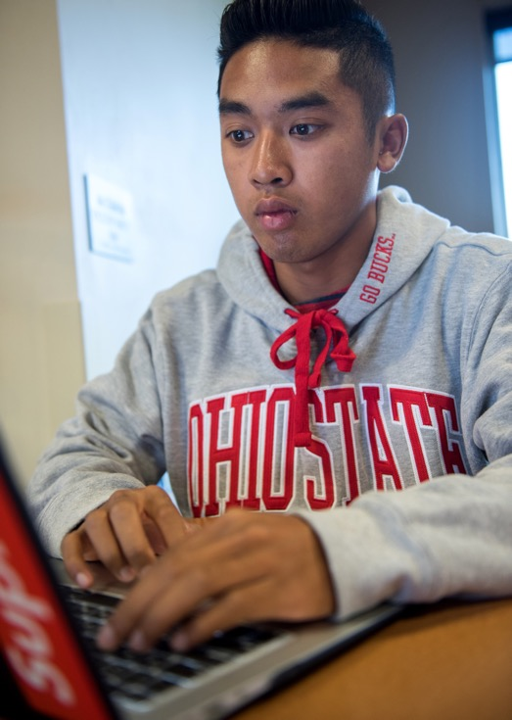
Learning Analytics
"Learning analytics is the collection, analysis, use, and appropriate dissemination of student-generated, actionable data with the purpose of creating appropriate cognitive, administrative, and effective support for learners.”
-Slade & Prinsloo, 2013

Slide 8
SCENARIO 1 Learning Dashboard

Slide 9
SCENARIO 2 Personalized Journey

Slide 10
Privacy Journey
Our community understands how Ohio State collects, uses and shares personal information - providing choices whenever possible.
Transparent
Privacy
Practices
Community-
Driven
Website Policy
Develop
Privacy
Personas
Understand
Digital
Footprints
Notes:
Start: The Ohio State community of students, faculty, staff, and visitors, understands their digital footprint and how digital footprints can be used (for personalization, for working or studying, for marketing...)
Next, Personas emerge from this understanding. Different community members have different experiences and expectations of their own privacy.
Then, our community can write a website privacy policy.
Next, our community knows how Ohio State collects, uses and shares their personal information. And, Ohio State provides choices whenever possible.
Now, Ohio State is transparent with privacy practices. And, our community trusts Ohio State with their personal information
privacy.osu.edu has our proposed privacy principles, which tie to the Ohio State Values.

Slide 11
Thank You!
Holly Drake Chief Privacy Officer drake.166@osu.edu
Marcia Ham, PhD Candidate Learning Analytics Consultant ham.73@osu.edu

