Slide 1
NAU Insights
Digital Learning Success relies on: a team with Awareness & Desire
Academic Leadership
Vice Provost for Teaching Design & Learning
Curriculum – course purpose & alignment
First Year Learning Initiative – coordinated courses
Faculty Professional Development – Learning Communities
Student support
Next Gen Office
Tutoring
Supplemental Instruction
Design support
Provider partnership – publishers & courseware vendors
Cohort institution partners – fellow university travelers

Slide 2
RESULTS
Our highly supported courses in our Active & Adaptive Program had >14,000 enrolled in AY18-19, 5.2% increase in pass rate..
BIO181 | Unity of Life I: Cell Metabolism
BIO182 | Unity of Life II: Multicellular Organisms
BIO181L | Unity of Life Lab I
FIN190 | Personal Finance in a Global Economy
GLG112 | Geologic Disasters
HIS100 | World History I
ISM120 | Introduction to Computer Information Systems
MAT100 | Mathematics Pathway
NTS135 | Introduction to Nutrition and Foods
POS110 | American Politics
PSY101 | Introduction to Psychology
PSY240 | Developmental Psychology
SOC101 | Introduction to Sociology

Slide 3
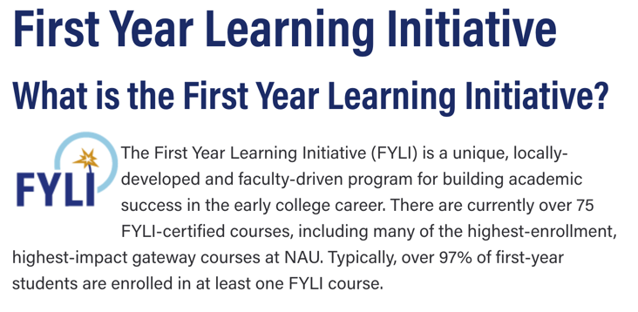
Critical Success Factor

Slide 4
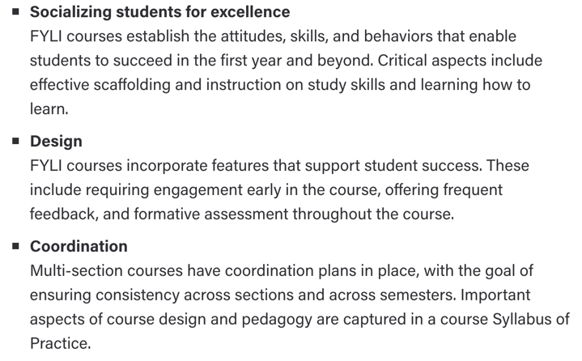
FYLI continue
FYLI Goals and Practices

