Slide 1
Rules of Engagement: When Your Customers Are Telling
Your Story
PRESENTERS:
Blake Cooper – University at Buffalo
Tracy Gale – University of Florida
Jeannine Sato – Duke University
Diana Tuorto – University at Buffalo

Slide 2
Session Overview
■ Faculty Engagement Strategies
Diana Tuorto and Blake Cooper
■ Student Engagement Strategies
Tracy Gale
■ Staff Engagement Strategies
Jeannine Sato
■ Interactive Speed Round
Everybody into the pool!

Slide 3
RULES OF ENGAGEMENT: FACULTY
Diana Tuorto, IT Communications Officer
Blake Cooper, IT Communications Specialist
UNIVERSITY AT BUFFALO INFORMATION TECHNOLOGY

Slide 4
What are some barriers to faculty engagement at your institution?

Slide 5

Problem: Faculty won’t (or can’t) engage
Solution: The Pareto Principle!
  Focus on the loudest voices
How UB handled it:
  Created a Faculty Fellow role
    Act as a liaison between faculty and IT
    Assist with communication opportunities between faculty and IT
  Faculty Senate IT Subcommittee, chaired by fellow
  Faculty IT Liaison program

Slide 6

Problem: Faculty don’t trust IT
…often because they don’t feel they are being heard
Strategy: Avoid “superficial engagement”
  Don’t just gather people and let them vent- let/make them take responsibility for change
  Share their/your successes! Let them know how they’ve made a difference
How UB handled it:
  Active participation in focus groups, blogs, direct emails, town halls…
  …lots of communication!

Slide 7
Faculty engagement strategy: cultivate Faculty IT Liaisons

Slide 8

Step one: outreach
Survey (formal or informal) to identify problem areas
Notice the loudest voices (so you can cultivate them)
Put it into motion (avoid superficial engagement)

Slide 9

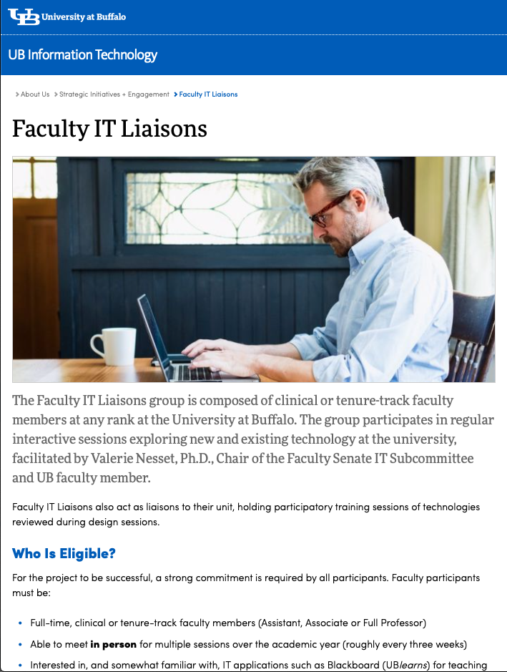
Step two: assemble your liaisons
Faculty and IT Staff
Less tech-savvy is better
Different academic areas

Slide 10
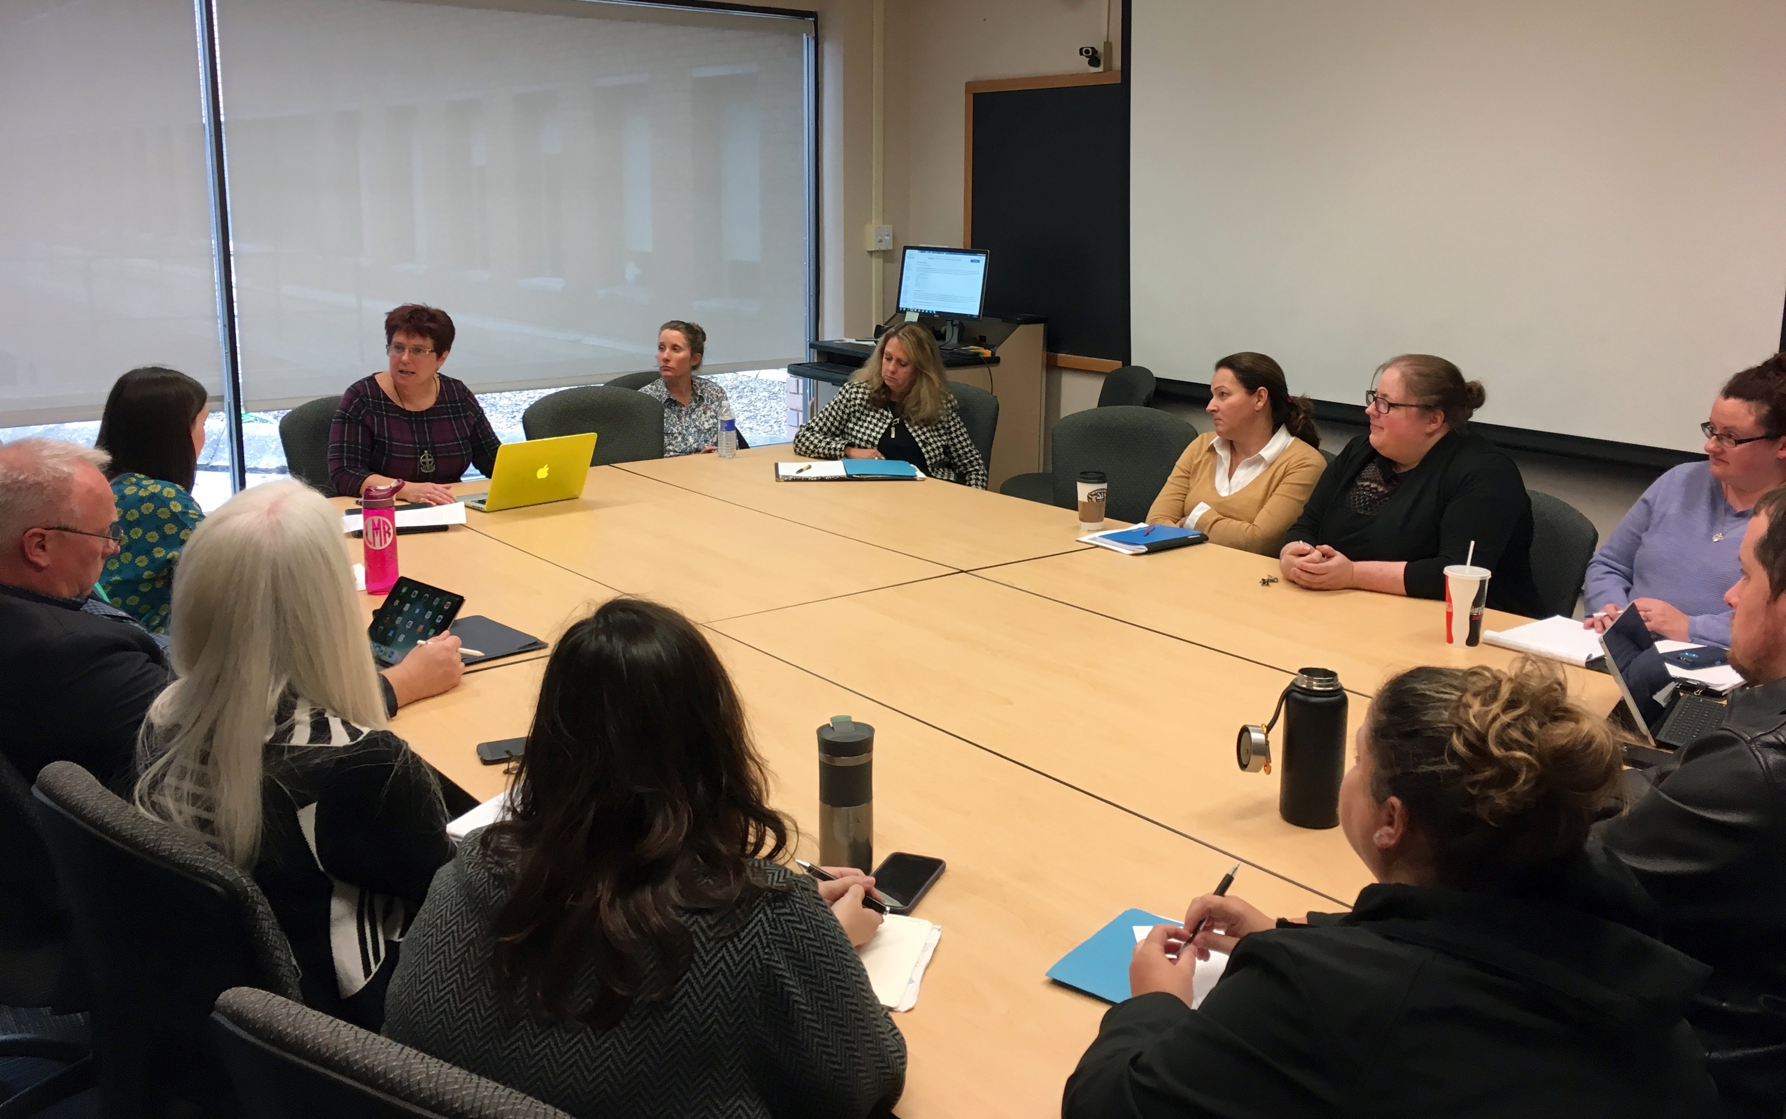
Step three: “bonded design”
Experts and users work together to “design” technology
Existing or forthcoming technology
Low-tech prototypes
“Must-have features”
Talk it out!
Large, Andrew & Nesset, Valerie & Beheshti, Jamshid & Bowler, Leanne. (2006). “Bonded design”: A novel approach to intergenerational information technology design. Library & Information Science Research. 28. 64-82. 10.1016/j.lisr.2005.11.014.

Slide 11
Your faculty are now power users 🦸‍♀️ who share their expertise with colleagues.

Slide 12
Your IT staff are now faculty advocates 👷‍♀️ building better technology.

Slide 13
“What I liked about it was that any brainstorm or idea was acceptable. No ideas are stifled and no one on the team was made to feel that their idea might be considered inappropriate.”
-Faculty member

Slide 14
“Everyone in the group seems very open to learning from each other… if one group member says they know how to do something, the others will say 'you'll have to show me how to do that.’”
-IT staff member

Slide 15
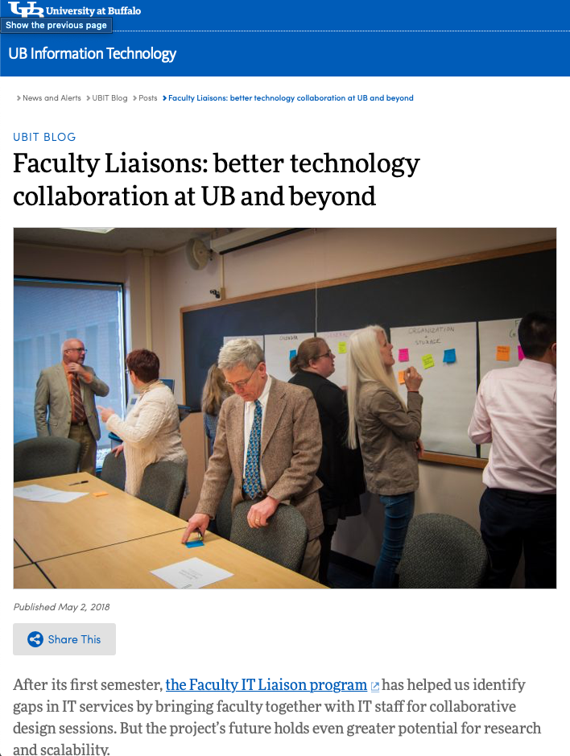
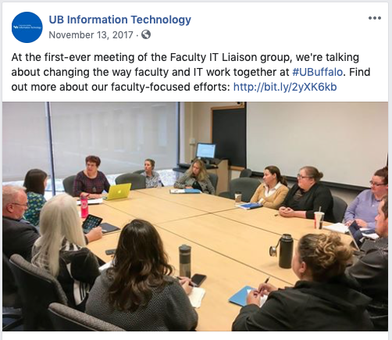
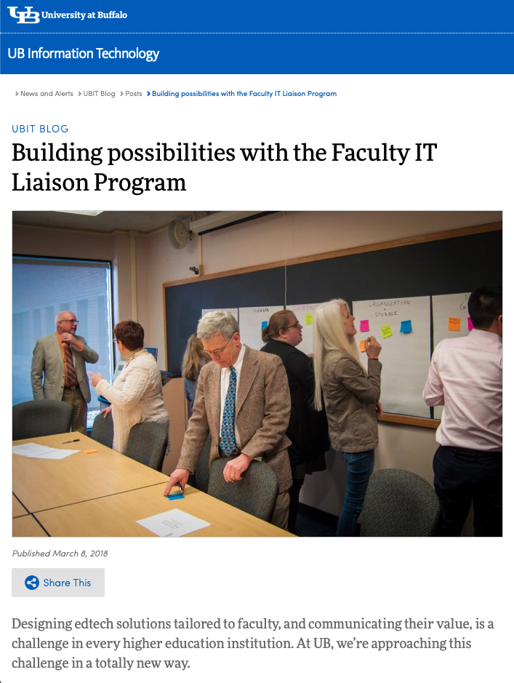
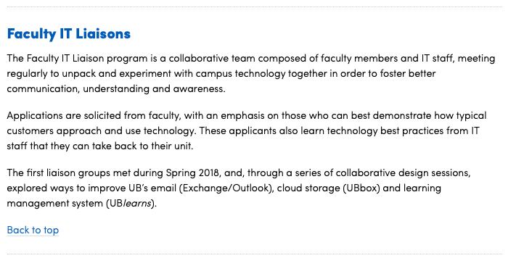
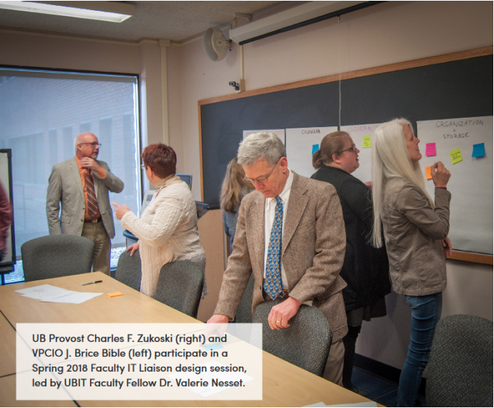
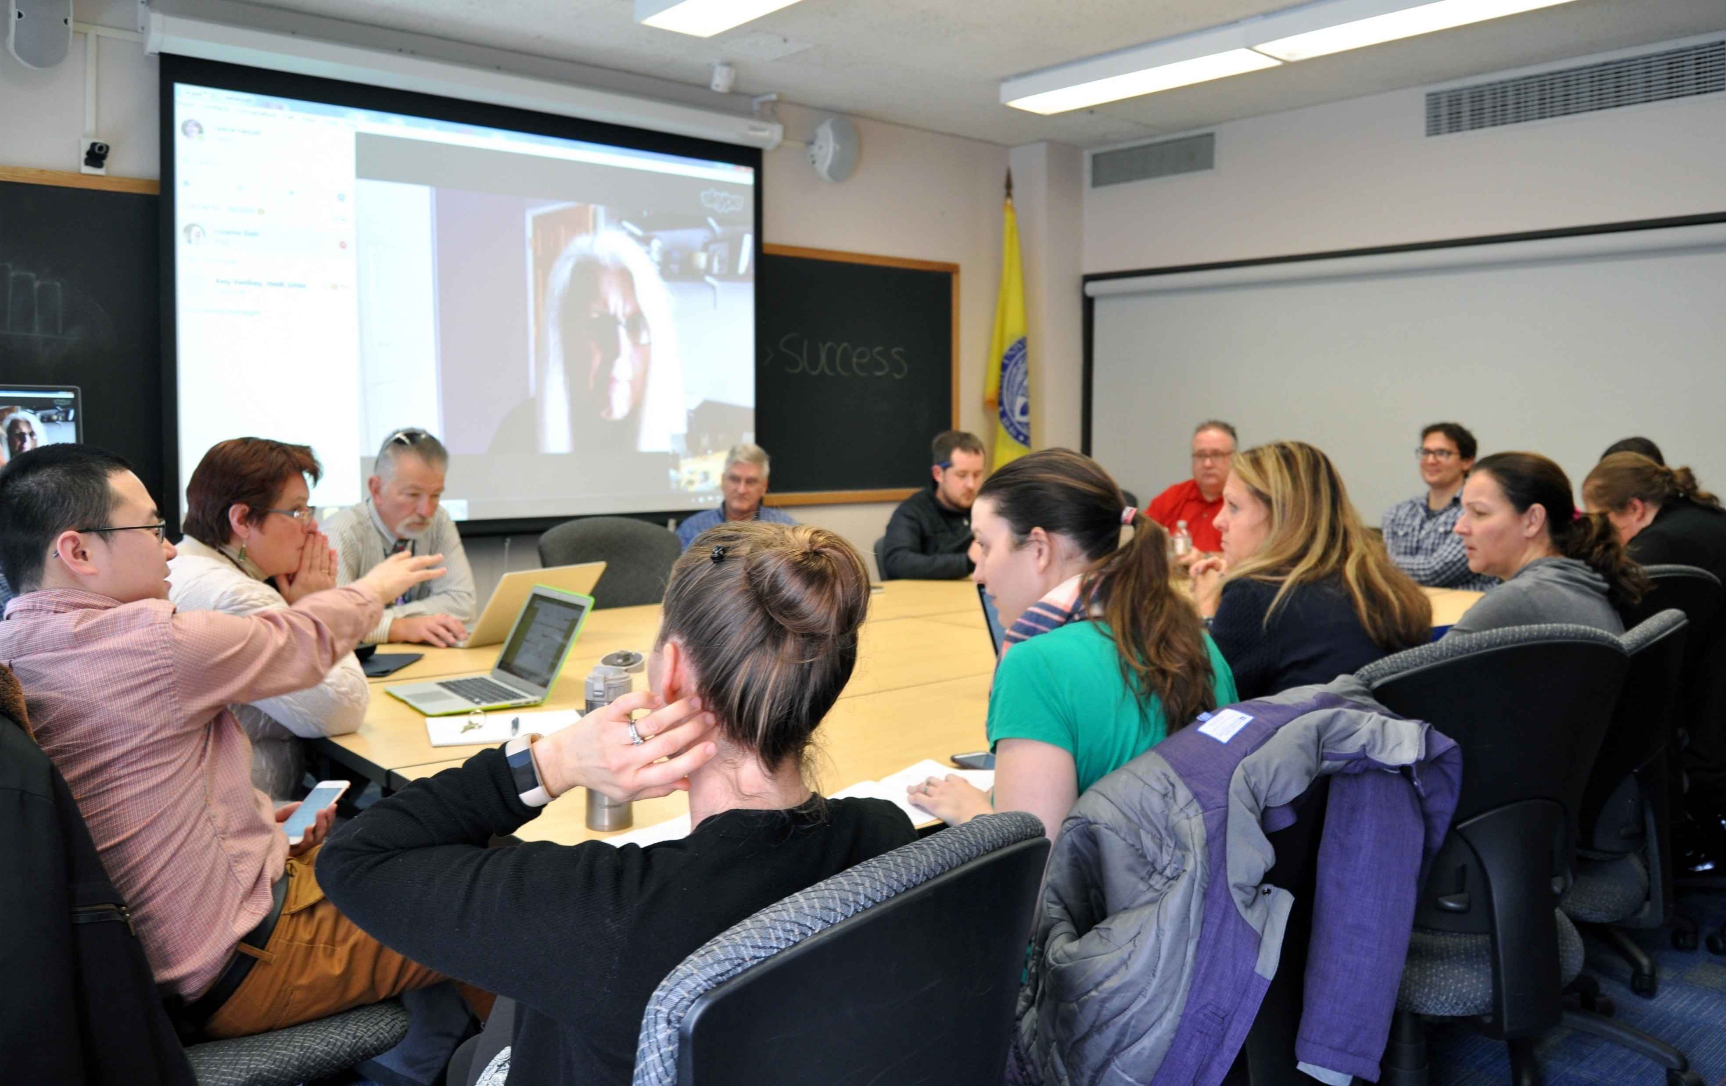
Don’t forget to share the successes!

Slide 16
ENGAGING WITH STUDENTS
ON THE VALUE IT PROVIDES
October 16, 2019
Tracy Gale
Communications Manager
Rise to Five

Slide 17
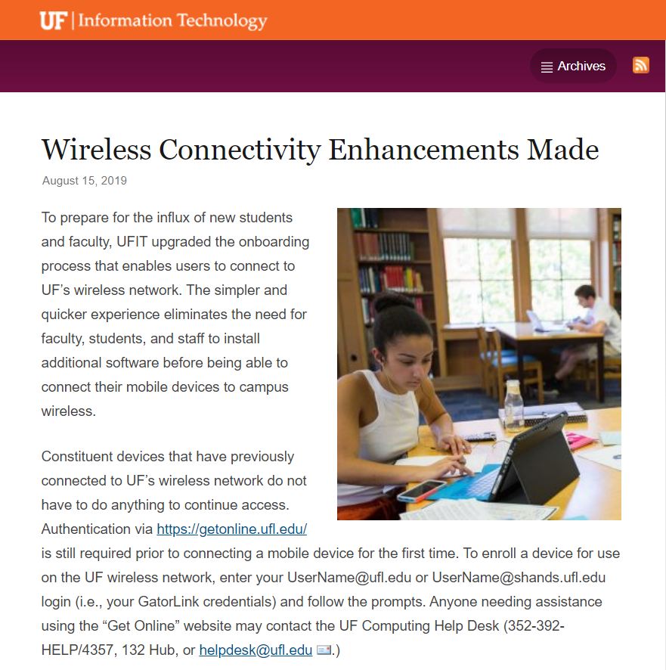
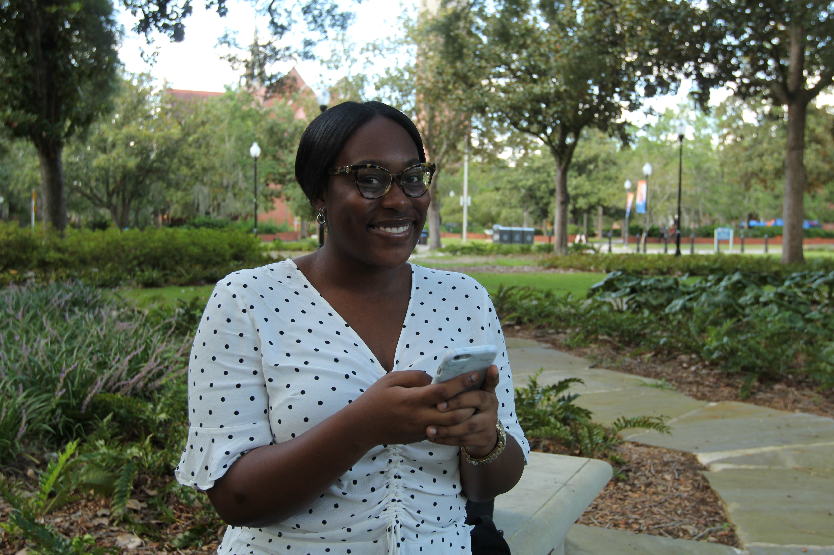

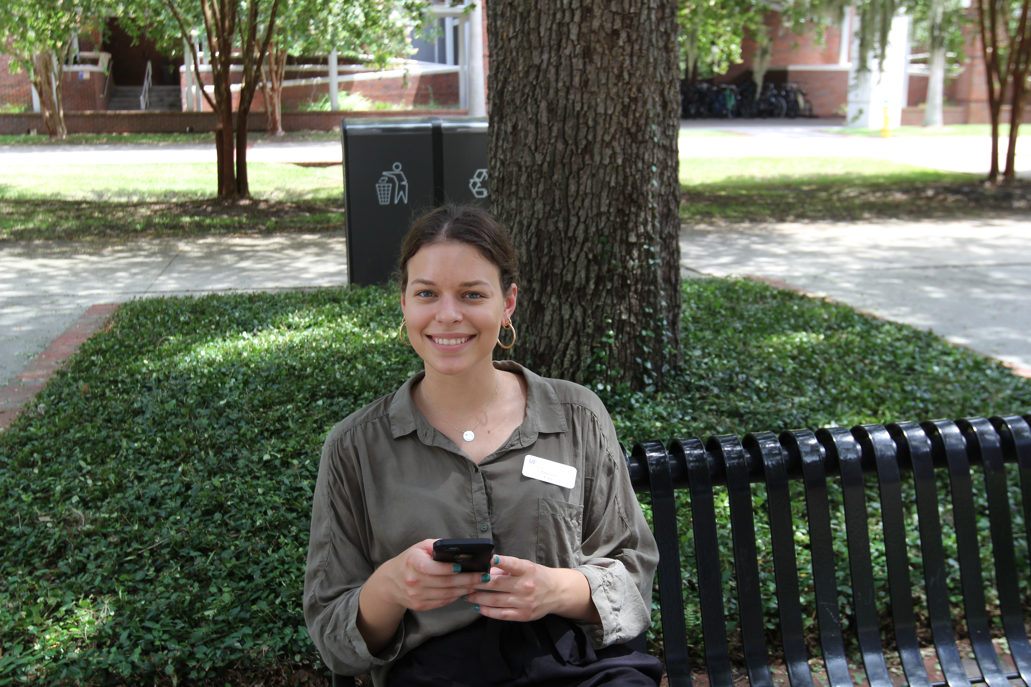

ENGAGING WITH STUDENTS: IT @ UF
UF FALL 2019
https://news.it.ufl.edu/
Students: 56,000
Faculty: 6,000
Staff: 31,000

Slide 18
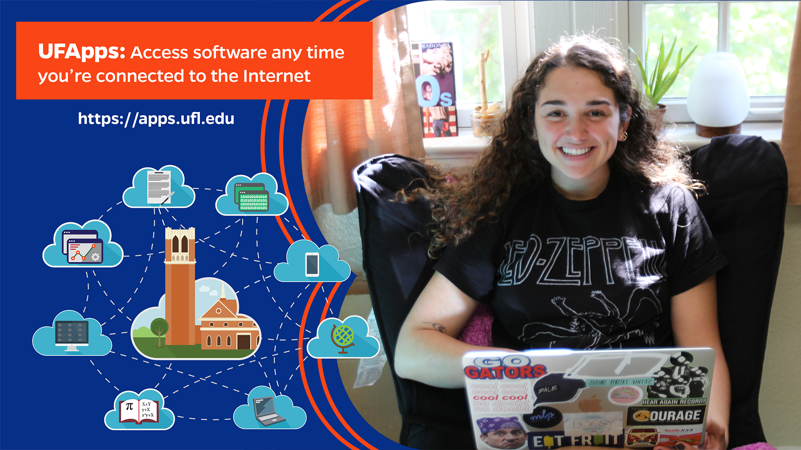
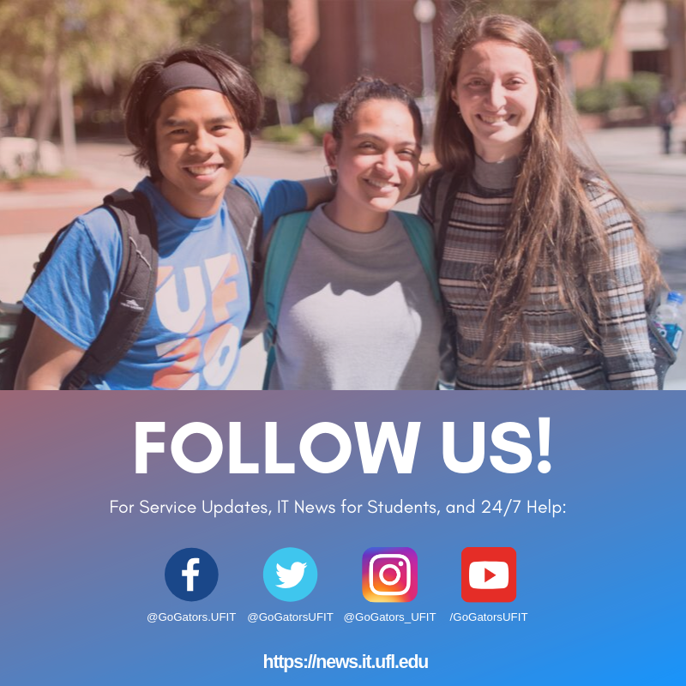
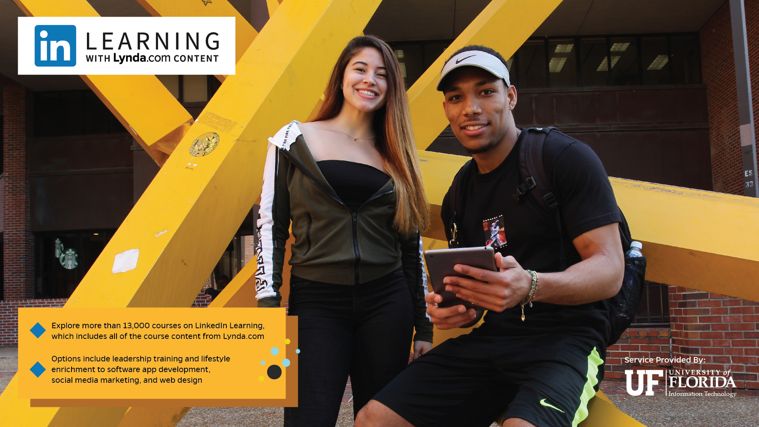
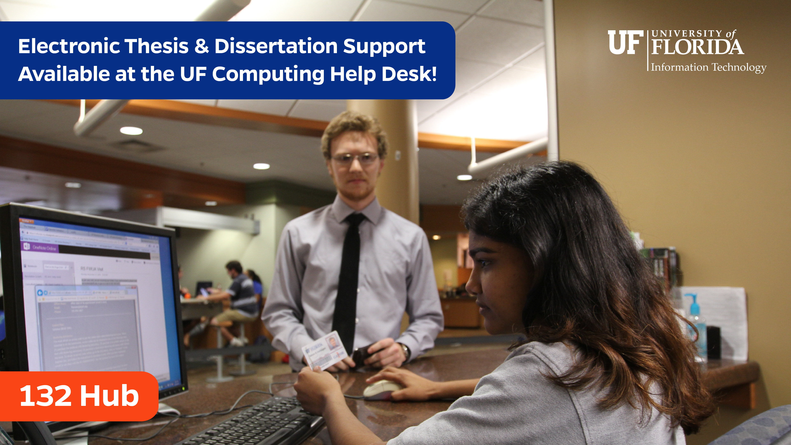
ENGAGING WITH STUDENTS: IT @ UF
REACHING STUDENTS: YOUR VALUE COMMUNICATED VISUALLY
IMAGES PROMOTING IT SERVICES ON DISPLAY IN:
    30+ RESIDENCE HALLS
    HEALTH SCIENCE CENTER COMMON AREAS MONITORS
    UF COLLEGES WITH DIGITAL SIGNAGE
    NEWELL HALL (24/7 STUDENT SPACE)

Slide 19
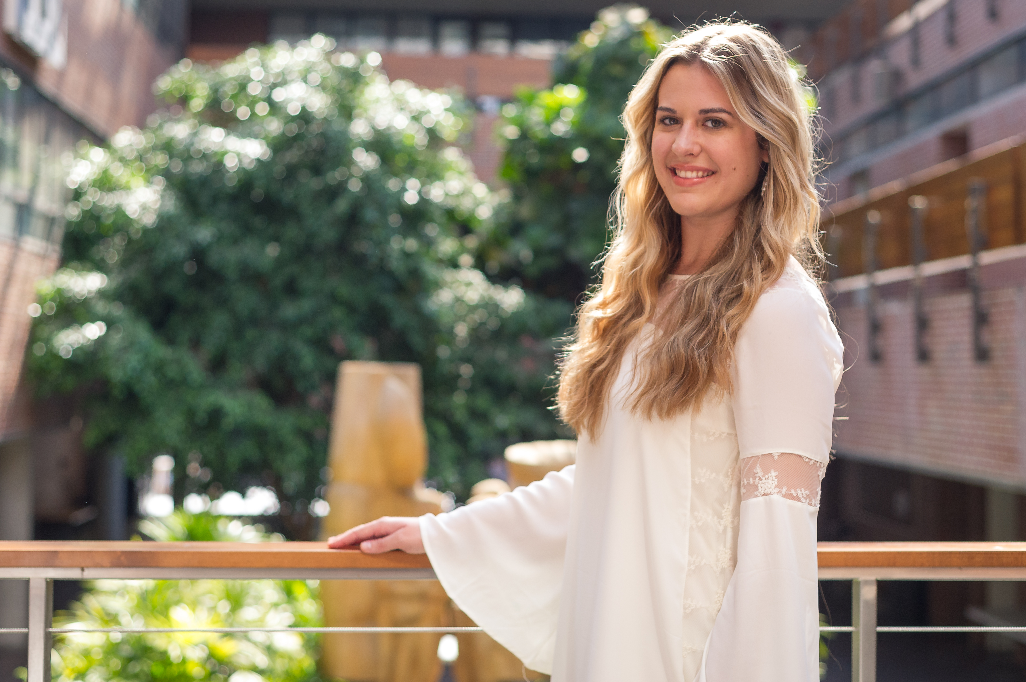
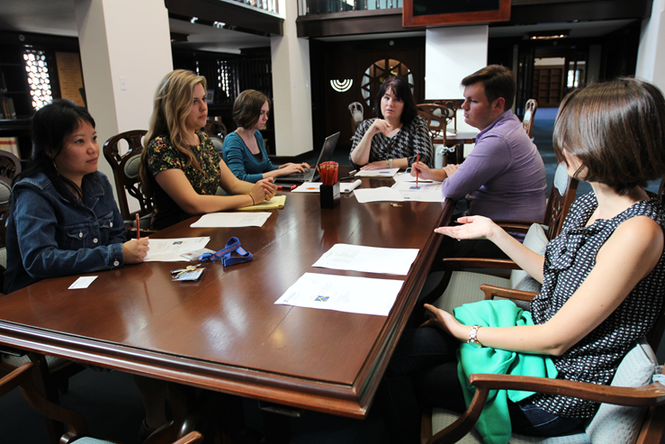
ENGAGING WITH STUDENTS: IT @ UF
STUDENT TECH FAIR
CONCEIVED BY UFIT STUDENT PR SPECIALIST
Student Committee Decisions and Actions:
Tabling Participants – Who Gets In
1-on-1 Meetings with Lead Representative of Participating Services
Social Media Content
Event Outreach Plan
Tech Fair Timeframe
Giveaway Items
THANK YOU, CHLOE!

Slide 20

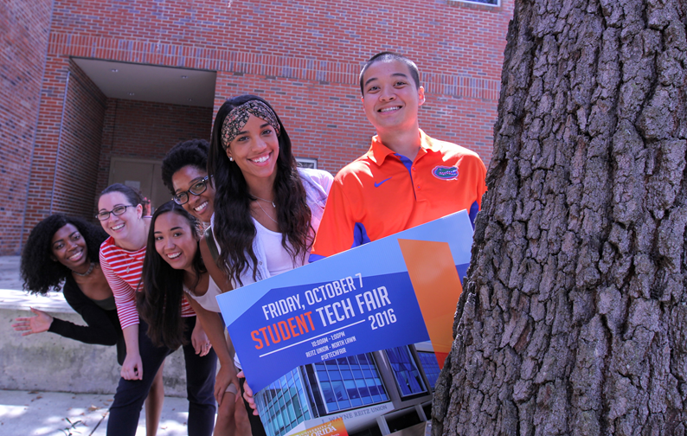
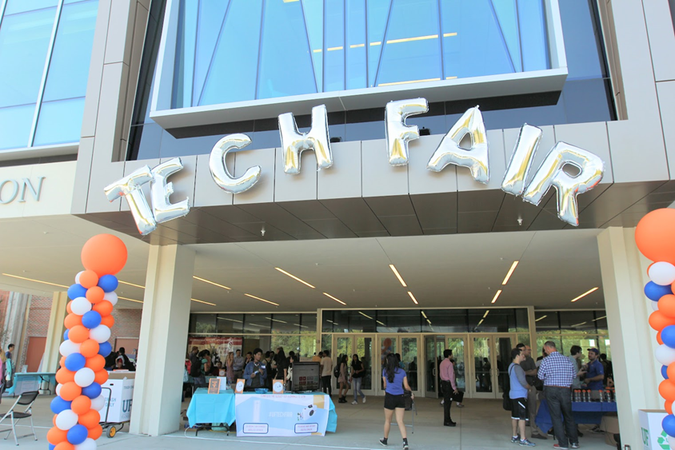
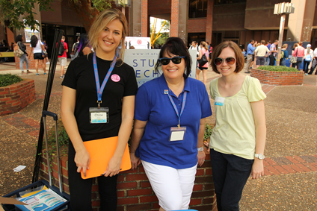
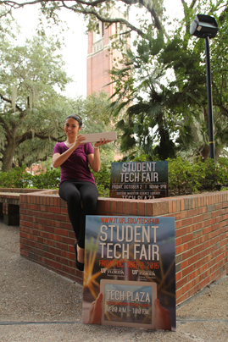
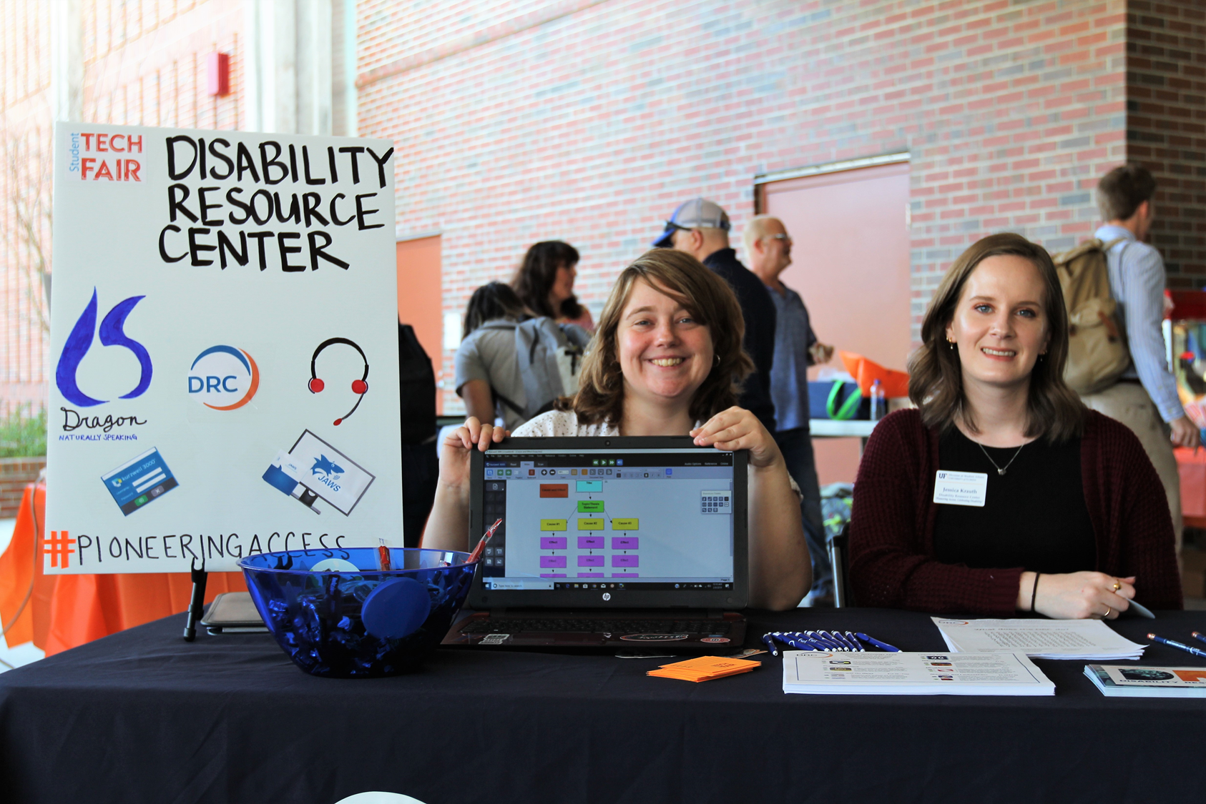
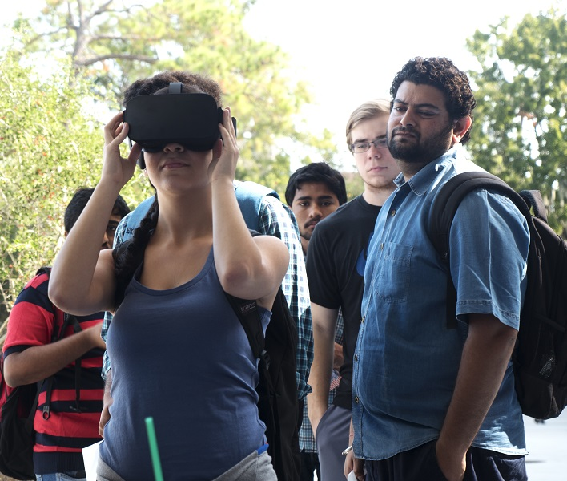

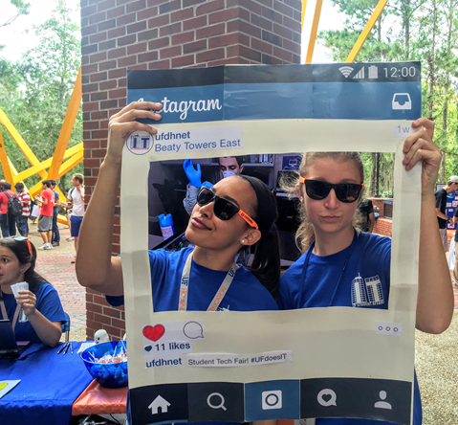
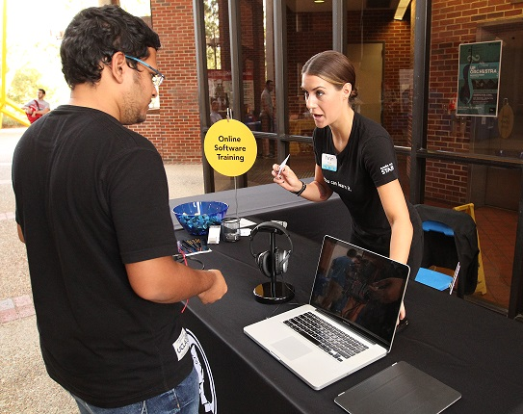

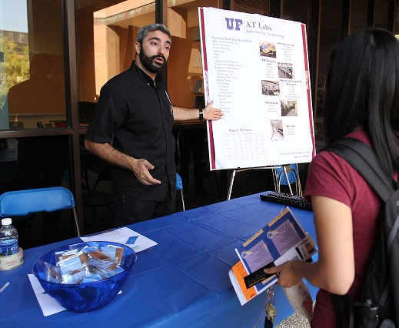
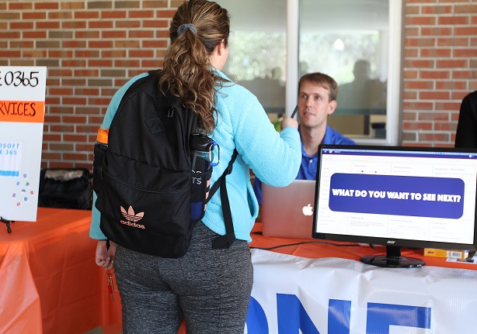
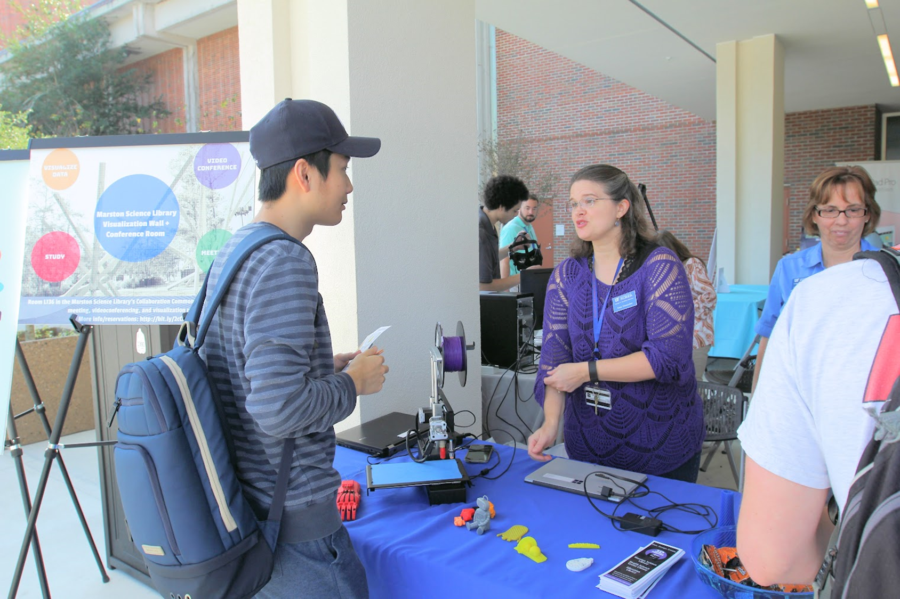
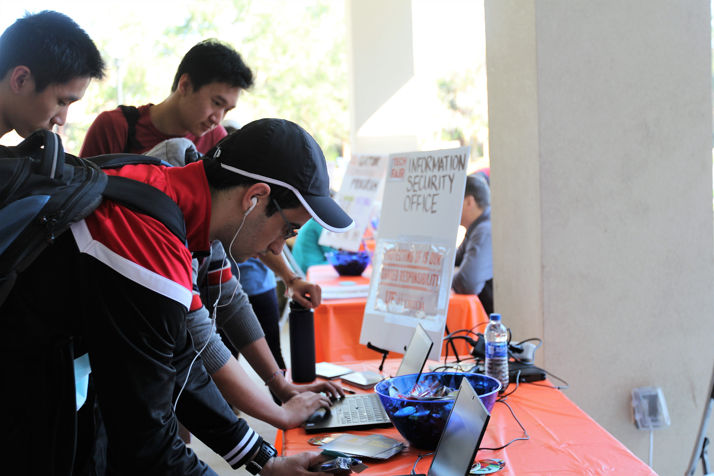
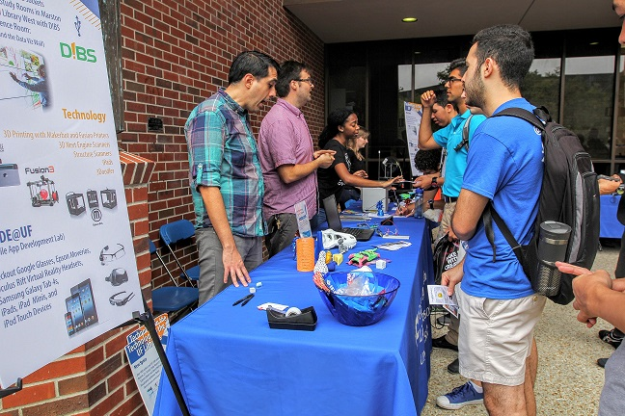
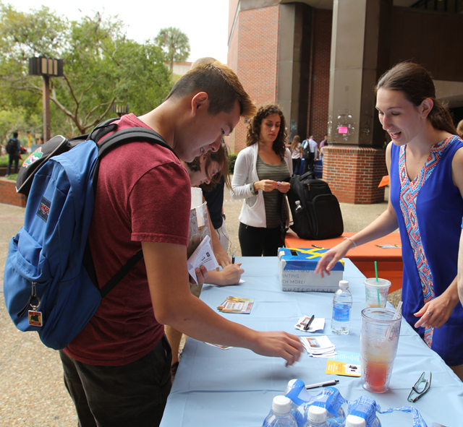
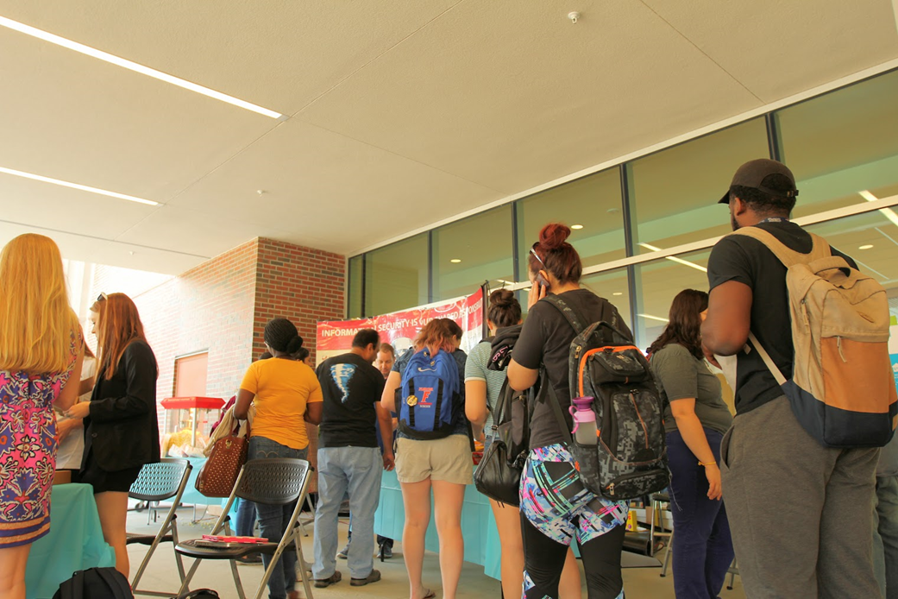
ENGAGING WITH STUDENTS: IT @ UF
STUDENT TECH FAIR https://it.ufl.edu/techfair/

Slide 21
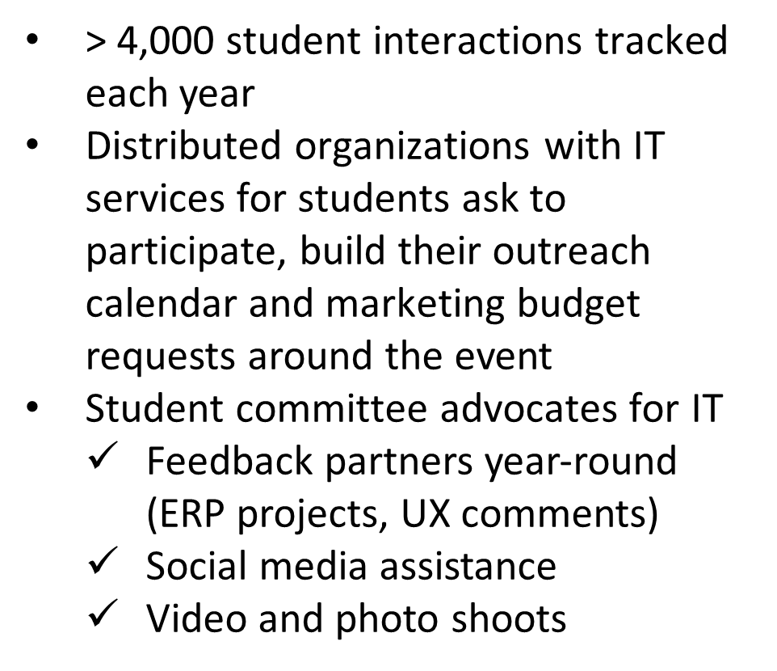
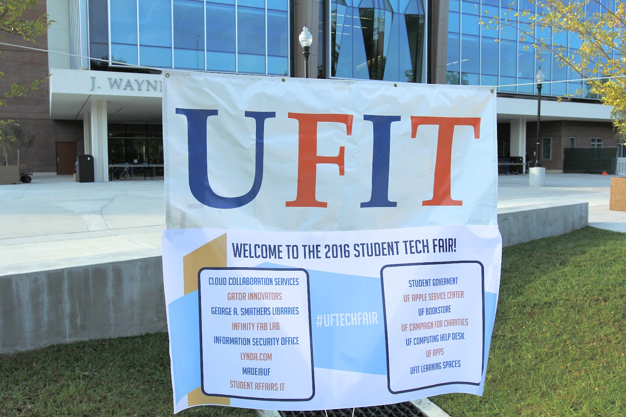
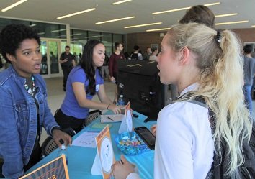
ENGAGING WITH STUDENTS: IT @ UF
STUDENT TECH FAIR - OUTCOMES
2019 Student Tech Fair Video (1:04)
https://youtu.be/UuHZWfL4r4E

Slide 22
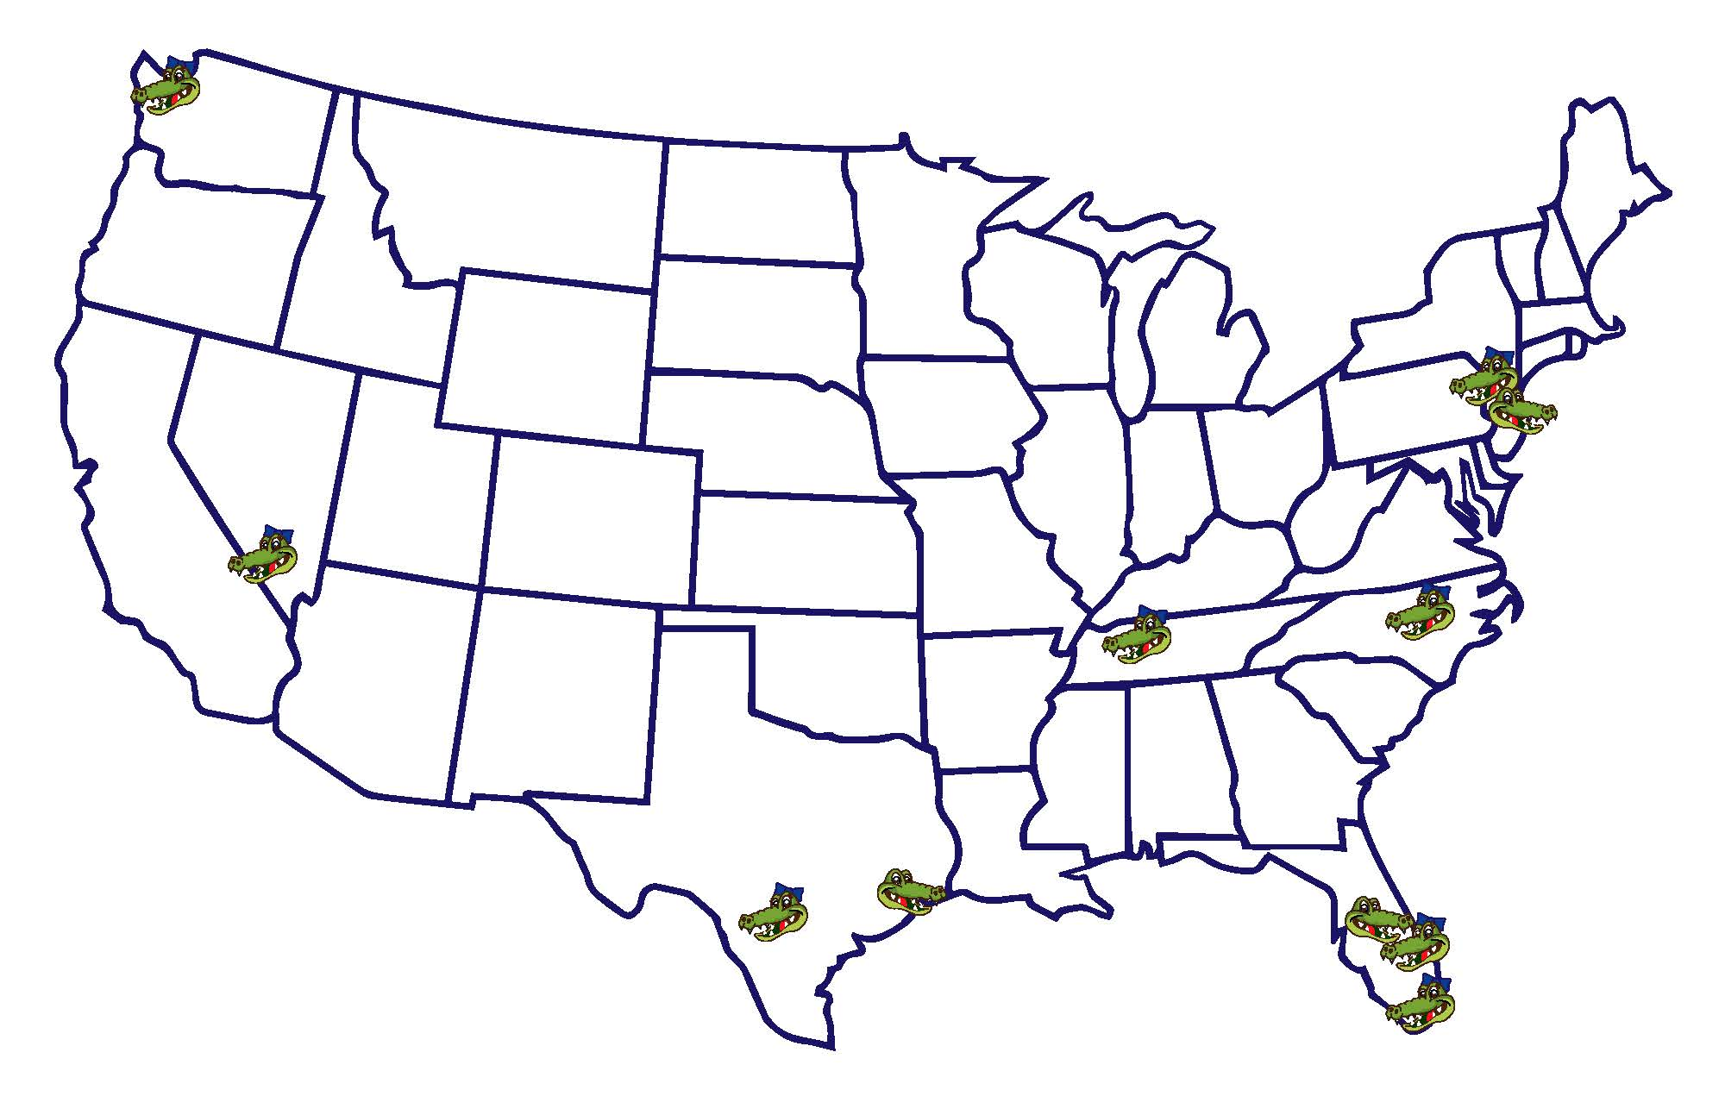
ENGAGING WITH STUDENTS: IT @ UF
THE RELATIONSHIP CONTINUES – STUDENT PR SPECIALISTS AND TECH FAIR COMMITTEE “ALUMNI”

Slide 23
RULES OF ENGAGEMENT: STAFF
Jeannine Sato, Communications Strategist
DUKE UNIVERSITY OFFICE OF INFORMATION TECHNOLOGY

Slide 24
IT Engagement Groups
A new way to engage major units across Duke
Routine, ongoing meetings
Key functional staff and leadership from OIT and units
Staff convey issues
Solutions based projects
Purpose is to generate and sustain dialogue about subject area needs, upcoming initiatives and projects, and to share knowledge on a continued basis, including new service offerings from IT and the ways in which those may be relevant to the group.

Slide 25
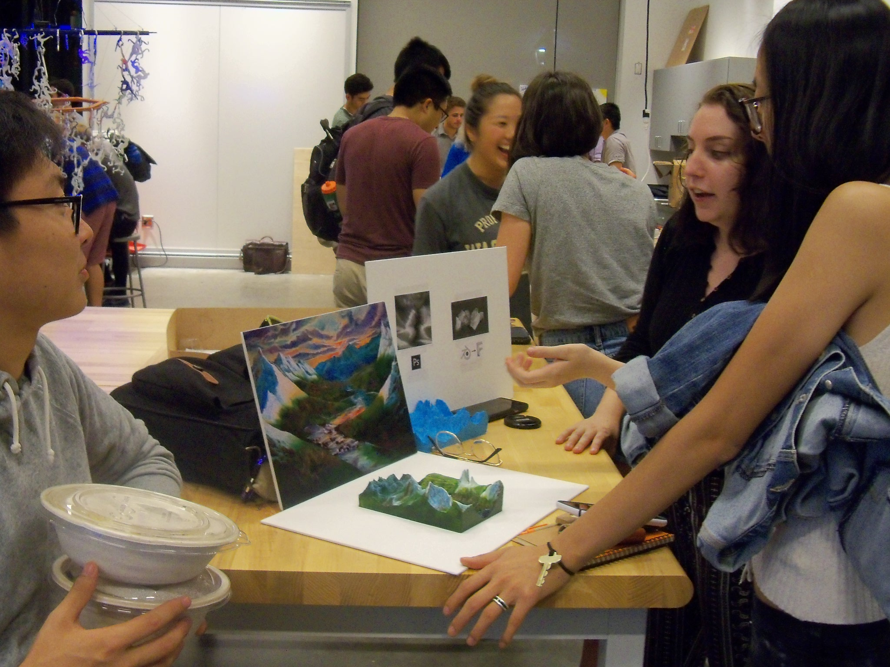
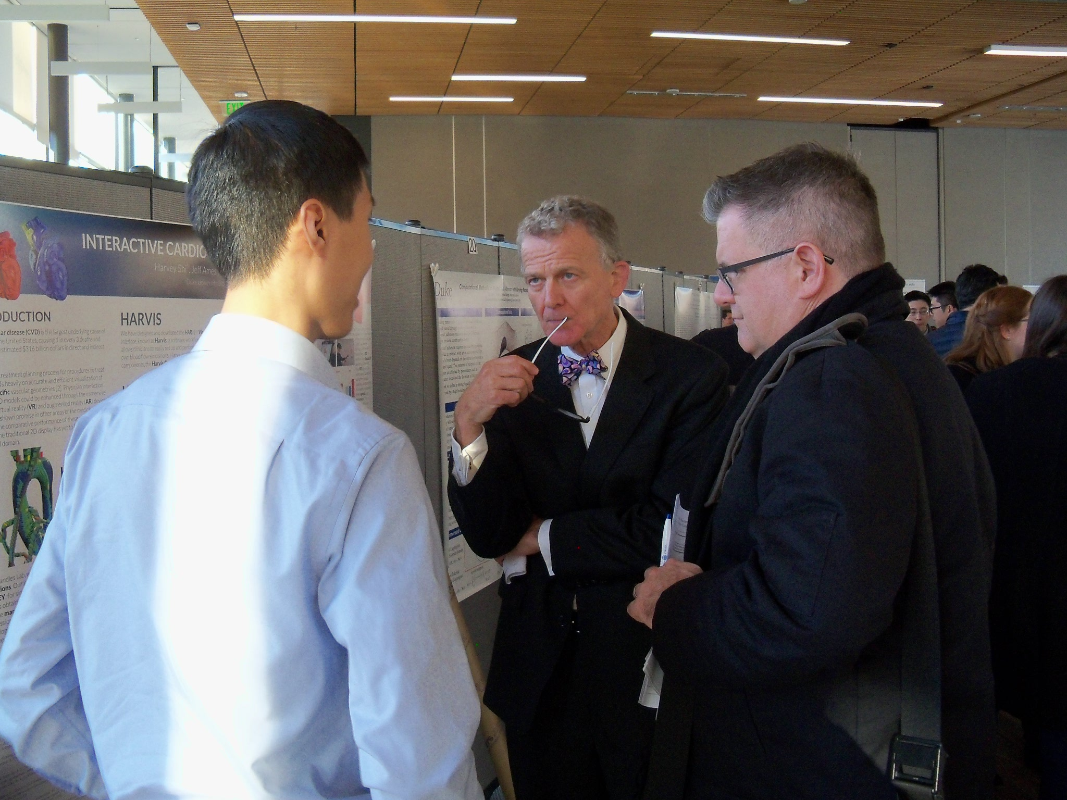
Engagement stakeholder groups
Student Affairs
Libraries
Public Affairs & Govt. Relations
Global
Facilities
Alumni Affairs
Campus safety
Athletics
Administration

Slide 26
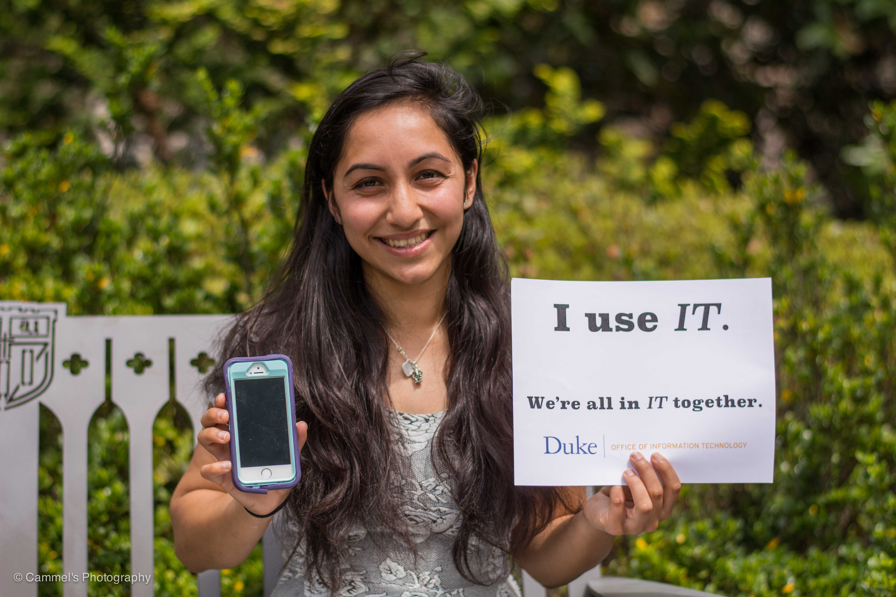
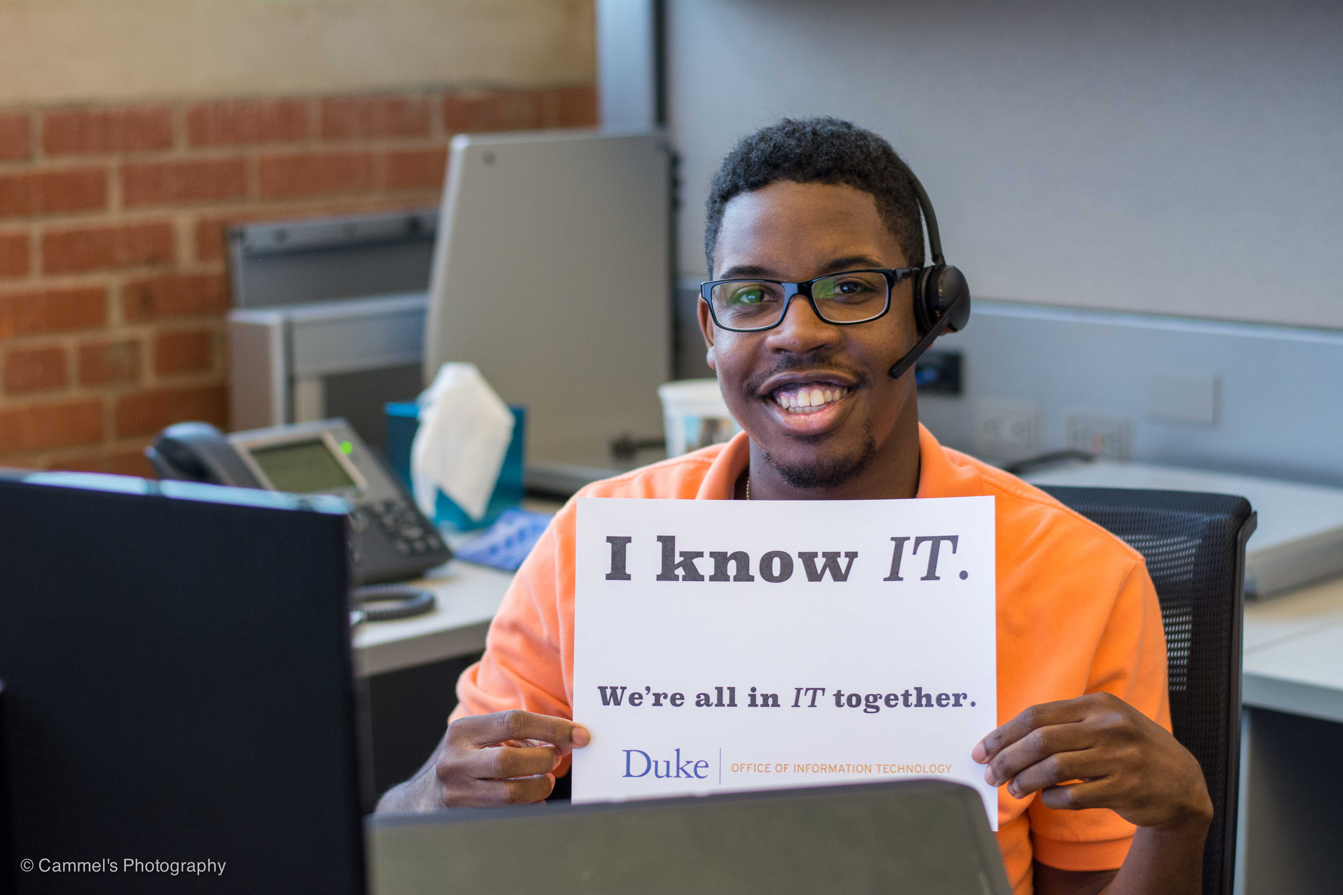
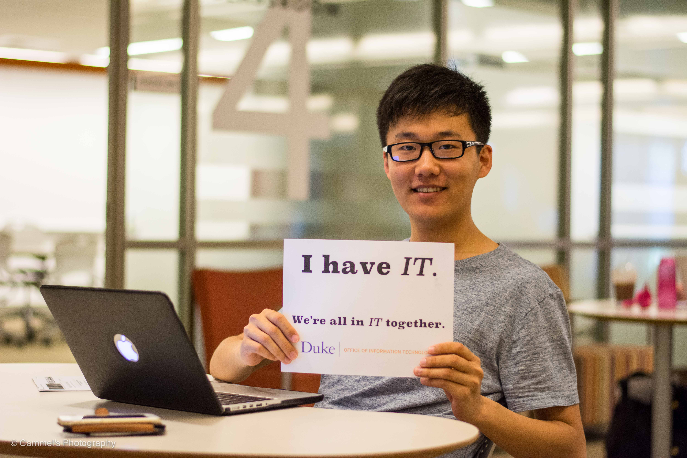
Structure
VP IT / CIO & counterpart sponsor (yearly updates with sponsors)
Sr. leaders from OIT and functional group co-chairs
Subject expert members
Group charters and charge
Meet regularly
Identify cross cutting projects, pain points
Document discussions & progress

Slide 27
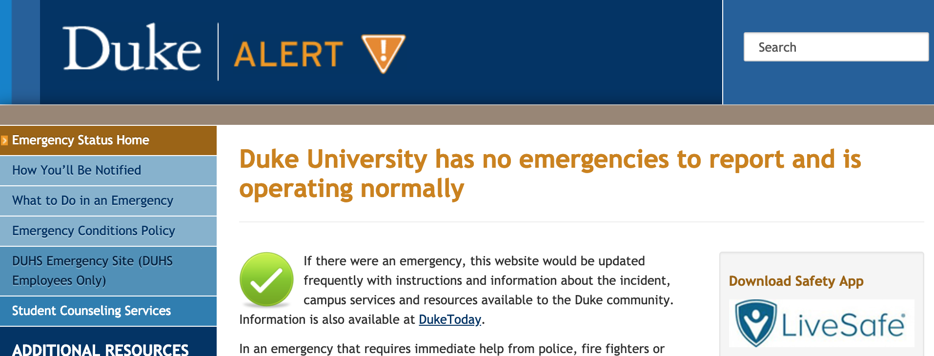
Project example – Campus Safety
Duke Alert & more
Created geo fencing for location specific alerts
iOS app to add alert via mobile device
Added new fields to easily add Cleary Act text
Cross promoted LiveSafe app at tech fairs

Slide 28
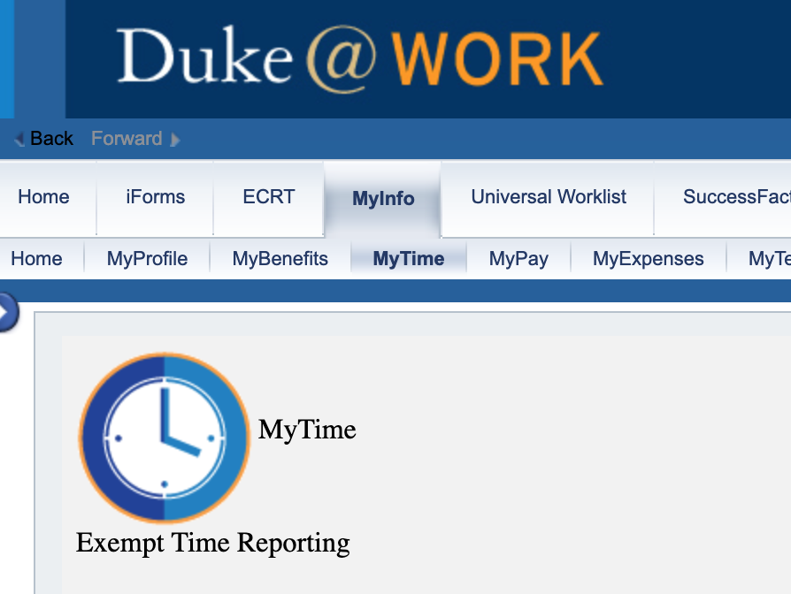
Outcome example
Time & Attendance
Moved manual to automated entry
Omitted manual report generation
Saved 100s hours/week staff time

Slide 29
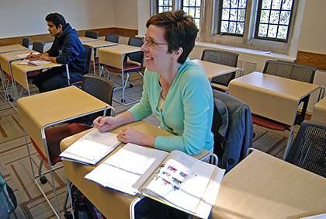
Outcome example – Tuition assistance
Automated payment to key outside universities
Omitted manual forms
Idea came from staff manually sending and processing forms

Slide 30
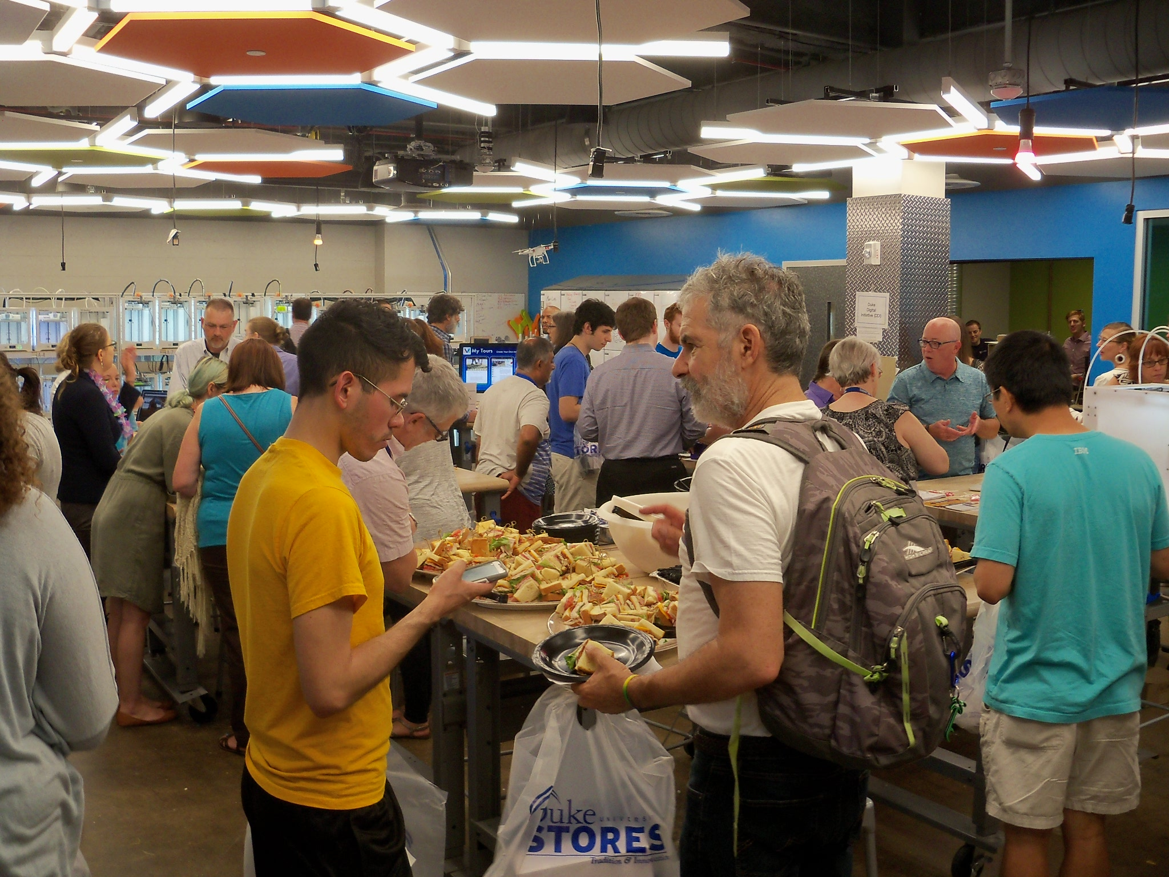
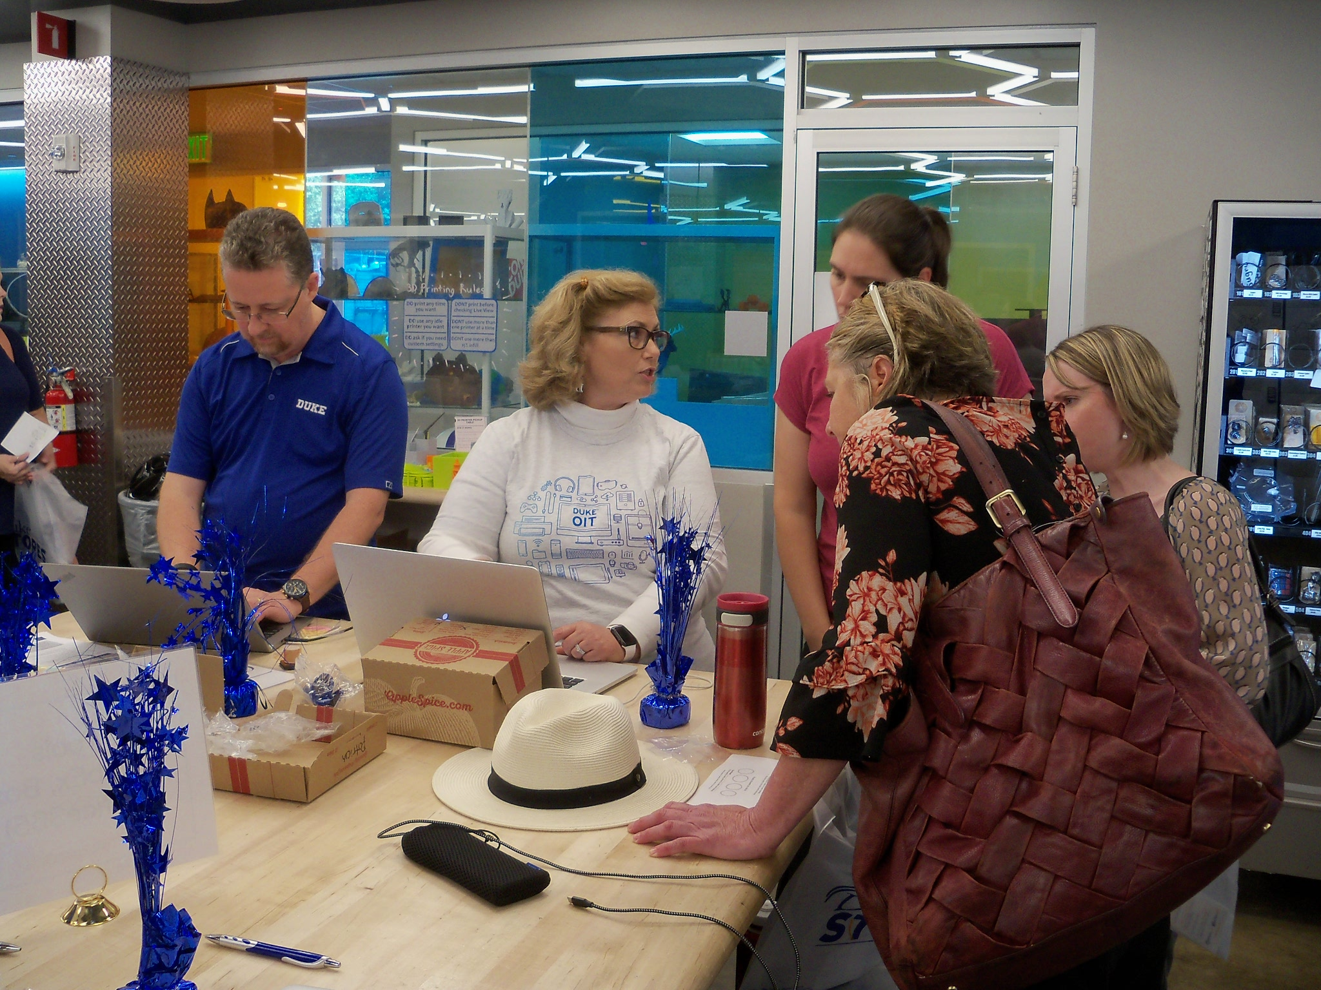
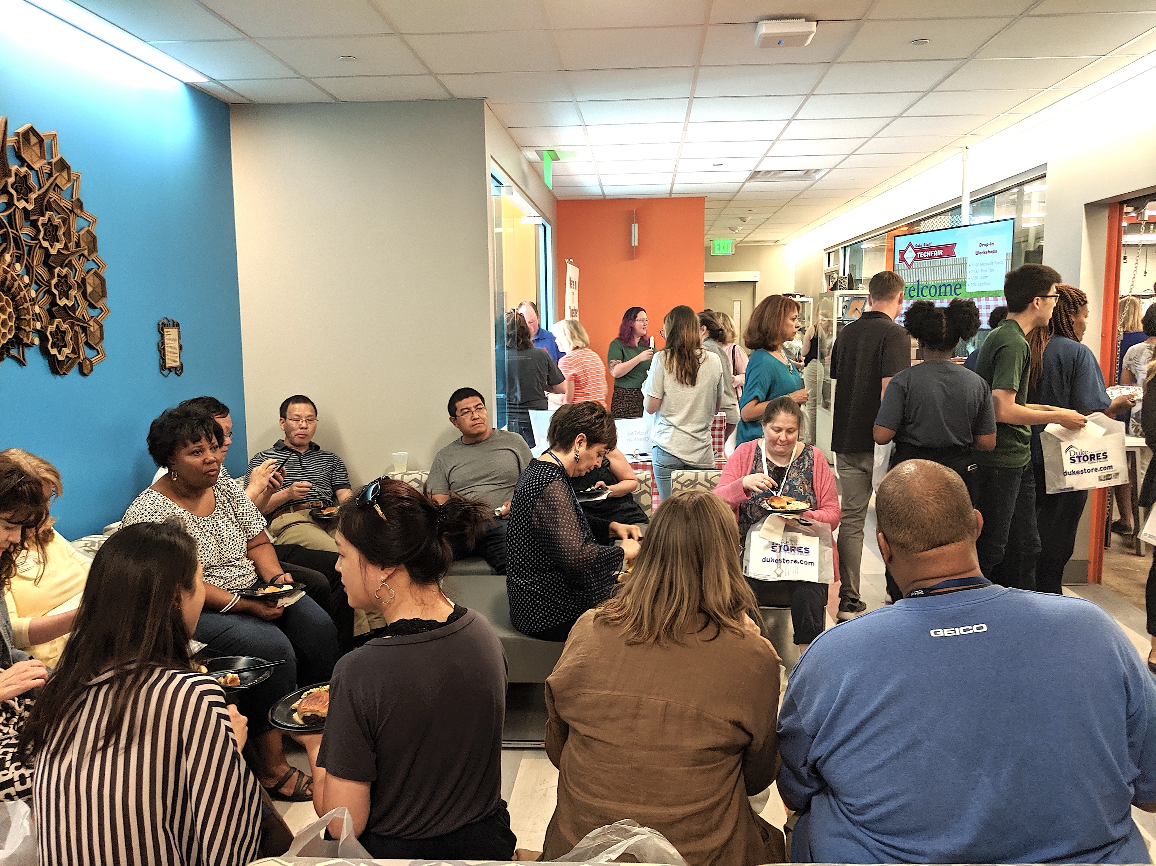
Face-to-Face Staff Tech Fairs
Fun
Campus makerspace
Listening
Tutorial
Create connections
Manage reputation
300+ attendees

Slide 31
SESSION INTERACTIVE

Slide 32
Small Group Breakout Activity
FACULTY
STUDENT
STAFF

Slide 33
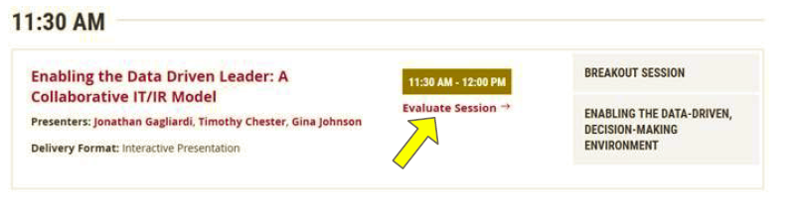
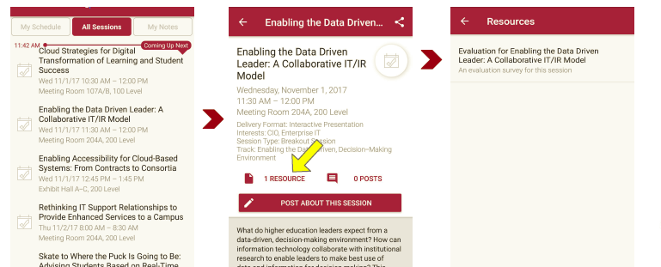
Session Evaluations
There are two ways to access the session and presenter evaluations:
1
2
In the online agenda, click on the “Evaluate Session” link
From the mobile app, click on the session you want from the schedule > then scroll down or click on the associated resources > and the evaluation will pop up in the list

Slide 34
Contact Information
Blake Cooper
blakecoo@buffalo.edu
716-645-5991
Tracy Gale
tgale@ufl.edu
352-273-1559
Jeannine Sato
j.sato@duke.edu
919-357-0324
Diana Tuorto
dianatuo@buffalo.edu
716-645-8127
NOTE: This presentation leaves copyright of the content to the presenter. Unless otherwise noted in the materials, uploaded content carries the Creative Commons Attribution 4.0 International (CC BY 4.0), which grants usage to the general public, with appropriate credit to the author.

