Slide 1
Analytics Driving Outcomes

Slide 2
Proposed
Decision Support is not a field of dreams. Achieving a mature decision-support environment requires a methodical approach, careful attention to change management, and constant care and feeding.
Understanding and attending to all stages of the following decision-support maturity model can help you empower your decision makers to inform decisions, drive outcomes, and catalyze change.
Notes:
Chris
Many (most?) of our institutions are grappling with the profound impact that data, analytics, and information is having on our future. Institutions that can find the right information, make sense of it, and use it to take the right action will be positioned for greater success than those that don’t.
Our presentation is based on this proposal. Our goal is to share the key lessons we’ve learned about how to move analytics to a strategic role in our institution and how you might apply what we’ve learned at yours.
Next up: Poll #1 What word that comes to mind when you think about analytics at your institution?

Slide 3
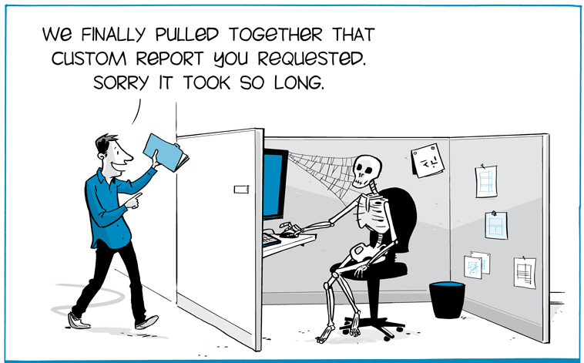

The Beginning
Notes:
Chris
We’re right there with you. We feel the pain too.
We all started somewhere that looked like this.
As we’ve moved through our analytics journey we’ve identified seven distinct stages that we believe face most institutions. We’ve developed a decision support maturity model that can help others develop strategies for embedding information into the fabric of decision-making.
Next up: Decision Support Maturity Model

Slide 4



Decision-Support Maturity Model
Governance/Org Structure
How do we scale and sustain?
Activation
How do I use data to drive action?
Literacy
What can I do? What meaning can I make?
Confidence/Trust
How do I know the information is correct?
Motivation
Why should I change?
Access
Where is the information?
Engagement/Alignment
What do decision-makers need?
Notes:
Chris
Our model is composed of seven levels of hierarchy and maturity, but the levels are not boundaries, but rather highly interactive and iterative interactions with and among campus stakeholders.
Recognizing and attending to each level will move the institution in the direction of decision-support sustainability.
We propose approaching the model as a loose hierarchy that can assist in navigating a path towards decision-support maturity, yet we also encourage adapting the model to the institution’s culture
Next Up: Poll #2 Which stage describes your organization’s current maturity level?

Slide 5

Stage 1: Executive Engagement/Alignment
What do decision-makers need?
“No one comes to President’s Council without data anymore…”
Drake President Earl Martin
Notes:
Chris
Why do we start with executive engagement and alignment?
It’s the most important foundation for success
With it, organizations can mature quickly
Success always comes back to this
It IS possible to engage with executives, and early in your process.
The keys
Look for allies/partners
Find something that key influencers need
Demonstrate value
Start with institutional strategy (the “real” priorities)
Lead from the middle
Next up: Preparing for Executive Engagement

Slide 6
Preparing for Executive Engagement
Strategic Priority | What Does this Mean | What Will Be Different
Data is embedded in the fabric of decision-making | Focus on what matters, align with priorities, improve the process | Design analytics that will be embedded in business practices Implement prioritization process
Decision support rests on strong (shared, holistic) foundation | Garbage in – garbage out, trust the data, aligning responsibility and authority | Ensure data governance Address foundational data issues
Effective decision support requires structured systems with dedicated capacity | Designing capacity, eliminating silos, developing analytics | Design decision support system Develop "federation" model for data needs Develop analysts
Notes here about formation, purpose, outcomes
Notes:
Chris
This slide is about “why”
Don’t go to your executives without preparation.
Answer this question first: Why are we spending so much of our time and attention on analytics?
Solve a problem
Prepare for the future
Improve performance/outcomes
Position for success
Don’t wait for someone else to identify the problems – walk in the shoes of your executives
Then, envision how better information can help them make more effective decisions
Help them see how analytics can help them. Show them how the outcomes will be different and valuable for them
We spent time getting above reports.
What are the big goals we want to set for our analytics future; how do we want to govern and manage business intelligence; where should we be focusing resources?
We learned that we can’t ask those questions without context – we need to make it real for our executives.
Listen and be prepared to interpret and apply what they say
Next up: Guiding Coalition – IR Strategy Group

Slide 7
Guiding Coalition – IR Strategy Group
Institutional Research Strategy Group
President
Provost
Deputy Provost, Admissions
CITO
Dir. IR and Assessment
Chief of Staff
CFO
Purpose is relationship, ongoing dialogue, and strategic alignment
Notes:
Chris
This slide is about “how” to align with executives
What matters:
Relationship
Structure
Engagement
Mindset – see the challenges facing participants and work to resolve them
Goodwill
Where does goodwill come from?
IR and IT can’t work in a vacuum. We can create reports forever
Responsibilities:
Advise development of an integrated Business Intelligence vision/plan
Consult to leverage business intelligence with the university’s goals
Advise on change management strategies
Identify systems opportunities for enhanced efficiency and effectiveness
Provide guidance concerning promising practices to enhance success
Recommend methods for improved transparency and communication (e.g., results to the broader community)
Next up: Stage 1 Taking Action

Slide 8
Stage 1: Taking Action
Prepare for Executive Engagement
Align Goals with Institutional Strategy
Build Relationships
Listen for Insights
Form a Guiding Coalition
Walk in Their Shoes
Notes:
Chris
Prepare for Executive Engagement: Don’t reach out to executives without preparing. Make sure you have a vision for where you want to be. Why are you doing this?
Align Goals with Institutional Strategy: Link everything you do to what your institution is trying to accomplish
Build Relationships: Don’t wait for executives to come to you, go to them. Show them you understand their issues and can help them
Listen for Insights: Don’t expect executives to provide clear direction and focus. Listen for insight and interpret to develop solutions.
Form a Guiding Coalition: Create both formal and informal advisory structures. Don’t try to do it alone
Walk in Their Shoes: ALWAYS put yourself in the shoes of your executives. See the issues from their perspectives so you can help address them
Next up: Stage 2 Access

Slide 9

Stage 2: Access
Where is the information?
Notes:
Chris
Providing access isn’t a field of dreams moment; it just opens the door to all of the maturity levels that follow.
In many ways, this is the easiest stage to achieve, and where many of us spend our time and often start
We acknowledge that we anticipated simply providing access would result in decision-support maturity
We started here, but it didn’t have the result we anticipated
Next Up: Self-Service Portal

Slide 10
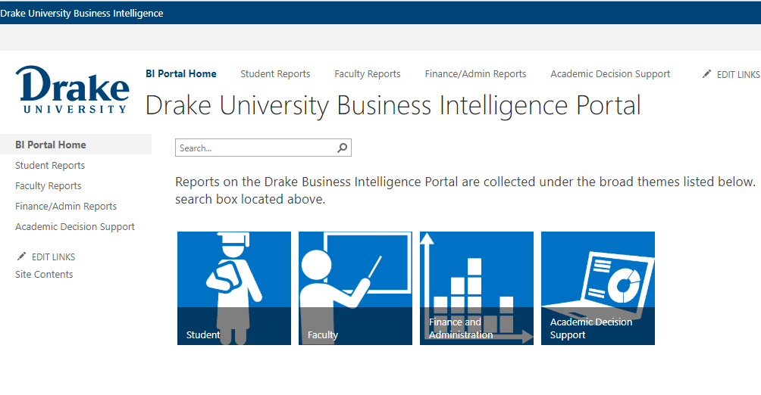
Self-Service Portal
Notes:
Chris
Self-service was essential
Our goal was to create a single stop for access to any type of institutional report. SharePoint was an ideal candidate for this portal because almost any type of content can be presented through the system and we had granular control over report security access privileges.
We then went beyond providing access to providing information…
Next up: The Basics Academic Decision Support v.1

Slide 11
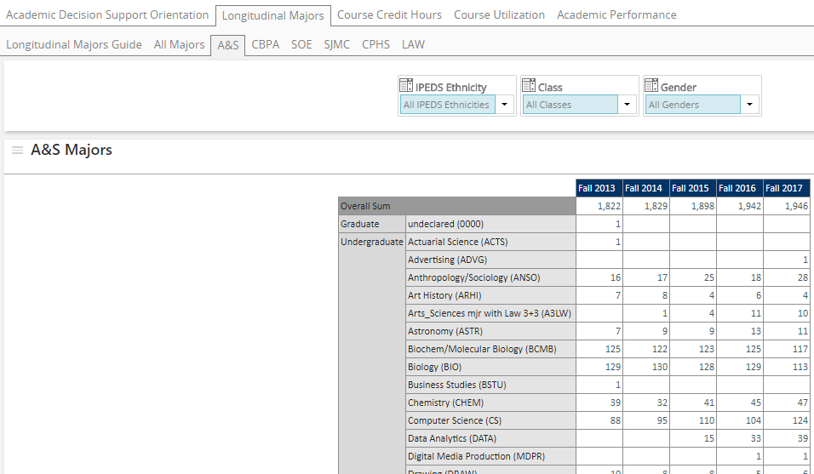
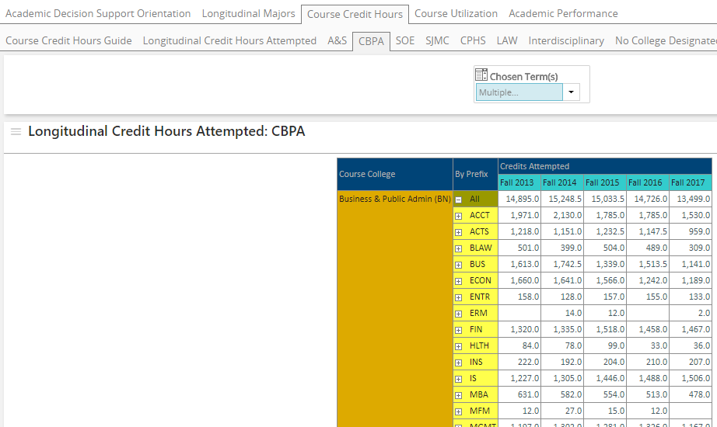


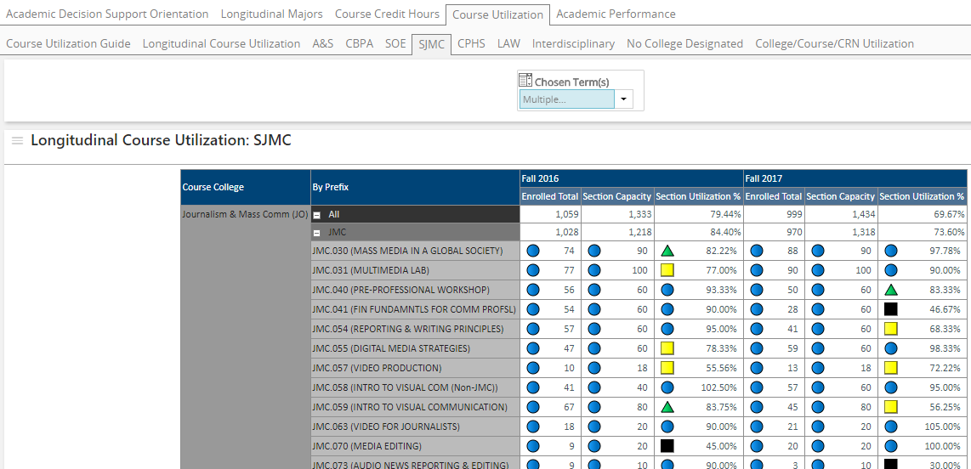
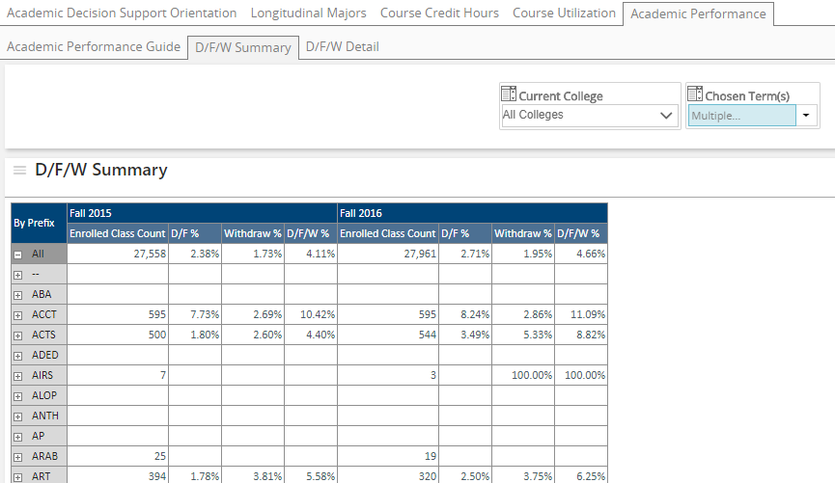
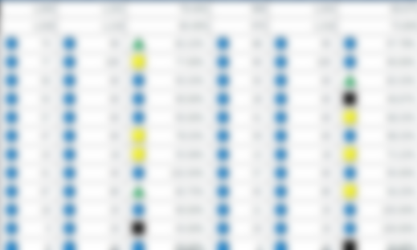
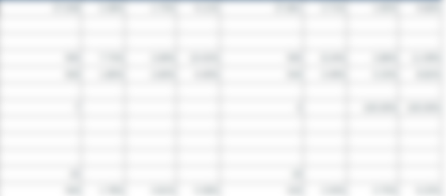
The Basics: Academic Decision Support v.1
Majors
5 Yr. Trend
Credit Hours Attempted
5 Yr. Trend
Course Utilization
5 Yr. Trend
D/F/W Rates
5 Yr. Trend
Notes:
Chris
Academic Decision Support marked the first major new capability delivered from the warehouse.
The concept was simple – the basic information that the Provost and Deans would use to assess academic trends from four critical perspectives
Animated slide showing the four components of ADS version 1. Quickly review the components to describe first attempt.
Our first attempt assumed that our primary audience was the Provost and academic Deans.
Over time, we learned that these audiences weren’t using it. It wasn’t in their day-to-day routine and they didn’t have a reason to access and use it
But, by this time, we were meeting with the Provost to better understand her big challenges and how we might help by developing analytics to help resolve them
Next up: Stage 2 Taking Action

Slide 12
Stage 2: Taking Action
Don’t Expect a Field of Dreams
Focus on Immediate and Accessible
Integrate Security/Authorization
Expand Relationships
  (Department Chairs, etc.)
Manage Expectations-Data as a Shared Asset
  (Data governance begins here)
Notes:
Chris
Don’t Expect a Field of Dreams: Providing access isn’t a field of dreams moment; it just opens the door to all of the maturity levels that follow
Focus on Immediate and Accessible: Continuous Improvement requires starting where you are and continuously iterating to make improvements. Focus first on real, basic, solvable problems to demonstrate capability and value. Then make the information easy to access and use
Integrate Security/Authorization: Security can’t be an afterthought, but must be integral to every solution and system. We can no longer afford to be lax about security of our valuable information
Expand Relationships (Department Chairs, etc.): Access improvements will open up new opportunities to build relationships. Be prepared to engage with every new stakeholder group
Manage Expectations-Data as a Shared Asset
Data governance begins with access and builds through every over stage of the model
Next Up: Stage 3 Motivation

Slide 13

Stage 3:
Motivation
Why should
I change?
Notes:
Kevin
To illustrate the intersection among the layers of the maturity model, Stage 3 “Motivation” is connected to the previous stages.
The initial mindset for ADS was to advance key metrics from our basic foundation and to deliver information to Academic Deans. Over time, we recognized that the Deans did not use the data regularly (or at all).
With the Provost, decided to design and publish information to Department Chairs. Provost recognized that previous case statement processes relied on subjective metrics and ad hoc narratives. Prior to ADS, there was no standard format and no evidence-based approach to allocating resources. Provost said she needed not only consistency, but also a methodology
Next up:
Provost puts ADS to work: Faculty Case Statements

Slide 14
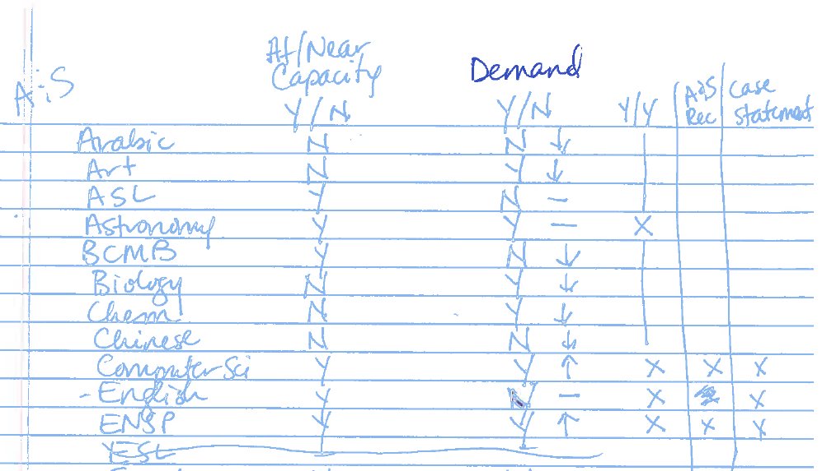
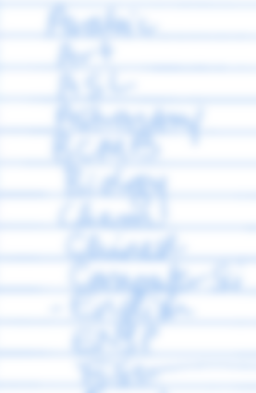
Faculty Case Statements:
Allocating Scarce Resources
Notes:
Kevin
Some changes start with a sketch on a piece of paper…The Provost decided to use ADS during her review of faculty case statements used to justify new and replacement position requests. She made a list of departments and the relevant data points to determine which case statements were justified and support by the data.
Dramatic changes ensued:
ADS suddenly became very important to Deans and Department Chairs
Established an expectation that ADS data would be used to evaluate case statements
Opened our eyes to the ways that the Provost wanted to use data strategically and her approach to data-informed decision making
Department Chairs began questioning the validity of the data in ADS
ADS enabled the Provost to act on her desire to make decisions based on evidence rather than judgment or persuasive capability. But her approach forced us to iterate and adapt quickly. It also earned us basic trust in our ability to deliver value.
Key concepts –
Engage leadership around how they use data
Closely connect data to decision making processes (How to reformulate the faculty case statement process)
Clearly communicate how data contributes to decisions
Lesson - Provost noted that data was still produced in variable ways (inconsistent case statements) and that additional clarity was needed to explain rationale/process; Research Strategy Group affirmed the embedded use of data in a structured process as a lever for institutional change
Next up: Department Chairs Dashboard

Slide 15
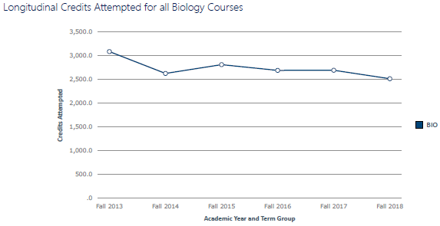
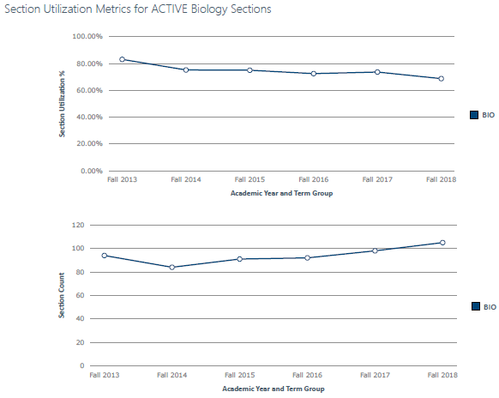
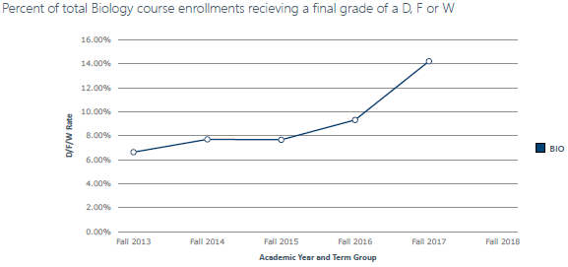
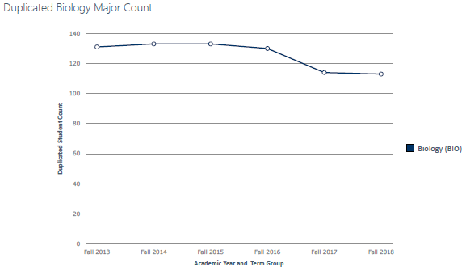
Academic Decision Support:
Department Chairs Dashboard
Notes:
Kevin
Academic Decision Support has changed the way that departments request new and replacement faculty lines.
Provost now reviews this data for all faculty line requests and uses the information to make decisions based on trusted data
1) Although we designed the BI portal to provide self-service access to data, we recognized multiple barriers including a) ease of access (navigation), b) difficulty of filtering (general design for masses), and lack of visualization (ease of use)
2) Designed dashboard with regular publication (automated) to provide information via email.
3) Anecdote regarding department chair... "Where Do I Start?" - Importance of developing analytics support (example: DFW analysis, example: alignment of enrollment trends and section capacity)
Institutional Research has now created a dashboard report for Department Chairs that gives the ADS data for their department. Uses the Pyramid Publication feature to send contextually relevant data to each department chair via email.
Next up: Stage 3 Taking Action

Slide 16
Stage 3: Taking Action
Directly Connect Data to Decisions
Engage with Leadership About Utility
Identify Levers and Focal Points
Pay Attention to Change Management
Notes:
Kevin
Reiterate points made regarding lessons learned in Faculty Case Statements
Notice the misalignment with initial roll-out to Deans (good things happen with data, trickle down theory, connection to daily decisions)
Importance of communication and transparency
Preparation for resistance to change (and impact on motivation)
Next Up:
Stage 4: Confidence/Trust

Slide 17

Stage 4: Confidence/Trust
How do I know the information is correct?
Notes:
Kevin
Next up:

Slide 18
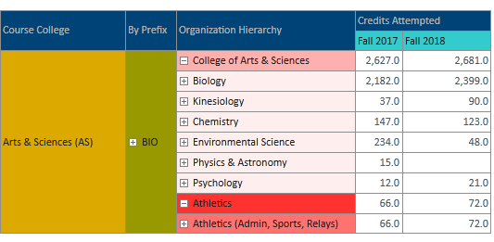
Understanding Ourselves
Notes:
Kevin
What happens when (not if) there is a data discrepancy?
Let me offer some context:
Data silos
No single source of truth
Advancing concepts before shared understanding
Case in point:
Credit Hours Taught by Faculty within a Department
Why is this different from the total credit hours taken by students with a specific subject code?
Your data…is wrong.
Key point:
Black box of data output
Interfered with ability of department chairs to engage around planning for the future
Remember context of faculty case statement (risk)
Next up:
New Department Chair Training

Slide 19
New Department Chair Training Fall 2019
Methodology
  When are you counting majors?
  Define "attempted" credit hours
  What about cross-listed courses?
The "Good Stuff"
  What factors shape the # of sections that we offer?
  Is academic performance related to a decline in majors, the number of sections, or changes in the course?
  How could this information help with course planning?
Notes:
Kevin
What is the cost in lower confidence/trust
Merry-go-round of methodology
Don’t get to the good stuff
Stall out within the maturity model (note that the same issue exists with continuing chairs who have seen the data in use for 2+ years)
Next up:
Stage 4: Taking Action

Slide 20
Stage 4: Taking Action
Communication, communication, communication
  Data dictionary
  Importance of dialogue
Transparency regarding how data is used
  Acknowledge/recognize fear
Attention to change management
Notes:
Kevin
Need clarity around terminology, methodology,
Need clarity around purpose and use of data
Need to open up dialogue around quality of data
Feedback loop
Attention and Response is critical (cross-listed courses)
Do not ignore institutional context (old baggage, current issues)
Breaking down silos of data
Reframing the conversation – cannot cut to greatness
Next Up:
Stage 5: Literacy

Slide 21

Stage 5: Literacy
What can I do? What meaning can I make?
Notes:
Kevin
Next up:

Slide 22
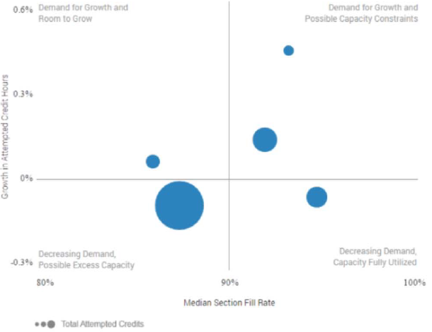
Connecting the Dots
Filters:
College/School: <Filter>
College/School
Growth Potential
Program | Disc. Margin % | Disc. Margin $
Scatterplot – All degree programs in college
X Axis – Disc. Margin %
Y Axis – Growth in Attempted Credit Hours
Size – Distinct Students in Program or Total Attempted Credits
Decreasing Potential
Program | Disc. Margin % | Disc. Margin $
Scatterplot – All degree programs in college
X Axis – Avg./Median Section Fill Rate
Y Axis – Growth in Attempted Credit Hours
Size – Distinct Students in Program or Total Attempted Credits
Notes:
Kevin
Another Field of Dreams moment: Study of Culture and Society – What do I do with this information?
Need to find ways of making the information actionable (benchmarking, visualizations, indicators, conditional logic, changes over time) to drive focus around essential findings
Thinking about information in new ways (intersections, distinct populations)
But it doesn’t end there…preview for next stage
Next up:
Stage 5: Taking Action

Slide 23
Stage 5: Taking Action
Develop Capacity
Avoid Data Paralysis
Structures for Using Data in Decisions
Notes:
Kevin
Error of our ways – building ATMs inside bank doors
Access to data does not equal literacy
Access to data is not the largest part of the equation (for driving outcomes)
Data Paralysis – what is essential, KPIs, CIP planning
Structures for using data
President – Unless we directly couple decisions to data, will not see organizational change
Value of ADS beyond faculty case statements
Next Up:
- Stage 6: Activation

Slide 24

Stage 6: Activation
How do I use data to drive action?
Notes:
Kevin
Next up:

Slide 25
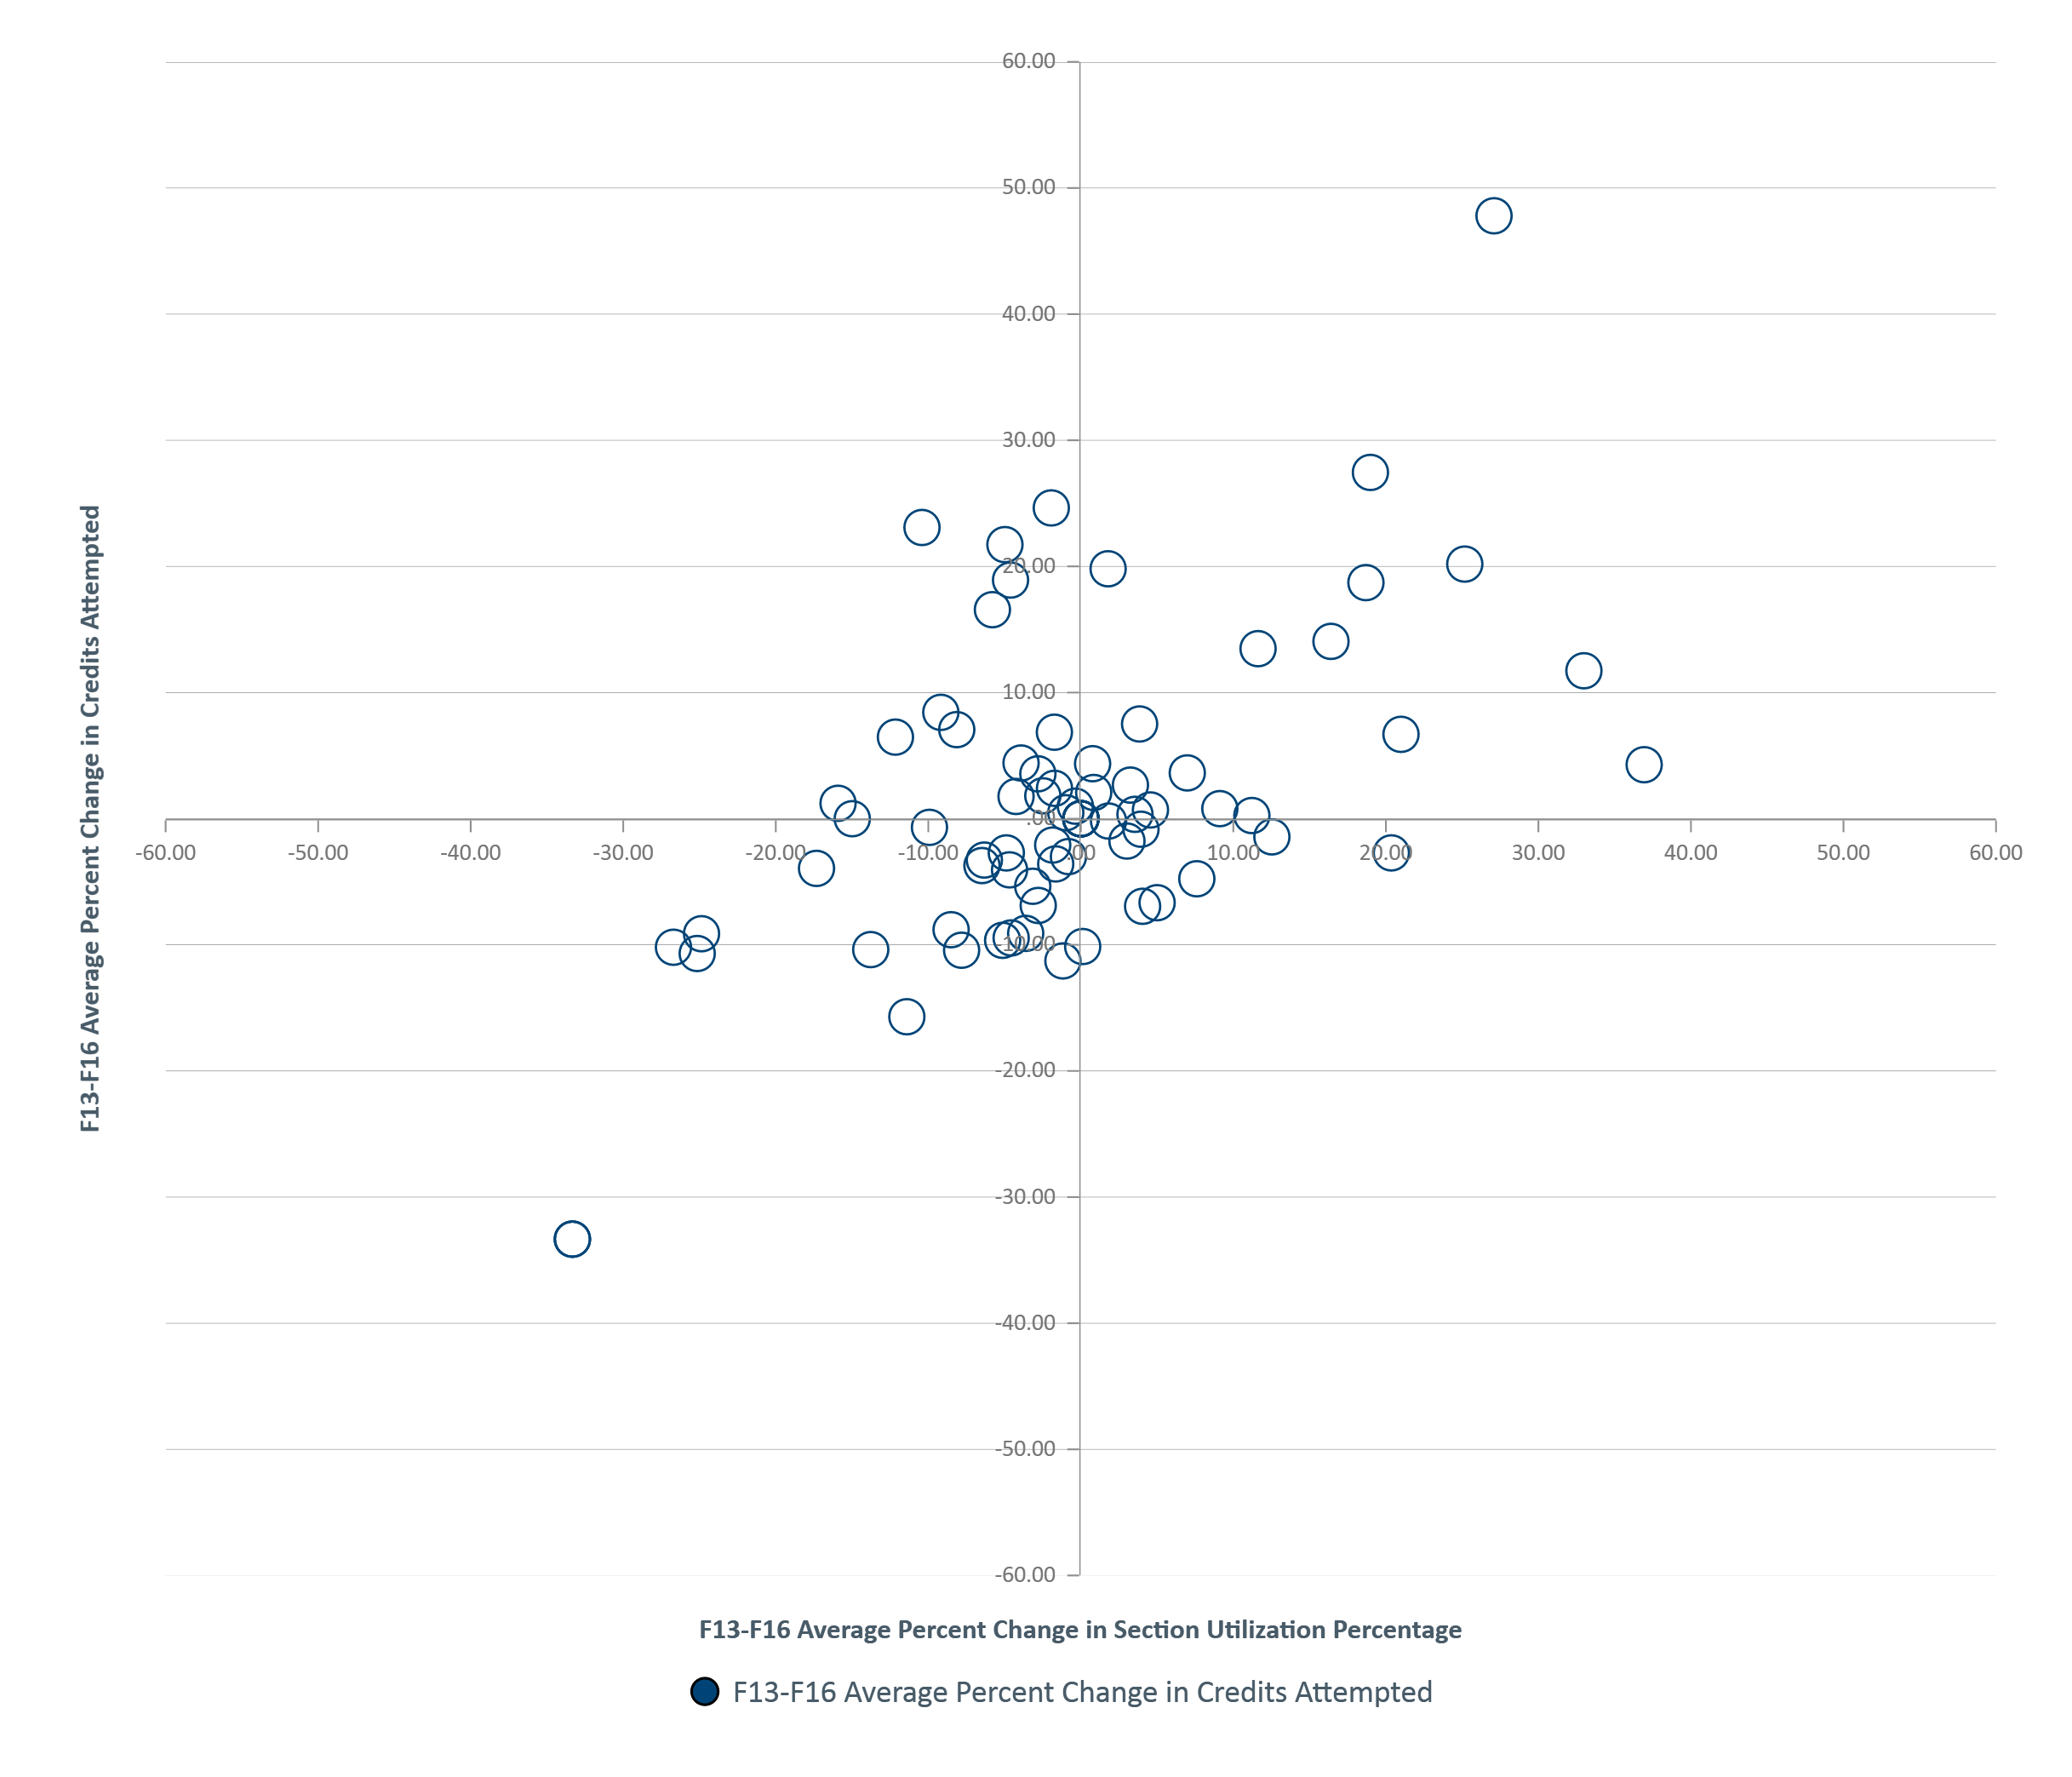

Constructing Insights
Notes:
Kevin
Next Up: Diagnostics With Pathway Resources

Slide 26
Diagnostics with Pathway Resources
How To: Manage # of Sections
How To: Increase Capacity
How To: Reallocate Faculty
How To: Manage Decline
Notes:
Kevin
Recall data journey
Mostly, some indicators
Visual dashboard with historical for single unit
Moving to “connecting the dots” – quadrant analysis
Imagine a quadrant matrix (vertical section capacity, horizontal number of SCH)
Switch - Motivate the elephant
Could we provide Action Pathway Resources
Next up:
Stage 6: Taking Action

Slide 27
Stage 6: Taking Action
Pay Attention to Where Change Can Happen
Design Tools to Empower Action
Embed in Culture: Continuous Improvement Mindset
Notes:
Kevin
Why working with department chairs? What do you do when asked if we can train administrative assistants?
Constant evolution of reporting to empower action and increased attention to the embedded structures/systems where data is used
Cannot ignore foundation (Stage 1 and the Continuous Improvement Plan)
How we do planning
Focus on metrics to understand progress
You don’t fatten the hog by weighing it
Next up:
Chris – Stage 7: Governance/Org

Slide 28

Stage 7: Governance/Org Structure
How do we scale and sustain?
Notes:
Chris
Why is governance last and highest on our model’s hierarchy?
Hardest to establish effective data governance
Value and effort is hardest to establish
Requires cross-institutional collaboration
Will mature alongside the rest of the model
We’re new but here’s how we’re taking action
Governance can begin alongside other levels, although generally informally
Next up: Data Governance Model

Slide 29
Data Governance Model
Access to Data
Quality & Consistency
Expectations & Accountability
Security & Privacy
Compliance
Retention & Archiving
Resources & Expertise
Enterprise Information Systems/Technology
Notes:
Chris
We’ve developed a framework, a guiding reference document that can educate our data governance council, assist in prioritization, align responsibility and accountability, and serve as an ongoing reference/guide.
Based on a model from University of Notre Dame
Also want to thank Mark Roman from Simon Fraser University, who willingly shared their data governance framework
The goal of data governance is to ensure appropriate and secure access to the right information at the right time (Access is at the top)
Technology forms the foundation and supports six different competencies that must be addressed to ensure effective governance
Barriers to decision-support maturity are often related to governance
Next up: Roles and Responsibilities

Slide 30
Roles and Responsibilities
Responsibility | President’s Council | Data Governance Council | Chief Data Steward | Data Stewards | Data Custodians | Data Users
Overall authority for institutional data and usage | A | S | R | S | S | S
Optimize data and Data Domains for institutional benefit and use | A | S | R | C | C | I
Develop and ensure review and approval of data governance policies | A | R | S | C | C | I
Ensure oversight, appropriate use, and protection of university data | A | R | S | S | S | S
Ensure data is appropriately classified and retained or disposed of as appropriate | A | C | C | R | S | I
Implement and ensure compliance with university policies approved by the President | A | R | S | S | S | S
Designate Data Stewards and members of the Data Governance Council | A/R | C | C | I
Resolve issues and conflicts related to institutional data | A | C | R | C | I | I
Notes:
Chris
As part of data governance, we’ve formalized a role/responsibility matrix and identified accountable, responsible, support, consulted, and informed roles, which have been approved by President and Provost.
Next Up: Roles and Responsibilities 2

Slide 31
Roles and Responsibilities
Responsibility | President’s Council | Data Governance Council | Chief Data Steward | Data Stewards | Data Custodians | Data Users
Overall authority for institutional data and usage | A | S | R | S | S | S
Optimize data and Data Domains for institutional benefit and use | A | S | R | C | C | I
Develop and ensure review and approval of data governance policies | A | R | S | C | C | I
Ensure oversight, appropriate use, and protection of university data | A | R | S | S | S | S
Ensure data is appropriately classified and retained or disposed of as appropriate | A | C | C | R | S | I
Implement and ensure compliance with university policies approved by the President | A | R | S | S | S | S
Designate Data Stewards and members of the Data Governance Council | A/R | C | C | I
Resolve issues and conflicts related to institutional data | A | C | R | C | I | I
Notes:
Chris
Walk through RASCI
Next Up: Roles and Responsibilities 3

Slide 32
Roles and Responsibilities
Responsibility | President’s Council | Data Governance Council | Chief Data Steward | Data Stewards | Data Custodians | Data Users
Overall authority for institutional data and usage | A | S | R | S | S | S
Optimize data and Data Domains for institutional benefit and use | A | S | R | C | C | I
Develop and ensure review and approval of data governance policies | A | R | S | C | C | I
Ensure oversight, appropriate use, and protection of university data | A | R | S | S | S | S
Ensure data is appropriately classified and retained or disposed of as appropriate | A | C | C | R | S | I
Implement and ensure compliance with university policies approved by the President | A | R | S | S | S | S
Designate Data Stewards and members of the Data Governance Council | A/R | C | C | I
Resolve issues and conflicts related to institutional data | A | C | R | C | I | I
Notes:
Chris
Note responsibility of the Data Governance Council
Next Up: Stage 7 Taking Action

Slide 33
Stage 7: Taking Action
Know your organizational culture
Make the business case
RASCI
Ensure authority of structure (Executive approval)
Use “just enough” governance
Notes:
Chris
Know your organizational culture: Know where you’re going and work with your culture to get there rather than against it
Make the business case: Be able to explain WHY you need governance
RASCI: Formalize roles and responsibilities
Ensure authority of structure (Executive approval): Make sure executives are prepared to back change
Use “just enough” governance: Formalize and structure only as much as you NEED to in order to achieve your governance goals
Next up: Poll #3 Which stage is the most challenging for your organization?

Slide 34
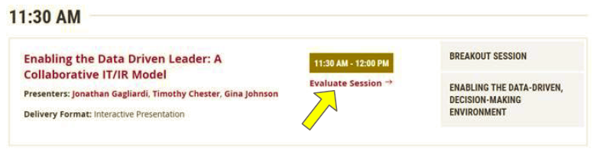
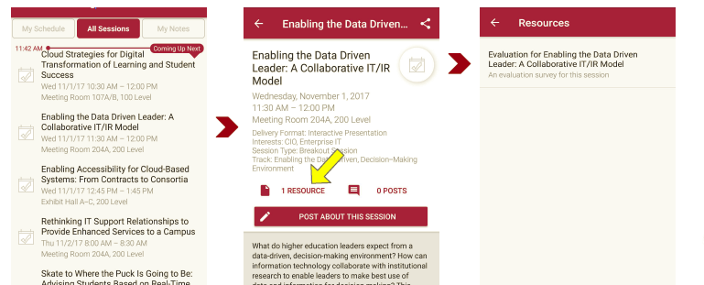
Session Evaluations
There are two ways to access the session and presenter evaluations:
1
2
In the online agenda, click on the “Evaluate Session” link
From the mobile app, click on the session you want from the schedule > then scroll down or click on the associated resources > and the evaluation will pop up in the list
Notes:
Chris
Next up:

Slide 35

Contact Information
Kevin Saunders – Director Institutional Research and Assessment
kevin.saunders@drake.edu
Chris Gill – Chief Information Technology Officer
chris.gill@drake.edu
Notes:
Chris
End of Presentation

