Slide 1
Leveraging Data-Driven Decision Making to Drive Student Success, Retention, and Accessibility Initiatives
Eric Kunnen (Grand Valley State University) John Scott (Blackboard Inc.) Virginia Lacefield (University of Kentucky) Brian Bourgon (College of Southern Nevada)

Slide 2
Objectives & Agenda
Objectives
Gain insight from an unprecedented data set around content accessibility and UDL in the LMS.
Learn strategies in using data integration to support student success and retention initiatives.
Discover ways to use student data not just for institutional reporting or service improvement, but to benefit individual students and increase campus collaboration.
Agenda
Introductions
Presentations
Discussion and Q&A

Slide 3
gvsu.edu/elearn | @gvsuelearn
A Data-Informed Approach to Inclusive Learning: Scaling Accessibility
Eric Kunnen | @ekunnen Associate Director of eLearning and Emerging Technologies
John Scott | @johnscottworks
Product Manager, Blackboard Inc.
Sherry Barricklow eLearning and Instructional Technology Specialist
Hunter Bridwell Digital Media Developer

Slide 4
Supporting UDL through BIG Data and Small Data
Grand Valley State University - eLearning and Emerging Technologies gvsu.edu/elearn | @gvsuelearn
Scaling Accessibility
Learner Preference through Multiple Modes of Representation
Addressing Content Accessibility Issues at Scale in the LMS
Catalyzing a Culture Shift at the Course Level
Data-informed Professional Development

Slide 5
Supporting Diverse Learner Needs and Abilities through Proactive Inclusion
Grand Valley State University - eLearning and Emerging Technologies gvsu.edu/elearn | @gvsuelearn

Slide 6
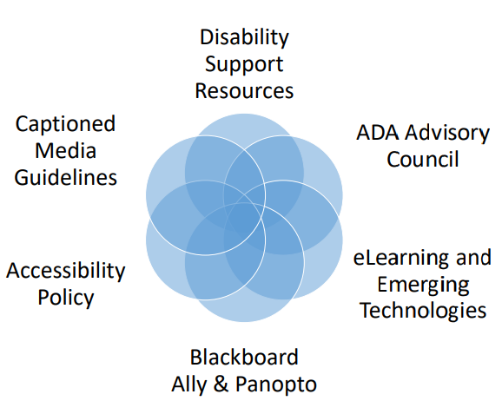
GVSU: Accessibility Context
Grand Valley State University - eLearning and Emerging Technologies gvsu.edu/elearn | @gvsuelearn
Policies & Guidelines
All systems and policies ensure inclusiveness and accessibility. (Compliance & Commitment)
Vision, Values, Strategic Plan
“GVSU demonstrates its commitment to providing an inclusive learning environment where all students can explore new directions, find their niches, and develop skills for life and productive careers.”
“GVSU values all identities, perspectives, and backgrounds and is dedicated to incorporating multiple voices and experiences into every aspect of its operations …removing the barriers to full participation and providing a safe, inclusive, vibrant community for all.”
Culture
Awareness, Capacity, Insight, Education

Slide 7
Machine Learning Algorithms to Scale Learner Preference
Grand Valley State University - eLearning and Emerging Technologies gvsu.edu/elearn | @gvsuelearn
650M+
Files Analyzed by Bb Ally
Worldwide

Slide 8
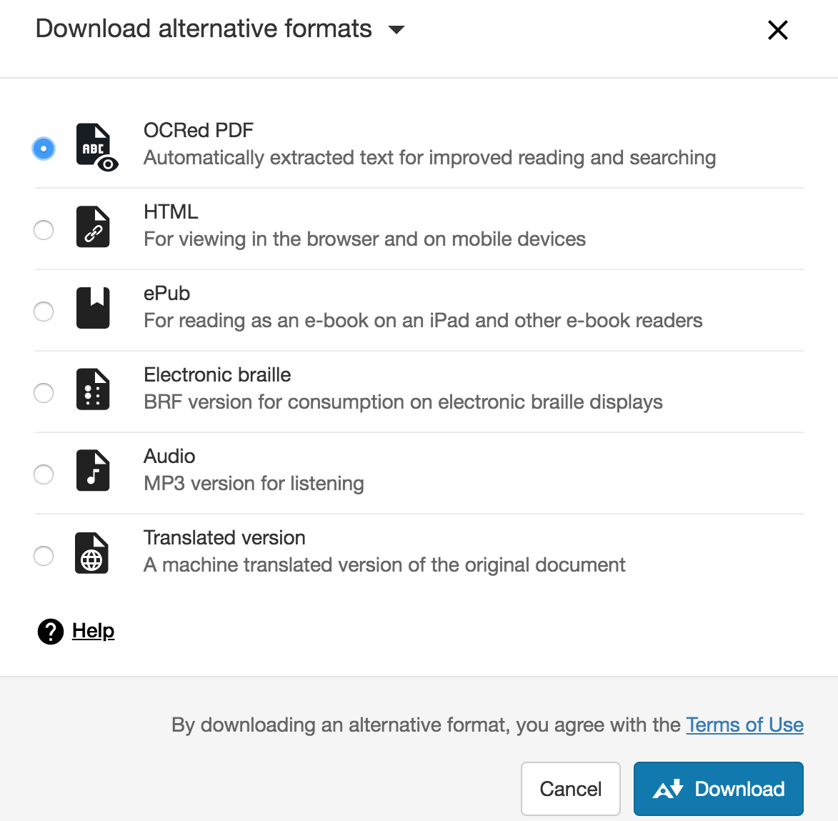
“Alternative Formats” On-demand
Grand Valley State University - eLearning and Emerging Technologies gvsu.edu/elearn | @gvsuelearn

Slide 9
Impact of “Alternative Formats” in North America Last 12 Months
Grand Valley State University - eLearning and Emerging Technologies gvsu.edu/elearn | @gvsuelearn
Format | Total Downloads
Tagged PDF | 1,592,783
HTML | 1,000,372
OCRed PDF | 116,412
ePub | 102,277
Audio MP3 | 76,316
Electronic Braille | 21,362
Machine Translated | 5,239*
2.9M+
Alternative Format Downloads

Slide 10
GVSU: Impact of “Alternative Formats” in last 12 Months
Grand Valley State University - eLearning and Emerging Technologies gvsu.edu/elearn | @gvsuelearn
24K+
Alternative Format Downloads
Format | Total Downloads
Tagged PDF | 16,017
HTML | 6,387
OCRed PDF | 1,036
ePub | 523
Audio MP3 | 316
Electronic Braille | 59
Over 4,000 Courses

Slide 11
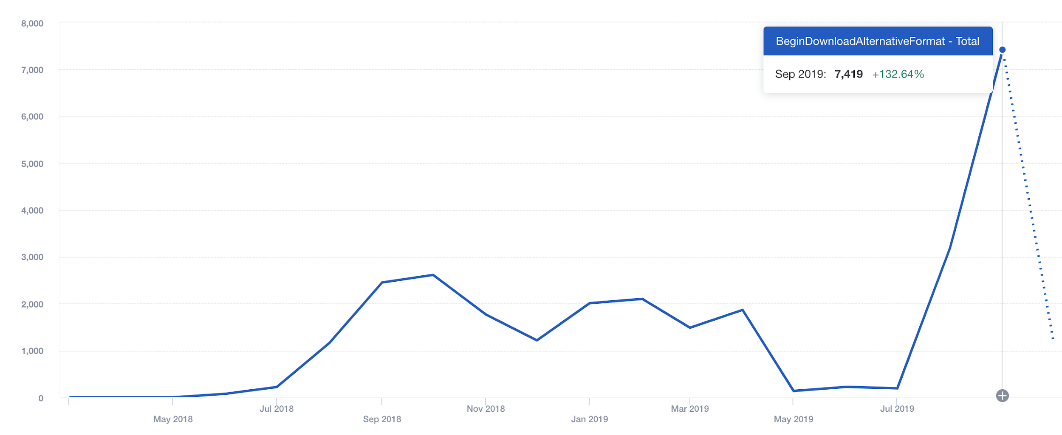
GVSU: Alternative Format Downloads over Time
Grand Valley State University - eLearning and Emerging Technologies gvsu.edu/elearn | @gvsuelearn

Slide 12
Digital Content in the LMS is FULL of Accessibility Barriers
Term | Issue Type | % of Files with Issue
Bb Ally Study 700K Courses 21M Content | Scanned PDFs | 12% (5%-7%)
 | Untagged PDFs | 45%
 | Docs Missing Headings | 47% (20-25%)
 | Images Missing Description | 78% (90%)
 | Docs with Contrast Issues | 35%

Slide 13
GVSU: Content Breakdown by Semester
Term | File Type | Total
Fall 18 4,031 Courses 238,514 Content | PDFs | 63,078 (26%)
 | Presentations | 24,027 (10%)
 | Docs | 47,607 (20%)
 | Images | 420,075 (8%)
 | HTML Items | 49,306 (21%)
Term | File Type | Total
Winter 19 3,583 Courses 230,978 Content | PDFs | 60,147 (26%)
 | Presentations | 22,384 (9%)
 | Docs | 45,982 (20%)
 | Images | 23,962 (10%)
 | HTML Items | 45,926 (20%)
Term | File Type | Total
Fall 19 3,649 Courses 193,051 Content | PDFs | 49,473 (26%)
 | Presentations | 17,805 (9%)
 | Docs | 37,646 (20%)
 | Images | 15,655 (8%)
 | HTML Items | 44,041 (23%)

Slide 14
GVSU: Accessibility over Time
Issue | Term | % of PDFs Total Issues
Scanned PDFs | F18 | 15,153 (11%)
 | W19 | 13,636 (11%)
 | F19 | 11,569 (11%)
Issue | Term | % of PDFs Total Issues
Untagged PDFs | F18 | 29,796 (47%)
 | W19 | 29,067 (48%)
 | F19 | 23,333 (47%)
Issue | Term | % of Docs Total Issues
Docs Missing Headings | F18 | 41,702 (31%)
 | W19 | 40,631 (32%)
 | F19 | 30,316 (29%)

Slide 15
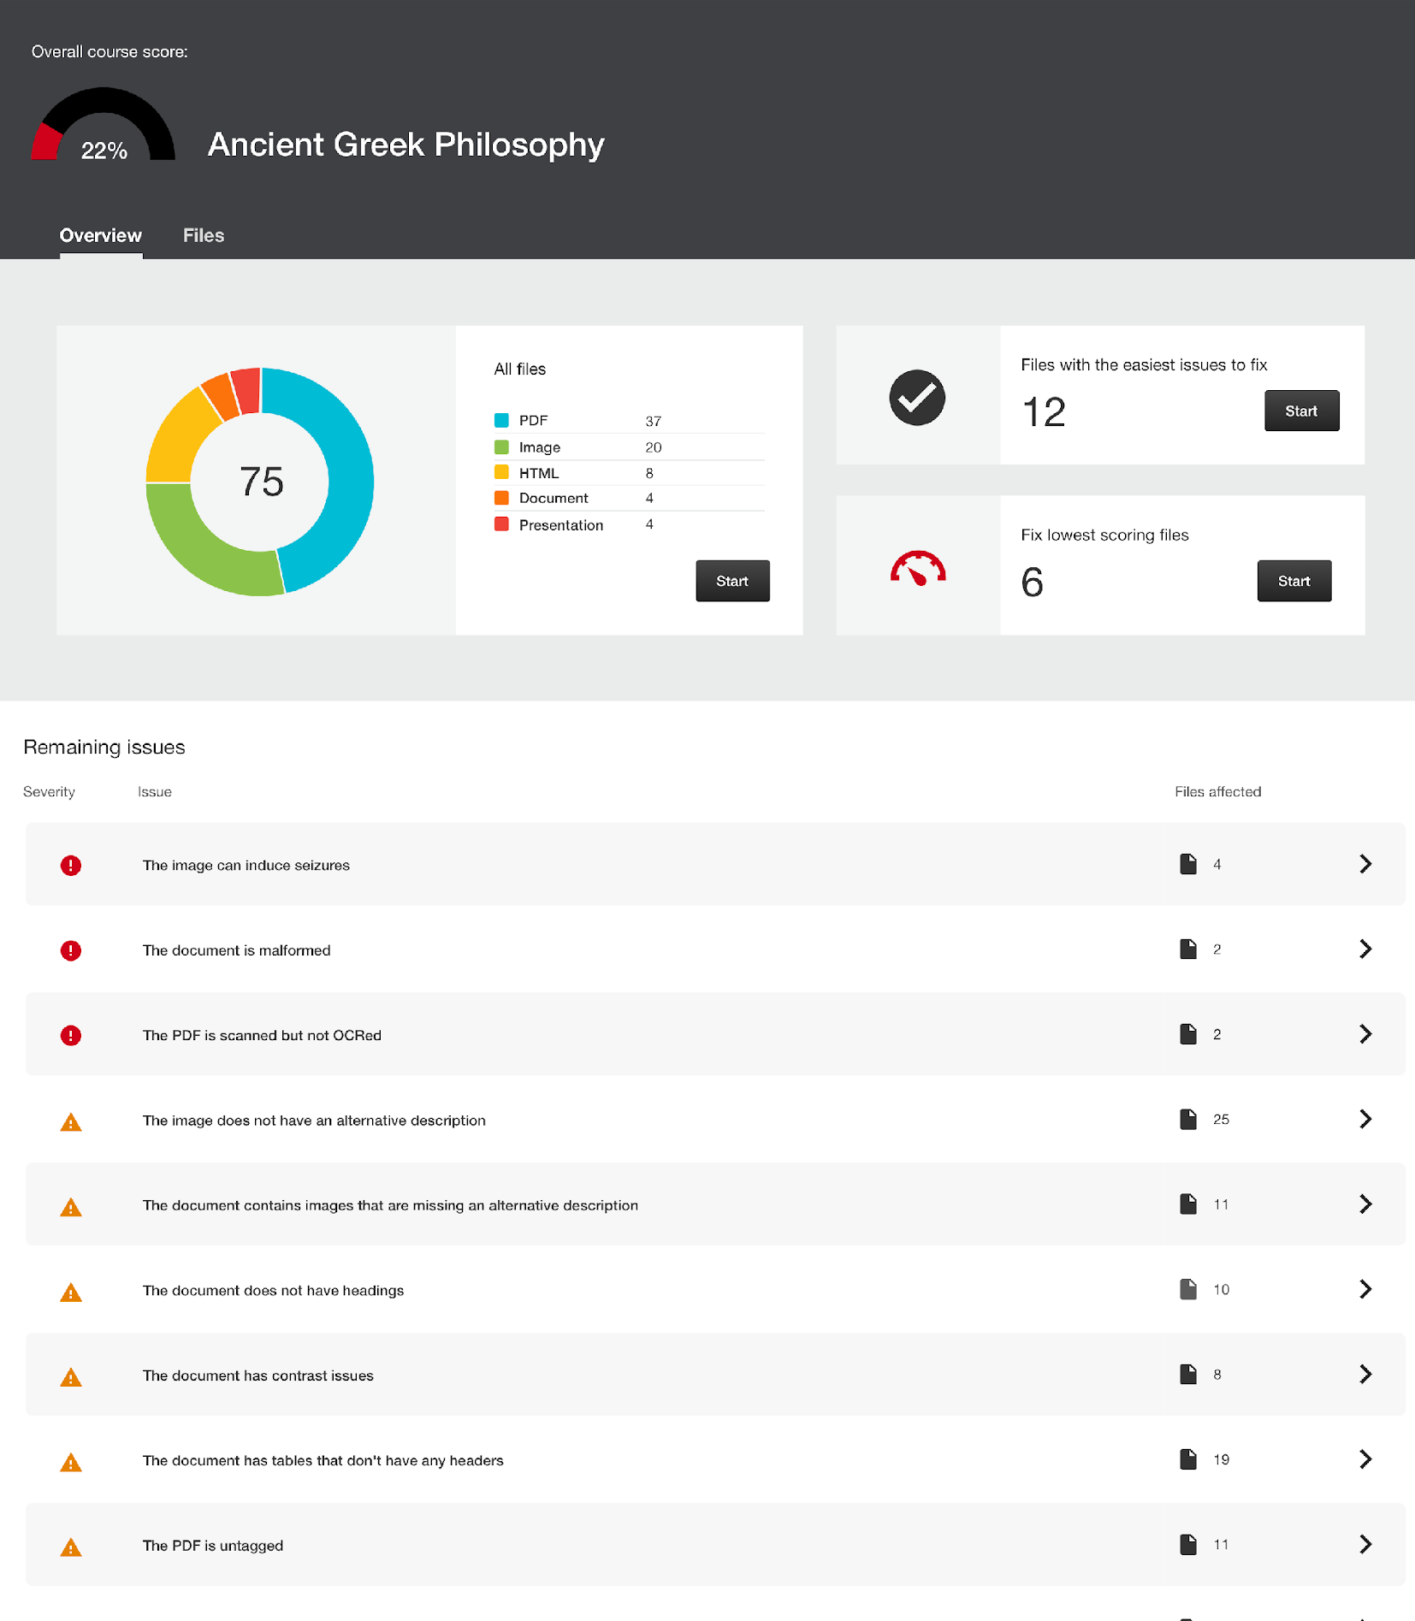
Course Accessibility Report:
For Instructors to Strategize and Prioritize
Grand Valley State University - eLearning and Emerging Technologies gvsu.edu/elearn | @gvsuelearn
Overall Score & Content Breakdown
Prioritize by:
Ease / Impact
Issue Severity
File Score

Slide 16
Files Fixed through Instructor Feedback in North America last 12 Months
39.5%
Click to Fix
431K+
Files Altered
83%
Improved Score

Slide 17
Types of Files Fixed in North America over 12 Months
Grand Valley State University - eLearning and Emerging Technologies gvsu.edu/elearn | @gvsuelearn
File Type | Total Fixes | Success Rate
Images | 247,397 | 88%
PDFs | 87,533 | 79%
Presentations | 27,951 | 81%
Docs | 61,877 | 74%

Slide 18
GVSU: Files Fixed Through Instructor Feedback since 8/1/18
Grand Valley State University - eLearning and Emerging Technologies gvsu.edu/elearn | @gvsuelearn
18.6%
Click to Fix
945
Files Altered in
305 courses
75%
Improved Score

Slide 19
GVSU: Using Data to Inform Strategy...
Grand Valley State University - eLearning and Emerging Technologies gvsu.edu/elearn | @gvsuelearn
Messaging Strategy: Reaching out to Faculty / Targeted Tips
Demonstrating Progress and Challenges to Academic Leadership
Gamifying and Engaging Culture - “Fix your Content” Contest

Slide 20
Student Success Through Data Integration and Targeted Student Outreach
Brian Bourgon
Director, Enterprise Applications
College of Southern Nevada

Slide 21
Nevada Promise Scholarship
CHALLENGES
SOLUTIONS
Centralized Application
Shared Instance of the SIS
Self-Reported Data
Duplicates, falsely reported data keys, segmented data
Diverse Reporting Needs
Institutional Leadership, NSHE BoR, NV Legislature
Institution Wide Collaboration
Data Warehousing
Mass Communication
Centralized Data Interface
Back End Data Protection
Trust
•

Slide 22
Nevada Promise Scholarship
POSITIVE RESULTS
Year Over Year Improvement
811 completers to 1120
16% increase when accounting for application pool size
Legislation Changes Based on Reapplication Data
Fewer Service Hours Required
SAP and Attempted Credits

Slide 23
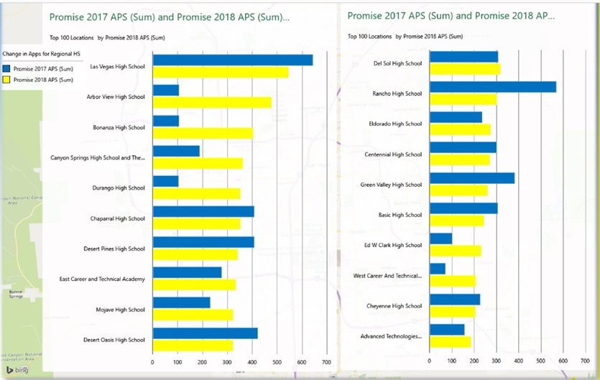
Nevada Promise Scholarship

Slide 24
Summer Bridge Program
CHALLENGES
SOLUTIONS
Identifying Targeted Audience
Short Turnaround Time
Multiple Iterations to Maximize Use of Funding
Cross-System Data Collection
Utilizing Existing Data Integrations
Collaborative Institutional Knowledge

Slide 25
Summer Bridge Program
POSITIVE RESULTS
College Credit Earned
192 New Students with College Level English Credit
Math Confidence and Remediation
Improved Placement Scores
Student Readiness
Student Connections
Institutional Familiarity
Leadership Training

Slide 26
NVP and Summer Bridge Program
ADDITIONAL TAKEAWAYS
Iterative Development
Flexible Schema
Keep the Raw Data
Audit Collaboratively
Record Anecdotal Data

Slide 27
First-Year Surveys as Drivers of
Early Interventions with At-Risk Students
Virginia Lacefield | @shanodine
Enterprise Architect / Data Acrobat
Institutional Research and Advanced Analytics

Slide 28
A Brief History of the First-Year Student Questionnaire
Descriptive Survey
Predictive Survey
Interactive Survey Questionnaire

Slide 29
Descriptive -> Predictive
Goal: Enhance existing predictive models of retention and academic performance
Tested a variety of psychosocial / behavioral scales
Motivation, Learning Strategies, Goal Setting, Grit, Academic and College Life Self-Efficacy, etc.
Initial efforts failed; factors did not add to predictive value of existing objective data
Test scores, HS GPA, Unmet $ need, First Generation

Slide 30
Success at last!
Useful variables found, 13-14% improvement in objective predictive model
–Belonging – Engagement
–Personal crisis – Academic capital
–Financial concerns – Academic support
–Peer comparison

Slide 31
Now that we can predict,
can we intervene in a timely way?
What do we need to make this happen?

Slide 32
Requirements for Timely Intervention
Actionable information
High response rate (≥90%)
Campus partnerships
Well-structured data
Automated data flow

Slide 33
Survey vs Questionnaire
Survey
Designed to collect information from large groups of people
Purpose is aggregate reporting
Can be anonymous
Can use a population sample
Voluntary participation
Low response rates may be acceptable
No personal benefit to respondent
Questionnaire
Designed to collect information from large groups of people
Purpose is individual intervention
Must be identifiable
Must invite entire population
Required for intervention action
Need high response rates (≥90%.)
Direct personal benefit to respondent, based on their needs

Slide 34
Primary Campus Partners
Institutional Research
Information Technology Services
Student and Academic Life
Campus Housing / Residence Life
Community of Concern / Basic Needs Office
...and many other student services offices

Slide 35
Data Sharing
Need to roll-up data into usable chunks for partners
Used response pattern mapping to create flags (pending action) and triggers (immediate action)
Self-reported areas of concern
Response patterns indicating risk
Shared data with partners using Qualtrics data connectors, API, email triggers

Slide 36
Student Interventions
~6000 responses, 56% have at least 1 flag, 31% have 2 or more, 1% have 7 or more (out of 10)
Combine FYSQ flags with info from other sources and triage
Reduces duplication of effort
Coordinates efforts so most critical concerns can be addressed first and/or holistically
Interventions can be low-, mid-, or high-touch depending on student need and institutional resources

Slide 37
THANK YOU - Q&A, DISCUSSION
Leveraging Data-Driven Decision Making to Drive Student Success, Retention, and Accessibility Initiatives
Eric Kunnen (Grand Valley State University) John Scott (Blackboard Inc.) Virginia Lacefield (University of Kentucky) Brian Bourgon (College of Southern Nevada)

Slide 38
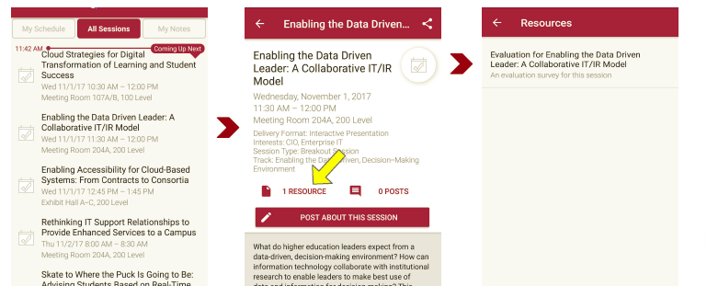
Session Evaluations There are two ways to access the session and presenter evaluations:
1
2
In the online agenda, click on the “Evaluate Session” link
From the mobile app, click on the session you want from the schedule > then scroll down or click on the associated resources > and the evaluation will pop up in the list

