Slide 1
Achieving the Promise of Learning Analytics:
Where We Are, Where We’re Going

Slide 2
IMS and the Integrated Analytics Ecoystem
Cary Brown, IMS Director of Higher Education Programs

Slide 3
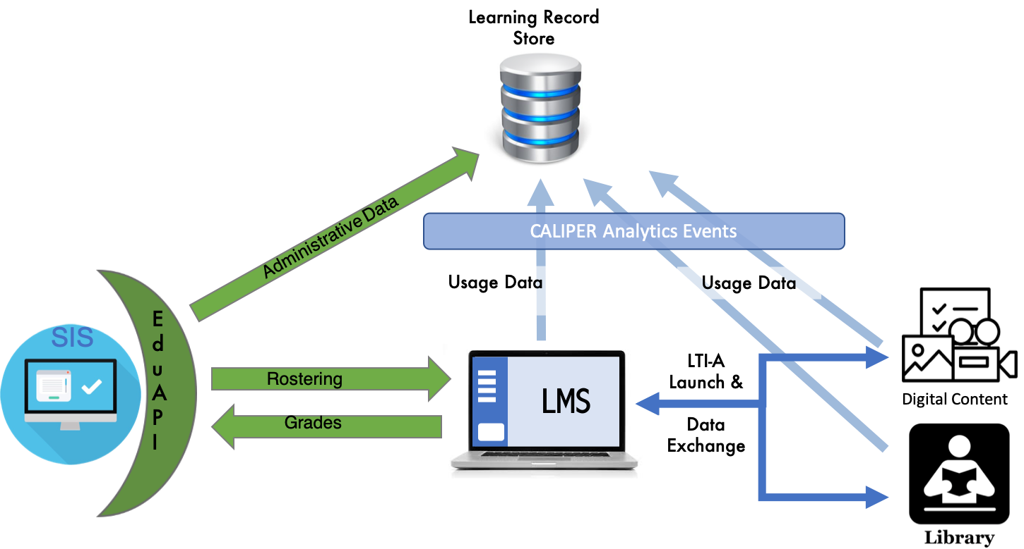
IMS and the
Analytics Ecosystem

Slide 4
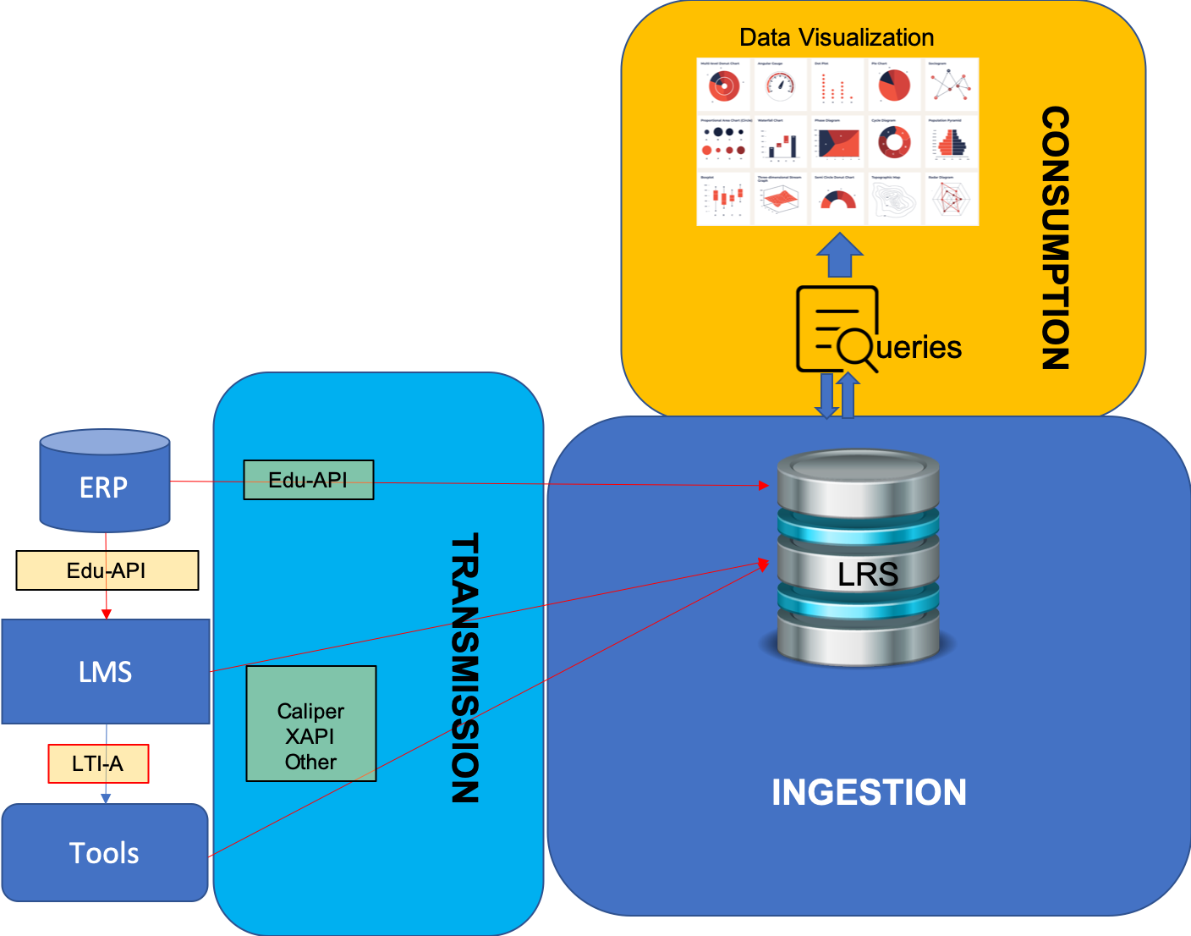
Integrated Analytics

Slide 5
Integrated Analytics Vision/Goals
Explore a common methodology and structure for the ingestion of learning data for the purposes of learning analytics
Either standards based, or shareable code libraries, etc.
Needs to support all relevant analytics streams (Caliper, xAPI, unstructured data, etc.)
Support scalable infrastructures
Explore delivery of a reference implementation including shareable artifacts (data model, queries, views)
Definition of a unified/common data model (cf. Unizin Data Platform, CEDS, etc.)
Articulate the value of learning analytics beyond IT/IR to staff/faculty & students

Slide 6
IMS and the Integrated Analytics Ecoystem
Jeff Rubenstein, VP Product Strategy
Kaltura, Inc.

Slide 7
Learning Analytics – The Vision
(yes, there are details to work out…)
Students
Full view of activities, comparison in aggregate to peer groups, self-reflection and better study choices
Improved personalization of learning
Instructors / Counselors / etc
360-degree view of student activity
Content improvement
Intervention and support
Program and graduation counseling
Administrators
Reducing attrition
Improved resourcing of teaching + learning content and technologies; accreditation
Improving overall student experience
Researchers
Large-scale effectiveness studies on content, program, practices, technologies

Slide 8
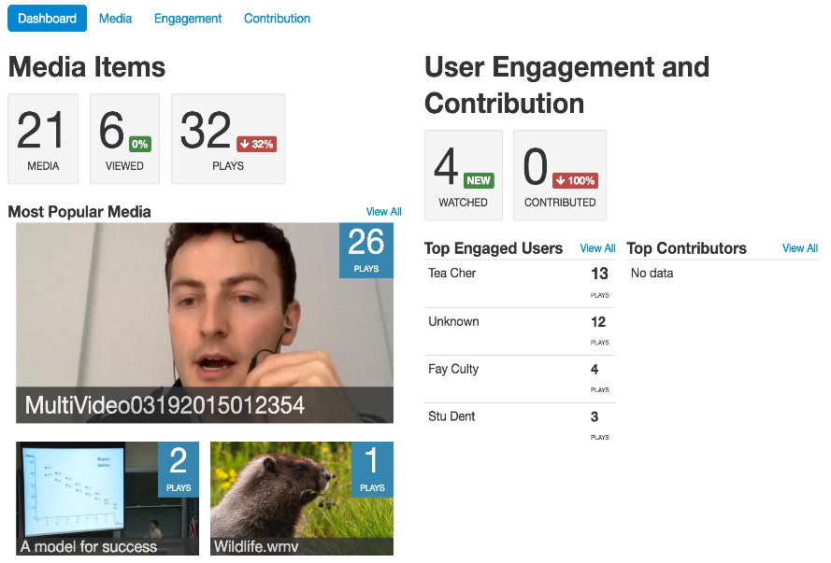
Learning Analytics
The (biggest?) challenge
TOOL 2
TOOL 1
TOOL 3
LMS
SIS

Slide 9
Learning Analytics
The (biggest?) challenge
All your data
are belong
to me!
TOOL 2
TOOL 1
TOOL 3
LRS
LMS
SIS

Slide 10
IMS and IMS Caliper
Who is IMS Global?
A consortium of EdTech providers, publishers and schools
Create, promulgate and certify against open standards: LTI Advantage, Caliper, OneRoster, etc.
https://www.imsglobal.org/lti-advantage-faq
What is IMS Caliper?
Open Standard for learner activity data telemetry
Enables In a standard extensible format with some semantic richness To permit, among other things:
learner + teacher visualization of learner data (360’ view)
Retention and intervention activities
Student success + guidance
Large scale effectiveness studies

Slide 11
IMS Caliper
Basic Format of Caliper:
ACTOR – ACTION - OBJECT
e.g.
Jeff (uniqueid) - Played - Video (uniqeid)

Slide 12
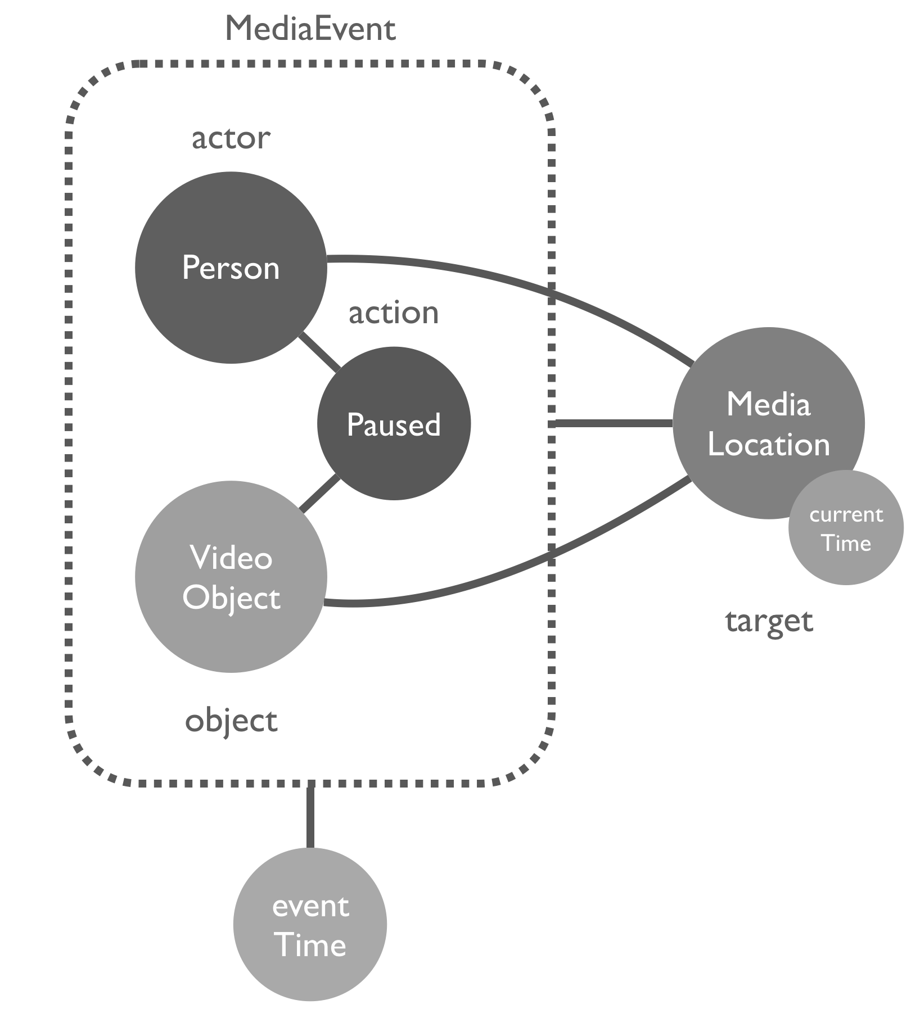
Kaltura and IMS Caliper
Currently emitting on the Media Metric Profile
In the future: Assessment Profile
Started, Paused, Resumed, Restarted, Ended,
ForwardedTo, JumpedTo,
ChangedResolution, ChangedSize, ChangedSpeed, ChangedVolume,
EnabledClosedCaptioning, DisabledClosedCaptioning,
EnteredFullScreen, ExitedFullScreen,
Muted, Unmuted,
OpenedPopout, ClosedPopout

Slide 13
The Unified Data Platform and the Un-Dashboard
John Johnston, IT Program Manager for Learning Analytics & Data Services
University of Michigan
Notes:
So you heard from Carol how IMS standards are enabling this vision of a cohesive learning analytics echo system, and you heard from Jeff how he as a educational tool provider, he recognizes the value of empowering his customers and users by emitting tool data using the Caliper standard, now my job is to demonstrate how we leveraged their significant efforts in a real-life implementation.
So up to now, this presentation has been fairly technical, so I want to see if we can ground this in your own experience. I want you to think back when you were a student. If you had access to the data Carol and Jeff just described, what questions would you ask regarding your performance, what should be working on, or even about what your peers are doing? Feel those neurocognitive juices flowing. Flex those reflective reasoning muscles.

Slide 14
What Interesting Questions Can We Ask of the Data?
How am I performing in relationship to my peers?
What is the most popular content in my course?
What content did I miss?
What are the high performers doing?
Which assignments have the greatest impact?
What should I be working on now?
How can I best budget my study time?
Notes:
Imagine as a student you had access to this rich pot of data Carol and Jeff just talked about; what questions would you want to ask to help inform how you might improve your performance and get the most out of the content?
A desire to answer these types of questions led to my institution’s involvement in Unizin. Unizin is a consortium made up of over a dozen large research universities and systems in an effort to align resources towards orchestrating a shared ecosystem of digital learning services. One of these services is the Unizin Data Platform.

Slide 15
UDP System Design
SIS
Context data
Advisors
Batch ingress
Ingestion
database
Complete
learner
record
Context
store
LMS
Researchers
Event ingress
Event
store
T&L
tools
Developers
Behavioral data
Collect
Unify
Connect
‹#›
Notes:
I’m not going to talk about this design diagram in detail. It’s really just there to impress you that there are complex things going on in the background. I’m happy to geek out with you after the session and talk about data workflows, ETL, and BigQuery, but for right now we’re going to focus on these ideas of Collect, Unify, and Connect.

Slide 16
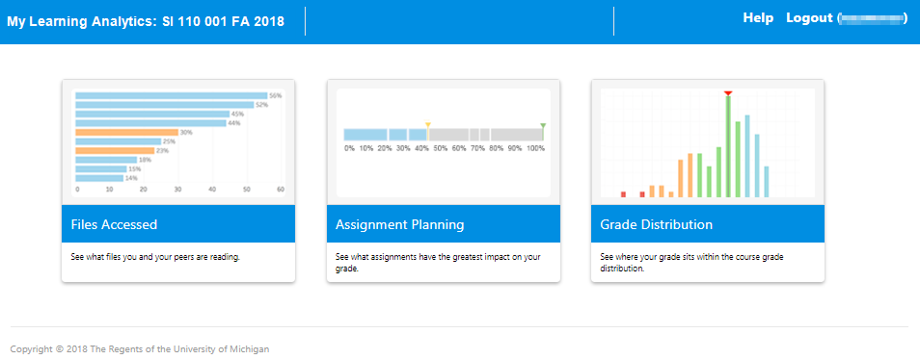
My Learning Analytics
The Un-Dashboard

Slide 17
On the Files page

Slide 18
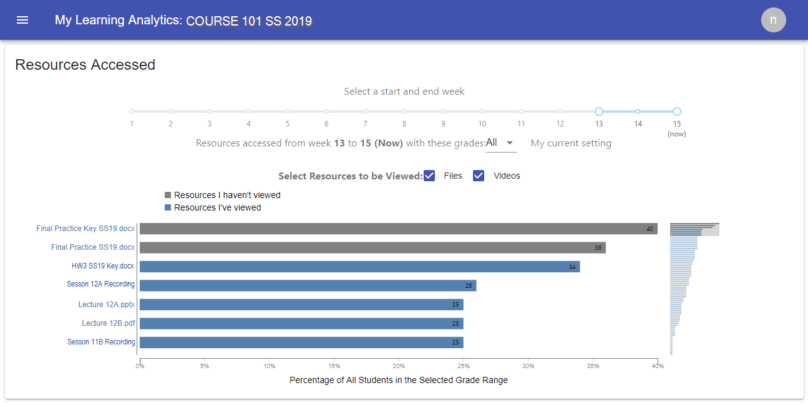
Files Accessed
You have viewed this file 3 times, last on 05/01/2019 @ 2:10pm
Files in blue I have viewed

Slide 19
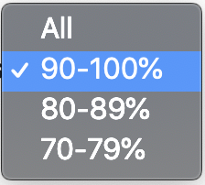
Files Accessed
Sort views by student performance

Slide 20
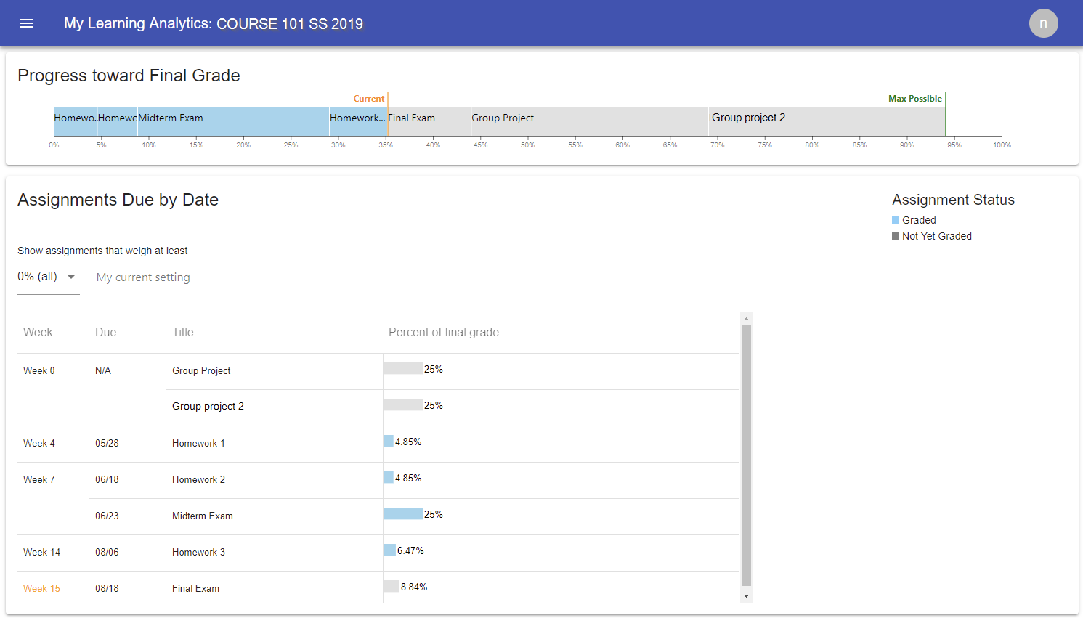
Assignment Planning
Graded activities are blue
Ungraded activities are gray

Slide 21
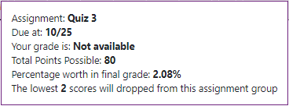
Assignment Planning
Mouse over activity to see details

Slide 22
Assignment Planning
Weekly Learning Activities

Slide 23
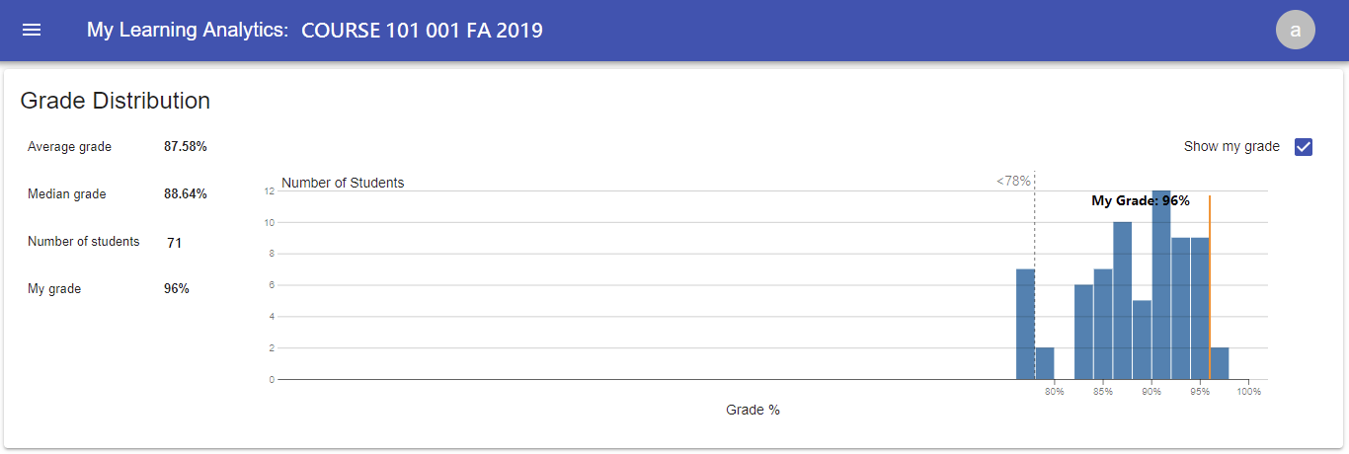
Grade Distribution

Slide 24
So What Did Students Think About MyLA?
88% of students agreed it changed the way they plan their course activity
86% agreed it changed their sense of control over their course performance
70% agreed it changed how much time and effort they put into the course
75% agreed it changed their confidence that they understand the course material
84% agreed it improved their performance in the course
Haynes, Karabenick, Teasley. My Learning Analytics Post Survey Fall 2018 (n=178)

Slide 26
Questions?

Slide 27
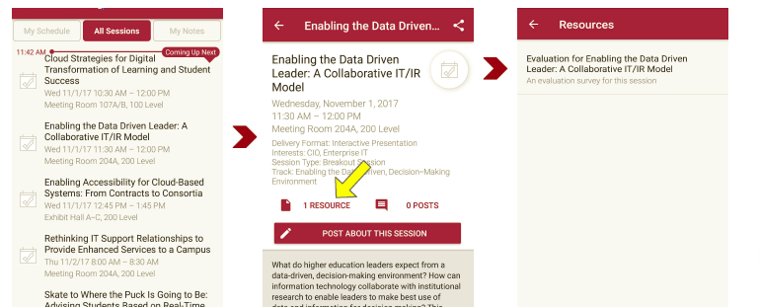
Session Evaluations There are two ways to access the session and presenter evaluations:
1
2
In the online agenda, click on the “Evaluate Session” link
From the mobile app, click on the session you want from the schedule > then scroll down or click on the associated resources > and the evaluation will pop up in the list

