Slide 1
Shared Cloud Security Assessments Working Group Update 2019
Notes:
Nick

Slide 2
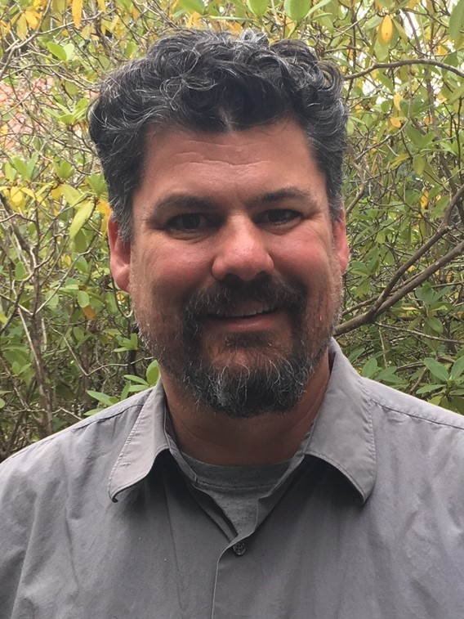
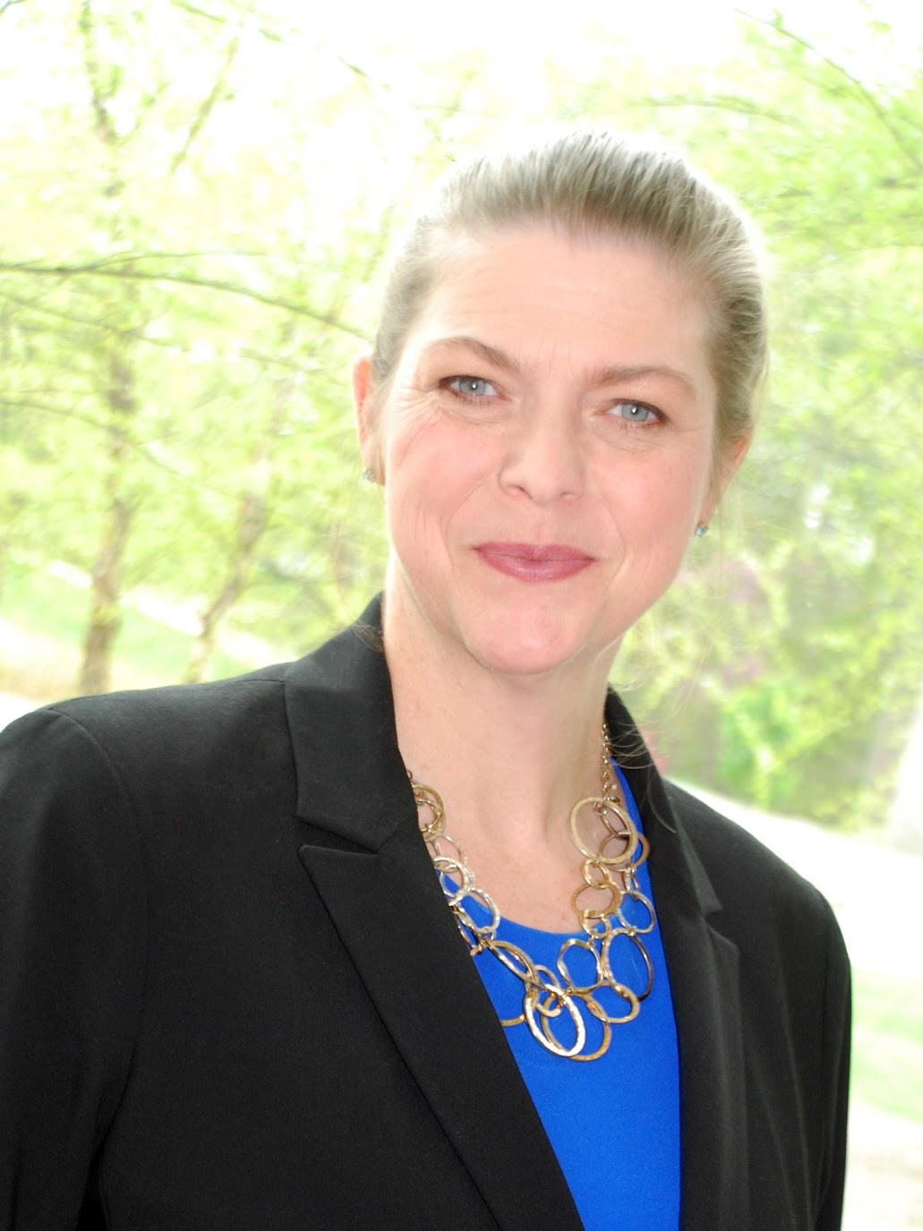
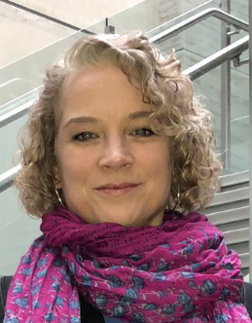
Presenters
Josh Callahan
Information Security Officer and CTO
Humboldt State University
Susan Coleman
Peer Assessment Program Mgr./Lead Security Analyst
REN-ISAC
Charlie Escue, CISSP
Extended Information Security Manager
Indiana University
Daphne Ireland
Senior Security Analyst
Princeton University
Nick Lewis
Program Manager
Internet2
Notes:
Nick

Slide 3
Agenda
HECVAT Update
Phase 4
Cloud Broker Index
Subgroups
Case Study: Princeton University
HECVAT Assessment – Automation & Demonstration
Questions & Discussion
Notes:
Nick
HECVAT UPDATE 10 Minutes
Princeton 15 MIN
Demo 10
Questions 10

Slide 4
HECVAT Update
Notes:
Nick

Slide 5
HECVAT Background
History
Unique Collaboration
Ongoing Project
Notes:
Nick

Slide 6
HECVAT Core Team
Jon Allen, Baylor University
Josh Callahan, Humboldt State University
Charles Escue, Indiana University
Staff Liaisons from EDUCAUSE, Internet2, and REN-ISAC
Valerie Vogel, Brian Kelly, Nick Lewis, Susan Coleman
Notes:
Nick

Slide 7
Phase 4 Volunteers – Many Thanks!
Jon Allen, Baylor University (working group chair)
Matthew Buss, Internet2
Josh Callahan, Humboldt State University
Andrea Childress, University of Nebraska
Tom Coffy, University of Tennessee
Susan Cullen, CSU Office of the Chancellor
Michael Cyr, University of Maine System
Debra Dandridge, Texas A&M University
Niranjan Davray, Colgate University
Charles Escue, Indiana University
Carl Flynn, Baylor University
Ruth Ginzberg, University of Wisconsin System
Sean Hagan, Yavapai College
Daphne Ireland, Princeton
Amy Kobezak, Virginia Tech
Sue McGlashan, University of Toronto
Hector Molina, East Carolina University
Mark Nichols, Virginia Tech
Laura Raderman, Carnegie Mellon University
Kyle Shachmut, Harvard University
Bob Smith, Longwood University
Kyle Smith, Georgia Tech
Christian Vinten-Johansen, Penn State University
Valerie Vogel and Brian Kelly, EDUCAUSE
Nick Lewis, Internet2
Susan Coleman, REN-ISAC
Notes:
Nick

Slide 8
Campuses Using the HECVAT
American University | Drexel University | Morgan State University | University of Delaware
Appalachian State University | Duquesne University | Northern Arizona University | University of Denver
Art Institute of Chicago | East Carolina University | Oakland University | University of Idaho
Bates College | Ferris State University | Ohio Northern University | University of Maine System
Baylor University | Foothill-De Anza Community College District | Oregon State University | University of Maryland Baltimore
Berry College | Franklin & Marshall College | Pace University | University of Massachusetts Amherst
Boston College | Georgia Institute of Technology | Pepperdine University | University of Oregon
Bowling Green State University | Hillsborough Community College | Princeton University | University of Portland
Brown University | Indiana University | Radford University | University of Rhode Island
California Baptist University | Indiana Wesleyan University | Rice University | University of Richmond
California State University, all Campuses and System | Institute for Advanced Study | Rutgers University | University of Tennessee, Knoxville
Carnegie Mellon University | John Carroll University | Sam Houston State University | University of Texas at Austin
Carthage College | Kent State University | Southern Alberta Institute of Technology | Virginia Tech
Champlain College | LeTourneau University | Springfield College | West Texas A&M University
Clarkson University | Linfield College | Stony Brook University | West Virginia University
Columbus State Community College | Longwood University | Suffolk County Community College | Western Carolina University
Cornell University | Madison College | Susquehanna University | Western Michigan University
Davidson College | Marylhurst University | Texas State University | William & Mary
Denison University | Miami University | Troy University | Williams College
DeSales University | Montclair State University | Truman State University | Yavapai College
Drake University | Montgomery College | University of California, Davis
Notes:
Nick

Slide 9
Phase 4 Deliverables
On-Prem version of HECVAT!
Triage tool inclusion with HECVAT!
Other updates to the questionnaires
Notes:
Nick

Slide 10
Updates in the last year
Engagement to Service Providers
HECVAT for GCP, LastPass, and others
Engagement with 3rd party risk service providers
Marketing and communications
IT Accessibility
Contracts
Naming! Still HECVAT.
Notes:
Nick

Slide 11
HECVAT & the CBI
CBI = Cloud Broker Index
HECVAT Phase 2
Convenience
Single source
Balance accessibility with privacy
Notes:
Susan

Slide 12
The Cloud Broker Index (CBI)
Public: Hosted and linked on REN-ISAC web site
Vendor sends completed assessment to HECVAT@REN-ISAC.net
Public2: Vendor hosts, REN-ISAC links
Vendor sends the link to completed questionnaire
Semi-public: Vendor hosts, REN-ISAC links
Vendor hosts behind paywall, sends the link and information
Private: Vendor controls, REN-ISAC links
Vendor keep private, send instructions on how people can request
Notes:
Susan

Slide 13
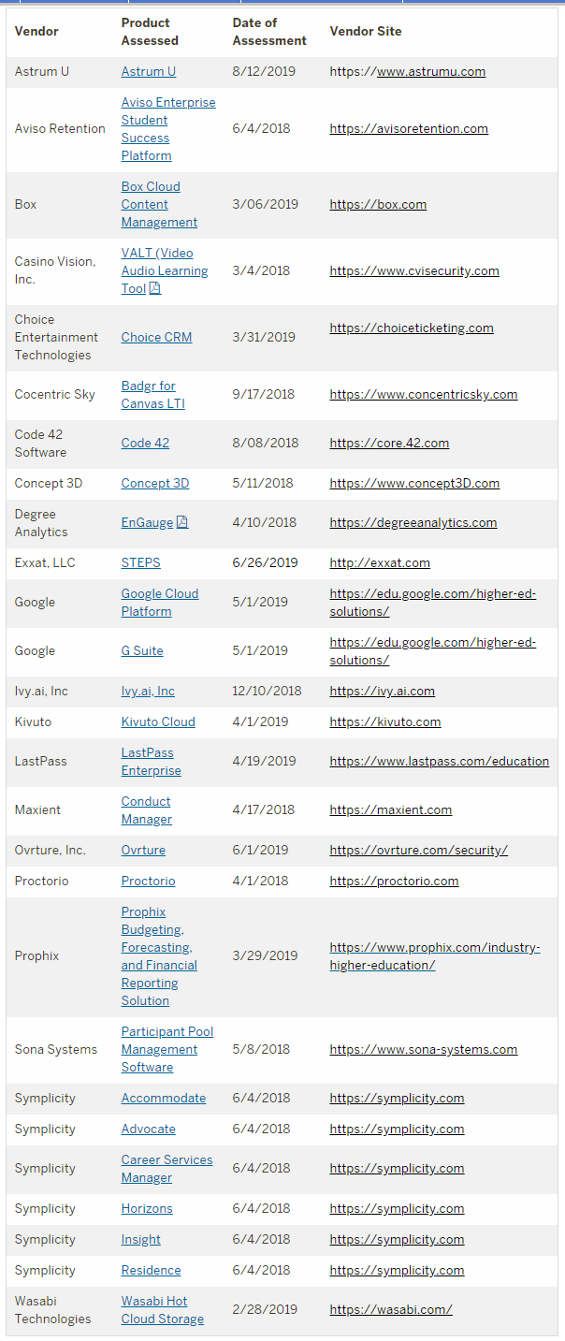
Service Providers Using HECVAT
20 Service Providers with
27 HECVATS
Notes:
Susan

Slide 14
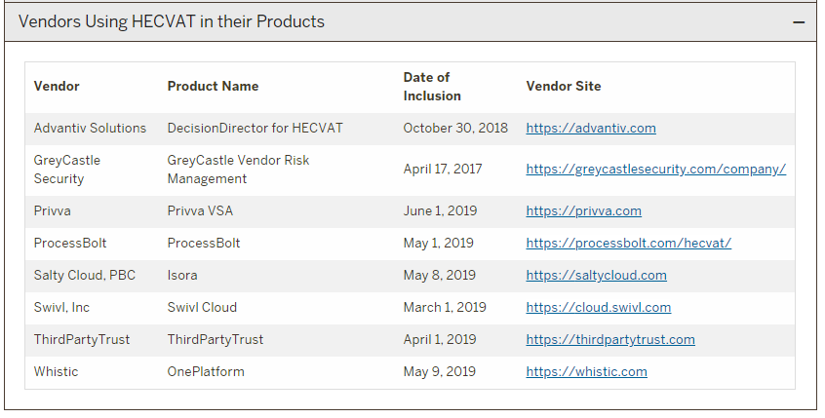
Service Providers Incorporating HECVAT
8 Service Providers
Notes:
Susan

Slide 15
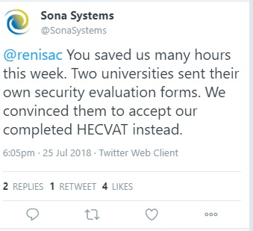
Vendor Partner Value
Shows engagement in the procurement conversation
Reduce redundant use or staff
Increase quality of assessments
Differentiation in the marketplace
Being seen as engaged with the community
Getting contacts at potential customers
Notes:
Susan

Slide 16
Self Assessment Princeton University
Notes:
Daphne

Slide 17
HECVAT
Notes:
Daphne

Slide 18
Vendor Review
Team
Partners
HECVAT
Process
Analysis
Notes:
Daphne

Slide 19
Architecture & Security Review (ASR)
To identify risks and ensure compatibility
with network & security principles
Notes:
Daphne

Slide 20
ASR Team Members
Office of Information Technology
Chair: Information Security Office
Cloud Services Architecture
Database Administration
Enterprise Servers & Storage
Identity & Access Management
Package Adaptation & Customization
Research Computing
Service Management
Software Architecture
Support & Operations Center
Vendor Contracts
Office of Audit & Compliance
Notes:
Daphne

Slide 21
ASR Process
Pre-Contract
RFP Process
OGC & OIT gateway
Implementation
recommendations
Change Management
Business Owner
contact for vendor
HECVAT completion
Intake
Cloud or On-prem
ASR: Regular, Lite, or None
ASR Meeting
weekly standing
vendor 2nd half
HECVAT order
Continuous Review
HECVAT
SOC 2
Notes:
Daphne

Slide 22
ASR Review
Special focus on these HECVAT sections:
Data classification
Restricted, Confidential, Unrestricted within Princeton, Public
Authentication
Encryption
Fourth parties
Accessibility readiness
Notes:
Daphne

Slide 23
ASR Review
Additional discussion:
Duplicative services
Recommendations for implementation
Escalate occasionally to senior management
Notes:
Daphne

Slide 24
ASR Partners
Central IT learns about and comments on campus projects
Campus departments listen and learn from technical discussion
Vendors highlight strengths and discover product enhancement opportunities
Notes:
Daphne

Slide 25
ASR Adoption
Notes:
Daphne

Slide 26
ASR Future State
Use On-Premises HECVAT
Enhance Accessibility review
Request ASR via ServiceNow ticket
Store risk scores in ServiceNow
Plan continuous periodic review
Notes:
Daphne

Slide 27
Benefits of the HECVAT
Identifies data security risks in a standard format
Provides opportunity for quantitative risk analysis
Engages vendor in dialog about security features
Surfaces recommendations for implementation
Highlights terms for contract
Provides opportunity for Accessibility review
Incentivizes business owner to understand security for the application or service
Notes:
Daphne

Slide 28
Demonstration
Notes:
Charlie/Josh

Slide 29
Call to Community and Future Direction
Notes:
Nick

Slide 30
Call to Community
Commit to HECVAT
Allow referencing
Educate Vendors
Give feedback
Notes:
Nick

Slide 31
Future Direction – Phase 5
Brainstorm on ideas for the next phase
Engage with existing working group members and new members to develop workplan.
Ongoing operations
We want your input!
Notes:
Nick

Slide 32
Feedback and Discussion
Notes:
Nick

Slide 33
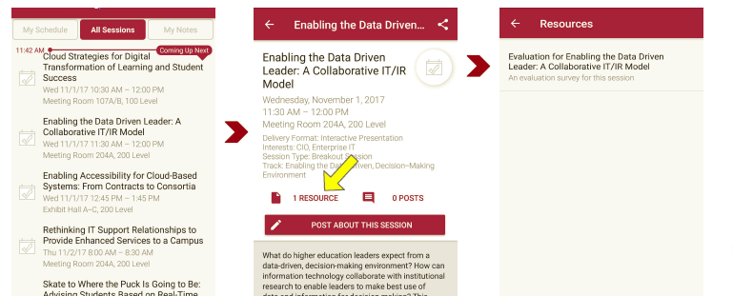
Session Evaluations There are two ways to access the session and presenter evaluations:
1
2
In the online agenda, click on the “Evaluate Session” link
From the mobile app, click on the session you want from the schedule > then scroll down or click on the associated resources > and the evaluation will pop up in the list

