Slide 1
Women & Marginalized Groups in Technology
The good the bad and the ugly.
Notes:
Note about change in title from Minorities to Marginalized groups: Since that language is more inclusive. We're all here to learn and share what we've learned, and the important thing is to keep improving and bringing awareness to help spread change.
Comment about Marginalized groups welcome and related similar tactics but we will likely default to talking about women.
White men are important too.

Slide 2
Agenda
Introductions
Poll results
Supporting yourself and others
Starting an initiative
Wrap-up

Slide 3
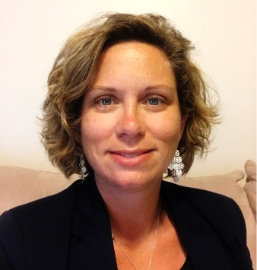
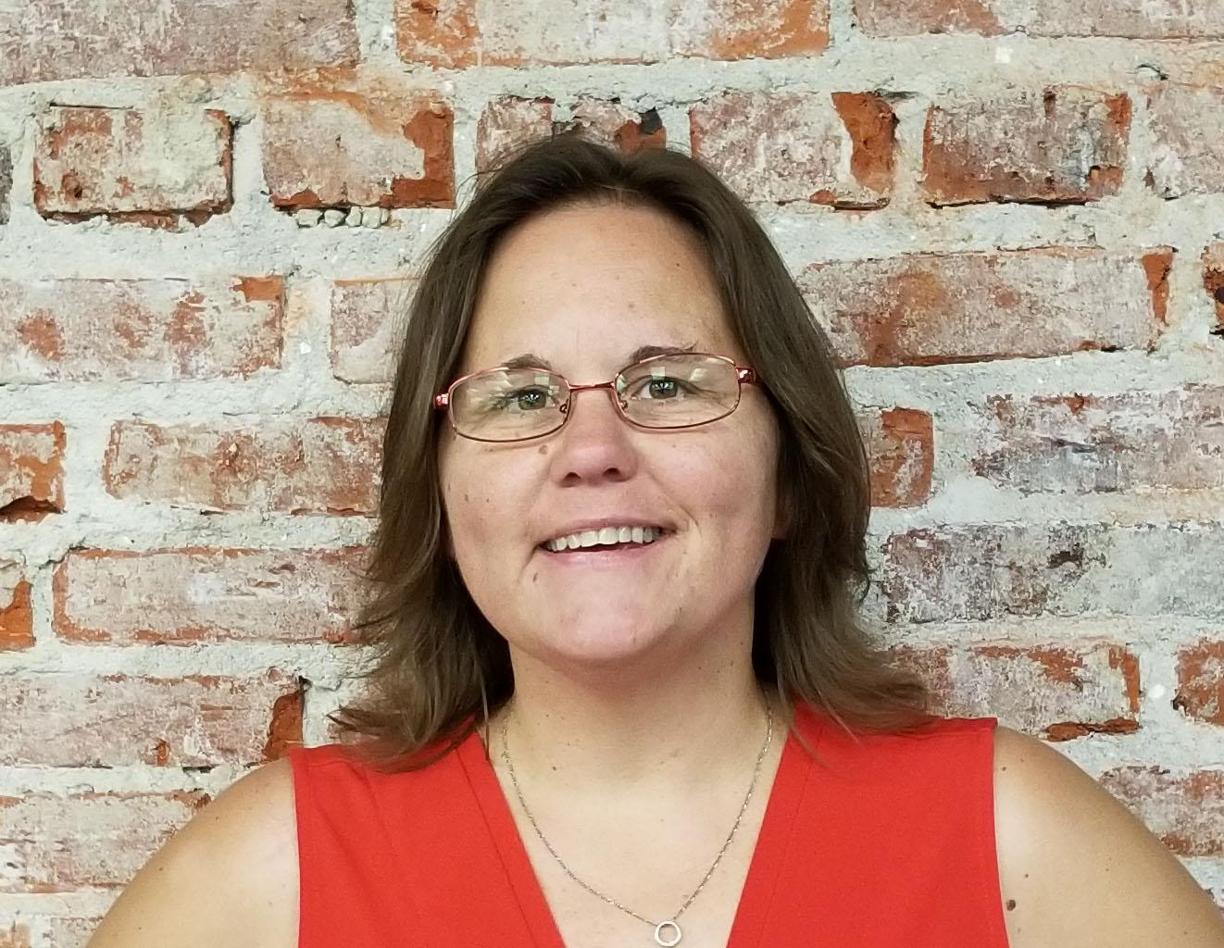
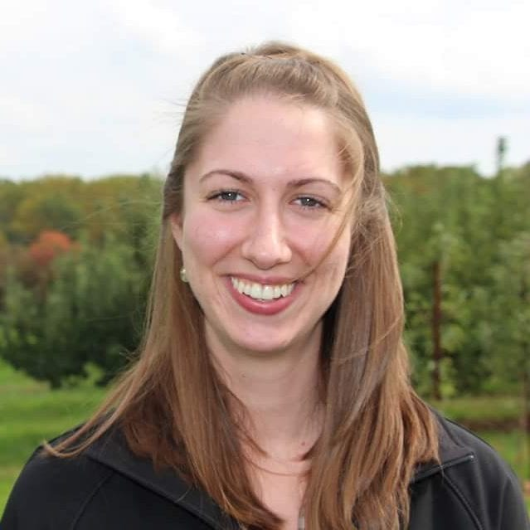
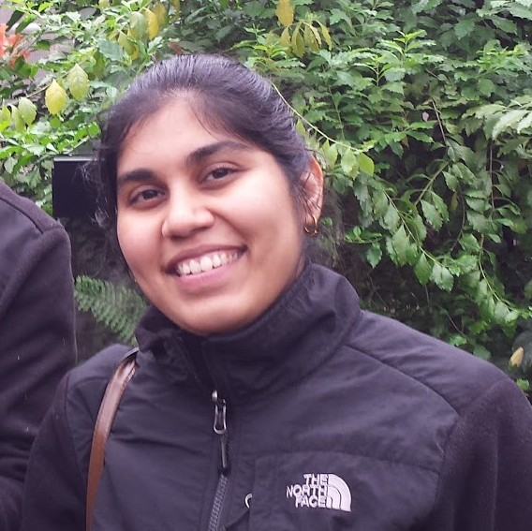
Introductions
Sara Laird
Mount St. Mary’s University
laird@msmary.edu
Jamie Summerfield
University of Delaware
jmsummer@udel.edu
Sowmya Shankar
University of Delaware
vsowmya@udel.edu
Sarah Meadows
University of Delaware
sarahem@udel.edu
Notes:
Jamie to transition into each of our introductions

Slide 4
Make a connection
Notes:
1st audience engagement- Business card exchange (30 seconds)
Stand up and if you have a business card, take it out, hand it to your neighbor. If you do not have a business card with you, you can create your own (show post-its).
If you get nothing else from this you will leave will a contact of someone you can connect with.

Slide 5
What have you experienced or witnessed in your tech career?
Complete the poll:
URL: sli.do
Code: EDU2019
Notes:
Welcome people to our presentation. Make them aware of the poll.

Slide 6
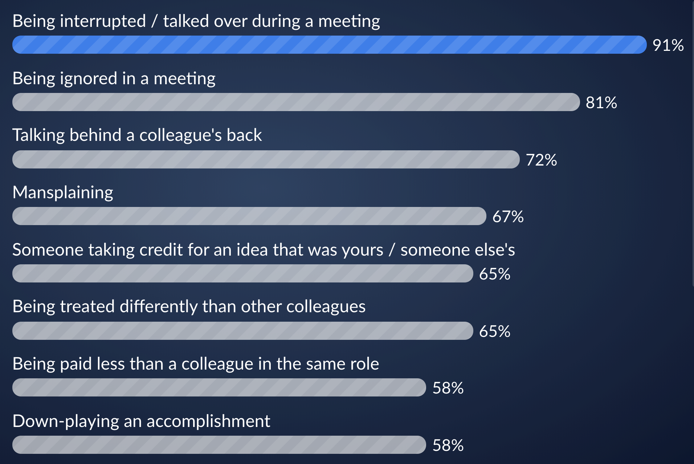
Poll results
Notes:
Jamie to talk about poll results. Ask a few questions about the results. Talk about the ones that stand out. Maybe make reference to our t-shirts that we are wearing and why. So it would appear that most of us in this room may have run into one or more of these situations. Did you do anything about it? Did speak up? Did you quietly let it go? So what can we do about it? Sara is going to talk about how to support yourself and others...how can we by an ally not only to ourselves but to others as well…..Transition into Sara L’s slides
Poll Results: https://wall.sli.do/event/jvy0jcmi?section=efcefb49-717e-4085-baf5-fc8ee07de69e&info_modal_version=default&open_info_modal=true
https://library.educause.edu/resources/2019/7/diversity-in-higher-education-information-technology-from-todays-workforce-to-tomorrows-leaders
81% white male

Slide 7
Supporting yourself and others
Everyone has the power to make a difference.
Notes:
Tell my story….. why I wanted to present.

Slide 8
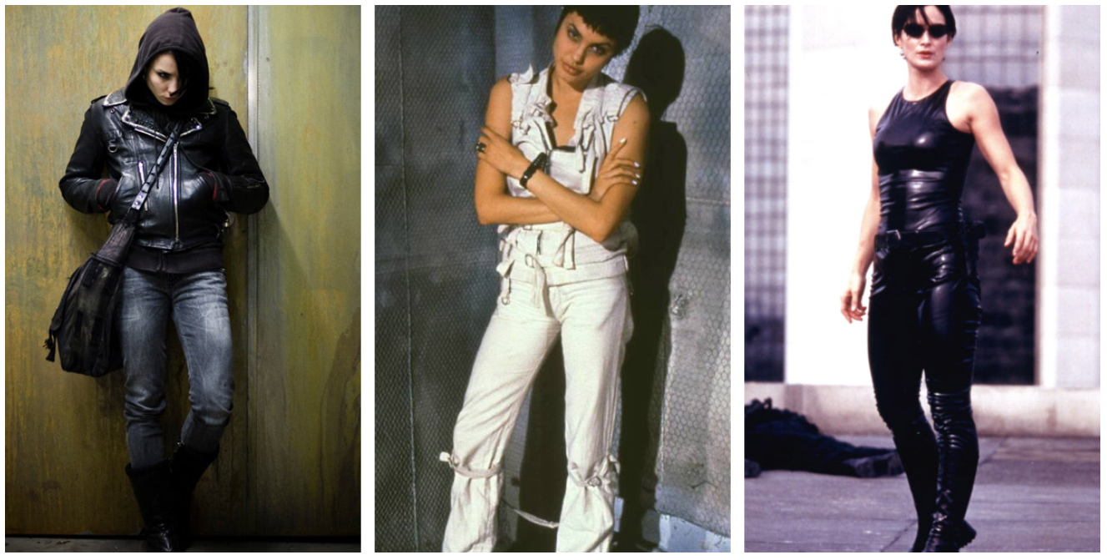
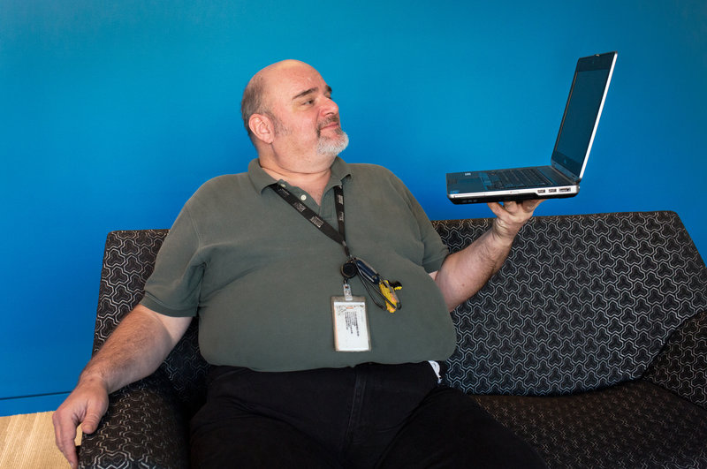
Stereotypes
Notes:
Google Search ( IT Girl, IT Women, IT Guy, technology professional
Race, Gender, Age, Appearance Ask for others????? Smart, neard, data guy, DBA?
So what does this have to do with supporting yourself and others? Elephant in the room. We have to stop falling victim to the stereotypes we are fighting against. Look around the room this is what

Slide 9
Public School Curriculums
35%
percent of high schools in the US teach computer
Science. (code.org)
Graduation Requirements | Credits
English | 4
Math | 4
Science | 3
Social Studies | 3
Phys Ed / Health | 2
Language | 2
Career Pathway | 3
Electives | 4
Code.org (2018) State of Computer Science Education Policy and Implementation.
Photo by osman alyaz from Pexels
Notes:
Sarah M

Slide 10
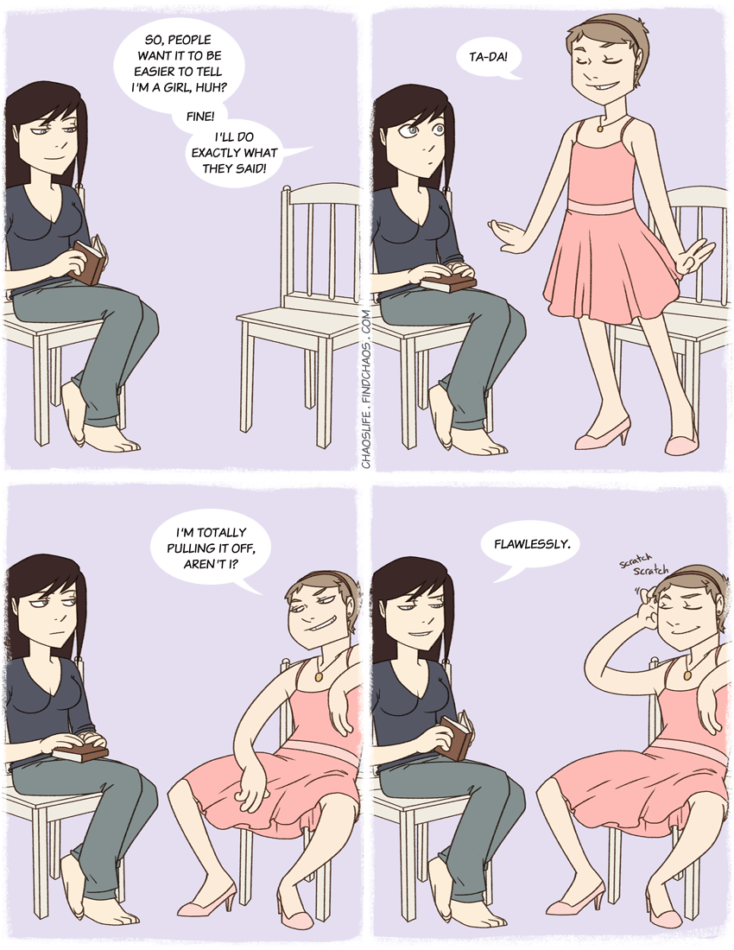
Gender norms & body language
Photo from Chaos Life
Notes:
Sowmya will present

Slide 11
It’s not who you are that holds you back, it’s who you think you aren’t.
Impostor Syndrome
Notes:
Impostor Syndrome is real and if you think your have experienced it your not alone. According to research published in the Journal of Behavioral Science it’s estimated that 70% of U.S. population has experienced Impostor Syndrome. Have you ever felt like a complete fraud and that everyone was going to find out that you didn’t deserve your accomplishments? Have you wrestled with feeling like you don’t belong?
slide for categories?? This could be another audience engagment or if hurting to time, Sara could just talk about it. But would be nice to see participants raise their hands for the categories.

Slide 12
Five Types of Impostor Syndrome
Photo by Pixabay from Pexels
Perfectionist - set excessively high goals, if they want something done right, they have to do it themselves
Superwoman/man - stays at the office late, even after work is completed, gets stressed when you’re not working.
Natural Genius - used to everything being easy, dislike the idea of having a mentor. Often avoids challenges.
Soloist - Does not need help, ever.
Expert - Can never know enough, fear being unknowledgeable.

Slide 13
Overcoming Imposter Syndrome
Remember what you do well.
Focus on adding value.
Realize that no one is perfect.
Call it by it’s name: l have “Impostor Syndrome”
Realize that nobody knows what they’re doing all of the time.

Slide 14
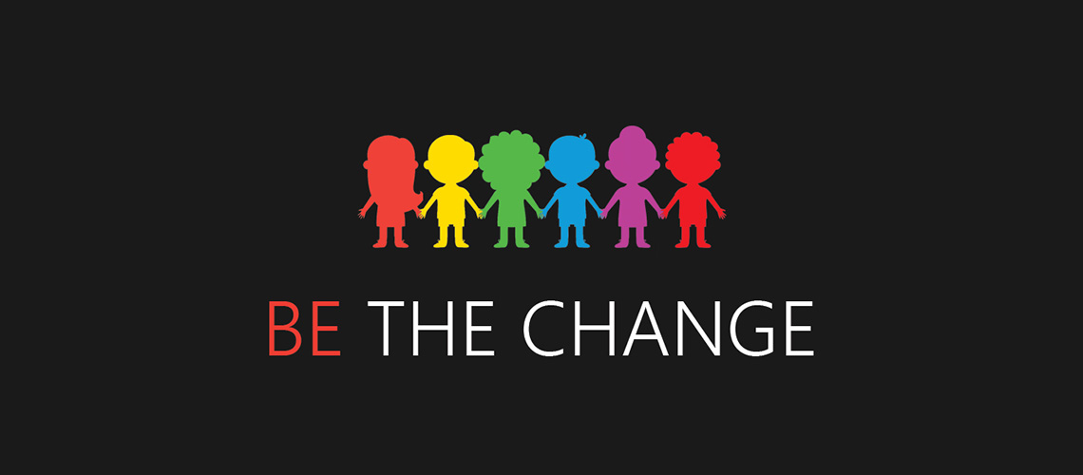
#EDUChangeMakers
Notes:
Give people an opportunity to speak, publicly praise others, help offer opportunities. Call out bad behavior even if not directed at you. Women stop being a barrier to other women or bullying. Become a mentor at your institution or another. Have open dialog. It’s not always intentional, sometimes it’s situational. Questions, comments, thoughts? Final thought prep the next generation….. transition to pipeline. So how do we start to do that? How do we as women, as allies, do that?

Slide 15
Starting an initiative
How to start a diversity group at your institution and bring others into the fold.
Notes:
Sarah M - Here’s what we did at UD in order to assist with this issue….

Slide 16
What works
Get buy-in from leadership
Engage a diverse audience
Build a community
Internal & external outreach
Create a pipeline
Photo from Pexels
Notes:
Jamie
buy- in from leadership- this is where our support system comes into play, we have a great support system at U of DE and here we have our very own……..(insert who is in the audience) Get buy in by showing that there is need and that there is a passion for your initiative.
Engage a diverse audience- Does not just have to be in “technology”, make it diverse, women, men, young, experienced,seasoned….. really anyone...be open
but you need a diversity
Building a community- I think back to what Steven Johnson said as the keynote speaker on Tuesday morning, he said don’t go it alone. Don’t do it by yourself.
Internal & external outreach- internally within our Universty- DEI groups on campus…office of equity and inclusion, college of engineering’s DEI groups and then we did some outreach externally by becoming involved our local high school and doing tech workshops with juniors over a several weeks.. We reached out and became a part of an annual event called Digi Girlz. By doing this, it always builds your community and it engages a diverse audience as well.
By doing all of the above, you start to create that pipeline that is going to fuel and support start up of your group of your organization.
Before we get into what some of our challenges were, let me ask you in this room….is there something not up there that has worked for you? or is there something up there that has also worked for you?
I’m going to hand it over to Sowyma & Sarah who are going to talk a little bit about some of the challenges in getting our WIT group started.

Slide 17
What’s challenging
Funding
Work balance
Volunteers
Awareness
Inconsistent communication
Pleasing everyone
Photo by Gratisography from Pexels
Notes:
Sowmya & Sarah

Slide 18
Getting started
Survey interest
Form a core team
Define mission & goals
Dive into action!
Networking
Workshop
Outreach
Keep pulling people in
Planning Canvas
www.udel.edu/006498
Photo by Bruno Moretti from Pexels
Notes:
Sarah M Business Model Canvas = Organization Planning Canvas

Slide 19
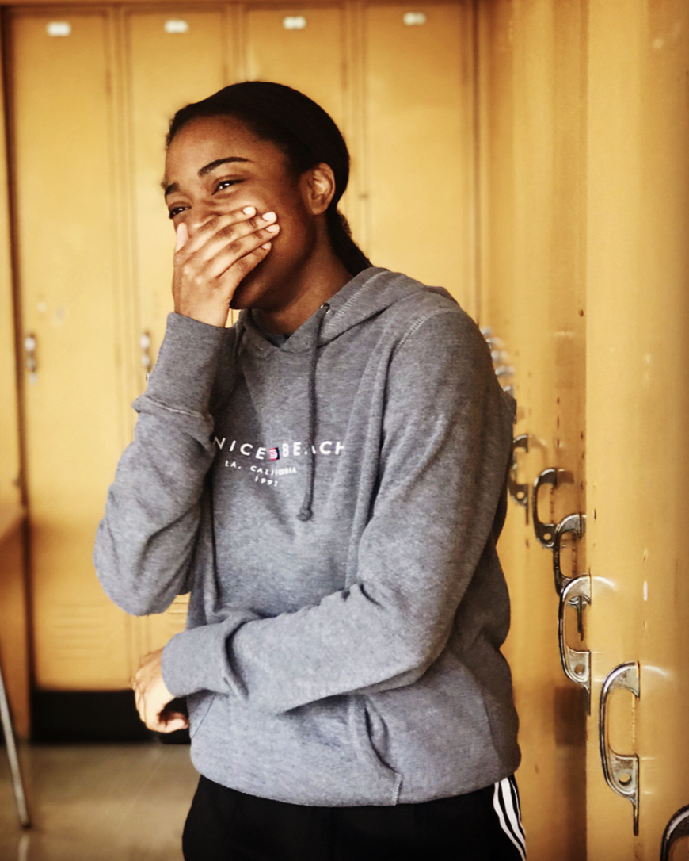
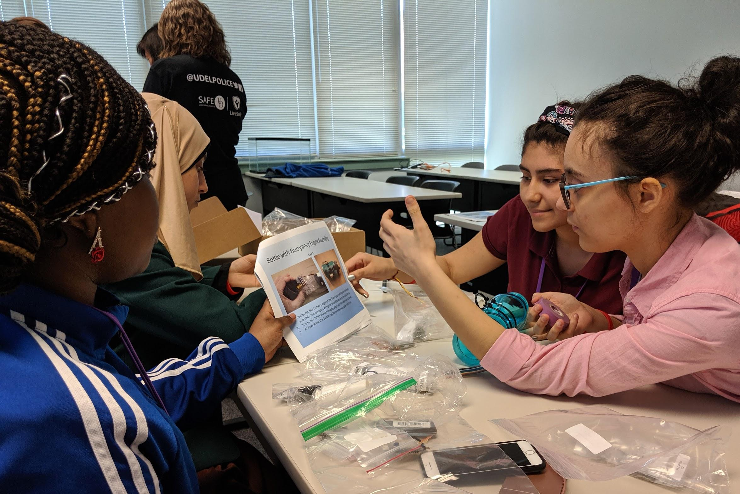
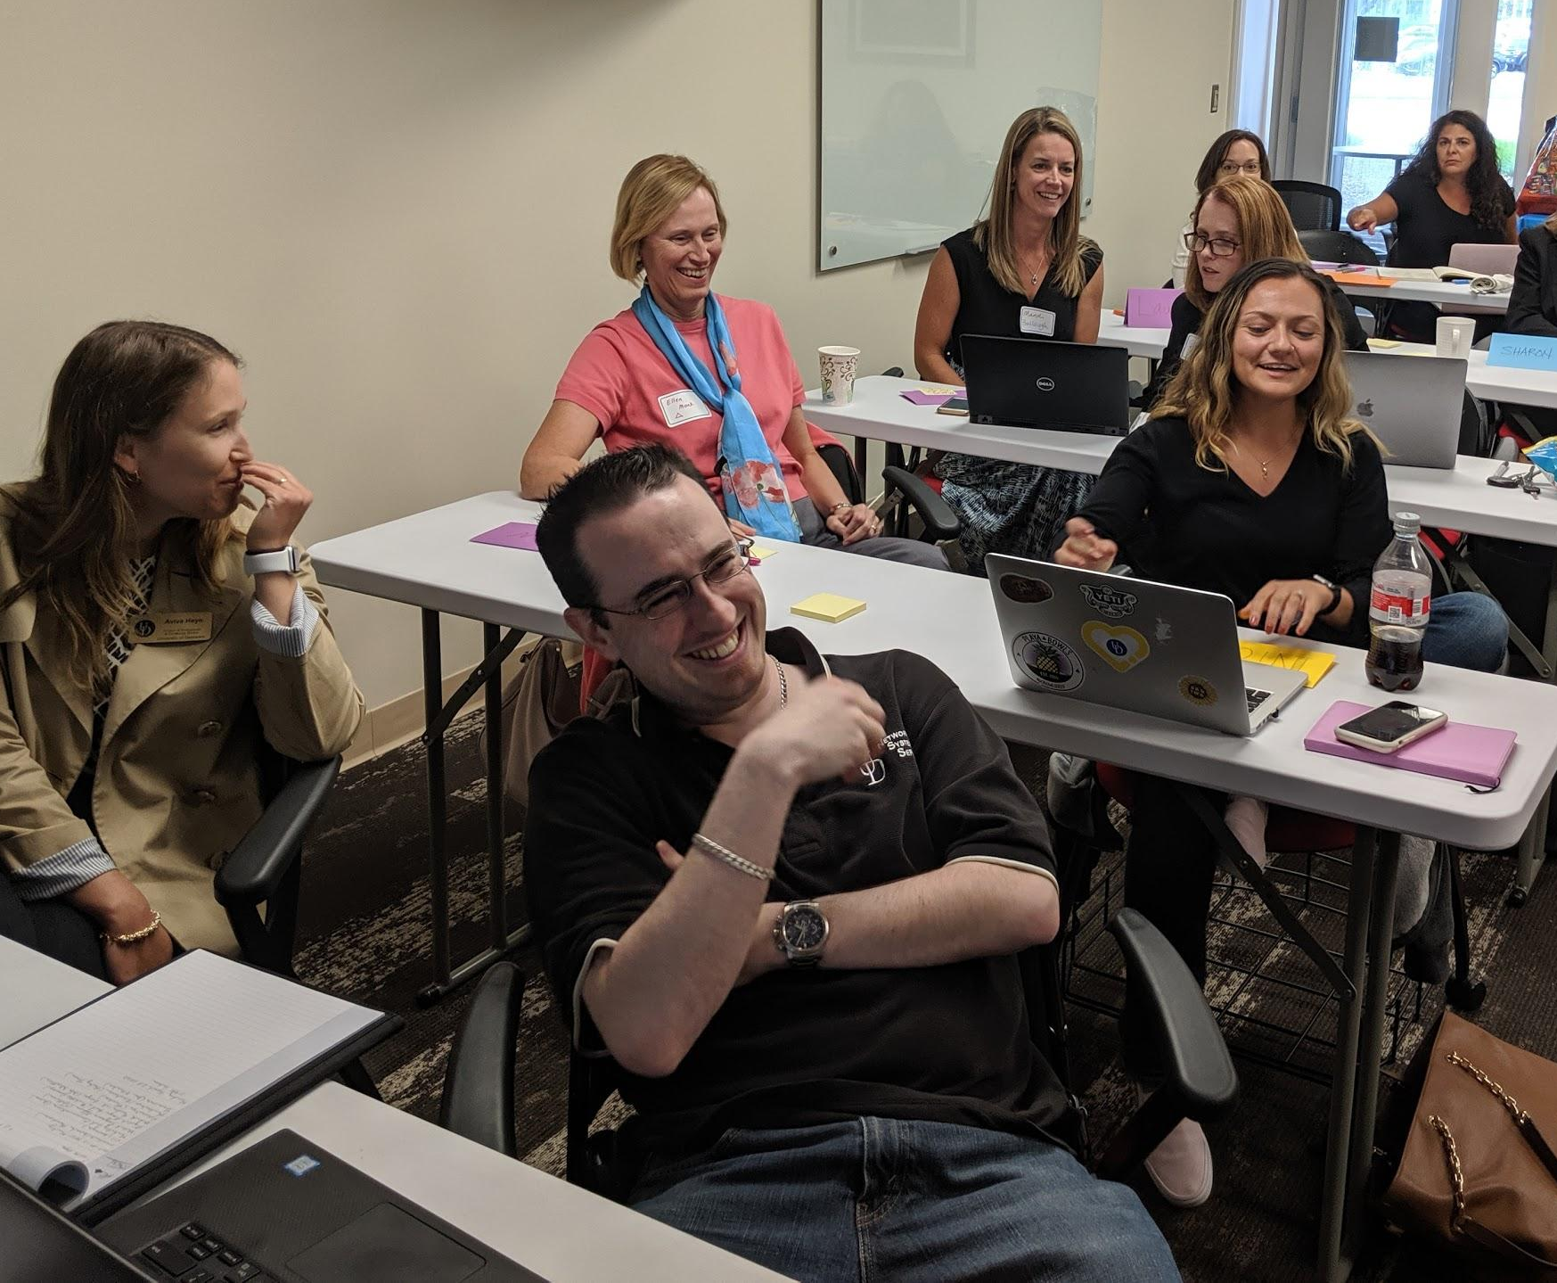
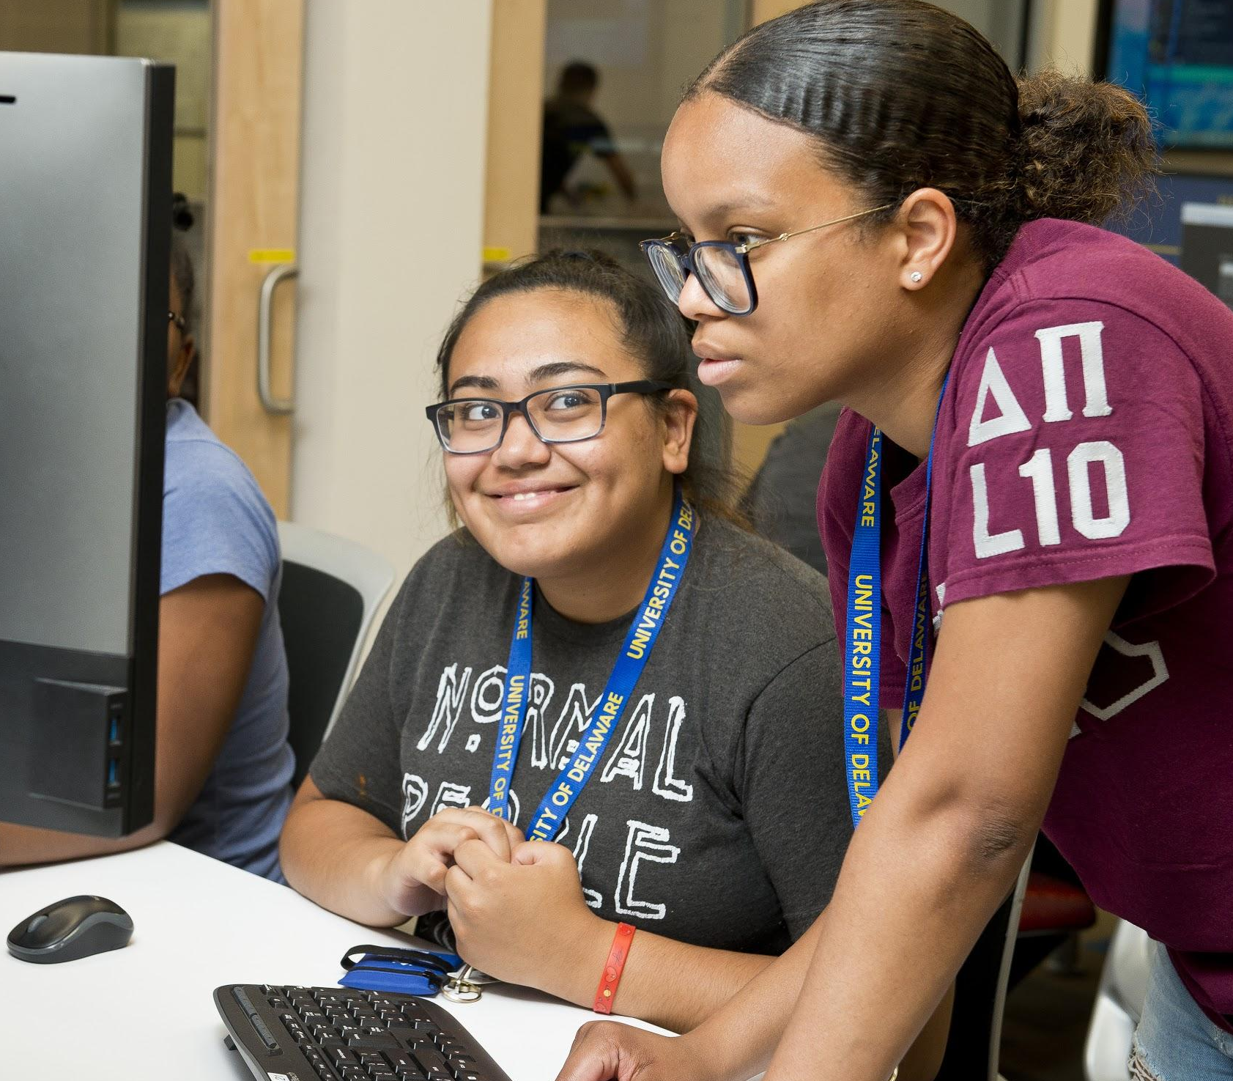
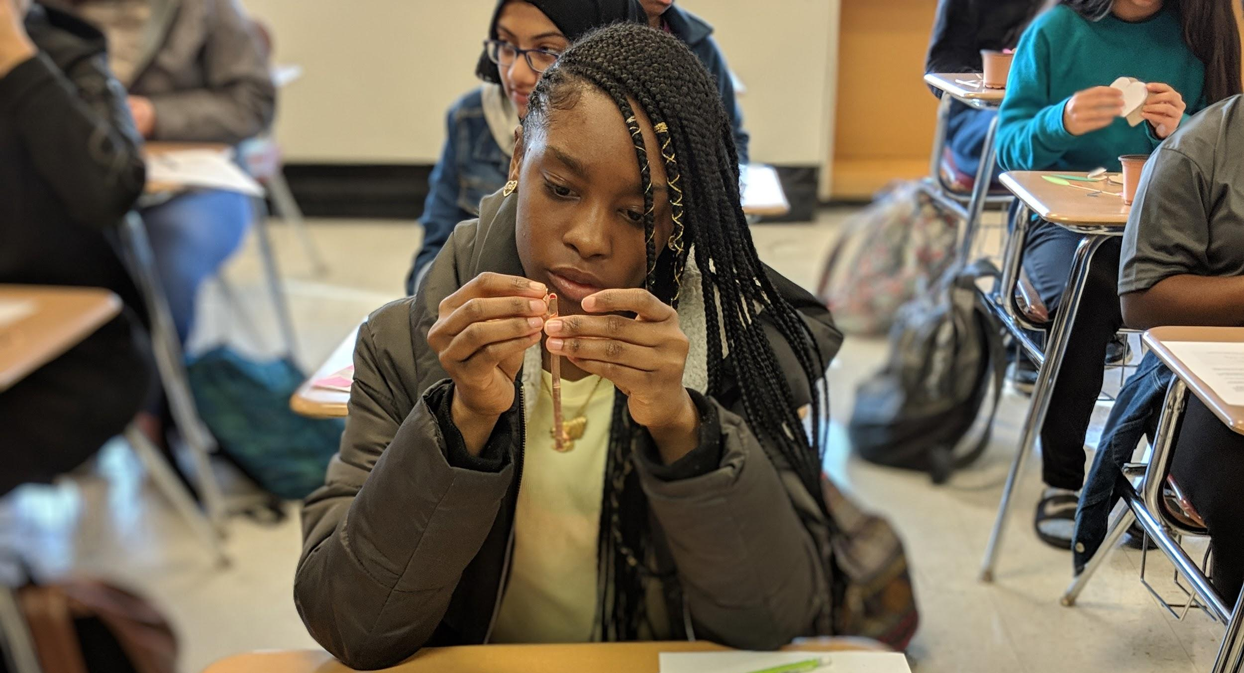
#EDUChangeMakers
Notes:
Jamie, Sarah, Sowmya
We need to put in another picture or rearrange the ones we have.

Slide 20
Resources
EDUCAUSE
Other tools
Diversity in IT Community Group
Women in IT Community Group
EDUCAUSE Institutes
Organization Planning Canvas
http://www.udel.edu/006498
Ally Bingo
https://maleallies.com/bingo-card
Project Implicit - Harvard University
https://implicit.harvard.edu/implicit/
ChickTech
https://chicktech.org

Slide 21
References
Code.org (2018) State of Computer Science Education Policy and Implementation.
Gender and the Body Language of Power
For women leaders, body language matters
Body Language and Gender Differences in Communication
Face it, You’re a Fraud: Dealing with Imposter Syndrome. (2016). Young Women in Energy. https://www.youngwomeninenergy.com/imposter-syndrome/

Slide 22
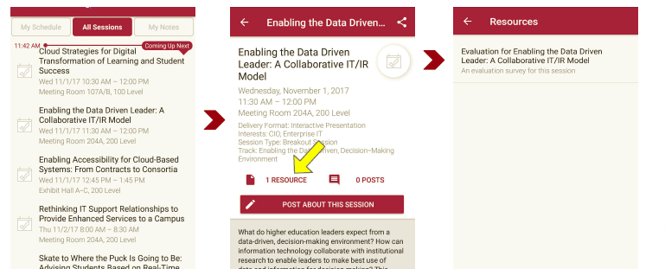
Session Evaluations There are two ways to access the session and presenter evaluations:
1
2
In the online agenda, click on the “Evaluate Session” link
From the mobile app, click on the session you want from the schedule > then scroll down or click on the associated resources > and the evaluation will pop up in the list

